Slide 1
Highlight of New and Featured Resources
Melanie J. Reese, Ph.D.
Director of CADRE
Presented at the 8th National CADRE Symposium
October 29, 2021

Slide 2
Welcome to Day Two!
2

Slide 3
Evaluation

Slide 4
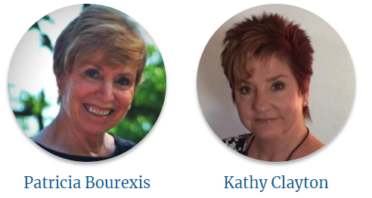
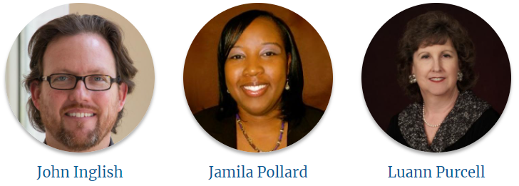
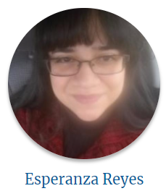
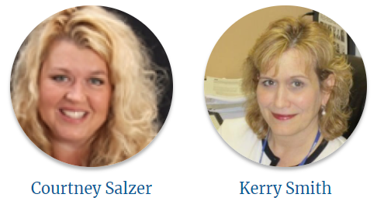
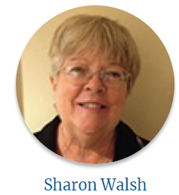
CADRE’s Advisory Board

Slide 5
Featured Resources
Dispute Resolution Coordination and Leadership Suite
F A Qs for Families
Dispute Resolution Guides
Working Together Series

Slide 6
One Person’s Experience as the New Dispute Resolution Coordinator
State Special Education Policies
State Agency Policies and Procedures
I D E A Regulations

Slide 7
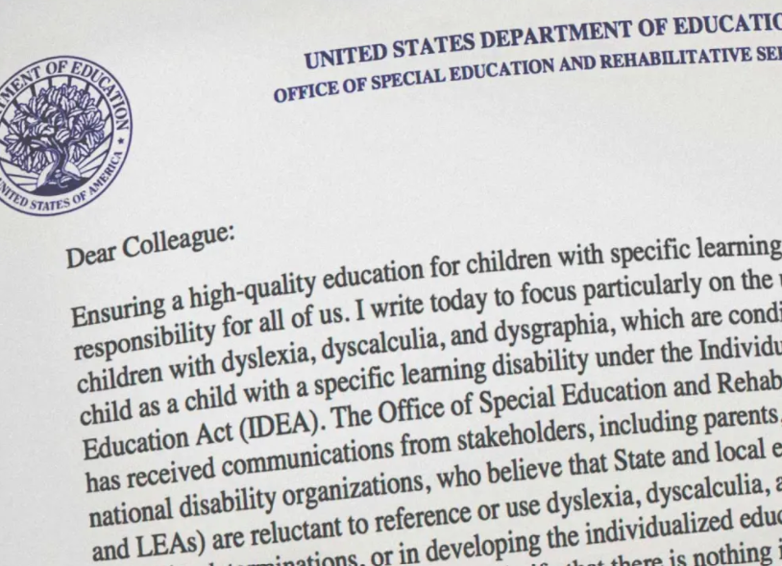
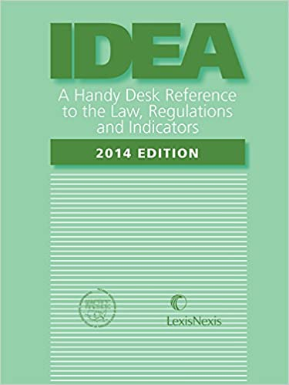
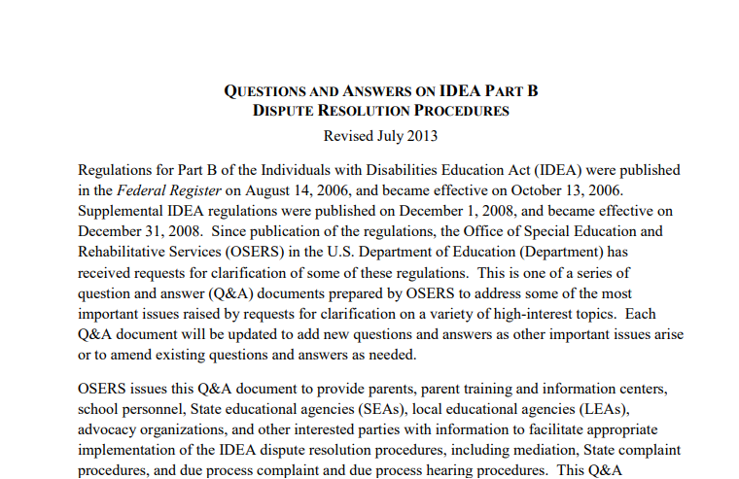
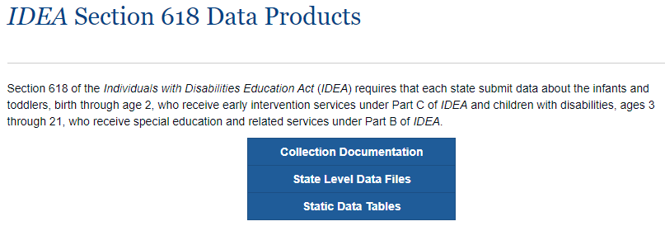
Myriad of Resources

Slide 8
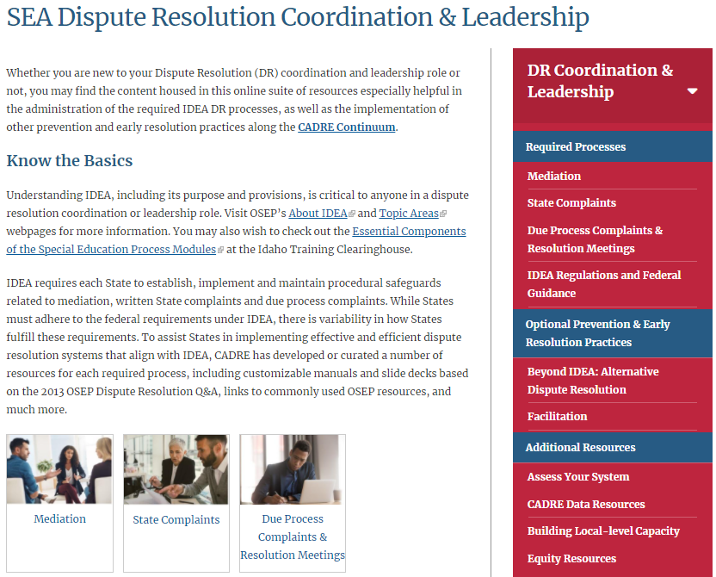
SEA Dispute Resolution Coordination & Leadership
www.cadreworks.org/dr-coordination-leadership

Slide 9
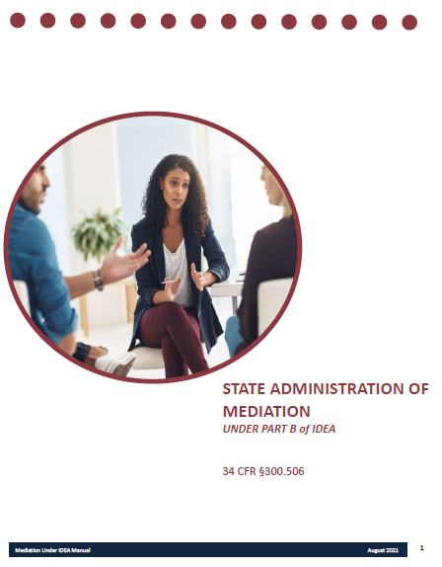
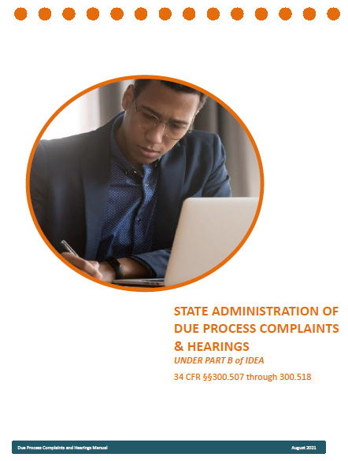
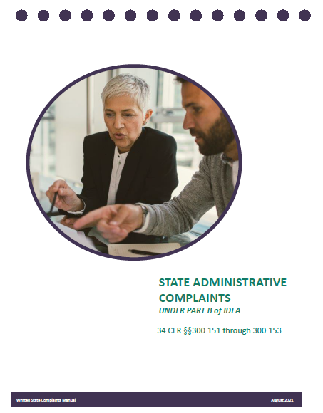
I D E A Dispute Resolution Process Manuals
Created in Collaboration with Art Cernosia and Reviewed by O S E P

Slide 10
Features of the Process Manuals
Hyperlinked & searchable expanded table of contents.
Explains required S E A procedures under the I D E A, with links to regulations
Hyperlinks to key citations, O S E P guidance documents and letters, etc. .
Coaching questions to explore system improvement areas .

Slide 11
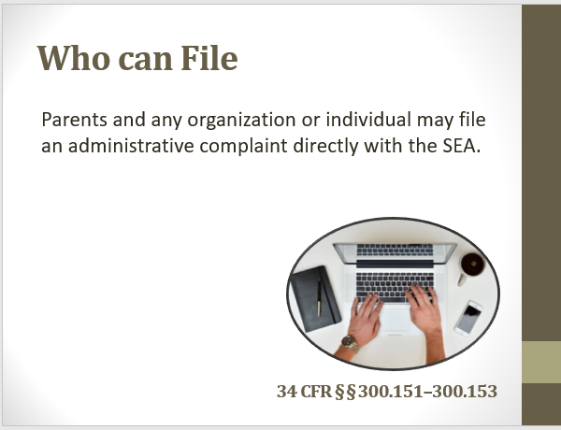
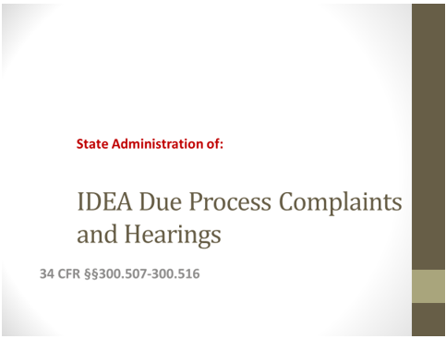
Companion Resources
Other presentations available:

Slide 12
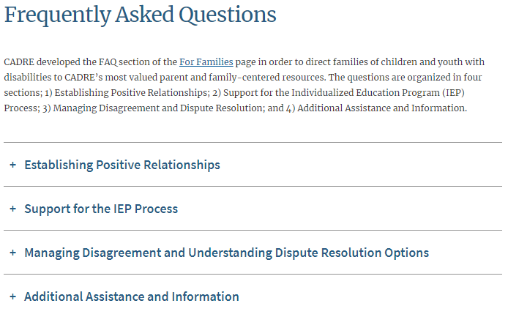
F.A.Q.s for Families

Slide 13
F.A.Q.s for Families: Example
+ Support for the IEP Process
Where can I learn more about preparing for an IEP meeting?
There are a number of things you can do to feel more prepared to participate in your child’s IEP meeting. You can begin with reviewing CADRE’s Working Together Series. CADRE developed this online learning series for both families and educators. The series contains five courses. While each course covers valuable information, IEP Meetings and Beyond (Course 2) addresses what you can do before, during and after an IEP meeting to be sure you are able to participate fully in the process.
If you need additional information and support, you may want to contact your local parent center. See Question 10 to locate your parent center’s contact information.
Working Together Series

Slide 14
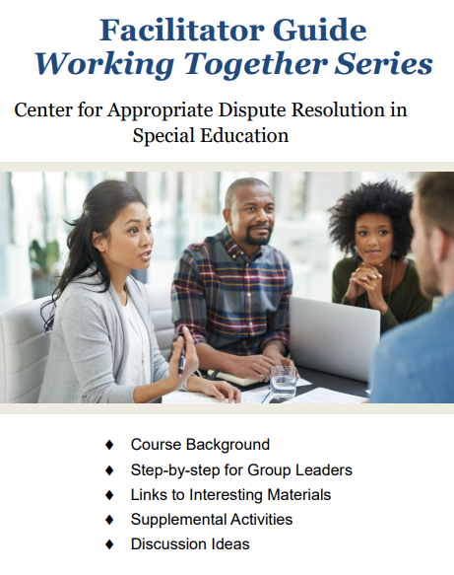
Working Together Series (La serie trabajar juntos)
Course 1: Introduction to the Working Together Series Course 2: IEP Meetings and Beyond Course 3: Listening and Responding Skills Course 4: Managing and Responding to Emotions Course 5: Focusing on Interests to Reach Agreement
With a comprehensive Facilitator Guide, also available in Spanish!
www.cadreworks.org/working-together

Slide 15
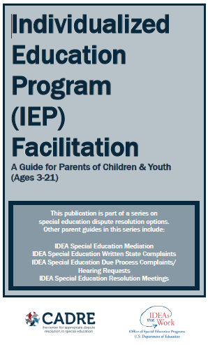
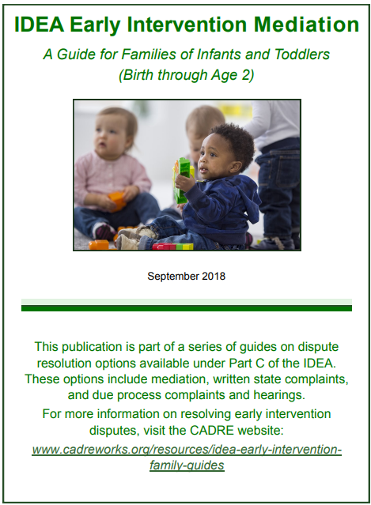
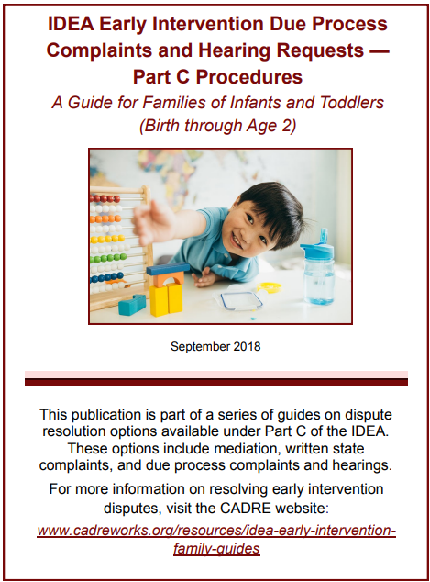
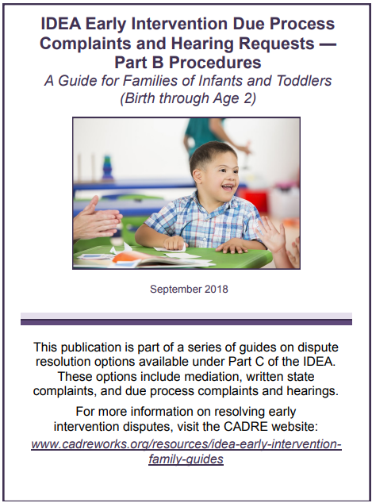
Dispute Resolution Resources for Families
Printed Guides in multiple languages
Now with Companion Videos in both English and Spanish!

Slide 16
Thank you for the opportunity to support your important work!

