Slide 1


Finding understanding in conflict: Steps, tips, and considerations for productive conversations and resolving differences.
Randall Reese, M.S.
RelationSmart
CADRE Symposium
October 20-23, 2025
Notes:
0

Slide 2

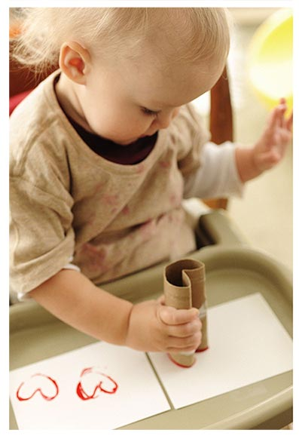
How We Roll
Today We Will Cover:
  Who we are and why we are here
  A brief discussion about conflict and the experience of conflict, and
  some principles which inform my mediation work
  Some things we can all put into practice to be better at conflict
  And we will practice a bit along the way
Notes:
We work in the service ofThe potential of children

Slide 3





About Your Facilitator
B.A. Communication
Education:
M.S. Human Performance Technology
Communication &
Dispute Resolution
Founding Faculty
Career:
Mediator/ Facilitator – IMA President
Performance Consultant
Senior Consultant

Slide 4


What do People in conflict need?
Notes:
What are people thinking and feeling when they call or visit you for help?
Collect answers- All forms of STRESS Leads to stress response Physically and psychologically prepared for danger
Their Immediate need is to reduce their stress. We can help if we know what to do and what is causing them stress.

Slide 5

People in Conflict
are often experiencing some level of uncertainty.
are often acting on misconceptions.
are usually interpreting things through a defensive lens.
have unmet material and/or relational goals.

Slide 6
Meeting Immediate Needs
Reassure
Reassure with Confidence
Inquire
Ask Open-ended Questions
Listen
Listen Empathically
Read
Read the Caller’s Emotional State
Validate
Validate Emotions and Interests
Reframe
Reframe Positions as Interests
Notes:
Each conflict is unique. Some need more time at the top of this ladder. Others are feeling confident and ready to problem-solve almost immediately. For those folks who need more reassurance, they are likely feeling as if they are under threat or attack.
Reassure: Agree with them about something or show empathy for their needs. READ – and needs

Slide 7
Conflict Threatens Our Self-Concept
We learn who we are through communicating with others. Difficult communication can threaten our self-concept, causing stress.
Threats to Our Perceived:
Roles
Experiences
Personality
Actions
Observations
and more
Attitudes
Beliefs
Values
Notes:
Interaction with others. Who had the most influence on who we became?
individuals vs society
Signification/importance

Slide 8
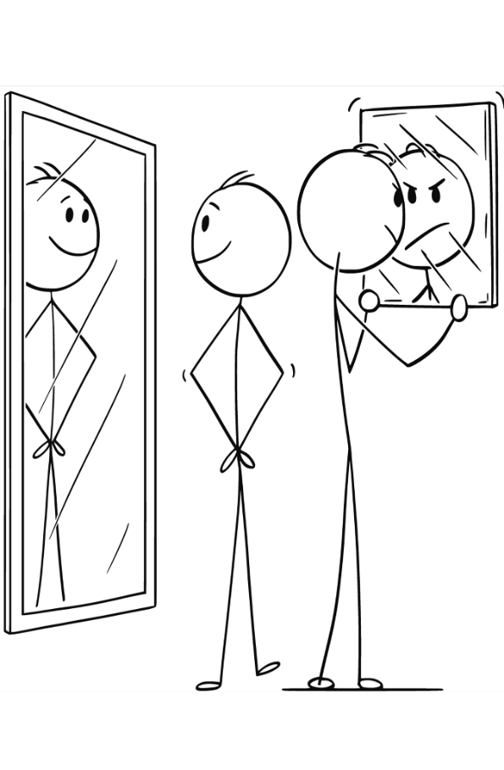
Helping People Feel Secure & Valued
In a conflict we can feel attacked.
When we feel attacked, we can accept it or blame the other for misjudging us.
We tend to judge our and other’s behavior in ways that support our self-concept.
We can lessen the hurt of an attack by finding flaws in the attacker.
Feeling powerless is hard on our self-esteem.
People often seek 3rd parties to empower them (validation and support).
The good or bad feelings we have about how we think the world sees us, affects our sense of safety.
Notes:
Self-esteem- The value we place on our self-concept and how we live up to it

Slide 9
Affirming and Building the Self-Concept
Reassure
Reassure with Confidence
Inquire
Use Open-ended Questions
Listen
Listen Empathically
Read
Read the Caller’s Emotional State
Validate
Validate Emotions and Interests
Reframe
Reframe Positions as Interests
Notes:
Communicate value of the person. They’ve come the right place to be heard. They are not alone. There are resources. You empathize with the difficulty. You can provide support and coach in helping them move toward problem-solving.
Self-concept lens

Slide 10
Validating and Reframing
Validation
“This challenge has been a bit overwhelming.”
“You love Andre and will do anything to make his life better.”
“You’ve struggled finding the resources you need to support the success of your students.
Reframing as Interests
“You want to feel more included in decisions about Acelyn.”
“You would like to see more progress in Shelly’s reading.”
“From your perspective, she needs more socialization.”

Slide 11
What Validation Is / Is Not
Validation IS…
• Reflecting key content in the speaker’s words
• Naming emotion/need (even tentatively)
• Normalizing: ‘Given X, it makes sense…’
• Non-defensive tone; Brief
Validation is NOT…
• Solving the problem or offering advice
• Investigating or fact-checking
• Defending your intent (‘I didn’t mean…’)
• Stacking questions or ‘why’ probes

Slide 12

3-Part Validation Formula
Formula: Reflect → Name Emotion/Need → Normalize
Stems:
• “I hear that …” / “I’m catching that …”
• “It sounds like you’re feeling … because …”
• “Given (context), it makes sense you’d …”
• “I want to get this right—did I miss anything?”
• “We can get to solutions next—first I want to understand .”

Slide 13

Reframing
What Is Reframing?
Restating and improving messages that are neither accurate nor useful.
Example
Parent: "You’re just not listening!"
Educator: “You want me to understand you. Could you tell me more about X?"
Strategies:
Ask open-ended questions (e.g., “What would success look like for you?”)
Reflect feelings, not just facts
Look for values or goals beneath the words
13

Slide 14



Interests vs Positions (cont.)
Positions
Interests
Collaboration
14

Slide 15

Responding Non-Defensively
Instead of…
• “That’s not what happened.”
Try…
• “It is clear we are seeing it differently—here’s what I’m hearing from you…”
• “Calm down.”
• “This is a lot to deal with— take your time”
• “I already explained this.”
• “Let me slow down and make sure I understand you.”
• “Why didn’t you…?”
• “What mattered most in that moment?”
Notes:
And NV

Slide 16

Validate and Reframe Micro-Exercise
Spot when a validating response is needed.
Use a 3-part validation formula with inclusive language.
Reframe positions as interests.
Practice in triads with quick, targeted feedback.
Timebox: 1 min setup • 1 min demo • 9 min practice (3×3 min) • 4 min debrief.

Slide 17

Role Descriptions
Speaker
1. Read the prompt; Feel free to add details from your world. 2. If the responder starts fixing, repeat your feeling statement.
Responder
Use the 3-part formula to validate and reframe an interest if possible.
Observer
Score 1–3 and note the phrase(s) that worked.
1 = Attempts reflection but misses content/emotion; adds advice or defense.
2 = Reflects content OR emotion; partial normalization; a bit long (>30s).
3 = Clear reflection + emotion/need + normalization; warm tone; ≤30s.
*Add a gold star for a reframe!

Slide 18

Exercise1: Interpersonal Conflict
Context: You are meeting a friend for dinner. Your boss asked you to drop a job off to the printer and there was a line when you got there. You want to call, but your phone is in the car charging. Since you are up for a promotion, you choose to be late for dinner and hope your friend will understand even though you have been late before.
Prompt: “I have been waiting for over 20 minutes; I feel like my time doesn’t matter to you!.”
Notes:
I agree that showing up late can signa disrespect for someone’s time. Given that we planned this together, it makes sense that you’d feel neglected by m showing up late..

Slide 19

Exercise 2: Workplace Conflict
Context: You are confronted by a co-worker about some data you and another person are collecting for a major project at work. You are almost done, but your data collecting partner has been getting the runaround from one of your providers of some particularly critical data.
Prompt: “I’ve asked you for the data three times and still don’t have it. This project can’t move forward without it. I’m worried I’ll look unprepared.”
Notes:
“You’ve followed up and still don’t have what you need to meet our objective. I agree that we need to solve this so we won’t look bad to management.

Slide 20

Exercise3: IDEA Conflict
Context: At the beginning of an annual IEP meeting, the chair asks the parent if they have anything they would like to say.
Prompt: : Parent: “At the last IEP, I felt rushed. My reading-support concerns were brushed off and now I’m afraid my child is falling behind.”
Notes:
“You felt hurried and not fully heard on reading supports; with your child’s progress on your mind, it makes complete sense you’d feel worried.”

Slide 21

Asking Effective Questions
Questions are the perfect accompaniment
or follow-up to validations and reframes. The
first key to an effective question is knowing
the goal of the question.

Slide 22

Why do we ask questions?
Gain Knowledge
Uncover Issues
Build Rapport
Uncover Needs
Underscore Key Points
Challenge Assumptions
Show Empathy
Validate Feelings
Encourage
Guide Conversation
Allow Other to Process Feelings
Clarification
Encourage Critical Thinking
Facilitate engagement
Notes:
Ask them and then reveal these additional.

Slide 23

Types of Questions: Open-ended
A way of asking others to say anything they want to say
Usually easy for them to answer
Useful for getting people to start or expand their story
Can show interest and empathy
Notes:
Can start with What or How
Vut Never Why!

Slide 24
Open-ended Examples
Opening
“I’m glad you mentioned that Mrs. Silva; we have a lot of resources and information that will help you. Please tell me as much as you can about your concerns with Malik’s education?”
Expanding
“You want to feel more included in her IEP decisions and you believe Bella should be getting more class time with her peers. Do you have any other concerns?”

Slide 25

Types of Questions: Probing & Clarifying
Probing questions
Search questions that seek to dig deeper or explore “side-streets.”
Can be a follow-up from a previous question or an attempt to explore new avenues of inquiry.
Clarifying questions
Seek understanding about something.
Can be used to softly challenge ideas.
Notes:
Who what when where how but never ______

Slide 26
Probing & Clarifying Examples
Probing:
“How long has this been an issue?”
Clarifying:
“What do you mean when you say it is inadequate?”
Clarifying to challenge ideas:
“When you said it was abusive, was that an accurate description?”
Probing/Clarifying:
“Did you feel your efforts were appreciated?”

Slide 27
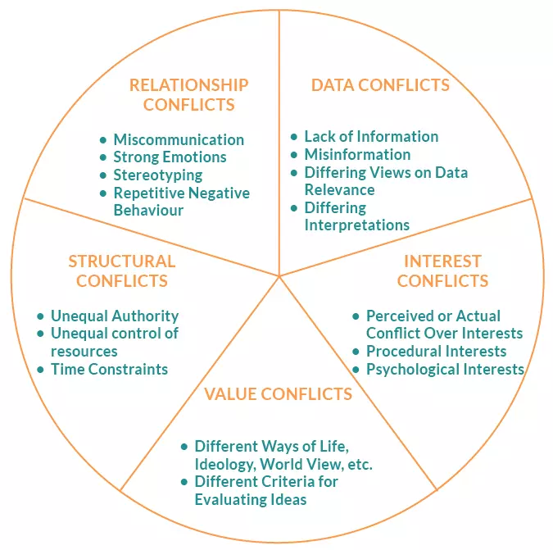
Moore's Circle of Conflict
By using the Circle of Conflict as a framework, you can ask targeted questions to learn more about the specific type of dispute.
This can help to uncover underlying issues, encourage focus, build trust, and encourage effective conflict engagement.
Notes:
See also: Brinkert (2006)

Slide 28
Data Conflicts
Questions to clarify information:
  "Can you elaborate on the records or notes that you have regarding the days Tyler was sent home?”
  “You said you have a neuro-psych report? Has the IEP team seen it?"
  "Is there any other information we should look at?"
Questions to explore interpretations:
  "Is there more than one way to interpret the doctor’s report?"
  “Do you have questions about how they are tracking progress?"
  "Would additional tests provide more clarity or trust in the decision?
  “If you got the same information from a trusted source, would that affect your position?”

Slide 29
Relationship Conflict
Questions to address emotions:
  "What was that experience like for you?"
  "How have you been affected by __________?”
  "How has this conflict impacted your relationship?" or, “What was your relationship like before this?”
Questions to build trust:
  "What would it take for you to feel more trust in the other party?"
  “How can we improve communication between you both?”
  “Is there a staff member at the school who you feel has supported you?”
Notes:
Melanie

Slide 30
Structural Conflict
Questions to identify power imbalances:
  "How do you feel about your ability to affect this situation?"
  “How included do you feel in the IEP decisions?”
  “Do you believe that you have access to the information you need to participate effectively?”
Questions to explore options for change:
  "What changes could be made to improve communication?"
  "What kind of barriers do you face in solving this situation?"
  “Could you offer your ideas for a short-term solution and then we can come back to see how it worked?”

Slide 31
Interest Conflict
Questions to uncover underlying needs:
  “What do you hope to accomplish this semester for your child?”
  “What is your most pressing concern?"
  “What does a good outcome look like to you?"
Questions to explore common ground:
  “Are there things that you and the school already agree on?”
  “Do you have any solutions in mind that might be easy to agree upon?”
  “What constraints do you think the school has in this matter?”
  “Are there any solutions that meet your child’s needs and address the school’s concerns?”

Slide 32
Values Conflict
Questions to understand values:
  "What is the most critical goal for Jackie’s success?"
  “Do you have any family or cultural values that we need to understand and honor?”
  "Can you explain the importance that transparency holds for you?"
  “Which of those ideas would you prioritize?”
Questions to find common ground:
  "Are there any shared values that we can build upon?"
  “Is there a difference between your view and the school’s view of the critical goal for Jaida?"

Slide 33
Exercise: Reading Supports Not Implemented Consistently
Scenario:
A parent says their 4th grader isn’t getting the agreed small-group reading intervention and extended time. The teacher says it happens “most days,” but intervention logs are incomplete. The parent fears regression; the teacher cites tight schedules and staff absences.
Assignment:
In your group, decide which of Moore’s categories you should address
Validate the parent and the teacher.
Design three or four good questions as follow-ups using “The Circle”
Notes:
Data – What do we know/need to verify?
“Which dates show the intervention delivered?”
“What recent progress-monitoring scores do we all accept as accurate?”
Interests – What matters/why now?
“What is most important to you about how the support shows up each week?”
“What outcomes are each of us hoping to see in 6 weeks?”
Structural – Systems, roles, resources, time
“What schedule or coverage constraints are blocking delivery?”
“Who is responsible for logging and who reviews?”
Value – Beliefs, principles
“What does ‘faithful implementation’ mean to each of us?”
“How do we define ‘meaningful progress’ for this student?”
Relationship – Trust, history, communication
“Where did communication break down about missed sessions?”
“What check-in rhythm would rebuild confidence?”

Slide 34
Exercise: Placement Disagreement (LRE vs. Support Intensity)
Scenario:
The team proposes a specialized program for math and literacy. The parent wants the student in the general education classroom with push-in support, citing social inclusion. The special educator worries current supports aren’t enough to meet goals.
Assignment:
In your group, decide which of Moore’s categories you should address
Validate the educator and parent.
Design three or four good questions as follow-ups using “The Circle”
Notes:
Data
“Which classroom observation notes best represent current performance?”
“What goal-by-goal data predicts success in each option?”
Interests
“What does the parent hope their child experiences during the school day?”
“What does the teacher need to confidently deliver grade-level content?”
Structural
“What staffing/service model exists for push-in vs. pull-out next term?”
“How will minutes, transitions, and transport be scheduled?”
Value
“How is ‘least restrictive environment’ interpreted by each of us?”
“What does inclusion mean in practice for peer interaction and dignity?”
Relationship
“Where do we already agree, even partly?”
“What commitments can we make about tone and next steps to keep trust intact?”

Slide 35
Additional Tips
Tips for avoiding leading questions and maintaining neutrality:
  Avoid making assumptions.
  Refrain from giving advice.
  Use non-judgmental language.
Strategies for using questions to identify underlying interests and needs:
  Ask about goals and aspirations.
  Explore past experiences and emotions.
  Identify key values and concerns.
Techniques for using questions to explore potential solutions:
  Ask about potential solutions and their feasibility.
  Explore potential obstacles and how to overcome them.
  Encourage others to think creatively.

Slide 36

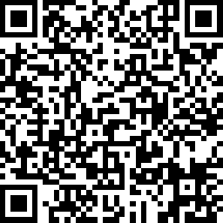
Feedback, please. . .
CADRE values your feedback! Please fill out a short evaluation on today’s presentation.
Thank you!
https://www.surveymonkey.com/r/casestrategies

Slide 37
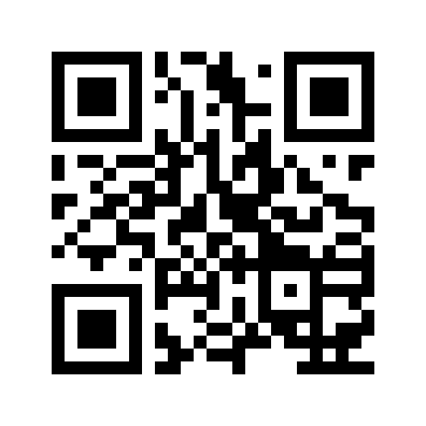


Interested in Updates from CADRE?
Find us at: www.cadreworks.org
Subscribe to the CADRE Newsletter!
The QR sends you to the subscription page

