Slide 1


Re-thinking Family Engagement in Special Education
Theresa Nicholls
Nell Quest Curran
Christina Kozik
exceptionallives.org
Notes:
Introductions
Family Engagement and ADR
Increases in conflict in special education
why the increases?
tell story to build empathy
the system has been set up to instill
confusion
Frustration
stress
Distrust
How do we build relationships and establish trust with families?
Family engagement versus family involvement
Barriers to family engagement
small group discussion
share out
Highlight themes
time
resources
lack of engagement from families
How do we mitigate those barriers?
Opportunities
Website review
Where do you go for information?
Meet families where they are
incorporate special education information into existing FE opportunities
parent info night
open house
social media
parent conferences
IEP meetings/Support through special education process

Slide 2
Who is Exceptional Lives?
We support families and educators of children with disabilities so our kids can thrive.
We provide clear guidance to families to help access resources, navigate school systems, communicate needs, and understand rights.
We’re a trusted partner for schools, offering comprehensive staff training, communication and compliance support, and tools for fostering strong relationships between schools, families, and the community.
By bridging the gap between families and education teams, we ensure that every child gets the care, attention, and opportunities they deserve!
exceptionallives.org

Slide 3

PartnerEd Solutions
PartnerEd Solutions offers a comprehensive approach to preventing and resolving conflict in special education
exceptionallives.org
Notes:
We work with state agencies, school districts, and families, to examine the underlying causes of conflict in special education to find solutions.

Slide 4
Session Objectives
Understand the role of family engagement in the ADR continuum.
Reflect on the barriers to meaningful family engagement in special education.
Identify untapped opportunities to engage families in the special education process.
exceptionallives.org

Slide 5
Agenda
Introductions
Family Engagement and ADR
Barriers to Family Engagement
Opportunities to engage families in the special education process
Review and Resources
exceptionallives.org

Slide 6
Main point up front:
Clear, respectful communication with families builds trust and contributes to effective family engagement.
This improves experiences and outcomes for students, families, teachers and schools.
exceptionallives.org

Slide 7

Introductions
Who is here?
exceptionallives.org

Slide 8
The role of family engagement in ADR
exceptionallives.org

Slide 9
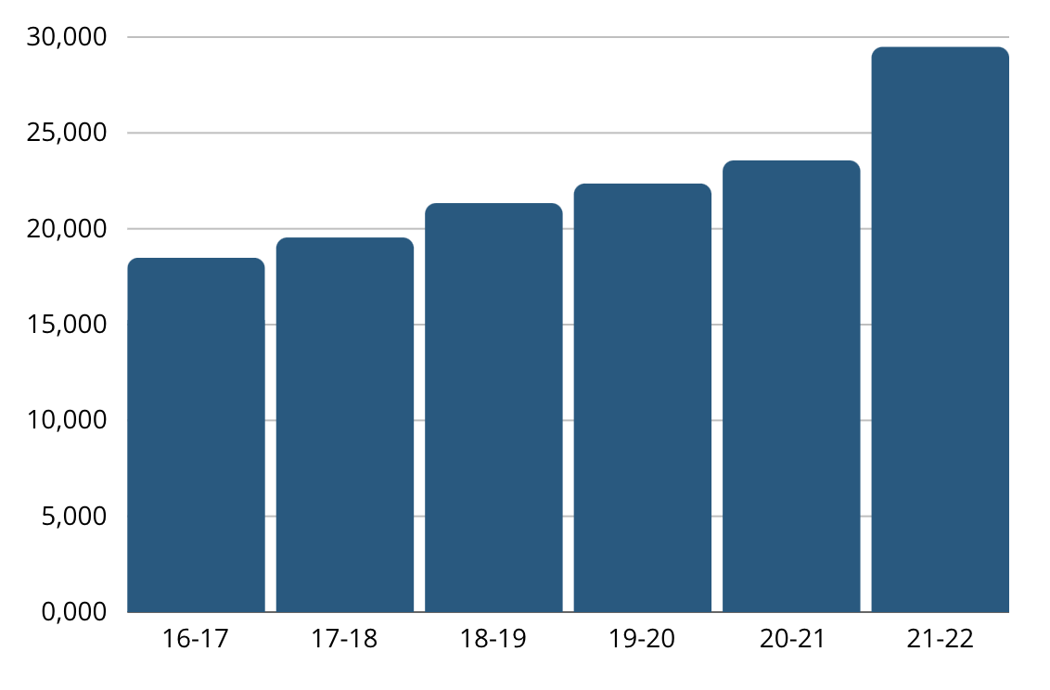
National Due Process Hearings
https://www.cadreworks.org/national-state-dr-data-dashboard
exceptionallives.org
Notes:
Due process hearings have been on the rise in the last several years, with a noticeable increase since COVID

Slide 10




National Due Process Hearings
IEP components
IEP team
Parent participation
IEP development
Zirkel, P. A., & Hetrick, A. (2017). Which Procedural Parts of the IEP Process Are the Most Judicially Vulnerable? Exceptional Children, 83(2), 219-235.
Accessed July 22, 2024: https://doi.org/10.1177/0014402916651849
exceptionallives.org
Notes:
Ask participants: what do you think was the most frequently tried IEP- related procedural violation in national due process hearings?
Click to reveal the correct answer: parent participation
Parent participation= The IEP team significantly impeded the parents’ opportunity to participate in the decision-making process regarding the provision of FAPE to the child;
Citation:
Zirkel, P. A., & Hetrick, A. (2017). Which Procedural Parts of the IEP Process Are the Most Judicially Vulnerable? Exceptional Children, 83(2), 219-235. https://doi.org/10.1177/0014402916651849
To provide a missing piece to the legal foundation of professional development and practice for the individualized education program (IEP) process, the authors report the results of a comprehensive systematic analysis of court decisions specific to IEP-related procedural violations after the 2004 amendments of the Individuals With Disabilities Education Act. Research questions focused on the frequency and outcomes of alleged procedural violations in the following categories: (a) IEP components, (b) IEP team, (c) parent participation, and (d) IEP development. Procedural violations in the parent participation category were the most frequently adjudicated; the outcomes ratio in court averaged approximately 3:1 in favor of school districts for cases across all four categories. Implications for practice include reconsideration of current policies and practices to whatever extent that they were based on case law rather than proactive priorities, per the lack of differentiation in prevailing publications and presentations in special education.
According to a recent study by Zirkel and Hetrick, what do you think was the most frequently tried IEP- related procedurally violation in national due process hearings/
Significantly impeded the parents’ opportunity to participate in the decision-making process regarding the provision of FAPE to the child;
Zirkel, P. A., & Hetrick, A. (2017). Which Procedural Parts of the IEP Process Are the Most Judicially Vulnerable? Exceptional Children, 83(2), 219-235. https://doi.org/10.1177/0014402916651849
To provide a missing piece to the legal foundation of professional development and practice for the individualized education program (IEP) process, the authors report the results of a comprehensive systematic analysis of court decisions specific to IEP-related procedural violations after the 2004 amendments of the Individuals With Disabilities Education Act. Research questions focused on the frequency and outcomes of alleged procedural violations in the following categories: (a) IEP components, (b) IEP team, (c) parent participation, and (d) IEP development. Procedural violations in the parent participation category were the most frequently adjudicated; the outcomes ratio in court averaged approximately 3:1 in favor of school districts for cases across all four categories. Implications for practice include reconsideration of current policies and practices to whatever extent that they were based on case law rather than proactive priorities, per the lack of differentiation in prevailing publications and presentations in special education.

Slide 11
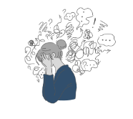
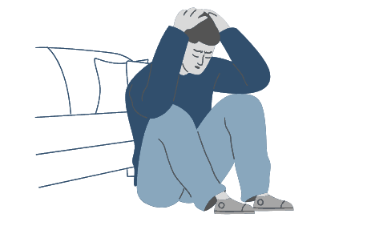


Conditions for Conflict
exceptionallives.org
Notes:
Let me tell you a story:
Last week, I had a doctor’s appointment and it wasn’t the best experience. Now I’m not the kind of person to write negative reviews or plaster my bad experience all over social media. But if I was… Let me tell you what happened.
I was told to get there early to fill out paperwork. So I did! My appointment was at 1:00 and I got there at 12:45. As someone who is notorious for running late, I thought I was doing good! When I arrived at the reception area, however, the receptionist asked for my name and started checking me in. Before she could even get the paperwork pulled together, she said to me, “Oh, you were supposed to be here at 12:30 to fill out paperwork. We’re going to have to hurry to get this done before your appointment time.” Really? How long does it take to fill out a few forms? And why did this person even feel the need to say anything at all? Just give me the forms and let me get to work. How was I supposed to know? This made me extremely frustrated.
When the nurse came back to get me at 1:00- I had my forms complete, thank you very much- she ran my vitals and rattled off two numbers for my blood pressure. Now I know that I should probably know what those numbers mean but I was already a bit upset and couldn’t remember- Do I want one number to be higher than the other? Is the first number supposed to be higher than the second one? What was my blood pressure last time I was here? What’s a normal blood pressure? I felt confused but the nurse had already walked away and I assumed I was supposed to follow.
Once in the examination room, the nurse asked me a few more questions and then left the room without making eye contact. Now remember, I’m at the doctor’s office. Even as someone who is relatively healthy, there’s always this lingering concern “what if they find something wrong with me?” So now, on top of feeling a bit anxious, I am now frustrated by these new rules about getting there 30 minutes before my appointment time (why have an appointment time if it’s not the real time? Just tell me my appointment is at 12:30 if that’s what time you want me there. In case you couldn't tell I’m a bit sensitive about being late to things). And now I’m confused about my blood pressure and whether I’m going to have a stroke or a heart attack.
When the doctor comes in, it’s clear that she’s in a hurry. No small talk, no “how are you today”, just straight to the point. When I asked her a question, she gave me the name of a website to check out. Within 10 minutes, she was on to the next patient. Do you think that I left there trusting her expertise? That I was healthy and, not, in fact, going to die of a stroke or heart attack? Absolutely not. Instead, I left feeling anxious, confused, frustrated, and distrustful. When I received the link to provide feedback, you can bet I had a thing or two to say!!
Do your families ever leave IEP meetings feeling this way? I’m sure we all would say “I hope not” but the reality is that, I doubt my doctors’ office thought so either!

Slide 12
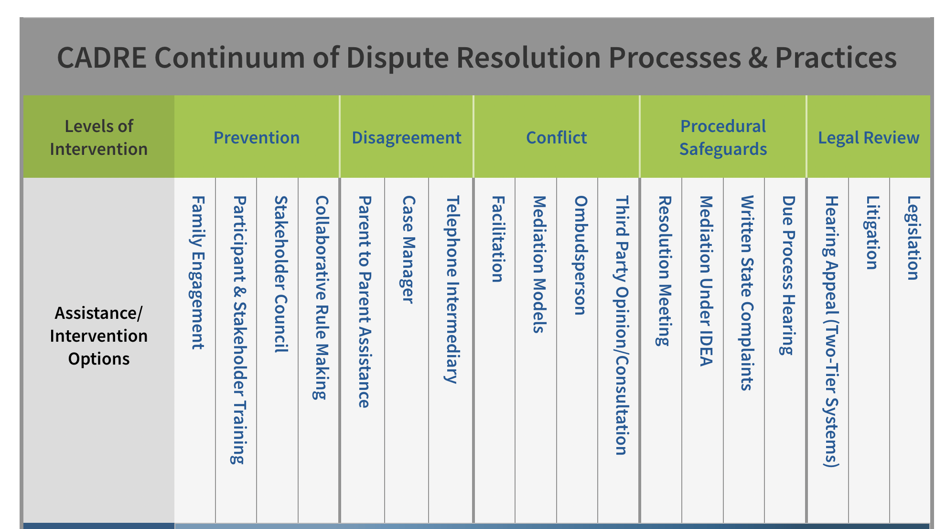
The ADR Continuum
exceptionallives.org
Notes:
Where does family engagement fall within the continuum?

Slide 13

What is real family engagement and why does it matter in SPED?
exceptionallives.org

Slide 14
Family involvement or family engagement?
Involvement | Engagement
School-based activities: school plays, PTO coffee, potlucks, etc. | Takes place both at home and in school
General announcements and mingling with many families | Focus on individual family and student
Directed by the school | Relationship-building, efforts in both directions
Success measured by turnout | Mutual understanding and feeling of being heard and seen
exceptionallives.org

Slide 15

Key elements of family engagement
Clear communication
Both sides build trust
Asset-based view
Power dynamic
Collaboration
exceptionallives.org

Slide 16
Tailoring family engagement for SPED families
Elements:
For SPED:
Clear communication | More frequent communication: make sure it’s clear and invite feedback
Both sides build trust | Be explicit about wanting to build trust and work together
Asset-based view | Emphasize the assets of the family and student and include them in the planning
Power dynamic | Treat families as equals: and make this clear
Collaboration | Families and also team members: SPED, admin and GenEd
exceptionallives.org

Slide 17

Building trust and relationships starts before the IEP meeting
exceptionallives.org

Slide 18

Building relationships before the meeting
Why is this important?
How do you do it?
exceptionallives.org

Slide 19
Barriers to family engagement
exceptionallives.org

Slide 20
What barriers have you experienced in your efforts to engage families?
exceptionallives.org
Notes:
Small group discussion and share out

Slide 21




Barriers to Family Engagement
Time
Resources
Worry
Lack of participation
exceptionallives.org
Notes:
Add graphics to represent the most common barriers:
time
resources
lack of engagement from families
fear of conflict (saying the wrong thing)- barrier to building strong relationships

Slide 22
We must think differently about how we engage families in Special Education!
exceptionallives.org
Notes:
Small group discussion and share out

Slide 23

Re-imagining family engagement in Special Education
exceptionallives.org
Notes:
How do we mitigate the barriers identified? RELATIONSHIPS
Time
Resources
lack of engagement
power dynamics
family experiences in school
fear
Fear of staff that they’ll say the wrong thing
families
district
state
outside organizations (moms for liberty)
Website review
Existing opportunities
IEP meeting/special education processes
relationships matter

Slide 24




How Do We Build Trust With Families?
Become a reliable source of information
Provide opportunities for feedback
Offer networking and support opportunities
Conduct collaborative IEP meetings
exceptionallives.org
Notes:
Start with the way we get information these days. When you want to know more about something what do you do? [search online]
Information: Where do your families go for information? Do they go to your website? Does that provide honest, reliable, and transparent information? If you were a family member that just found out your child was being tested, or were preparing for their first IEP meeting, could they trust the school based on what they find on your website? Or would they have to look elsewhere? Where do you think they might look instead? [FB groups, advocacy groups, etc]
Feedback: How do families provide input and feedback? Are there opportunities for families to share information about their experiences? Are there opportunities for families to share their feedback when considering changes or improvements?
Networking and Support:
Collaborative IEP meetings

Slide 25

Every communication is an opportunity to build trust or lose trust.
exceptionallives.org
Notes:
With families and your teams.
“The single biggest problem in communication is the illusion that it has taken place.” - George Bernard Shaw
Building trust

Slide 26





What do we mean by communication?
 | Written | Verbal
 | Non-verbal | Cultural context
 | Listening
exceptionallives.org

Slide 27

Strategies for great communication
Keep it human. Use your empathy.
Keep it moving in both directions. Ask questions. Listen.
Be explicit that you’re a team and you value their input.
Keep it clear and simple. Use Plain Language.
exceptionallives.org

Slide 28

Helping families navigate the SPED process
exceptionallives.org

Slide 29

The IEP process
Referral
Consent
Evaluation
Eligibility meeting
Sign IEP
Services start
Monitor progress
exceptionallives.org

Slide 30

What do families need to know?
Acronyms and jargon
The evaluation process
Their rights through IDEA
Timelines
Who to contact with questions
How to collaborate with the school to best support their child!
exceptionallives.org

Slide 31

Let’s discuss:
Why do IEP meetings not go well?
What is a reason a parent files a complaint?
exceptionallives.org
Notes:
Turn and discuss with shoulder partner. Ask for a few answers.

Slide 32
At the meeting: tips to make it positive
Preparation
Do introductions and have an agenda
Actively listen
Be aware of the power dynamic
Explicitly value the family’s contributions and ideas
Make sure they understand everything–encourage questions
Keep it human
exceptionallives.org

Slide 33
What’s next?
How to keep relationships going in between meetings?
It's important to follow up
Monitor child’s progress and make sure family knows how to interpret progress reports
How do you stay in touch with the family?
Regular check-ins? Does anyone do those?
Recognize the family’s need for other services
exceptionallives.org

Slide 34
Review
&
Resources
exceptionallives.org

Slide 35


Bottom line: recap
Family engagement is critical for SPED families. It takes intention, commitment, and grace.
Clear, respectful communication builds trust with families and helps them engage with their child’s education.
Families need to learn about Early Intervention and Special Ed. When schools help, it can strengthen the relationship.
Share resources that are easy to understand.
exceptionallives.org

Slide 36
Resources from Exceptional Lives
Special Ed Hub
IEP Welcome Kit
Articles, blog posts, videos, and podcasts on Early Intervention and the transition into Special Ed.
(en español)
Customizable tools for welcoming families new to the IEP process.
SPED Glossary
(en español)
Disability Services Finder
(en español)
Tools for Educators
Other Supports for Families
Resources and tools for teachers, administrators, and support staff working with families in Special Education.
SSI & Financial Benefits
Health Insurance (inc. Medicaid)
Reading & Literacy
Autism Information
Disability Services Finder
exceptionallives.org

Slide 37
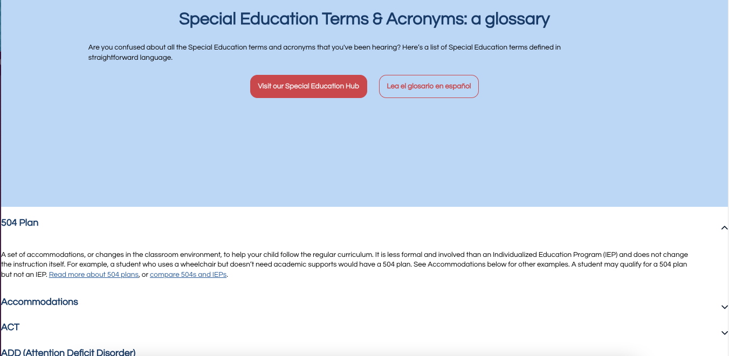
Special Education Glossary
exceptionallives.org

Slide 38
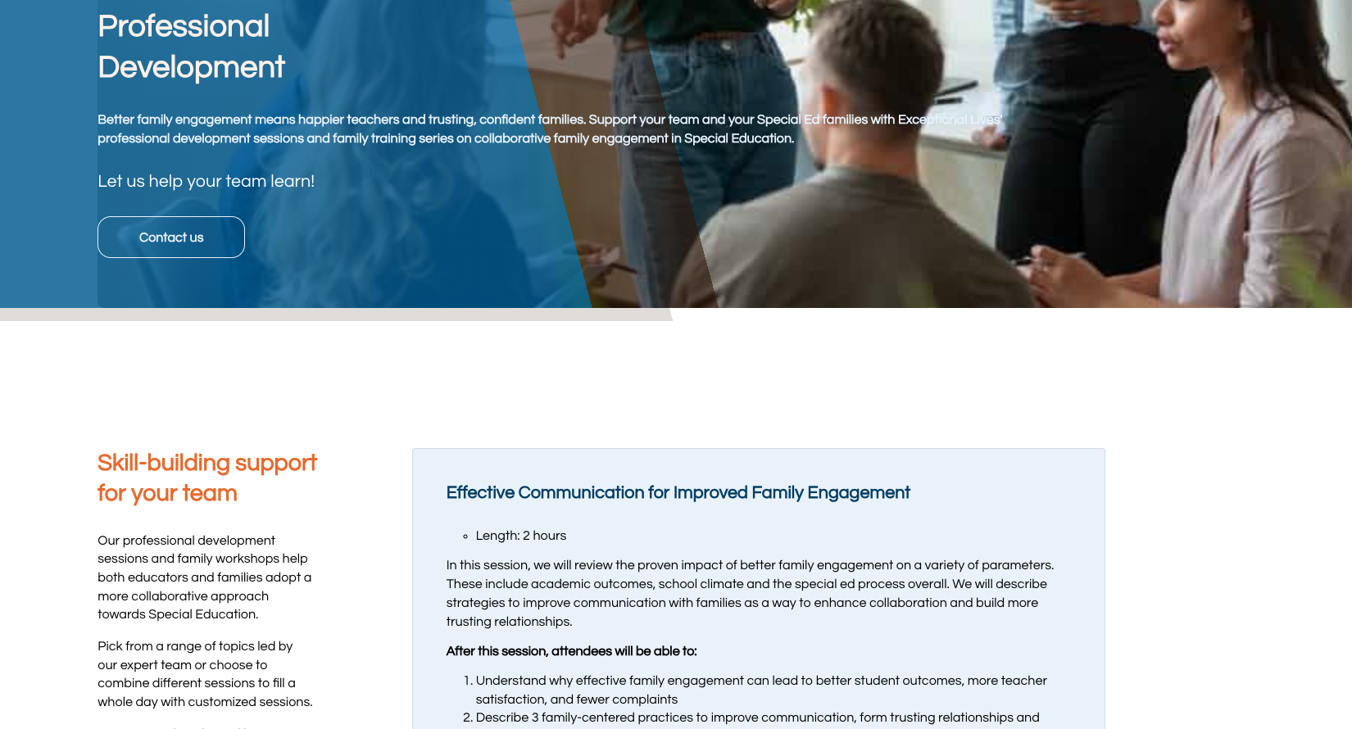
Professional Development Offerings
exceptionallives.org

Slide 39
Quick links to specific resources:
Building a school climate that welcomes families of children with disabilities
How to communicate with parents of SPED students: 5 tips for an IEP veteran
Using Plain Language for effective communication with parents
Introducing families to SPED
exceptionallives.org

Slide 40
Discussion questions for your team
How do you communicate with families to explain the Special Education process?
What does your school do to encourage family engagement?
How can you do better? Think about:
Getting buy-in
Building awareness
Creating policies
Offering training
exceptionallives.org

Slide 41

Reflection:
What is one thing you’ll do differently as a result of this training?
Keep in Touch!
Slides and newsletter
nell.questcurran@exceptionallives.org christina.kozik@exceptionallives.org
exceptionallives.org

Slide 42
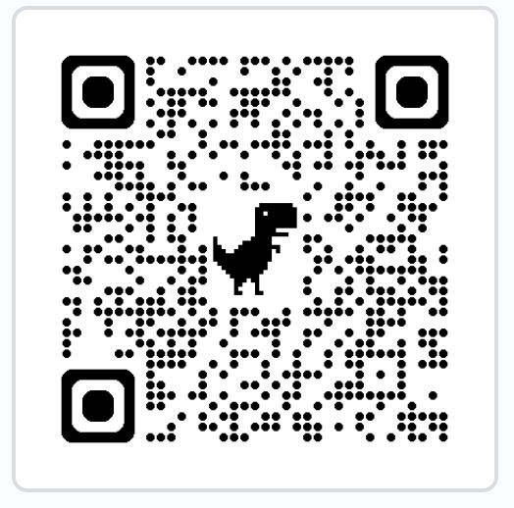
Theresa Nicholls
tnicholls@partneredsolutions.org
615-207-3594
www.partneredsolutions.org

