Slide 1
Enhancing Hawai‘i’s Dispute Resolution System: A Collaborative Journey with Educational and Community Partners
Allison Eby, Hawai‘i State Department of Education
Amanda Kaahanui, Special Information Parent Network (SPIN)
Brikena White, Hawai‘i State Department of Education
Jasmine Williams, Parent/Grandparent of a Student with a Disability
Steven Vannatta, Community Children’s Councils

Slide 2
Session Description
This session will explore the Hawaiʻi State Department of Education’s (HIDOE) journey and innovative efforts to enhance its Dispute Resolution System by engaging educational partners and community organizations. HIDOE has transformed its approach to conflict resolution by leveraging alternative collaborative dispute resolution methods, such as IEP facilitation, mediation, and conflict resolution training for staff and parents.
The presentation will be facilitated by HIDOE’s Monitoring and Compliance Branch in collaboration with the Special Education Advisory Council (SEAC). HIDOE’s journey in improving its Dispute Resolution System highlights the power of community engagement, cross-sector collaboration, and culturally sensitive practices. HIDOE has created a more inclusive and effective system for resolving conflicts through educational outreach, training, and integrating alternative dispute resolution options.

Slide 3
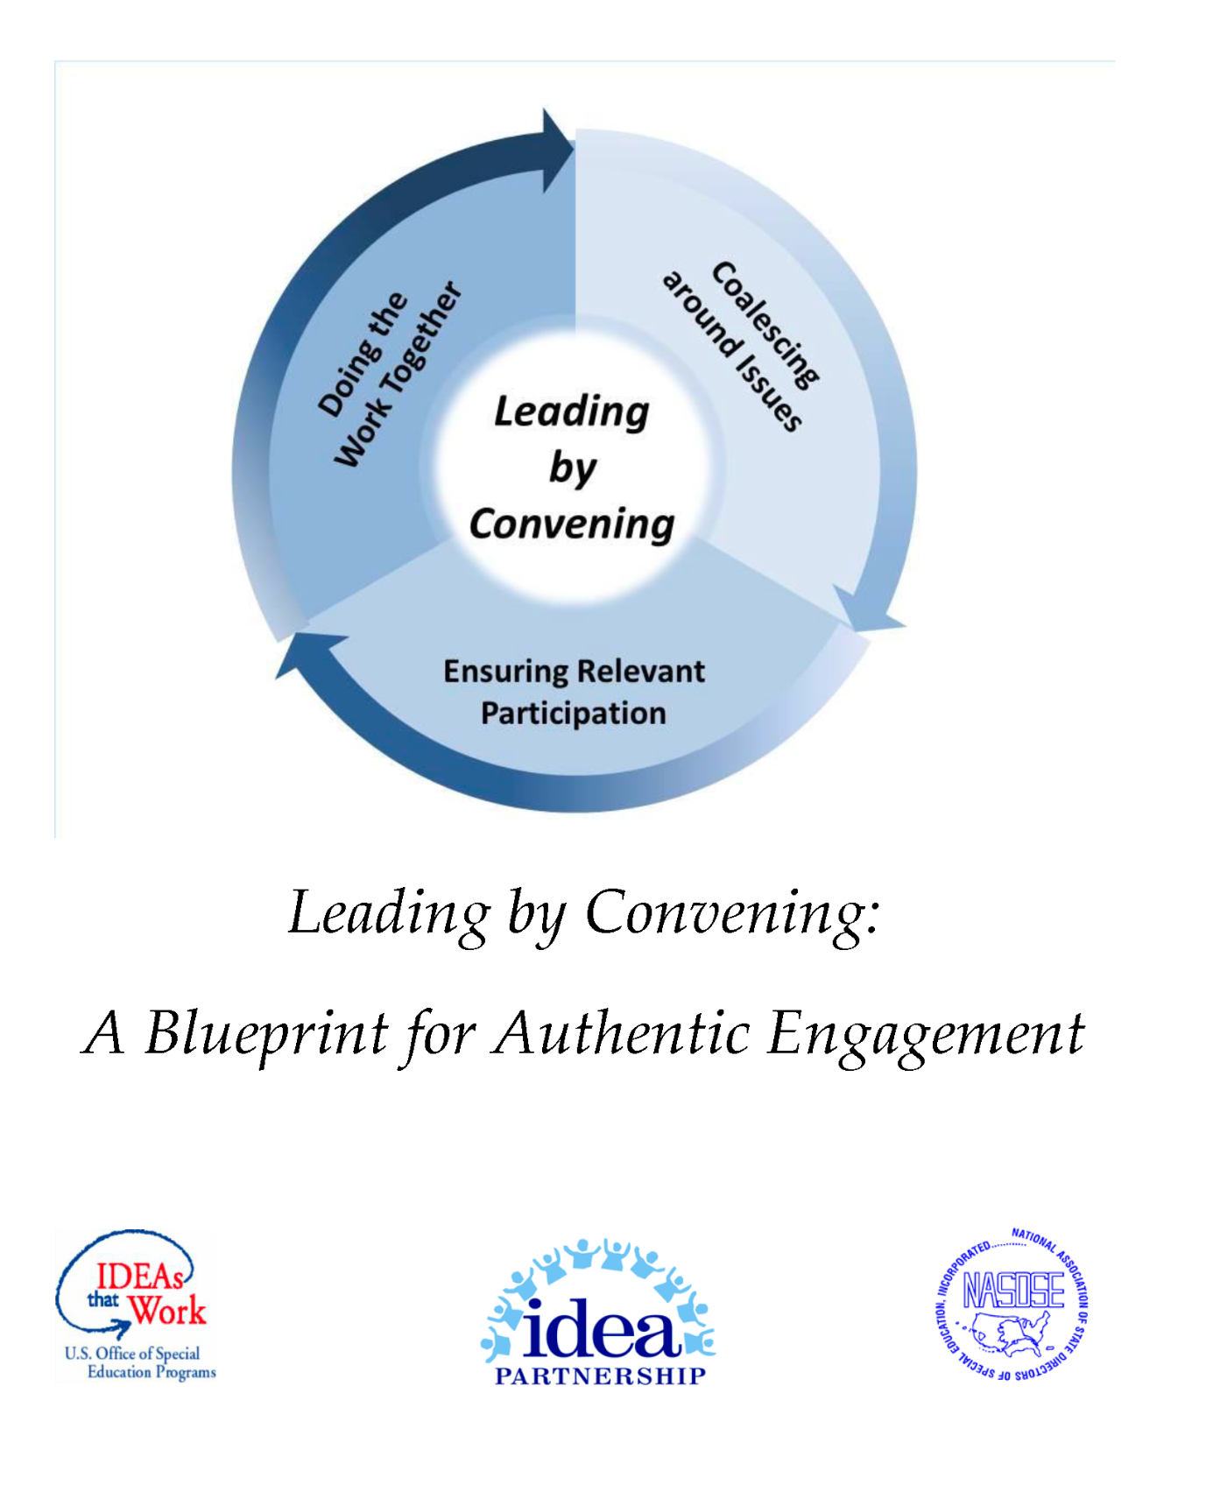
Leading By Convening
Preparing our students for Hawai‘i’s future depends on our united, collective effort — ne‘epapa.
The Leading by Convening becomes a reality when we routinely:
Coalesce Around Issues
Ensure Relevant Participation
Do the Work Together

Slide 4

A Glance at Hawaiʻi State Department of Education
One SEA/LEA
Schools - 296
Student Enrollment - 165,347
Economically Disadvantaged - 41%
Special Education Students - 12%
English Language Learners - 10%
Official Languages
English & Hawaiian
Most Common Languages
Ilocano, Chuukese, Marshallese, Tagalog, Spanish, Japanese, Mandarin, and Samoan

Slide 5

Globally Competitive, Locally Committed
We envision a K-12 public education system that prepares all graduates to be Globally Competitive, Locally Committed. That means our students not only have the academic knowledge and skills to thrive and be successful, but also possess that special sense of responsibility to give back to our communities and island home.

Slide 6
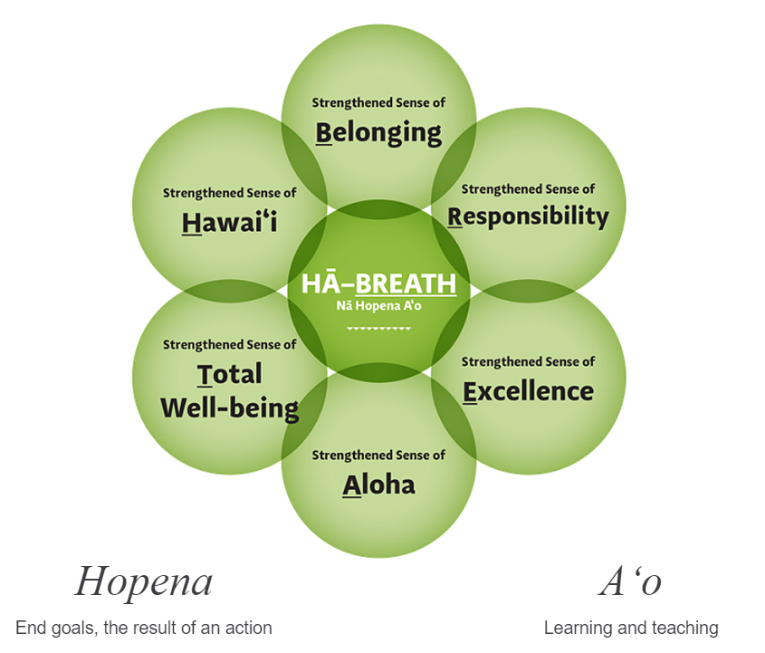
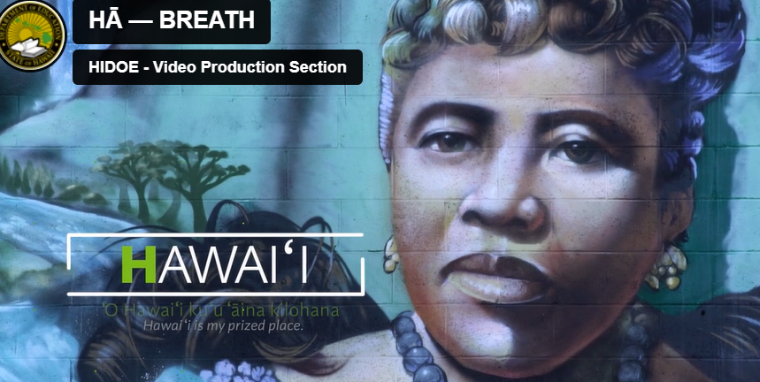
Nā Hopena A‘o HĀ: BREATH
What makes Hawai‘i a place unlike anywhere else are the unique values and qualities of the indigenous language and culture. ‘O Hawai‘i ke kahua o ka ho‘ona‘auao. Hawai‘i is the foundation of our learning. The following learning outcomes, Nā Hopena A‘o, are rooted in Hawai‘i, and we become a reflection of this special place.
Nā Hopena A‘o HĀ: BREATH

Slide 7
Dispute Resolution Improvements
HIDOE collaborated with WestEd consultants to conduct interviews and surveys on the dispute resolution system
Reviewed procedures, procedural safeguards, data systems, and public materials
Analyzed findings using a Strengths, Weakness, Opportunities and Threats (SWOT) framework
Developed recommendations to strengthen systems and partnerships

Slide 8
Recommendation Highlights
Update and translate State Complaint and Due Process forms
Develop parent and community guidance for completing the forms
Simplify and tailor the Procedural Safeguards Notice (PSN) in an understandable format
Train administrators and parents on conflict resolution and mediation skills
Increase mediation awareness among parents and staff

Slide 9
Recommendation Highlights Cont…
Establish policies and procedures for data collection
Develop business rules for data management
Generate and analyze dispute resolution data
Partner with the Special Education Advisory Council (SEAC), and parent support and training centers to co-develop accessible informational materials for parents
Conduct parent trainings to increase understanding of dispute resolution option and promote early collaborative problem-solving

Slide 10
Building Capacity
Statewide training for Administrators, District Educational Specialists, State Office Staff, Parents, Advocates and Parent Support and Training Centers by Special Education Solutions, LLC & Mediation Center of the Pacific.
Individuals with Disabilities Education Act Training for Underrepresented Parents (Pro Se)
IDEA Boot Camp: Building Capacity in Special Education Law
Conflict Resolution and Mediation Training

Slide 11
Community Children’s Council (CCC)
Local Forums for Systemic Impact
Role & Mission | Activity & Focus | Collaboration
Host forums in 17 Hawaiʻi communities Unite members as equal partners to address systems-level issues Advance solutions that benefit all students, families, and communities | Safe, welcoming space for community engagement Build relationships & solve problems together Volunteer opportunities to strengthen communities Focuses on needs, resources, and activities | Collaborate across agencies serving children: Education Medical Vocational Judicial

Slide 12
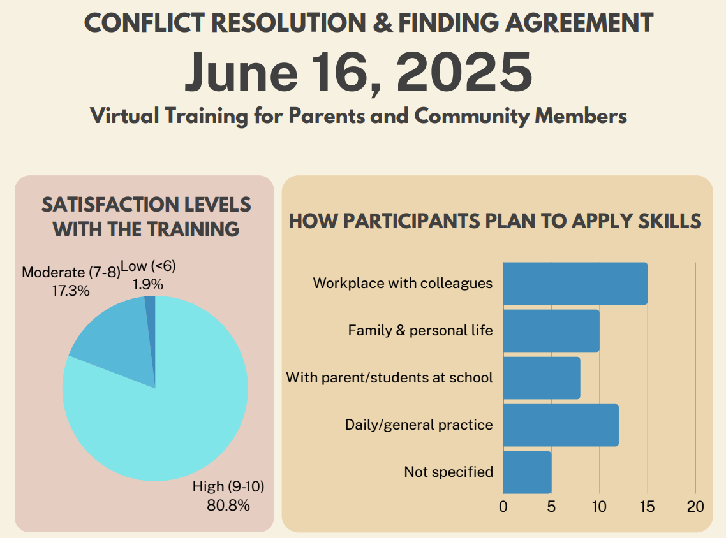
Conflict Resolution & Finding Agreement
What Did Participants Learn?
Communication tools & techniques
Practical application through practice
Understanding conflict styles and perspectives
Personal growth and mindset shifts

Slide 13
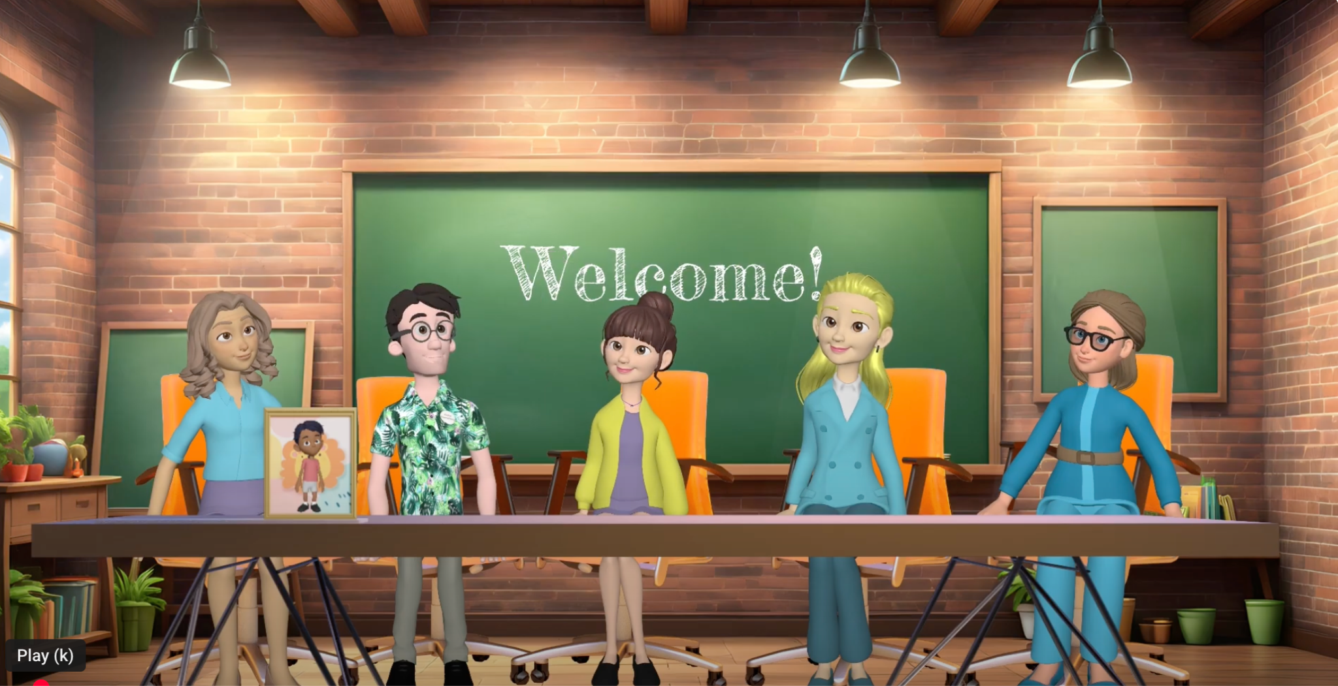

Interests & Position
Video
YouTube:

Slide 14
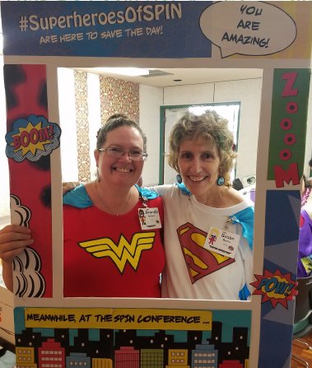
SPIN - 42 Years of Advocacy
Who We Are
A two-mama team dedicated to empowering families.
Susan Rocco – 41 years with SPIN
Amanda Kaahanui – 11 years with SPIN
What We Do
Partner with HIDOE through an annual contract to provide:
Family information and resources
Support for the Advisory Council - SEAC
An annual statewide parent conference
https://spinhawaii.org/; https://spinconference.org/

Slide 15
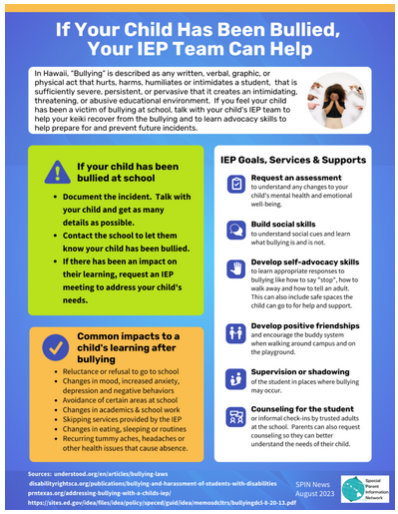
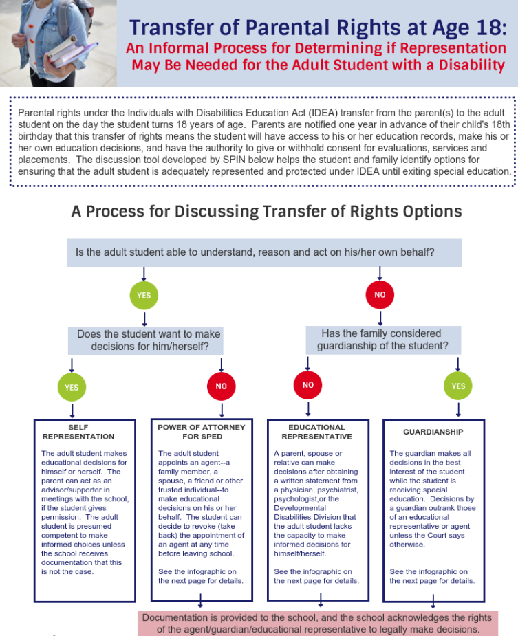
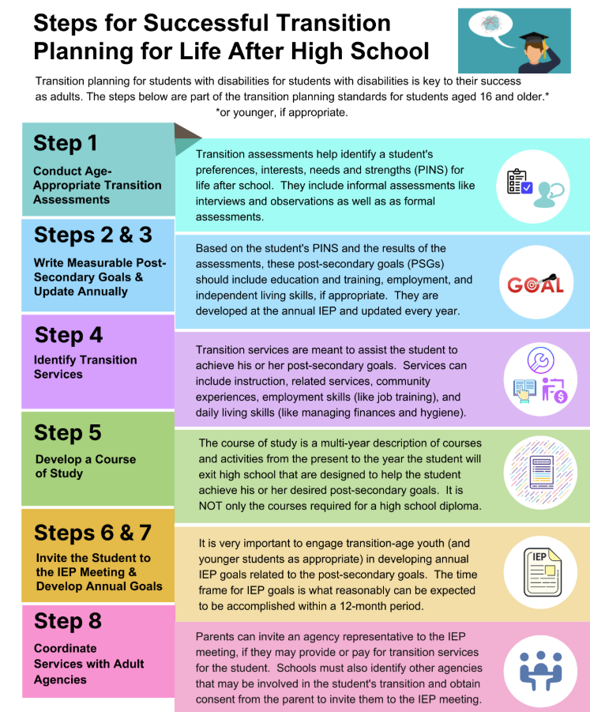
Infographics
Partner with HIDOE to develop infographics to help parents better understand the special education process and rights.
https://spinhawaii.org/infographics/

Slide 16
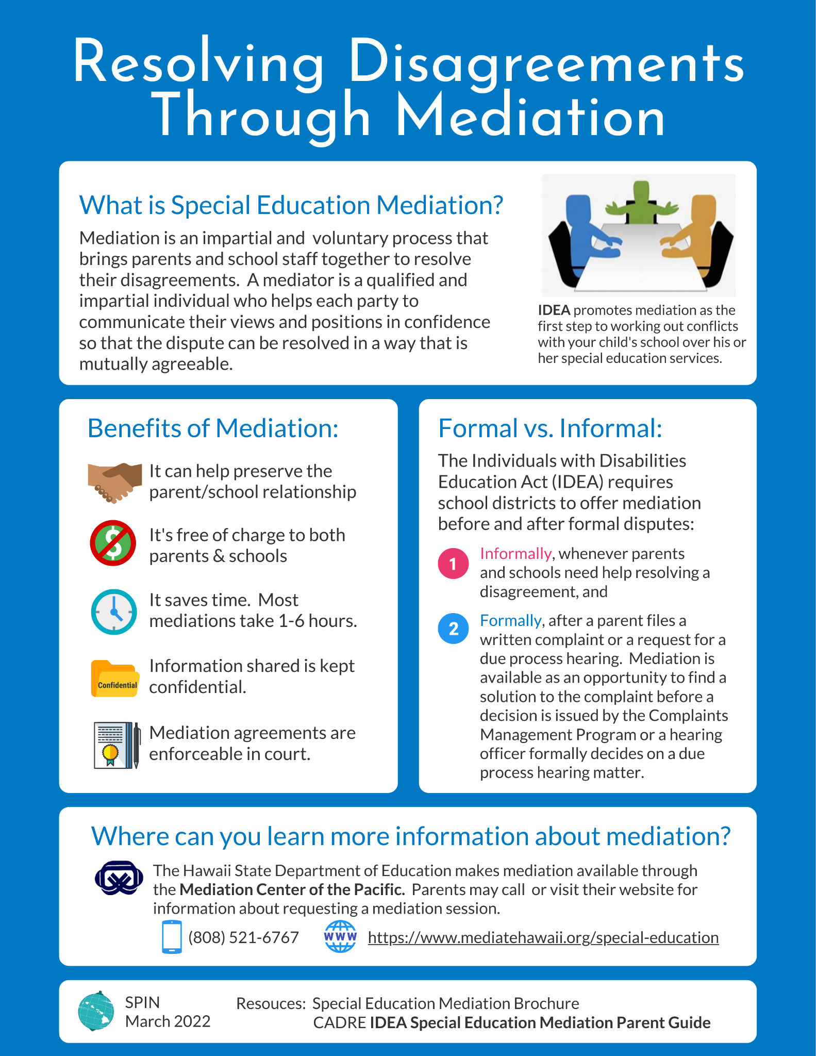
Resolving Disagreements Through Mediation
Mediation can be confusing for families unfamiliar with the process. Developing clear, visual infographics helps parents understand what mediation is, how to access it, and the benefits it offers. By simplifying complex information, these tools empower parents to participate confidently, make informed decisions, and work collaboratively with schools to resolve special education concerns.
https://spinhawaii.org/school-collection/

Slide 17
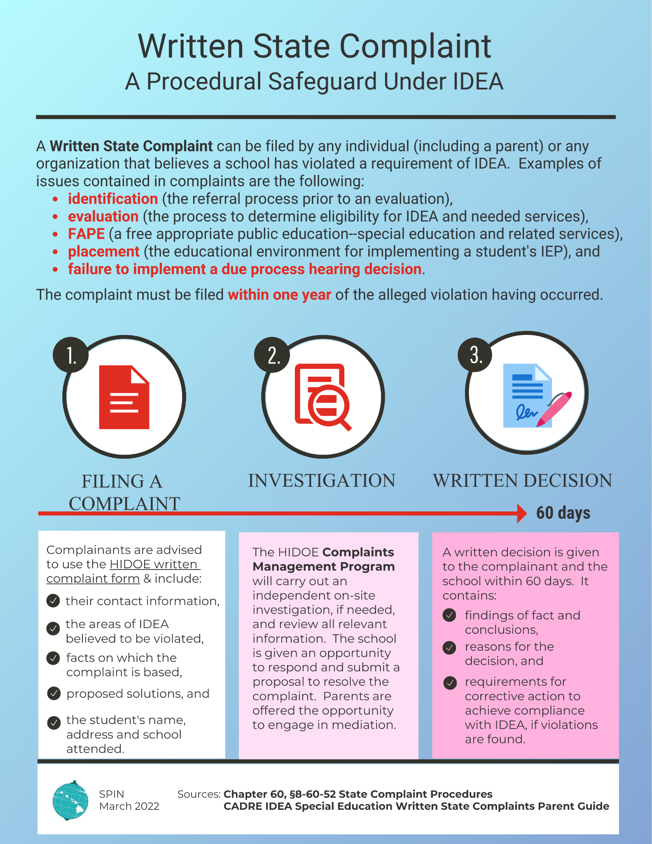
Written State Complaint
Filing a state written complaint can be complex and overwhelming for parents. SPIN’s infographic breaks down the process visually, showing step-by-step instructions, key timelines, and important considerations. By simplifying this information, parents can navigate the complaint process with confidence, ensuring their child’s rights are protected and that they can actively participate in resolving issues.
https://spinhawaii.org/school-collection/

Slide 18
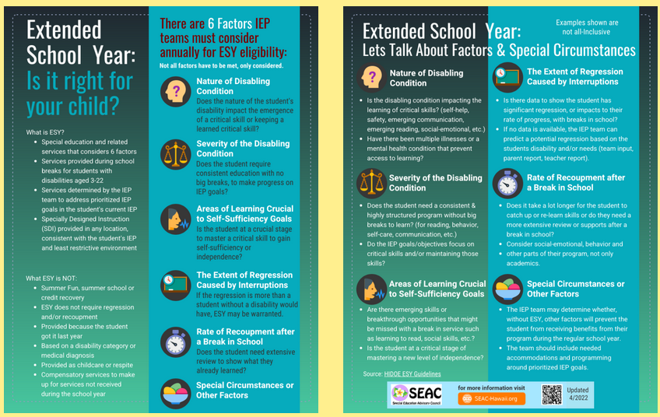
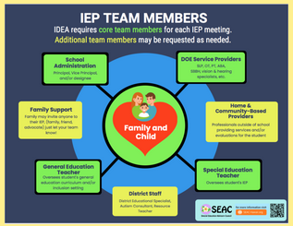
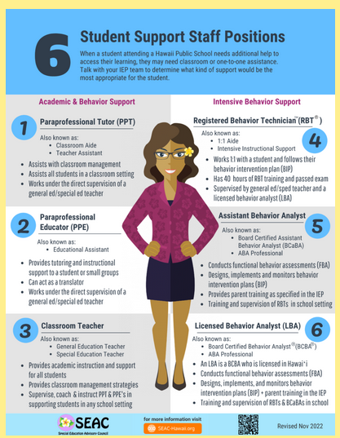
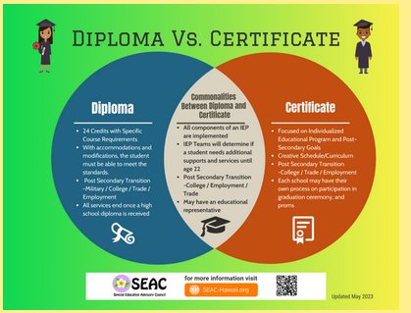
Infographic Development at SEAC Meetings
During monthly SEAC meetings, members and guests collaborate to develop infographics that address issues important to families. These visual tools simplify complex information, making it easier for parents to understand their rights, navigate special education processes, and access support.
https://seac-hawaii.org/infographics/

Slide 19
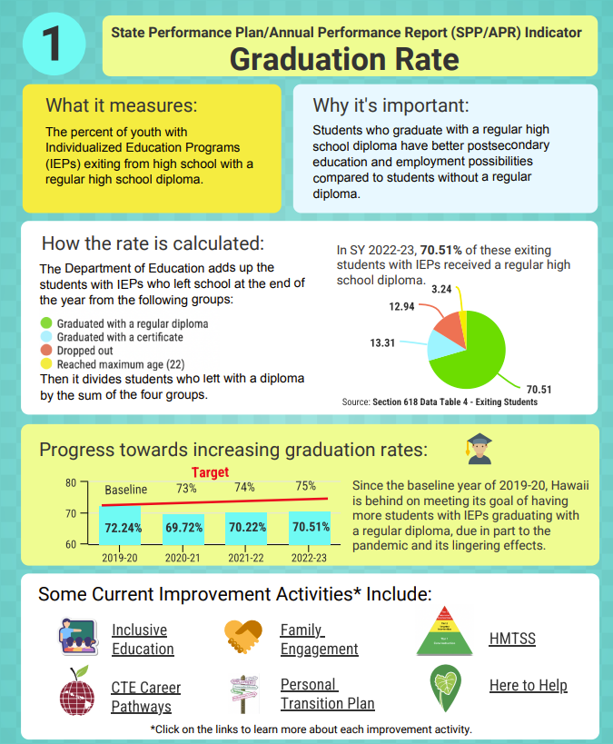
State Performance Plan/Annual Performance Report Engagement
HIDOE engages educational partners through multiple avenues:
Ongoing monthly SEAC meetings
Annual full-day engagement meeting where partners review SPP/APR indicator data and provide feedback on improvement strategies.
For each indicator, infographics are developed to simplify complex data, helping both parents and educational partners understand the information and actively participate in discussions and decision-making.
https://seac-hawaii.org/infographics/

Slide 20
Co-Training with HIDOE Staff
Zoom support for IDEA Boot Camp & Pro Se Training
Guest speaker on partnerships & family engagement at new SPED teacher trainings
Speducator Conference – sessions on IEPs & transition
Special Education & Transition Conferences – statewide participation
SPIN Conference – co-training by parents & teachers to model collaboration
2024 Workshop – conflict resolution strategies co-presented by a parent & HIDOE

Slide 21
SPIN Outreach & Parent Support
SPIN shares resources through multiple voluntary channels, including:
E-Blasts: ~1,000 recipients
Newsletter: ~1,000 recipients
Facebook: ~1,000 followers
SPIN website: <4,000 page views on infographic resources
While these channels are voluntary and do not reach all special education families, they provide critical access to information, helping parents understand their rights, navigate special education processes, and engage confidently with schools.

Slide 22
How do you share information with families?

Slide 23

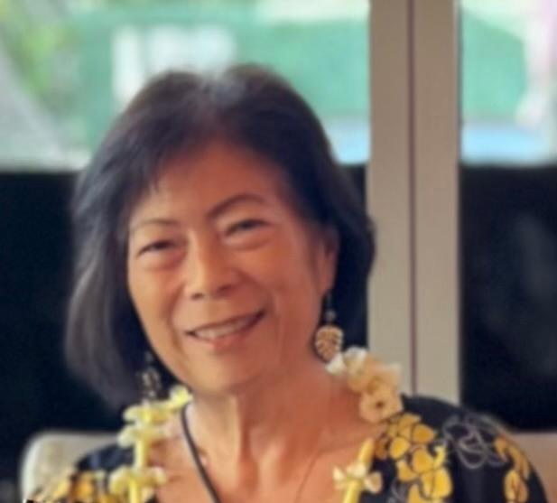
30 + Years of Advocacy
Mother
Grandmother
Advocate

Slide 24
Introduction
To the World of Special Education
Personal advocacy
Special education has its own language, acronyms, procedures, and laws, which can be confusing for parents and families.
Focus on active participation in the IEP team

Slide 25
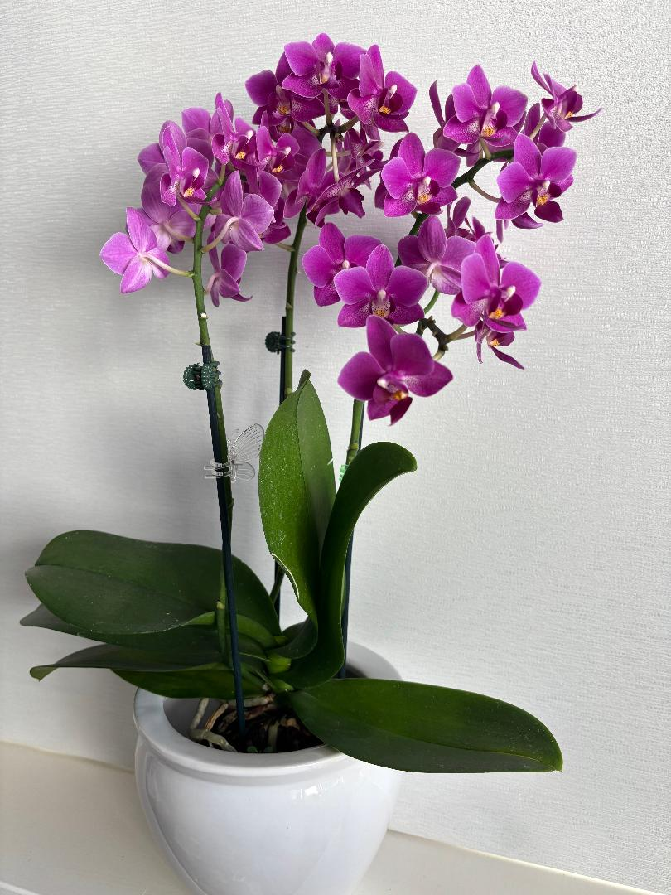
Introduction
To Systems Advocacy
Hawaiʻi Parent Training & Information Center (PTI)
Special Education Advisory Council (SEAC)

Slide 26
Special Education Advisory Council (SEAC)
Membership: 27 members representing a diverse group of parents, individuals with disabilities, and professionals with expertise in special education and related areas. A majority are parents of children with disabilities (age 26 or younger) and persons with disabilities.
Purpose: Provide policy guidance to the Hawaiʻi Department of Education on special education and related services for children with disabilities (34 C.F.R. § 300.167).
Vision: A proactive, supportive public education system that optimizes the achievement of every child through collaboration among students, families, and educators.
Mission: To guide and assist the Hawaiʻi Department of Education in meeting the individual needs of children with disabilities.

Slide 27
SEAC Monthly Meetings
Review and discuss current issues, policies, and data related to special education and related services.
Advise HIDOE leadership on proposed policies, initiatives, and program improvements.
Gather input from families, educators, and community partners to ensure diverse perspectives are represented.
Monitor progress toward improving outcomes for students with disabilities.
Promote collaboration among stakeholders to strengthen the delivery of equitable and effective services statewide.
https://seac-hawaii.org/

Slide 28
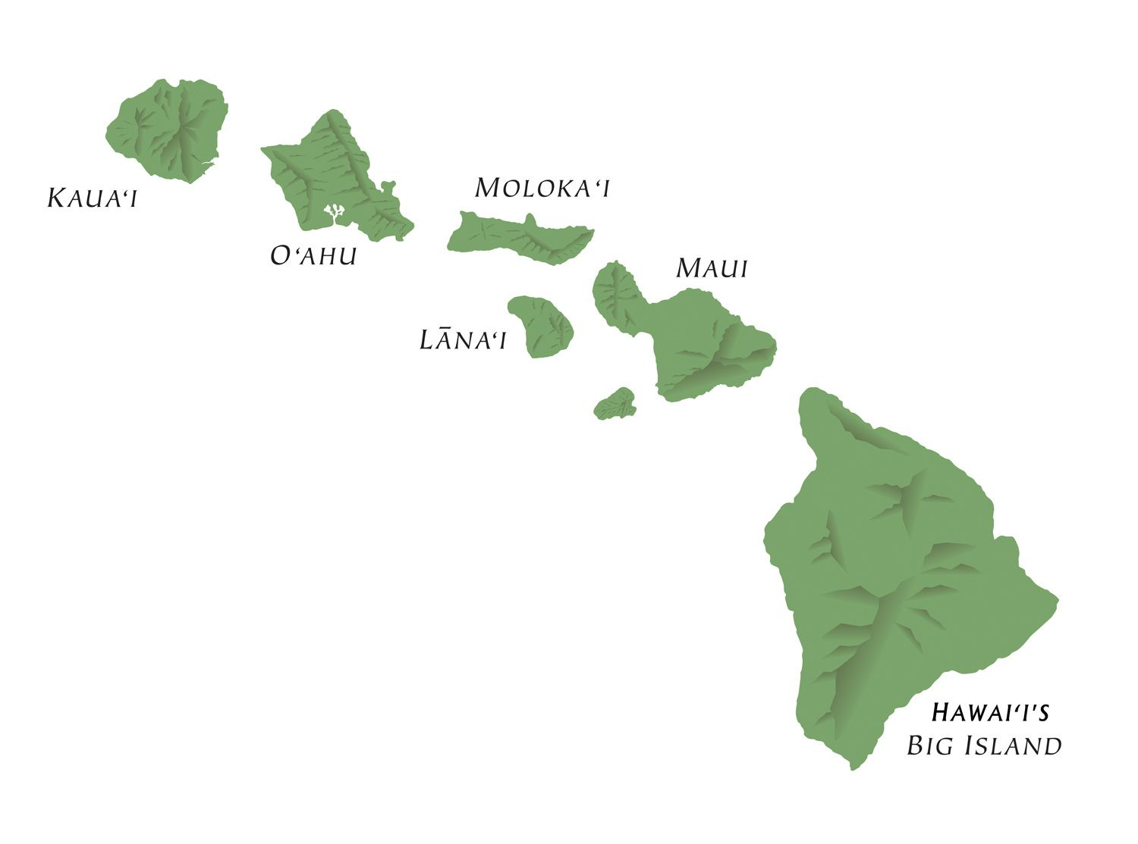
SEAC & HIDOE Priorities
School Year 2025-2026
Preschool
High Quality Individualized Education Programs (IEPs)
Dispute Resolution
Transitions
Early Intervention to HIDOE
Elementary → Middle → High School
Post-Secondary
Joint Training for Parents and HIDOE Personnel
Notes:
J

Slide 29

Legislative Advocacy
SEAC actively engages in legislative advocacy to support students with disabilities.
SY 24-25, SEAC supported
8 Bills, 4 passed.

Slide 30
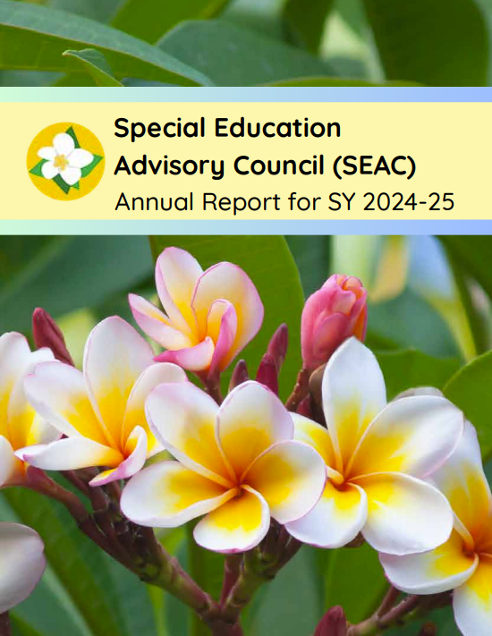
Annual Report
One of SEAC’s most important duties is to advise HIDOE of the unmet needs of students with disabilities.
Annually, based on the HIDOE’s and SEAC’s priorities, and discussions during monthly meetings, an annual report is developed to HIDOE’s Superintendent of Schools.
https://seac-hawaii.org/reports/

Slide 31
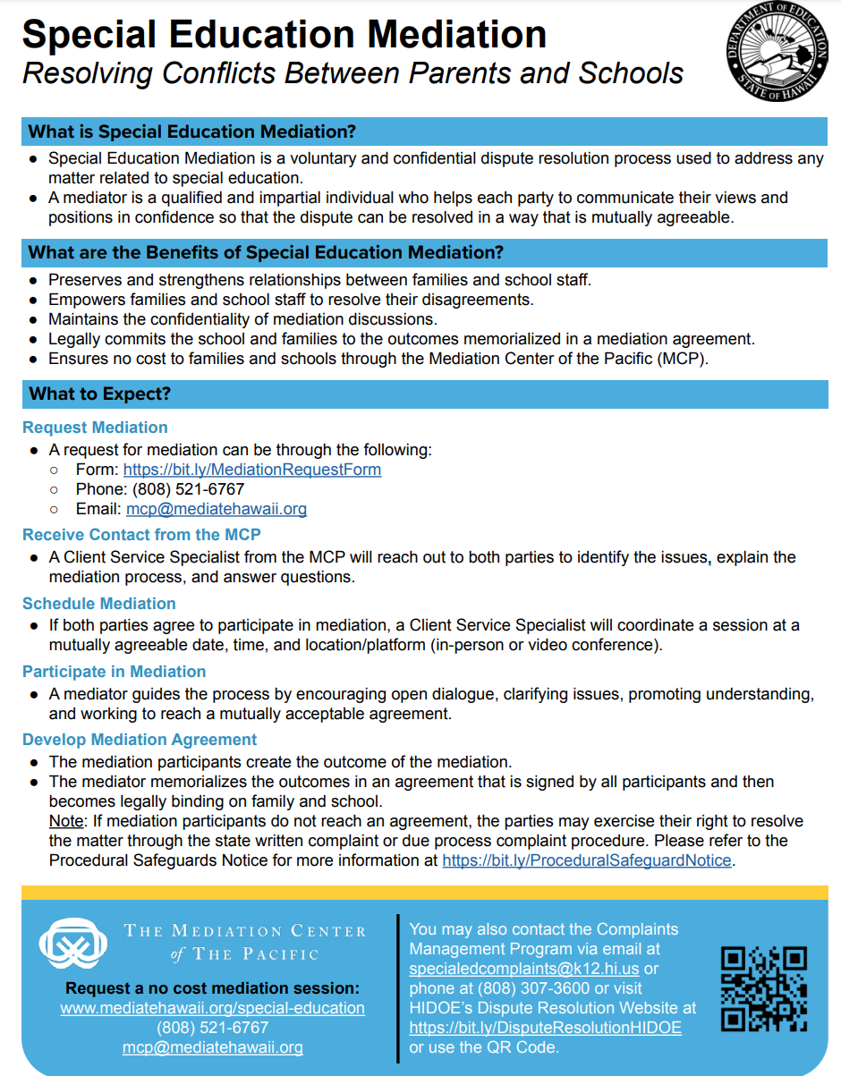
Dispute Resolution
Feedback on Revisions of Materials
Participated in revising/updating Mediation, State Written Complaint, and Due Process model forms and other materials such as flyers
Incorporated feedback from educational partner groups and refined content for clarity and accessibility
Access the updated forms and resources on HIDOE’s Dispute Resolution Website.

Slide 32
Parent Engagement & Collaboration Activity
How does your Department/Local Educational Agencies/Schools engage parents?
How do you work together with State Advisory Panel to make systemic changes?
To parents and advocates - what things have the state/schools done to actively engage you that has made you felt truly listened to?

Slide 33
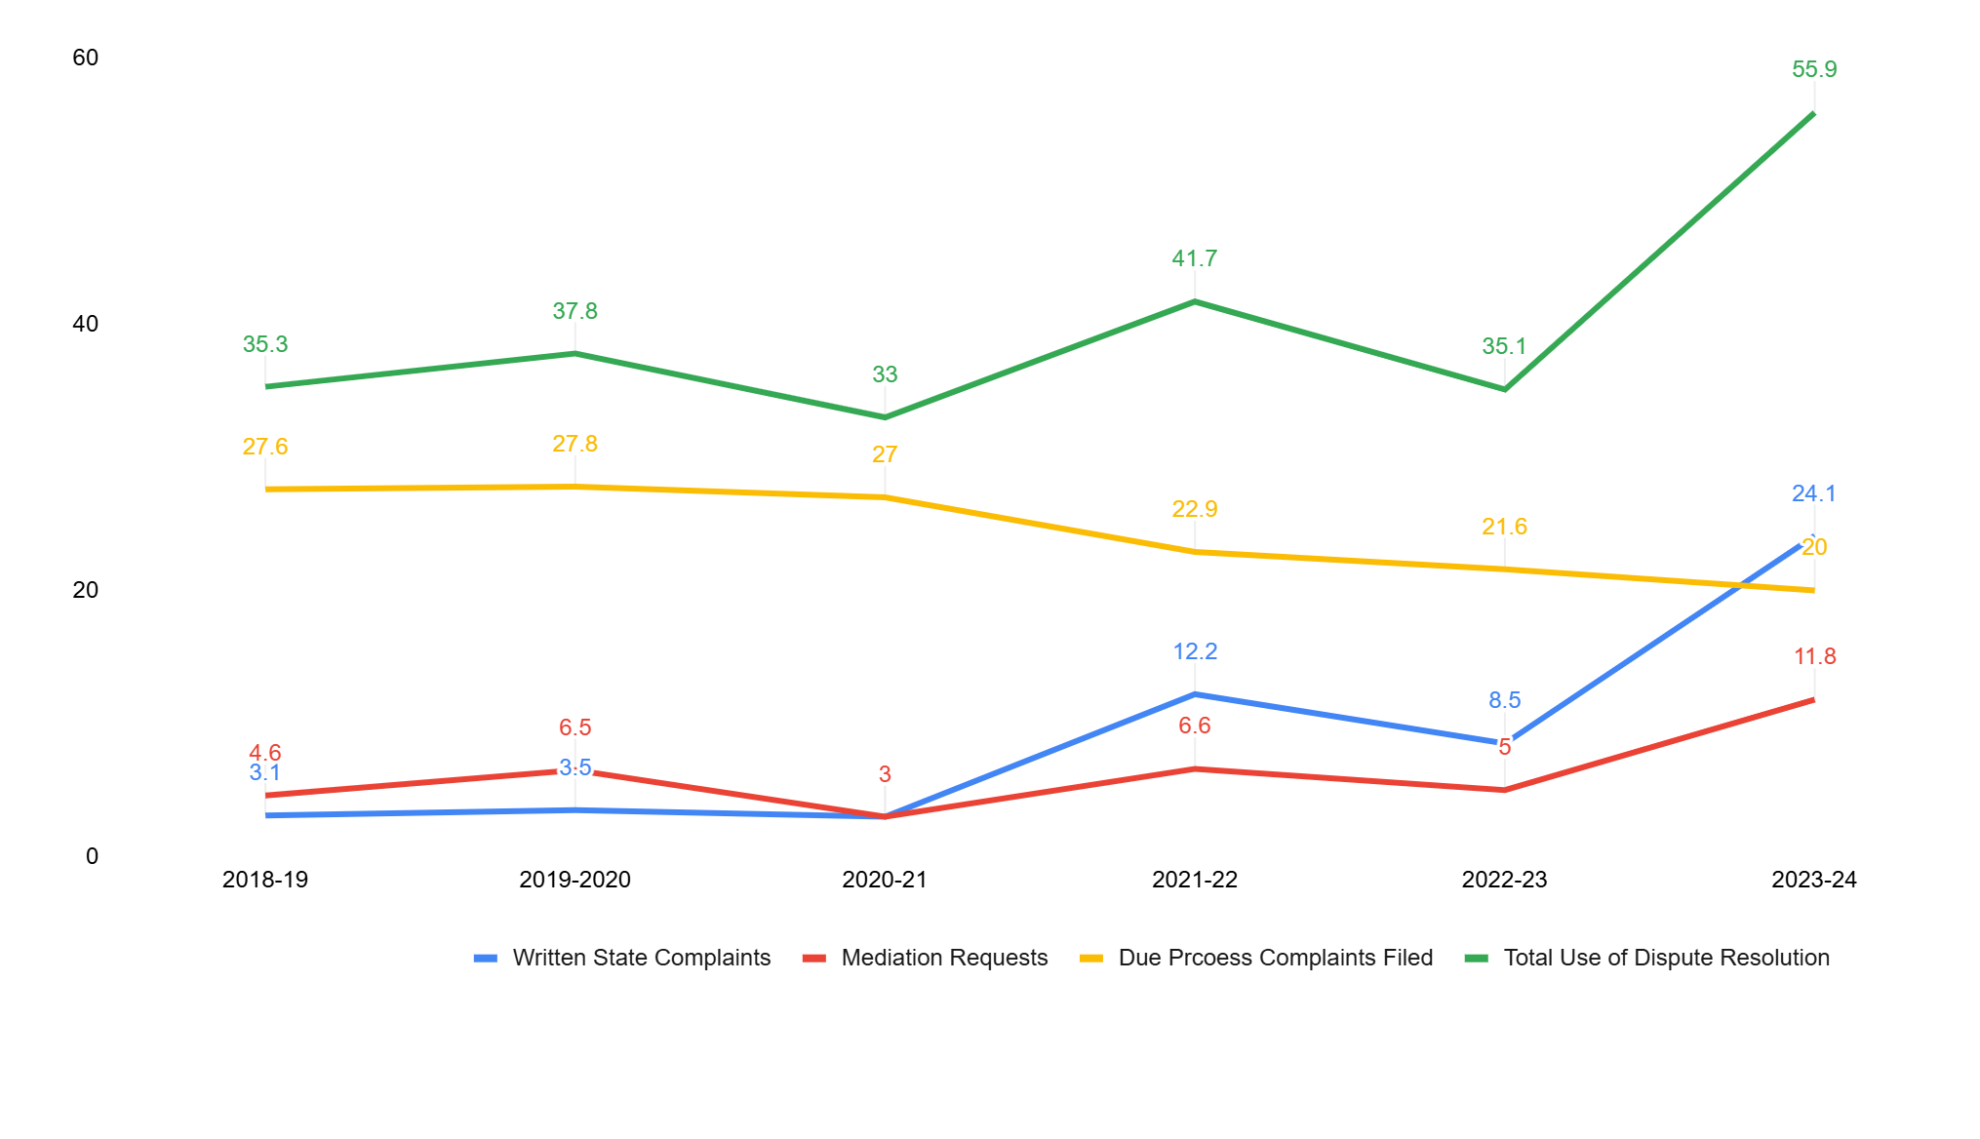
Dispute Resolution Data in Hawai‘i
The Center for Appropriate Dispute Resolution in Special Education (CADRE), Data Dashboard https://cadreworks.org/national-state-dr-data-dashboard

Slide 34
Resources
HIDOE Dispute Resolution: https://hawaiipublicschools.org/school-services/parent-rights/dispute-resolutions-and-mediations/
NCSI Leading by Convening: https://ncsi.wested.org/resource/leading-by-convening-a-user-guide/
SEAC Homepage: https://seac-hawaii.org/
SEAC Infographics: https://seac-hawaii.org/infographics/
SPIN Homepage: https://spinhawaii.org/
SPIN Infographics: https://spinhawaii.org/infographics/

Slide 35

MAHALO
Aloha Pumehana A Hui Hou
With warm regard, until we meet again

