Slide 1
The Future of IDEA State Complaint Investigations: Protecting and Enhancing Special Education Accountability
Improving frameworks and strategies for CONTINUOUS special education oversight
Presented By: Claudette Rushing, M.ED., JD – Principal Attorney, Education Resolutions, LLC
Natalie Campbell, Supervising Attorney, New Mexico Office of Special Education- Office of General Counsel
CADRE Fall Conference- 2025
Notes:
---
This presentation explores the evolving landscape of IDEA State Complaint Investigations, focusing on enhancing accountability in special education. We will examine the current framework, challenges, emerging technologies, policy trends, and strategies to build a robust future system.

Slide 2
Meet the Presenters
Natalie Campbell, B.S. Zoology/Chemistry, M.Ed., JD
Former General Ed Teacher
Investigator, Supervising Attorney, Office of Spec. Ed., NM
Former Asst. Gen. Counsel, Human Services Dept, NM; Asst. District Attorney, Defense Atty
- Veteran
Claudette Rushing, M.Ed., JD
- Former General and SPED Teacher
- Attorney, Hearing Officer, Investigator, Mediator
- Owner of National IDEA Consulting Company
- Former Attorney, US Department of Education, Office of Civil Rights (Seattle) and the U.S. Department of the Interior- Office of the Solicitor General (DC and Remote)
- Person with a Disability/Mom
-

Slide 3
DISCLAIMERS
The following slides are for informational purposes only.
This training is not legal advice.
The views and opinions expressed in this presentation are wholly those of the individual speakers, and not representative of CADRE; Education Resolutions, LLC; any state or federal entity; or any other organization.

Slide 4

Session Roadmap
Current Framework of IDEA State Complaint Investigations
Challenges in Existing Complaint Investigation Procedures and State Systems
Innovative Approaches and Emerging Technologies
Policy Trends and Future Directions
Building a Robust State Complaint and IDEA State General Supervision System for Tomorrow
Notes:
Today's session covers five key areas: the existing framework of IDEA complaint investigations, challenges faced, innovative technological approaches, policy trends shaping the future, and building a stronger system for accountability and family support.

Slide 5
Who is Attending this Session?
Please prepare to raise your hand, or otherwise indicate what group you most align with:
  State Agency Employees?
  Complaint Investigators?
  Federal Employees?
  Consultants?
  Parents?
  Other?

Slide 6
Current Framework of IDEA State Complaint Investigations
Notes:
Understanding the current structure and purpose of IDEA complaint investigations is essential. This section outlines the law’s intent, procedural steps, timelines, and key players involved in the investigation process.

Slide 7

Overview of IDEA and Its Purpose
IDEA Educational Rights
  Based on a Student’s Individual Needs
IDEA State Complaint Investigations
  Investigations ensure compliance with IDEA to protect rights and improve educational outcomes.
  - Part of the State General Supervision System
  - Tied to federal funding, based on enrolled eligible IDEA students
Notes:
---
The Individuals with Disabilities Education Act (IDEA) ensures students with disabilities receive a free appropriate public education. State complaint investigations address allegations of noncompliance to protect students' rights and improve educational outcomes.
Image source: Microsoft 365 content library

Slide 8

Process and Timeline for State Complaints
Formal Filing Process
  Complaints begin with a formal filing step where concerns are submitted in writing by families or advocates.
Investigation Phase
  An investigation is conducted to review the complaint details and gather relevant information. Resolution Timeline
  Resolve issues within a 60-day timeframe .
Notes:
---
State complaints follow a formal process including filing, investigation, and resolution, typically within a 60-day timeline. This ensures timely responses to concerns raised by families or advocates.
Image source: Microsoft 365 content library

Slide 9

Key Stakeholders in Investigations
Diverse Stakeholders
  Investigations involve families, schools, education agencies, advocates, and legal representatives as key participants.
Importance of Collaboration
  Effective collaboration among stakeholders ensures thorough and fair investigative processes.
Notes:
---
Stakeholders include families, schools, state education agencies, advocates, and legal representatives. Collaboration among these parties is critical for thorough and fair investigations.
Image source: Microsoft 365 content library

Slide 10
Challenges in Existing Complaint Investigation Procedures
Notes:
Despite its importance, IDEA complaint investigations face challenges such as barriers for families and schools, inconsistent procedures, and limited resources for agencies. These impact effectiveness and equity.

Slide 11

Current Barriers Faced by Families and Schools
Information Access/Cultural Challenges
  Families struggle to access necessary legal information and navigate complex procedures, impacting effective engagement.
School Responsiveness Issues
  Schools often face challenges in providing timely responses to family inquiries and concerns, limiting collaboration.
  SPED Staffing Shortages
.
Notes:
SPED staffing shortage National Data as of 10-3-25:
https://nycdailypost.com/2025/10/02/education/special-education-staffing-gaps-ongoing-demand/
e U.S. Commission on Civil Rights (USCCR), a persistent shortage of special education teachers nationwide is leading to a lack of supports and services needed to help students with disabilities thrive in schools. The investigation into special educator shortages comes amid an increase in the population of students with disabilities qualifying for services under the Individuals with Disabilities Education Act. During the 2023-24 school year, there were 7.9 million IDEA-eligible students ages 3-21. The previous year, there were 7.6 million, according to data from the U.S. Department of Education (USDE) analyzed by The Advocacy Institute.
---
Families often encounter difficulties accessing information and navigating procedures, while schools face challenges responding promptly. Language, cultural differences, and lack of awareness can hinder participation.
Image source: Microsoft 365 content library

Slide 12

Increasing IDEA Eligibility & School Enrollment
US Commission on Civil Rights (USCCR) issued a report on September 29, 2025
Focused on increased SPED students and decreased SPED staffing options
During the 2023-24 school year, there were 7.9 million IDEA-eligible students ages 3-21. The previous year, there were 7.6 million, according to data from the U.S. Department of Education (USDE) analyzed by The Advocacy Institute.
Notes:
See: https://papsa-web.org/usccr-issues-report-on-sp-ed-teacher-shortage-october-1-2025/
On September 29, 2025, the USCCR reported the growing population of students with disabilities, combined with a lag in special education hiring, “has resulted in a dearth of special educators, thus depriving students with disabilities of their right to a free appropriate public education.” The report also found that special education teacher shortages are being caused by a myriad of factors, including both a lack of people interested in the field and retention challenges stemming from demanding workloads, administrative burdens, high student loan debt and poor working conditions.

Slide 13

2025 Civil Rights Report on SPED Staffing Shortages
On September 30, 2025, the U.S. Commission on Civil Rights issued a report related to staffing shortages for public schools
Independent bipartisan agency established by Congress in 1957
Nearly half of all public schools report SPED vacancies that could not be filled, from 2022-2024
There is no federal database or metric to track educational staffing shortages
See https://www.usccr.gov/news/2025/us-commission-civil-rights-releases-report-federal-response-teacher-shortage-impacts
Notes:
This all results in issues for children with disabilities in particular in public schools- letters sent to President and Congress to detail the findings in September of this year
Notes that SPED staffing issues are worse post COVID details case studies from: Maine, Kansas, Mississippi, North Dakota, Nevada, and West Virginia in the report.
The report urges eight things:
1) Fully fund IDEA, 2) Pay teachers more, 3) recruit and train teachers through a robust pipeline 4) promote a representative educator workforce 5) strengthen state-federal collaboration and 6) collect and publish federal data 7) protect parental rights under IDEA and 8) ensure ethical and transparent hiring in school districts and government agencies
See: chrome-extension://efaidnbmnnnibpcajpcglclefindmkaj/https://www.usccr.gov/files/2025-09/teacher-shortage-report-final.pdf

Slide 14
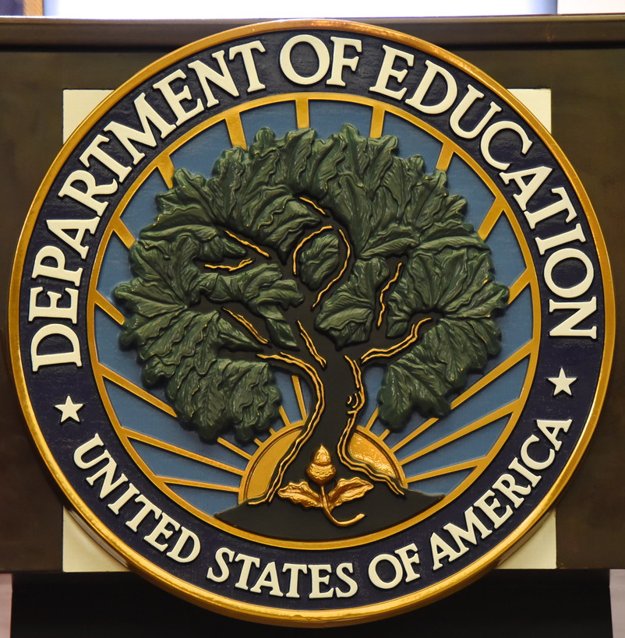
Less Options for Filing Federal Complaints
ED Issued a press report on March 11, 2025, which announced a 50% reduction in force (RIF)
All ED divisions are impacted with some “requiring significant reorganization”
This press statement said that on inauguration day, ED reported 4,133 workers after actions associated with the press release, there would be 2,183 workers
Nearly 600 ED workers “accepted voluntary resignation opportunities and retirement”
Many ED employees on Admin Leave.
This Photo by Unknown Author is licensed under CC BY
Notes:
Remaining employees impacted by the RIF, were placed on paid administrative leave, beginning March 21, 2025

Slide 15
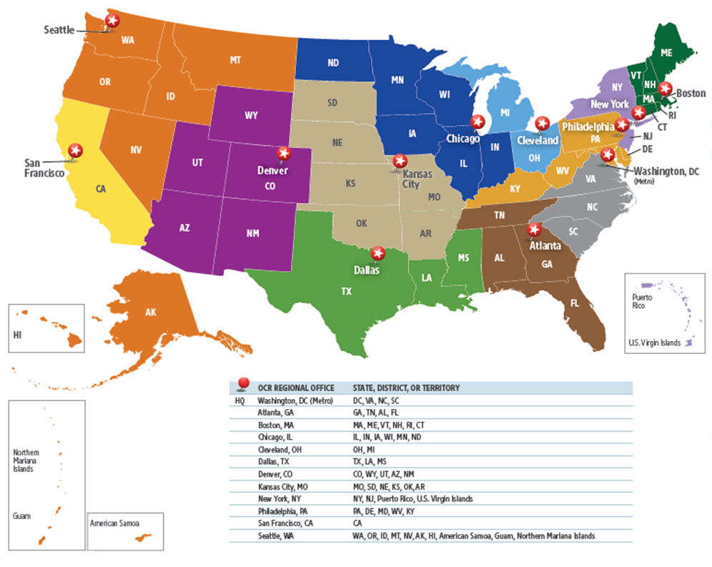
ED OCR Before 2025
Notes:
See 2024 Congressional Report for ED
chrome-extension://efaidnbmnnnibpcajpcglclefindmkaj/https://www.ed.gov/media/document/ocr-report-president-and-secretary-of-education-2024-109012.pdf

Slide 16
Impacts on IDEA State Complaints
Significant Increases in State IDEA Complaints Filings Nationally
Some “frequent filers” from ED OCR are now filing IDEA complaints with SEAs
CADRE data shows that IDEA state compliant filings jumped 22% in the 2022-2023 school year, compared to data from the prior year
There were 9,927 written state complaints filed in 2023-24, which represents a 79% rise over the previous 10-year average of 5,537. CADRE’s analysis is based on data collected by the U.S. Department of Education
Notes:
See https://www.k12dive.com/news/increase-in-special-education-complaints-parents-school-dispute-resolution/759435/
https://www.napsa.com/states-struggle-with-increase-in-special-ed-complaints/
https://www.napsa.com/states-struggle-with-increase-in-special-ed-complaints/

Slide 17

Complaint Consistency and Transparency Concerns
Impact of Outcome Variability
  Variation in investigation results can decrease public trust and raise questions about fairness.
Need for Standardized Protocols
  Standard protocols help ensure investigations are uniform, increasing fairness and reliability.
Importance of Clear Communication
  Transparent and clear communication enhances understanding and builds confidence in the process.
Notes:
---
Variability in investigation outcomes and limited transparency can erode trust. Standardized protocols and clear communication are needed to ensure fair and understandable processes.
Image source: Microsoft 365 content library

Slide 18
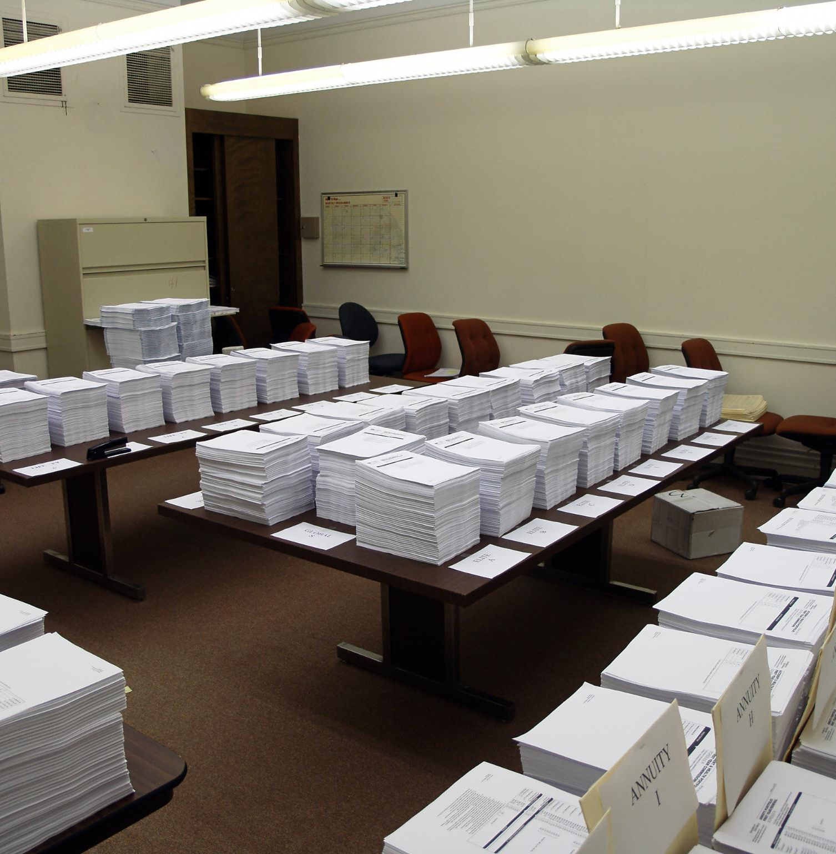
Resource Limitations for State Agencies
Budget Constraints
  Limited financial resources restrict state agencies from expanding operations and investing in necessary tools.
Staffing Shortages
  Insufficient staff numbers reduce agencies' ability to conduct thorough investigations and resolve cases promptly.
Notes:
IDEA is still only partially funded by the federal government
---
Many state agencies operate with constrained budgets and staffing shortages, limiting their capacity to conduct thorough investigations and timely resolutions.
Image source: Microsoft 365 content library

Slide 19
Innovative Approaches and Emerging Technologies to Help SEAs
Notes:
Technological advancements offer opportunities to improve complaint investigations. This section highlights digital platforms, artificial intelligence, and virtual tools enhancing efficiency and access.

Slide 20

Digital Platforms and Data Management
Streamlined Complaint Submission
  Centralized digital platforms enable easy and efficient submission of complaints by users.
Progress Tracking
  Digital systems track complaint progress to keep stakeholders informed in real-time and ensure staff meet complaint deadlines
Document Management
  Managing and organizing documents digitally improves accuracy and accessibility for stakeholders.
Notes:
Examples:
Share File/ MS SharePoint sites/ Google platforms and shared files
Others?
---
Centralized digital systems streamline complaint submissions, track progress, and manage documentation, improving accuracy and stakeholder access to information.
Image source: Microsoft 365 content library

Slide 21
Use of Artificial Intelligence in Investigations
Document Analysis
AI aids in analyzing large volumes of documents quickly to extract relevant information.
Pattern Recognition
AI identifies hidden patterns and connections within data to support investigations.
Case Prioritization
AI helps prioritize cases to optimize resource allocation and investigative focus.
Notes:
AI can also be used to generate standard legal text/find citations/ draft general legal standards templates/ create training materials/ generate interview questions
Run demo on Claude AI
Any other uses?
---
AI can assist in analyzing documents, identifying patterns, and prioritizing cases, helping investigators allocate resources effectively and uncover critical insights.
Image source: Microsoft 365 content library

Slide 22

Other Uses of AI for IDEA Complaint Investigations
Generate Interview Questions with a Neutral Tone
Create standard legal information paragraphs to cut and paste into MS Word
Find citations for state and federal rules
Translation into other Languages
Create training materials for new staff
AI systems to use for free include- Chat GPT, Claude, MS PowerPoint, Google, others?

Slide 23

IDEA and AI Demo
Using Claude AI
We will focus on Generative AI features
Feel free to follow along on your computer
What do you want to see it do?
This Photo by Unknown Author is licensed under CC BY-NC-ND

Slide 24

AI DEMO
Demo Scenario: You are an SEA Complaint Coordinator and on a team of two. Your coworker is on extended leave, and you just received 10 new complaints, from different families, for the same issues in 10 different districts. You have never heard of the disability, which apparently makes children eat random things all of the time. The complaints do not use standard IDEA legal language for the allegations. How can you use AI to generate a quick opening letter for 10 people? One family filed in Spanish.

Slide 25
Concerns with Use of AI for IDEA Complaints
Brainstorming examples: privacy risks, loss of human experience brought to analysis (e.g. when informal change of location is removal), loss of individualization in process itself when IDEA Part B steeped in individual nature of special education, i.e. tailoring to needs of particular student…others?
How mitigate potential risks/weaknesses?
Use for administrative tasks, not for applying law to unique facts
Rules built into AI, e.g. recognition of PII and rule to not share with non-parent complainant during process.
Others?

Slide 26

Virtual Interviews - Remote Evidence Gathering
Increased Accessibility
  Virtual hearings make legal processes accessible to more participants
  Reduced Delays
  Online evidence submission speeds up case processing by minimizing scheduling conflicts and physical document handling.
Broader Stakeholder Involvement
  Remote hearings enable wider participation from stakeholders dispersed geographically, improving collaboration.
Notes:
- Helps to accommodate work schedules/ limited staffing/ parents with no respite support for caregiving, etc.
---
Virtual hearings and online evidence submission increase accessibility, reduce delays, and allow broader stakeholder participation, especially in geographically dispersed areas.
Image source: Microsoft 365 content library

Slide 27
Policy Trends and Future Directions
Notes:
Emerging policy initiatives aim to reform complaint investigations by enhancing equity, community engagement, and accountability. This section explores the latest federal and state proposals.

Slide 28

Proposed Federal and State Reforms
Streamlining Procedures
  Reform efforts aim to simplify and speed up complaint handling processes for better efficiency.
Increasing Funding
  Additional financial resources are proposed to support complaint resolution systems and reforms.
Clearer Guidelines
  Establishing explicit rules and standards to ensure consistent and timely complaint resolutions.
Notes:
---
Reform efforts focus on streamlining procedures, increasing funding, and establishing clearer guidelines to ensure timely and effective complaint resolutions.
Image source: Microsoft 365 content library

Slide 29

Community and Stakeholder Engagement
Inclusive Participation
  Engaging families, advocates, and educators fosters diverse perspectives in policy making.
Transparency in Development
  Community involvement ensures open and transparent policy development processes.
Responsive Systems
  Policies created reflect the real needs and concerns of the community served.
Notes:
---
Involving families, advocates, and educators in policy development promotes transparency and responsiveness, ensuring systems reflect community needs.
Image source: Microsoft 365 content library

Slide 30

Ensuring Equity and Accessibility
Equitable Access to Complaints
  Policies ensure all students and families can access complaint mechanisms.
Addressing Language Barriers
  Support systems are designed to overcome language barriers for effective communication
  Inclusion of Disabilities and Socioeconomic Factors
  Complaint mechanisms accommodate disabilities & socioeconomic challenges
Notes:
- Discuss MSFT accessibility check features
---
Policies are emphasizing equitable access to complaint mechanisms for all students and families, addressing language barriers, disabilities, and socioeconomic factors.
Image source: Microsoft 365 content library

Slide 31
Building a Robust System for Tomorrow
Notes:
To meet future demands, the complaint system requires ongoing improvements including training, outcome measurement, and family support mechanisms.

Slide 32

Continuous Training for Investigators
Ongoing Recruitment, Training and Professional Development
  Continuous training keeps investigators updated on evolving laws and investigative procedures.
Cultural Competency
  Training enhances investigators' understanding of other cultures to ensure fair investigations.
Improved Investigation Quality
  Regular training needed
Notes:
---
Regular professional development ensures investigators stay current on laws, cultural competency, and best practices, enhancing investigation quality and fairness.
Image source: Microsoft 365 content library

Slide 33

Measuring Outcomes and Accountability
Importance of Metrics
  Using metrics helps evaluate investigation effectiveness and supports accountability in processes.
Fostering Accountability
  Metrics promote transparency and responsibility by monitoring outcomes and performance consistently.
Continuous Improvement
  Outcome assessments guide ongoing enhancements to systems and investigation procedures.
Notes:
---
Implementing metrics to assess investigation effectiveness fosters accountability and informs continuous system improvements.
Image source: Microsoft 365 content library

Slide 34

Supporting Families Through the Process
Clear Guidance
  Offering straightforward and understandable instructions helps families navigate complex processes with confidence.
Access to Resources
  Providing families with necessary resources ensures they have the tools needed to engage effectively in investigations.
Increased Advocacy Support
  Advocates empower families
Notes:
---
Providing clear guidance, resources, and advocacy support empowers families to participate confidently and effectively in investigations.
Image source: Microsoft 365 content library

Slide 35
WHY do we do State Complaints?
Yes, federal law requires it. 34 C.F.R. Section 300.151-153 [20 U.S.C. 1400 et. seq.]
Yes, in New Mexico, our state law requires it. Section 6.31.2 et. seq. NMAC
Why is it important? What are practical goals of state complaints?
Bring Local Education Agencies (LEAs) into compliance with the law
Ensure students eligible for special education and related services receive them
  Timely identification of eligibility (Child Find)
  Timely, comprehensive evaluation
  Development of IEP
  Implementation of IEP with fidelity
  Least Restrictive Environment
  Parental participation
  Appropriate decisions around discipline (MDR, provision of services, FBA/BIP)

Slide 36
Types of corrective actions NMPED issues to help LEAs comply with IDEA Part B
The District will submit a written assurance to the PED OSE Corrective Action Plan Monitor that it will abide by the provisions of this Corrective Action Plan (CAP).
The District Special Education Director and the school principal shall meet with the PED OSE Education Administrator assigned to the District and the PED OSE CAP Monitor to review the Complaint Resolution Report, the Corrective Action Plan, and any other measures that the District plans to take to ensure that the violations are corrected and do not recur. The District Special Education Director shall be responsible for arranging this meeting with OSE.

Slide 37
Sample Corrective Action for Districts
The District Special Education Director will meet with Student’s special education teachers, related service providers, principal, and general education teachers to review the Complaint Resolution Report to ensure that those persons understand the complaint, the violations that were found, and the corrective actions that will be taken to address the violations.
IF IEP DEVELOPMENT/IMPLEMENTATION IS AN ISSUE – MAY HAVE ONE OR MORE ACTIONS:
*Comprehensive Evaluation
*REED [Review of Existing Evaluation Data]
*Functional Behavior Assessment – Behavioral Intervention Plan
*Facilitated IEP – NMPED provides and pays for facilitators

Slide 38
If behaviors impact Student’s learning/learning of others with or without proposed discipline –
FBA, BIP work – look at data and develop appropriate functional behavioral goals, positive behavioral interventions and supports, appropriate accommodations – this may be done as part of an FIEP.
If Discipline imposed, 10+ times either at one time or per set of removals = pattern and a Manifestation Determination Hearing/Report was not done or was not done in valid manner,
Then such shall be conducted > can be done with facilitator.
**Law does not REQUIRE FBA or BIP – NM has correction actions that are best practices. States who have appeals to State complaints or view role more narrowly may do it differently. NM’s Due Process Hearings are much narrower in scope and remedy.

Slide 39
Sometimes if the violation occurred at administrative level, or there are unique circumstances, the CAP will require LEA to have virtual meeting with Counsel for OSE. This meeting is meant to be positive, forward-looking chance to have a dialogue. Also – I have invited LEA to help craft CAP in unique cases.
It is rare that CAP will not include training.
The breadth and type of training will be directly related to the particular IDEA violations.
Often, training by experienced external individuals or with NMPED is required.

Slide 40
Things LEAs can do
PROACTIVELY
Train administrators and staff using experienced practitioners
Self-monitor
Reach out to SEA team with questions as they come up
During Complaint Process
Cooperate by providing requested information
Agree to participate in alternative disputes resolution – e.g. Mediation, Facilitated IEPs
Work to informally correct non-compliance if discovered through their own investigation before CAP issued
Post Complaint Process
Diligently work to accomplish each action in CAP
If lateness on step/task becomes an issue, communicate such with CAP monitor at your State agency
Ask questions of CAP Monitor or assigned state agency staff

Slide 41
Conclusion
Addressing Challenges
Improving investigations by tackling current issues with innovative solutions and updated policies.
Technology Integration
Utilizing modern technology to streamline complaint investigations and improve accuracy.
Community Support and Engagement / Viable CA
Involving diverse stakeholders ensures accountability and equitable education services for all students.
Notes:
Enhancing IDEA State Complaint Investigations involves addressing current challenges through technology, policy reform, and community engagement. Together, these efforts will strengthen accountability and ensure equitable special education services for all students.

Slide 42
CADRE Time Capsule- Predictions, Hopes for Complaints and our Work
Before you leave, please write your predictions/hopes/wishes for CADRE and IDEA Complaints/Dispute Resolution on the sheet of paper you were provided
Write you commitment to a community organization or entity that you pledge to support for the next decade
Feel free to get creative, doodle, draw, collage, etc.
You can leave your name, state, agency, or leave it anonymous
We have extra paper up front
You can submit more than 1!
Please provide Claudette or Natalie with your paper slips before you head out!

Slide 43

Questions and Thank you!
Thanks for attending!
Email: claudetterushing@educationlawnorthwest.com
WWW.educationlawnorthwest.com
& New Mexico Department of Education- Office of General Counsel
Natalie.Campbell@ped.nm.gov

