Slide 1
Despite Best Intentions...Unraveling the Mess
Using Strategic Questions to Address Systemic Challenges in Special Education

Slide 2
Welcome and Introductions
Jana Rosborough, Limestone Education
Kevin Davis, Pittsburg State University | Kansas TASN

Slide 3
Session Objectives
View special education through a systemic lens to understand the interconnected challenges.
Gain insight into the nature of complex, systemic issues and how they impact student outcomes.
Learn a process for identifying actionable steps and solutions to address complex challenges, driving progress and improving educational outcomes.

Slide 4
Strategic Questioning
What is the actual problem?
What’s underneath the action?
How do policies, procedures, and practices interact?
Where is readiness for change - strong or weak?

Slide 5
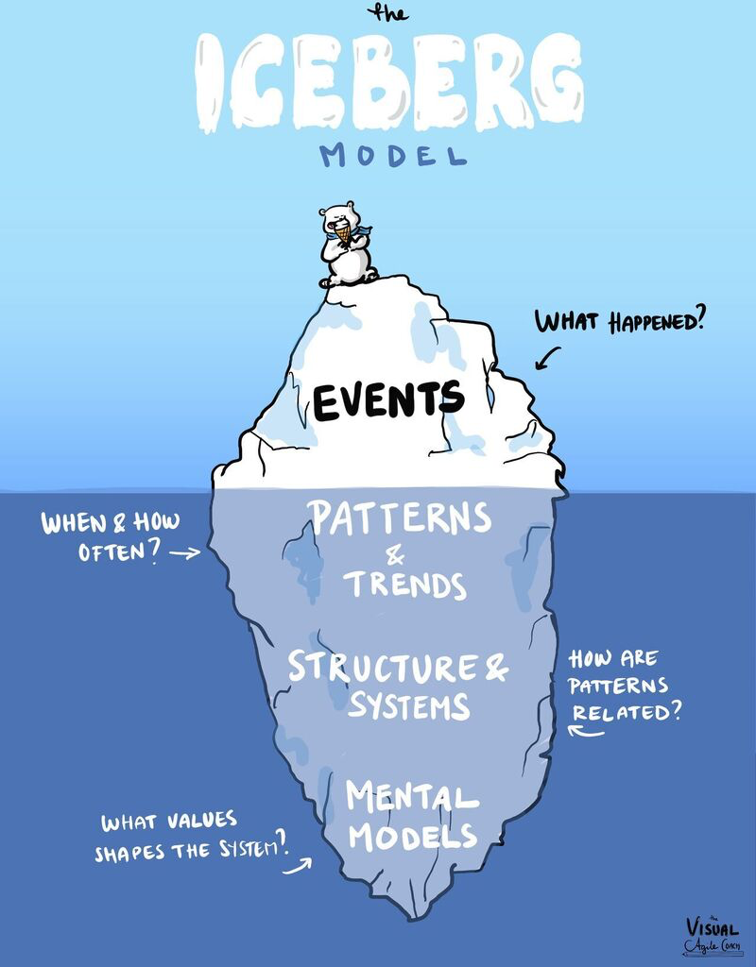
The Reality Check
Challenges rarely stem from bad intentions.
Visible problems are just the tip.
Problems come bundled - technical + adaptive.

Slide 6
Let’s Dive In

Slide 7
Action Framework
Identify bundled problems.
Separate technical from adaptive.
Apply strategic questions to uncover barriers.
Developing actions for change.

Slide 8
Strategic Questioning
Defining the Problem:
Something you care about
A barrier to your organization's priorities
Is within your control
Is regularly occurring
Is the right level of specificity
Doesn’t include an implied solution
“We fail more often because we solve the wrong problem than because we get the wrong solution to the right problem.”
– Russell L. Ackoff

Slide 9
Autopsy of a Dispute
Scenario
Aiden, a 4th-grade student with an IEP for reading and written expression, receives 45 minutes of daily specialized reading instruction with the special education teacher.
This year, the district adopted a 90-minute literacy block for all 4th graders, co-taught by two general education teachers. The new schedule eliminates the pull-out reading time and instead includes occasional in-class support from the special education teacher.
After two months, Aiden’s reading progress has plateaued. Parents are concerned, and the special education teacher has expressed that her time is stretched thin due to the new schedule.
Question:
What are the problems?
Capture on a notecard - one problem per card
Problems should be
Something you care about
A barrier to your organization's priorities
Is within your control
Is regularly occurring
Is the right level of specificity
Doesn’t include an implied solution
Notes:
Surface problem?
Underlying issues?
Strategic questions to dig deeper?

Slide 10
Debundling the Problem

Slide 11
Action Framework
Identify bundled problems.
Separate technical from adaptive.
Apply strategic questions to uncover barriers.
Developing actions for change.

Slide 12
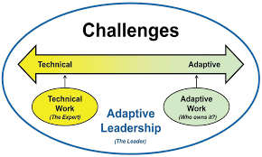
Technical vs. Adaptive
Technical: Clear steps, compliance-driven, procedural fixes
Adaptive: Beliefs, relationship, culture change
Example:
Technical: New progress monitoring form
Adaptive: Trust between general education and special education
Image accessed at: https://www.heffelfingerco.com/blog/unleashing-the-power-of-disruption-5-adaptive-leadership
Notes:
Activity: Card Sort. What is Technical? and What is Adaptive?

Slide 13
Application

Slide 14
Action Framework
Identify bundled problems.
Separate technical from adaptive.
Apply strategic questions to uncover barriers.
Developing actions for change.

Slide 15
Defining Strategic Questions
Strategic Questions are crafted to uncover root causes, challenge assumptions, and open pathways to systemic solutions.
Key Characteristics:
Open-ended (cannot be answered with yes/no)
Focused on systems, not individuals
Encourage reflection and exploration
Aim to reveal patterns, relationships, and impacts
Examples:
“How does our current process support or hinder collaboration between gen ed and special ed?"
"What patterns have emerged in dispute cases over the past year?"

Slide 16
Your Turn
Asking the “Right” Questions

Slide 17
Strategic Question Brainstorm
Instructions:
Think of that earlier dispute.
Write 3–5 strategic questions that could open deeper insight into one of the problems you identified. Remember: Adaptive and technical.
Swap with a partner and have them add at least one more question.
Notes:
Thinking of that earlier dispute, what are 3-5 strategic questions that would help you understand the adaptive challenges that lead to the dispute.

Slide 18
Autopsy of a Dispute
Scenario
Aiden, a 4th-grade student with an IEP for reading and written expression, receives 45 minutes of daily specialized reading instruction with the special education teacher.
This year, the district adopted a 90-minute literacy block for all 4th graders, co-taught by two general education teachers. The new schedule eliminates the pull-out reading time and instead includes occasional in-class support from the special education teacher.
After two months, Aiden’s reading progress has plateaued. Parents are concerned, and the special education teacher has expressed that her time is stretched thin due to the new schedule.
Your Turn:
Write 3–5 strategic questions that could open deeper insight into one of the problems you identified. Remember: Adaptive and technical.
Swap with a partner and have them add at least one more question.
Notes:
Surface problem?
Underlying issues?
Strategic questions to dig deeper?

Slide 19
Autopsy of a Dispute
Scenario
Aiden, a 4th-grade student with an IEP for reading and written expression, receives 45 minutes of daily specialized reading instruction with the special education teacher.
This year, the district adopted a 90-minute literacy block for all 4th graders, co-taught by two general education teachers. The new schedule eliminates the pull-out reading time and instead includes occasional in-class support from the special education teacher.
After two months, Aiden’s reading progress has plateaued. Parents are concerned, and the special education teacher has expressed that her time is stretched thin due to the new schedule.
Strategic Question 1 – Compliance Angle
“What legal or policy requirements apply to the delivery of Aiden’s IEP services, and how do these intersect with the new district literacy block schedule?”
Strategic Question 2 – Systems & Communication
“How are general education and special education staff coordinating to ensure IEP services are implemented consistently across all subject areas?”
Strategic Question 3 – Resource & Capacity
“What structural or resource barriers (time, staffing, technology) are preventing consistent delivery of services, and what system-level changes could remove them?”
Notes:
Surface problem?
Underlying issues?
Strategic questions to dig deeper?

Slide 20
Action Framework
Identify bundled problems.
Separate technical from adaptive.
Apply strategic questions to uncover barriers.
Developing actions for change.

Slide 21
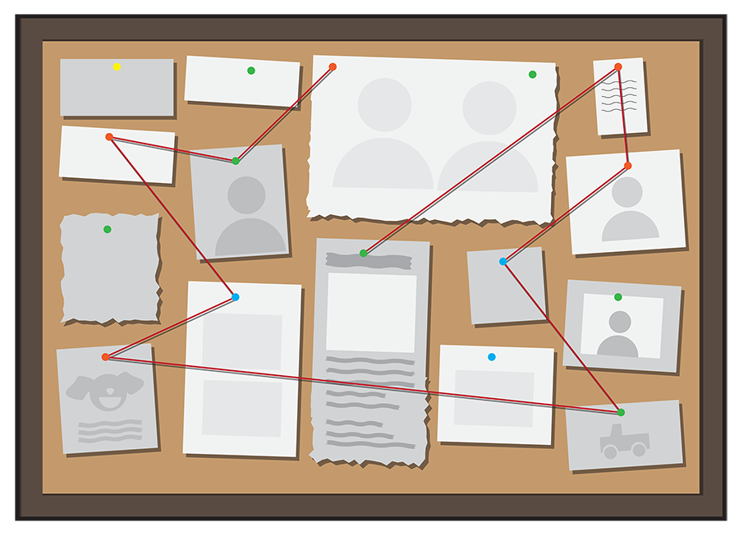
Moving Into Action
From the strategic questions you generated
What is a best next action for the team? Why?
Possible Places to Begin:
Empathy Interviews
Data
Process Maps

Slide 22
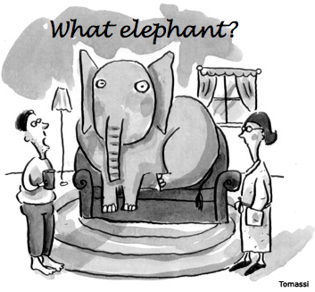
Change:
Elephant in the Room
Adaptive Considerations

Slide 23
Sustaining Change
Build readiness before changes.
Strengthen relationships.
Document what and why.
Keep feedback loops open.
“People don’t resist change. They resist being changed.” - Peter Senge

Slide 24
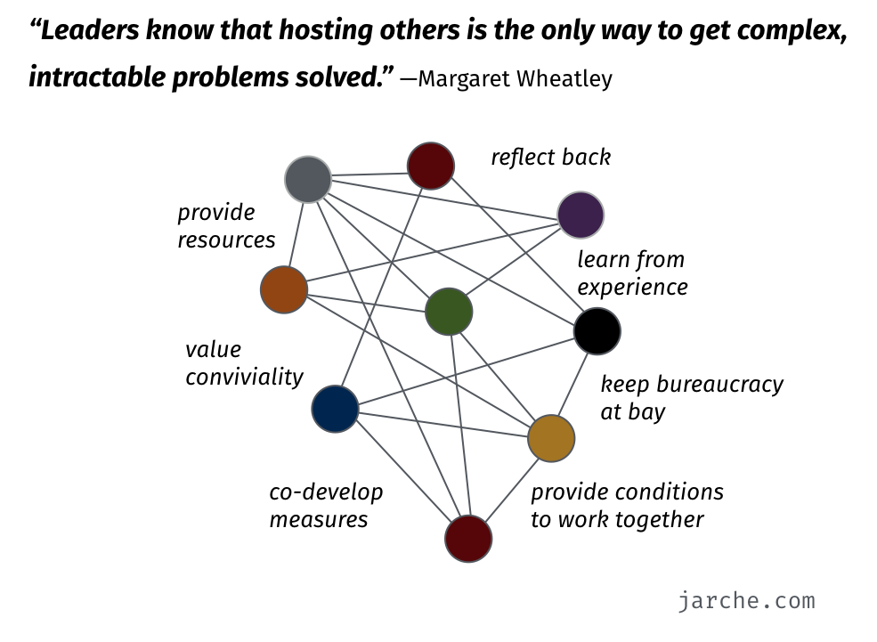
Moving Beyond the Hero Model
Hero = one person, unstainable
Team = collective responsibility

Slide 25
Before We Leave Today
Reflect on Your System.
Identify one systemic question to ask in the next month.
Reminder:
Should address a bundled problem (technical and adaptive).
Should be related to something that is an actual problem.
Should need additional information to come up with a possible “solution.”

Slide 26
Thank You!
Jana Rosborough, jana.rosborough@limestoneeducation.org
Kevin Davis, kddavis@pittstate.edu

