Slide 1

Building Family-Professional Partnerships Using the Sunshine Model:
The PEPTI Project
Dr. Natalie Holdren
Sarah Hughes Thompson

Slide 2


Welcome & Introductions
Natalie Holdren
Teacher Educator, UC Santa Barbara
Educational Consultant, PEPTI Project
Sarah Hughes Thompson
Napa County Office of Education
Program Manager, PEPTI Project
Notes:
After we introduce ourselves we can ask participants to raise hands to indicate what roles are represented in our audience (some may represent more than 1 group):
Parent Center
State Education Agency Staff
Practitioners Early Intervention
Lead Agency Staff
District/Local Education Agency
Other

Slide 3

About the PEPTI project
Focused on personnel development in early intervention, early education, and transition services
Supported by a State Personnel Development Grant from the Office of Special Education Programs
Notes:
The Partnerships for Effective Practices in Transition and Inclusion is a personnel development project addressing critical needs in early intervention, early education, and transition services. Supported by a State Personnel Development Grant from the Office of Special Education, PEPTI is administered by the Napa County Office of Education in collaboration between the California Department of Education’s Special Education and Early Childhood Divisions and the Department of Developmental Services.

Slide 4

Today’s Agenda
Family-professional partnership (FPP) and its benefits
The Sunshine Model of Trusting FPP
Core dimensions
Opportunities
Reflect & connect
PEPTI project
Questions & feedback

Slide 5

Trusting Family-Professional Partnerships Definition
An alliance in which families and professionals confidently build on each other’s word, judgment, and wise actions to increase benefits (educational, behavioral, social emotional, etc.) for their children and themselves.

Slide 6

Trusting Family-Professional Partnerships
Trust occurs as a conscious effort. Families and professionals build trust and partnerships together.
When deciding whether or not they can trust their team, families usually decide cognitively, affectively, and behaviorally (Forsyth, Adams, & Hoy, 2011)
Notes:
The work of partnership involves these three things together.
Cognitive - thinking and reason
Affective - feelings and attitudes
Behavioral - actions, how one conducts oneself

Slide 7

The Benefits of Family-Professional Partnership For Children
Greater academic achievement
Improved behavioral outcomes
More time spent in general education classrooms

Slide 8
The Benefits of Family-Professional Partnerships
For families:
Reduction in family stress
Increase in family quality of life measures
Greater satisfaction with the school experience
For professionals:
Positive, productive, collaborative experiences

Slide 9
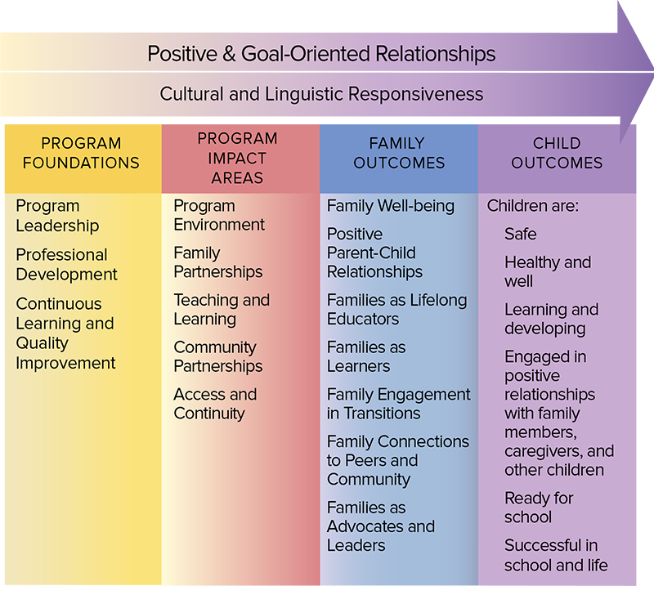
Laws, Policies & Professional Standards Guiding FPP
Head Start’s Parent, Family & Community Engagement (PFCE) Framework

Slide 10
Laws, Policies & Professional Standards (continued)
“Family engagement is an interactive process through which program staff and families, family members, and their children build positive and goal-oriented relationships. It is a shared responsibility of families and professionals that requires mutual respect for the roles and strengths each has to offer. Family engagement means doing with—not doing to or for—families.”
Head Start’s Parent, Family & Community Engagement (PFCE) Framework

Slide 11
Laws, Policies & Professional Standards (IDEA)
Individuals with Disabilities Education Act (IDEA)
The IDEA supports the right of parents to be a member of the IEP team and involved in each step of the IEP process. Parents are to be provided opportunities to actively participate in the development of the IEP and in discussions regarding their child’s educational program. (34 C.F.R. § 300.322-300.327)

Slide 12
Laws, Policies & Professional Standards (Policy Statement)
Joint policy statement by the Departments of Education and Health and Human Services on Family Engagement
“For family engagement to be integrated throughout early childhood systems and programs, providers and schools must engage families as essential partners when providing services that promote children’s learning and development, nurture positive relationships between families and staff, and support families” (p. 1).
“It is the goal of the Departments that all early childhood systems recognize and support families as essential partners in providing services that improve children’s development, learning, and wellness” (p. 2).

Slide 13
Laws, Policies & Professional Standards (Policy Statement continued)
Joint policy statement by the Departments of Education and Health and Human Services on Family Engagement
“It is the goal of the Departments that all early childhood systems recognize and support families as essential partners in providing services that improve children’s development, learning, and wellness” (p. 2).

Slide 14
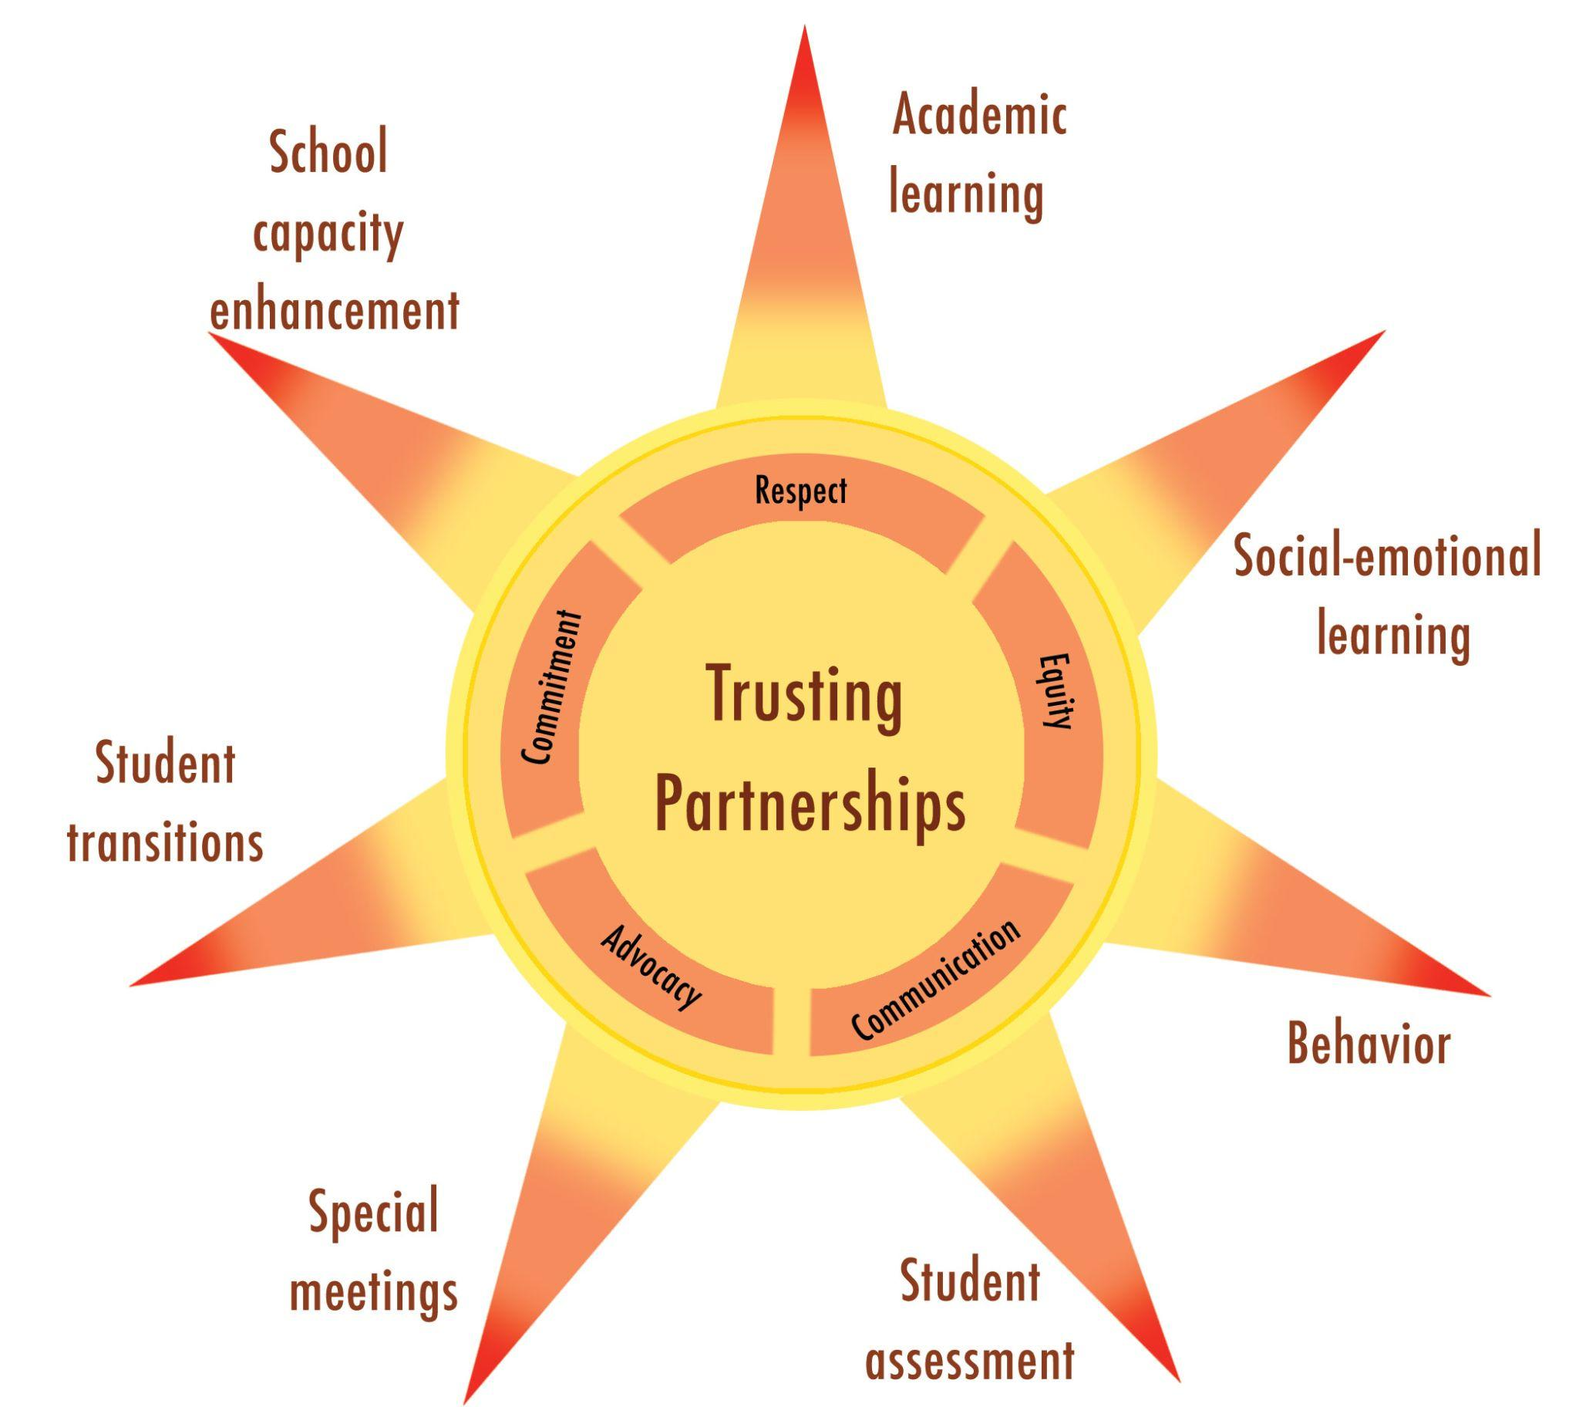
The Sunshine Model of Trusting Family Professional Partnership
Notes:
Talk about the challenge of having so many different frameworks guiding this practice and the value of one shared and comprehensive framework. The Sunshine Model is a research-based model for enacting trusting family professional partnerships that was developed by a team of researchers and practitioners led by Drs. Ann and Rud Turnbull. We created the model based on seminal research exploring the specific interactions between families and professionals that ultimately lead to trusting partnerships. You will find on the inner ring of the sun, the core dimensions (equity, respect, commitment, communication and advocacy). We call these the HOW of the model and they represent effort and behaviors we can engage in to foster trusting family-professional partnerships. The rays of the model, represent the opportunities or contexts where partnership occurs. For example, we may partner with families around supporting a child’s behavioral needs. We may also partner with families as they navigate transitions or in the context of a meeting.

Slide 15
Sunshine Model
Potential application
As a model for evaluating what FPP research exists and what needs further investigation
As a framework to guide collaborative professional development for both families and professionals
As a tool for self-assessment of partnerships strengths and areas for growth (as an individual or an organization)
Notes:
How this model can be used to guide research, professional development and practice.

Slide 16
Sunshine Model Core Dimensions & Indicators:
Communication
Definition:
Listening, connecting and expressing perspectives within two-way, frequent, and regular interactions. Communication should be grounded in cultural responsiveness and empathy.

Slide 17
Sunshine Model Core Dimensions & Indicators: Communication
Indicators/Strategies:
Listening in order to understand
Connecting with families through empathy
Expressing perspectives honestly, with kindness and clarity

Slide 18
Sunshine Model Core Dimensions & Indicators: Equity
Definition:
Ensuring that partnerships are
characterized by equal
opportunity that strengthens
the social justice of education.
Indicators/Strategies:
Getting to know families
Addressing your implicit biases
Becoming familiar with resources
Sharing information
Overcoming logistical barriers

Slide 19
Sunshine Model Core Dimensions & Indicators: Respect
Definition:
Conveying appreciation for good or valuable qualities and having genuine concern for families’ needs and feelings.
Indicators/Strategies:
Treating students and families with dignity
Being empathetic
Honoring diversity of backgrounds and perspectives
Being responsive to family concerns

Slide 20
Sunshine Model Core Dimensions & Indicators: Advocacy
Definition:
Taking action to solve problems or remove barriers to accomplish valued outcomes.
Indicators/Strategies:
Develop viewpoints on key issues
Pinpoint and document concerns
Identify all key players and work to find a common ground
Generate solutions

Slide 21
Sunshine Model Core Dimensions & Indicators: Commitment
Definition:
Remaining dedicated to and responsible for building and sustaining partnership.

Slide 22
Sunshine Model Core Dimensions & Indicators: Commitment Indicators/Strategies:
Define goals and reasons for expanding your partnership commitment
Develop and implement reasonable action plans
Work to prioritize and manage your commitments (and remember that trusting partnership is an investment)

Slide 23
Reflect & Connect
On your own:
Choose a core dimension that resonates with you and reflect on ways you put it into practice in your work with families
With a partner:
Introduce yourself and your role as it relates to family partnership
Take turns sharing examples of how you put this dimension into practice
Equity
Respect
Communication
Advocacy
Commitment

Slide 24
Core Dimensions Activity:
Share Out
Equity
Ensuring that partnerships are characterized by equal opportunity that strengthens the social social justice of education.
Commitment
Remaining dedicated to and responsible for building and sustaining partnership.
Communication
Listening, connecting, and expressing perspectives within two-way, frequent, and regular interactions.
Advocacy
Taking action to solve problems or remove barriers to accomplish valued outcomes.
Respect
Conveying appreciation for good or valuable qualities and having genuine concern for families’ needs and feelings.
Notes:
Core Dimensions of trusting family partnerships on screen as a visual cue on the screen while people share out about the dimension they picked.

Slide 25
Sunshine Model: The Rays
Partnership Opportunities
Academic Learning
Social-Emotional Learning
Behavior
Student Assessment
Special Meetings
Student Transitions
School Capacity Enhancement
Notes:
Talk about the rays as the partnership opportunities or contexts where partnership occurs.

Slide 26
Reflect (On your own)
Choose a Sunshine Model “ray” or opportunity for partnership that you engage in often in your work (special meetings, transition, etc.)
Using the graphic organizer:
Reflect on your chosen “ray” as it relates to the 5 core dimensions (equity, communication, respect, etc.)
Note areas of strength (ways you or your agency/organization succeed at putting these dimensions into practice)
Note barriers or challenges to this work (things that hinder or get in the way of this work)

Slide 27
Connect (With a partner)
Identify a barrier or challenge that you would like to overcome
Using the graphic organizer:
Share the details of the barrier or challenge with your partner
Together, take turns talking through actionable next steps to help you persist through the challenge
Identify and note resources or partnerships that might make this work more feasible
Notes:
Graphic Organizer

Slide 28

Volunteers to Share Out?
Examples of strengths & barriers
Actionable next steps
How might you use this process with your team to further this work?
How might you modify it to make it more useful for your setting?

Slide 29

PEPTI Sunshine Model Activities
In Spring 2024, PEPTI offered a Professional Learning Series (PLS) on the Sunshine Model for Family Resource Center Staff.
Following the PLS, participants were invited to join a Community of Practice to dig deeper into the model.
Notes:
Slide where we talk more about what we’ve done and what’s coming (PLS, CopPs, module)? Can update this slide once teams are in place and we have an idea of the roles/organizations that are represented in the PLS participants this fall.

Slide 30
PEPTI Sunshine Model Activities in 25-26
In 2025-26, PEPTI will offer the PLS again followed by a Community of Practice for teams who support families through the transition from Part C to Part B services.
An e-learning course on the Sunshine Model is in development.
Notes:
Slide where we talk more about what we’ve done and what’s coming (PLS, CopPs, module)? Can update this slide once teams are in place and we have an idea of the roles/organizations that are represented in the PLS participants this fall.

Slide 31

Resources
To learn more about the Sunshine Model,
Check out the book
Families and Professionals:
Trusting Partnerships in
General and Special Education,
8th edition

Slide 32

Questions & Feedback?
Feel free to contact us:
Natalie Holdren
nholdren@education.ucsb.edu
Sarah Hughes Thompson
sthompson@napacoe.org
© 2025 The contents of this presentation were developed through a federally funded State Personnel Development Grant (SPDG), provided from the U.S. Department of Education, Office of Special Education Projects, Part D of the Individuals with Disabilities Education Act (IDEA), #H322A220004, Project Officer Sunyoung.Ahn@ed.gov. The SPDG funds are competitively awarded to the California Department of Education, Special Education Division and administered by the Napa County Office of Education – Research and Professional Development Center. The contents of this presentation do not necessarily represent the policy of the US Department of Education and no assumption of endorsement by the Federal government should be made.​

