Slide 1

Breaking Barriers: Strengthening Family Engagement & Advocacy in Special Education
Presented by: Diana Cruz, UNCO CADRE’s 10th National Symposium
Heather Oliver, FACT Oregon Portland, Oregon
Britania Vazquez-Elorza, FACT Oregon

Slide 2
Session Overview
Explore Barriers
Review Research & Results
Discuss Implications
Engage in Q&A

Slide 3
Why This Work Matters
Almost 30 years of research and experience has demonstrated that the education of children with disabilities can be made more effective by – strengthening the role and responsibility of parents and ensuring that families… have meaningful opportunities to participate in the education of their children at school and at home. (IDEA, 2004, 20 U.S.C. § 1400 (c)(5)(B))

Slide 4
Parent Participation – IDEA Core Principle
Informed Consent
For evaluation
For initial provision of services
To release PII
Meaningful Participation
Prereferral
Evaluation
Eligibility
IEP development
Placement
Procedural Safeguards
Prior Written Notice
Manifestation determinations
Dispute resolution
Record access
State Performance Plan
Indicator 8 – parent survey
Performance indicator target setting
Special Education Advisory Panel
And more…

Slide 5
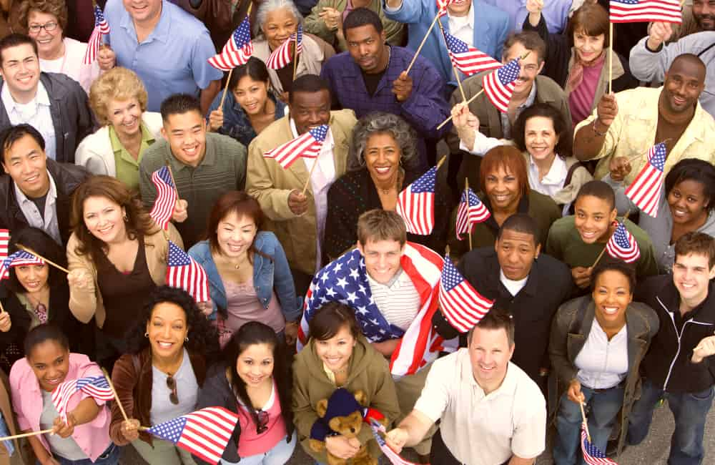
THE PROBLEM
Education systems do not adequately support the meaningful participation of culturally and linguistically diverse families of students with disabilities.

Slide 6
Unique Challenges for CLD families
Unique barriers limiting participation in special education processes:
Language access
Discrimination
Deficit views
Fixed work schedules
Access to accommodations
Cultural norms often clash with IDEA participation and advocacy expectations:
Communication norms
Views on disability
Hierarchy and respect
Trust in government systems
Views on education
Pursuit of individualism

Slide 7
Demographics of IDEA Writers, Implementors & End Users by Percentage
Notes:
539 members
Senate - 86 men, 14 women
House of Representatives – 376 men, 63 women

Slide 8
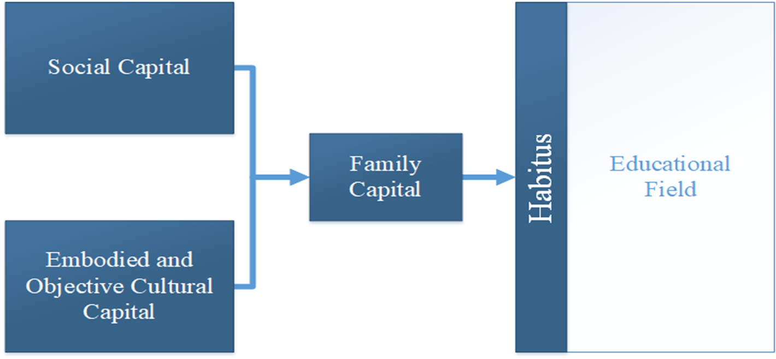
Theory Considerations
Bourdieu Social Cultural Capital Theory

Slide 9
The Promise of Ishimaru’s Equitable Collaboration
Concept | Traditional Engagement | Equitable Collaboration
Roles | Families as beneficiaries Educators as experts | Families as leaders Educators as learners
Goals | System-driven goals | Family-driven goals
Strategies | Build educator capacity | Build educator and family capacity
Educational Change | Individual student or family focus | Community focus

Slide 10
Activate Your Advocacy
About the Program
Goals and Objectives
FACT Oregon’s signature leadership and advocacy training
Designed for parents, caregivers, and family members of children with disabilities
Focuses on building knowledge, skills, and confidence to advocate within education systems and beyond
Graduates become part of a growing statewide network of advocates
Empower families with tools to effectively advocate for their child and others
Develop leadership skills to influence systems change in education and community services
Foster collaboration between families, schools, and agencies to improve outcomes for students
Cultivate a network of informed advocates who can support each other and amplify impact

Slide 11
Activate Your Advocacy
Recruitment and Selection Process
Course Schedule and Delivery
Application process open to parents and family members across Oregon
Recruitment outreach through schools, community partners, and disability networks
Selection emphasizes:
Commitment to advocacy
Representation from diverse communities and regions
Readiness to engage in both learning and action
Cohort-based learning model (small group, high interaction)
Multi-session series delivered over several weeks
Virtual delivery → Increased accessibility statewide
Mix of virtual workshops, interactive discussions, and action assignments
Includes practical application
Culminates in a personal or community advocacy project

Slide 12
Activate Your Advocacy
About the Facilitators
Experienced advocates and family leaders with lived experience
Deep knowledge of special education law, policy, and systems navigation
Skilled trainers who model collaborative problem-solving
Serve as ongoing mentors and connectors to statewide advocacy efforts

Slide 13
Purpose of Study
Research Questions:
What are the factors that led CLD families of students with disabilities to participate in the AYA leadership program offered through the PTIC?
What are the experiences of CLD families of students with disabilities who participated in the AYA parent leadership program offered through the PTIC?
How did CLD families’ participation in the AYA program support their involvement in special education processes with their children’s schools and within their communities?
The purpose of this qualitative study was to explore the experiences of CLD families of students with disabilities who participated in a parent leadership training program titled “Activate Your Advocacy,” offered through the parent training and information center.

Slide 14
Participant Pseudonym | Gender Identity | Age | Age of Child with Disability | Race/ Ethnicity | Participant Disability Status | Language | Annual Household Income | Highest Level of Education
Abigale | Female | 48 | 3-5 years old, 16-21 years old | Hispanic/Latino | Individual w/ Disability | Spanish | Less than $30,000 | High school diploma/GED
Aya | Female | 47 | 11-15 years old | Black or African American | Undisclosed | Bilingual | $60,000 - $99,999 | Masters
Chris | Prefer not to say | 32 | 6-10 years old | White | Individual w/ Disability | English | Less than $30,000 | Some college
Emma | Female | 31 | 6-10 years old | Hispanic/Latino | Nondisabled | Bilingual | Less than $30,000 | Some college
George | Male | 42 | 6-10 years old, 11-15 years old | Hispanic/Latino | Nondisabled | English | $100,000 or more | Masters
Jess | Female | 44 | 6-10 years old | White | Individual w/ Disability | English | Less than $30,000 | Masters
Ka'mara | Female | 41 | 6-10 years old | White | Individual w/ Disability | English | Less than $30,000 | Associates
Kirsten | Female | 48 | 11-15 years old | White | Individual w/ Disability | Bilingual | Less than $30,000 | Bachelors
Serena | Female | 39 | 11-15 years old | Hispanic/Latino | Undisclosed | Bilingual | $100,000 or more | Some college
Zendaya | Female | 43 | 11-15 years old | Two or more races | Individual w/ Disability | English | $30,000 - $59,999 | Bachelors

Slide 15
Motivation to Participate in AYA
The Struggle
The Hope for Improved Outcomes
Navigating diagnosis and disability
Navigating cultural barriers
Navigating systems
Navigating the pandemic
For self and child
For other parents
For education systems

Slide 16
Participant Quotes - Struggle
[Son] was diagnosed… And it's like, ever since then, everything that he has needed to be in this world and interact with it has been a struggle to get for him.
When we first enter into these services, what we as parents have experienced is years of struggle.
The meltdowns that come with autism, it's constant noise and struggle that makes neighbors dislike us. It causes struggles with the landlord. We actually got evicted twice because of my son's behavior.
Disability to some communities of color, especially for immigrants, it is the shame of like, like hiding their children and thinking that their child is sick
Sometimes in our countries as Hispanics, we think that the doctor, the priest, the teacher, even the town healer, is 100% correct and we sometimes stay quiet.
It felt like there was a baseline of knowledge that I was expected to already have. That I wasn't up to par.
I was primarily socializing through social media. I was so isolated that was my only real connection to community.

Slide 17
Participant Quotes - Hope
I wanted to know how to get the district to do what they were supposed to be doing for my child.
I was hoping to get a more concrete idea of different things that I could do around the IEP process and, kind of some of the very specifics of it
I just wanted to learn, and the driving force was to break that stigma barrier for my son, within our family, within our community.
That was my big motivation. Hope. Being able to know on my own level that I have, like, done everything possible, to help keep [Daughter] thriving and growing in a positive manner. My hope to find resources and become better educated about being a parent of a neurodivergent child
I was really excited to have the kind of knowledge to be able to support other families. Like just people I know, people in my personal community.

Slide 18
AYA Experiences
Course content
Comprehensive
Disability history
IEP process and content
Introducing disability
Ideology embedded within course
Tools and strategies
One page profile
Parent input form
Prioritizing Requests
Documenting
Template letters
Access and delivery
Virtual
Two evenings a week
Translation and interpretation
Challenges with accommodations for individuals with disabilities
Facilitation challenges
Relationships and connection
Less along
Connection to other parents
Lived experiences

Slide 19
Participant Quotes –
Comprehensive soup to nuts training.
It was just giving me a new perspective. You know, a new insight into the disability system
I felt that we were given tools to have a voice.
There were some issues with accessibility for my particular disability
There were two facets to the benefits of this program. One was obviously the education, right, like just learning about it and being more prepared and having all the information and having all the context for supporting my kid. The other side, it was really healing to be able to be in a meeting with a bunch of other families who were feeling the same feelings I was feeling, asking the same questions
I learned so much from the other Moms. And above all, what they gave us (Spanish-speaking participants) was a sense of worth as a mother. Even though we did not speak English.
I felt so much less alone

Slide 20
Application to Advocacy
Individual advocacy
Meaningful participation
Achieved desired outcomes
Confidence
Community advocacy
Share on social media
Bring information to work colleagues
Community specific parent groups
System-level advocacy
District advisory boards
State advisory boards
Planning committees
Legislative advocacy

Slide 21
Participant Quotes – Advocacy
I am an active participant in his education. At this point, I have the confidence to be able to reach out to his teachers and start those conversations and be proactive. I was not confident before, and now I am confident. day.
I'm working with families of color and marginalized groups to understand disability and all that.
I do one on one support with families. I attend IEP meetings.
I get invited to the Latino group that I mentioned and I share. And I also organize the meetings with other parents.
We ended up we've come together to connect and build ourselves into an advocacy corps.

Slide 22
Discussion Points
Struggles fueled their hope - motivation
Participants directly tied AYA to advocacy successes and positive outcomes
One participant took AYA prior to first IEP meeting, no negative experiences with the school
“Tools to have a voice” – social/cultural capital
AYA used many principles from Equitable Collaboration
Participants described serving as cultural brokers
Intersectional impact of multiple marginalized identities = potential for unintended exclusion

Slide 23
FACT – lessons learned/ changes to AYA
Lessons Learned
Families need both knowledge and practice → Practical application of learning was most effective
Representation matters → Stronger cohorts when participants reflected Oregon’s diversity
Connection is as valuable as content → Peer networks increased engagement and confidence
Advocacy grows in stages → Participants often shift from personal advocacy to systems-level advocacy

Slide 24
FACT – lessons learned/ changes to AYA
Program Changes
AYA 2.0 launched → Advanced training series for alumni ready for systemic advocacy
Refined curriculum → More interactive learning, streamlined sessions, focus on applied practice
Enhanced recruitment & selection → Prioritized readiness, commitment, and diverse representation
Action projects added → Structured opportunities to put advocacy into practice

Slide 25
FACT – lessons learned/ changes to AYA
What’s Next for AYA
Continue growing the AYA alumni network as a statewide advocacy community
Expand AYA 2.0 offerings with deeper dives into systems change and leadership development
Strengthen partnerships with schools, agencies, and community organizations
Support alumni in moving from personal advocacy to policy influence

Slide 26
Turn and Talk - Engaging CLD Parents
What methods do you use to engage hard to reach communities?
How do you build parent capacity to participate in special education?
What stands out to you about the information presented today?

Slide 27
Questions
???
!!!

Slide 28
Take aways
CLD families face unique and persistent barriers, but also demonstrate incredible resilience and hope
Parent leadership programs work:
Increase knowledge and skills
Develop support networks in communities
Parents learn from and support their peers
Accessibility for individuals with disabilities should be considered early and often in planning processes

Slide 29


THANK YOU!
Diana Cruz Heather Oliver
cruz0926@bears.unco.edu heather@factoregon.org
Britania Vazquez-Elorza
britania@factoregon.org

