Slide 1
SPARCing Conversations: Strategies for Equitable Dispute Resolution
Joy V. Jordan & Sarah Marshall, SPARC Facilitator & Mediator
Conflict Resolution Program, Institute for Public Administration
University of Delaware

Slide 2
SPARC—Special Education Partnership for the Amicable Resolution of Conflict
Free
Confidential
Voluntary
Statewide special education dispute-resolution program
Offers mediation and facilitation
Supports families and schools to work collaboratively to address the educational needs of exceptional children.
Notes:
We work with schools, parent and families to create a positive way to resolve conflict by creating conditions for constructive dialogue and collaborative decision-making
2. Process is built on respect and self-determination to nurture the family and school relationship.

Slide 3
Workshop Overview
Learn how to foster equity and empathy in special education dispute resolution by acknowledging and developing cultural competency, effective communication skills, and mental health awareness.
Notes:
Joy read this slide

Slide 4
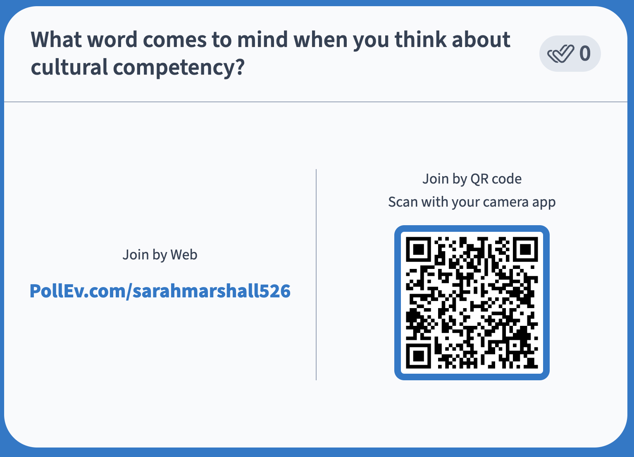
Notes:
What word comes to mind when you think about cultural competency? https://www.polleverywhere.com/free_text_polls/3AxoYawktOKDys21XkFvu

Slide 5

Self-Awareness
“Self-awareness is our capacity to stand apart from ourselves and examine our thinking, our motives, our history, our scripts, our actions, and our habits and tendencies.”
— Stephen R. Covey, author of The 7 Habits of Highly Effective People

Slide 6
Culture

Slide 7
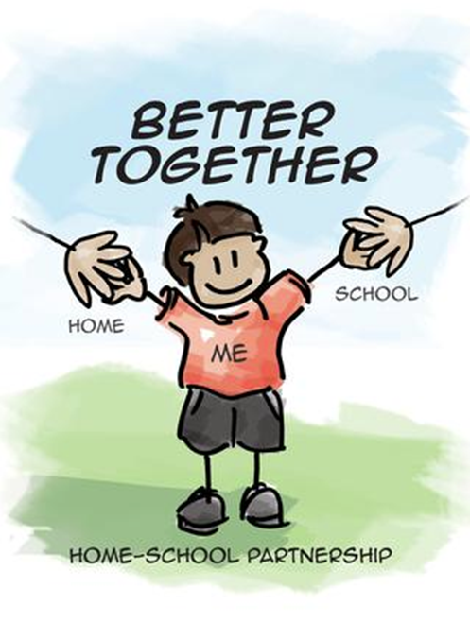
Family Engagement Leads to Student Success
Parents and families are a student’s first teachers.
Support and advocacy leads to better educational outcomes for children.
Parents and families can help close equity gaps in education.
Notes:
As we begin to discus culture and equity, it’s important to remember that parent and family members are a child’s first teachers. Children learn from what they see and hear from parents and families, and how they interact with parents and family members.
Bullet 2
Parents who consistently support, monitor and advocate for their children’s education are more likely to have children who are successful in school.
Success is defined as a student developing to their fullest academically, socially and personally.
It requires support not from just parents and family, but also it requires educators to provide a environment that is conducive to this development
Bullet 3
Students not only perform better academically when their families are engaged but are more likely to graduate and pursue a postsecondary education when families and educators work together.
Post secondary education includes, trade and vocational schools, colleges and universities and life skills programs

Slide 8
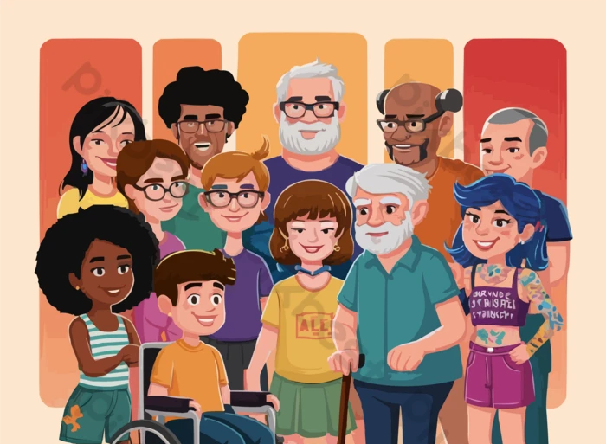
Diverse Family Backgrounds
Socioeconomic
Race
Ethnicity
Language
Ability/disability
Family structure
Gender
Religion
Voice quality
Notes:
Schools consist of diverse students coming from diverse family backgrounds
These includes but are not limited to Socioeconomic, Race, Voice Quality….
Ability/disability – We often consider diverse disabilities, but not diverse abilities
Ability - The skill and/or capacity to do something, to perform everyday tasks. It includes intellectual (cognitive) and physical task(physical strength to accomplish something)
Disabilities are both visible or hidden, and temporary or permanent
They are conditions that provide barriers or challenges, and impact individuals of every age and social group
Voice Quality refers to the sound of your voice. Voice quality can be impacted by culture. Some cultures have high pitch voices, some low, some speak fast and some speak slow.
A persons’ voice can affect their likeability – research has shown that likeable voices are considered attractive and confident
It’s important to remember that not only do students and families come from diverse backgrounds but so do teachers and school staff.

Slide 9
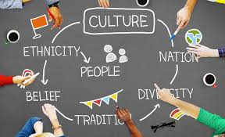
Why Talk About Culture?
“Educators’ awareness of culture in the classroom, along with its different values and behaviors that may accompany culture, can remove unintentional barriers to a child’s success” (Zion, et al. 6).
Notes:
Let’s talk about Culture.
I thought this quote was appropriate for today’s session.
In 2022 a Rodel Survey noted that there were over 97 languages spoken by Delaware Students who were multilingual Learners
So let talk about culture

Slide 10
Culture Defined
The customary beliefs, social norms, and material traits of a racial, religious, or social group.
The set of shared attitudes, values, goals, and practices that characterizes an institution or organization.
The integrated pattern of human knowledge, belief, and behavior that depends upon the capacity for learning and transmitting knowledge to succeeding generations.
(Merriam-Webster Dictionary)
Notes:
We are all members of cultural groups.
We are a blend of all cultural groups that we belong to that influence our beliefs, values and behavior, etc..
Culture is present in every interaction. We do not enter an environment without bringing our whole being and our experiences into that environment
Culture is not static, it’s fluid– it changes with time, environment, circumstances.
Also, we all move between cultures. For example, learning a new language or moving from a rural area to suburban or urban area will provide us new cultural experiences.

Slide 11
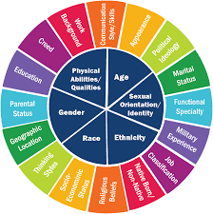
Activity: Recognizing Your Identities
We all have multiple identities that all intersect, many of which are largely out of our control.
How do your identities show up in your work?
Notes:
We approach circumstances with a unique lens associated with our identities.

Slide 12
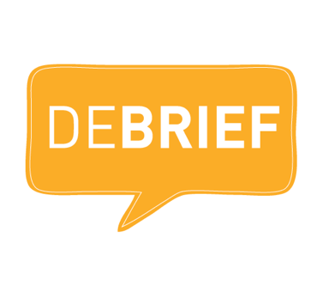
Activity: Debrief
Share out with the group:
How do your identities show up in your work?

Slide 13
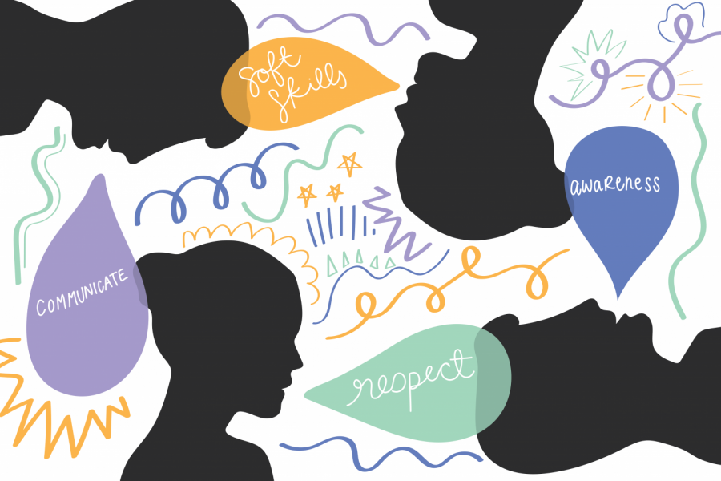
Defining Cultural Competency
The ability to understand, appreciate, and interact with people from cultures and belief systems different from one’s own (DeAngelis, 1).
Adapting to other cultural environments and being aware of the influence of culture on your thoughts and behaviors.
Notes:
How do we learn to interact with students, parents and teachers from different cultures? By working towards cultural competence
Cultural Competence is …
Culture Competence is not about changing others to be more like you.
It involves exploring and honoring your own culture while learning about and honoring other people’s cultures.
Developing cultural competence allows better engagement between parents, families and schools
And it allows for parents, families and educators to value and respect each other
How do you develop knowledge and experience to become culturally competent? Let’s take a look at steps in the process to developing cultural competency.

Slide 14
Step 1 to Reach Cultural Competency
Cultural Awareness
Understanding that culture drives our own (and others’) beliefs, values, and behaviors.
This awareness creates more positive interactions and understanding.
Cultural Awareness
Notes:
Starts with cultural awareness – familiarizing yourself with social norms, understanding culture’s role in personal identities, daily life, mental and physical health of different groups of people
It’s Seeking meaningful opportunities to participate in activities that expose you to interactions with different cultures
Being culturally aware results in more cultural connections and less cultural conflict
Developing cultural awareness is the first step in becoming proficient in working well with people from a variety of cultures

Slide 15
Step 2 to Reach Cultural Competency
Cultural Knowledge
Understanding cultural characteristics, history, values, beliefs, and behaviors of other cultural groups.
Cultural Knowledge
Cultural Awareness
Notes:
Cultural Knowledge
It is the desire and effort to learn more about different cultures.
It’s learning about the differences and similarities between cultures
It’s seeking opportunities to interact with other cultures and not being fearful of the new experiences
It requires you to understand your own culture and your personal biases

Slide 16
Step 3 to Reach Cultural Competency
Cultural Sensitivity
Recognizing differences and similarities between cultures but not assigning values to the difference.
Cultural Sensitivity
Cultural Knowledge
Cultural Awareness
Notes:
The final step on your journey to cultural competence is developing cultural sensitivity
Cultural sensitivity is recognizing differences and similarities but not assigning a value to those difference or similarities – such as this behavior is appropriate or inappropriate
Or this is not a good ideal family structure, or not a bad family structure
Or this person belongs to the other group, but they speak the right language – our language. Which is good.

Slide 17
Step 4 to Reach Cultural Competency
Culturally Competent
Vast multicultural knowledge and the desire to learn more.
Culturally Competent
Cultural Sensitivity
Cultural Knowledge
Cultural Awareness
Notes:
Once you traveled through these steps, you have developed some cultural competency, but it’s not something that you master once and then forget about it.
Because you are culturally competent with one group does not mean that you are competent with another
Developing cultural competency is never ending. It is built on increases in knowledge and skill development
Developing the ability to be culturally competent and responsive is a life-time journey

Slide 18
Activity: Reflect on Your Competency
At what stage of Cultural Competency do you see yourself?
Culturally Competent
Cultural Sensitivity
Cultural Knowledge
Cultural Awareness
Notes:
Breakout Room
We approach circumstances with a unique lens associated with our identities.

Slide 19
Activity: Debrief
Share out with the group:
How might someone advance to the next stage of cultural competency?

Slide 20
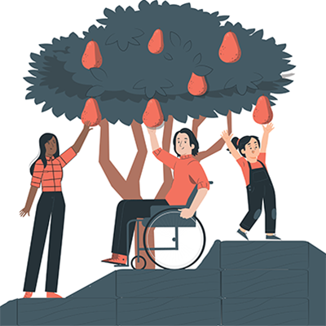
Equity
Equitable access to opportunities and fair, just, and impartial treatment regardless of an individual’s background.
Takes into consideration an individual’s circumstances with the goal of an equitable outcome for everyone.
Notes:
Let’s look at Equity in Culture. Read slide
Equality is providing the same for everyone, Equity recognizes and acknowledges that we do not all start from the same place and may need adjustments to create balance.
Cultural Equity is valuing all cultures where one is not valued more than another or considered better than another.
No culture should be considered the dominate or preferred culture
Creating Equity is creating an environment where all cultures can thrive

Slide 21
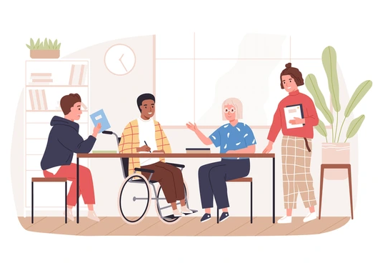
Belonging
Encourages and values each person’s contribution to a decision.
Considers “who has a voice” and ensures everyone has a say in the process.
Enables diverse individuals to work together effectively by providing a deliberate environment.
Notes:
Read slide
Cultural inclusion is incorporating the values and needs of individuals from diverse cultures into an environment for engagement and collaboration.
It’s creating an environment where all cultures feel welcomed and their input valued.

Slide 22
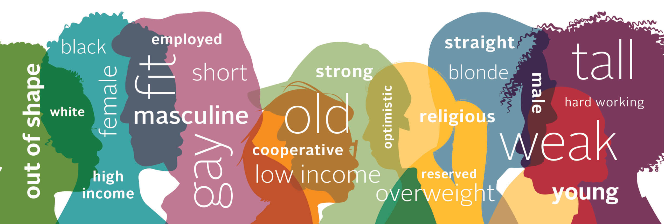
Be Conscious of Cultural Stereotypes
Generalization about all members of a group
Can be positive or negative
Notes:
In developing Cultural Competence, be aware of developing stereotypes
Stereotypes can, and often do, lead to prejudice and intentional or unintentional discrimination. They tend to lead to negative ideas and negative assumptions
They are traits and characteristics, attributed to a social group and to its individual members.
A stereo type can be negative or positive. A positive stereotype is an evaluation of a group that indicates an advantage over another group. It can lead to negative assumptions
For example, certain groups are better in science and math, or certain groups are better athletes

Slide 23
Culture & Mental Health
Notes:
Why are we talking about communication? The number 1 reason for conflict between home and school is miscommunication or no communication
It’s easier to be culturally competent and inclusive if you are a good communicator
At its basic, communication is an exchange of information or ideas.
It can be verbal and non-verbal, written, it can be gestures and behaviors, etc.
The goal is to deliver your message in a culturally sensitive, respectful way.

Slide 24
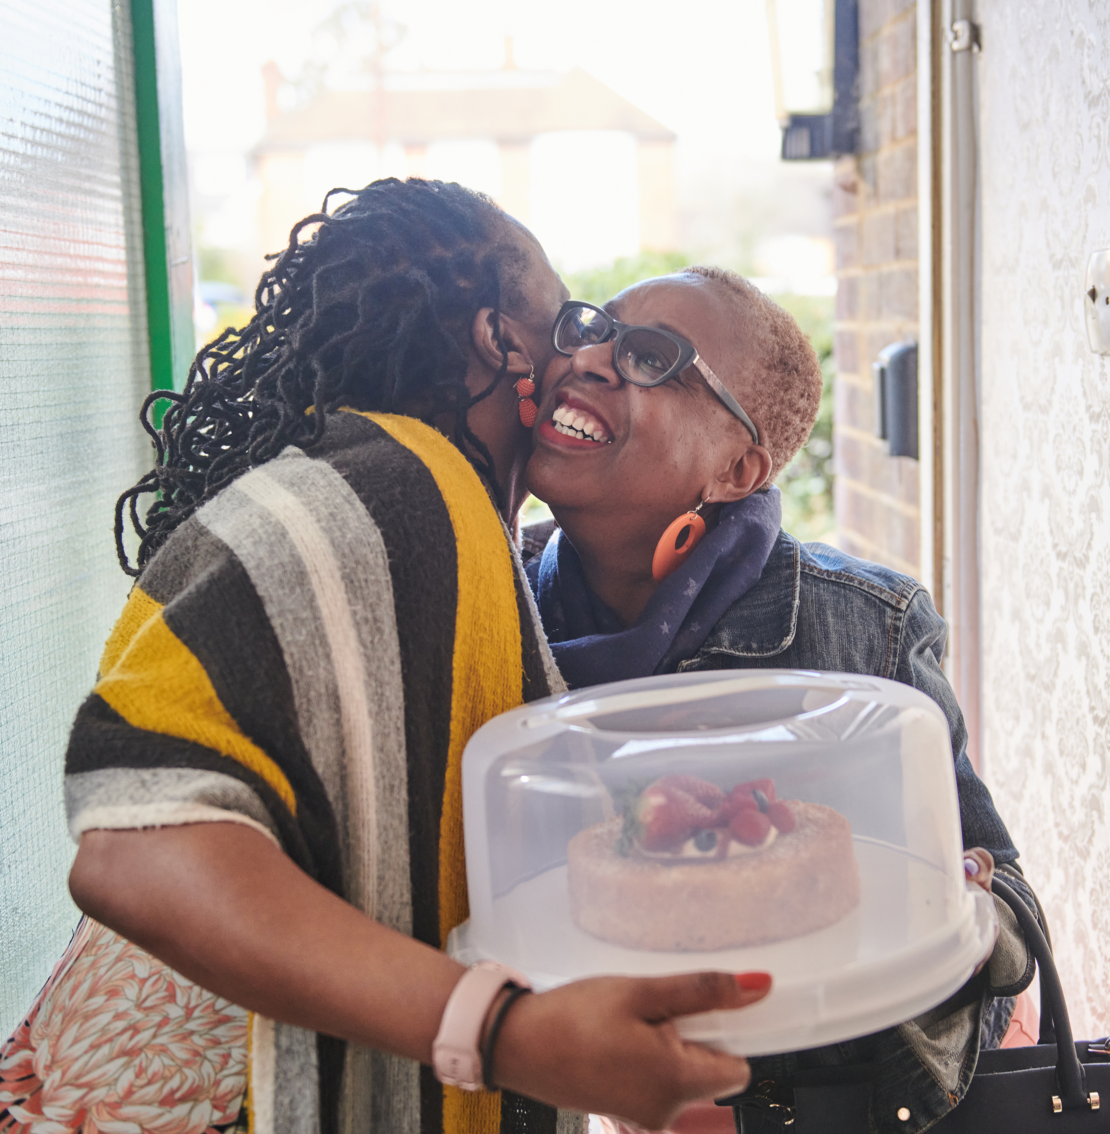
Culture Influences Mental Health
For families and educators alike, mental health is affected by the culture that surrounds us.
Notes:
Bullet 1
Culture can impact how individuals recognize, accept and treat mental illness
Bullet 2
Different cultures are impacted differently environmentally which increases their risk of experiencing mental health conditions. Environment includes poverty, violence, inequality and environmental deprivation (clean water and air, access to green spaces and shopping facilities.)
Bullet 3
For some groups, their mental health is at crisis levels. For example, Generation or Gen Z (13- 23) is experiencing elevated stress and depression. They are still feeling the impact of COVID.
Illnesses in households impacts family interactions and student behaviors
LIFESTYLE, such as diet and physical activity, can impact families and educators

Slide 25
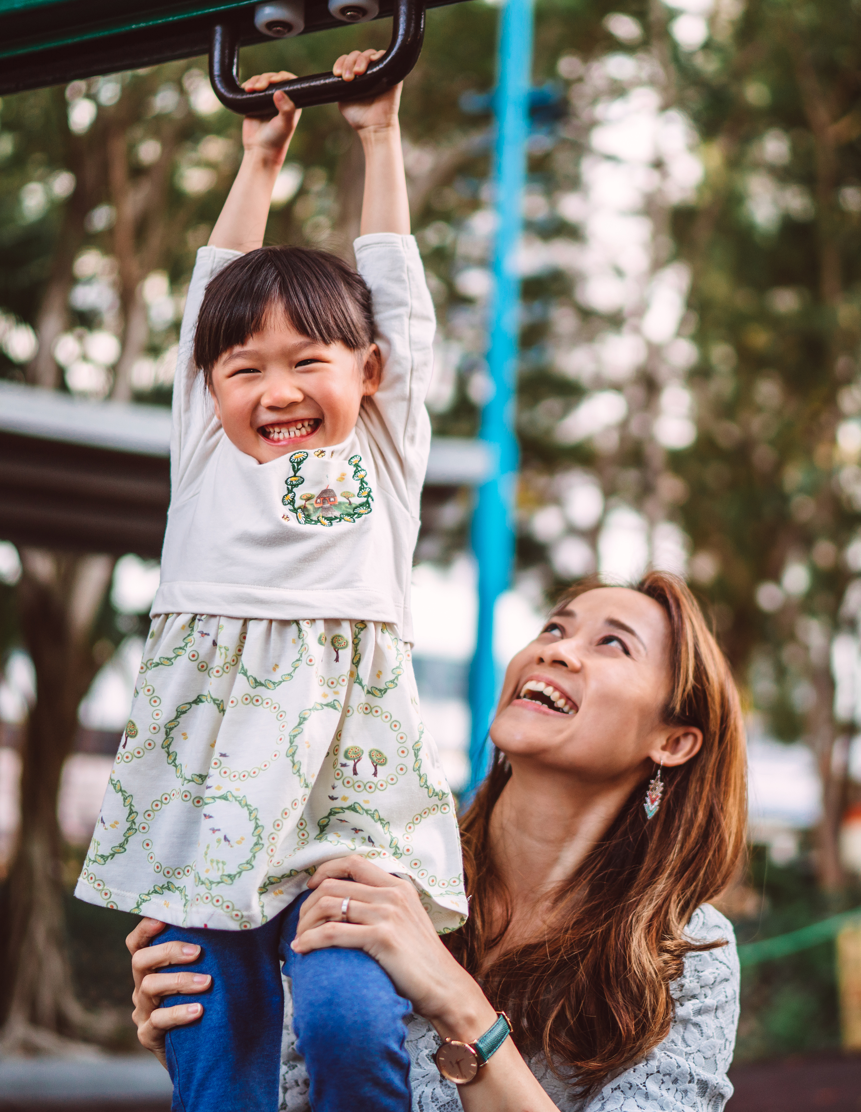
Environmental Factors
Mental health is impacted by lifestyle, economy, and environment.
Notes:
Bullet 1
Culture can impact how individuals recognize, accept and treat mental illness
Bullet 2
Different cultures are impacted differently environmentally which increases their risk of experiencing mental health conditions. Environment includes poverty, violence, inequality and environmental deprivation (clean water and air, access to green spaces and shopping facilities.)
Bullet 3
For some groups, their mental health is at crisis levels. For example, Generation or Gen Z (13- 23) is experiencing elevated stress and depression. They are still feeling the impact of COVID.
Illnesses in households impacts family interactions and student behaviors
LIFESTYLE, such as diet and physical activity, can impact families and educators

Slide 26
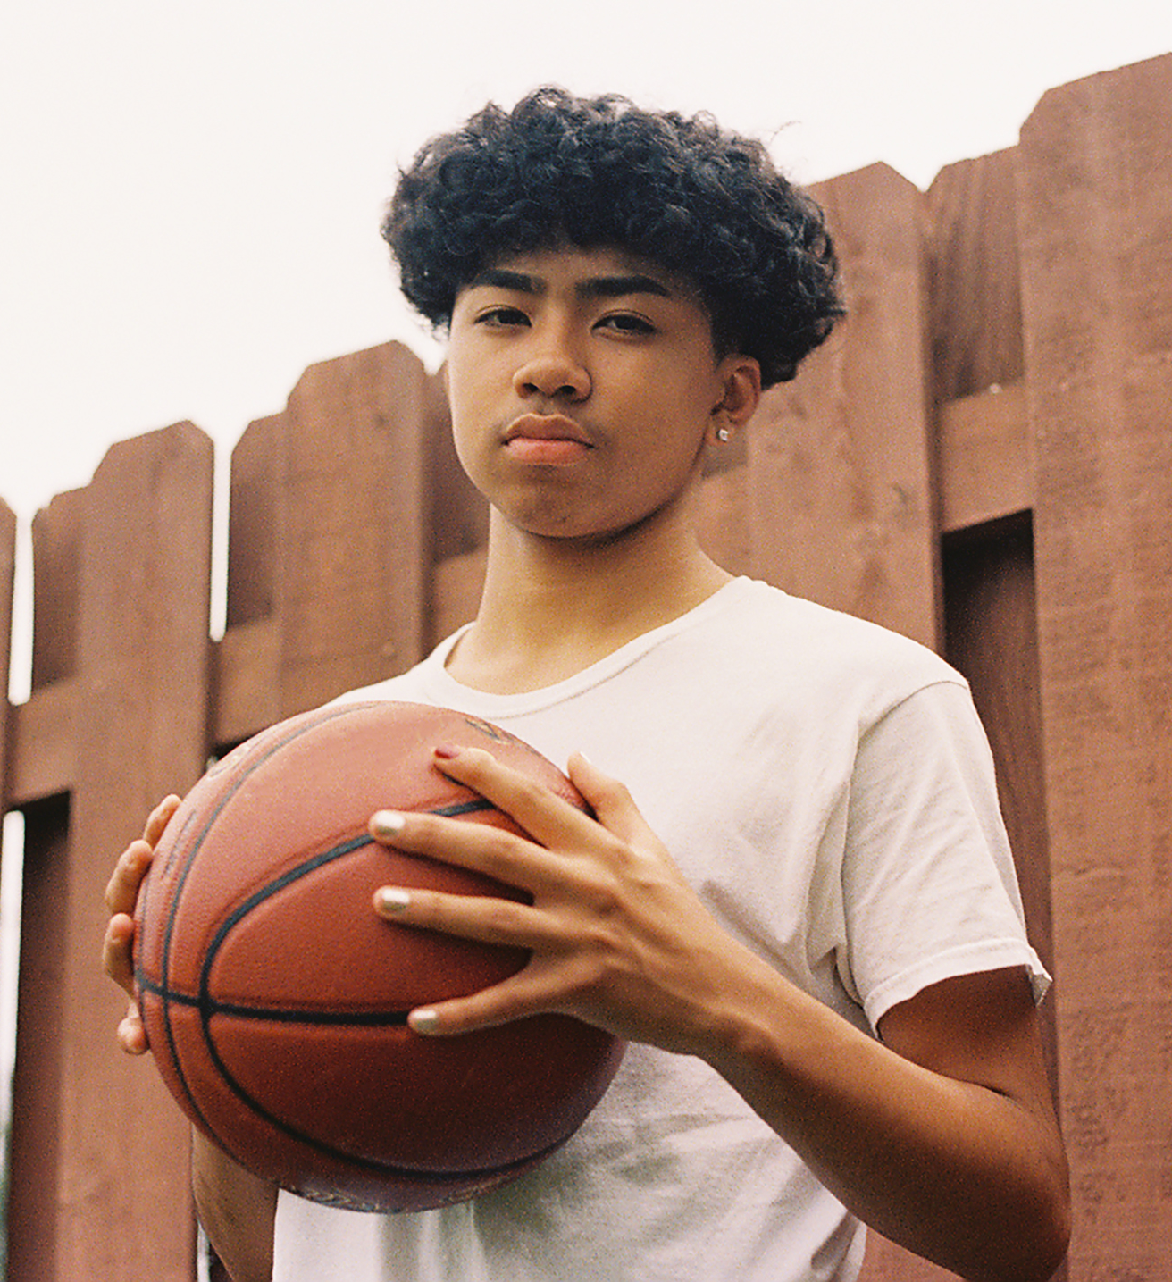
Higher Risks of Mental Health
Crisis levels in some groups, based on generation, race, gender, and sexual orientation
Notes:
Bullet 1
Culture can impact how individuals recognize, accept and treat mental illness
Bullet 2
Different cultures are impacted differently environmentally which increases their risk of experiencing mental health conditions. Environment includes poverty, violence, inequality and environmental deprivation (clean water and air, access to green spaces and shopping facilities.)
Bullet 3
For some groups, their mental health is at crisis levels. For example, Generation or Gen Z (13- 23) is experiencing elevated stress and depression. They are still feeling the impact of COVID.
Illnesses in households impacts family interactions and student behaviors
LIFESTYLE, such as diet and physical activity, can impact families and educators

Slide 27
Activity: Reflect on Your Experience
How have you seen culture impact mental health in students, families, and educators?
Notes:
Breakout Room
We approach circumstances with a unique lens associated with our identities.

Slide 28
Communication
Notes:
Why are we talking about communication? The number 1 reason for conflict between home and school is miscommunication or no communication
It’s easier to be culturally competent and inclusive if you are a good communicator
At its basic, communication is an exchange of information or ideas.
It can be verbal and non-verbal, written, it can be gestures and behaviors, etc.
The goal is to deliver your message in a culturally sensitive, respectful way.

Slide 29
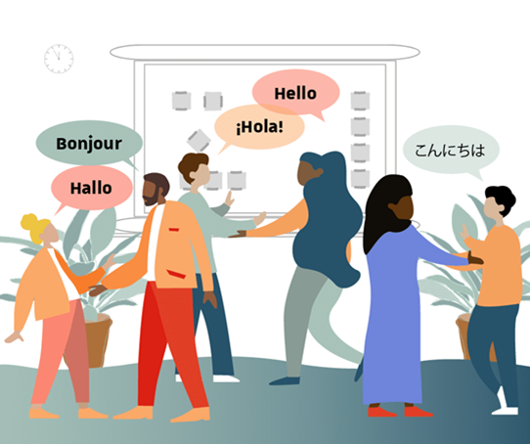
Effective Intercultural Communication
How individuals from different cultural backgrounds adjust to improve communication (Shana)
Verbal and nonverbal interactions between individuals from diverse backgrounds
Reduces misunderstandings
Notes:
What is intercultural communication
It’s sharing information across different cultural groups
Read Bullet 2
Let’s look at what we consider the most important communication skill in a conflict

Slide 30
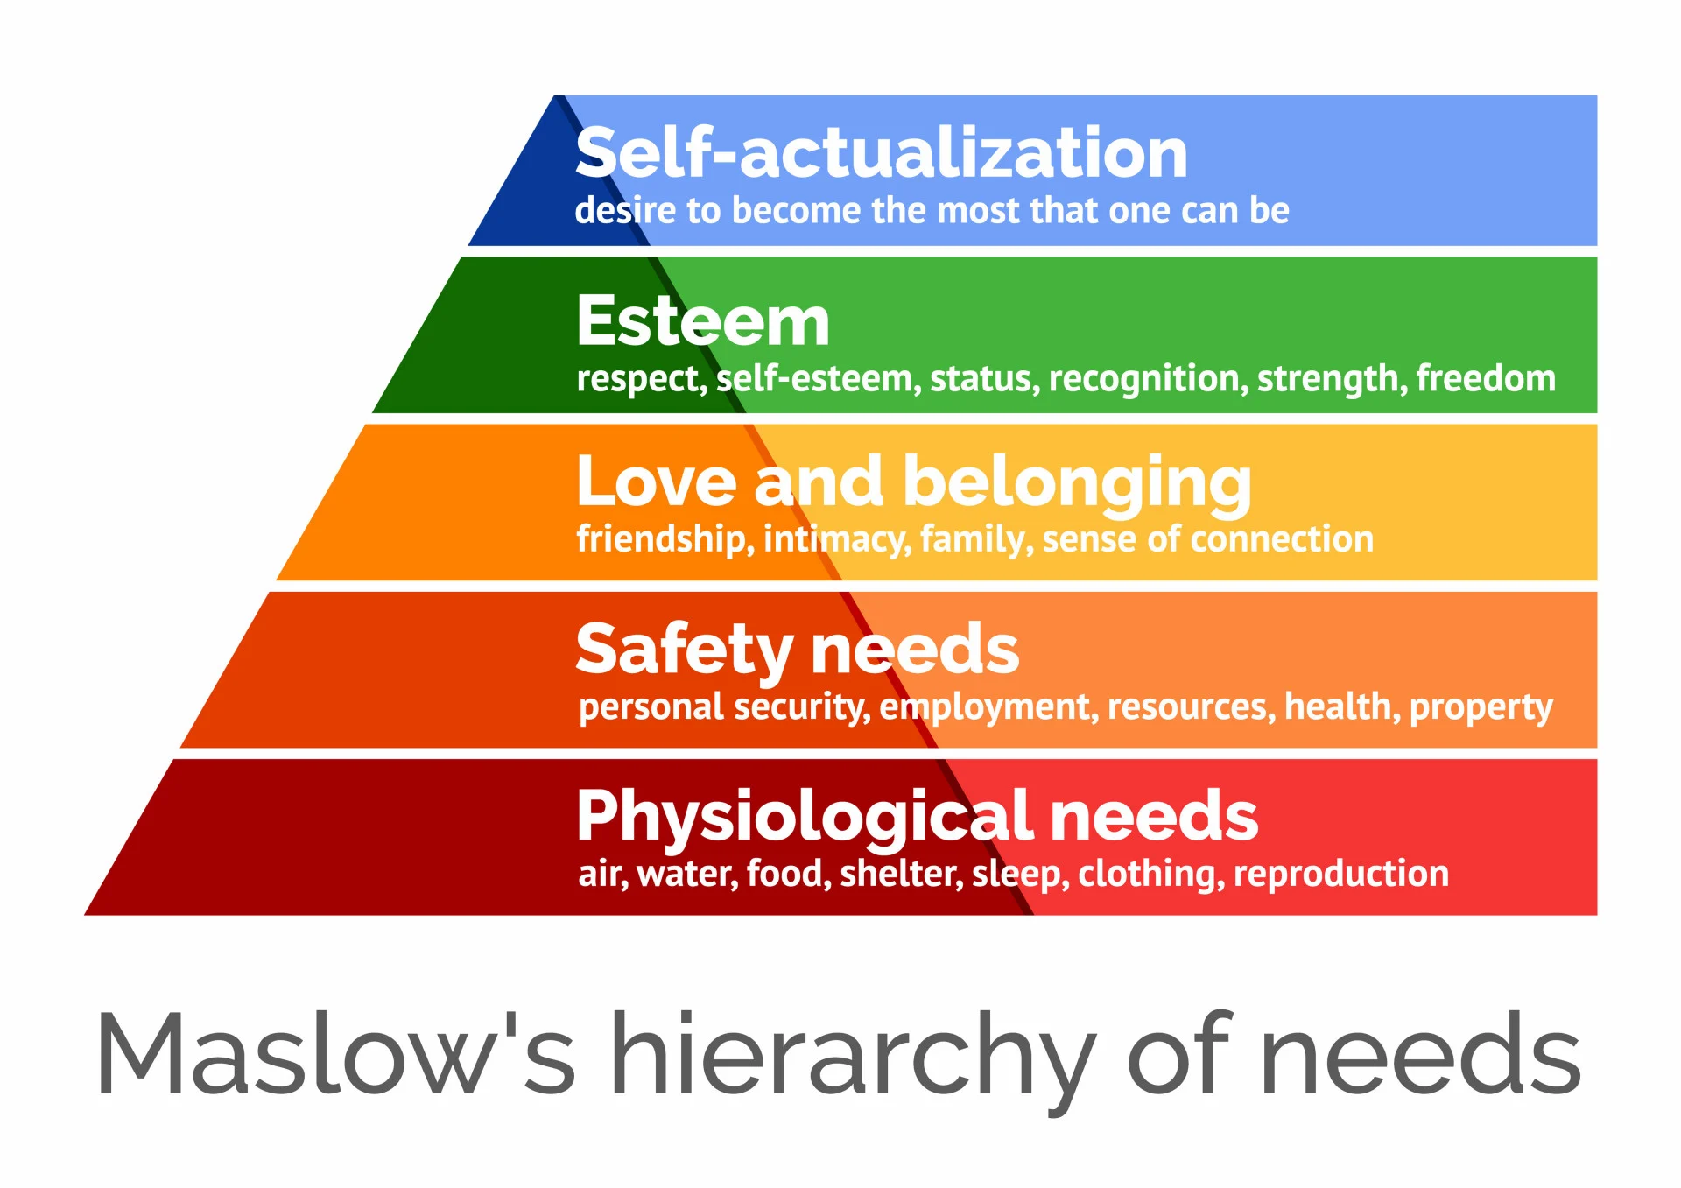
Identifying and Addressing Needs
Individuals may have different expectations of respect, connection, safety, and security based on their culture.
Notes:
Maslow’s Hierarchy:
Food and Water
Safety & Security
Welcoming them

Slide 31

Active Listening & Cultural Competency
Listening to understand the other person’s point of view.
Displaying the cultural competency behaviors of active listening, empathy, and effective engagement can help us to create a welcoming environment and establish the appreciation of similarities and differences among cultures (de Guzman et al. 1).
Notes:
Most important communications skill
Displaying the cultural competency behaviors of active listening, empathy, and effective engagement can help us to create a welcoming environment and establish the appreciation of similarities and differences among cultures
Everyone wants their time to be heard. Heard and understood.

Slide 32
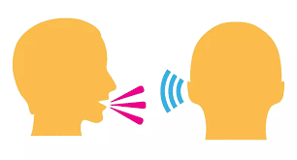
Active Listening Defined
Listen attentively without interrupting.
Listen to understand NOT respond.
Tell the other person what you heard.
Notes:
Read Bullet 1
Read Bullet 2
You give 100% of your attention to the speaker.
Note their non-verbal communication in addition to their verbal
When listening to understand. You want to know
How they feel
What they want
Why they want it
Summarize
Why do you summarize? To acknowledge the main points and feelings expressed by the speaker
How do you summarize? In your own words and ask the speaker if you “got it” correct
Restate what you hear
Why do you restate: To help the speaker feel heard and understood by using their own words
How do you restate: By repeating back what was said using the speaker’s own words instead of your own
At this time, we will break into groups for an Active Listening Exercise
Joy stop sharing and Kathy post the activity. You will have about 10 minutes…

Slide 33
Activity: Practice Active Listening
Think of a past interaction with an upset parent.
How did/could you apply active listening in that situation?
In pairs:
Person 1: Answer question.
Person 2: Listens and summarizes.
Then switch roles and repeat.
Notes:
Breakout Room

Slide 34
Activity: Debrief
How did the interaction with the parent make you feel?
How did it feel to be heard during this activity?
Did you feel like you were heard, why or why not?

Slide 35
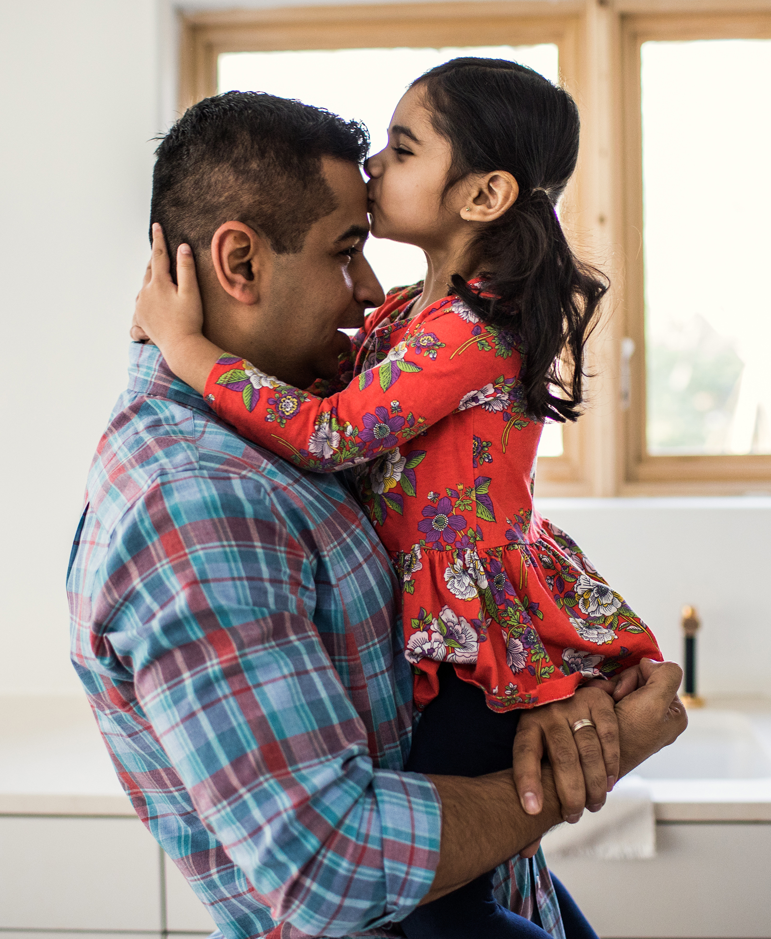
Managing Expectations with Parents and Schools
Often parents are completely new to the dispute resolution process. They wonder…
Who can I talk to?
Who can I trust?
What are these meetings?
What are these email attachments?

Slide 36
Activity: Reflecting on the Parent Perspective
Given what you’ve learned thus far in this session, how might you support parents through the dispute resolution process?
What tools and resources do you have at your disposal?
What do you wish you had?
Notes:
Breakout Room

Slide 37
Activity: Debrief
Share your reflections with the group.

Slide 38
Thank You!
Joy Jordan and Sarah Marshall
Conflict Resolution Program
Institute for Public Administration
Biden School of Public Policy & Administration
University of Delaware
For more about SPARC Services visit:
www.ipa.udel.edu/crp

Slide 39
Sources
American Psychological Association – Tori DeAngelis, “In search of cultural competence” March 2015, Vol 46, No. 3, https://www.apa.org/monitor/2015/03/cultural-competence
Community Tool Box. https://communityhealth.ku.edu/community-tool-box. Accessed 13 Aug. 2024.
Cultural Competence: An Important Skill Set for the 21st Century (G1375) | G1375 | 2016 | Nebraska Extension Publications. https://extensionpubs.unl.edu/publication/g1375/cultural-competence-an-important-skill-set-for-the-21st-century-g1375. Accessed 15 Aug. 2024.
“Cultural Enhancement Module Series.” Georgetown University National Center for Cultural Competence, Modules 1-4, Georgetown University, Summer 2004. https://nccc.georgetown.edu/curricula/awareness/index.html.

Slide 40
Sources
“DEI: What It Is & How to Champion It in the Workplace.” Business Insights Blog, 3 Oct. 2023, Harvard Business School Online, https://online.hbs.edu/blog/post/what-is-dei.
Epstein, Joyce L. “School, Family, and Community Partnerships in Teachers” Professional Work.” Journal of Education for Teaching : JET, vol. 44, no. 3, 2018, pp. 397–406, https://doi.org/10.1080/02607476.2018.1465669.
“Implicit Bias.” American Psychological Association, https://www.apa.org/topics/implicit-bias. Accessed 13 Aug. 2024.
Joubert, Shayna. “How To Improve Cross-Cultural Communication in the Workplace.” Graduate Blog, 5 July 2024, https://graduate.northeastern.edu/resources/cross-cultural-communication/.

Slide 41
Sources
“Stress in AmericaTM 2020: A National Mental Health Crisis.” Https://Www.Apa.Org, https://www.apa.org/news/press/releases/stress/2020/report-october.
Sociology. Institute, Sociology of Kinship, Diverse Family Structure and Societal Impact. https://sociology.institute/sociology-of-kinship/diverse-family-structures-societal-impact/
Thomas-Breitfeld, Sean, and Frances Kunreuther. “Diversity, Equity and Inclusion in Nonprofit Organizations.” International Encyclopedia of Civil Society, edited by Regina A. List et al., Springer International Publishing, 2022, pp. 1–5. DOI.org (Crossref), https://doi.org/10.1007/978-3-319-99675-2_9579-1.

Slide 42
Sources
What Is Cultural Competence and How to Develop It? Updated May 1, 2023, Penn State Extension, The Pennsylvania State University, https://extension.psu.edu/what-is-cultural-competence-and-how-to-develop-it.
Zion, Shelley & Kozleski, Elizabeth. (2005). Understanding Culture. National Institute for Urban School Improvement.

