Slide 1

Title Slide
Generating Interest to Utilize the ADR Process
Erik Lopez
Ricardo Toland
Mapping the Future Together: Rediscovering our Purpose October 2025
Notes:
When delivering a presentation, enable the Always Use Subtitles checkbox on the Accessibility ribbon tab. PowerPoint will use the microphone to listen to you speak and use an AI-powered service to convert the speech into captions displayed on the screen as you present. The closer you are to your microphone, the higher quality the captioning will be. For more information, go to Present with real-time, automatic captions or subtitles in PowerPoint.
Prior to your presentation:
Google Slides
Move into presentation mode
Hover over the bottom left corner
Select the 3 dots and then the option for closed captions will appear for you to select.
PowerPoint Slides
Move into presentation mode
Select the “cc” in the bottom left corner (for older versions of Power Point)
- Or -
2. Select the 3 dots and then the option for closed captions will appear for you to select. Choose the placement of the subtitles (best if above or below the PowerPoint slide).

Slide 2


Poll
POLL
Rate your knowledge of the special education process.
Have you ever attended an Individualized Education Program (“IEP”) team meeting that resulted in a disagreement?
Rate your familiarity with ADR practices.

Slide 3
OBJECTIVES
Through the LAUSD's journey in developing an Alternate Dispute Resolution process in a large urban school district, participants will gain a better understanding of:
Collaborative strategies used to communicate and engage with stakeholders.
An overview of systems developed to implement and refine the ADR process.
Strategies that can be readily implemented to begin, enhance, and/or augment the ADR practice.
Successes and lessons learned to improve the ADR practice.

Slide 4

TRIPLE TRACK AGENDA
Content: How might the information shared today be used to support my personal growth in utilizing the ADR process?
Facilitation: How might this information support better outcomes for students in my district?
Schools/Classrooms: How might today’s learning increase family engagement in the ADR process?

Slide 5

WHO WE ARE
394,000 Students Enrolled
65,000 Students with Disabilities
17% of enrollment
62,000 English Language Learners
1,000+ Schools
4 Regions (East, West, North, South)
110,000+ IEP team meetings yearly
.

Slide 6

TYPES of DISTRICT FILINGS
California Dept. of Education (CDE)
Due Process
Informal Dispute Resolution (IDR)
Alternate Dispute Resolution (ADR)

Slide 7
DISPUTE RESOLUTION OPTIONS
Informal Dispute Resolution
Mediation Only
Formal Due Process

Slide 8
WHY ADR?

Slide 9
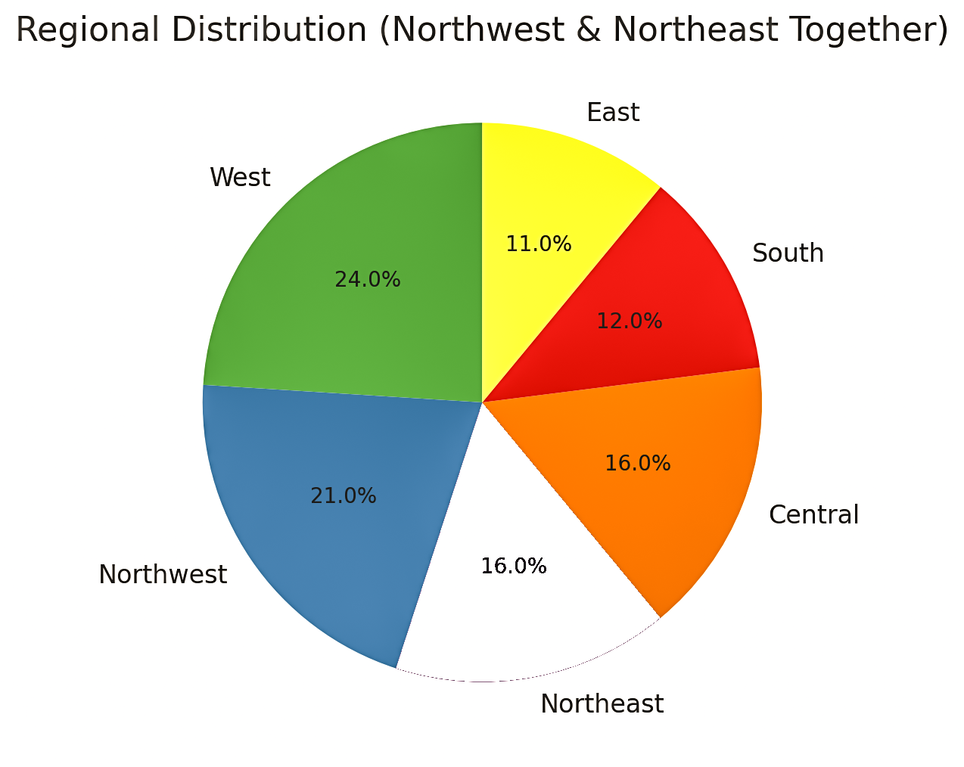
Due Process Filings
DUE PROCESS FILINGS

Slide 10
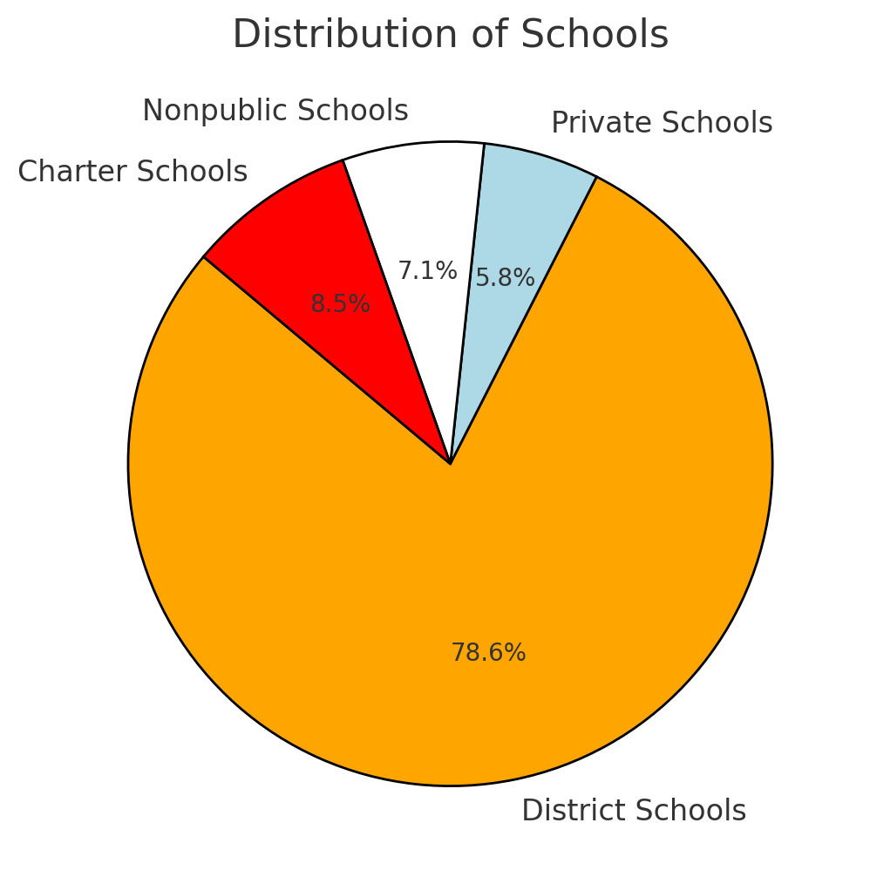
IDR FILINGS

Slide 11
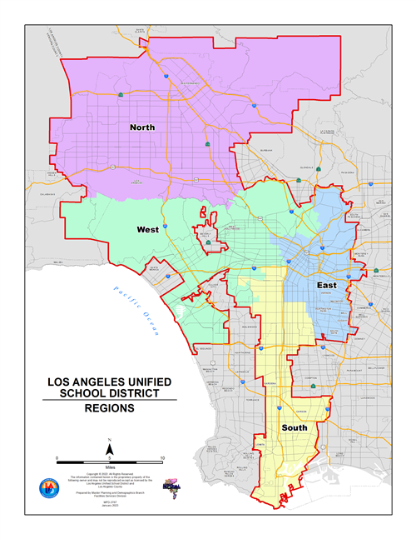
ADR Pilot Program
ADR PILOT PROGRAM
2020-2021
Local District Northwest
181 Schools
10,000 Students with Disabilities
Local District West
226 Schools
9,700 Students with Disabilities

Slide 12
WHY ADR?
Keeps decision-making with school site team and parents who know the child best.
Local and school site decision-making by those who know the circumstances pertaining to the child's needs first-hand.
Expands and improves relationships amongst all members of the IEP team, including school site staff and parents.
Supports effective and efficient collaboration to assist in resolving parent concerns.
Resolves disagreements more quickly than any other dispute resolution option.

Slide 13
ADR vs. IDR
 | ADR | IDR
Informal
Timely resolution of parent disagreements
Voluntary
At no cost to parents
Collaborative
Central Office Administrator | X
School site staff direct involvement |  | X

Slide 14
ADR VISION
Expediated, non-adversarial opportunity to address IEP concerns in a positive, engaging student-centered approach at the earliest level possible, with the goal of resolving parent concerns and/or disagreements, with the support of school and region staff at the school level.

Slide 15
WHAT IS ADR?
A process
An informal, voluntary process designed by LAUSD for resolving special education conflicts early.
Parent engagement
School site staff engage parents in difficult/challenging conversations incorporating positive communication strategies to address IEP issues/disagreements at the earliest stage of disagreement/conflict, using data-driven decision making.
A practice
Increases communication, collaboration, and consultation to resolve IEP disagreement(s) at the school/local level.
A statewide initiative
Alternate Dispute Resolution is supported by the California Department of Education (CDE).
An LAUSD grant
Successful implementation of ADR practices to resolve CDE Compliance Complaints at the local level.
Expand ADR practices to the school site level.

Slide 16

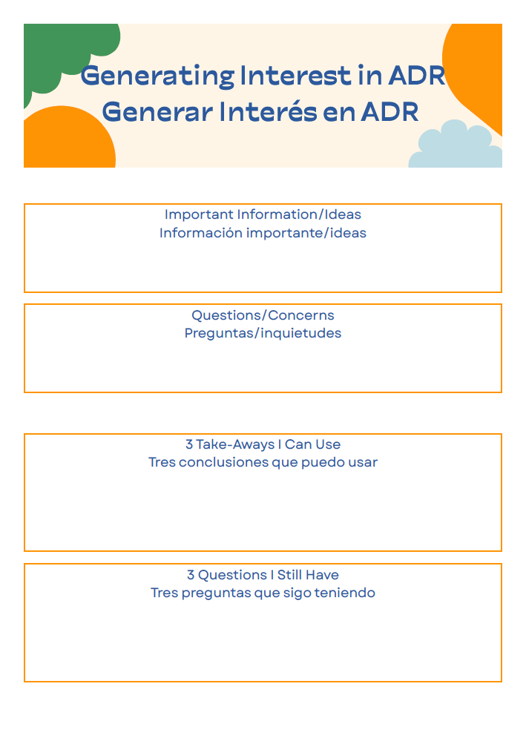
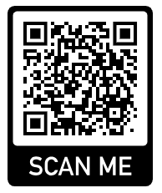
Time for an Activity and Q&A
*Edit using the Google Docs app

Slide 17




Considerations for District-Wide Implementation
CONSIDERATIONS FOR DISTRICT-WIDE IMPLEMENTATION
PD for STAFF
PD for STAKEHOLDERS
RESOURCES for STAFF
PARENT ENGAGEMENT
RESOURCES for PARENTS

Slide 18
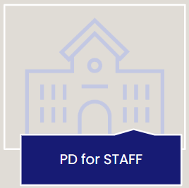
CONSIDERATIONS FOR DISTRICT-WIDE IMPLEMENTATION

Slide 19

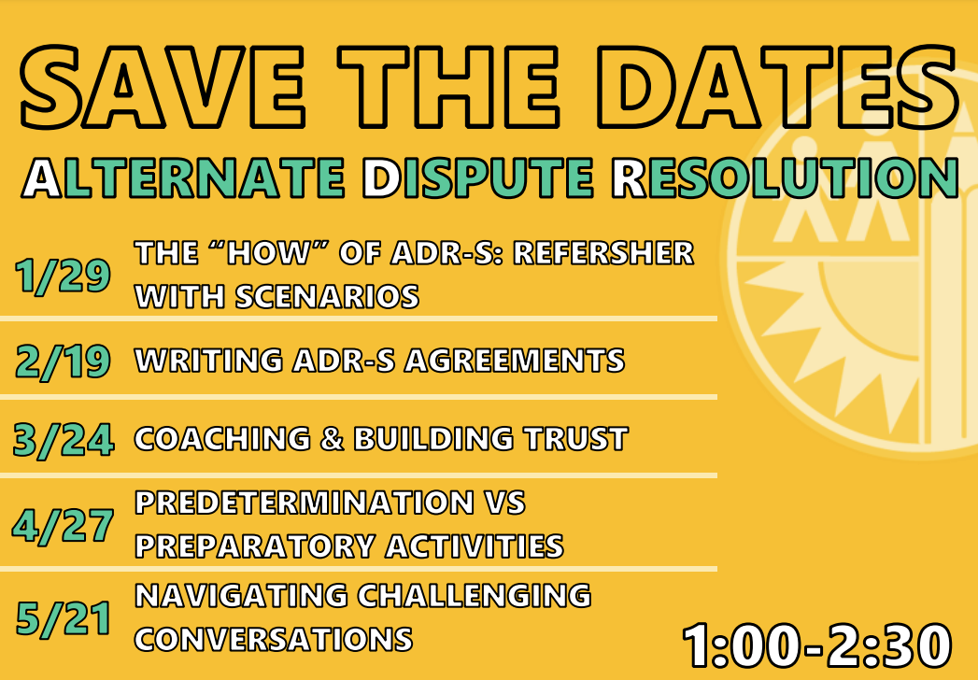
PILOT PROGRAM WEBINARS

Slide 20


District Wide Webinars
DISTRICT WIDE WEBINARS

Slide 21
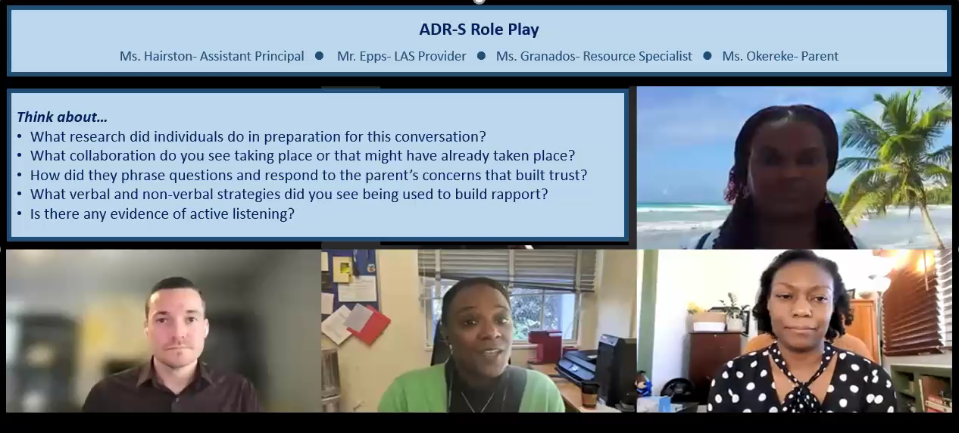
Coaching and Role Play
COACHING AND ROLE PLAY

Slide 22

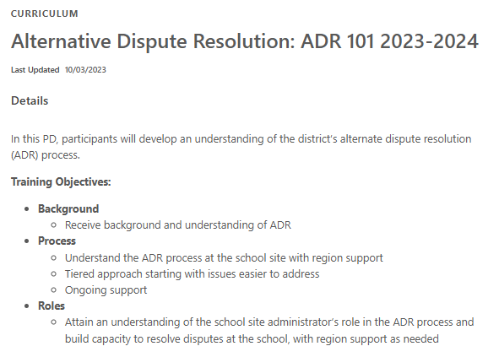
Recorded Virtual Trainings
RECORDED VIRTUAL TRAININGS

Slide 23
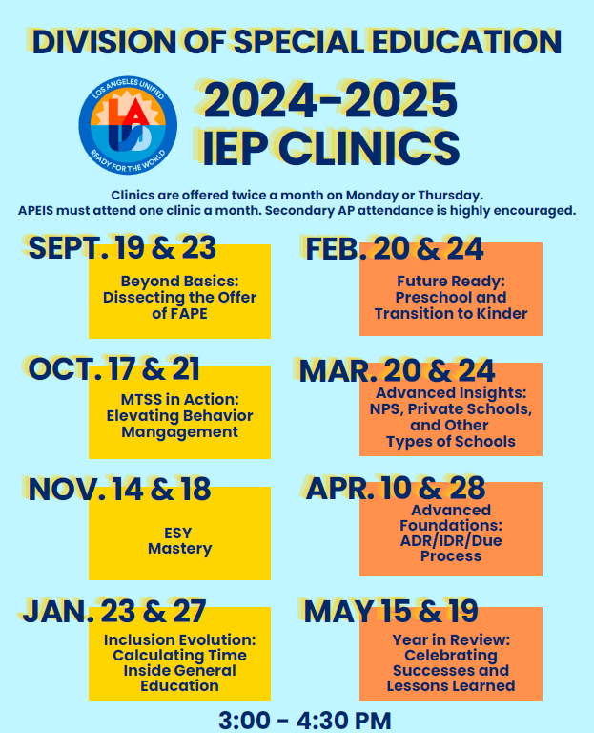
Ongoing Professional Development
ONGOING PROFESSIONAL DEVELOPMENT

Slide 24

IN-PERSON TRAINING/GUEST PRESENTERS
Opportunity to connect
Provide clarity around the work
Topics Supporting the ADR Vision
Implicit/Explicit Bias
Strategies for High Emotion IEPs
Effective Communication during the IEP Meeting
Cognitive Coaching
Time for Q&A

Slide 25
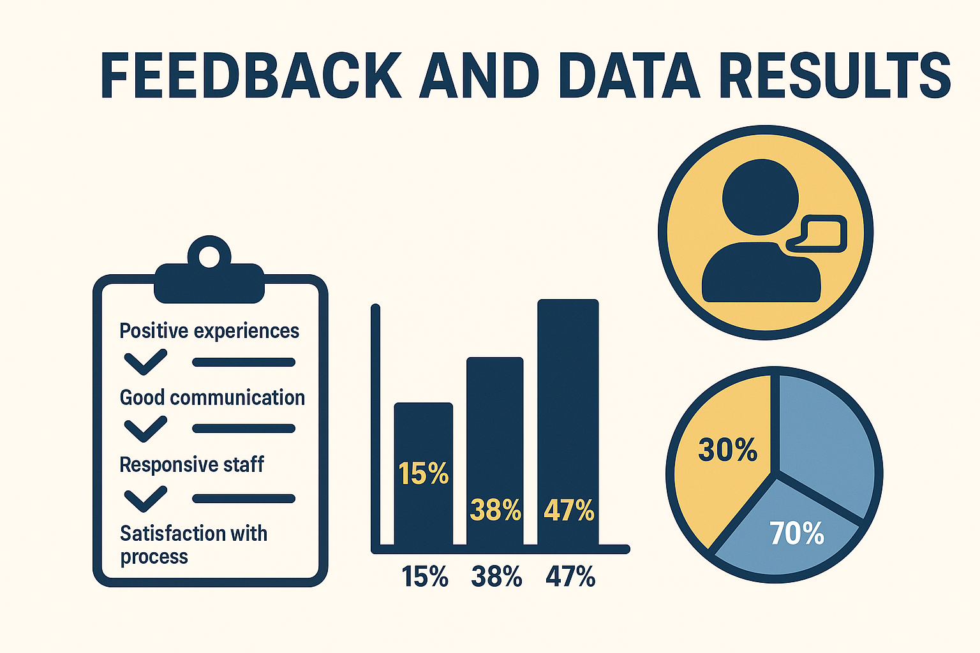
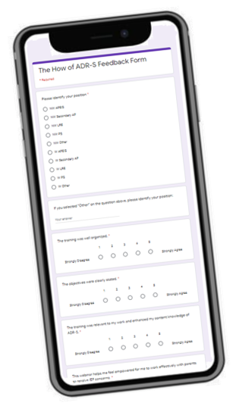
FEEDBACK AND EVALUATIONS

Slide 26
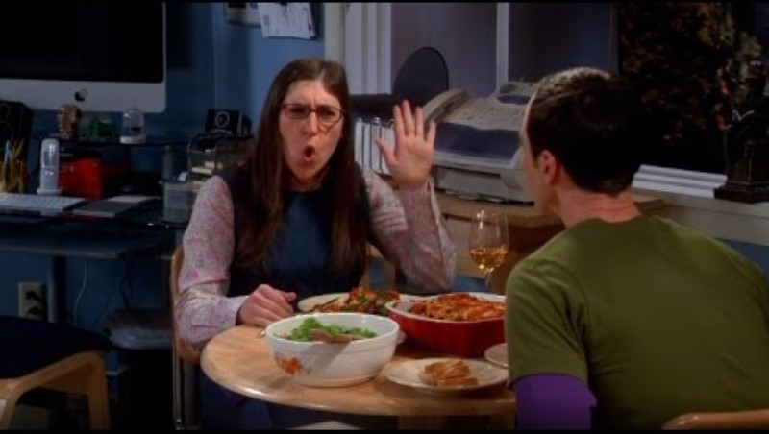
What’s the Outcome?
WHAT’S THE OUTCOME?

Slide 27
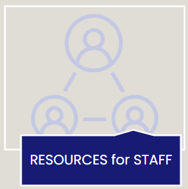
Considerations for District-Wide Implementation
CONSIDERATIONS FOR DISTRICT-WIDE IMPLEMENTATION

Slide 28
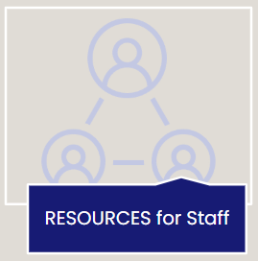
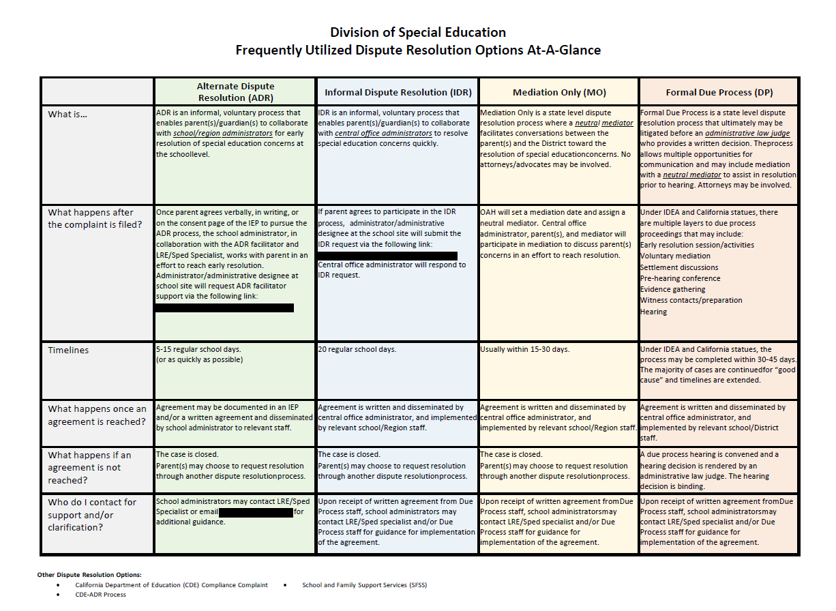
DISPUTE RESOLUTION OPTIONS

Slide 29
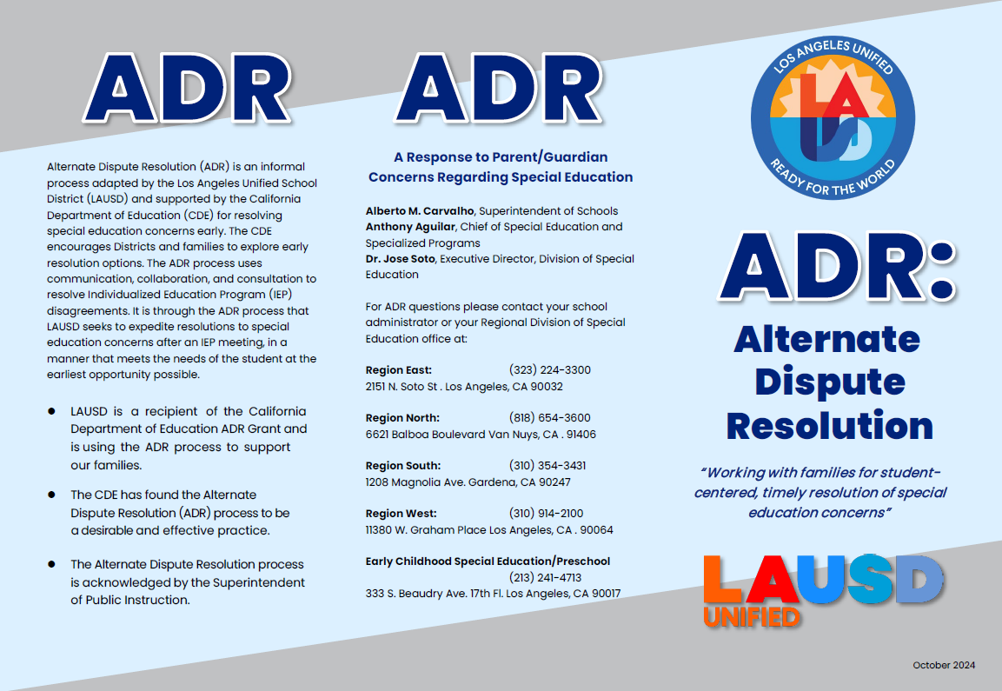
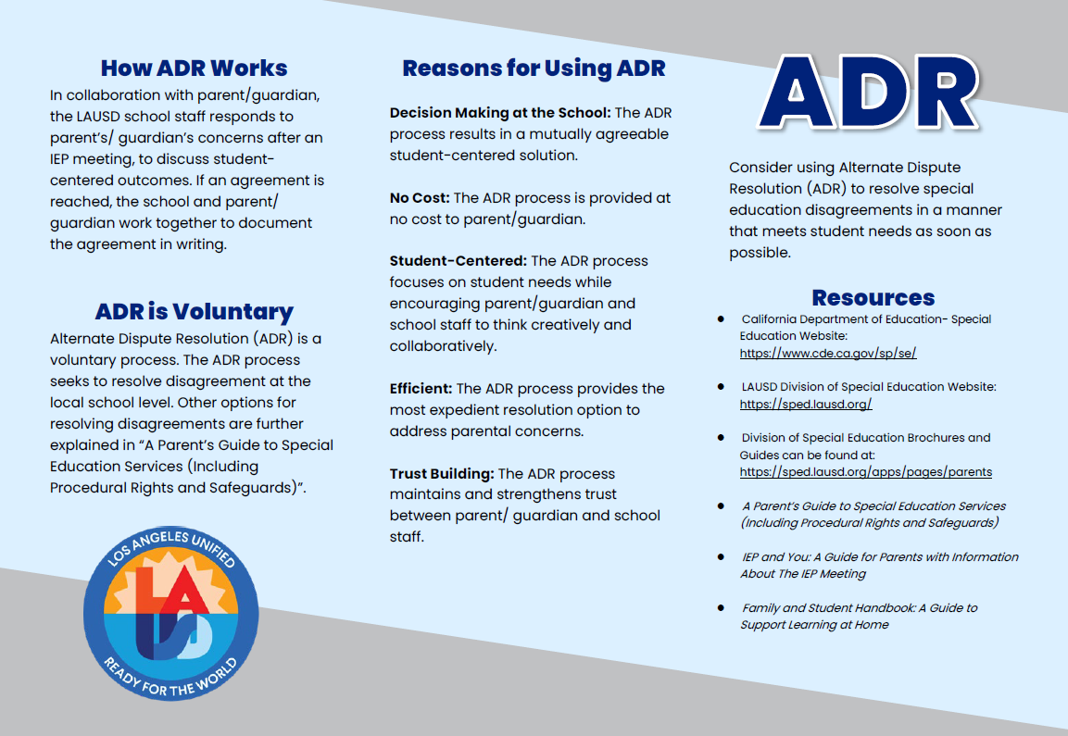
BROCHURES

Slide 30
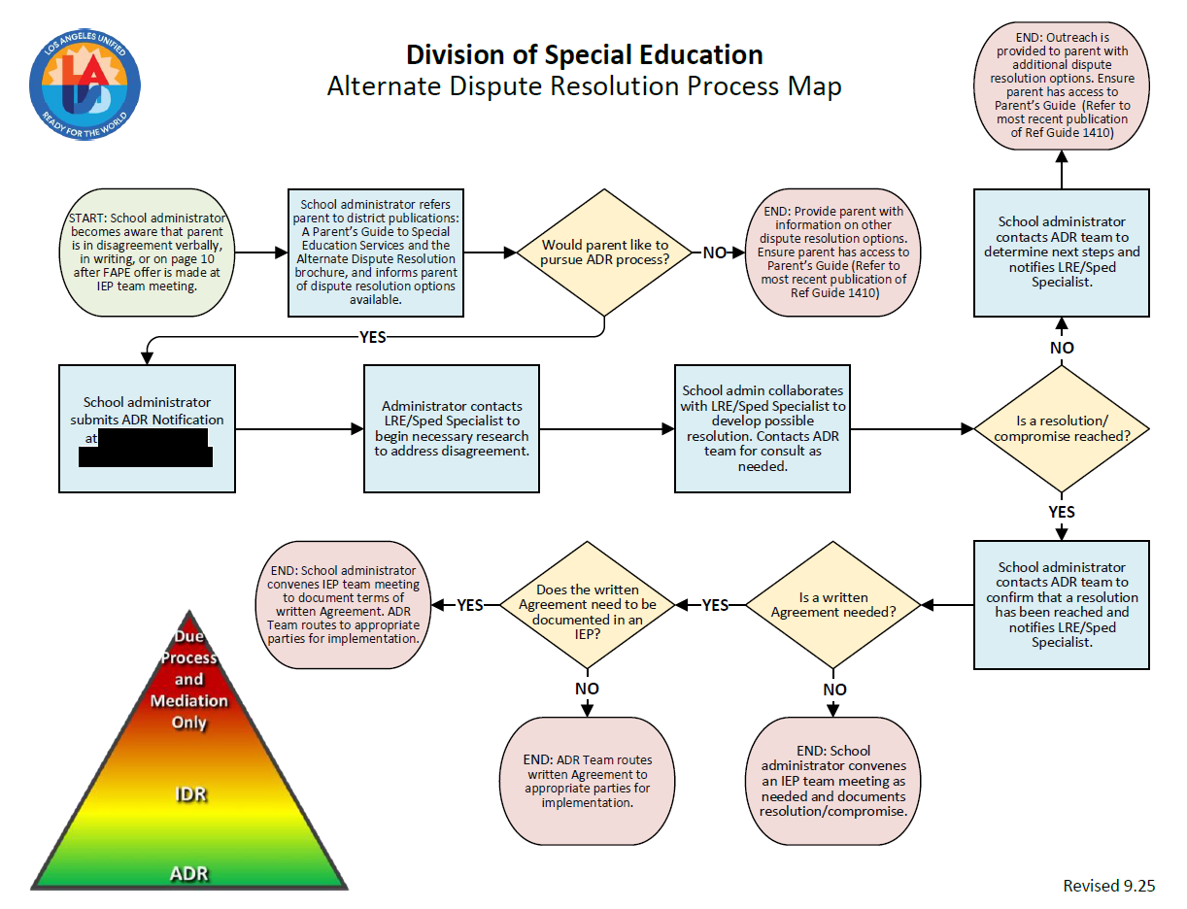
ADR Process Map
ADR PROCESS MAP

Slide 31

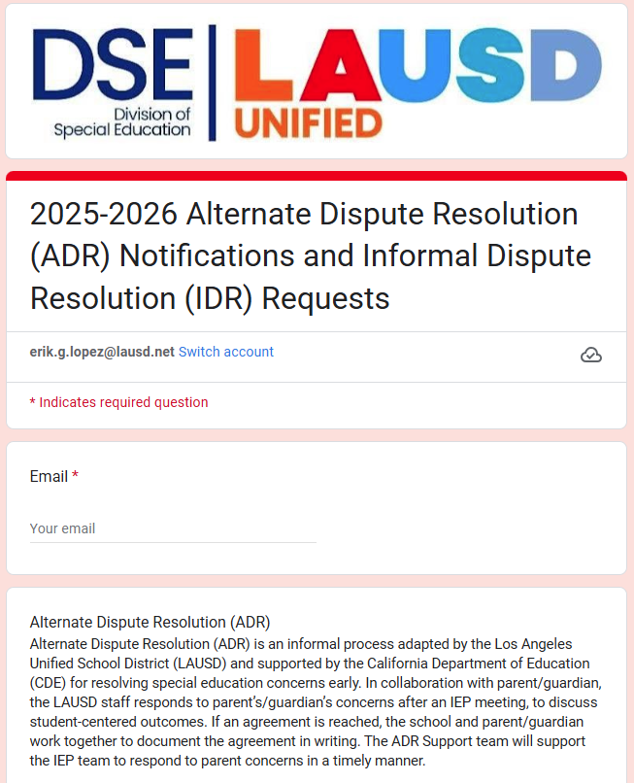

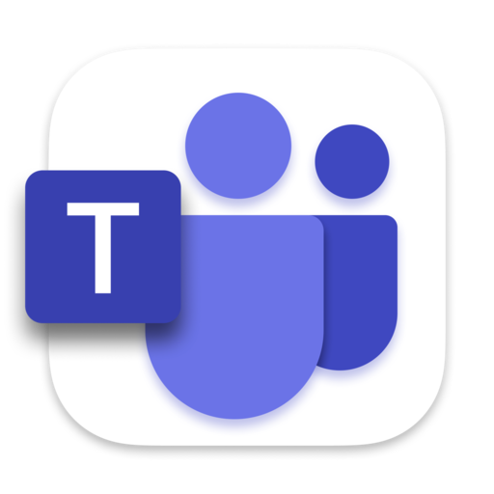
GOOGLE SUBMISSION FORM AND CASE MANAGEMENT TRACKING SYSTEMS

Slide 32

CONSIDERATIONS FOR DISTRICT-WIDE IMPLEMENTATION

Slide 33
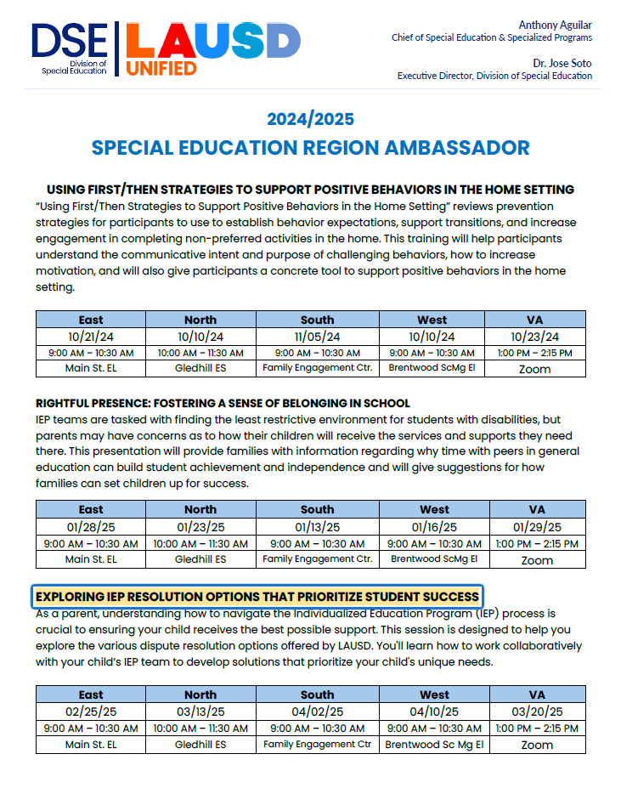
IN-PERSON PARENT TRAININGS

Slide 34

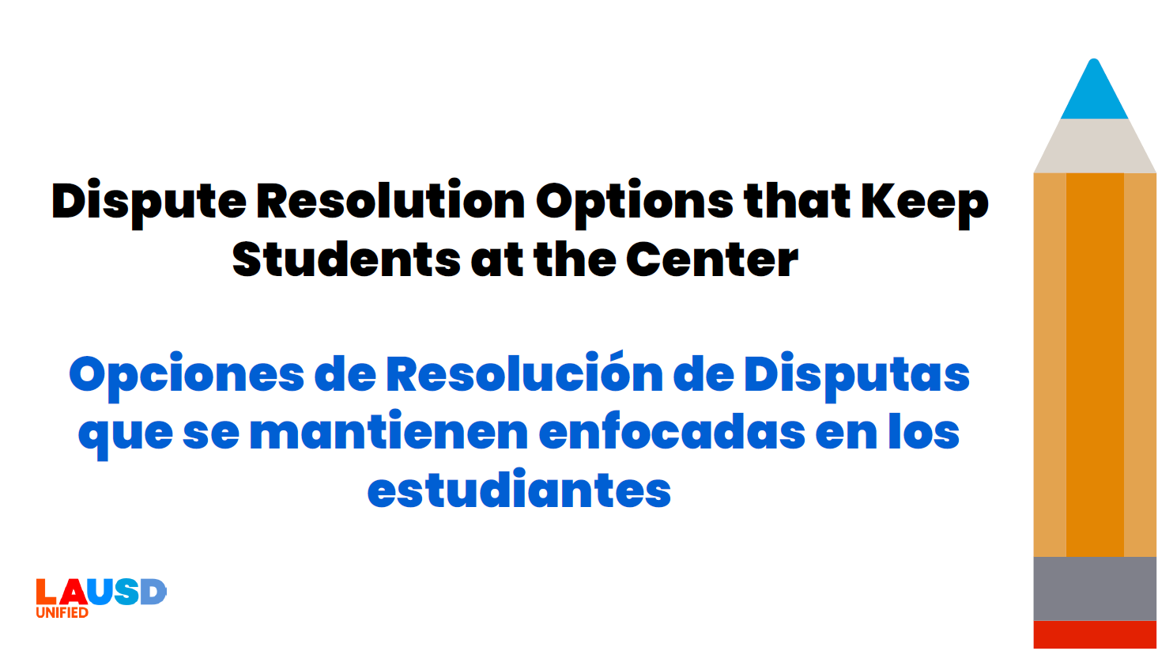
In-Person/Virtual Parent Trainings
IN-PERSON/VIRTUAL PARENT TRAININGS
Utilizing various means of access for families and staff:
Recorded and live Zoom meetings
Language translation
America Sign Language Interpretation

Slide 35
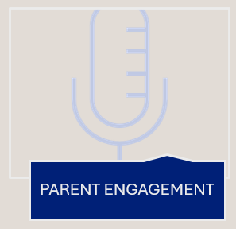
Considerations for District-Wide Implementation
CONSIDERATIONS FOR DISTRICT-WIDE IMPLEMENTATION

Slide 36
GUEST PRESENTERS
Provide clarity around the parent’s role in the ADR process.
Topics Supporting the ADR Vision
Strategies for High Emotion IEPs
Effective Communication during the IEP Meeting
Time for Q&A

Slide 37

CONSIDERATIONS FOR DISTRICT-WIDE IMPLEMENTATION

Slide 38

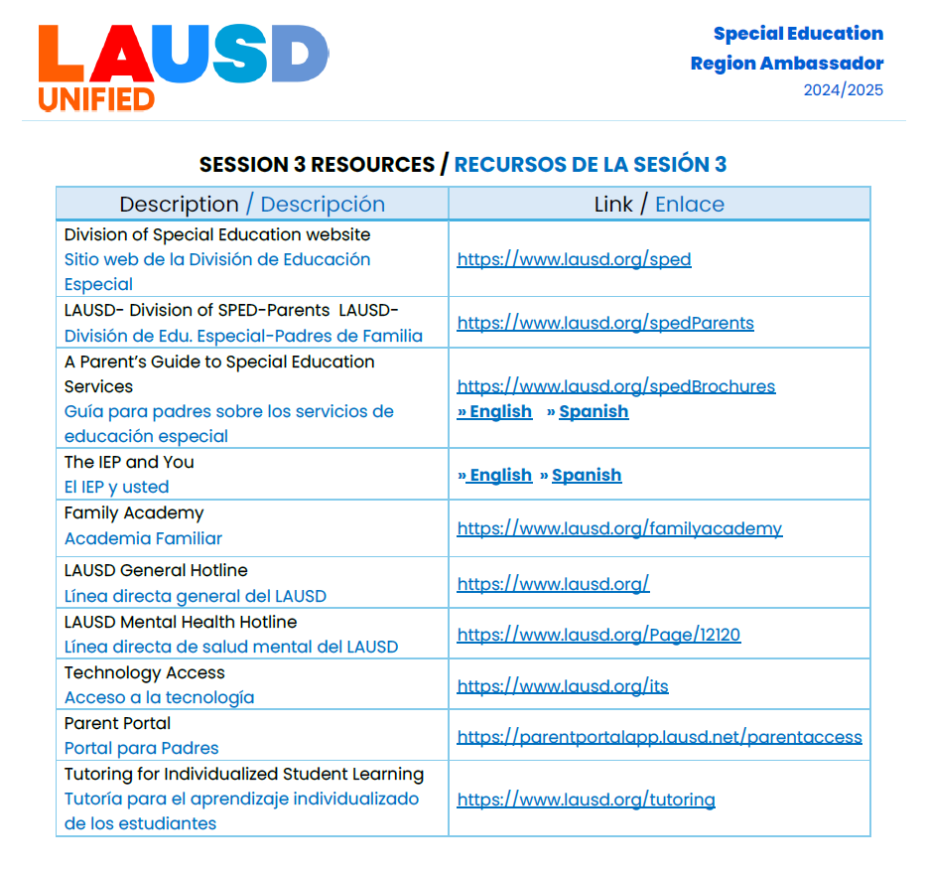
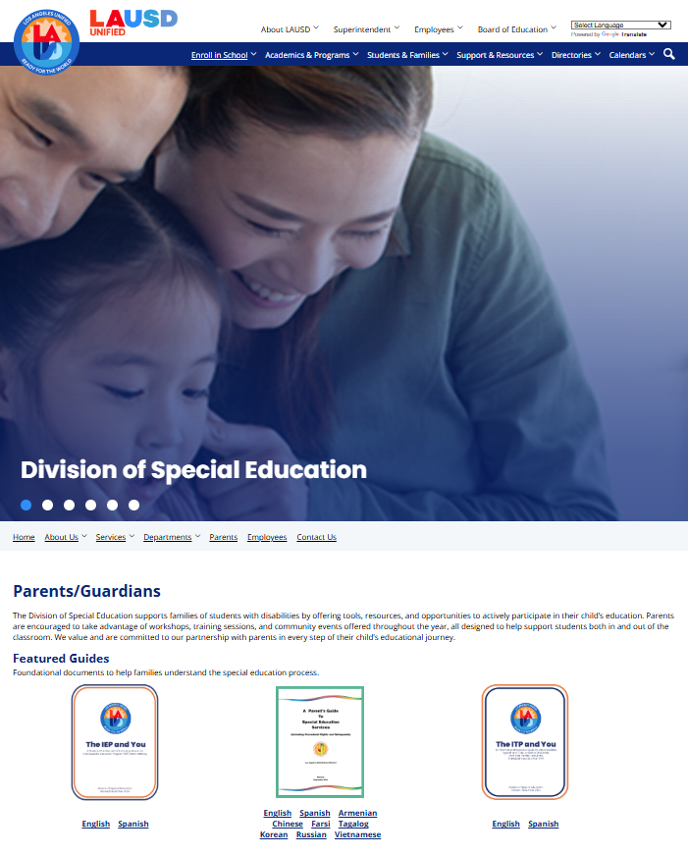
ONLINE RESOURCES

Slide 39
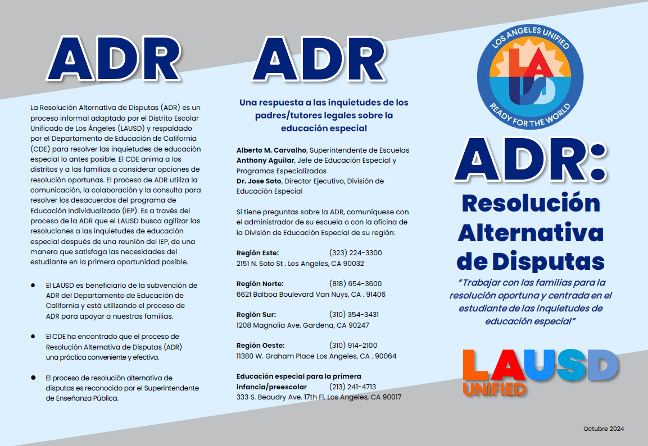
BROCHURES

Slide 40
STRENGTHENING COMMUNICATION
Open communication and ongoing dialogue to enhance IEP team meetings and positive outcomes for students.

Slide 41
WHERE ARE WE NOW?

Slide 42
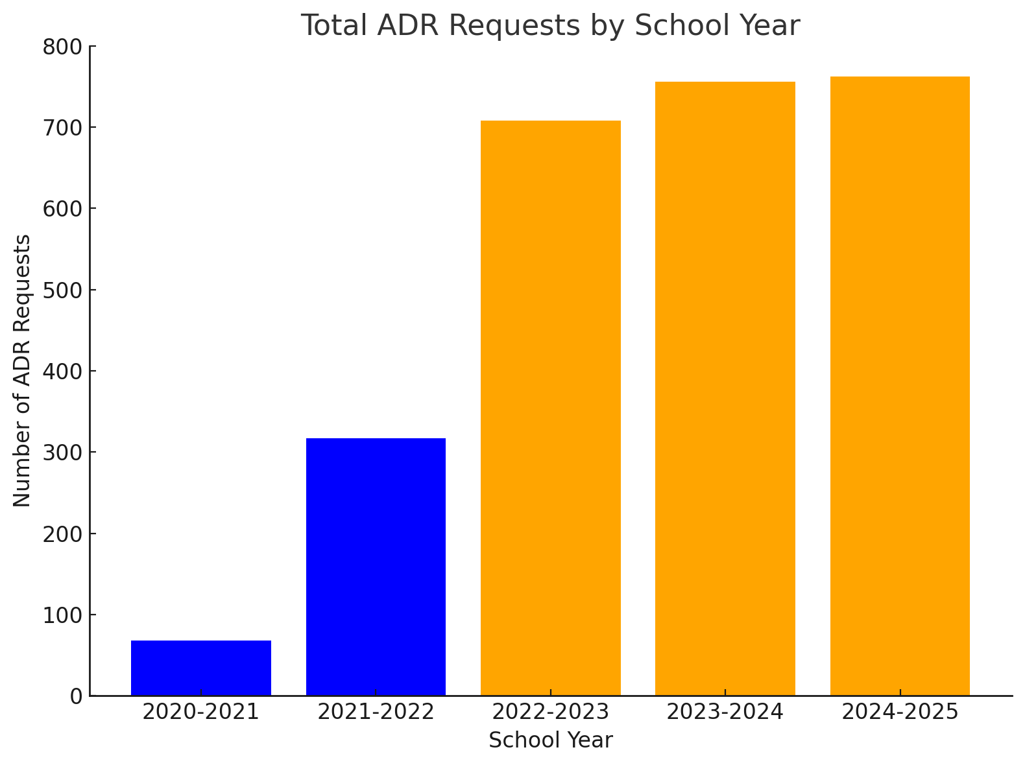
ADR DATA

Slide 43
ADR TRENDS
Placement
Services
Assessment
Compensatory Education

Slide 44
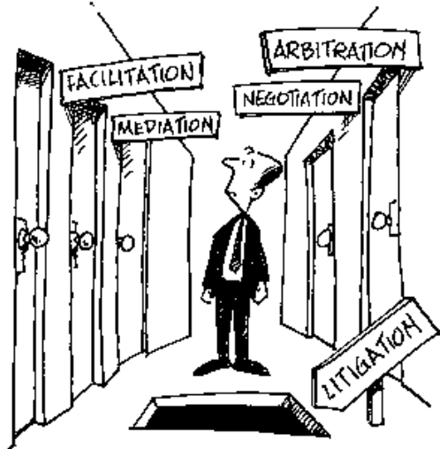
Adding ADR to Parent Choice
ADR

Slide 45
STRATEGIES TO BUILD/ENHANCE YOUR ADR PRACTICE
Survey your School Communities
Analyze Data
Create Your Vision
Consider Resources
Develop/Deliver Targeted Professional Development for Staff and Parents
Create Systems to Capture ADR data
Promote ADR
Ensure Continuing Guidance/Support
Review, Reflect, Revise

Slide 46
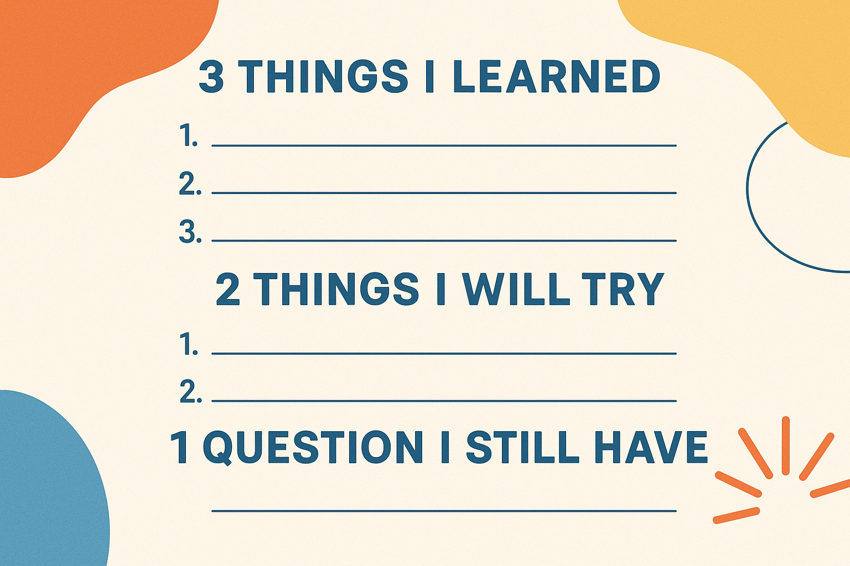
Time for an Activity and Q&A

Slide 47

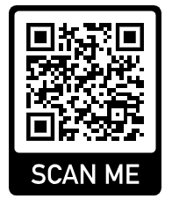
YOUR FEEDBACK IS APPRECIATED!

Slide 48
THANK YOU!
Erik Lopez
Specialist
erik.g.lopez@lausd.net
Ricardo Toland
Specialist
ricardo.f.toland@lausd.net

