Slide 1

Cultural and Linguistic Considerations for Family Engagement within Nonprofit organizations

Slide 2
HOW WE HELP
We support the special education process from birth to age 26 by providing:
assistance by phone and email
training classes
support and information at school meetings
ways for schools and families to work together
special education liaisons who serve the entire state of Indiana
transition-aged students with training on self-advocacy
special education training for school interpreters
a wealth of resources and trainings at www.insource.org.
Notes:
We support families statewide; Regional staff are located throughout the state in the areas where they live.
This allows the Regional staff to establish and develop relationships with the families and school they work with.
We provide phone and electronic assistance and also attend case conferences and 504 meetings when needed to help facilitate communication.
We have a number of online learning opportunities
IN*SOURCE staff…
Assist in the understanding of parents and students educational rights and responsibilities
Provide information about the special education process
Help families and schools work together and develop positive working relationships
And most importantly, we help parents and students become better advocates

Slide 3
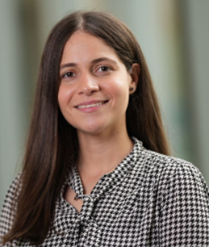
BRIGETTE TAVÁREZ
IN*SOURCE Bilingual Team Leader.
Originally from the Dominican Republic.
Graduated with a Doctor of Medicine (MD) degree in 2021.
Over a decade of experience as an ESL teacher.
TODAY’S PRESENTER

Slide 4
TODAY’S AGENDA
Current Challenges in Multilingual Engagement
Importance of Language
Key Concepts
Linguistic and Cultural Differences
Activity: Cultural Insights Circle.

Slide 5
TODAY’S OBJECTIVES
Identify and articulate key cultural and linguistic factors that influence the experiences and perceptions of families with children and young adults with disabilities.
Develop strategies to overcome common barriers faced by families.
Create actionable plans that incorporate culturally responsive practices into their organizations.

Slide 6
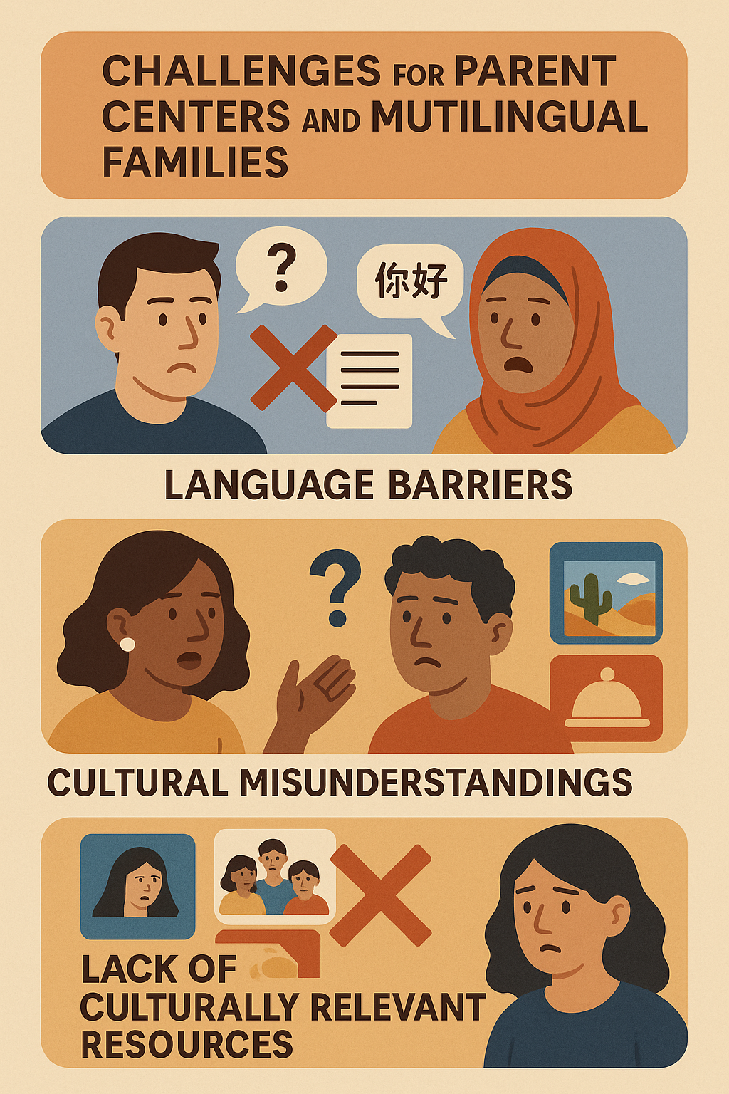
Challenges
Language barriers.
Cultural misunderstandings.
Lack of culturally relevant resources.
Qualify interpreters
Variations in the language
Notes:
In our diverse society, cultural and linguistic considerations play a pivotal role in the effectiveness of nonprofit organizations serving families of children and young adults with disabilities.
This 90-minute workshop aims to deepen parent centers to understand how cultural backgrounds and language preferences impact service delivery and family engagement.
Many parent centers struggle with reaching out to multilingual families and building trust, often due to language barriers, cultural misunderstandings, and a lack of culturally relevant resources. Additionally, systemic challenges such as limited funding and staff training exacerbate these issues, making it difficult to effectively support families.

Slide 7

Notes:
The power of language: How words shape people, culture
“language as a cultural, social and psychological phenomenon.”
“Language can play a big role in how we and others perceive the world, and linguists work to discover what words and phrases can influence us, unknowingly.”

Slide 8
Definitions and Key Concepts
Cultural Competence: is the ability to understand, appreciate, and effectively interact with people from diverse cultures, backgrounds, and belief systems.
Linguistic Competence: is the capacity of an organization and its personnel to communicate effectively, and convey information in a manner that is easily understood by diverse groups.
Notes:
Cultural competence is a developmental process that evolves over an extended period. Both individuals and organizations are at various levels of awareness, knowledge, and skills along the cultural competence continuum.
Linguistic competence is the capacity of an organization and its personnel to communicate effectively, and convey information in a manner that is easily understood by diverse groups including persons of limited English proficiency, those who have low literacy skills or are not literate, individuals experiencing disabilities, and those who are deaf or hard of hearing.
https://nccc.georgetown.edu/documents/NCCC-CLCADO-Assessment.pdf

Slide 9
Definitions and Key Concepts
Cultural Brokering: Is the act of bridging, linking, or mediating between groups or persons of different cultural backgrounds for the purpose of reducing conflict or producing change.
Ableism: is a societal prejudice and discrimination against people with disabilities, rooted in the belief that those with disabilities are less valuable or less capable than those without disabilities
Notes:
https://fpg.unc.edu/sites/fpg.unc.edu/files/resources/presentations-and-webinars/Zhang-Bennett-IEP-CLD-familes.pdf

Slide 10

Cultural Differences
Notes:
Cultural differences examples:
Affection, personal space.
For Latinos and Latinas, family plays a central role.
Latinos and Latinas tend to be conservative and traditional in their lifestyle and beliefs.
Male chauvinism
Being on time is essential in the United States. Americans pride themselves on being punctual and efficient with their time. The cultural belief is that being on time is a sign of respect for other people’s time. Most Americans will apologize if they arrive for an appointment even five minutes late.
In contrast, most events in Latin America do not start on time. If the party invitation says 5 p.m., no one will show up until 7 p.m. In fact, many Latinos and Latinas think it’s rude to be right on time to a social function because the hosts are likely still getting ready.
Present my own experiences. Not knowing race vs ethicnity, DR- white/black ( having to say what my daughter etincity was,) hugging someone frst time you meet them.

Slide 11
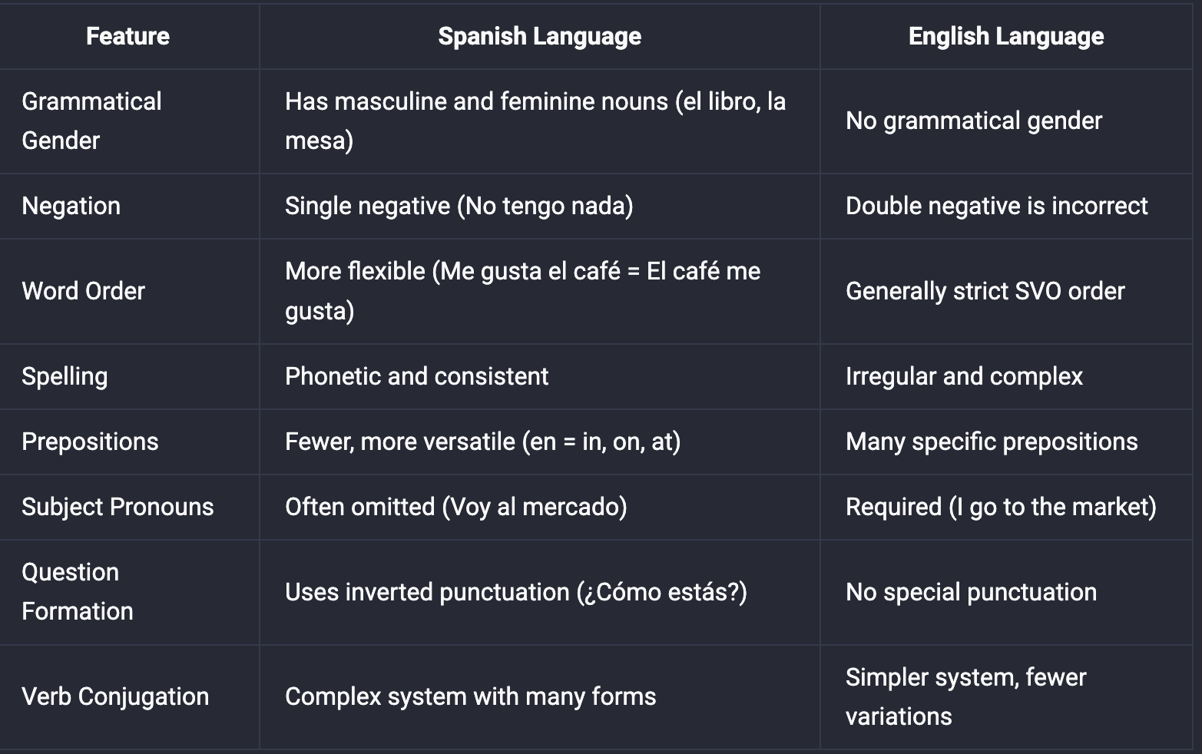
Differences
Notes:
https://lingopie.com/blog/spanish-vs-english-11-differences-between-spanish-english/
English is a Germanic language, while Spanish is a Romance language derived from Latin.
English- indirect, spanish- more direct.

Slide 12

Cultural Insights Circle.
Notes:
To foster self-awareness, deepen cultural understanding, and encourage peer learning by sharing personal cultural insights that affect how we engage with diverse families. 30 minutes total.
“This is a reflective group activity to explore how our cultural backgrounds and assumptions shape how we engage with families.” Each person takes 5-6 minutes to respond to one or more of the prompts below.
Describe a value or tradition from your own background that influences how you interact with families. What’s a time you misunderstood someone due to cultural or language differences? What did you learn? How might assumptions about education or parenting vary across cultures? What does “respectful communication” look like in your culture? How might that differ from others? What’s one thing nonprofits often overlook when working with multilingual families? Using slido.
Short discussion: What surprised you?
What common themes did you hear?
How can we apply these insights in our work with families?

Slide 13
Idioms
Hope the damage is only in cash
Spill the beans
Under the weather.
Beat around the bush.
Let someone off the hook
Your guess is as good as mine
Notes:
English idioms, proverbs, and expressions are an important part of everyday English. They come up all the time in both written and spoken English. Because idioms don't always make sense literally, you'll need to familiarize yourself with the meaning and usage of each idiom.
Wrap your head around something
Speak of the devil
Add insult to injury
By the skin of your teeth
Don't cry over spilt milk
The elephant in the room

Slide 14
Interpreter Training: Building Cultural Bridges.
Participants will receive training in specific areas like:
1. Understanding Special Education Law and Policies
2. Familiarity with Educational Settings and Processes.
3. Specialized Terminology and Concepts.
4. Language Proficiency and Interpretation Skills.
5. Cultural Competence and Sensitivity.
6. Ethical Considerations.
Notes:
Limited Language Proficiency
Interpreters without full fluency in both the source and target languages may misrepresent key educational, legal, or developmental terms.
This can lead to misunderstandings between schools and families, and impact the accuracy of IEP (Individualized Education Program) discussions.
Lack of Cultural Competence
When interpreters are unfamiliar with the cultural backgrounds of families, they may fail to convey messages in ways that are respectful, relevant, and understandable.
This can result in families feeling misunderstood or excluded from decision-making.
Unfamiliarity with Special Education Terminology
Special education includes complex jargon and legal terms. Interpreters without specific training often struggle to translate these concepts accurately and clearly.
Ethical Concerns
Without proper training in interpreter ethics, some may inappropriately insert personal opinions, edit messages, or act outside of their role.
This jeopardizes confidentiality, neutrality, and the integrity of the interpretation process.
Role Confusion
Some interpreters may act as advocates or case workers due to unclear role boundaries, especially in high-stakes settings like IEP meetings.
This creates confusion and can undermine professional collaboration.
Lack of Training & Professional Development
Many interpreters in schools are hired without formal credentials in interpretation or special education, which limits the quality and consistency of their work.

Slide 15
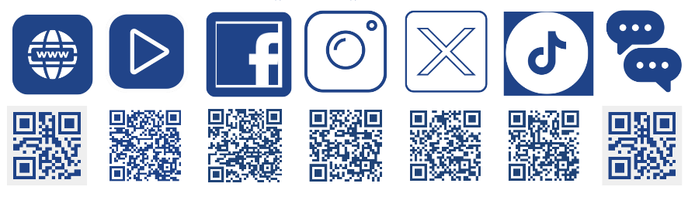
CONTACT US
574.234.7101
www.insource.org

