Slide 1
Building the Bridge: Creating a Facilitated IEP Culture
Carrie McCulloch
Alternative Dispute Resolution Specialist
Arizona Department of Education

Slide 2
Training Agenda
Welcome
Purpose
Create a FIEP culture where schools and families collaborate to support student success
Outcomes
Offer tools to help to create a FIEP culture where schools and families collaborate to support student success
Provide a variety of strategies to strengthen the partnership with families
Group Norms
Communicate clearly and listen carefully
Share your views and respect the views of others
Ask and welcome questions for clarification
Silence cell phones
Honor time limits and stay on task
IEP Facilitation
Benefits
Build a Partnership
Tools
Communication Techniques
Closing
Options

Slide 3
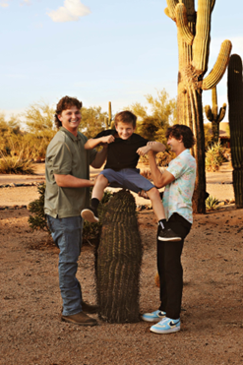
Introduction
Education/Certification
MEd Educational Leadership
BS Sped & El Education
National Board Certification
Arizona Principal Certification
Professional Experience
Gen & Sped Teacher
Assistant Principal
Special Education Coordinator
University Associate Professor
Alternative Dispute Resolution Specialist
Personal Experience
Three boys
One on a 504 and gifted
One on an IEP
One is twice-exceptional

Slide 4

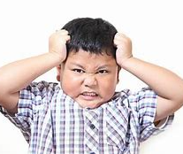
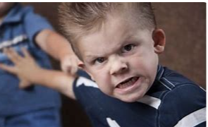

How Do You Feel When You Hear the Words “IEP Meeting”?
1 2 3 4

Slide 5
How Can We Change This?
Nearly four decades of studies have identified negative parent experiences with the IEP meeting process, including excessive paperwork, lack of parent inclusion during team discussions, overuse of jargon, and confusing procedures that typically include professionals focusing on IEP paperwork and compliance, rather than collaborative practices.
(Mueller & Vick, 2019)
A FIEP culture can change IEP experiences.

Slide 6
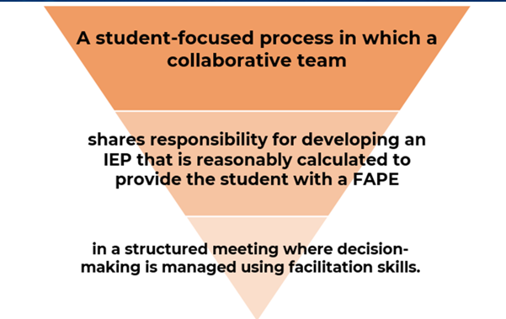
What Is IEP Facilitation?

Slide 7
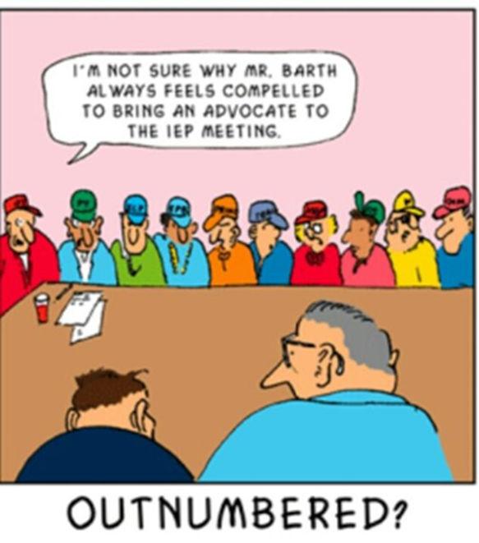
Visualize A Successful IEP

Slide 8
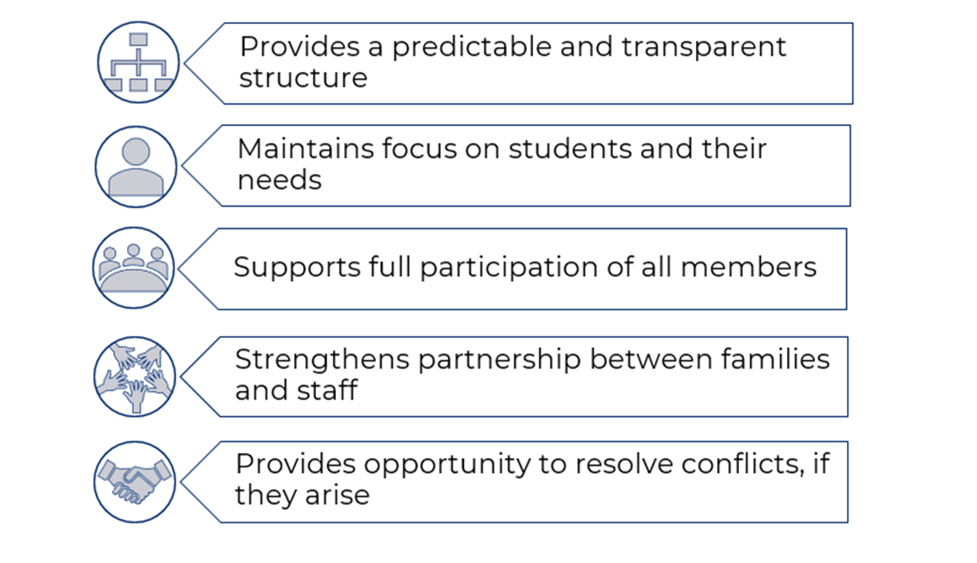
Benefits of an FIEP Culture

Slide 9
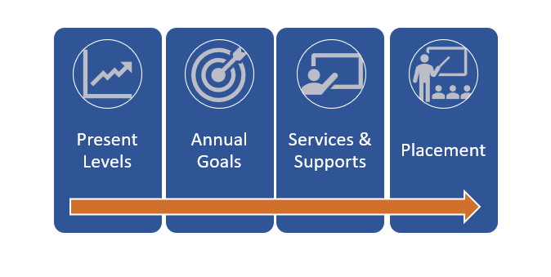
Determination of FAPE

Slide 10
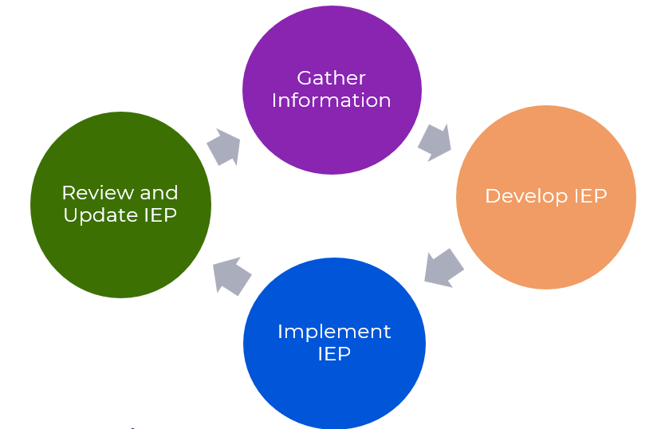
Individualize Educational Program Process

Slide 11

What Is the Most Important Part of the IEP?

Slide 12
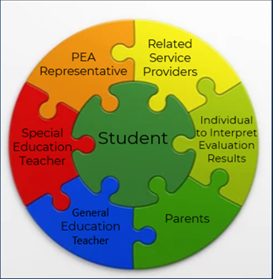
It Takes the Entire Team To Create a Strong IEP

Slide 13
Creating a Partnership
Create a Partnership Right from the Start
Communicate with the student’s family and staff from day one
Follow through with anything discussed to build trust
Pre-Meeting Communication
Give advanced notice and be as flexible as possible when scheduling meetings
Ask for parent, staff, and student input before the meetings
Share an agenda and a draft of the IEP before the meetings
Welcoming Environment
Supplies: paper, pens, sticky notes, tissues, busy box/books for kids
Be prepared and greet the parents when they arrive
Seating arrangement
Be hospitable
Listen…

Slide 14
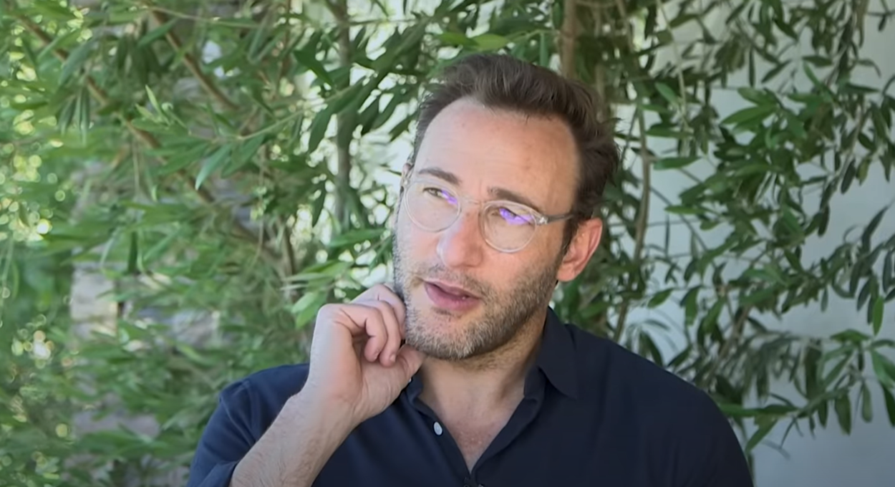
The Art of Listening Simon Sinek
YouTube Video of The Art of Listening

Slide 15
Basic Tool for IEP Meetings: Agenda
A logical, sequential, and predictable plan
Provide copy and/or post at meeting
Redirection tool to keep team on track
Helpful if one is adopted for all
Fosters meeting efficiency
Primary purpose of meeting
Meeting Norms
Consistent with PEA
Secure Agreement
Outcome of the meeting
Sequence of topics
Prioritized issues

Slide 16

Basic Tool for IEP Meetings: Parking Lot
A list of issues to be addressed at a later time
Topics outside of the IEP process
Validates the concern was heard and will be addressed later
Allows team to focus on the meeting purpose

Slide 17
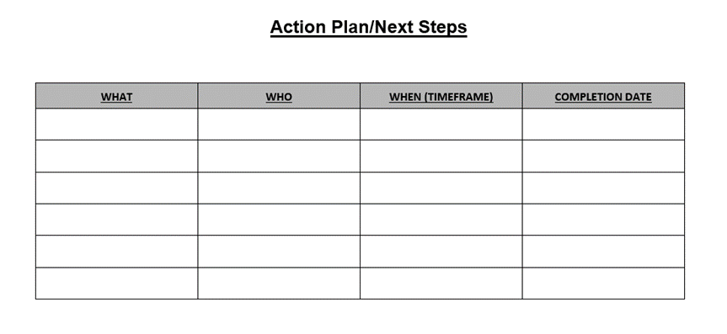
Basic Tool for IEP Meetings: Action Plan
A list of action items that need to be completed as agreed upon in the meeting
Items that support the student
Clearly defined
Accountability

Slide 18
Conflict
Conflict is neither positive or negative.
Conflict occurs when needs, values, or goals are not in alignment
Possible Ways to Handle Conflict
Empathize
Listen and focus on the speaker's perspective
Check for understanding by paraphrasing or restating what is being said in a neutral language
Ask for options/Encourage participation through open ended questioning
Reframing
Changes the tone of conversation
Focuses on the core needs/One need at a time
Discover Underlying Root Causes
Take a learning stance not a telling stance: Be Curious, Not Furious
Notes:
Empathize – not just listening to words but showing that you hear the speaker.
Ask for Options – Encourage the entire team to brainstorm, include everyone. Make sure everyone is feeling welcomed.
When we reframe a conflict discussion, we give it a new look just like we can give a painting a new frame. The painting stays the same, but it may look quite different based on its new surroundings.
Helps people to identify what matters to them and verbalize their interests/perspective
Clarifies boundaries/limits of the IEP process
Generates innovative solutions
Unifies the team
Strengthens soft skills (e.g., flexibility, active listening, empathy, etc.)
Discover Root Causes - We don’t know the person’s history or why they are thinking they way they are.
The way we set the stage for dialogue will invite different responses. We need to enter with curiosity and listen to understand, not judge. Think of it like, I may know a lot, but I want to learn even more.

Slide 19
Closing the Meeting
Questions to Consider:
Was a consensus reached?
Were key concepts reviewed?
Did you thank the team?
Follow Up On:
The 'mood' of the meeting; who needs to be contacted?
The roles and responsibilities; are they clearly defined and understood?
The IEP is a legal document; are we implementing it as written?
Continue to Communicate!

Slide 20
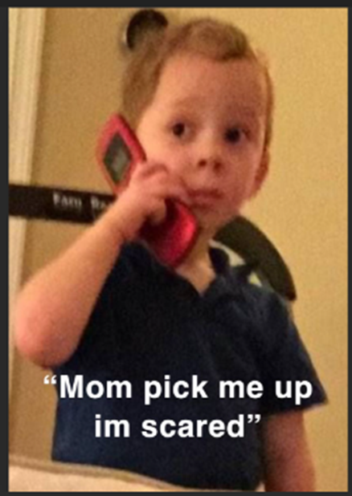
What Options Do PEAs and Parents Have If They Need Additional Support?

Slide 21
Arizona State-Coordinated FIEP Program
State-coordinated Facilitated IEP is a no cost early resolution option available to public school districts/charter schools and parents of children with disabilities to ensure that a student’s Individualized Education Program (IEP) is developed by a collaborative team in a structured meeting.
Participation is voluntary, meaning both parties must agree to have a neutral facilitator who keeps the meeting focused on developing an IEP that is reasonably calculated to provide the student with a free appropriate public education (FAPE). The aim is to build capacity among educators and families to ensure that collaborative, student-focused IEP teams are equipped to make sound decisions in the development of IEPs.

Slide 22
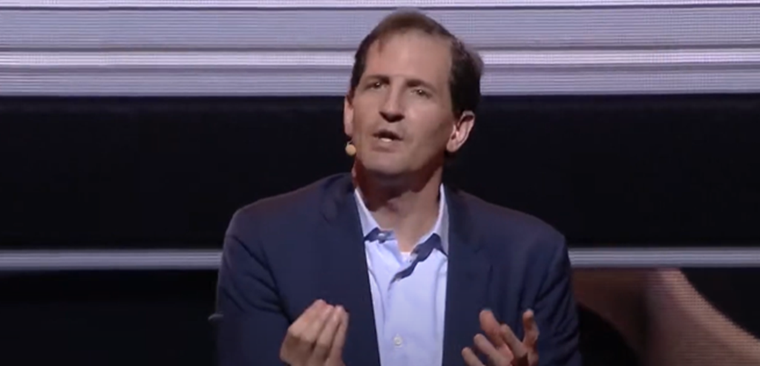
Negotiation: Us Versus the Problem Daniel Shapiro
You Tube Video Negotiation

Slide 23
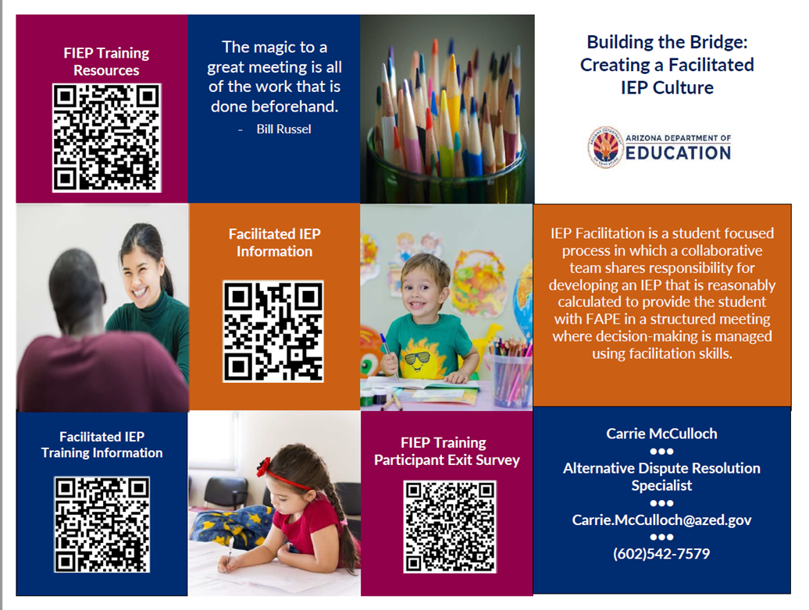
QR Codes For Additional Information

Slide 24
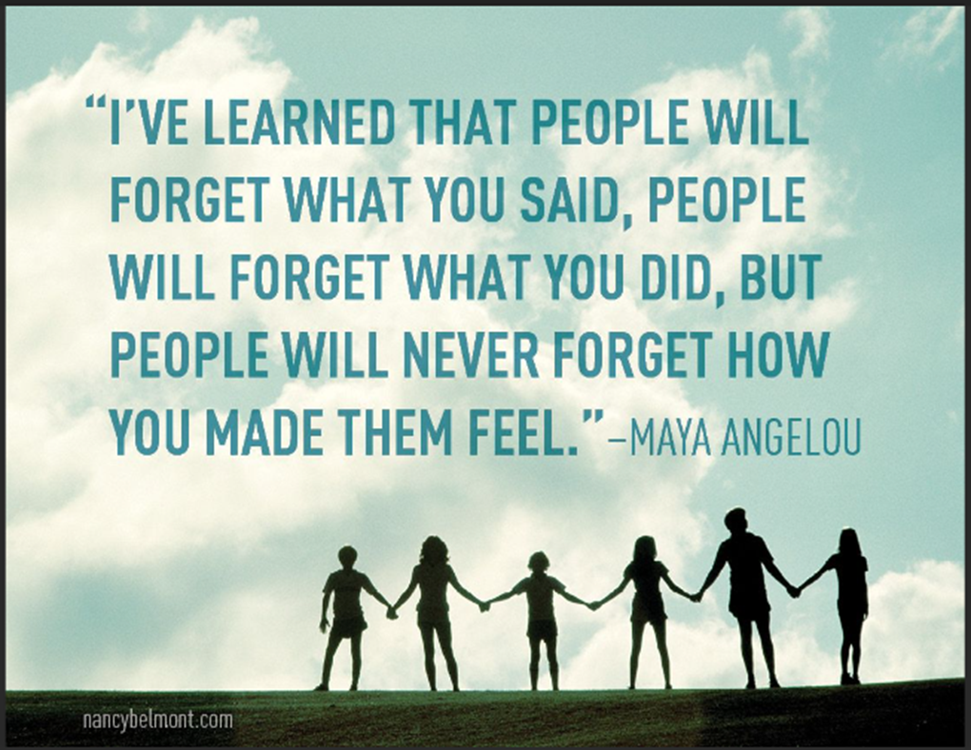
Questions?

Slide 25
Contact Us
Carrie McCulloch
Alternative Dispute Resolution Specialist
Carrie.McCulloch@azed.gov
602-542-7579
Visit the ADE/ESS Dispute Resolution website for more information and resources!

