Slide 1
The Past, Present, and Future of Special Education Advocacy
Presented by: Diana Cruz, WestEd
October 22, 2025

Slide 2
Welcome
This session is designed to be an interactive discussion.
Please share your perspectives and experiences.
Please respect the views of others.
Let's learn from and with each other.

Slide 3
Overview
Explore the experiences of individuals with disabilities before parent advocacy
Discuss the impact of parent advocacy on the design of special education
Identify the role of advocacy on implementation of IDEA
Discuss the future of advocacy in the current context

Slide 4
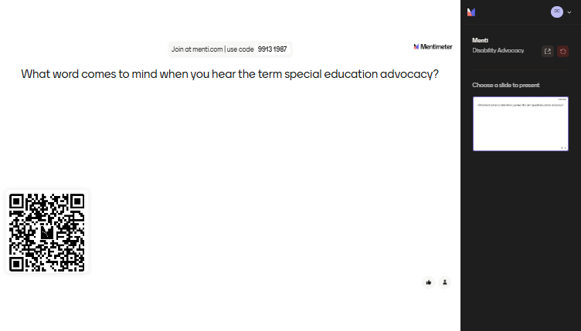
Grounding

Slide 5
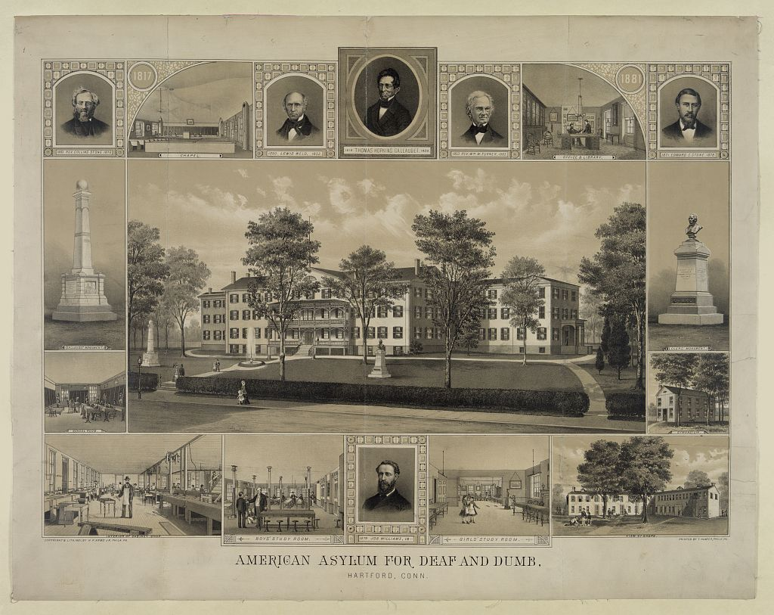
The Past: Exclusion and Institutionalization
1817: First American School for the Deaf in Hartford, CT
1848: Perkins Institute opens
1852: MA enacts first compulsory attendance law
1918: All states have compulsory school attendance
1940-50: Institutions expand; public schools deny access

Slide 6
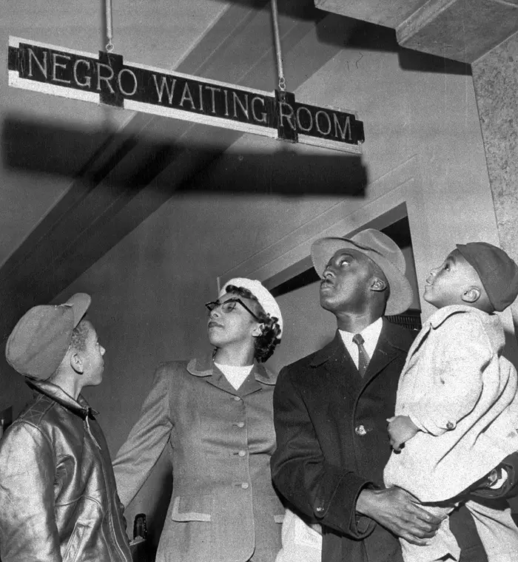
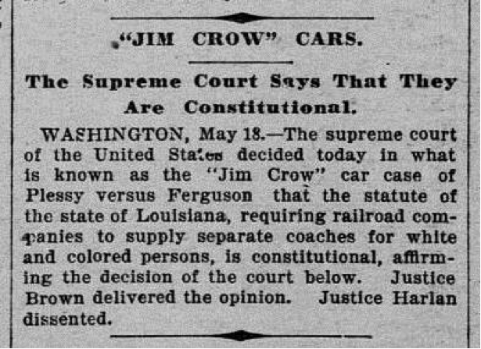
1896 Plessy v Ferguson: The Court Upholds Segregation

Slide 7
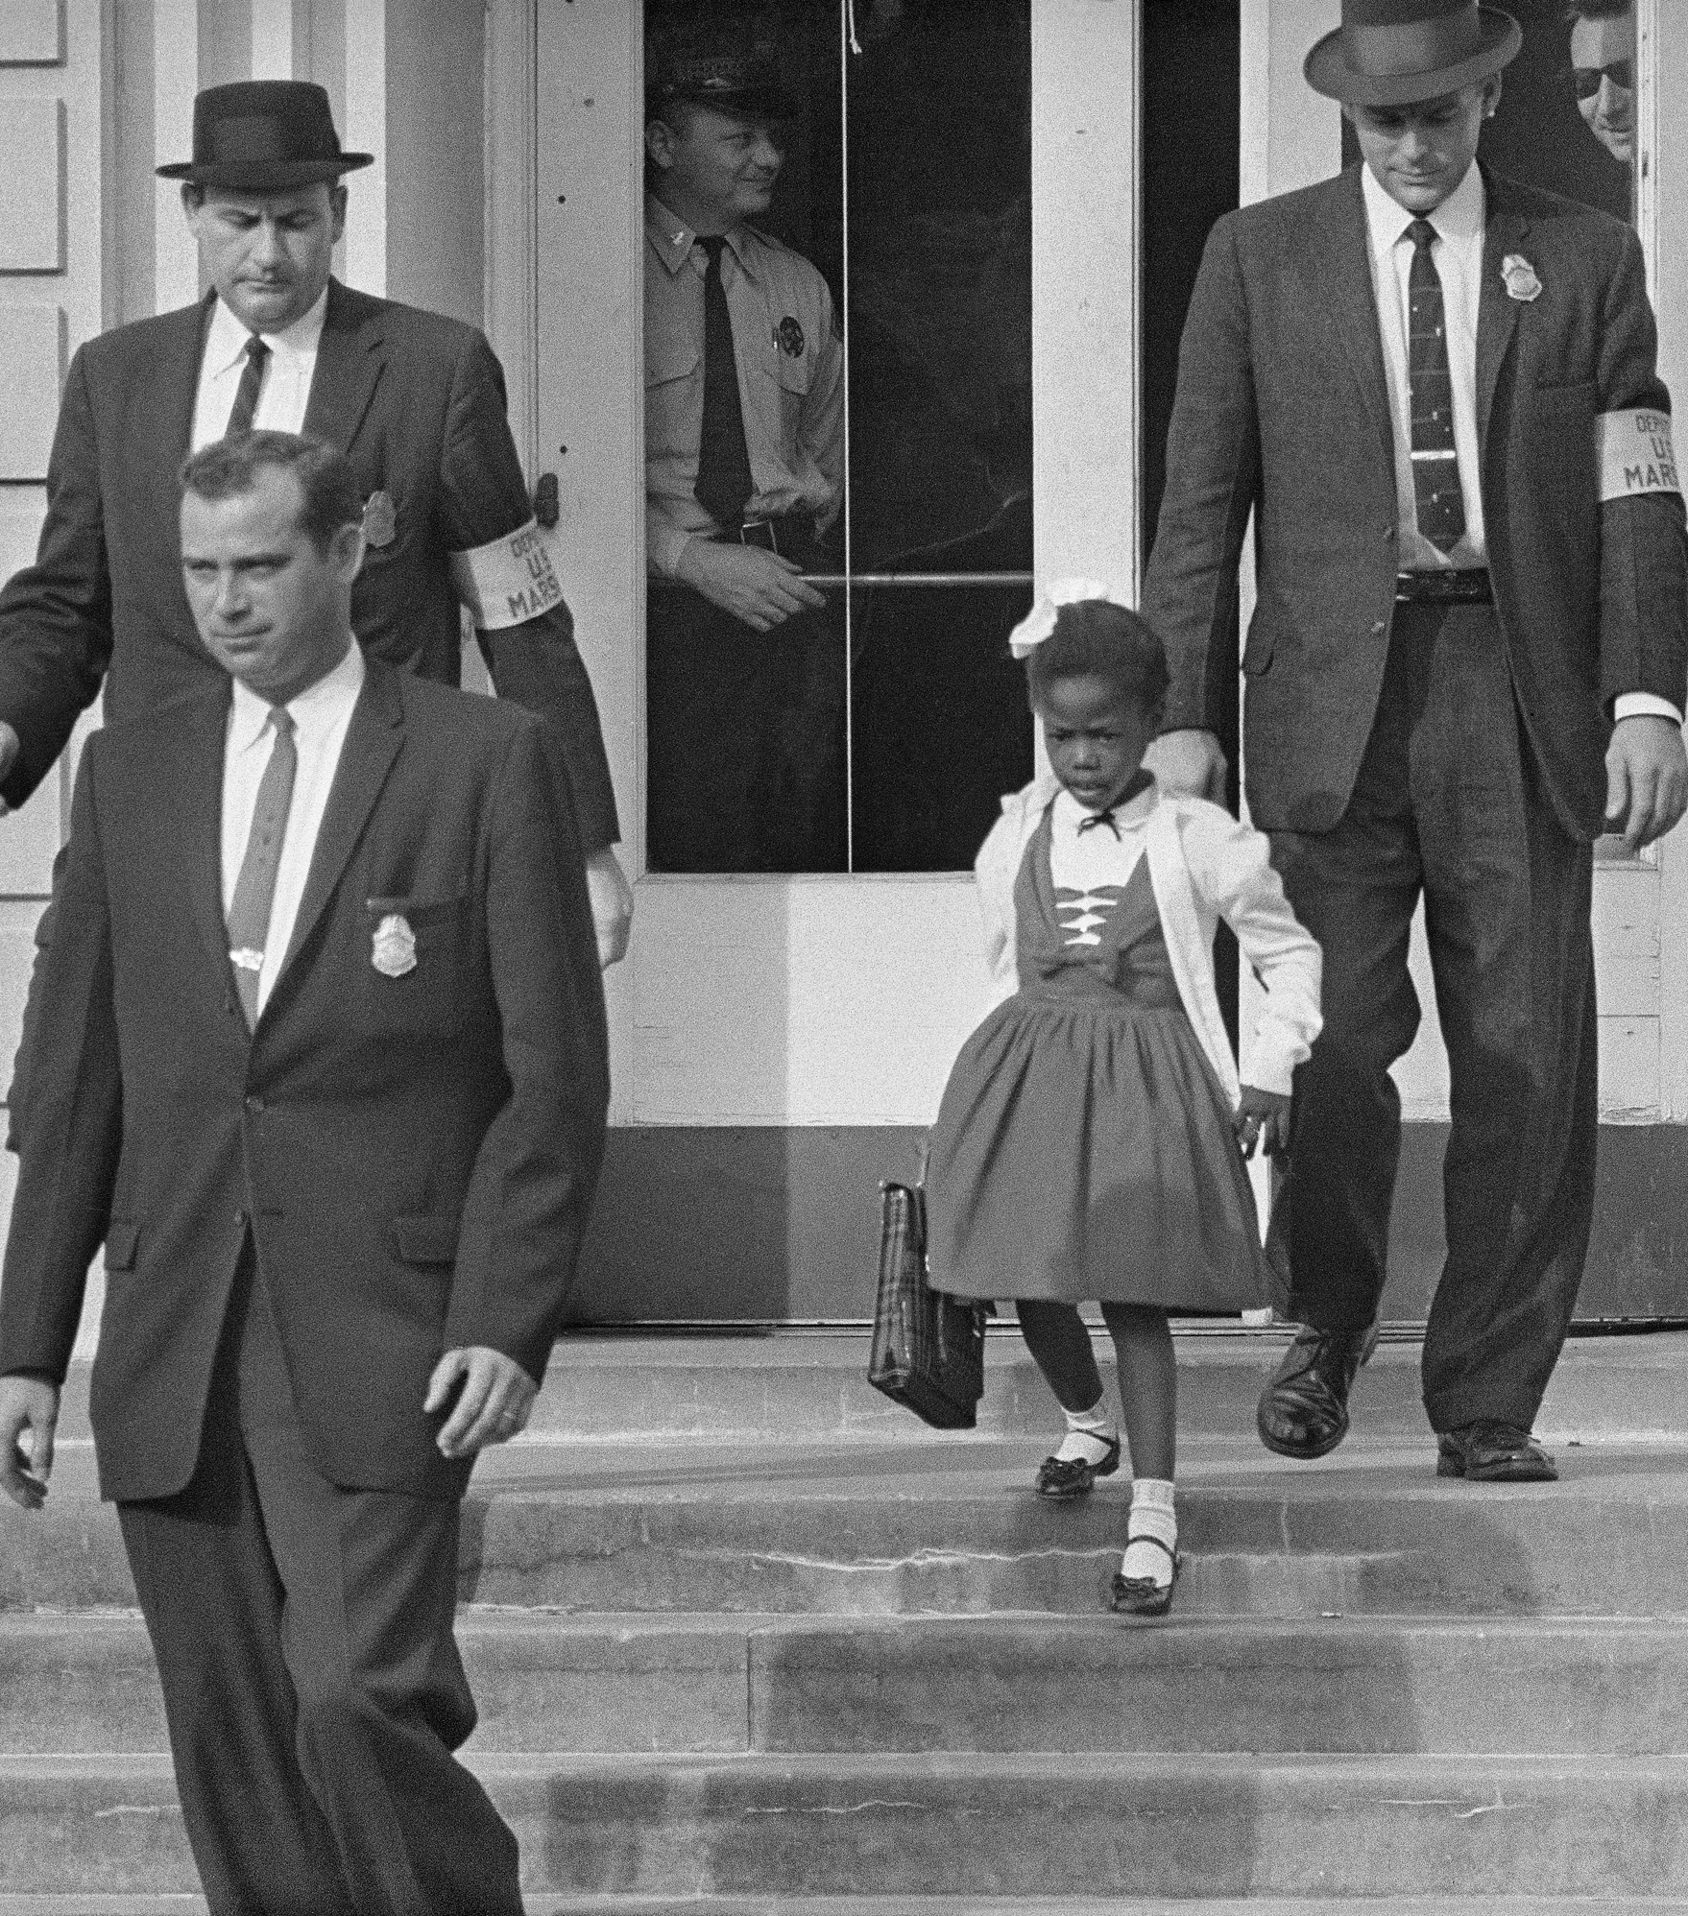
1954 Brown v. Board of Education
“Separate educational facilities are inherently unequal.”
- Chief Justice Warren

Slide 8
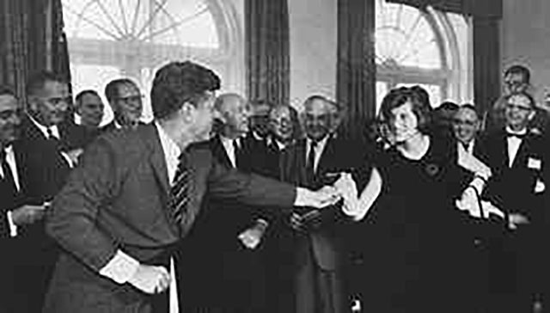
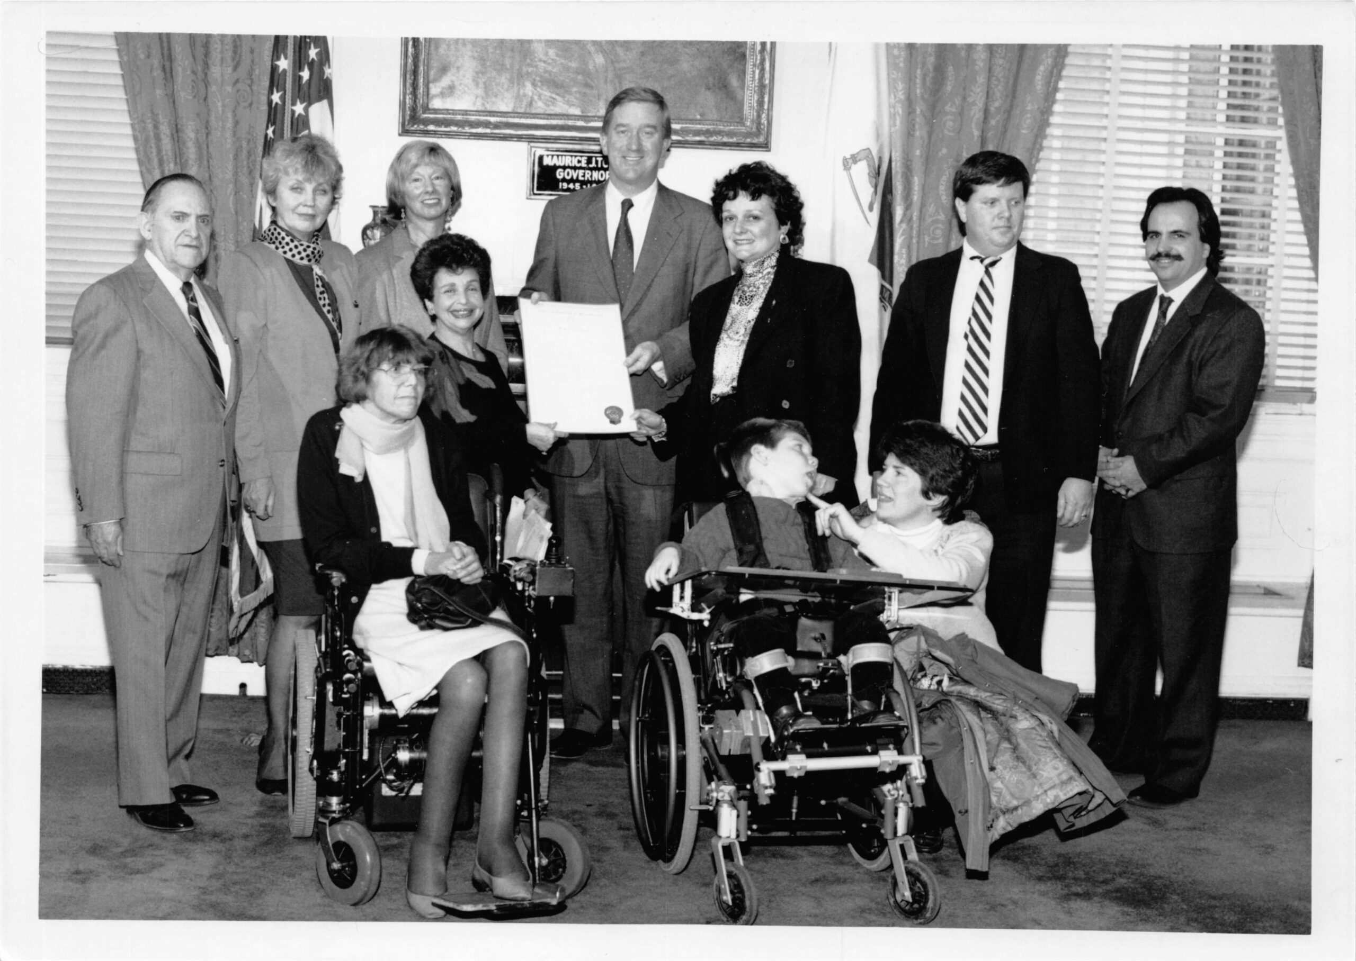
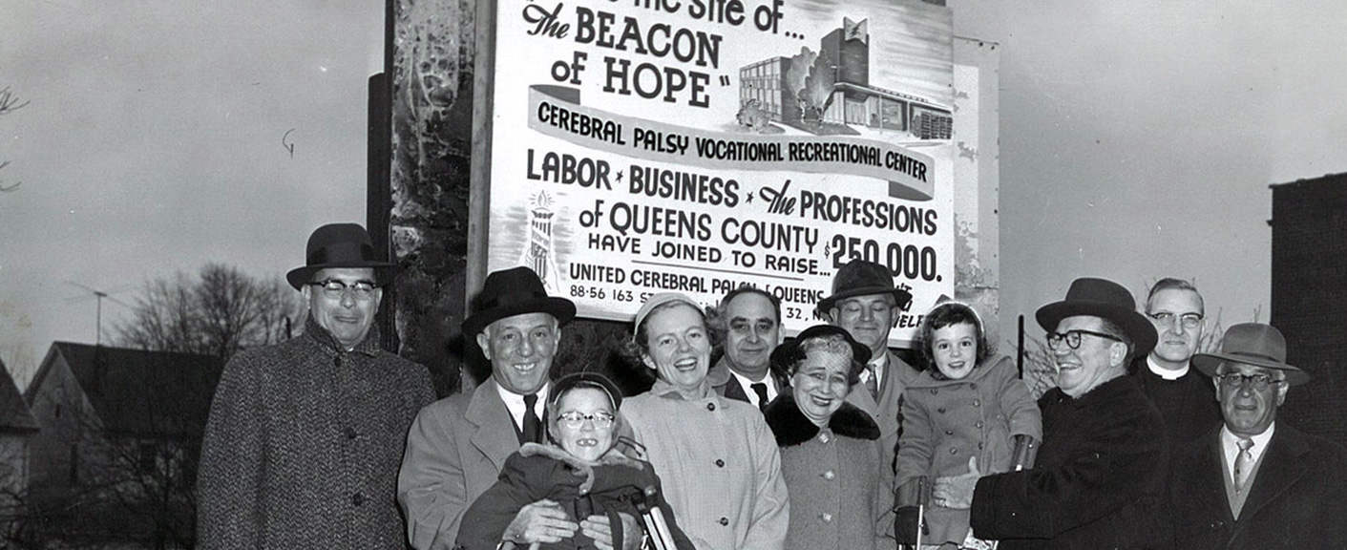
Parent Advocacy Networks Organize
In response to exclusion and abuses at institutions
Built off the success of the Civil Rights Movement

Slide 9
Parent Advocacy and Activism
Parent organizations such as The Arc, UPC, and Council for Exceptional Children led grassroots advocacy demanding access and equality.
Key moments:
1972 – PARC v. Pennsylvania
1972 – Mills v. Board of Education of D.C.
1975 – Education for All Handicapped Children Act (EAHCA)

Slide 10
Turn and Talk
How did parent and community advocacy shape the creation of IDEA?
How might special education be different now if not for their advocacy?

Slide 11
Parents’ knowledge and untiring advocacy… provided the energy and will to create special education programs wherever they occurred. They had petitioned school administrators, school board members, state officials, state legislators, and increasingly, federal legislators and administrators. It became apparent to me that there would be little, if any, special education if the parents had not created it directly or through political persuasion.
- E.W. Martin Jr.
Drafter of the EAHCA
First Assistant Secretary of Education for Special Education and Rehabilitative Services

Slide 12
Federal Landscape Evolves
IDEA’s evolution has emphasized accountability, equity, inclusion, and measurable progress.
Key events:
1979 – President Carter forms U.S. Department of Education
1982 – Board of Education v. Rowley
1990 – ADA signed
1990 – EAHCA becomes IDEA and aligns with ADA
1997 & 2004 – IDEA Reauthorizations
2017 – Endrew F. decision

Slide 13
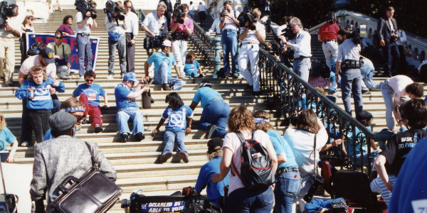
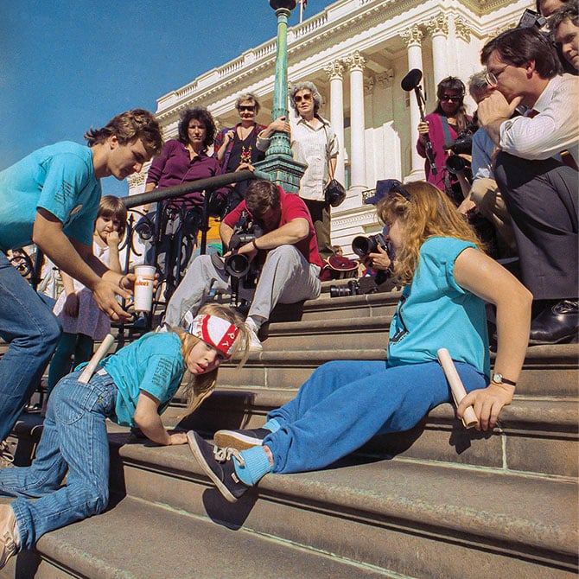
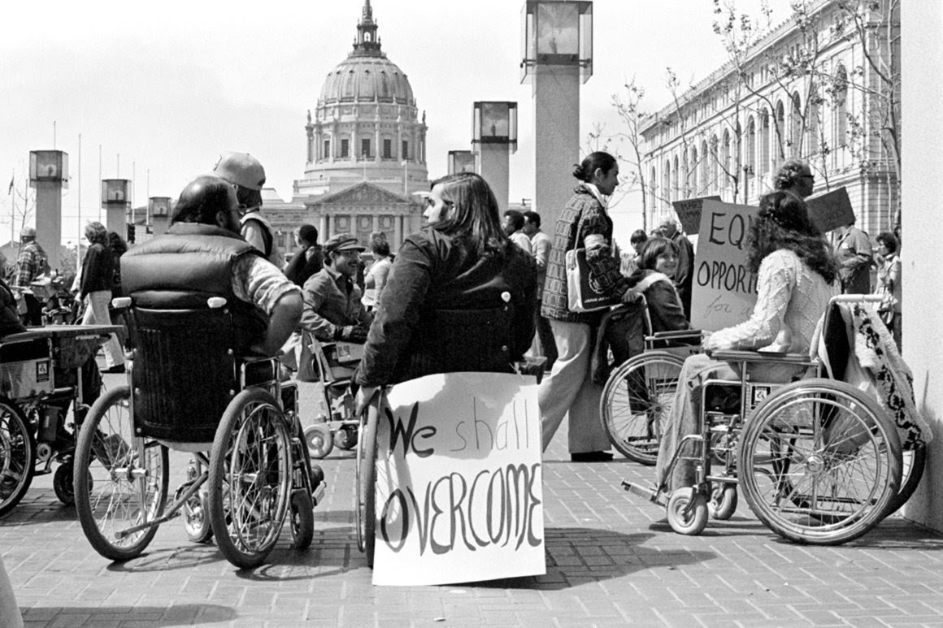
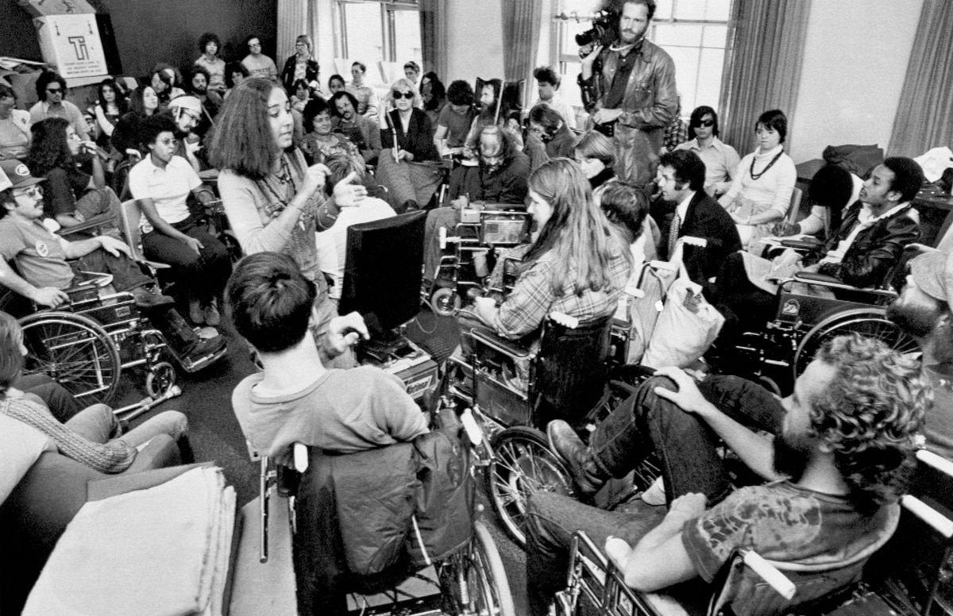
The Signing of 504 & Passage of ADA

Slide 14
Whole Group Discussion
How has individual and collective advocacy shaped the federal landscape for individuals with disabilities?

Slide 15
Federal Oversight and Enforcement
Federal protections rely on oversight from:
U.S. Department of Education
Office for Civil Rights
Judicial system via individual parent advocacy
Changes to Federal Landscape
Federal workforce reductions
Reduction in federal grants supporting inclusion

Slide 16
Discuss the Present
What challenges are we currently facing in protecting students’ rights?
What are the key barriers to equitable implementation of IDEA?

Slide 17
Sustaining Advocacy
Ensure continued federal protection and amplify diverse voices.
Opportunities:
Strengthen alternative dispute resolution options
Build parent capacity to organize and advocate
Utilize Parent Training and Information Centers, Centers for Parent Resources and Information
Consider Equitable Collaboration strategies

Slide 18
Reflection
How will we sustain IDEA’s promise for the next 50 years?
One action I can take to strengthen advocacy is…

Slide 19
Thank You
Let’s connect:
dcruz@wested.org

