Slide 1
Addressing Special Education Disputes: A Systems-Based Approach to Collaborative Conflict Resolution
Theresa Nicholls, Ed.S.
Jana Rosborough, JD, MEd
Notes:
Session Sketch:
Welcome and Introductions
Why are we here?
Landscape around dispute resolution
What are the issues that are leading to disputes?
Brainstorm and table share
Collect responses
Include story to build empathy around the family’s experience in special education
Key idea- there has been an increase in formal dispute resolution but often times the root causes cannot be addressed through formal dispute resolution OR could be resolved through early or alternative dispute resolution.
Key idea- need to address the root causes of disputes
Proactive Lens
Define systems level approaches to challenges we’re facing
Reflection
Leadership Iceberg
Data rich, information poor
Stepping Back to Identify What Actually Has Impact
Understand root causes
5 Whys (introduce with example)
What are the root causes of special education conflict?
5 Whys at the Table
Pull out some themes- systemic distrust
Communication
What are the systems that build trust?
For trust, we need:
Reliability
Honesty and transparency
Competence
Empathy and understanding
Introduce ADR as a “system”
How do we build trust within the system?
Apply a “Student-Centered, Family- Focused” approach
Contact Us
Theresa
engage constituents to better understand the opportunities to build trust between families and schools
Provide PL to build the capacity of practitioners and administrators to meaningfully collaborate during IEP meetings

Slide 2
Welcome and Introductions

Slide 3


Introductions
Theresa Nicholls, Ed.S
Owner/Founder
PartnerEd Solutions
Jana Rosborough, JD, MEd
Partner/Founder
Limestone Education

Slide 4
Session Objectives
Gain a deeper understanding of how to identify and address systemic issues underlying special education disputes
Apply systems-based tools and techniques to facilitate more constructive and lasting ADR solutions.
Foster collaboration among all interested parties by considering the broader system of relationships, interests, and impacts involved and impacted in special education disputes.

Slide 5
Why are we here?

Slide 6
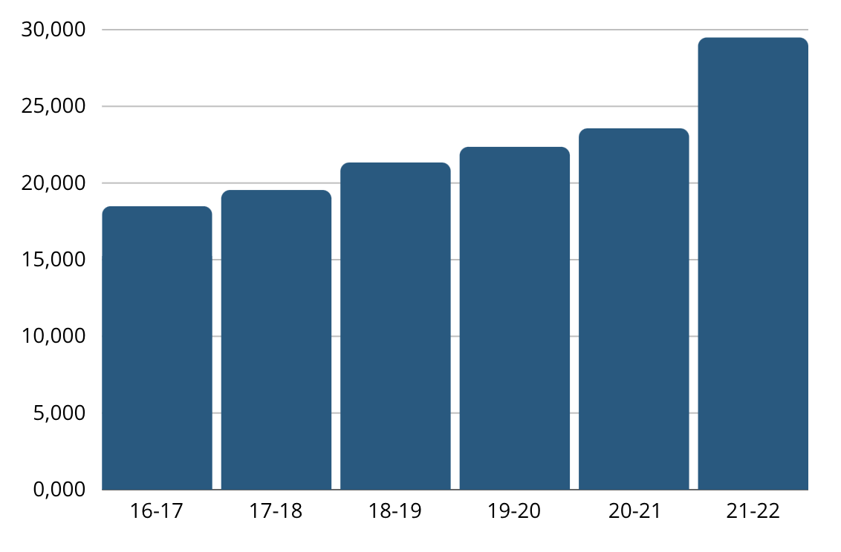
National Due Process Hearings
https://www.cadreworks.org/national-state-dr-data-dashboard
Notes:
Due process hearings have been on the rise in the last several years, with a noticeable increase since COVID

Slide 7




Procedural Violations
IEP components
IEP team
Parent participation
IEP development
Zirkel, P. A., & Hetrick, A. (2017). Which Procedural Parts of the IEP Process Are the Most Judicially Vulnerable? Exceptional Children, 83(2), 219-235.
Accessed July 22, 2024: https://doi.org/10.1177/0014402916651849
Notes:
Ask participants: what do you think was the most frequently tried IEP- related procedural violation in national due process hearings?
Click to reveal the correct answer: parent participation
Parent participation= The IEP team significantly impeded the parents’ opportunity to participate in the decision-making process regarding the provision of FAPE to the child;
Citation:
Zirkel, P. A., & Hetrick, A. (2017). Which Procedural Parts of the IEP Process Are the Most Judicially Vulnerable? Exceptional Children, 83(2), 219-235. https://doi.org/10.1177/0014402916651849
To provide a missing piece to the legal foundation of professional development and practice for the individualized education program (IEP) process, the authors report the results of a comprehensive systematic analysis of court decisions specific to IEP-related procedural violations after the 2004 amendments of the Individuals With Disabilities Education Act. Research questions focused on the frequency and outcomes of alleged procedural violations in the following categories: (a) IEP components, (b) IEP team, (c) parent participation, and (d) IEP development. Procedural violations in the parent participation category were the most frequently adjudicated; the outcomes ratio in court averaged approximately 3:1 in favor of school districts for cases across all four categories. Implications for practice include reconsideration of current policies and practices to whatever extent that they were based on case law rather than proactive priorities, per the lack of differentiation in prevailing publications and presentations in special education.
According to a recent study by Zirkel and Hetrick, what do you think was the most frequently tried IEP- related procedurally violation in national due process hearings/
Significantly impeded the parents’ opportunity to participate in the decision-making process regarding the provision of FAPE to the child;
Zirkel, P. A., & Hetrick, A. (2017). Which Procedural Parts of the IEP Process Are the Most Judicially Vulnerable? Exceptional Children, 83(2), 219-235. https://doi.org/10.1177/0014402916651849
To provide a missing piece to the legal foundation of professional development and practice for the individualized education program (IEP) process, the authors report the results of a comprehensive systematic analysis of court decisions specific to IEP-related procedural violations after the 2004 amendments of the Individuals With Disabilities Education Act. Research questions focused on the frequency and outcomes of alleged procedural violations in the following categories: (a) IEP components, (b) IEP team, (c) parent participation, and (d) IEP development. Procedural violations in the parent participation category were the most frequently adjudicated; the outcomes ratio in court averaged approximately 3:1 in favor of school districts for cases across all four categories. Implications for practice include reconsideration of current policies and practices to whatever extent that they were based on case law rather than proactive priorities, per the lack of differentiation in prevailing publications and presentations in special education.

Slide 8
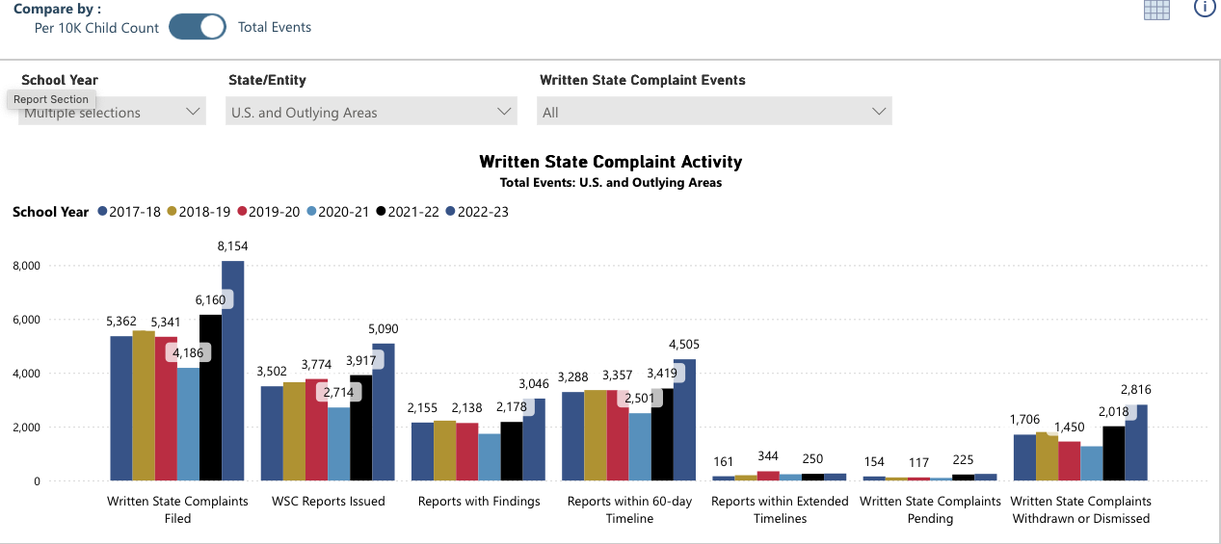
Written State Complaints
https://www.cadreworks.org/national-state-dr-data-dashboard

Slide 9
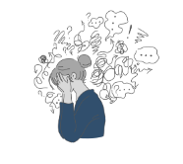
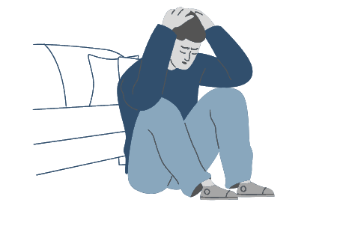
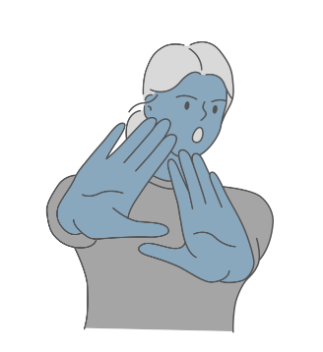

Conditions for Conflict
Notes:
Let me tell you a story:
Last week, I had a doctor’s appointment and it wasn’t the best experience. Let me tell you what happened.
I was told to get there early to fill out paperwork. So I did! My appointment was at 1:00 and I got there at 12:45. As someone who is notorious for running late, I thought I was doing good! When I arrived at the reception area, however, the receptionist asked for my name and started checking me in. Before she could even get the paperwork pulled together, she said to me, “Oh, you were supposed to be here at 12:30 to fill out paperwork. We’re going to have to hurry to get this done before your appointment time.” Really? How long does it take to fill out a few forms? And why did this person even feel the need to say anything at all? Just give me the forms and let me get to work. How was I supposed to know? This made me extremely frustrated.
When the nurse came back to get me at 1:00- I had my forms complete, thank you very much- she ran my vitals and rattled off two numbers for my blood pressure. Now I know that I should probably know what those numbers mean but I was already a bit upset and couldn’t remember- Do I want one number to be higher than the other? Is the first number supposed to be higher than the second one? What was my blood pressure last time I was here? What’s a normal blood pressure? I felt confused but the nurse had already walked away and I assumed I was supposed to follow.
Once in the examination room, the nurse asked me a few more questions and then left the room without making eye contact. Now remember, I’m at the doctor’s office. Even as someone who is relatively healthy, there’s always this lingering concern “what if they find something wrong with me?” So now, on top of feeling a bit anxious, I am now frustrated by these new rules about getting there 30 minutes before my appointment time (why have an appointment time if it’s not the real time? Just tell me my appointment is at 12:30 if that’s what time you want me there. In case you couldn't tell I’m a bit sensitive about being late to things). And now I’m confused about my blood pressure and whether I’m going to have a stroke or a heart attack.
When the doctor comes in, it’s clear that she’s in a hurry. No small talk, no “how are you today”, just straight to the point. When I asked her a question, she gave me the name of a website to check out. Within 10 minutes, she was on to the next patient. Do you think that I left there trusting her expertise? That I was healthy and, not, in fact, going to die of a stroke or heart attack? Absolutely not. Instead, I left feeling anxious, confused, frustrated, and distrustful. When I received the link to provide feedback, you can bet I had a thing or two to say!!
Do your families ever leave IEP meetings feeling this way? I’m sure we all would say “I hope not” but the reality is that, I doubt my doctors’ office thought so either!

Slide 10
Conditions for Conflict
Notes:
What conditions make conflict more likely to occur? And what conditions make that conflict more likely to escalate when it does?
Let’s think about this for a minute
Frustration- There seem to be unspoken rules, I wasn’t sure what they were, but I was expected to follow them.
Confusion- I wasn’t sure what was going on but everyone else seemed to. The situation is unfamiliar and everyone is throwing around terms like it’s a new language.
Stress and anxiety- the situation itself is high stakes. I wasn’t sure what the outcome was going to be and I wasn’t sure what was going to happen next
Distrust- I didn’t feel like I had an opportunity to ask questions and when I did, that feeling was validated because I didn’t feel heard or valued.
IEP meetings do all of these things!! No wonder we have FB groups that give parents tips on how to fight. No wonder we have advocates and special education attorneys popping up on every corner. And no wonder conflict in special education has soared over the last few years.

Slide 11




Key Idea
Conflict is Costly!
We must think differently about how we support our staff through conflict!
Notes:
Regardless of the type of conflict you’ve experienced- or perhaps you’re one of the lucky ones and haven’t experienced it yet-
Conflict costs money in the form of legal fees but it also costs us relationships, time, and energy.

Slide 12
We have an opportunity to address the conditions for conflict!

Slide 13
A Systems Level Approach
Notes:
Define systems level approaches to challenges we’re facing
Reflection
Leadership Iceberg
Data rich, information poor
Stepping Back to Identify What Actually Has Impact
Understand root causes
5 Whys (introduce with example)

Slide 14
“Every system is perfectly designed to get the results that it gets.”
W. Edward Deming*

Slide 15
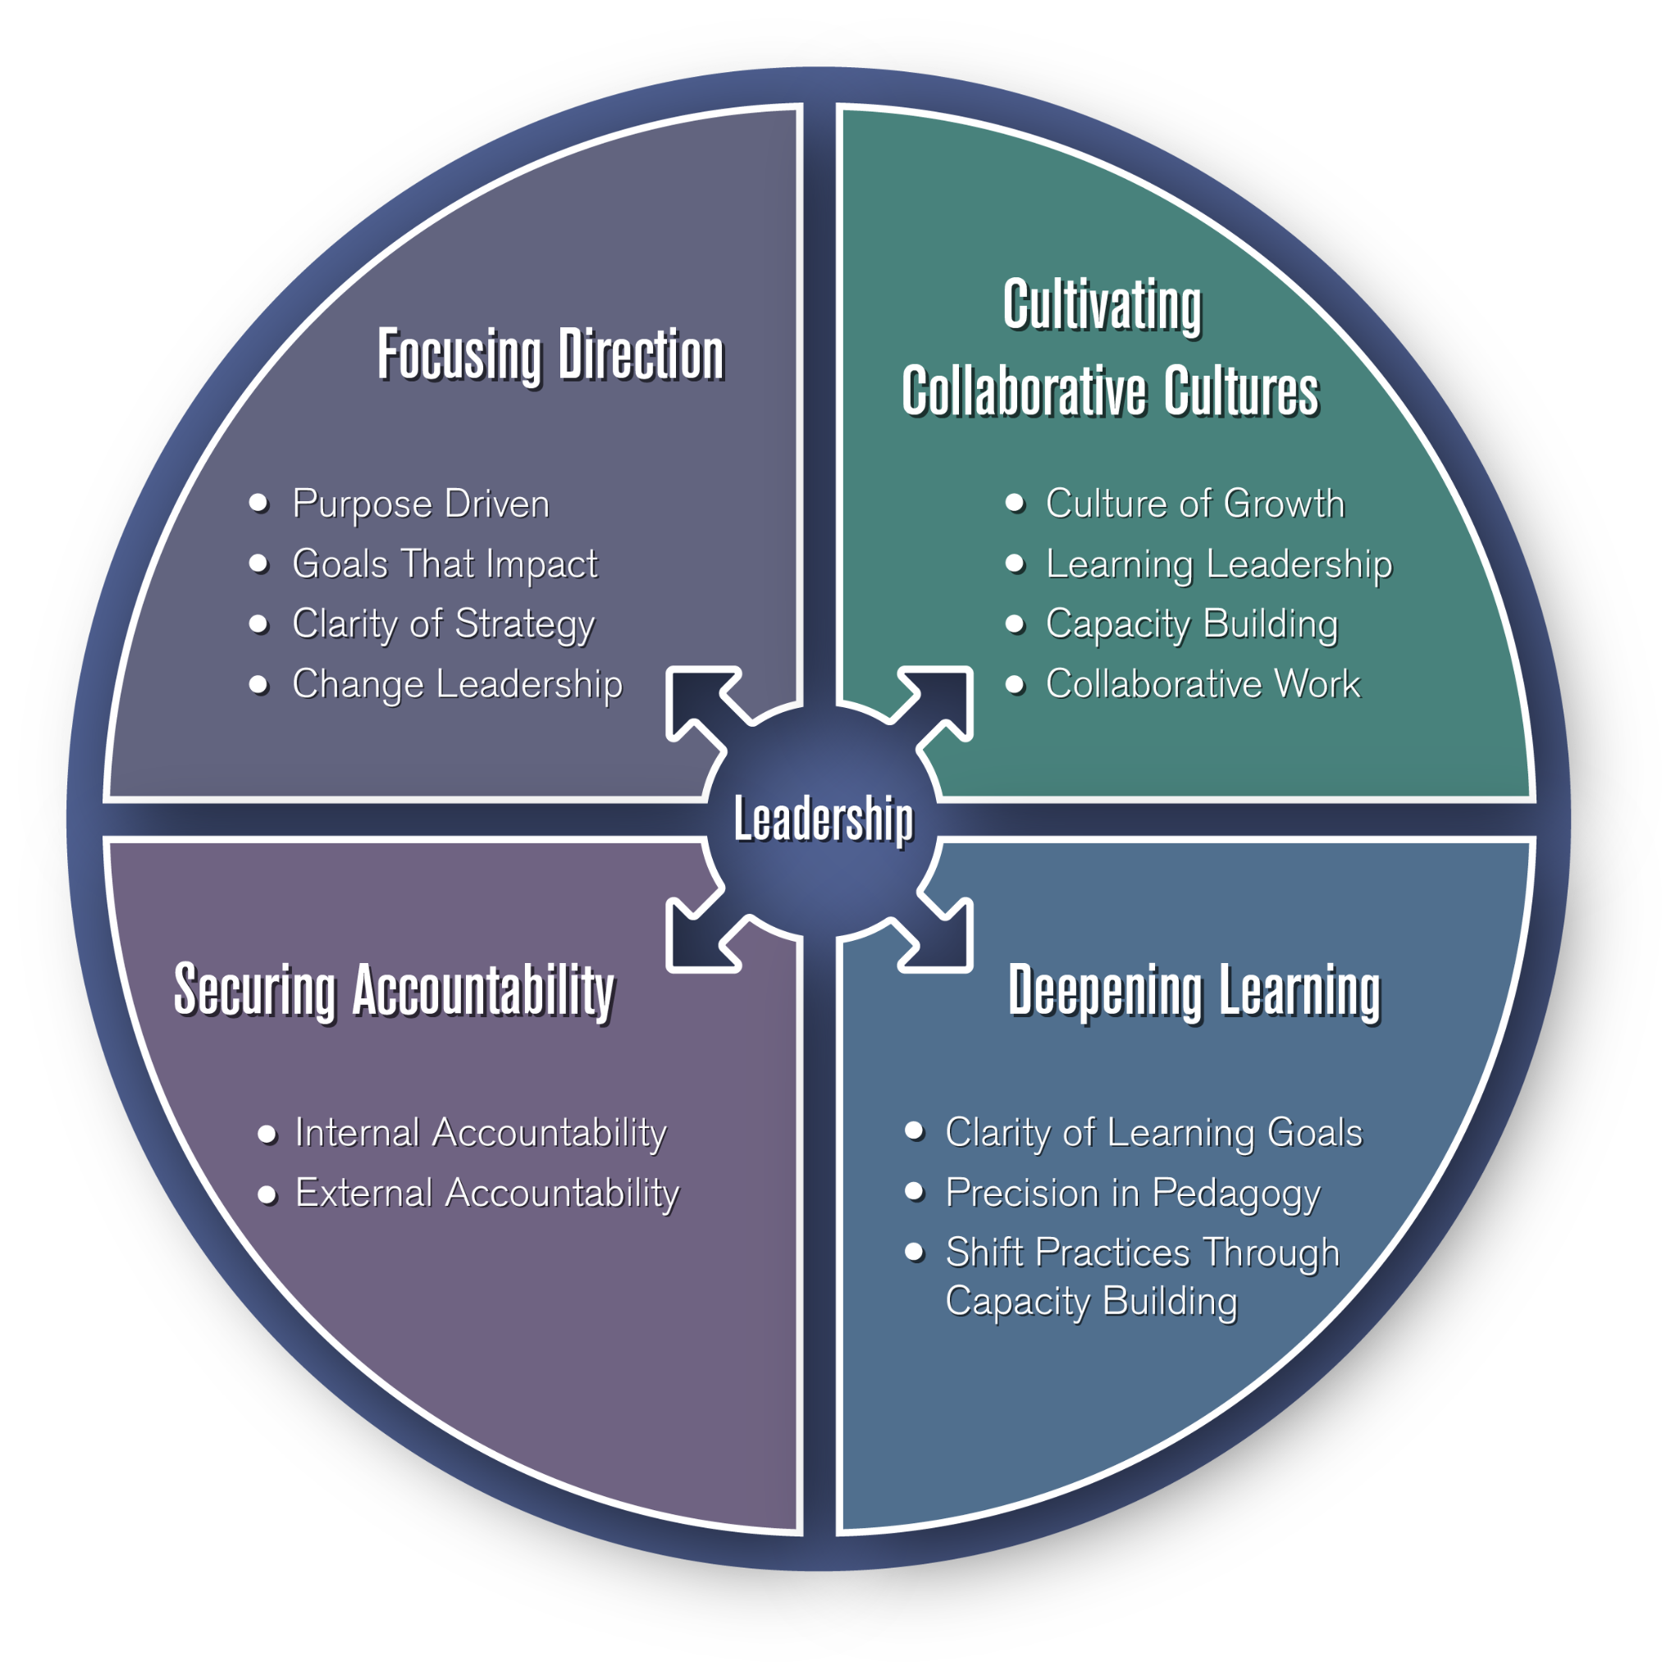
Benefits of a Systems Approach
Coherence and Clarity
Collaborative Culture
Capacity for Deep Learning
  Vertical and Horizontal
Long Term Sustainability
Continuous Improvement
© Michael Fullan
https://michaelfullan.ca/coherence-the-right-drivers-in-action-for-schools-districts-and-systems/coherence-framework-extended/
Notes:
A systems approach to problem-solving involves understanding and addressing issues by considering the entire system in which the problem exists, rather than focusing on isolated components. This approach is particularly useful in complex, interconnected situations where multiple factors influence the problem, and traditional methods may fail to identify all variables or potential solutions. Here are some key benefits of using a systems approach to solving problems:
Addresses root causes
Long term solutions
efficiency
better decision making
proactive problem solving

Slide 16
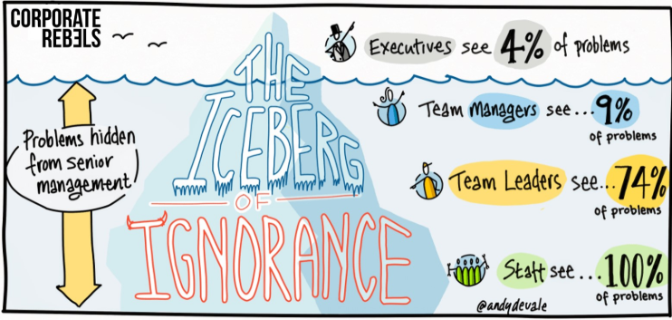
The Iceberg of Ignorance

Slide 17
Are We “Seeing” What Matters?
Let’s talk Data.
How do we know what is important?
How do we know what can be improved?
How do we know something is improved?

Slide 18
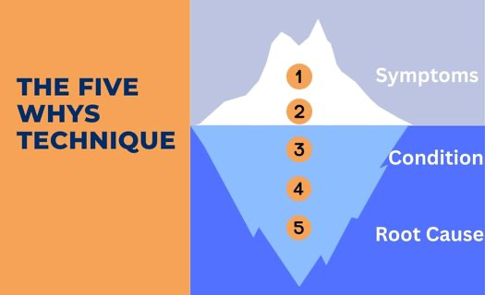
What are the Root Causes of Special Education Conflict?
Notes:
5 Whys at the Table

Slide 19
Applying a Systems Based Approach to ADR
Notes:
Relationships, interests, and impacts
https://cadreworks.org/resources/cadre-materials/district-self-assessment-for-collaborative-and-early-dispute-resolution

Slide 20
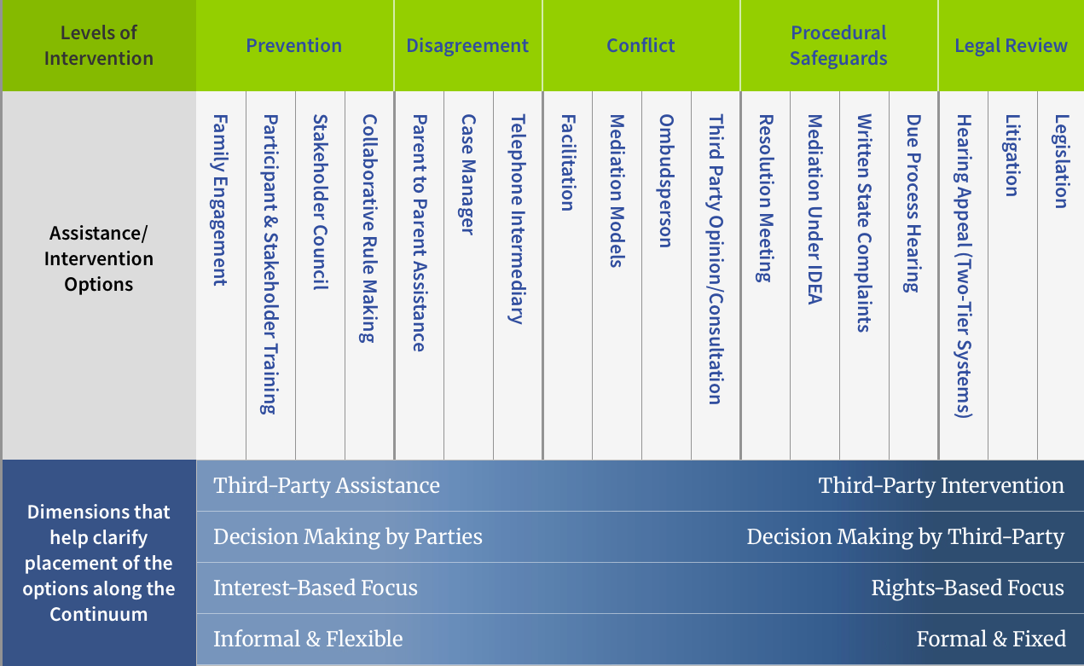
The ADR Continuum
Notes:
Introduce ADR as a system
Ask participants- which of these have you implemented?
What other ADR options have you implemented?
What root causes did they address?
What data have you collected to inform these strategies?

Slide 21
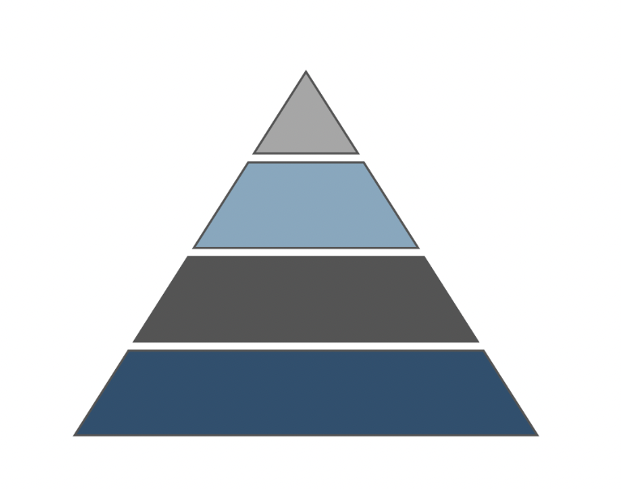
A Framework for Conflict Engagement
Intensive
Dispute Resolution
Conflict
Targeted
Disagreement
Universal
Prevention

Slide 22
A Framework for Conflict Engagement
Intensive
Targeted
Universal
Prevention

Slide 23

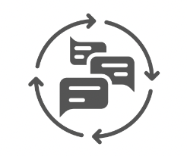


How Do We Meaningfully Engage Families?
Become a Reliable Source of Information
Provide Opportunities for Feedback
Offer Networking and Support Opportunities
Conduct Collaborative IEP Meetings
Notes:
Start with the way we get information these days. When you want to know more about something what do you do? [search online]
Information: Where do your families go for information? Do they go to your website? Does that provide honest, reliable, and transparent information? If you were a family member that just found out your child was being tested, or were preparing for their first IEP meeting, could they trust the school based on what they find on your website? Or would they have to look elsewhere? Where do you think they might look instead? [FB groups, advocacy groups, etc]
Feedback: How do families provide input and feedback? Are there opportunities for families to share information about their experiences? Are there opportunities for families to share their feedback when considering changes or improvements?
Networking and Support:
Collaborative IEP meetings

Slide 24
A Framework for Conflict Engagement
Intensive
Targeted
Disagreement
Universal

Slide 25
How Do We Support Teams Through Disagreement?
Establish transparent policies and procedures for:
staff to receive conflict coaching
families to express concerns
IEP teams to request support
Provide professional learning to build the capacity of school and district leaders to effectively and productively help IEP teams resolve disagreements.

Slide 26
A Framework for Conflict Engagement
Intensive
Conflict
Targeted
Universal

Slide 27
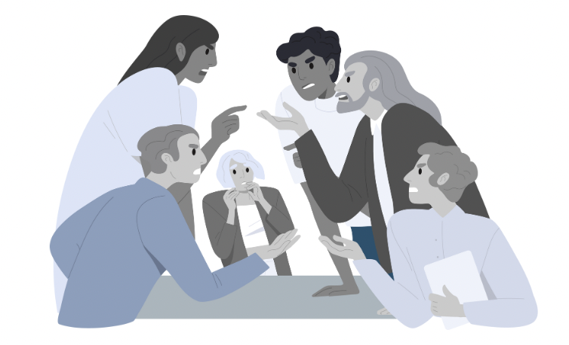
How Do We Support Teams Through Conflict?
Provide opportunities for:
Parent ombudsman
Third party case consultation
Neutral IEP facilitation
Notes:
When teams struggle to reach consensus, it might be helpful to bring in a third person perspective

Slide 28
A Framework for Conflict Engagement
Intensive
Dispute Resolution
Targeted
Universal

Slide 29
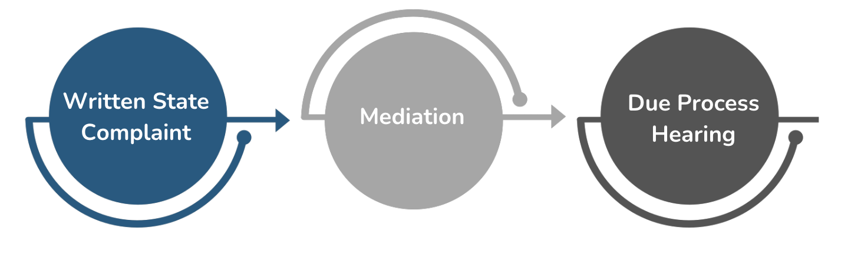
Procedural Safeguards
Notes:
Do your staff know what to do when they receive a complaint? When a parent refuses to sign and indicates they plan to file?
What steps does the district take? Who is responsible?
Do your staff know what to expect?
The key here is to help your staff feel prepared so they aren’t worried or afraid of conflict.

Slide 30
Conditions for Conflict
How might applying a systems approach address the conditions for conflict?
Notes:
What conditions make conflict more likely to occur? And what conditions make that conflict more likely to escalate when it does?
Let’s think about this for a minute
Frustration- There seem to be unspoken rules, I wasn’t sure what they were, but I was expected to follow them.
Confusion- I wasn’t sure what was going on but everyone else seemed to. The situation is unfamiliar and everyone is throwing around terms like it’s a new language.
Stress and anxiety- the situation itself is high stakes. I wasn’t sure what the outcome was going to be and I wasn’t sure what was going to happen next
Distrust- I didn’t feel like I had an opportunity to ask questions and when I did, that feeling was validated because I didn’t feel heard or valued.
IEP meetings do all of these things!! No wonder we have FB groups that give parents tips on how to fight. No wonder we have advocates and special education attorneys popping up on every corner. And no wonder conflict in special education has soared over the last few years.

Slide 31
Assessing Your System

Slide 32
Five Why Example
Statement: I’m always running late.
Why? Because I leave the house later than planned.
Why? Because it takes me longer to get ready than I expect.
Why? Because I don’t prepare things (clothes, keys, lunch) the night before.
Why? Because I tell myself I’ll have time in the morning.
Why? Because I always underestimate how much I have to do in the morning.

Slide 33
In Practice…
Question: Why are we seeing more conflict in special education?
Start with the Question.
Then ask “Why”. Record that answer.
Ask “Why” again. Record that answer.
Ask “Why” again. Record that answer.
Repeat until you have asked “Why” five times.
Looking at your last answer, what stands out to you?
Share with the table. Are there similarities/themes? Differences?
Notes:
Share with the table. Are there themes?

Slide 34
Systems Level Disruptors
Communication
  Consistent, Clear, and Two-Way
Policies, Procedures, and Practice(!)
  In Place and In Action with Fidelity
Culture and Climate
  Same Team with Clear Roles and Responsibilities
Data
  Identifying What Is Critical and Actionable

Slide 35
Making the Connection
What is a Question You Need to Ask About Your System?
  Focus on Collaboration.
  Test Your Question Using the 5 Whys.
    Does the original question make sense or does it need revised?
Then Ask,
Who do you need to talk to?
What data do we need to collect?

Slide 36
Resources
CADRE's Dispute Resolution System Self-assessment Tool
Success Gaps Toolkit
PartnerEdSolutions.org

Slide 37
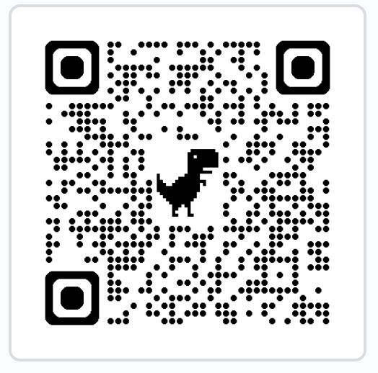
Contact Us!
Theresa Nicholls Jana Rosborough
tnicholls@partneredsolutions.org jana.rosborough@limestoneeducation.org
615-207-3594 913-219-9136
http://www.partneredsolutions.org

Slide 38
Thank You!

