Slide 1

What Michigan Learned While Building a Successful Informal and Early Special Education Dispute Resolution System
Michigan Special Education Mediation Services
Cheryl Levine, Program Coordinator
Beth Kohler, Outreach Coordinator

Slide 2

Special Education Mediation Services
A Grant-Funded Initiative of the Michigan Department of Education Office of Special Education (OSE).
Offer FREE mediation, IEP facilitation and collaborative communication training to schools and parents across Michigan.
Enables the OSE to meet its obligation under the IDEA to provide statewide mediation services at no-cost to schools and parents to resolve special education disputes.

Slide 3

What We Do
How
IDEA Mediation
Neutral meeting facilitation
What
Foster cooperation
Encourage effective teamwork
Open communication channels
For Whom
Students who receive special education supports and services birth to age 26;
Those who plan their education.
Why
The overall goal is to help students, parents and educators make decisions that improve education outcomes.
It’s all about building trust

Slide 4

Elephant in the Room
Not all states have a funding model like Michigan’s.
The future is uncertain.

Slide 5

Today’s Agenda
A look at the data
Staff Experience
5 Keys to a successful program
Database
Program administration
Covid pivot
It’s all about building trust

Slide 6
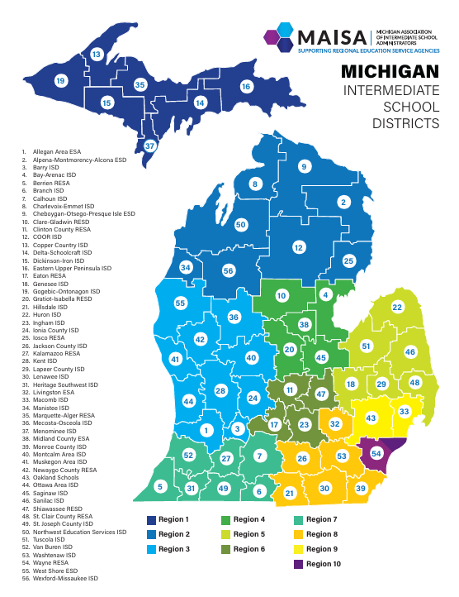
Michigan is Different
56 Intermediate School Districts
536 local school districts
288 public school academies
622 non-public schools
1,427,386 students (24/25 school year)
211,666 SWD or 14.83%
In Michigan, intermediate school districts (ISDs) are subrecipients of IDEA grant funds and, thus, serve as LEAs, with the responsibility to support member districts in improving results and ensuring program requirements are met.

Slide 7
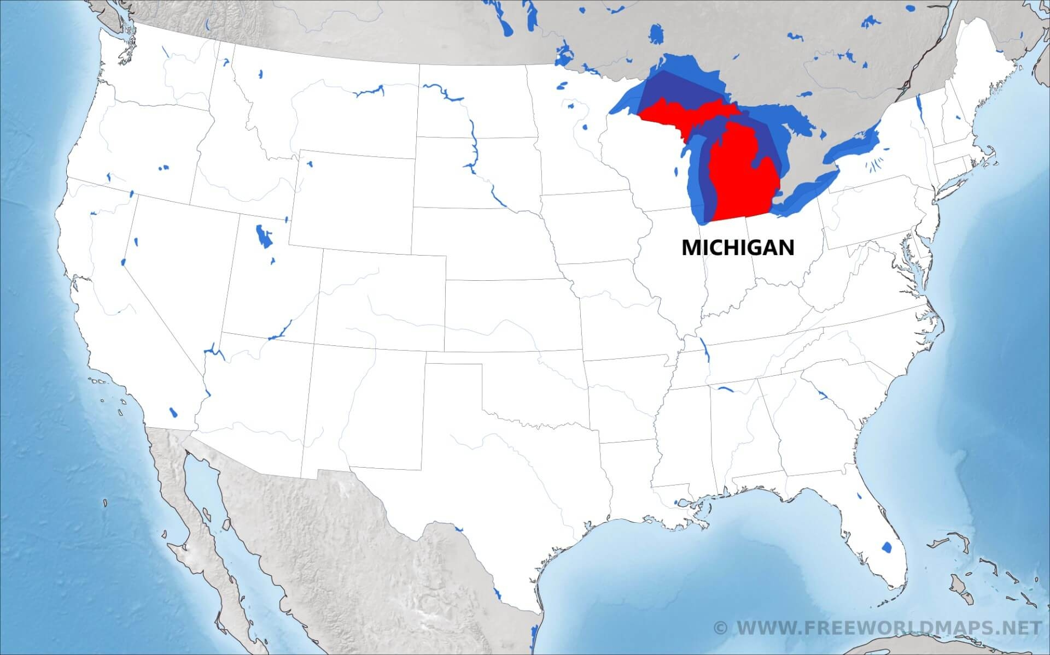
What the CADRE Data Shows 2022-2023
U.S. Average– 4.3 mediation agreements per 10,000 students, 51% mediation agreement rate, 33% Due Process related mediation agreement rate.
Michigan – 7.9 mediation agreements per 10,000 students, 74% mediation agreement rate , 71% Due Process related mediation agreement rate.
https://cadreworks.org/national-state-dr-data-dashboard

Slide 8

Why Providing Meeting Facilitation Can Make a Big Difference
Facilitations Held
2024-2025: 745
2023-2024: 679
2022-2023: 582
2021-2022: 558
2020-2021: 387
2019-2020: 403
2018-2019: 421
2024-2025
Review IEP: 269
Planning Conf: 150
MET and IEP: 81
REED: 59
MDR: 54
BIP: 43
IEP Amendment: 39
(+Initial IEP, MET, REED/IEP, RS)
Note: These are not facilitated by school personnel but rather NEUTRAL outside facilitators.

Slide 9
Participant Feedback
I was very nervous entering this meeting, as I have never been required to attend a mediated/ facilitated meeting. {The facilitator’s} presence made this situation much better than I could've imagined. His calm demeanor and neutral standpoint helped our team to get to the root of the conflict and work through it, keeping the student as the center focus. I am very grateful for the parents having contacted MDE with this request, as I truly feel we would have taken far longer to get to this point in our relationship with the parents, had we not utilized SEMS' facilitation service. Thank you!
- School District
It was like at a totally different meeting with different staff members. They were more prepared. They allowed me to make changes and even asked more of my opinion and suggestions…..thank you for listening to my concerns and executing effectively, efficiently, and expeditiously.
- Parent
It’s all about building trust

Slide 10
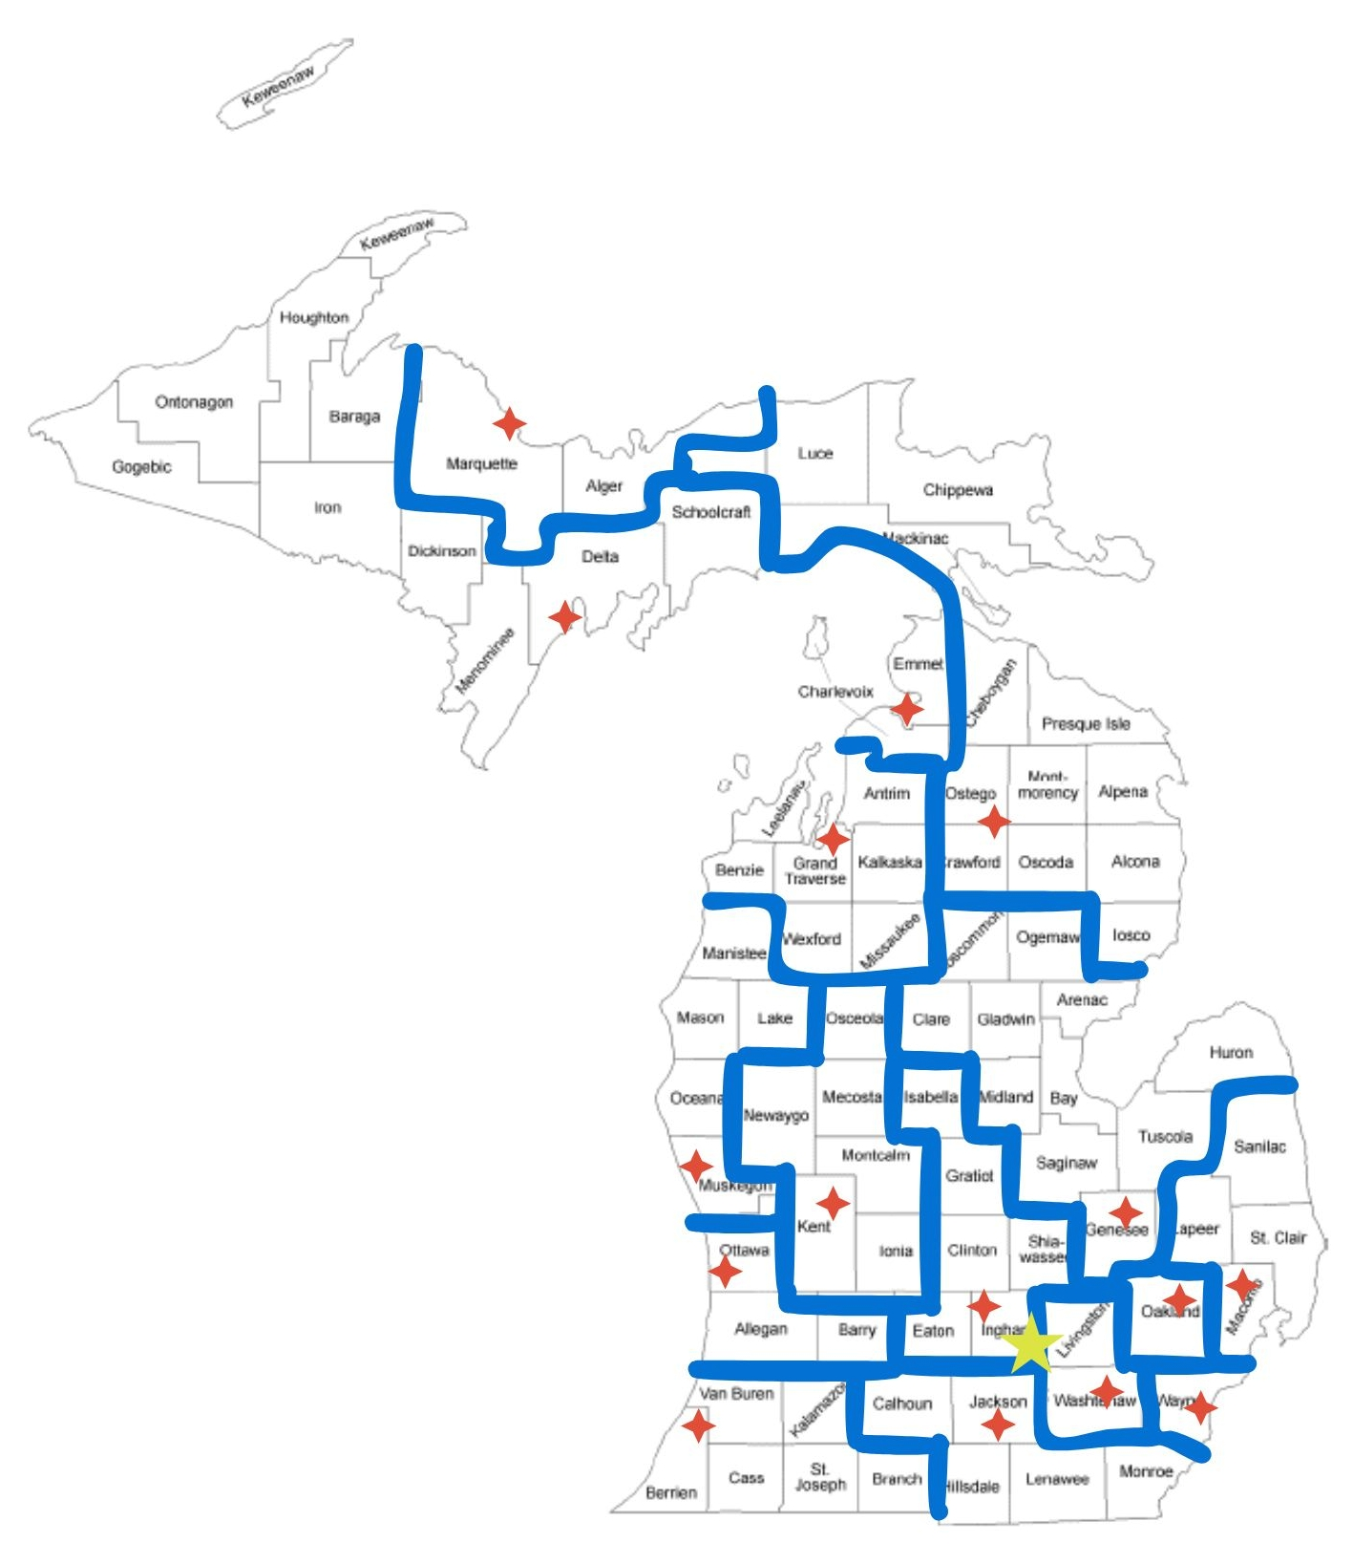
Make-Up of Michigan Program
Local Dispute Resolution Centers
To pay or not to pay mediators
Database
Mediator Assignment
Help meet random/rotational guidelines

Slide 11

Building Trust Leads to Successful Program
Robust state support
Outreach
Intake
High quality Facilitation
Training and support
High quality Mediation
Training and support

Slide 12

State Support
Michigan was the first state to provide facilitations beginning in 1997.
State funds formal marketing campaign separately from operational budget.
The Michigan Department of Education, Office of Special Education (OSE) model complaint forms include a checkbox allowing the complainant to request contact from SEMS to discuss the option of mediation.
State Complaint Model Form
Model Due Process Complaint/Request for Hearing form

Slide 13
State Support2
Direct link on OSE website for dispute resolution options.
Benefits of mediation and resolution sessions listed on complaint process descriptions.
Written into Michigan Administrative Rules for Special Education
Family Matters
Michigan Alliance for Families Partnership
What are some things your state does?

Slide 14
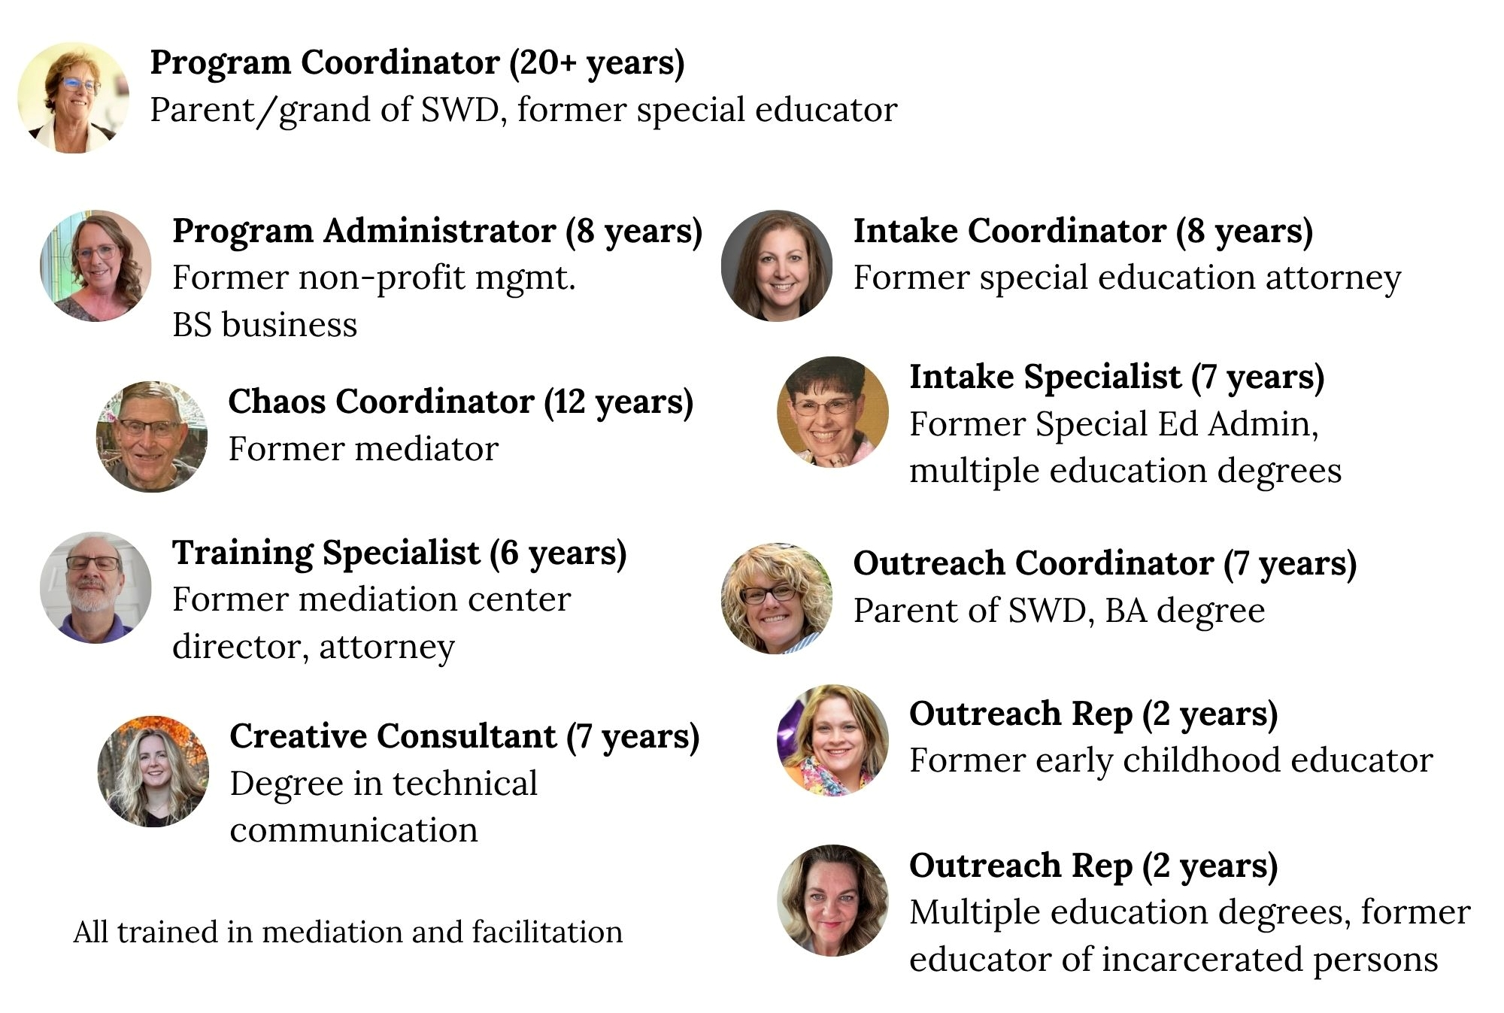
SEMS Team

Slide 15
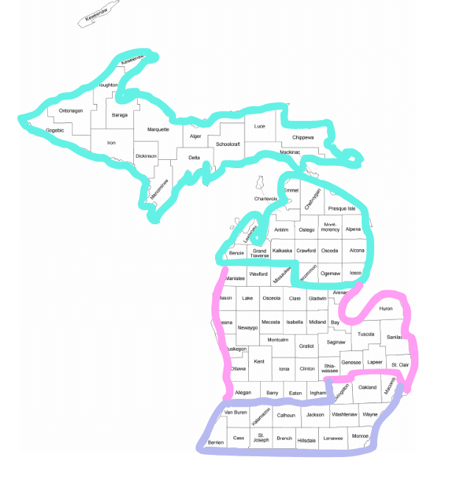

Outreach Team
GOAL
Ensure accurate, consistent messaging is delivered to all potential users statewide on a regular basis.
It’s all about building trust

Slide 16

Outreach Plan
Communicate with special education administrators minimum 3 times per year.
Targeted audiences
Underserved populations
Early childhood
School principals
Parent Advisory Committees
Family serving agencies and Community Partners
ie: Autism Alliance, Behavior Health, ARC, etc.
Objective : Increase engagement in and understanding of proactive collaborative dispute resolution processes. Increase awareness to use SEMS services early and often to minimize adversary relationships which negatively impact planning for students with disabilities.

Slide 17

Outreach Plan 2
Attended 30+ conferences related to special education and family serving agencies
Exhibit tables (elevator speech)
Breakout sessions
Keynote
Speak at PAC meetings, exhibit at resource fairs, and related community events.
Objective : Increase engagement in and understanding of proactive collaborative dispute resolution processes. Increase awareness to use SEMS services early and often to minimize adversary relationships which negatively impact planning for students with disabilities.
It’s all about building trust​

Slide 18

Outreach Plan 3
Webinars with Parent Training and Information Center – Michigan Alliance for Families
Collaborative communication in special education
Disciplinary removals
Manifestation determination reviews
How to prepare for facilitation and mediation
Among others
Objective : Increase engagement in and understanding of proactive collaborative dispute resolution processes. Increase awareness to use SEMS services early and often to minimize adversary relationships which negatively impact planning for students with disabilities.
Let’s Discuss!
What partners do you engage with outside of school?

Slide 19
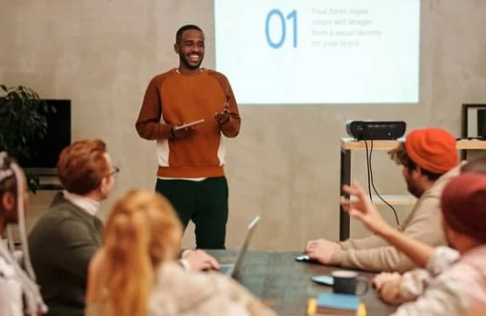
Outreach Plan 4
Ongoing development of new learning opportunities
Dispute Resolution Options in Special Education
Conflict Resolution and Communication in Special Education
Discipline for Students with Disabilities
Effective IEP Team Meeting Participation Techniques
How to Develop Trusting Relationships Between Families and Schools
How to Communicate with the Most Challenging Personalities
Objective : Increase engagement in and understanding of proactive collaborative dispute resolution processes. Increase awareness to use SEMS services early and often to minimize adversary relationships which negatively impact planning for students with disabilities.

Slide 20

Program Presentation
Outreach Plan
Objective : Increase engagement in and understanding of proactive collaborative dispute resolution processes. Increase awareness to use SEMS services early and often to minimize adversary relationships which negatively impact planning for students with disabilities.

Slide 21
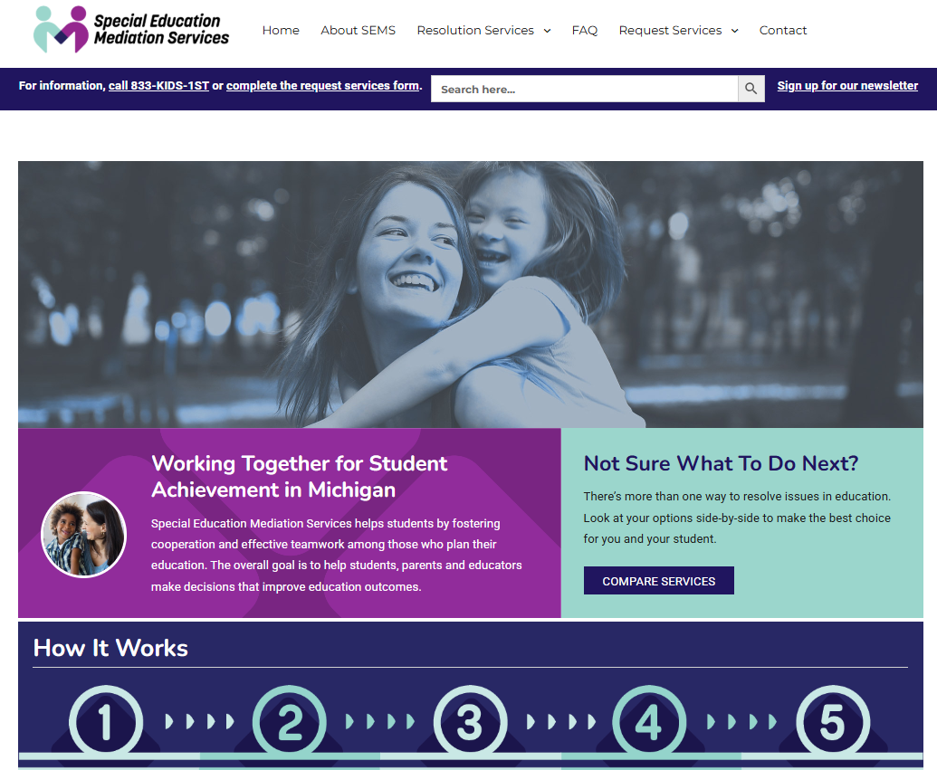
Website
Outreach Plan
Objective : Increase engagement in and understanding of proactive collaborative dispute resolution processes. Increase awareness to use SEMS services early and often to minimize adversary relationships which negatively impact planning for students with disabilities.

Slide 22


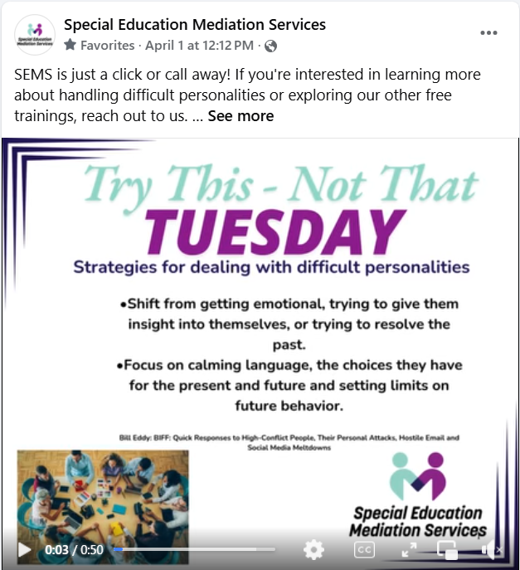
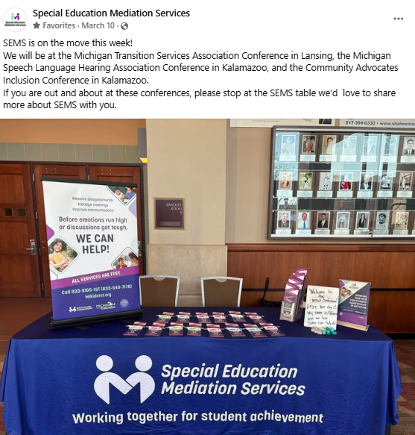
Social Media
Outreach Plan
Objective : Increase engagement in and understanding of proactive collaborative dispute resolution processes. Increase awareness to use SEMS services early and often to minimize adversary relationships which negatively impact planning for students with disabilities.
Share your ideas on use of social media!

Slide 23
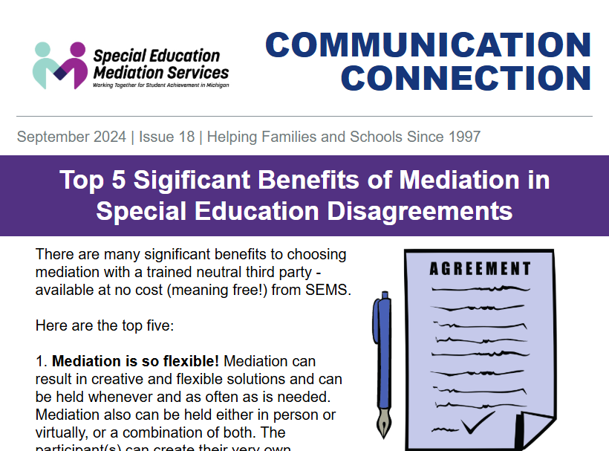
Newsletter
Outreach Plan
Objective : Increase engagement in and understanding of proactive collaborative dispute resolution processes. Increase awareness to use SEMS services early and often to minimize adversary relationships which negatively impact planning for students with disabilities.
Communication tips
Special Education Guidance
Calendar of Professional Development/Conferences
Links to important articles

Slide 24
State Supported Campaign
Bus Banners
Digital Audio
Digital Display
Paid Social Media
Paid Search

Slide 25
State Supported
Deliverables
Outreach Plan
Objective : Increase engagement in and understanding of proactive collaborative dispute resolution processes. Increase awareness to use SEMS services early and often to minimize adversary relationships which negatively impact planning for students with disabilities.
Banners
Pens
Brochures in English, Spanish, Arabic
Exhibit tablecloths
Presentation in English, Spanish and Arabic

Slide 26
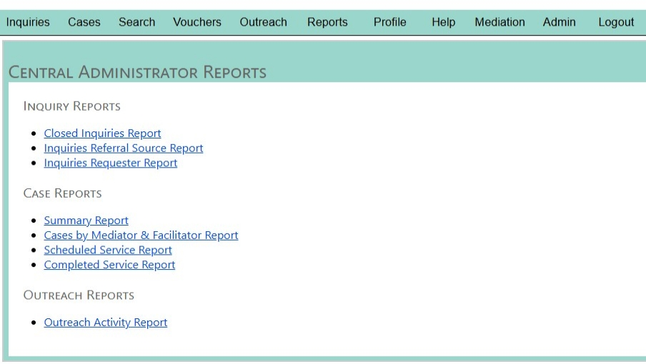
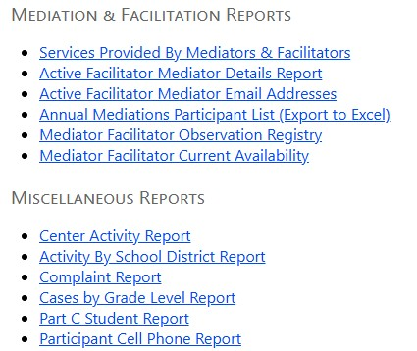
Maximum Impact
Outreach Plan
Outreach Data Collection
Where, when, what, how many, etc.
Statewide outreach conducted by SEMS
Local Dispute Resolution Center Partner outreach

Slide 27

Elevator
Speech
Outreach Plan
Objective : Increase engagement in and understanding of proactive collaborative dispute resolution processes. Increase awareness to use SEMS services early and often to minimize adversary relationships which negatively impact planning for students with disabilities.
What are some examples of the quick way in which you introduce someone to your services?
This should be no more than 30 seconds. Ideally shorter.
Let’s practice!

Slide 28
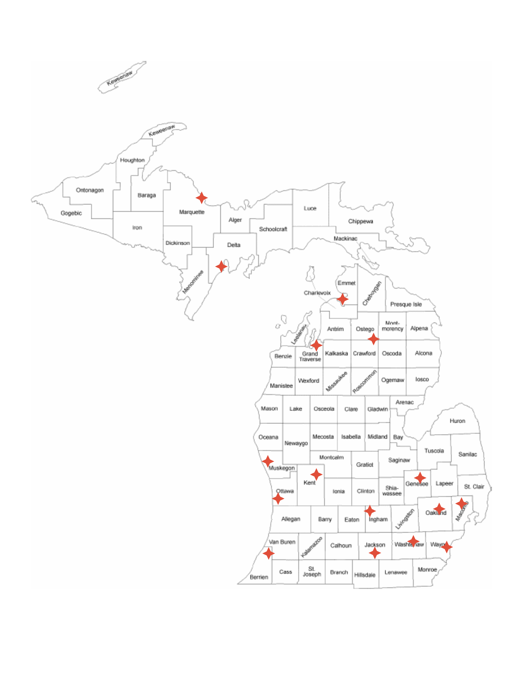
Centralized
Intake Process
Pre-2017
Regional service partners responsible for intake
Centralized Intake process
Ease of access
Consistent messaging & Procedure
Knowledgeable information gathering and sharing
Quality service assurance
Objective : Coordinate case intake and referrals.

Slide 29

Intake Process Poll

Slide 30

Overview
Receive initial contact information
Gather information
Explain services offered
Determine appropriate service
mediation
meeting facilitation
Secure FERPA release
Confirm participation agreement of both parent and LEA
Assign case to a SEMS service partner
Intake Process
It’s all about building trust

Slide 31
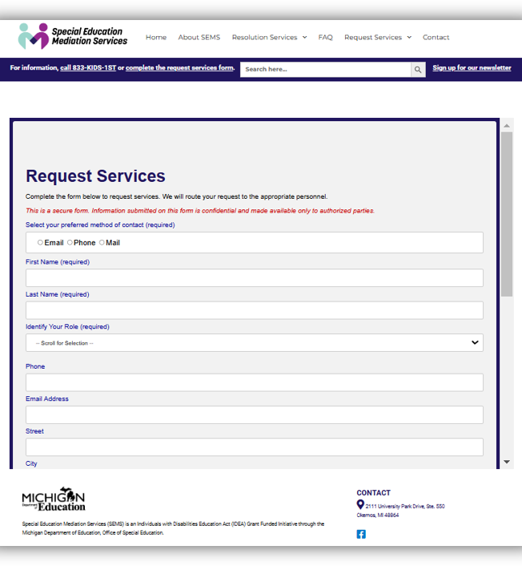
Service Request Process “Easy” Access and Multiple Ways to Connect
Phone
Toll free number (833) KIDS-1ST (833.543.7178)
Website: mikids1st.org
Online request form
Email
Direct to SEMS staff
info@mykids1st.org
SEA Model Complaint forms
Contact through Service Partners
Social Media

Slide 32
Knowledgeable Information Gathering2 Specialist Role
Basic information
Parent Name/contact
Student name, birthdate, grade level, eligibility category
Complaint information (if any)
School district name
Concerns
Potential resolutions
SEMS arranges required translation or sign language interpretation for our intake process.
Jeenie interpretation services
Intake Process
This call is the participants’ opportunity to explain what has happened and what they would like changed. Average is one hour

Slide 33
Consistent Messaging & Procedure Specialists Role
It’s all about building trust
Share a common language to explain mediation and meeting facilitation
Provide written information to all parties during intake
Family Matters
Preparing for Special Education Mediation
Walk alongside parties throughout the process
Implement & Monitor uniform service procedures statewide
This includes securing a FERPA release from the parent
DocuSign
Intake Process

Slide 34
Knowledgeable Information Gathering Specialist Role
Use expertise and knowledge of special education to get the information needed
Prepares the mediator or facilitator
Lends to higher agreement rates
Begins to build trust in the process
Provide information through available resources
Remain neutral
Don’t advocate
Don’t provide legal advice
Intake Process

Slide 35

Quality Service Assurance Responsiveness
Intake Process
Quick/reliable responses
Ensure follow-up & follow-through
Communicate with & support service partners
Preparation with mediators
It’s all about building trust

Slide 36

Quality Service Assurance Scheduling and Paperwork
Intake is complete when both the parent and district agree to participate in good faith
Service partner is notified of a new service that needs attention
Intake specialist introduces the parties to the service partner case manager through email
The case manager may receive additional information if it was not provided during intake.
SEMS staff review all open services several times weekly
Ensure mediations are scheduled timely.
Ensure mediators are assigned on a random, rotational, or other impartial basis
Specialist provide support for document distribution & completion
Intake Process

Slide 37

Quality Service Assurance How Quick?
It depends
SEMS makes every effort to meet ALL service requests.
Completion of the Intake Process steps presents a challenge if the time between the request and a scheduled meeting is less than 3 school days.
We are often able to provide services with as little as less than a day’s notice
Opportunities we use to expedite the process
Incredible Database
DocuSign
Flexible availability of staff
& mediators
Relationships with
stakeholders
Intake Process

Slide 38

Paperwork
Paperwork & Post Mediation
Intake Process
Statement of Understanding
Mediation Agreement
Model Form
Attorney involvement
Complaint withdrawal
Debrief after sessions
Participant Evaluation

Slide 39
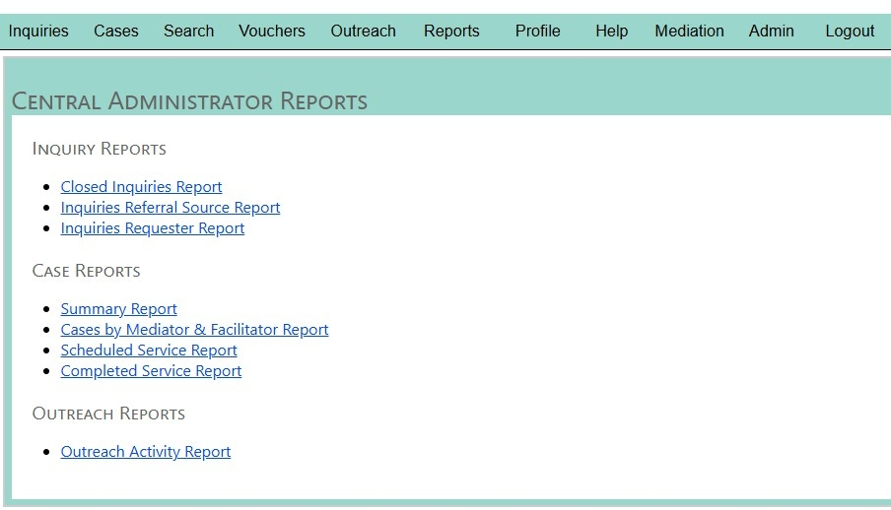
Database and Reporting
Why is data collection important?
How do you use data on case management?
Notes:
.

Slide 40
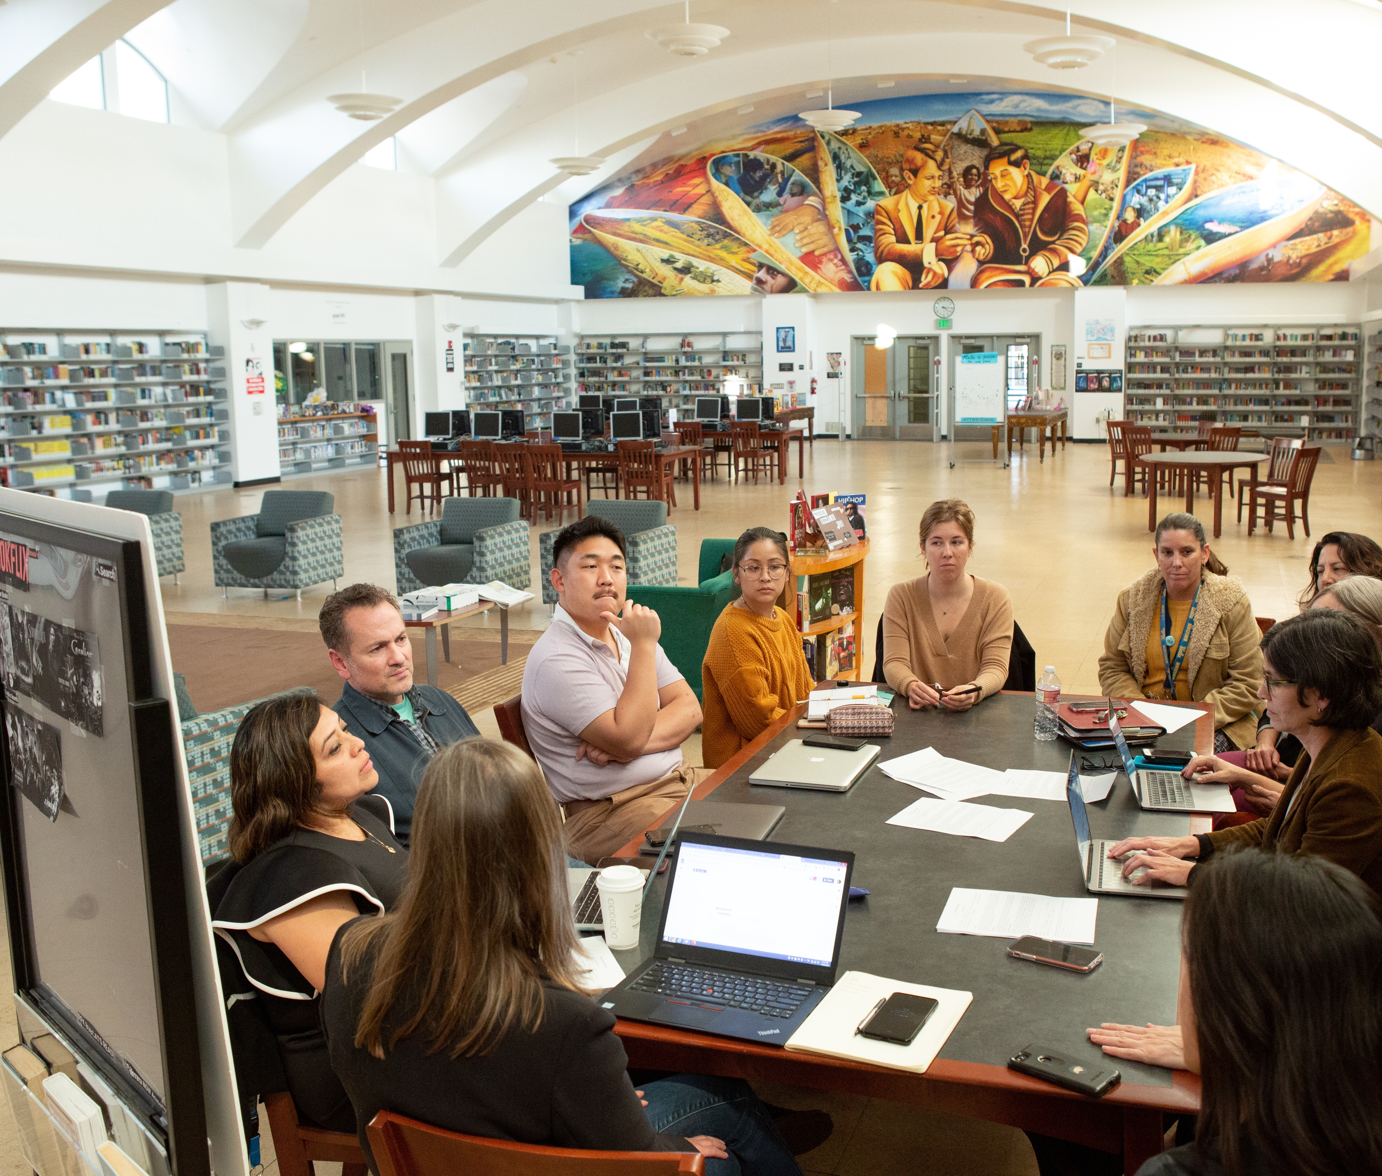
Quality Mediation and Facilitation
GOAL
Recruit, train, and maintain a sufficient number of highly trained and skilled mediators and facilitators knowledgeable about special education to ensure timely provision of high quality, reliable, early dispute resolution services are delivered statewide.

Slide 41

Recruitment
One-page flyer distributed to local partners and at conferences, with a link to our application.
Looking for individuals passionate about helping students with special needs and a commitment to dispute resolution.
Virtual applicant interviews to ensure understanding of high level of skills and dedication needed.
Quality Mediation and Facilitation
It’s all about building trust

Slide 42

Recruitment 2
Approximately half of our mediators are attorneys.
The great majority of our facilitators are not attorneys.
Most of our mediators and facilitators serve as volunteers for a statewide network of non-profit community dispute resolution centers. We rely on these local partners to:
provide basic mediation training.
provide mediation experience.
refer us their best mediators!
Quality Mediation and Facilitation

Slide 43
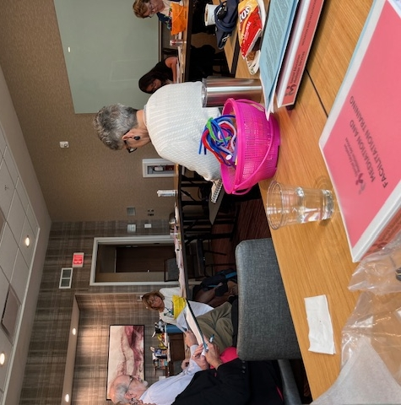
Training
We have developed a multiple part training program for new mediators and facilitators consisting of:
Sixteen recorded modules
Two-days in person skills training
A manual with a comprehensive set of one-page bullet point strategies and potential questions.
Observing live mediations and facilitations.
A two-hour mediation roleplay
Quality Mediation and Facilitation
Objective: Raise mediator and facilitator skill and knowledge levels to meet the increased referrals of complex cases.

Slide 44
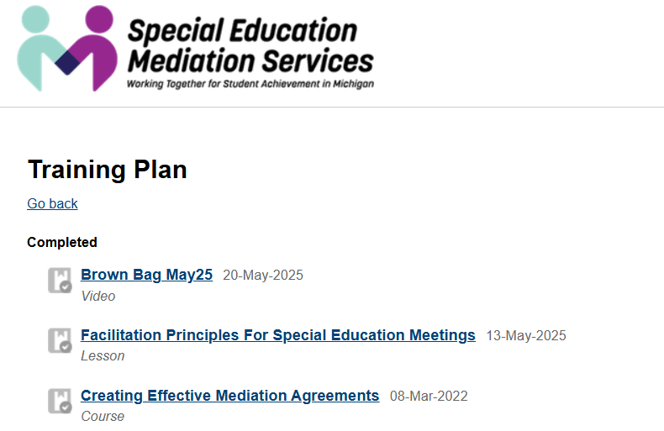
Asynchronous Learning
We have created sixteen interactive training modules using "Articulate" software.
Each is approximately 30 minutes in length.
There is a quiz after each section.
Approximately half are substantive and half are skill based.
Quality Mediation and Facilitation

Slide 45
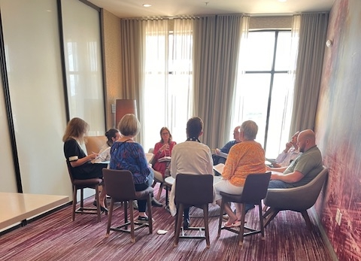
In-Person Training
Our in-person training is focused on real case fact exercises, analyzing scenarios and conducting roleplays.
We provide it once or twice a year as needed.
The three main things we teach are:
How to focus the conversation on the student.
How to “thread the needle” to avoid perceptions of bias (the hardest part!).
To ask lots and lots of questions.
We also tell them to be patient with themselves-- succeeding takes lots of practice and patience!
Quality Mediation and Facilitation

Slide 46
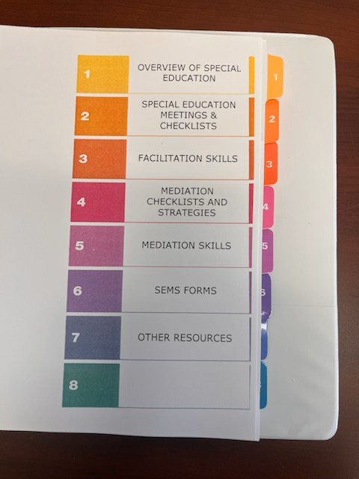
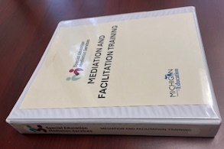
Training Materials
We have created a training manual made up of one-to-two-page bullet points of substantive issue summaries, potential questions and strategies.
These short documents are updated regularly and distributed based upon feedback received.
Quality Mediation and Facilitation

Slide 47

Highly Complex Mediations
We identify and mark at intake those cases that we consider complex.
They involve challenging relationships, many pages of relevant documents and intake notes and often State or Due Process complaints.
A one or two-page fact summary, along with some potential questions are provided in advance to the mediator.
If it is a newer mediator or a particularly complex case, we offer to “brainstorm” with the mediator in advance of the session over Zoom.
Quality Mediation and Facilitation

Slide 48

Ongoing Training and Mentoring
We send a monthly newsletter and conduct a one hour monthly “lunch and learn” session on Zoom.
Sessions consist mostly of brainstorming strategies for handling recent challenges or emerging issues.
They are recorded and we require watching or attending six sessions a year.
Quality Mediation and Facilitation
It’s all about building trust

Slide 49

Participant Feedback
A critical means of quality control is participant and mediator/facilitator feedback.
Automated participant survey system goes through our database and are distributed following every session, usually within 24 hours.
Receive participant reviews from almost every session we mediate or facilitate.
Provides invaluable feedback to and from our mediators and facilitators, who have automatic access to all their evaluations.
Quality Mediation and Facilitation

Slide 50
Feedback
“We would like to thank you for all your help.
It was very important to have the Mediation Service present at our IEP meeting today, we felt safer and more comfortable, (Mediator name) was truly incredible.
Your support was essential to ensure better conditions to support our child more and better. Our journey is very challenging and knowing that we are not alone is wonderful, thank you very much for everything,
thank you for helping my family.”
- Parent
The most beneficial aspect of this mediation was undoubtedly the creation of a safe and neutral space for genuine dialogue.
The mediator's ability to facilitate active listening was also incredibly impactful. She encouraged us to truly hear what the other person was saying, and to reflect back our understanding.
It's clear that SEMS' core mission revolves around "improving education outcomes for students with disabilities."
This student-first philosophy is crucial in emotionally charged special education disputes, helping to keep the focus on the child's needs rather than just the adult disagreements.
- School District
Good morning,
I apologize for not responding sooner. You were angels in our lives, we are very grateful for helping us, we feel much safer and more protected, in the next IEP we will definitely ask you for help again.
Thank you very much.
- Parent

Slide 51

Pivot to Virtual Platforms
Since Covid, we have learned to use virtual platforms.
We use them for almost 50% of our sessions, including hybrid situations.
Some advantages:
Convenience of easy caucus, shared agreement writing, being at home.
Less escalation.
No travel time.
Flexibility.
Some disadvantages:
Easier to not engage.
Can’t read body language.
Less personal.
Technical imperfections.
Quality Mediation and Facilitation

Slide 52

Virtual Backup
We offer to provide technical and agreement writing backup to all mediators handling virtual sessions.
This frees up the mediator to focus on the participants and allows us to observe them, help when needed and ensure that an agreement is complete and signed (via DocuSign) while at the table.
Quality Mediation and Facilitation

Slide 53
Database and Reporting
What data do you use to reflect on quality mediation or facilitation?

Slide 54
Building Trust Leads to Successful Program
Robust state support
Outreach
Intake
High quality Facilitation
Training and support
High quality Mediation
Training and support

Slide 55
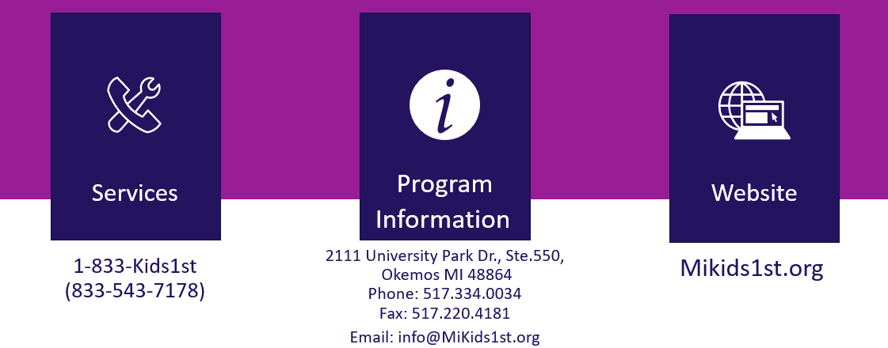
Contact SEMS

Slide 56


Thank you!
Bern Dempsey, Training Coordinator
Sue Feenstra, Grant Administrator
Taryn Francis, Outreach Representative
Beth Kohler, Outreach Coordinator
Rebecca Kozlow, Outreach Representative
Diane Kullis, Intake Specialist
Cheryl Levine, Project Coordinator
Laura Zangara, Intake Coordinator

