Slide 1
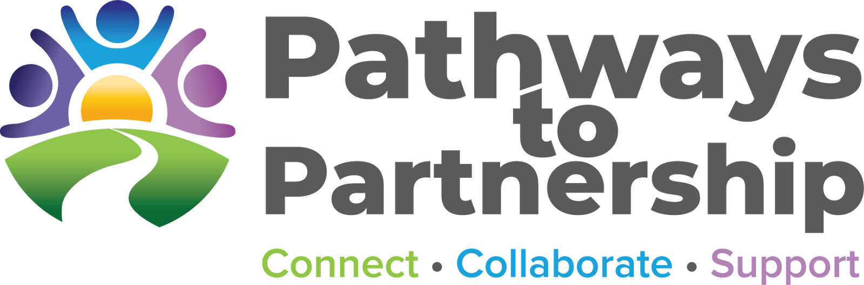
Pathways to Partnership: Cultivating Communities of Practice in Alternative Dispute Resolution
Presented by:
Aubrie Fulk, Co-Director, M.S., LEP
Stacy Alvey, Co-Director, LCSW, PPS
Michelle Kinner, Program Specialist, M.Ed.
Peter Aguirre, Program Specialist, M.S., BCBA, PPS
Pathways2Partnership.org

Slide 2

WELCOME AND INTRODUCTIONS
Notes:
10 mins
P2P STAFF INTRODUCE THEMSELVES AND THEN POLL THE AUDIENCE FOR:
How many of you are special education teachers?
Parents?
School psychologists, speech pathologists, or other service providers?
Administrators or program specialists?
Family advocates?
Others?

Slide 3
CONNECTIONS & CHALLENGES
How many of you are currently part of a professional network or Community of Practice (CoP)?
Icebreaker:
In pairs, share one challenge you face in ADR collaboration.
Notes:
10 mins
To get us started, we’ll do a quick icebreaker. First, a quick poll or show of hands—how many of you are already part of a professional network or Community of Practice?
Next, we’ll pair up for a brief conversation. Share with your partner one challenge you face in ADR collaboration. This helps us start thinking about common experiences and sets the stage for the learning ahead.

Slide 4
PATHWAYS TO PARTNERSHIP: OVERVIEW
Build a statewide educational community with skills to prevent, reduce, and resolve conflicts
Strengthen trust and mutual understanding between families and educational agencies
Resolve conflict at the lowest level while preserving IEP team relationships
Ensure the IEP process leads to positive, equitable outcomes for all students with disabilities
Transform educator responses to conflict in California’s special education system
Build a sustainable, accessible continuum for dispute prevention and resolution within Statewide System of Support (SSOS)
Notes:
Pathways to Partnership Overview
One of California’s Special Education Resource Leads (SERLs).
SERLs act as capacity builders, connectors, and facilitators → goal: ensure an integrated education system that meets the needs of all learners, including students with disabilities.
Partnership between Ventura County SELPA (urban) and Tehama County SELPA (rural).
Collaboration includes educators and parent partners → building a statewide ADR system.
Funded by CDE and CCEE.
Program Goals
Build community capacity
Create regional leads, CoPs, PD, and TA.
Strengthen trust
Work with Family Empowerment Centers, parent orgs, and educators.
Resolve conflict at the lowest level
Preserve IEP team relationships, reduce costly legal disputes.
Ensure positive, equitable IEP outcomes
Facilitated IEP training of trainers → equips teams with collaboration and facilitation skills.
Transform educator responses to conflict
Provide prevention + resolution skills to shift culture.
Build a sustainable continuum of support
Partner with other SERLs to develop resources, trainings, and stronger communication across the state.

Slide 5
OBJECTIVES
Understand the Concept of Communities of Practice (CoP): Define and explore the role of CoPs in the context of Alternative Dispute Resolution (ADR), emphasizing their importance in fostering collaboration and knowledge sharing.
Enhance Professional Development: Discuss how participating in CoPs can support continuous learning, skill-building, and the exchange of best practices to improve ADR outcomes.
Build Sustainable and Effective Dispute Resolution Strategies: Demonstrate how CoPs contribute to long-term improvements in dispute resolution processes by strengthening relationships, promoting shared values, and creating a supportive community of practitioners.
Notes:
Our objectives for today’s session are to:
Introduce the concept of a Community of Practice (CoP) within the ADR context and highlight how it fosters collaboration and knowledge sharing.
Explore how CoPs can strengthen learning, professional growth, and skill-building for both ADR practitioners and parents.
Demonstrate how CoPs contribute to long-term improvements in dispute prevention and resolution by strengthening relationships, promoting shared values, and cultivating a supportive community of practitioners.

Slide 6
UNDERSTANDING COMMUNITIES OF PRACTICES (CoP)
A Community of Practice for ADR is a structured, but flexible, group of people who share a common interest in Alternative Dispute Prevention and Resolution and come together regularly to learn from each other, share knowledge, and improve their practice.
Purpose: To strengthen skills, share promising practices, and solve challenges in ADR implementation across regions or organizations.
Participants: Can include Statewide System of Support (SSOS) resource leads, ADR practitioners, educators, families, parent groups, child advocates, and other stakeholders involved in ADR prevention and support.
Notes:
Communities of Practice are all about learning together and sharing knowledge. To experience that, we’re going to do a quick activity.
It’s a Think–Pair–Share: take a moment to think about the communities—formal or informal—you’ve already learned from in your work. Then, turn to a partner and share your thoughts. Finally, we’ll invite a few people to share highlights with the whole group.
This gives you a taste of how a CoP works in real life—connecting, learning from others, and bringing ideas back to your own work.

Slide 7
HOW WE STRENGTHEN CONNECTIONS
Connect Across Regions
Cross-regional peer learning visits and networking with families, practitioners, and advocates
Share & Innovate
Regional Innovation Showcases and collaborative problem-solving projects
Learn Together
Regular meetings, webinars, workshops, and case study skill-building sessions
Collaborate with Families
Workshops and panels engaging parent groups, Family Empowerment Centers, and child advocates
Build Resources
Co-created toolkits, templates, and guides shared via online platforms and forums
Notes:
On this slide, we’re showing the different ways we build stronger connections across our ADR work — with families, practitioners, and communities statewide.
Connect Across Regions
We bring people together across counties and SELPAs.
Through peer learning visits and networking, families, practitioners, and advocates learn from one another and strengthen ties across regions.
Share & Innovate
We highlight promising practices through Regional Innovation Showcases.
And we engage in collaborative problem-solving projects so new ideas can be tested and scaled.
Learn Together
Our community continues to grow skills through regular meetings, webinars, and workshops.
We also do case study sessions to practice applying ADR tools in real-world scenarios.
Collaborate with Families
Families are at the heart of this work.
We host workshops and panels with parent groups, Family Empowerment Centers, and child advocates to make sure their voices are central.
Build Resources
Finally, we strengthen connections by co-creating resources — toolkits, templates, and guides.
These are shared broadly through online platforms and forums so they’re accessible to both families and practitioners across the state.

Slide 8
BENEFITS OF COMMUNITIES OF PRACTICE
Knowledge Sharing – exchange best practices and case studies
Connections – network across regions with educators, families, and advocates
Collaboration – work together on solutions and projects
Skill Building – learn new strategies through workshops and webinars
Empowerment – involve families, parent groups, and child advocates
Notes:
Before we jump into the activity, we want to highlight why Communities of Practice are so powerful.
They give us a space to share knowledge and best practices, to make connections across regions with educators, families, and advocates, and to collaborate on real solutions.
They also give us opportunities for skill building through workshops and webinars, and—maybe most importantly—they empower families and parent groups to have a strong voice in the process.
These are the benefits we want you to keep in mind as we move into our activity.
Turn to your neighbor and share one way a CoP could help your work or your community.
After 1–2 minutes, ask 2–3 pairs to share highlights.

Slide 9
PROFESSIONAL GROWTH & SUSTAINABILITY
Professional Growth:
Continuous learning through CoPs, workshops, and webinars
Skill-building via case studies, peer mentoring, and collaborative projects
Exposure to innovative ADR strategies and best practices
Sustainability:
Cross-regional knowledge sharing ensures long-term impact
Co-created resources, toolkits, and templates for statewide use
Collaboration and partnership with families and educators ensures ADR sustainability
Notes:
This slide really brings together two key outcomes of our work — professional growth and sustainability.
Professional Growth
Communities of Practice, workshops, and webinars provide ongoing opportunities for continuous learning.
We also emphasize skill-building through case studies, peer mentoring, and collaborative projects — so learning is applied, not just theoretical.
By connecting practitioners to innovative ADR strategies and best practices, we expand the tools people can use in their daily work.
Sustainability
Cross-regional knowledge sharing helps ensure this work has a long-term impact beyond individual trainings.
The resources we co-create — toolkits, templates, guides — are designed for statewide use, so everyone has access.
And by building strong partnerships with families and educators, we make sure ADR practices remain embedded and sustainable across systems.

Slide 10
SPOTLIGHT: BUILDING A STATEWIDE COP
Expanded existing CoP
Smaller statewide CoP for ADR was informally started after colleagues began collaborating at conferences
Expanded partners and focus
Invited in parents, Family Empowerment Centers, SELPAs, districts, etc. and gathered needs/input
Collaborated with regional CoPs
Helped develop regional CoPs and invited regions to attend statewide CoP
Notes:
We started with a small, informal statewide CoP for ADR after colleagues connected at conferences.
Over time, we expanded it—inviting parents, Family Empowerment Centers, SELPAs, districts, and other partners.
We gathered input to understand needs and worked closely with regional CoPs.
This collaboration helped develop regional CoPs and encouraged regions to engage in the statewide network.
Key Point:
This CoP connects diverse stakeholders and promotes shared learning across the state.

Slide 11

CULTIVATE & LAUNCH
Design a mini action plan for starting or strengthening a CoP in your region or role.
Identify key participants and partners
Decide on activities or knowledge-sharing strategies
Outline how to maintain engagement over time
Community of Practice Action Plan Template
Notes:
Time: 5–7 minutes discussion per group
Task: Design a mini action plan for starting or strengthening a CoP in your region or role Steps:
Identify key participants and partners
Decide on activities or knowledge-sharing strategies
Outline how to maintain engagement over time
Share Back: One representative from each group shares a highlight with the larger audience

Slide 12
CASE STUDY: STARTING A REGIONAL COP
IDENTIFY KEY POTENTIAL PARTICIPANTS
2. SURVEY/INTERVIEW FOR NEEDS ASSESSMENT
3. PLAN FOR SKILL-BUILDING AND SHARE RESOURCES
4. SCHEDULE MEETINGS AND INVITE PARTICIPANTS
5. CONTINUOUS FEEDBACK AND PLANNING
Notes:
Michelle
When we initially began planning for our regional CoPs we started with our own regions.
We started by personally calling our SELPA administrators in our region; SPED Directors, and/or other partners like our Family Empowerment Centers and having conversations with them.
We asked them what they were currently doing for ADR, what supports they needed, what they could possibly share with the group for the common good, and what their needs for availability, frequency, time of day, etc. for the CoP meetings.
After completing all the interviews and data gathered, we then began planning out some dates throughout the year and potential topics and speakers for the skill-building and professional development.
We created an email listserv and running Google sheet to continue to add contact information to for future invites and created flyers to send out to our lists. Prior to each meeting we sent out an agenda and reminder email. At each CoP, at the end of the meeting, we asked part to help us build the next CoP agenda so that we ensured that their unique needs were being addressed.
Finally, we continuously ask the members what is working, what they want to add, what skills or tools are they needing support with, is the time/date ok, etc.

Slide 13
COLLABORATIVE TOOLS AND RESOURCES
IEP Success Companion Guide
Fostering Collaborative IEP Processes
Pathways to Partnership Information Sheet
Regional Community of Practice Blueprint
Notes:
We wanted to make sure you leave today with some concrete tools you can use right away. We’ve put together a set of collaborative resources designed to support your work: an IEP Companion Guide, a guide on fostering collaborative IEP processes, an information sheet about Pathways to Partnership, and even a regional CoP blueprint to help you get started in building your own community of practice. These are all meant to give you practical strategies and a starting point for collaboration.

Slide 14

STAY CONNECTED!
pathways2partnership.org
info@pathways2partnership.org
pathways2partnership
Pathways to Partnership
Notes:
Follow us online, reach out by email, and join our community on Facebook and Instagram to keep up with updates, resources, and upcoming events.

Slide 15

QUESTIONS AND ANSWERS
What questions do you have about CoPs?
What partnerships are most important in your work
and where are the gaps?
What benefits could a CoP bring to your role or agency?
What questions do you have about Pathways to Partnership
or our work in California?

Slide 16
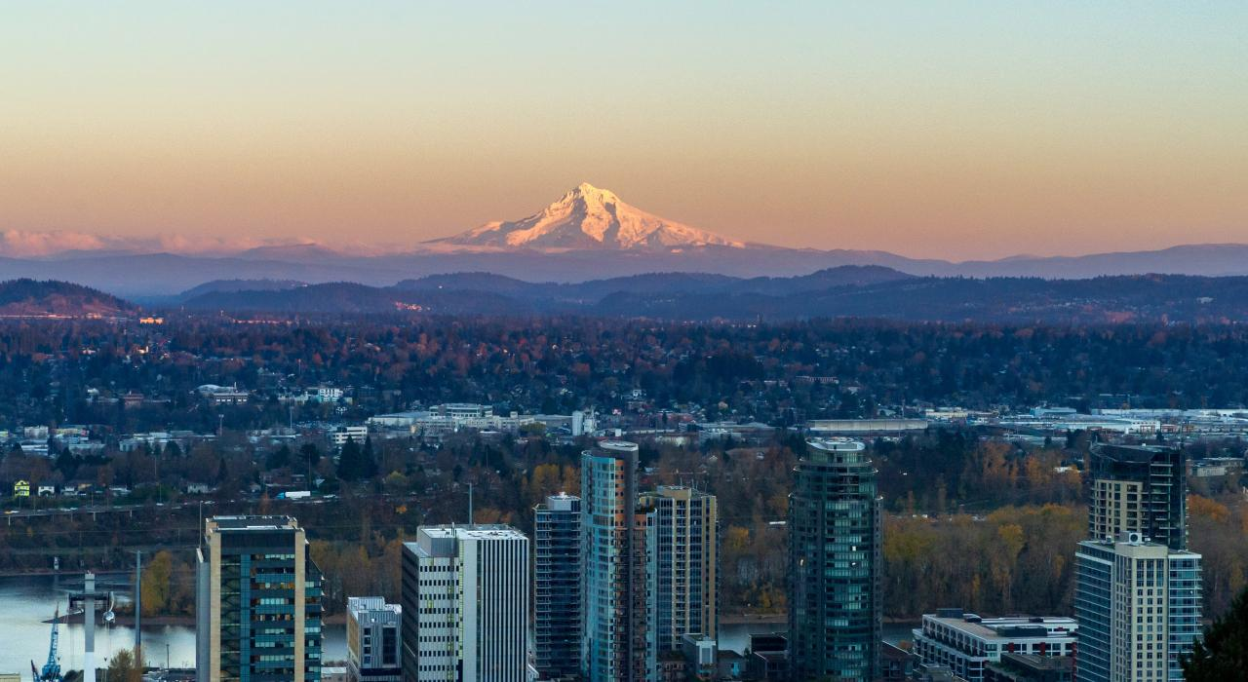
THANK YOU

