Slide 1
Parents, Advocates, and Schools:
A Collaborative Approach
Crystal Sanford, M.Ed., M.A. CCC-SLP, ASDCS

Slide 2

Welcome!!

Slide 3

Housekeeping
Please silence all cell phones
Respect those who are speaking (quiet voices)
After conference survey

Slide 4
Disclosure & Proprietary Information
Information presented today should not be construed as legal or medical advice. For guiding information regarding your specific case, please contact a legal or medical professional.
The information presented today is subject to change. Please do not depend on this information for an actual case.

Slide 5

Norms & Expectations
Here’s how to get the most out of today’s presentation:
Be present (physically and mentally)
Try on new ideas (keep what fits)
Please be patient with technology

Slide 6





A LITTLE ABOUT ME…

Slide 7
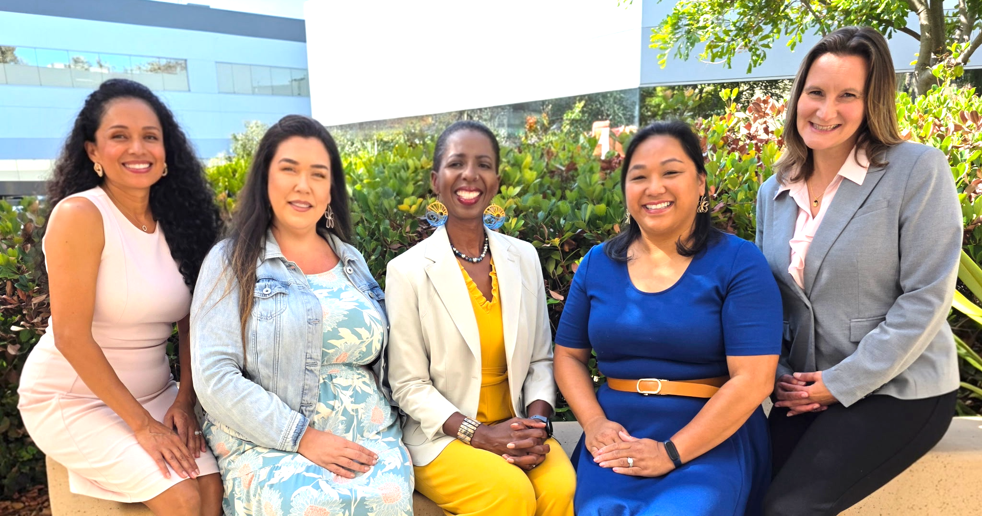
Our Presenter
Parent Of Autistic Child
Sibling with Unique Needs
Speech-Language Pathologist
Educational Consultant
Author
National Speaker
Owner, Sanford Autism Advocacy Group, LLC (2016)
Crystal Sanford, M.Ed., M.A. CCC-SLP, ASDCS

Slide 8

Learner Outcomes
*Examine the historical relationship between parents, advocates, and schools while identifying key patterns to continue or avoid.
*Understand at least three strategies to improve collaboration between parents, advocates, and schools.
*Develop a personal action plan to facilitate improved collaboration in the special education/IEP process.
*PARENTS: Determine if working with a special education advocate is required now or in the future along your special education journey.

Slide 9

Who is in the room today?
Parent of a child with an IEP (disabilities, neurodivergent, etc.)
School Staff (admin, teacher, related service provider, etc.)
Community Partner (advocate, attorney, volunteer, etc.)
You wear multiple hats (ex: parent and school staff)
Other

Slide 10

No matter where you are/who you are…today you will likely gain tools for your toolbox.

Slide 11

Members of a Special Education/IEP Team
Child
Parent
School Administrator
Case Manager
General Education Teacher
Related Service Provider
Outside/Private/Community Professionals

Slide 12

A Historical perspective: parents, advocates, and schools

Slide 13

Historical Perspective: Parents
2004 amendment to IDEA: Congress noted that the students who were the most successful were those whose parents had meaningful parent participation
Section 300.322 (IDEA) outlines parent participation, including notifying parents of meetings, providing copies of the IEP, and the use of interpreters
Notes:
Should be 10:10-10:15am. Always bring teams back to IDEA and FAPE when having difficulty navigating IEP meetings. Federal law and state law matters. Check the timeline video at your leisure.

Slide 14
Historical Perspective: Advocates (1)
IDEA exists because of community advocates, disability allies, etc. who demanded change in education the 1950s, 60s, and 70s
Organizations who have supported families along the way include: EasterSeals, The Arc, COPAA (Council of Parents, Attorneys, and Advocates), Wrightslaw.com (Peter Wright), CADRE, and PTI (Sped Parent Training and Information) Centers
Notes:
Should be 10:10-10:15am. Always bring teams back to IDEA and FAPE when having difficulty navigating IEP meetings. Federal law and state law matters. Check the timeline video at your leisure.

Slide 15
Historical Perspective: Advocates (2)
Non-Attorney Advocate: IEP Advocate, Special Education Advocate
Someone who understands IDEA/state laws and helps parents navigate the process
No nationally recognized, mandatory certification
Many advocates lean on their personal or professional experience; some have completed certification-based programs such as IEP Coach ©, SELAS, etc.
Closest monitoring organization is COPAA
Notes:
Should be 10:10-10:15am. Always bring teams back to IDEA and FAPE when having difficulty navigating IEP meetings. Federal law and state law matters. Check the timeline video at your leisure.

Slide 16

Historical Perspective: Schools
The Individuals with Disabilities Education Act (IDEA), originated in 1975 (Education for All Handicapped Children’s Act of 1975 or PL 94-142). It is our nation’s special education law. Most recent update=2004.
IDEA requires that schools find and provide a Free and Appropriate Public Education (FAPE) to students suspected of having a disability in the Least Restrictive Environment (LRE), at no cost to the caregiver. This education should emphasize “special education and related services designed to meet a student’s unique needs”. (Section 300.111)
Notes:
Should be 10:10-10:15am. Always bring teams back to IDEA and FAPE when having difficulty navigating IEP meetings. Federal law and state law matters. Check the timeline video at your leisure.

Slide 17

The Relationship Between P, A, S
QUESTION: When you think about the relationship between parents, advocates, and schools…what words come to mind?
Notes:
Take 3 to 4 answers from the audience

Slide 18

The Relationship between P, A, S (2)
Complex
Adversarial/Contention
Supportive/Connected
(Sharon Link, 2021; Reynolds et al., 2015)
Notes:
https://pmc.ncbi.nlm.nih.gov/articles/PMC12356156/

Slide 19
The Relationship between P, A, S (3)
Parents operating out of passion and “googled” special education knowledge; not feeling heard, ideas are dismissed (Kurth et al., 2020)
Advocates operating out of inaccurate or incomplete information; hidden agendas
Schools operating out of inaccurate or incomplete information regarding special education law; limited resources; outdated paradigms

Slide 20

The Relationship between P, A, S (4)
Best case scenario: Collaboration
Notes:
Take 3 to 4 answers from the audience

Slide 21
Why Collaboration? Parents
Slade, et al. (2018) found that parents who experienced “parent-school connectedness” reported the most overall IEP satisfaction, regardless of teachers’ years of experience
Sanderson & Goldman (2023) found that where parents reported some degree of satisfaction with their child’s IEP, parent/child/family/professional partnership was a significant factor
Notes:
Should be 10:10-10:15am. Always bring teams back to IDEA and FAPE when having difficulty navigating IEP meetings. Federal law and state law matters. Check the timeline video at your leisure.

Slide 22
Why Collaboration?
Students collaboration/respect/trust-→student success
(Greg Abell-expert mediation/conflict resolution in WA/coach/cadre consultant)

Slide 23
Why Collaboration? Students-2
Spann, et al. (2003); Newmann & Sconzert (2000), Barger et al (2019)
Greater generalization and maintenance of student treatment gains
Positively influences student attendance, homework completion, social/behavioral adjustment, and leadership skills

Slide 24

How to Facilitate Collaboration?

Slide 25

Trust- Building Practices
Trust- a central factor for promoting positive relationships between schools and parents
Schools/Teachers: read student IEPs and ask specific questions
Parents sharing relevant information related to students' unique profile

Slide 26
Trust- Building Practices 2
Follow Through: Consistency builds trust
Informing the IEP team that an advocate or parent support representative will be assisting in the meeting

Slide 27

Increase Transparency
Informing parents when challenging situations occur at school
Send a copy of the IEP/assessment repots prior to the meeting
Parents/Advocates: Share a brief meeting agenda with the school team
Notes:
Not after the fact, days later, or a parent hears from the child or someone else

Slide 28

Acknowledge and Embrace Parent Expertise

Slide 29

Foster
Open Communication
Provide progress reports related to IEP goals
Acknowledge parents’ concerns/requests
Acknowledge community or cultural barriers that may impact parent communication practices
Notes:
A parent may not be communicating with a teacher because culturally they have been taught not to question teachers and those in authority; parents may not be communicating because they are working 5 jobs

Slide 30
Foster Open Communication 2
Advocates can support parents in crafting written communication
Parents: use bullet points, concise language in written communication
Refrain from ALL CAPS, multiple emails/day, sending large video files

Slide 31

A Check for Understanding
Look at the following statements/scenarios and determine if they facilitate collaboration. If so, why or why not?

Slide 32
Trust-Building, Increase Transparency, Embrace Parent Expertise, Foster Open Communication-1
A parent asks about their student’s progress towards their IEP goal. The SLP responds “He’s doing fine. We’ll talk about it at the IEP meeting next month”

Slide 33
Trust-Building, Increase Transparency, Embrace Parent Expertise, Foster Open Communication-2
An advocate supports a client in adjusting their email to their case manager. It moves from 8 paragraphs to 5 succinct bullet points

Slide 34
Trust-Building, Increase Transparency, Embrace Parent Expertise, Foster Open Communication-3
A parent attempts to share about a strategy that works at home to reduce anxiety for their student. The teacher responds “That’s fine for you, but I know how to handle children in my classroom”

Slide 35
Facilitate Equal Understanding
Share and review
Share and review procedural safeguards annually
Provide
Provide information in the parents’ primary language and/or use an interpreter
Explain
Schools/Advocates: explain special education acronyms to parents

Slide 36

A thought for school staff…
Is there a “clear offer of FAPE” in the IEP?
If the student moves to another school, state, or district…will the provider in your position be able to easily understand the IEP with a clear picture of the student, services, etc.?
A parent must understand the offer in the IEP before they can legally consent.

Slide 37
Consider the POSITIVES-1
School Staff: What’s going well at school? Share with families
Unconditional Positive Regard (Carl Rogers, psychologist, 1957); “Believing the best” of others; considering that each team member is doing “the best they can with what they have”; you attract what you expect
Notes:
Meta analysis of studies fro 2008-2018 by Johnston, Wildy, and Shand revealed that when teachers set high expectations, their students follow suit

Slide 38
Consider the POSITIVES-2
All Parties: Focus on developing a “strength-based” IEP
Notes:
Meta analysis of studies fro 2008-2018 by Johnston, Wildy, and Shand revealed that when teachers set high expectations, their students follow suit

Slide 39
Defining Strength-Based IEPs
An approach that focuses on students’ strengths, preferences, interests, learning styles
Explain challenges as “matter of fact” (objective)
What can they do now? What do we want them to do next?

Slide 40
Why Write Strength-Based IEPs?-1
“We believe that adopting strength-based IEP writing practices is vital to reconstructing students with disabilities as capable contributors to their inclusive classrooms”
A way to naturally increase student motivation; higher investment in their educational and social-emotional growth

Slide 41
Why Write Strength-Based IEPs?-2
A way for teachers and families to become partners in a child’s learning
Weishaar, 2010; Elder, et. al, 2018

Slide 42

Promote a Culture of Shared Responsibility

Slide 43
Other Patterns that Facilitate Collaboration
Being loosely attached to outcomes: Consider multiple outcomes that you would be satisfied with; Leave room for “trial and error” if needed; lastly, some outcomes may take longer than expected (Ashley McGuire, National Conflict Resolution Center)

Slide 44
Other Patterns that Facilitate Collaboration-2
Release what’s “best”; Consider what’s appropriate to meet a child’s unique needs (FAPE); also, is the IEP “Reasonable”- even more objective, attempting to confer educational benefit, 12 months attainable progress (Endrew F. case, 2017)

Slide 45
“Best” vs “Reasonable”
Endrew F. v. Douglas County School District (March 2017) The U.S. Supreme Court issued a unanimous opinion, determining that “to meet it’s substantive obligation under IDEA, a school must offer an IEP that is reasonably calculated to enable a student to make progress appropriate in light of their unique circumstances”.

Slide 46

Facilitating Collaboration:
How to say it…
What would it look like if….?
How can I help…?
What makes you concerned about…?
Have you considered…?
Who will be responsible for…?

Slide 47
How Can YOU Facilitate Collaboration??
QUESTION: Identify 1-2 things you can do in your role as a school staff member, parent, advocate, etc. to facilitate collaboration in the IEP process?
Notes:
Partner or table talk, then share answers; 5-10 min

Slide 48
For Parents …
When should you consider involving an advocate along your IEP journey?
An impasse with your team
Limited acknowledgement of your concerns; concerns are pushed aside
You just want to learn more about your rights/your child’s rights to empower yourself

Slide 49

What to look for in an Advocate…
”Bridges the gap” between home & school
Collaborative, not combative
Deep knowledge of special education law (federal/state)
Life-long learner
School-based IEP experience
Solutions oriented

Slide 50
More For Parents …
When should you consider involving an attorney along your IEP journey?
Significant procedural violation
Significant denial of FAPE for your child
You’ve attempted negotiation, even with support, but to no avail
Your ability to “meaningfully participate” in your child’s education is repeatedly and purposefully impeded

Slide 51

“When resolving IEP disagreements, litigation should be a last resort”
~Art Cernosia, Esq., CADRE (Center for Appropriate Dispute Resolution in Special Education) Senior Consultant
Notes:
Some districts offer an ADR/IDR meeting

Slide 52
Final Thoughts
Federal law IDEA mandates FAPE in the LRE, based on each students’ unique needs/strengths.
The history of the relationship between schools, parents, and advocates is complicated and complex
Research shows us that collaboration is an important key to student success and parent satisfaction in the IEP process
Trust building, increasing communication, and equal understanding are a few ways to get there

Slide 53

Sanford Autism Advocacy Group, LLC (2025) (c)
"The strength of a child’s education lies in the partnership between parents and teachers (and advocates).”
~Anonymous

Slide 54

Questions and Answers

Slide 55


Let’s Connect
Crystal Sanford, M.Ed., M.A. CCC-SLP, ASDCS
www.sdautismhelp.com
info@sdautismhelp.com

