Slide 1



BUILDING CAPACITY FOR FAMILIES THROUGH PEATC’S DISPUTE RESOLUTION TOOLKITS
Equitable, Early, and Effective Solutions
PRESENTED BY
LOVE KINGSBURY

Slide 2





WHY EARLY RESOLUTION MATTERS
PREVENTS ESCALATION
BUILDS TRUST & RELATIONSHIPS
REDUCES STRESS/COSTS

Slide 3
OVERVIEW OF DISPUTE
RESOLUTION IN SPECIAL EDUCATION
  Prevention: Communication, Facilitation
  Resolution: Mediation, Complaints, Manifestation Determination Reviews (MDR)
  Adjudication: Due Process, Courts

Slide 4


PEATC DISPUTE RESOLUTION OVERVIEW

Slide 5

DISPUTE RESOLUTION GUIDE
AT-A-GLANCE RESOURCE FOR FAMILIES
COMPARES ALL PROCESSES SIDE-BY-SIDE
HELPS FAMILIES CHOOSE THE RIGHT OPTION
FREE AND ACCESSIBLE IN ENGLISH/SPANISH

Slide 6




PEATC’S TOOLKITS

Slide 7

MEDIATION TOOLKIT
SIMPLIFIES THE PROCESS
BUILDS COMMUNICATION SKILLS
PROMOTES RELATIONSHIP-BASED RESOLUTION
MODELS PROBLEM-SOLVING FRAMEWORKS

Slide 8

COMPLAINT TOOLKIT
DEMYSTIFIES LEGAL RIGHTS AND PROCEDURES
STRENGTHENS ADVOCACY THROUGH DOCUMENTATION
PROMOTES REFLECTION AND SELF-ASSESSMENT
REINFORCES ACCOUNTABILITY AND SYSTEMS CHANGE

Slide 9
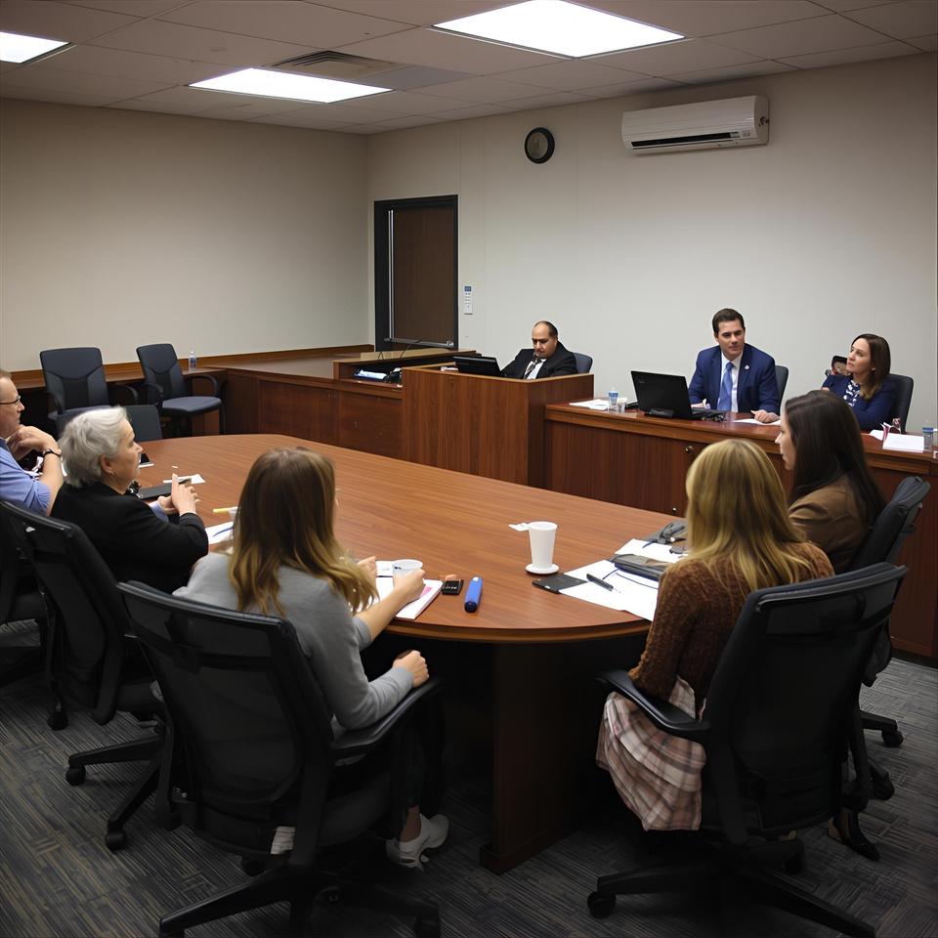
DUE PROCESS TOOLKIT
CLARIFIES A COMPLEX LEGAL OPTION
BUILDS CONFIDENCE IN PARTICIPATION
ENCOURAGES INFORMED DECISION-MAKING
PROVIDES TEMPLATES AND EXAMPLES

Slide 10

MANIFESTATION DETERMINATION REVIEW (MDR)
EDUCATES PARENTS ON DISCIPLINARY PROTECTIONS
EQUIPS PARENTS TO PARTICIPATE EFFECTIVELY
CONNECTS BEHAVIOR TO DISABILITY AND SUPPORTS
ENCOURAGES CONSTRUCTIVE ADVOCACY

Slide 11


INTERACTIVE CASE STUDY
ACTIVITY
REVIEW SCENARIO
APPLY TOOLKIT STRATEGIES
REPORT BACK

Slide 12



MEET THE RIVERA FAMILY
  Lucas (Age 9) has ADHD and a specific learning disabiltiy in reading.
  Lucas receives specialized reading instruction and small-group testing accommodations.
  Parents report missed services and recent disciplinary removals, including an 11-day suspension.
  The Riveras are frustrated and unsure what to do next.
HOW WOULD YOU GUIDE THIS FAMILY?

Slide 13





DECISION POINT 1
COMMUNICATION BREAKDOWN
After an emotional IEP meeting, the Riveras are considering filing a complaint.
EXPLORATION OF INTERESTS
SKILL DEVELOPMENT
COLLABORATION

Slide 14


DECISION POINT 2
MANIFESTATION DETERMINATION REVIEW (MDR)
Lucas has been suspended for 11 consecutive days; an MDR is scheduled.
What rights and supports does the MDR process provide?

Slide 15

DECISION POINT 3:
CONSIDERING DUE PROCESS
WHAT FAMILIES SHOULD DO BEFORE FILING
HOW PROFESSIONALS CAN EXPLORE OPTIONS

Slide 16
BUILDING CAPACITY FOR FAMILIES
INCREASE KNOWLEDGE AND UNDERSTANDING OF RIGHTS
STRENGHTEN ADVOCACY AND PROBLEM-SOLVING SKILLS
Each toolkit explains complex special education laws (IDEA and Virginia regulations) in clear, accessible language.
The toolkits walk families step-by-step through each process - showing them how to identify issues, organize documentation, and communicate concerns effectively.
PROMOTE EARLY AND COLLABORATIVE RESOLUTION
EMPOWER FAMILIES TO NAVIGATE SYSTEMS INDEPENDENTLY
By focusing on communication, relationship-building, and understanding the range of dispute resolution options, the toolkits encourage families to address problems early and collaboratively.
The toolkits provide checklists, sample letters, forms, and examples to guide families through real scenarios.

Slide 17
BUILDING CAPACITY FOR PROFESSIONALS
BUILDING CAPACITY
EMPOWERING FAMILIES
The toolkits provide clear explanations, timelines, and sample langue that makes it easier for professionals to communicate accurate, consistent information.
When professionals walk through the toolkits with families, they help demystify complex systems and promote informed decision-making.
INTEGRATING RESOURCES INTO DAILY WORK
NEW STRATEGIES
The toolkits offer ready-to-use resources that professionals can easily incorporate into consultations, trainings, or meetings.
The toolkits encourage early problem solving, proactive communication, and practices that help professionals guide families towards positive outcomes.

Slide 18





THANK YOU
703-559-8210
lkingsbury@peatc.org
www.peatc.org

