Slide 1
Digging Deep Into Data: Best Practices in Understanding a Psycho-Educational Evaluation
Sara E. Rich, PhD, NCSP and Brit’ny Stein, PhD, NCSP
February 6, 2024
CADRE
1

Slide 2
Introductions
2

Slide 3
Objectives
Learn a framework for reviewing assessment reports
Develop an understanding of different educational assessment data and their uses
3

Slide 4
Purpose of Evaluation
Identification, Needs, & Programming
4

Slide 5
Purpose of Evaluation According to IDEA
To determine if the child is a “child with a disability,” as defined by IDEA
To gather information that will help determine the child’s educational needs
To guide decision making about appropriate educational programming for the child
^{1. 34 CFR § 300.8}
5

Slide 6
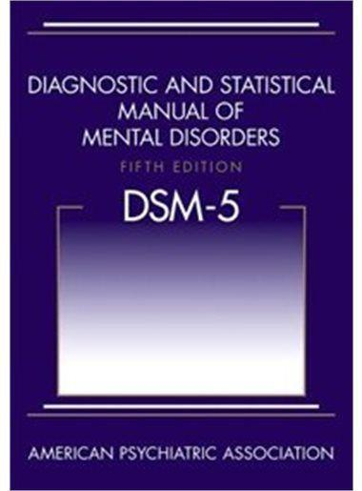
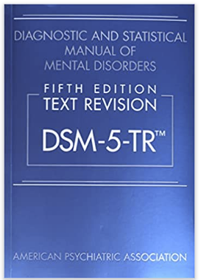
Medical Mental Health
vs
Educational Evaluations and Diagnoses
DSM (Medical/ Mental Health)
IDEA (Educational)
Diagnosis.
Meets DSM criteria for disorder.
Licensed medical professional: MD, DO, PhD (psychologist).
IEP ≠ Medical Diagnosis
Categorization for services.
Meets criteria for disability (medical or educational) AND has an educational need.
IEP Team with a qualified examiner (i.e., school psychologist).
Medical diagnosis ≠ IEP.
Notes:
These two systems use different language in their diagnostic criteria, which leads to misunderstandings and frustrations by the parents and educators. To facilitate communication, I recommend focusing on the behavioral terms and objective descriptions of the issues. For example, a child may have a diagnosis of Disruptive Mood Dysregulation Disorder, which is not anywhere in the IDEA criteria. However, the IDEA does indicate emotional disturbance include “Inappropriate types of behavior or feelings under normal circumstances.” which is similar to the DSM diagnostic feature of DMDD The tantrums/outbursts are considered out of proportion (in duration and intensity) to the situation or triggering event and The irritable/angry mood occurs nearly every day, for most of the day. Really have to move beyond the diagnostic label and into the diagnostic criteria.

Slide 7
Tests, Assessments, and Evaluations
The process of using tests in assessments as part of the overall evaluation framework
7

Slide 8
Evaluation versus Assessment
Assessments are the individual procedures used to determine levels of performance and current functioning.
Assessments can be used across a variety of contexts including classroom assessments, screening tools, and standardized individualized assessments.
Evaluation is the process of determining a students’ needs.
Evaluations are made of a set of assessment procedures.
“Evaluation” usually refers to Special Education Evaluations.
8

Slide 9
Assessment versus Test
Assessments and tests are not synonymous, but sometimes used interchangeably.
Tests are tools administered to determine a specific level of skills, performance, or functioning based on a pre-set criteria or norm-reference.
Assessment procedures usually include administering different tests, as well as other data collection processes.
9

Slide 10
Evaluation, Assessments, and Tests -1
Tests
Tools administered as part of an assessment process
Assessment
Procedure made up of testing tools and other processes to gather data
Evaluation
Process of analyzing data from assessment procedures to make conclusions about needs, strengths, and recommendations
10

Slide 11
Evaluation, Assessments, and Tests -2
Tests
Tools administered as part of an assessment process
Assessment
Procedure made up of testing tools and other processes to gather data
Evaluation
Process of analyzing data from assessment procedures to make conclusions about needs, strengths, and recommendations
11

Slide 12
Evaluation, Assessments, and Tests -3
Tests
Tools administered as part of an assessment process
Assessment
Procedure made up of testing tools and other processes to gather data
Evaluation
Process of analyzing data from assessment procedures to make conclusions about needs, strengths, and recommendations
12

Slide 13
Assessment Procedures (RIOT)
Record Review: Review of educational records, background information, discipline records medical information
Interview: Interviews with relevant individuals, including parents/guardians, teachers, and students
Observations: Many different types of observations. Should produce data on frequency, intensity, and context of the problem. Also includes observations to determine validity of assessment results
Testing
Rating forms: Measures perception of experiences, not direct behaviors.
Standardized assessments: Either direct measurement of skills or measurement of theoretically relevant skills.
13
Notes:
Related to observations: Observations are a broad category and may be done in lots of different ways. Observations of the student in the classroom can confirm 1) is the student actively engaged in learning activities, 2) how does the student’s behavior compare to their peers, 3) how much support is the student receiving from the teacher, and 4) context for any identified behavior difficulties. Observations are critical and should be included in all assessments. In a clinical setting, these observations will be less formal and relate more to how much they engaged in the assessment process.
I give more weight to direct observations than I do to rating forms. Rating forms are a sampling of the perception of behavior, and observations are a direct measure of the behavior. However, caution should be used if only one observation was conducted and it is not in alignment with other data.
Ultimately, we are looking for a synthesis of all data collected.

Slide 14
Commonly Used Tests
Commonly used tests in schools and their purpose
14

Slide 15
Types of Commonly Used Tests - 1 -1
Standardized Individual Assessments
Assessments administered to individual students that measure broad set of skills. Examples include:
IQ/Cognitive assessments
Standardized achievement assessments
Neuropsychology assessments
Speech and language assessments
15

Slide 16
Types of Commonly Used Tests -- 21
Rating Forms
Standardized measures that require respondents to rate different dimensions of behavior. Examples of rating form dimensions include:
Behavior rating scales
Adaptive behavior ratings
Personality assessments
Mood ratings
Ratings of behaviors associated with specific diagnoses/categories
16

Slide 17
Types of Commonly Used Tests --31
Individual Skill Curriculum Assessments/Measurement
Assessments that measure a specific academic skills. These assessments are useful in identifying skills for intervention, as well as progress monitoring growth of skills. Examples of curriculum-based assessment include:
Nonsense Word Reading Fluency assessment
Oral Reading Fluency assessment
Math Computation Sums to 9 assessment
17

Slide 18
Types of Commonly Used Tests -1-4
Computer Adaptive Tests
Computer based assessment of academic skills that adapts as the student completes the assessment. Assesses a variety of skill levels within one assessment. The assessment calibrates to the student's level based on their responses. Example computer adaptive assessments include:
STAR Reading and Math
NWEA MAP
18

Slide 19
What does “standardization” mean?
19

Slide 20
Standardization
Standardized assessments have specific administration directions that must be followed.
Standardization usually includes:
Protocol/record forms used
Physical Environment
Verbatim directions and responses to students
Scoring procedures
Standardized tests are interpreted via norm or criterion references
20

Slide 21
What is norm and criterion reference?
21

Slide 22
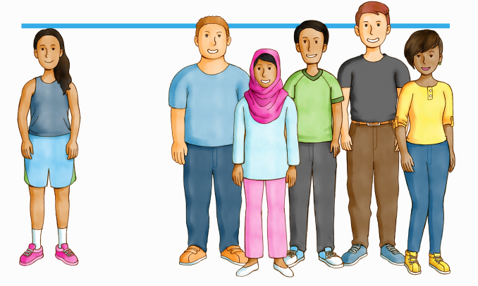
Criterion and Norm referenced testing
Criterion-Referenced
Norm-Referenced
Criterion-referenced tests compare a student’s knowledge and skills against a predetermined standard, cut-score, or criterion
Norm-referenced tests compare a student’s performance against the performance of their peers
Images from Renaissance: https://www.renaissance.com/2018/07/11/blog-criterion-referenced-tests-norm-referenced-tests/

Slide 23
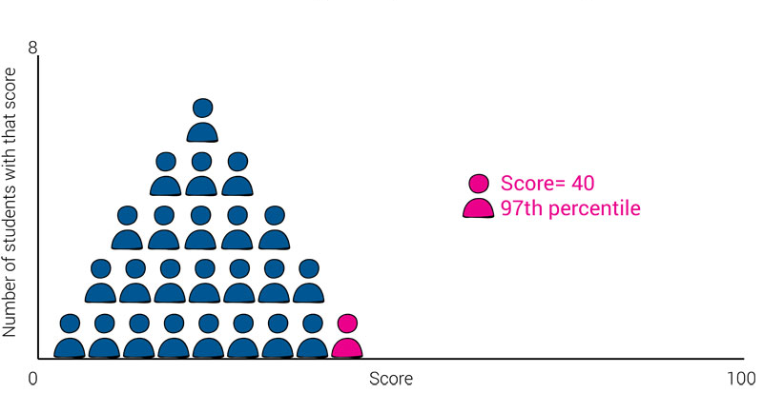
Norm-Referenced Score Example 1
On a norm-referenced test, an individual student’s percentile rank is calculating according to the performance of their peers.
Renaissance, 2018
23

Slide 24
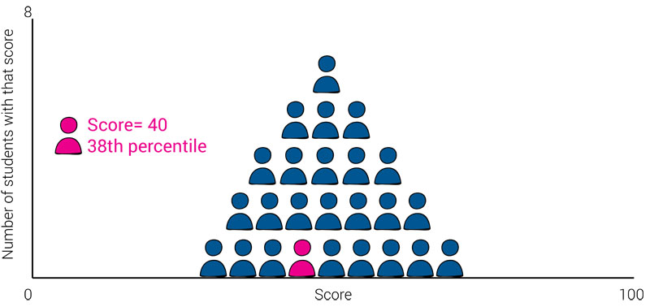
Norm-Referenced Score Example 2
Renaissance, 2018
24

Slide 25
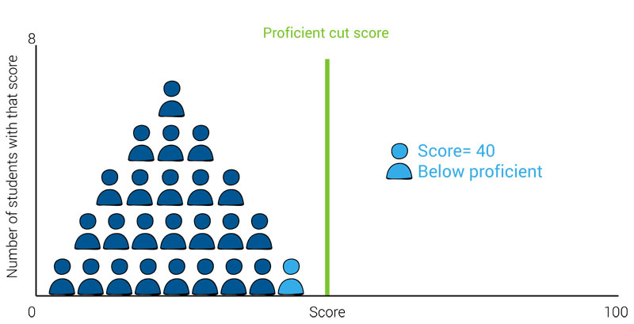
Criterion-Referenced Score Example 1
On a criterion-referenced test, an individual student’s score is not affected by the performance of their peers.
Renaissance, 2018
25

Slide 26
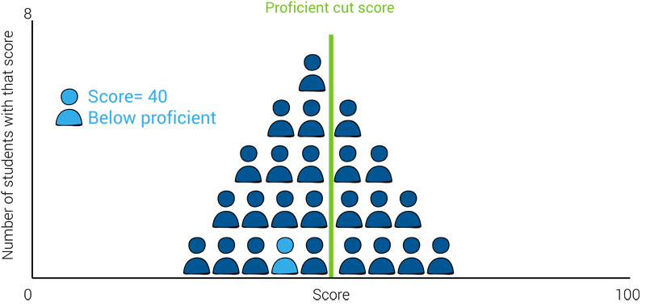
Criterion-Referenced Score Example 2
Renaissance, 2018
26

Slide 27
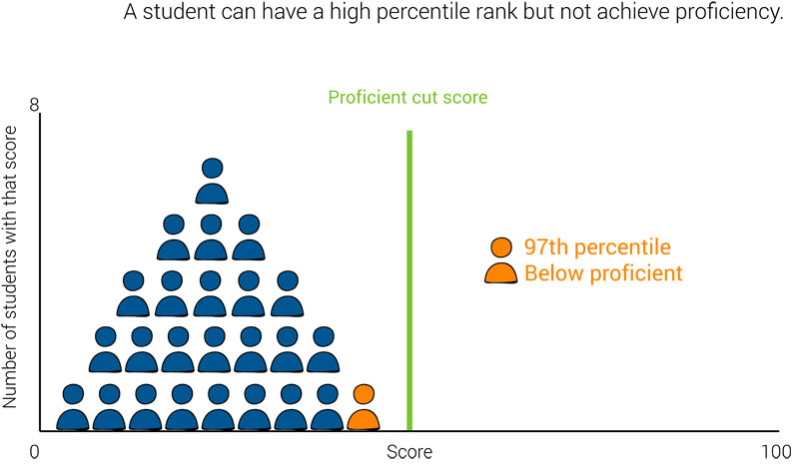
Norm and Criterion Reference Score Example 1
A student can have a high percentile rank but not achieve proficiency
27
Renaissance, 2018

Slide 28
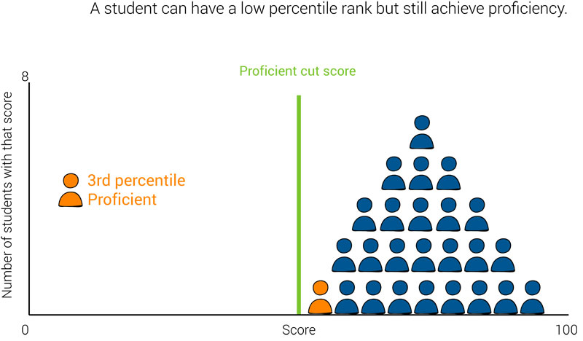
Norm and Criterion Reference Score Example 2
A student can have a low percentile rank but still achieve proficiency
Renaissance, 2018
28

Slide 29
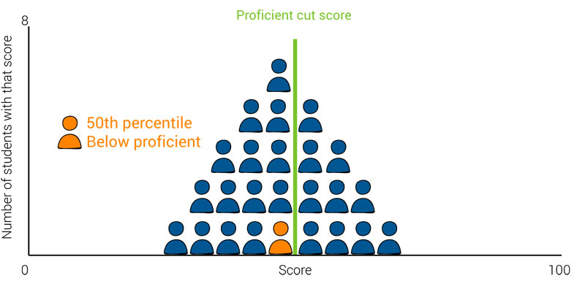
Norm and Criterion Reference Score Example 3 (more realistic)
A student may be “typical” according to their norm-reference measures but not achieve proficiency according to criterion-reference measures
Renaissance, 2018
29

Slide 30
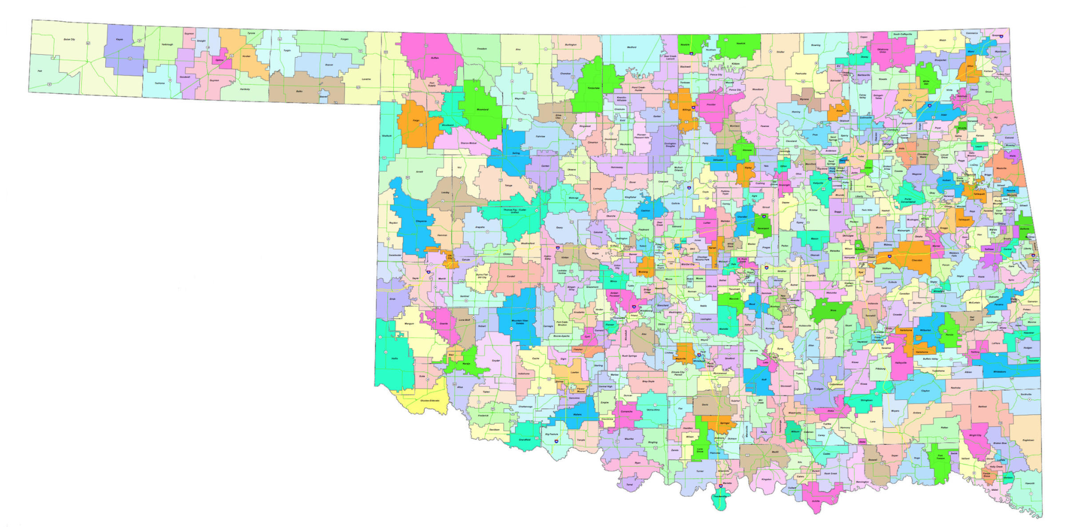
National versus Local Norms and Criteria
Local Norms & Criteria
National Norms & Criteria
National norms are based on performance on a group that SHOULD be similar to the schools’ students.
National criteria are set based on research and theoretical frameworks
Local norms are developed using the schools’ own population of students.
Local criteria are set based on previous performance from the schools’ own students.

Slide 31
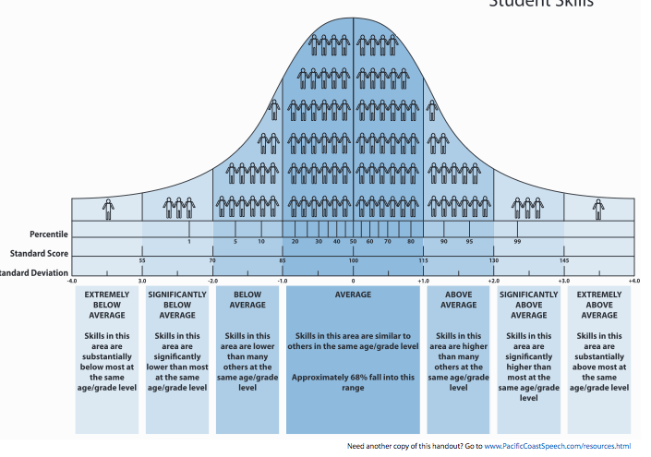
Standard distribution of Student Skills
Normal Curve for Norm Reference
31

Slide 32
Types of Scores
Score | Definition | Interpretation
Raw Scores | Actual number of points or tasks | Only useful when there is a criterion-reference point.
Standardized Score | Distance of raw score above or below the mean relative to norm group | “Standard Score of 100 indicates average level of performance”
Percentile Ranks | Describe rank relative to others in the norm group | “Percentile rank of 50, indicates they scored at or above 50% of others in the same age group.”
*Grade/Age Equivalents | Indicate the same raw score (not skill) as an average student at that same age/grade | “Scored the same number of problems correct as the average 3rd grade student.”
32

Slide 33
Grade Equivalents
Indicate the same raw score (not skill) as an average student at that same age/grade.
For example, a GE of 3.9 indicates that the student’s raw score for the test was the same as the average raw score for the group of students in the ninth month of third grade on whom the test was normed.
At best, a grade (or age) equivalent score can tell if that student’s raw score is similar to other raw scores in that grade (or age) group. It does not give you an indicator of actual level of skills.
33

Slide 34
From KTEA-3 Manual
“Grade Equivalents do not indicate the curriculum level at which at student is working. Grade equivalents are not related to what students at a particular grade ought to be capable of performing or what they are being taught. Similarly, age equivalents do not indicate what students at a particular age ought to be capable of performing. Rather, grade and age equivalents are based entirely on the median performance of students at each grade or age, respectively, on the KTEA-3 subtests.”
34

Slide 35
Standardized Scores
Score | Interpretation | Typical Use
Standard Score (SS) | Mean of 100, SD of 15 Average range: 85-115 | Broad summary scores of IQ, achievement, and communication tests
Scale Scores (S) | Mean of 10, SD of 3 Average range: 7 - 13 | Individual subtest scores
T-Scores Ranks | Mean of 50, SD of 10 Average range: 40 - 60 | Rating forms of behavior Caution for interpretation because “high scores” may indicate more problems
35

Slide 36
What are commonly used tests?
36

Slide 37
Common Individual Standardized Tests
Academic/Achievement
KTEA-3, 2014
WIAT-4, 2020
WJ-IV Ach, 2014
WRAT-5, 2017
Full Cognitive
K-ABC-II (NU), 2018
WISC-V, 2015
WPPSI-IV, 2012
WJ-IV-Cog, 2014
*Stanford-Binet-5, 2003
Developmental
Bayley-4, 2019
BBCS-4:R, 2022
DAYC-2, 2012
DIAL-4, 2011
WJ-ECAD, 2014
Communication
CASL-2, 2017
CELF-4, 2004
EVT-3, 2018
GFTA-3, 2015
PLS-5, 2010
PPVT-5, 2018
Nonverbal Cognitive
CTONI-2, 2009
Leiter-3, 2013
TONI-4, 2010
UNIT-2, 2018
Autism
ADI-R, 2003
ADOS-2, 2012
CARS-2, 2010
37

Slide 38
Common Standardized Rating Forms
Adaptive Behavior
ABAS-3, 2015
Vineland-3, 2016
Autism
ASRS, 2009
GARS-3, 2013
SRS-2, 2012
Behavior
BASC-3, 2015
BRIEF-2, 2015
Conners-4, 2023
CBRS, 2008
Conners-EC, 2009
Personality
MMPI-A-RF, 2016
M-PACI, 2005
Emotional
BYI-2, 2005
CDI-2, 2010
MASC-2, 2012
RCMAS-2, 2008
Developmental
DP-4, 2020
DBC-2, 2018
38

Slide 39
Common Curriculum Based Measurements
Early Reading Skills
First sound fluency
Nonsense word fluency
Phoneme segmentation fluency
Letter sound fluency
Early Math skills
Quantity discrimination
Number fluency
Number sequencing
CBM Assessment Systems
DIBELS/Acadience
Aimsweb
Fast-Bridge
Easy CBM
Amira
Some CAT systems have added CBM, such as STAR
Some CBMs have added CAT including Fast-Bridge and Aimsweb
Reading/Writing skills
Oral Reading Fluency
MAZE (fill in blank-comprehension)
Spelling
Written expression
Math
Math computation
Concepts and applications
39

Slide 40
How should the different assessments be used in evaluations?
40

Slide 41
How different assessment tools are used-1
Disability Identification
Almost always uses norm-referenced data.
May include criterion reference data.
May include intervention progress monitoring data to evaluate response to interventions.
Needs
Identification
Criterion-based and absolute levels of performance.
Standardized scores only identify broad areas of deficits
CAT or CBM assessment may be used for this
Goal is Identify specific skills for intervention
Monitoring
Progress
Measure a specific skill development over time.
Criterion-based assessments, same as what was used to identify needs or baseline performance
41

Slide 42
How different assessment tools are used-2
Disability Identification
Almost always uses norm-referenced data.
May include criterion reference data.
May include intervention progress monitoring data to evaluate response to interventions.
Criterion-based and absolute levels of performance..
Standardized scores only identify broad areas of deficits.
CAT or CBM assessment may be used for this.
Goal is Identify specific skills for intervention.
Needs
Identification
Monitoring
Progress
Measure a specific skill development over time.
Criterion-based assessments, same as what was used to identify needs or baseline performance.
42

Slide 43
How different assessment tools are used-3
Disability Identification
Almost always uses norm-referenced data.
May include criterion reference data.
May include intervention progress monitoring data to evaluate response to interventions.
Criterion-based and absolute levels of performance..
Standardized scores only identify broad areas of deficits.
CAT or CBM assessment may be used for this.
Goal is Identify specific skills for intervention.
Needs
Identification
Monitoring
Progress
Measure a specific skill development over time.
Criterion-based assessments, same as what was used to identify needs or baseline performance.
43

Slide 44
Example Standardized Scores
6-year-old female- re-evaluated for intellectual disability
Full Scale IQ: Standard Score = 69 (Extremely Low Range)
95% Confidence Interval = 65-76
Percentile Rank: 2
Verbal Reasoning: Standard Score = 66 (Extremely Low Range)
Fluid Reasoning: Standard Score = 79 (Borderline-Low range)
44
Notes:
What does this tell us? What type of educational decision could be made with this data?

Slide 45
Assessment of Growth with Norm Referenced
Time 1 | Time 2 | Time 3
45

Slide 46
Example Curriculum Based Assessments
6-year-old female- re-evaluated for intellectual disability
Letter sound fluency assessment
Goal: 30 letters correct per minute
Performance: 10 letters correct per minute
46
Notes:
What does this tell us? What type of educational decision could be made with this data?

Slide 47
Assessment of Growth with Criterion Referenced
Time 1 | Time 2 | Time 3
47

Slide 48
Example Curriculum Based Assessments-Graph
Letter sound intervention administered, and this is her progress:
48
Notes:
What does this tell us? What type of educational decision could be made with this data?

Slide 49
Key Take Aways
Tests are individual tools that are used in assessments, and assessments are the procedures used in an evaluation.
When examining test results in a report, it is important to understand if norm-referenced or criterion referenced scores were used.
Individual standardized assessments are useful for disability identification, curriculum-based assessments are better for identify skill deficits.
49

Slide 50
Recommended Resources
Books:
Assessment of disorders in childhood and adolescence. Younstrom, Prinstein, Mash, and Barkley. Guilford Publications.
Guidance Documents:
Principles for SLD Eligibility: Practice & Policy Considerations for States and School Districts Procedures/assessments used for the evaluation.
50

Slide 51
Wrap up
Sara Rich, PhD, HSP, NCSP
Clinical Assistant Professor, OSU-CHS
OSU BRIDGE Center Co-Director
sara.e.house@okstate.edu
Brit’ny Stein, PhD, HSP, NCSP
Clinical Assistant Professor, OSU-CHS
OSU BRIDGE Center Director of Technical Assistance
britny.stein@okstate.edu
Questions?
Thank you!
51

