Slide 1
The State Needs What?: Due Process Compliance for State Agencies under IDEA

Slide 2
Welcome and About Us
Education Resolutions LLC, 2019-Present
U.S. Department of Interior, Office of the Solicitor 2021-2023
Vermont Agency of Education, IDEA HO, 2019-Present
U.S. Department of Education, OCR Attorney, 2015-2021
Oregon Dept. of Education, DR Coordinator, 2011--2015
General and Special Education Teacher, 2002-2010
Claudette
CADRE - National Center for Dispute Resolution - Director, 2017 to present
Idaho Dept. of Education, DR Coordinator, 2010-17
College of Western Idaho, Ombuds, 2009-2010
Boise State University, Professor Emerita, 1992-2009
Mediator and mediator trainer, 1986 to present
Melanie
2

Slide 3
Agenda
Federal Oversight of IDEA Formula Grants
Regulatory Responsibilities of the State Agencies
OSEP’s “New” Differentiated Monitoring Support System (DMS 2.0)
Examples of Noncompliance in Due Process
Resources
3

Slide 4
Federal Oversight of IDEA Formula Grants
The IDEA authorizes formula grants to states to support special education and related services and early intervention services.
The Office of Special Education Programs (OSEP) administers the grant programs:
Grants to States: Part B, Section 611 for children ages 3-21
Preschool Grants: Part B, Section 619 for ages 3-5
Grants for Infants and Families: Part C, birth through age 2
4

Slide 5
The Myth of the Great Wall
5

Slide 6
Regulatory Responsibilities of the State Education Agency/Lead Agency
Under the IDEA, each State Agency (SEA & LA) is required to establish, implement, and maintain procedural safeguards related to due process hearings.
The State must effectively and efficiently administer due process complaints and hearings by:
having written procedures that align with IDEA;
overseeing an infrastructure to support the case management, data collection, federal reporting requirements, and implementation of due process complaints and hearings;
maintaining a list of trained and impartial hearing officers that align practices and decisions with federal and State law.

Slide 7
Federal Regulatory Requirements for State Agencies tied to IDEA Formula Grants 34 C.F.R. §§ 300.500, 300.100, 303.101-102
OSEP monitors all IDEA Part C and B programs through its Differentiated Monitoring and Support system (DMS) – a cyclical monitoring process that focuses on states’ general supervision systems.
OSEP will examine state polices and procedures and implementation of 1. Monitoring and Improvement 2. Data 3. Fiscal 4. Dispute Resolution.
The State Education Agency (Part B) or Lead Agency (Part C) must establish, implement and maintain procedural safeguards related to due process hearings (DPH) of the IDEA.
7

Slide 8
Supremacy Clause
U.S. Constitution, Article VI, Paragraph 2, establishes that the federal constitution, and federal law generally, take precedence over state laws and state constitutions.
In other words,
State Administrative Rules are fine,
but if they conflict with IDEA,
the State will be out of compliance if they
do not follow the IDEA.
8

Slide 9
DMS 2.0 – Selected Protocols Related to Due Process Hearings
How does the State ensure that hearing officers have the necessary knowledge and ability to conduct due process hearings and issue written decisions? 34 C.F.R. § 300.511; 34 C.F.R §§ 303.435 and 303.443
How does the State ensure the impartiality of the due process hearing officers? 34 C.F.R. § 300.511; 34 C.F.R §§ 303.435 and 303.443; Question C-15 of the IDEA Part B Dispute Resolution Q&A (July 2013)
How does the State ensure that written due process hearing decisions are issued within required timelines? 34 C.F.R. §§ 300.510, 300.515, and 300.532; 34 C.F.R §§ 303.430 and 303.437
How does the State ensure that expedited due process hearings are implemented consistently with IDEA requirements? 34 C.F.R. § 300.532 Questions E-6 and E-7 of the IDEA Part B Dispute Resolution Q&A (July 2013)
How does the State ensure the implementation of due process hearing officer decisions? 34 C.F.R. §§ 300.149 and 300.600; 34 C.F.R. §§ 303.120 and 303.700; Question C-26 of the IDEA Part B Dispute Resolution Q&A (July 2013)
9

Slide 10
DMS 2.0 – OSEP Reports
Find the reports on the OSEP site:
Part B Differentiated Monitoring and Support Reports
https://www2.ed.gov/fund/data/report/idea/dmsrpts/index.html#partb-dms
Part C Differentiated Monitoring and Support Reports
https://www2.ed.gov/fund/data/report/idea/dmsrpts/index.html#partc-dms
10

Slide 11
Findings of States’ Noncompliance by OSEP Related to Due Process Systems
11

Slide 12
Findings Related to DPH and State Complaints
A State set aside issues in a State complaint that were also subject to a DPH.
But the State did not have a mechanism for resolving those issues after a hearing officer dismissed the DP or did not rule on the substance of the complaint.
A State relied on parties to notify them that the DPH did not address the issue.
12

Slide 13
What do the Regulations Say about Dual Filings?
If a due process complaint is filed on an issue that is also the subject of a State complaint, the State must set aside any part of the State complaint that is being addressed in the due process hearing until the hearing officer issues a final decision. However, any issue in the State complaint that is not part of the due process action must be resolved using the 60-day time limit and procedures described in §300.152(a) and (b) [34 CFR §300.152(c)(1)].
How does your State ensure that issues in a pending State complaint are not also the subject of an open due process complaint?
How is the State informed of any issue not part of the due process action in order to resolve it through the State complaint procedures?
13

Slide 14
Findings Related to the 15-day Resolution Meeting
Staff informed OSEP that it runs the resolution meeting timeline concurrent or within the 45-day due process timeline, and therefore was not providing for a separate resolution period.
As a result, the State had no method in place to determine whether LEAs have met the timeline to convene a resolution meeting as required or to determine the beginning of the due process hearing timelines.
14

Slide 15
What do the Regulations Say about Resolution Meetings?
Under 34 C.F.R. § 300.510(a), the agency (LEA) must convene a resolution meeting no later than 15 days of receiving notice of the parent’s due process complaint, and prior to the initiation of a due process hearing under 34 C.F.R. § 300.511.
In your state, does the local agency report to the hearing officer the status of the resolution meeting? If so, how is that communicated to the state agency?
While not addressed in the finding, how are settlement agreements, if reached, communicated to the state agency? Do hearing officers report to the state when a case is dismissed or withdrawn?

Slide 16
Findings Related to the 45-day Timeline
A State did not have a mechanism to determine precisely when the 45-day hearing timeline began following a failed mediation.
16

Slide 17
What do the Regulations Say about when the 45-day timeline begins?
The resolution period is 30-days from the receipt of the parent’s due process complaint, but the period may be adjusted if:
Both parties agree in writing to waive the resolution period;
After either mediation or resolution meeting starts, but before the end of the 30-day period, the parties agree in writing that no agreement is possible; or
Both parties agree in writing to continue the mediation at the end of the 30-day resolution period, but later a party withdraws from the mediation process. [34 CFR §300.510(c)(2-3)].
Also See: 34 CFR §§ 300.510(a), 300.510(b), 300.515(a), 303.430
1. How is the State informed of any adjustments to the 30-day resolution period that is communicated to the ALJ/HO?
2. Would you treat settlement negotiations or settlement conferences the same as mediation? How does your state agency determine mediation is occurring? Is it only state-sponsored mediation that applies to extending the 30 day period?
3. The regs require a Written Settlement Agreement to be signed by the parent and agency. How does the HO verify this is a legally binding agreement per 300.510?
17

Slide 18
Findings Related to Extensions
States have been found out of compliance for allowing extensions that:
Were for an unspecified period of time (open ended)
Made for administrative convenience, not at the request of a party
Were not ensured as timely hearing decisions by the state 34 C.F.R. § 300.515
Not tracked by the State
Made in Expedited DPH
18

Slide 19
What’s your State’s Process for Monitoring Extensions?
The State must ensure that not later that 45-days after expiration of the 30-day resolution period (or adjusted time period) – (FOR PART B only)
A final decision is reached in the hearing; and
A copy of the decision is mailed to each of the parties.
A hearing officer may grant specific extensions of time beyond the periods at the request of either party. See: 34 CFR §§ 300.515, 300.516, 300.532, 303.447
Questions OSEP may ask your State
What are the circumstances that would warrant an extension?
How does the State ensure that the extension is for a specific period of time?
Does the State have any additional limitations or criteria for extensions?
How is the length of the extension recorded? Tracked?
If the State finds that a hearing officer is inappropriately extending timelines, or issuing too many extensions, what action is taken?
19

Slide 20
Findings Related to Implementation
Staff reported they did not have a formal mechanism in place to ensure that hearing decisions are implemented in a timely manner. 34 C.F.R. §§ 300.511-300.514.
Staff indicated they may hear from a parent if the hearing decision was not implemented, and that if they become aware, staff will follow up with the LEA to address the issue.
No evidence of the State using any appropriate enforcement actions consistent with its general supervisory responsibility to achieve compliance from the LEA, if needed. 34 C.F.R. §§ 300.149, 300.600 and 300.608
20

Slide 21
What do the Regulations Say about Enforcing Hearing Decisions?
OSEP cited the State’s General Supervisory Responsibility in their finding. 34 C.F.R. § 300.600 (See also §§ 300.149, 300.608)
The State must—
monitor the implementation
enforce using appropriate enforcement mechanisms
ensure agencies meet the program requirements with a particular emphasis on those requirements that are most closely related to improving educational results for children with disabilities.
ensure that when it identifies noncompliance with the requirements of this part by LEAs, the noncompliance is corrected as soon as possible, and in no case later than one year after the State's identification of the noncompliance.
How does the hearing decision get to the state agency?
What is the timeline?
Where is the record maintained?

Slide 22
What’s Your State’s Process for Maintaining a Qualified Roster?
Each State must keep a list of the persons who conduct DPHs, including their qualifications [34 CFR §300.511(c)(3)].
At minimum, a HO must:
Not be an employee of the SEA/LEA involved in the education of the child or have personal or professional interest that conflicts with the person’s objectivity in the hearing;
Possess knowledge of and the ability to understand the provisions of the Act, Federal and State regulations pertaining to the Act, and legal interpretations of the Act by Federal and State courts;
Possess the knowledge and ability to conduct hearings in accordance with appropriate, standard legal practice; and
Possess the knowledge and ability to render and write decisions in accordance with appropriate, standard legal practice [34 CFR §300.511(c)(1)]
22

Slide 23
Training and Support of DPH Roster
States have the discretion to determine the required training and frequency of training consistent with State rules and procedures [71 Federal Register, August 14, 2006, pg. 46705].
What initial and ongoing training and support is provided to IDEA hearing officers to ensure necessary knowledge of the IDEA?
How are training needs determined by and/or communicated to the State?
23

Slide 24
What are the communication mechanisms for the State and ALJ/HO
Generally?
Sharing Data
System Improvement
Professional Development
During cases?
Communicating about Timelines
Procedural Issues (translators? Zoom support? accommodations?)
What other considerations for contracting with SEAs?
Transcripts of DP Hearings
Licensure
Attorney Ethics Requirements
Accessibility Work
24

Slide 25
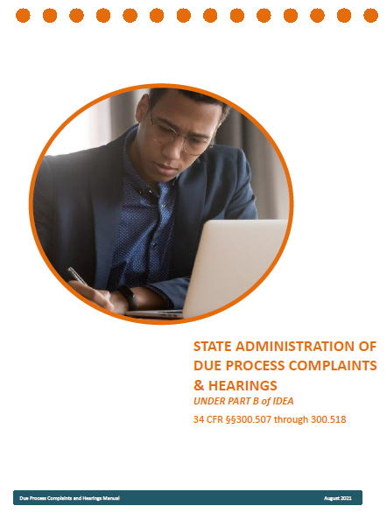
Dispute Resolution Coordination and Leadership Suite
Featuring the Due Process Complaints and Hearings State Process Manual
Created in Collaboration with Art Cernosia and Reviewed by OSEP

Slide 26
States’ Part C DPH Procedures
For Part C Due Process Hearings, states may either follow
Part C Procedures
(34 C.F.R. §§ 303.435 through 303.438)
or
Part B Procedures
(34 C.F.R. §§ 300.440 through 303.449)
As of 2022, the following adopted Part B DPH procedures:
Alaska, Arkansas, District of Columbia, Florida, Illinois, Maine, Maryland, Michigan, Minnesota, Nebraska, New Jersey, Oklahoma, Oregon, South Dakota, Tennessee, Vermont, Guam, Northern Mariana Islands
26

Slide 27
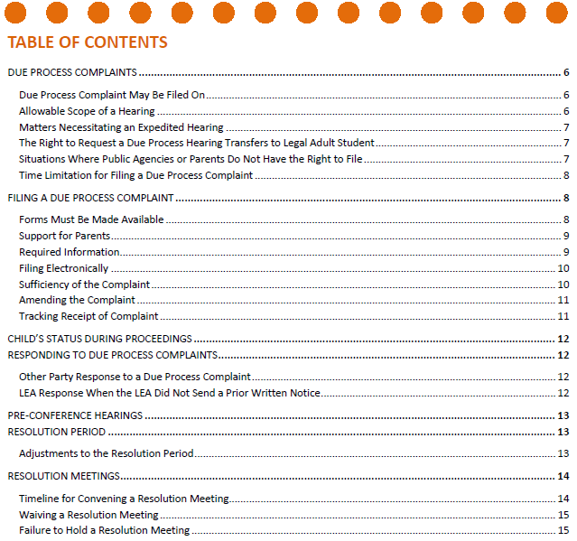
State Administration of Due Process Manuals
Hyperlinked & Searchable Table of Contents
At a Glance Topics:
Allowable Scope of DPH
Matters Necessitating Expedited DPH
Filing a DPH Request
Child’s Status During DP
Responding to a DP Request
Pre-conference Hearings
Resolution Period
Resolution Meetings
Mediation and Settlement
Hearing Rights
Civil Action Timeline and Requirements
Expedited DP Hearings
Maintaining a Qualified Roster of HOs
State Reporting
More!

Slide 28
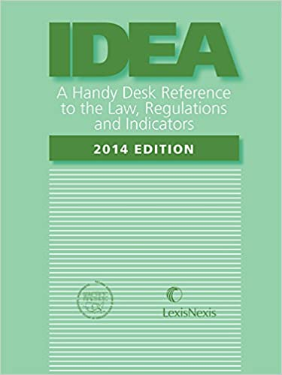
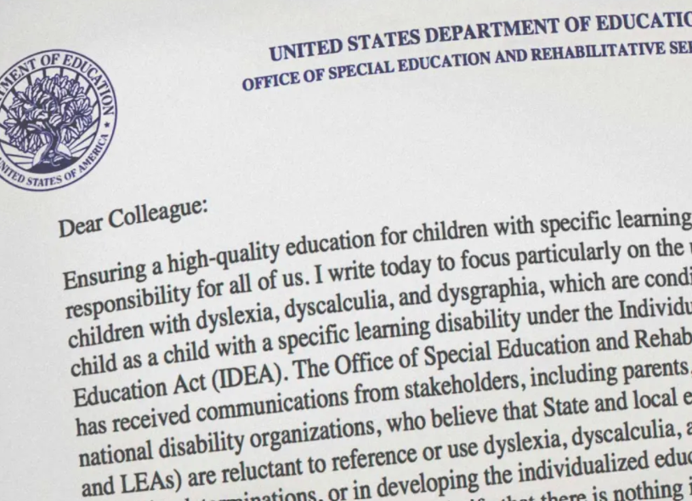
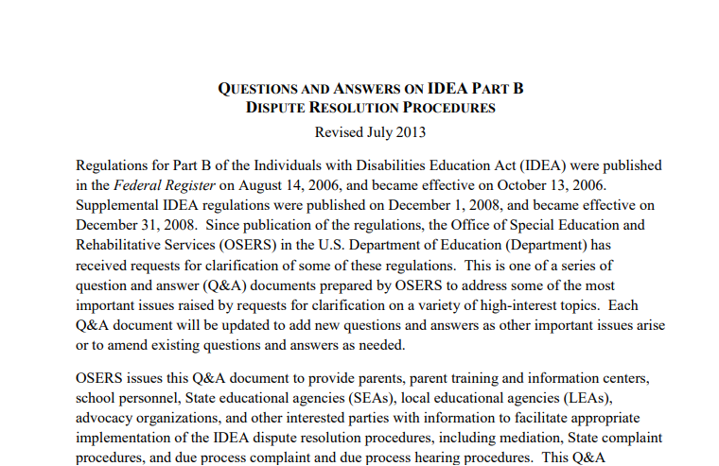
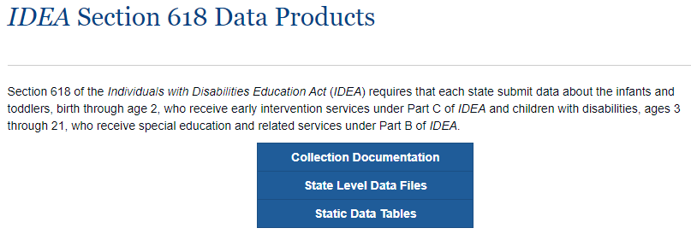
Sources of IDEA Regs. and Guidance

Slide 29
IDEA Regulations
Explains required SEA procedures under IDEA

Slide 30
Relevant Citations Linked
Imbedded Links to Key Citations
IDEA Regulations
Federal Register Comments to the Regulations
Federal Guidance and Key “Dear Colleague” Letters
Other Federal Guidance

Slide 31
Key Elements Highlighted

Slide 32
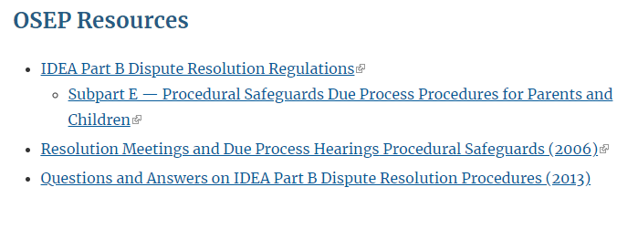
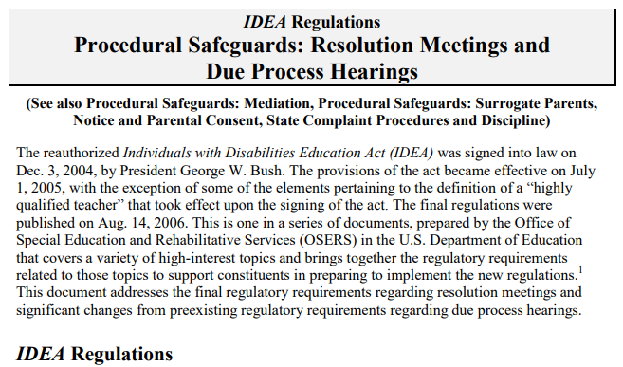
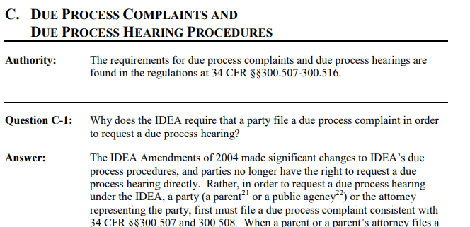
Due Process Resources Page

Slide 33
Questions, Comments, Peer-to-Peer Time

Slide 34
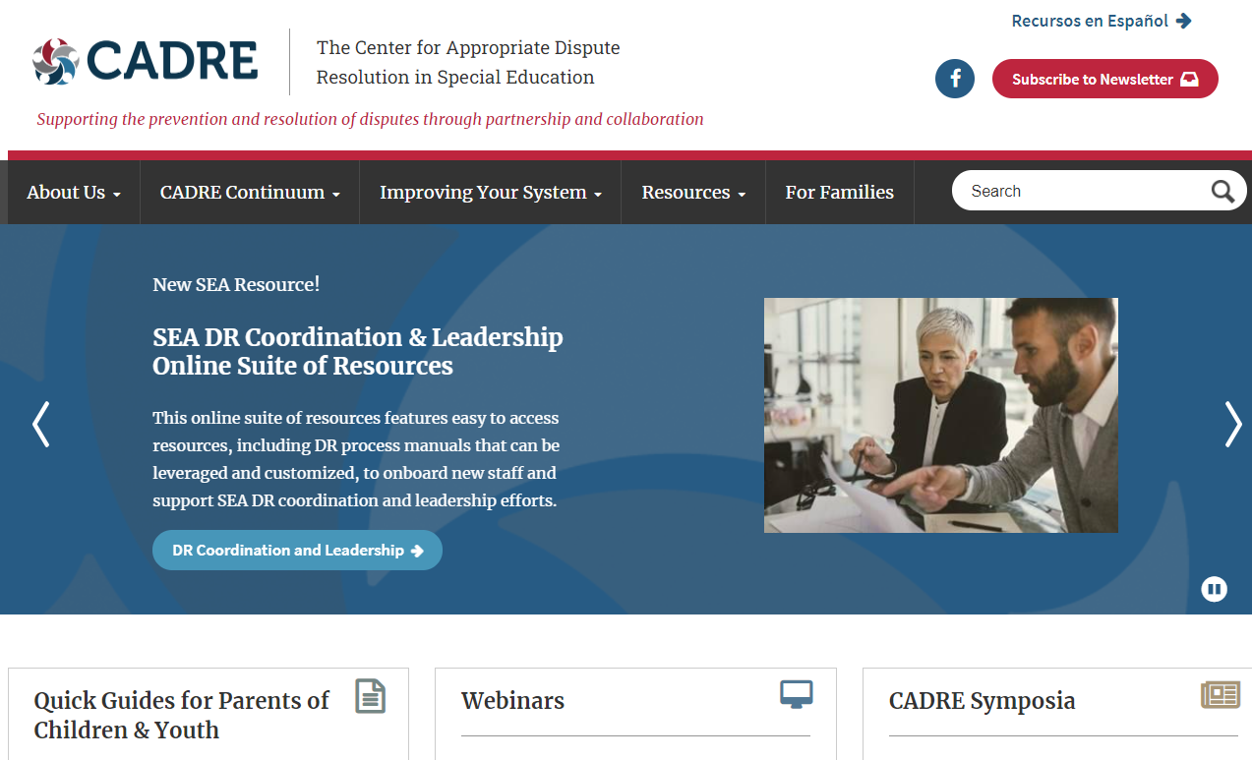
www.cadreworks.org

Slide 35
Thank you

