Slide 1
Addressing Equity in the Deaf-Blind Technical Assistance Network
Megan Cote, Technical Assistance Coordinator, NCDB
Julie Durando, Co-Director, NCDB
Esther Owusu, Parent, CHARGE Family Liaison, Intervener

Slide 2
Connection Before Content
Diversity means…
Cultural Competency means…
Deafblind means…

Slide 3
What is “culture”?
"Culture" refers to integrated patterns of human behavior that include the language, thoughts, communications, actions, customs, beliefs, values, and institutions of racial, ethnic, religious, or social groups.
"Competence" is the capacity to function effectively within the context of the cultural beliefs, behaviors, and needs presented by individuals and their communities.
(National Prevention Information Network)

Slide 4
What is “Cultural Competence”?
Cultural competence is a set of “behaviors, attitudes, and policies . . . in a system, agency, or among professionals, that enables effective work in cross-cultural situations.”
(National Prevention Information Network)

Slide 5
Reflection
Reflect on the following:
What have you personally and/or your organization done around this work?
Who have been your key partners?
Keep thinking as we share today!

Slide 6
Agenda:
Quick overview of NCDB & deafblindness
The Deafblind Network Cultural Competency Work Group -
How and why it was created
What the group has accomplished over the past 4 years
Lessons learned/ outcomes/ next steps
Cultural Ambassador Programs
Individual and Group Thinking

Slide 7
About NCDB
The National Center on Deaf-Blindness is a Technical Assistance and Information Dissemination Center
Our goal is to improve services, educational results, and quality of life for children who are deaf-blind
Work closely with state deaf-blind projects and other partners across the country
Funded by the U.S. Department of Education’s Office of Special Education Programs

Slide 8
NCDB Initiatives
Family Engagement – Helping families partner with service providers and advocate for their children
Identification and Referral – Receiving appropriate services as early as possible
Interveners and Qualified Personnel – Personnel development and adoption of interveners and teachers of the deaf-blind
Transition – Educational opportunities and planning that lead to a meaningful adult life

Slide 9
NCDB Website
Extensive information about deaf-blindness, educational practices, and professional development opportunities
Details about our initiative-focused work
The National Deaf-Blind Child Count - data on on children and youth who are deaf-blind, including demographics and causes of deaf-blindness
Contact information for state deaf-blind projects
Resources to help families learn and connect to agencies and organizations
nationaldb.org

Slide 10
National Deaf-Blind Child Count
Authorized by the U.S. Department of Education, Office of Special Education
Started in 1986
Each state conducts a count of children and youth who are deaf-blind (birth through age 21).
State data is compiled and reported in the annual National Child Count of Children and Youth who are Deaf-Blind.
87% of children on the deaf-blind child count have one or more disabilities in addition to deaf-blindness

Slide 11
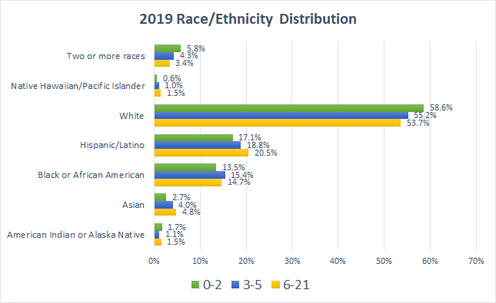
What our Child Count Data Says
Notes:
In 2020, the percentage of unknown went up bc people weren’t getting data back
Race and ethnicity were coded as separate categories.
In 2020, hispanic went up & others went down
120120 RaceEth Comparison - Google Sheets
National Center for Education Statistics. (2022). Racial/Ethnic Enrollment in Public Schools. Condition of Education. U.S. Department of Education, Institute of Education Sciences. Retrieved [date], from https://nces.ed.gov/programs/coe/indicator/cge.
“Between fall 2009 and fall 2020, the percentage of public school students who were:
Hispanic increased from 22 to 28 percent…
White decreased from 54 to 46 percent…
Black decreased from 17 to 15 percent.”
In 2020:
Asian students 5 percent
Two or more races 5 percent

Slide 12
Cultural Competency Workgroup Commitments
Exploration
Training
Engagement
Population
Child Find

Slide 13
Let’s listen to a parent perspective

Slide 14
This is our WHY…
To build successful strategies to:
increase child find and referral
be more intentional in our equitable service delivery
Deaf-Blindness is the lowest of low incidence disability
Deaf-Blind families experience unusual amounts of isolation and ability to be informed
Being a marginalized group compounds these challenges

Slide 15
What’s your why?
What’s your WHY about dispute resolution and cultural competence and equity?

Slide 16
Step One: Exploration
Purpose:
Assessing & prioritizing the needs of the population
Evaluate internal project capacity to meet the needs
Identify state systems and agency partners who are already engaging in this work
Formalize partnerships to better serve families (local, state, and national)

Slide 17
Step 2: Training
To date, we have organized a 3-Part Training Series for all state deaf-blind projects on Cultural Competence.
National Webinar Series on Cultural Competence
Part 1: The Implications of Cultural Bias and Population Data on the Provision of TA
Part 2: Supporting Families from a Variety of Cultures
Part 3: Parent Advisory Councils and Cultural Ambassadors
Hosted a reverse immersion webinar for the DB TA network to gain perspective on the challenges and barriers families face in navigating supports and services.

Slide 18
Step 3: Engagement
Workgroup met regularly to define processes
state deaf-blind projects can use to examine their culturally
responsive practices.
Each state created their own state action plan and has been
working to refine and implement the plan.
The result was a process for states to follow to begin this work.
Increasing Cultural Competency

Slide 19
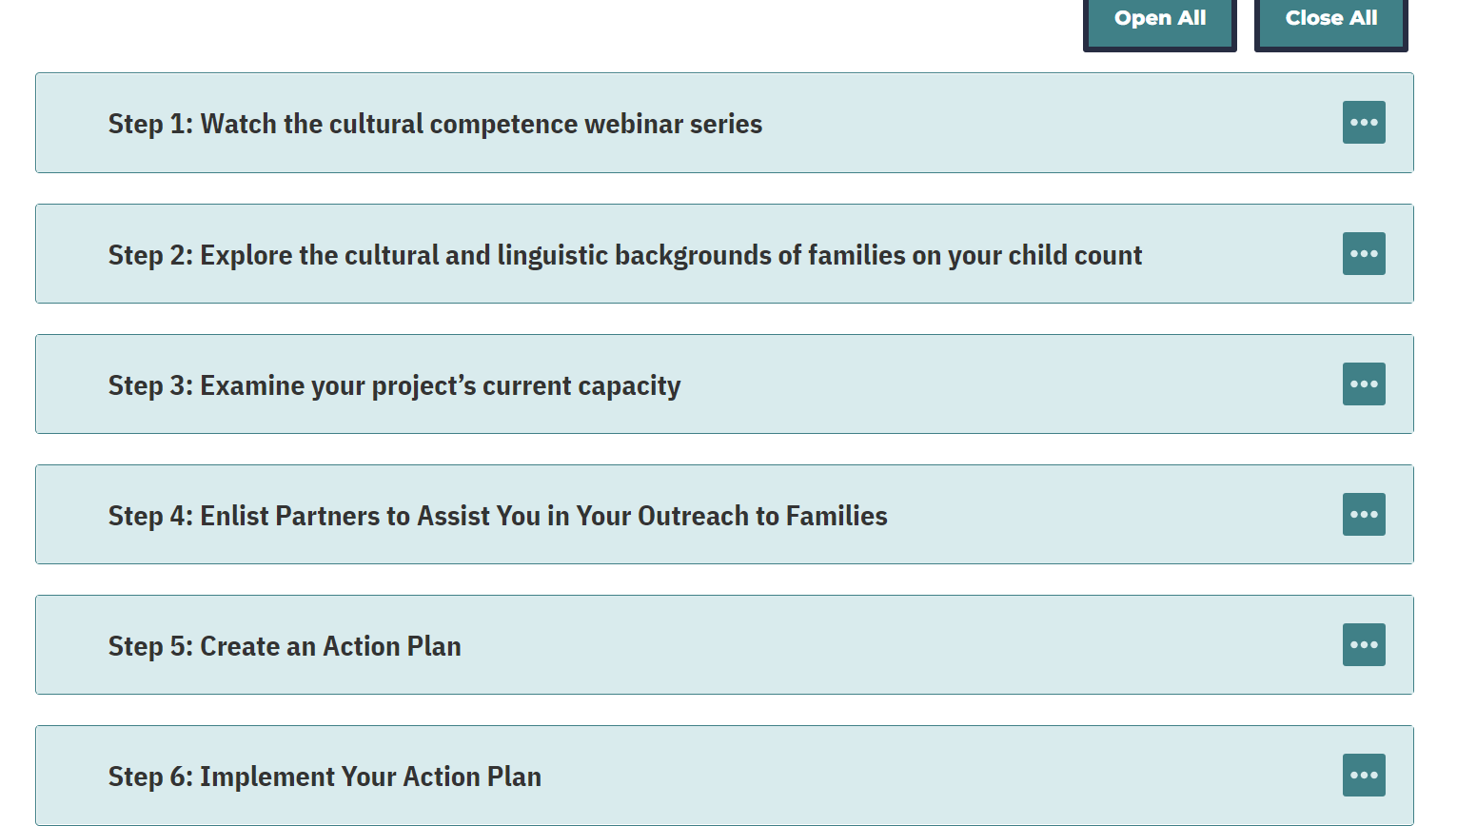
Increasing Cultural Competency Resource

Slide 20
Cultural Brokers/ Ambassadors
A go-between, one who advocates on behalf of another individual or group (Jezewski & Sotnik, 2001)
The characteristics, roles, and skills of cultural brokers are highly variable.
Can play a critical and beneficial role on a personal level, in the community in which they live, and on a professional level, in their respective agencies.
Using a community member as a cultural broker is acknowledgment that this expertise resides within the community (= trust of the community)
National Center for Cultural Competence (georgetown.edu)

Slide 21
Core = Building Trusting Relationships
The 4 Guiding Principles of Transformative Family Engagement:
Inclusive family engagement embraces and values diverse perspectives.
Individualized family engagement meets the unique needs of every family and child.
Integrated family engagement connects and align with the educational system.
Impactful family engagement empowers families to support their child’s success.
ptas-leading-the-way-on-transformative-family-engagement.pdf
Notes:
From The Center for Family Engagement created a resource called “PTAs Leading the Way in Transformative Family Engagement”

Slide 22
Time for a bit of self-assessment…
Ask yourself:
Do I have access to data?
Do I have the data I need?
Do I have partners I need?
What do I need to move forward with this work?
We realized it was time to pump the brakes!
The Value of Family Engagement: Identifying Unique Needs and Priorities of Families with Children Who Are Deaf-Blind

Slide 23
8 Direct Service Priorities (1 of 2)
Meet families where they are.
Grow family connections with other families and with the deaf-blind community.
Deepen professional sensitivity and understanding of the unique experiences and needs of individuals who are deaf-blind and their families.
Empower and honor the family as the child’s primary teacher and champion.
Strengthen family and self-advocate voices, stories, and confidence.

Slide 24
8 Direct Service Priorities (2 of 2)
6. Deliver meaningful information in multiple modalities and transformative ways to reach families in all of their diversity, preferences, and needs at key moments in their personal journeys.
7. Enable equity of family engagement through universally accessible, culturally affirmative, and unbiased services and supports.
8. Amplify diverse family voices, inclusion, and leadership at all levels (i.e., classroom; local, state, and national levels; services, agencies, policy, and legislation; technical assistance systems; and national organizations). “Nothing about us without us.”

Slide 25
Discussion
Reflect on the following:
Additional thoughts about what you have personally and/or your organization done around this work?
Who have been your key partners?
How might we partner to better support/refer families?

Slide 26
5 Potential Ways to Build Partnership with the Deaf-Blind Network
Contact your State Deaf-Blind Project and look for common needs and activities
Integrate deaf-blind supports and organizations into your family resources
Have someone from your state deaf-blind project come to present on project activities and objectives
Partner with your state deaf-blind project to recruit volunteers to participate in your activities and planning (e.g., advisory council, trainings, etc.)

Slide 27
NCDB Resources at Your Fingertips
National Center on Deaf-Blindness
State Deaf-Blind Projects Contact
Deaf-blindness, educational practices, and professional development opportunities
The National Deaf-Blind Child Count
Risk Factors for Combined Vision and Hearing Loss
Increasing Cultural Competence
For Families Section of the NCDB website

Slide 28
We’d love to connect!
Megan Cote - mcote@helenkeller.org
Julie Durando -
jdurando@helenkeller.org

Slide 29
The contents of this presentation were developed under a grant from the U.S. Department of Education, #H326T180026. However, those contents do not necessarily represent the policy of the U.S. Department of Education, and you should not assume endorsement by the Federal Government. Project Officer, Susan Weigert.

