Slide 1
Working within the Cross-section of Mindfulness and Dispute Resolution
Diana Nadeau
Dispute Resolution & Equity Specialist
CADRE Symposium: Planting Seeds: Growing an Inclusive & Informed Community
October 26, 2022

Slide 2
Today’s
Introductions
Discussion
What is mindfulness?
Practicing mindfulness activities
How does it fit into the work you do?
A little about inclusivity
From mindfulness to perspective-taking
Scenarios pre-mindfulness activity
Scenarios post-mindfulness activity
Discussion
Plan for incorporating mindfulness into your work

Slide 3
Introductions
Who is in the room, and why?

Slide 4
Prompts for Introductions
How are you involved in special ed. dispute resolution?
What interested you about this workshop?
How do you hope this helps you in the work you do?
What is your experience with mindfulness?

Slide 5
More Prompts…
Do you enjoy engagement and participate frequently?
Are you a little shy or less apt to share?
Do you prefer to take notes?
Or ask frequent questions?
Is there any support you need so that you get as much out of this session as you can?

Slide 6
Scenarios - Activity 1
Splitting the room into three groups
Handing out IEP scenarios
Take a brief moment to read the scenario
Decide who will take which role

Slide 7
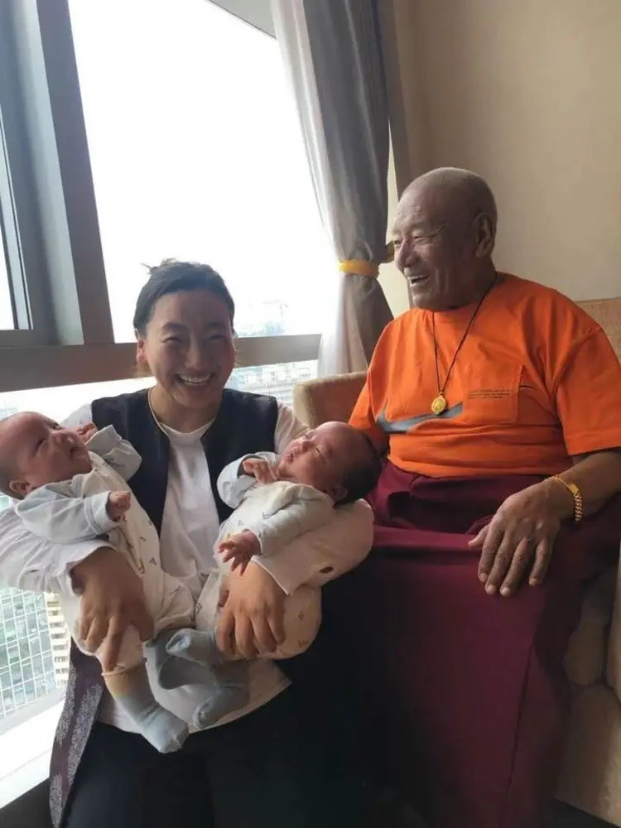
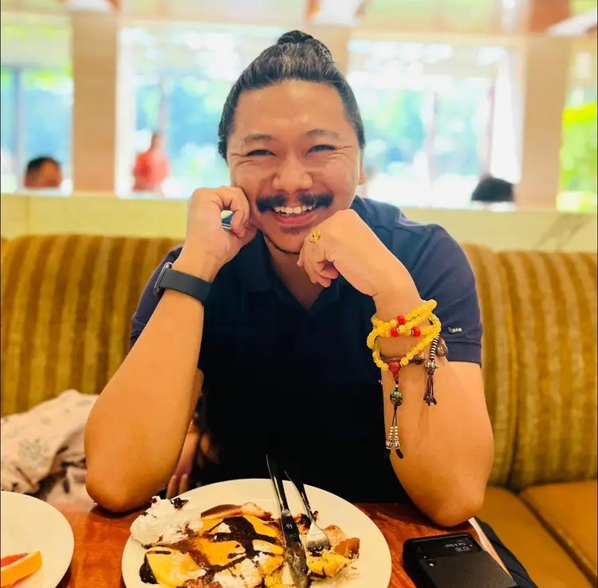
Cultures of Mindfulness

Slide 8
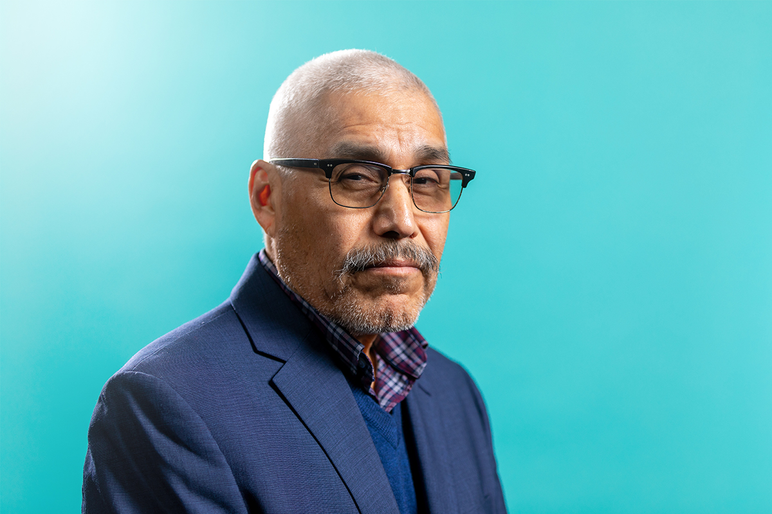
Mindfulness
“Our mind is one of the most powerful allies that we have. You can’t be healthy in one place and unhealthy in others – it’s not the way the body works.”
– Dr. Michael Yellow Bird

Slide 9
Small Group Discussion
As a group, pick one discussion prompt and answer true, false, or maybe, and why:
Not everyone can meditate.
The goal of meditation is to clear the mind of all thoughts.
Meditation is hard.
You must be sitting to meditate.

Slide 10
Concepts of Meditation
Utilizing a meditative support to focus attention
Allowing the natural flow of thoughts to arise and dissolve
Observing how the mind becomes distracted
Letting go of self-judgement
Consciously choosing how to use the mind

Slide 11
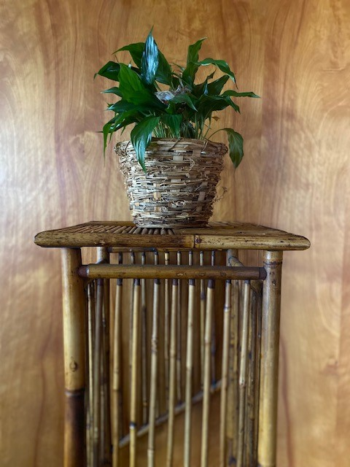
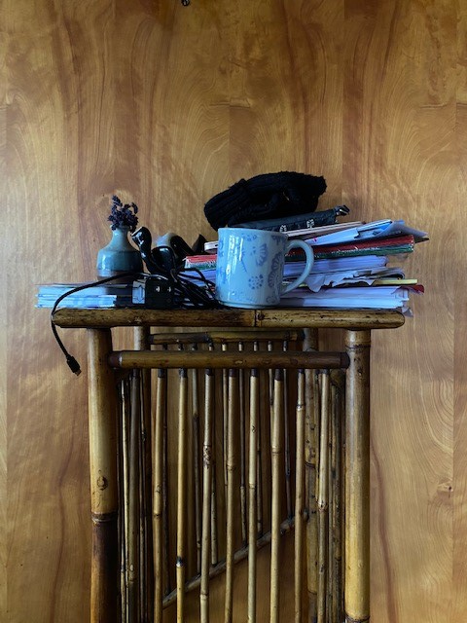
How does the mind work?

Slide 12
Mindfulness Practice – image 1

Slide 13
Mindfulness Practice – image 2

Slide 14
Mindfulness Practice – image 3

Slide 15
Steps to Mindfulness Practice
lend your attention to your breath
allow distractions to come and go
remember thoughts do not stop, they merely slow
when you are distracted, start over without judgment
short sessions with breaks in between

Slide 16
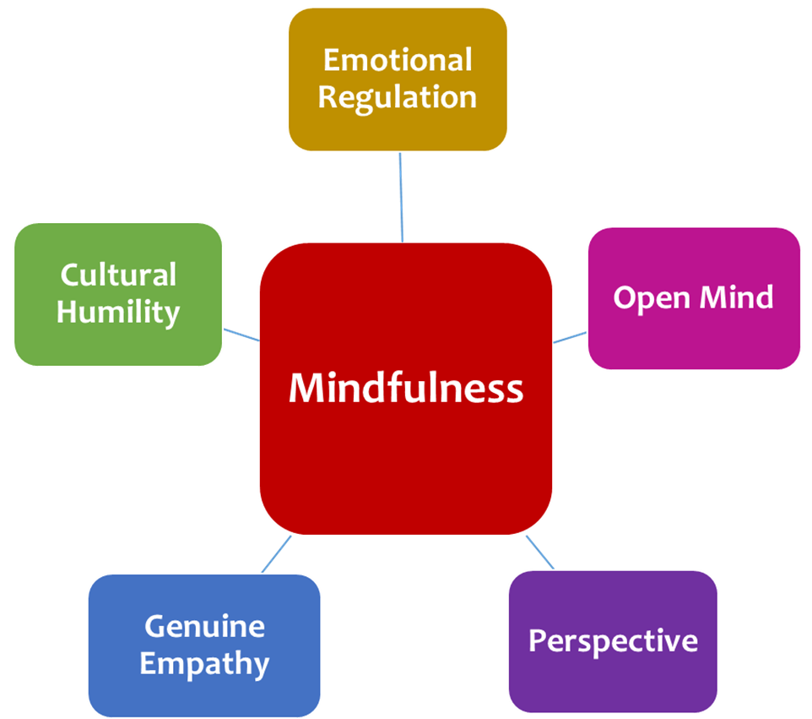
Mindfulness & Dispute Resolution
Here are some benefits of mindfulness within the work we do.

Slide 17
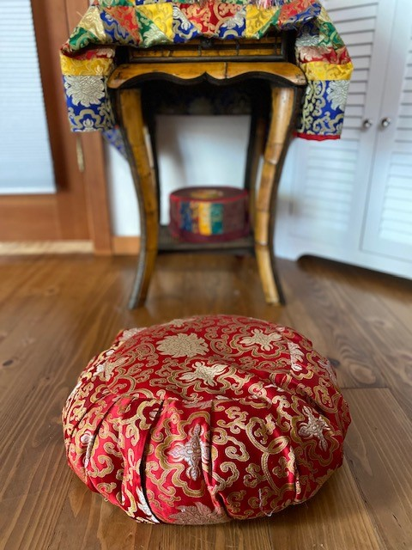
Practicing “Off the Cushion”
Pick a partner.
Pull your chairs together
Sit across from one another.
Pick one person to go first.
When prompted, that person will tell their partner a story about an upsetting situation that occurred.
The listener will train their attention on the voice of their partner.

Slide 18
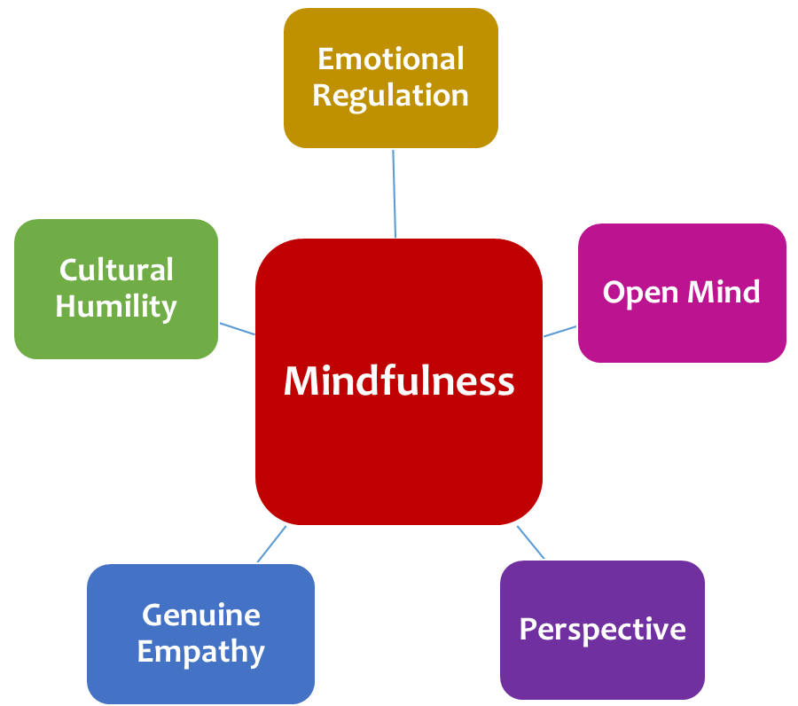
Discussion

Slide 19
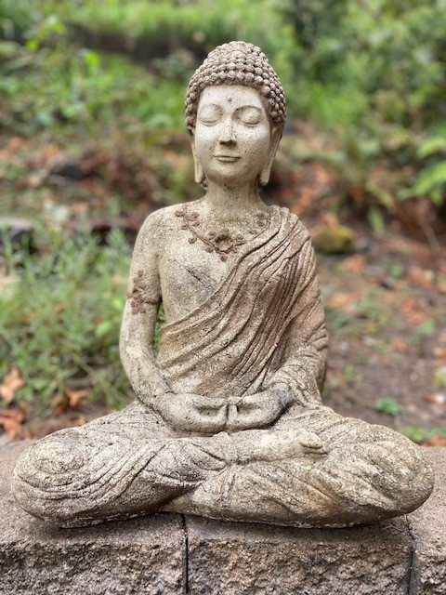
Mindfulness in the Context of Diversity and Inclusivity
Mindfulness:
Helps us understand our own perspectives
Opens us up to other perspectives
Leads to less judgement of others
Helps us find our biases
Assists us in equity improvement efforts

Slide 20
Diversity and Perspective-taking
Opening up to diversity of thought as it stems from diverse cultures, traditions, and personal experience is only possible with the understanding that everyone has their own perspective.

Slide 21
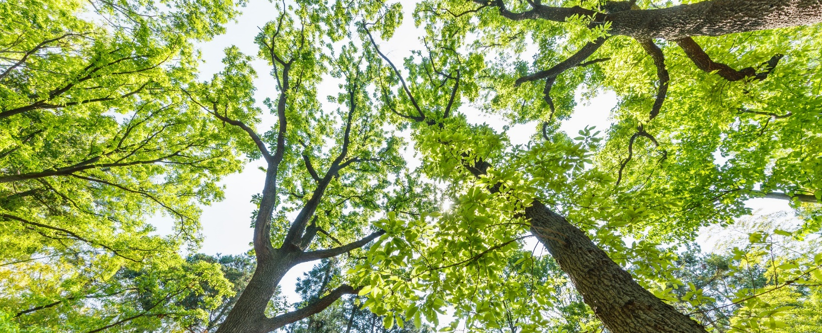
Positions
Positions are representative of our expectations for a specific outcome.
Positions are strategies we dream up based on our perspectives.
Perspective-taking allows us to loosen our grip on our position.

Slide 22
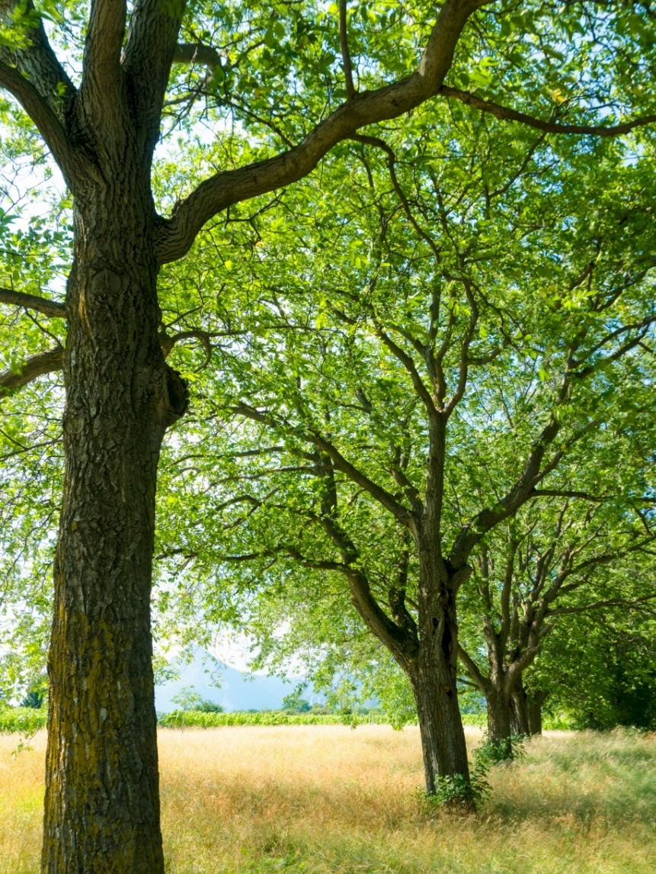
Interests
Our interests are based on outcomes we’d like to see.
Interests encompass our hopes and fears.
Interests are what motivate us to create strategies that we hope will lead to our desired outcomes.

Slide 23
Issues
Issues are the initiating concern.
Being open to perspectives leads us to naming the issue.
Agreeing on the issue at hand is the way to finding mutuality.

Slide 24
Separate Person from Problem
Problem
Person A
When conflicts arise due to combating positions, people often see the other person as the “problem.”
Problem
Person B

Slide 25
Problem on the Other Side
Person A
Person B
When we do not see the other person as the problem, we can:
join in mutuality;
put the issue on the other side of the table; and
work together to resolve it.
Problem

Slide 26
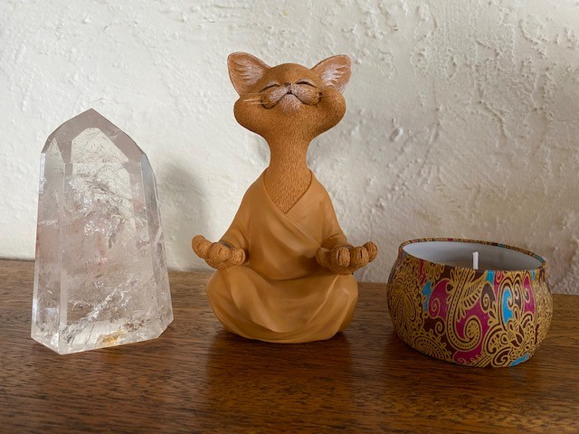
Scenarios - Activity 2
Sit where you are and bring your attention to your breath
Count from 1-5, then 5-1
Allow thoughts, sounds, sights, smells, all of it to exist without distracting you from your breath
Return mindfully to your group and begin the scenario over again.

Slide 27
What did you notice?
Was there a difference in how the scenarios unfolded before and after the mindfulness practice?

Slide 28
Setting a Plan in Motion
Make the commitment
Start out small
Engage in regular self-encouragement
Identify real obstacles
Identify perceived obstacles
Keep realistic expectations
Get support
Celebrate your wins, especially the small ones!

Slide 29
Group Share
How do you see yourself incorporating mindfulness into your work?
How do you imagine mindfulness may affect prevention? And dispute resolution?
What barriers do you foresee with implementing mindfulness in the work you do?

Slide 30
Questions?

Slide 31
Feedback for us?
What Worked Well?
Suggestions for Improvement?

