Slide 1
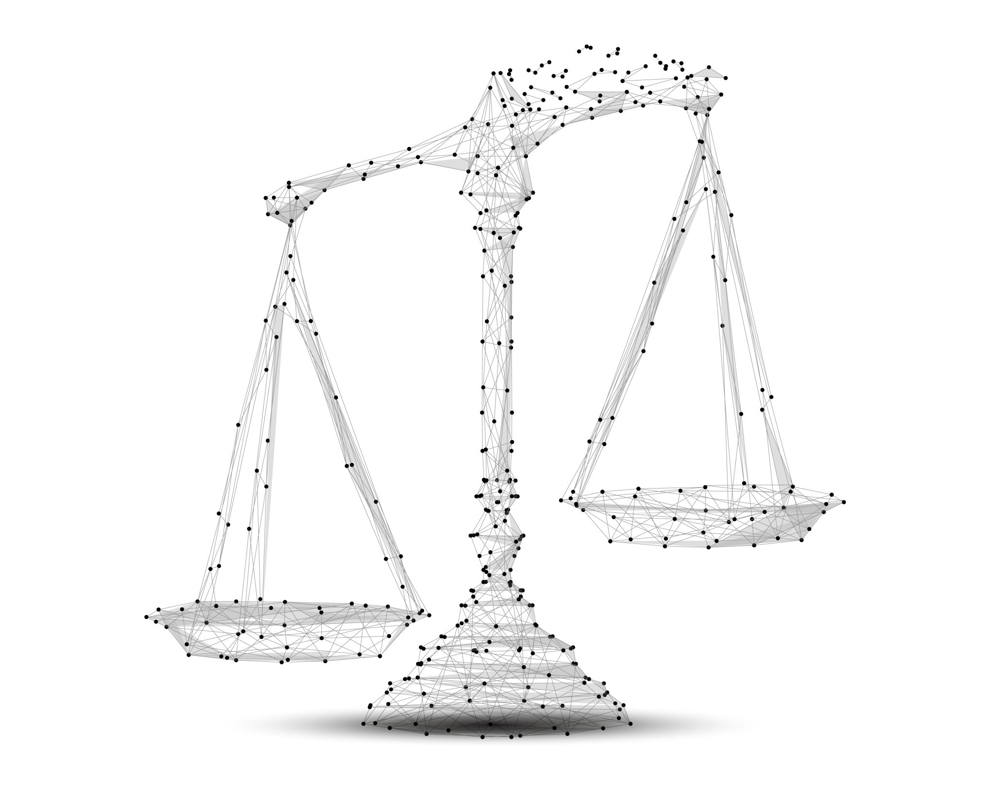
Accessing Justice Equally
Culturally Competent Mediation
CADRE 2022

Slide 2
Who we are
Pingora Consulting, LLC is dedicated to improving outcomes for students with disabilities across the country.
We work with states to provide professional development, systems building, rule and policy drafting, and dispute resolution services.

Slide 3
What is “culture” anyway?
Embracing “Cultural Diversity” in Mediation, Malcolm Sher (2015).

Slide 4
Culture Defined
Webster defines culture as the “customary beliefs, social forms and material traits of a racial, religious or social group.”
Dutch psychologist Geert Hofstede, defines culture more generally as “the collective programming of the mind that distinguishes the members of one group or category of people from another.”

Slide 5
Culture Defined
The whole complex of distinctive spiritual, material, intellectual, and emotional features that characterize a society or social group.
It includes not only the arts and letters, but also the modes of life, the fundamental rights of the human being, value systems, traditions, and beliefs.
Mediating Multiculturally: Culture and the Ethical Mediator, Menkel-Meadow and Abramson (2011).

Slide 6
In other words . . .
Anyone unlike me, and anyone like me.

Slide 7
Affinity Bias
Bias, specifically affinity bias refers to the tendency to get along with, or relate to, people who are like you.
Affinity bias can directly affect how you interact with parties. The more you connect with an interviewee the more comfortable you are.
You may be more inclined to view them as honest and consider their statements to be credible. You may also spend more time talking to them because doing so is natural and easy.
Conversely, you may rush through an interview with someone with whom you have little in common and may subconsciously view them as less credible.
Adapted from Society of Corporate Compliance & Ethics, Minnesota.

Slide 8
Implicit Bias
Implicit bias is based on unconscious attitudes regarding race, ethnicity, age, gender, and sexual orientation.
National Institute of health (2022).
Implicit bias is a form of bias that occurs automatically and unintentionally, that nevertheless affects judgments, decisions, and behaviors.

Slide 9
First Mindset, then Skillset
Embrace the space of change.

Slide 10
Challenge yourself.
Allow each party in mediation to have equal –
Emotional access to you;
Mental access to you;
Physical access to you;
Telephonic access to you; and
Electronic access to you.

Slide 11
Challenge yourself.
Create a space where each party is welcomed and valued, even if they don’t look like you, speak like you, believe like you, live like you, or love like you.

Slide 12
Space of Change
Mediators create the space where change occurs.
Forward facing
Respectful
Skilled
Present

Slide 13
Be. Here. Now.

Slide 14
Be that mediator . . . How to Be Open Minded, Kendra Cherry (2022).
Be curious to hear what others think.
01
Be able to have their ideas challenged.
02
Not feel upset when they are wrong.
03
Have empathy for other people.
04

Slide 15
Be that leader . . .
Consider what other people are thinking.
Be humble about their own knowledge and expertise.
Want to hear what other people have to say.
Believe others have a right to share their beliefs and thoughts.

Slide 16
Empathy
A mediator understands and operationalizes the subtle difference between empathy and sympathy:
Empathy is the demonstration of understanding, compassion, and responsiveness.
Sympathy is the demonstration of endorsement and pity disguised as understanding.

Slide 17
Similar, Not Synonymous
Empathy is NO value judgment.
It is the skill of active listening without taking sides.
Empathy is sensitivity to, rather than endorsement of, emotions expressed by others.
It is the artful ability to reflect back without owning the feelings being expressed.
Empathy is offered to all and takes no sides.
It is impartial.

Slide 18
Similar, Not Synonymous
Sympathy is the mediator’s judgment.
It is taking sides by perceiving unfairness or misfortune.
Sympathy is the mediator’s endorsement of harm, and it destroys trust.
Sympathy is taking on the pain of another and making it your own.
It can never be impartial.
Sympathy, rather than empathy, creates an emotional cost for the mediator.

Slide 19
No Judgment
Empathy allows you to demonstrate compassion without infringing on your beliefs.

Slide 20
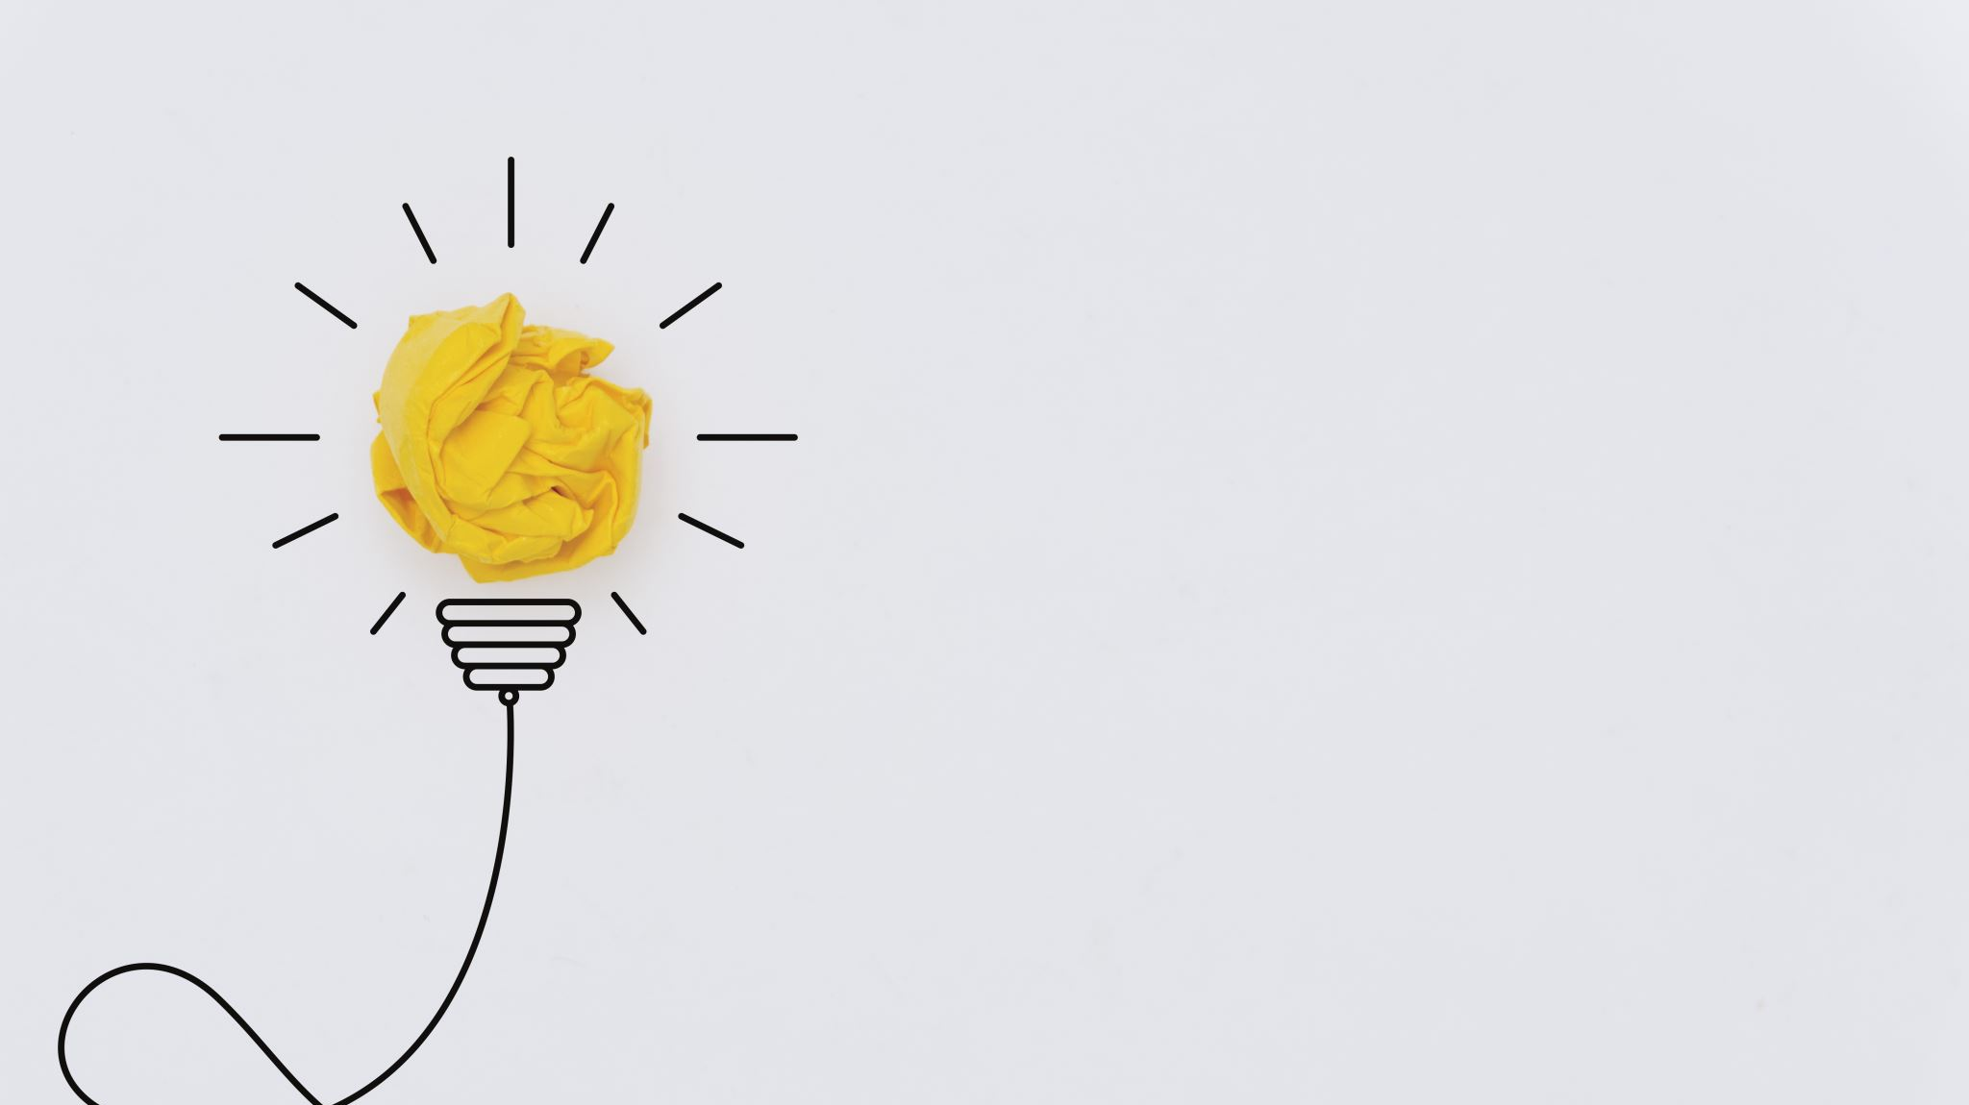
Balance of Power
Find it, mind it.

Slide 21
Pay Attention to Power
Assess
Assess the factors contributing to the impression of power. (Education, representation, language use, poverty, resources...)
Balance
Balance the power with intentional, directed actions and communication.
Encourage
Encourage participation, use parity, symmetry, proximity, etc.

Slide 22
Environment and Power
Adjust for an imbalance of power or cultural factors.
The space should emanate respect and be comfortable.
Remove access barriers.

Slide 23
Achieve the Balance
Use symmetry to balance power:
Ensure equal attention, interaction, eye contact, etc. between parties.
Use parity to balance power:
Consider neutral, equally accessible space;
Encourage reluctant participants.
Use proximity to balance power:
The Leader becomes a physical force.

Slide 24
Mind Chatter
Learn to quiet your mind.

Slide 25
Circle of Concern
A Circle of Concern is the group of people we think about, care about, and interact with in thoughtful ways.
People in our Circle of Concern tend to be like us – they look like us, act like us, share our values.
As a Leader, you must be intentional about expanding your Circle of Concern.
Making Caring Common Project, Harvard University.

Slide 26
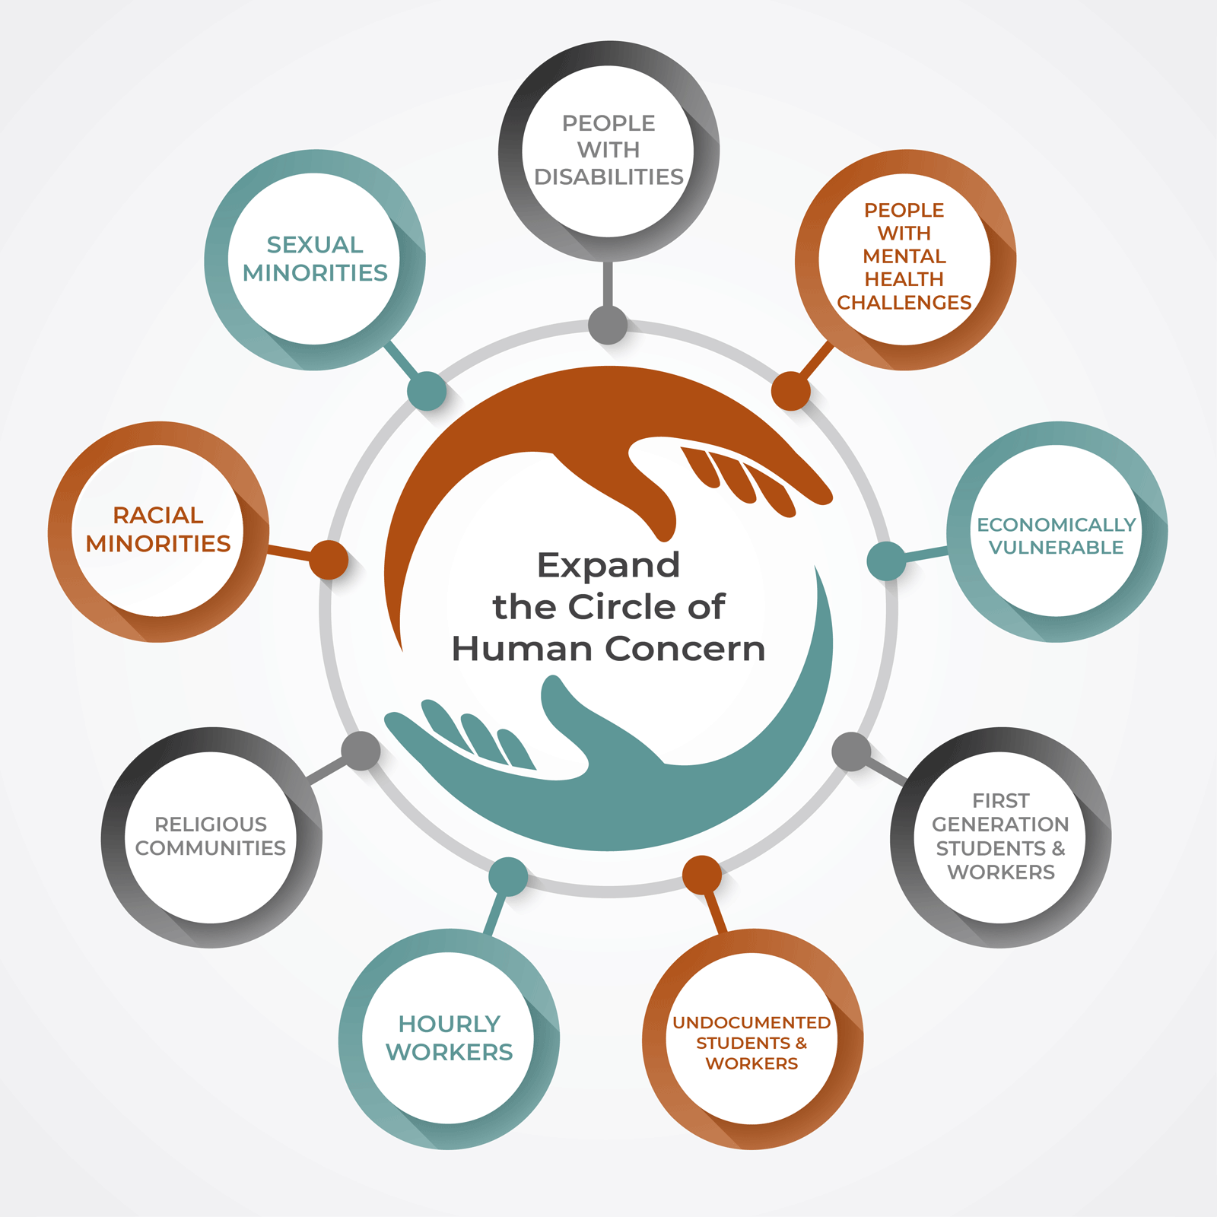
Expand the Circle of Human Concern

Slide 27
Cultural Sensitivity
Guard against reactive devaluation, or the tendency to dismiss or devalue the content of a message based on negative feelings about the person delivering the message. Meierding (2012).
Be mindful of language and cultural barriers.
Avoid assumptions.
WATCH this video. It is powerful!

Slide 28
Avoid Assumptions

Slide 29
Mind Chatter
Eliminate
Eliminate the mind chatter regarding your preconceived negative beliefs or assumptions.
Model
Model respectful, culturally neutral behavior to the parties.
Be
Be intentional in your quest for an open mind.

Slide 30
Normalizing
A must-have skill for mediators.

Slide 31
Conflict
Conflict is a signal or message that something is not working and needs to be different.
~ Talk Through Conflict Using Interest-Based Problem Solving, Education Service Center Region 4 (2011). ~

Slide 32
NORMALIZE, don’t awfulize.
What a mediator communicates:
Conflict happens.
It is an opportunity for growth.
Confidence in your ability to lead.
The participants come out on the other side of conflict better than before.

Slide 33
Normalizing is a critical skill.
Remember, there are many different considerations, perspectives, views.
Disagreement encourages us to learn more and develop a deeper understanding of others’ views.
Do not draw conclusions, over-react, or make it worse.

Slide 34
Conflict is part of life.
Disagreement or conflict is a necessary ingredient in the growth and development of individuals, families, communities, and societies.
Conflict can help build community, define and balance needs, and make difficult choices.
Working through conflict can be an important bonding experience.
Mayer (2012).

Slide 35
Physical Space
Must show respect.

Slide 36
Physical Space
Comfort
The space should be comfortable for a full day meeting.
Respect
The space should respect the differences in the room.
Private
The space should afford privacy for the emotions in the room.

Slide 37
Space Considerations
Consider the history of the participants when organizing a facilitated meeting.
Consider the potential emotionality of the meeting.
Consider accessibility for all participants.
Consider the need for equal seating at the table.

Slide 38
Location
The location chosen for the meeting may affect the interaction and dynamics between or among participants.
In general, select (or encourage the selection) of a neutral location that is easily accessible and where neither party has a strong emotional identification or maintains physical control of the space.
Moore (2014).

Slide 39
Now, Skillset
Culturally sensitive toolkits.

Slide 40
The problem in conflict is not whether the party listens to us, but rather whether we listen to and understand the other parties’ perspective.”
∼ Patterson, et al. ∼

Slide 41
Listen Effectively
If your want to hear someone.

Slide 42
Active Listening
Cultural Competence, An Important Skill for the 21st Century, Nebraska Extension (2016).

Slide 43
Effective Listening
Effective listening requires an understanding that it is not just the speaker's responsibility to make sure he/she is understood.
The listener has a major role to play in hearing the complete message.
The following ideas will assist the listener in understanding the message.

Slide 44
Stop talking!
You cannot listen when you are talking.
You will be thinking about what you are going to say instead of paying attention to what the other person is saying.
Consciously focus your attention on the speaker.

Slide 45
Put the speaker at ease.
Relax, look at the speaker and help that person feel free to talk.
Look and act interested.
Stop what you are doing and pay attention.

Slide 46
Pay attention!
Observe the nonverbal language of physical gesture, facial expressions, tone of voice, and body posture.
55% of the message is nonverbal.
38% is indicated by tone of voice.
7% is conveyed by the words used in a spoken message.

Slide 47
Be patient.
Don't interrupt the speaker.
This is disrespectful in nearly every culture.
Allow plenty of time for the speaker to convey ideas and meaning.
Be courteous and give the speaker adequate time to present the full message.

Slide 48
Be still!
Hold your spontaneous reaction!
Try to keep your own emotions from interfering with your listening efficiency.
You don't have to substantively agree to be a good listener.

Slide 49
Ask questions!
Clarify the meaning of words and feelings involved.
Be tolerant of emotions.
What people hesitate to say is often the most critical point.

Slide 50
“Question everything.” Albert Einstein
Practice ending far fewer sentences with a period – and more with a question mark.
Asking questions supports group process and improves interpersonal relationships.

Slide 51
If you want to find out what is at the heart of an issue. . .
Ask questions.

Slide 52
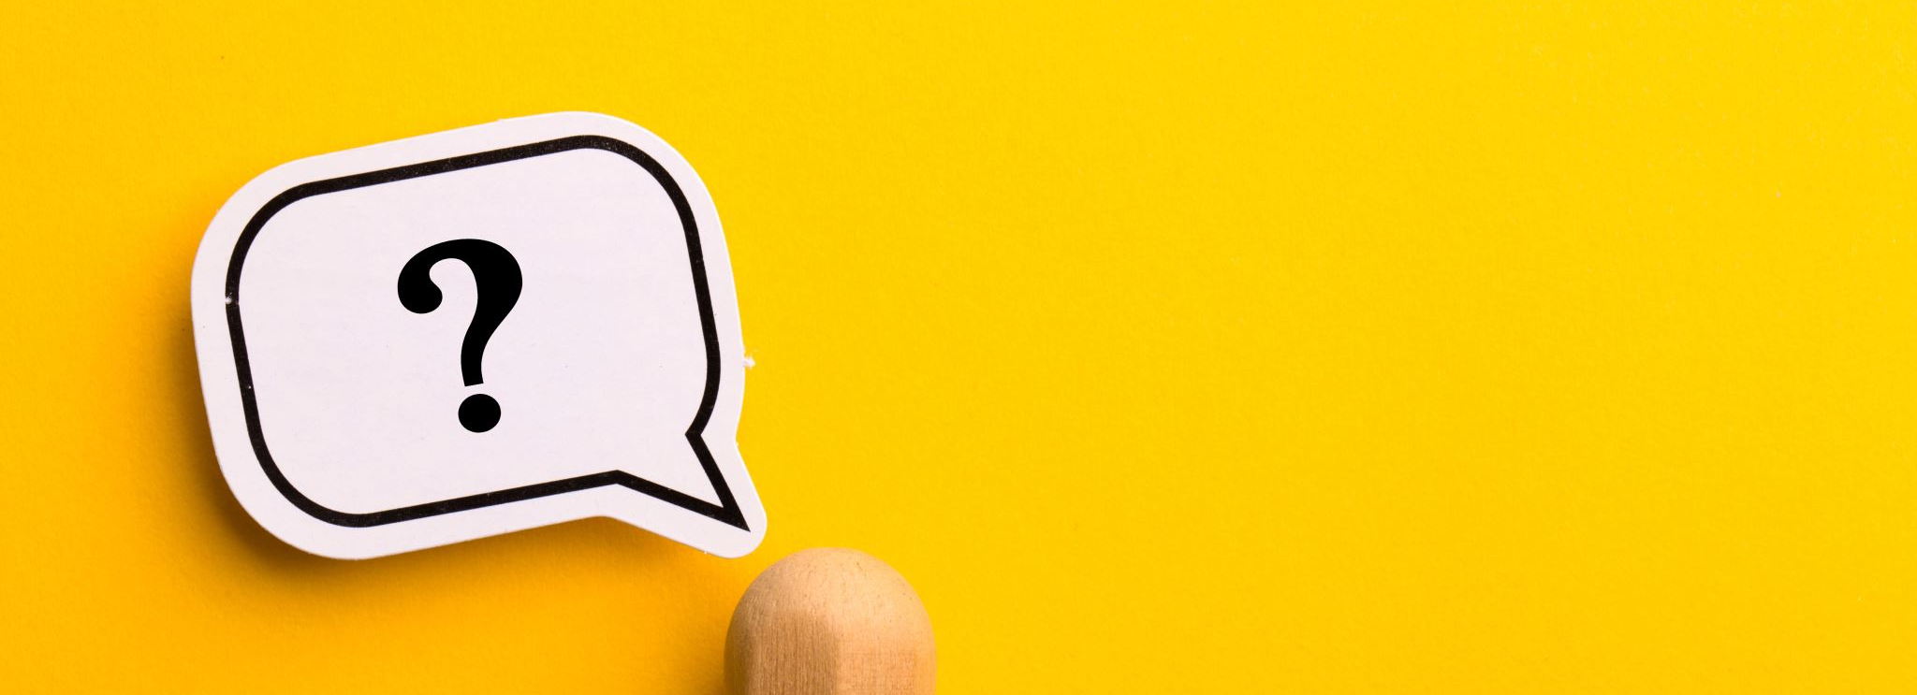
Sincere questions.
Avoid humor.

Slide 53
Ask LOTS of questions.
These 10 types of questions model the kinds of questions a team leader might ask participants in order to prompt deeper engagement with challenging topics.
Selected from

Slide 54
Exploratory Questions

Slide 55
Open-ended Questions

Slide 56
Challenge Questions

Slide 57
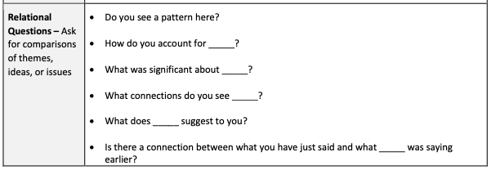
Relational Questions

Slide 58
Cause & Effect Questions

Slide 59
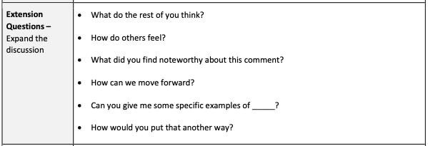
Extension Questions

Slide 60
Diagnostic Questions

Slide 61
Priority Questions

Slide 62
Summary Questions

Slide 63
Evaluative Questions

Slide 64
Offer assistance
To respect differences,
To respect culture,
To achieve full engagement.

Slide 65
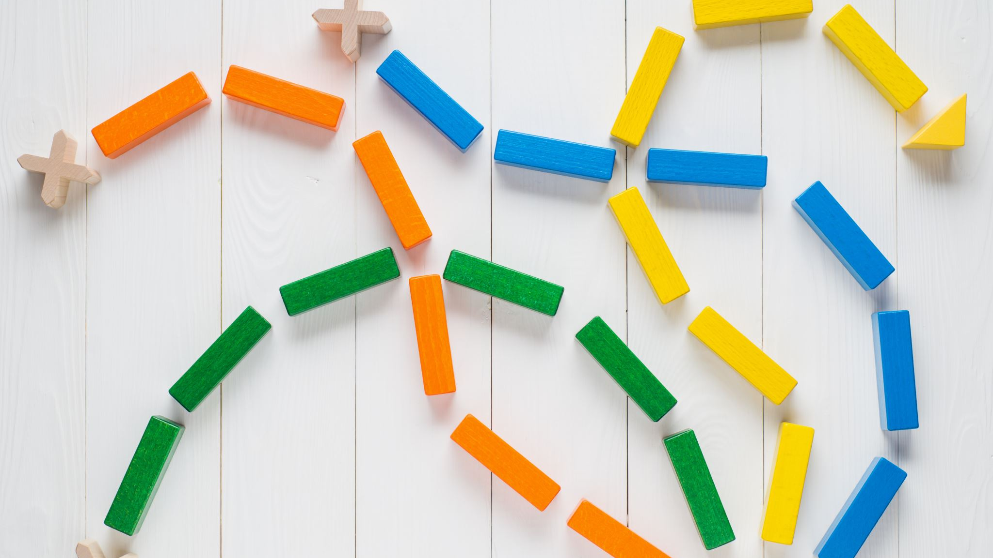
AVOID OVERLOAD
Cognitive and emotional.

Slide 66
Overloaded Participants
Too much information too fast can overwhelm participants.
The amount of information is so great that the processing demands go beyond the processing limits of the listener.
The listener is unable to integrate new information with what they already know.

Slide 67
Overloaded Participants
Cognitive overload produces stress and anxiety.
This type of resistance can have several sources, including grief, new to the complex process of special education, or disability.
Meaningful participation cannot be attained with overloaded participants.
67

Slide 68
Potential Solution
Slow down!
Pay attention to pacing.
Take smaller bites.
Use the Groan Zone.
68

Slide 69
From the beginning,
What can you do to be a culturally competent mediator?

Slide 70
Avoid and Ask
Avoid gender stereotypes, AND
Ask how participants want to be addressed.

Slide 71
Avoid and Adjust
Avoid awkward pronouns like “mom and mom,” “grandma,” or “boyfriend,” AND
Adjust your language to be responsive to the participant’s requests.

Slide 72
Avoid and Adapt
Avoid overloading participants, AND
Adapt your pace and delivery to match the needs of the participants due to factors such as disability, language barriers, need for interpreters/translators, etc.

Slide 73
Avoid and Approach
Avoid humor/sarcasm, AND
Approach all participants in an authentic manner.

Slide 74
Our sense of humor is deeply rooted in our nationhood, our shared view of the world, and the norms that are so familiar to us.
Culture Shocks: Humor across cultures, leap.london.

Slide 75
Before you start, ask yourself the important question: “Do I really need humor to get my message across?”

Slide 76
We must identify and address our own cultural and gender perceptions and biases and be ever curious discouraging attitudes that are judgmental or stereotypical, in order to avoid creating barriers, and instead foster the credibility and trust that is necessary for successful mediation.
Embracing “Cultural Diversity” in Mediation, Malcolm Sher (2015).

Slide 77
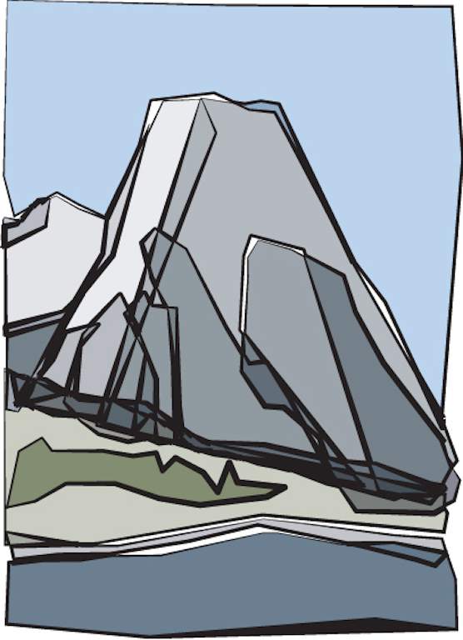
Thank you!
PingoraConsulting.com

