Slide 1
Pulling Back The Curtain On Motives And Discovering
The Whys Behind Conflict Behaviors
RelationSmart
Randall Reese, M.S., C.P.M.
- Conflict -
“The opportunity in a relationship to ensure your needs will be met while making your relationship more enjoyable and stronger”

Slide 2
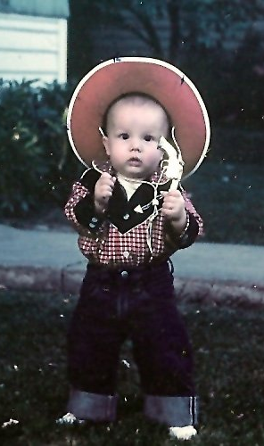
About Me
RelationSmart
Who am I and how did I come to be here?
Do I know what I am talking about?

Slide 3



People make meaning
People are constantly creating, remembering, receiving, and conveying meaning to get our needs met.
We do this internally and through interaction with others and our world.
Attribution is the act of giving things meaning.
We will act towards those things according to the meaning that we give them.
Meaning makes people
Imagine what type of meaning is each person pictured is constructing about themselves and others?

Slide 4
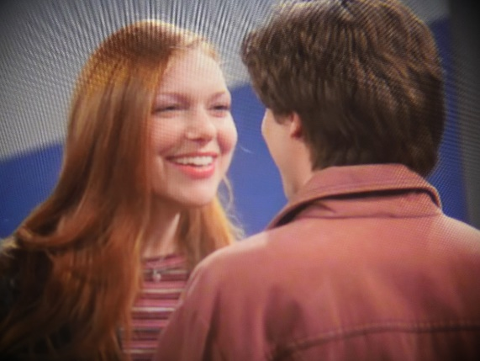
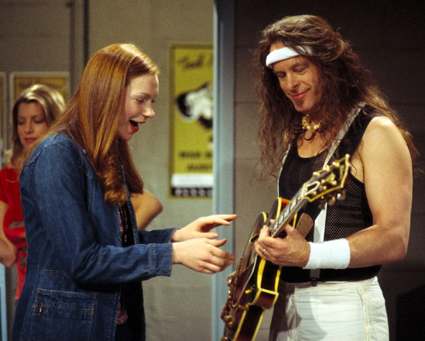
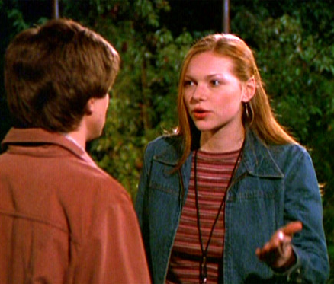
A story about attributions
Eric and Donna get tickets to a
concert. She got a backstage
pass because she works at a
radio station. Eric agrees she
should go backstage for 5-10 minutes to meet a rock star.
What are Eric’s and Donna’s likely attributions about each other’s behavior? Why?
She goes and meets a rock star. She
stays there for much longer than
the promised 5-10 minutes. Donna
is starstruck, but easily fends off the
rocker’s advances while she gets an
important interview for the station.
She is exuberant about her good luck.
Eric is not.
What are Eric’s and Donna’s likely attributions about their own behavior? Why?
What questions can we ask them to reveal their attribution process? Do we want to do that and why?
She returns and starts to tell him of her good fortune backstage when Eric suddenly accuses Donna of ditching him. Eric and Donna get into an argument and say some mean things to each other.

Slide 5
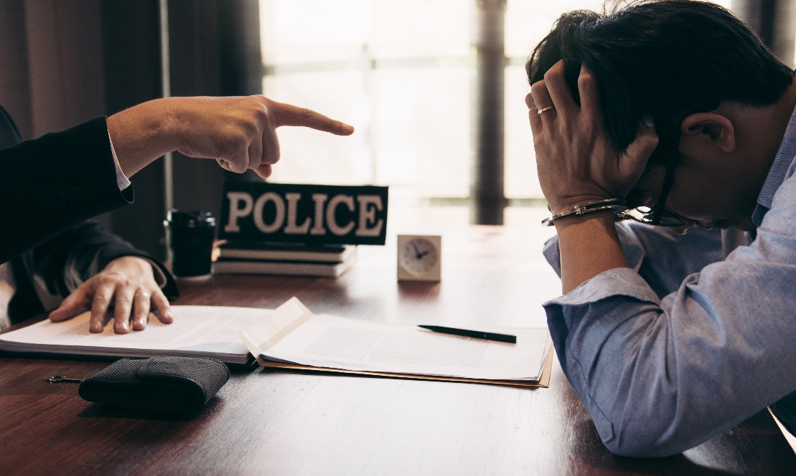
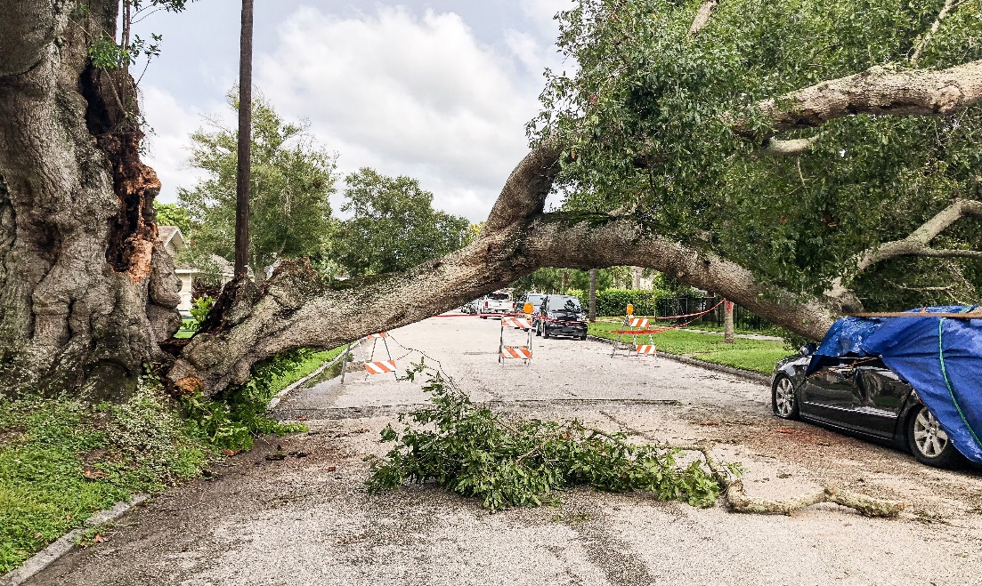
When bad things happen
RelationSmart
Internal Attributions
External Attributions
“They did or caused this.”
“This is your fault”
“This was a difficult situation.”
“There was nothing I/you could do”
BIAS
Other
Self

Slide 6
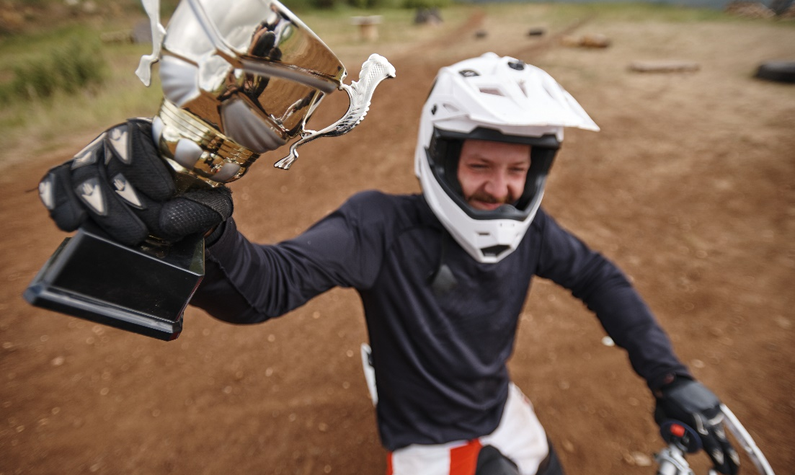
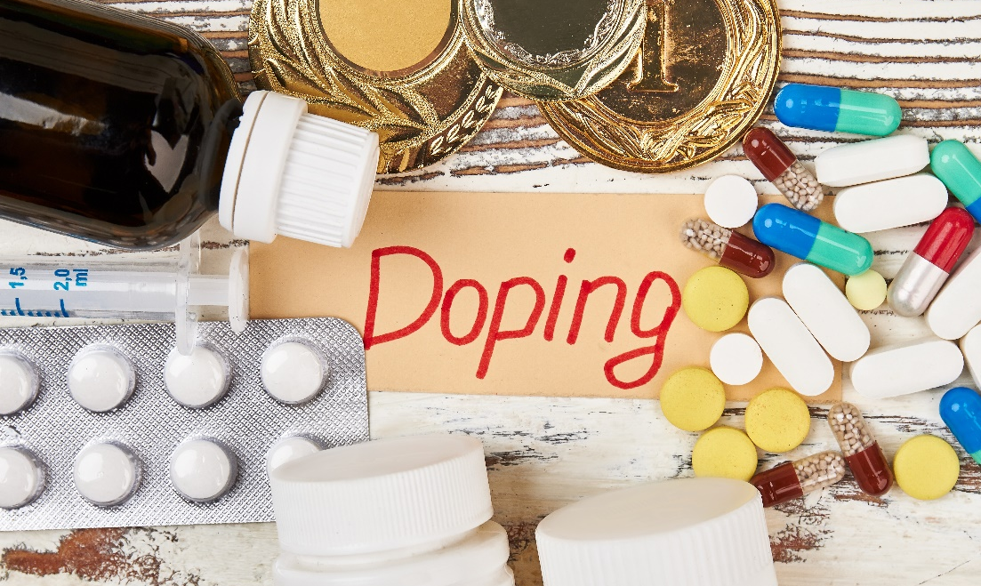
When good things happen
RelationSmart
Internal Attributions
External Attributions
“They did or earned this.”
“I have what it takes”
“They didn’t do this.”
“They didn’t play fair”
BIAS
Self
Others

Slide 7




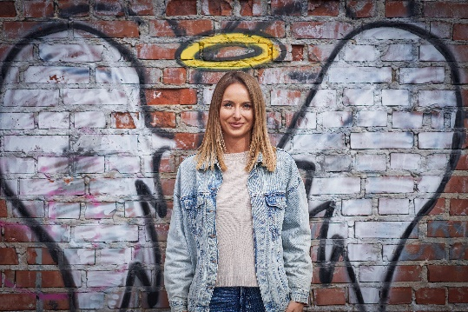

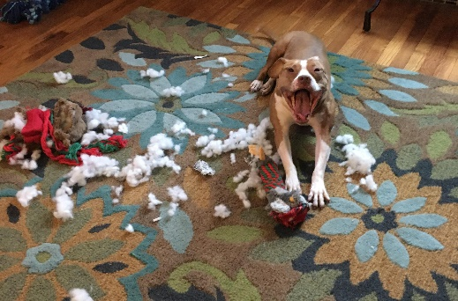
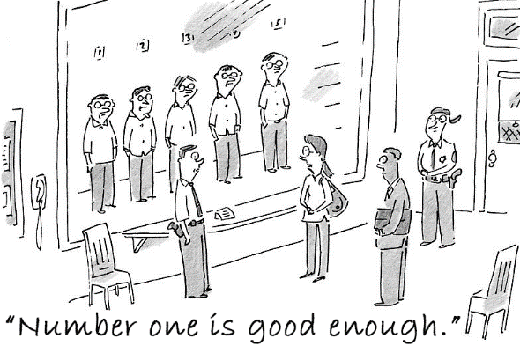
Some key causes of attribution errors
RelationSmart
01
Similarity
02
Consistency
03
Self–serving Bias
04
Social Influence
We attribute similar meaning to similar things
We are influenced by individuals and groups we deem significant.
Old attributions influence new ones.
We tend to make attributions that support our self-view.
05
Golden Halo
06
Rusty Halo
07
Causality
08
Premature Judgment
We extend our positive bias to some others.
We often attribute cause or motive to things that occur close together.
We have a negative bias against some people.
Our need to predict can cause us to rush to judgment.

Slide 8


Consistency and Prediction
We xperience
discmfort wen we sense incnsistency
between our
Peeeeeeeercptions of
our thouhts an d d deeeds. This stat of discmffort is caled cgnitive dissnance
Consistency
Prediction
People do not like to find inconsistency between their various thoughts, like beliefs, and attitudes about things. We also like to believe our actions are consistent with each other and our thoughts.
We will act to reduce or eliminate dissonance
We will act to avoid dissonance
We will reduce dissonance in less than virtuous ways sometimes (or often)
People make lots of predictions about social situations. They think about choices they may make, imagine scenarios and more. We do this to be more effective and to help avoid dissonance.

Slide 9

Prediction and Consistency
We experience discomfort when we sense inconsistency between our perceptions of our thoughts and deeds. This state of discomfort is called cognitive dissonance
Consistency
Prediction
People do not like to find inconsistency between their various thoughts, like beliefs and attitudes about things. We also like to believe our actions are consistent with each other and our thoughts.
We will act to reduce or eliminate dissonance
We will act to avoid dissonance
We will reduce dissonance in less than virtuous ways sometimes (or often)
People make lots of predictions about social situations. They think about choices they may make, imagine scenarios and more. We do this to be more effective and also to help avoid dissonance.

Slide 10
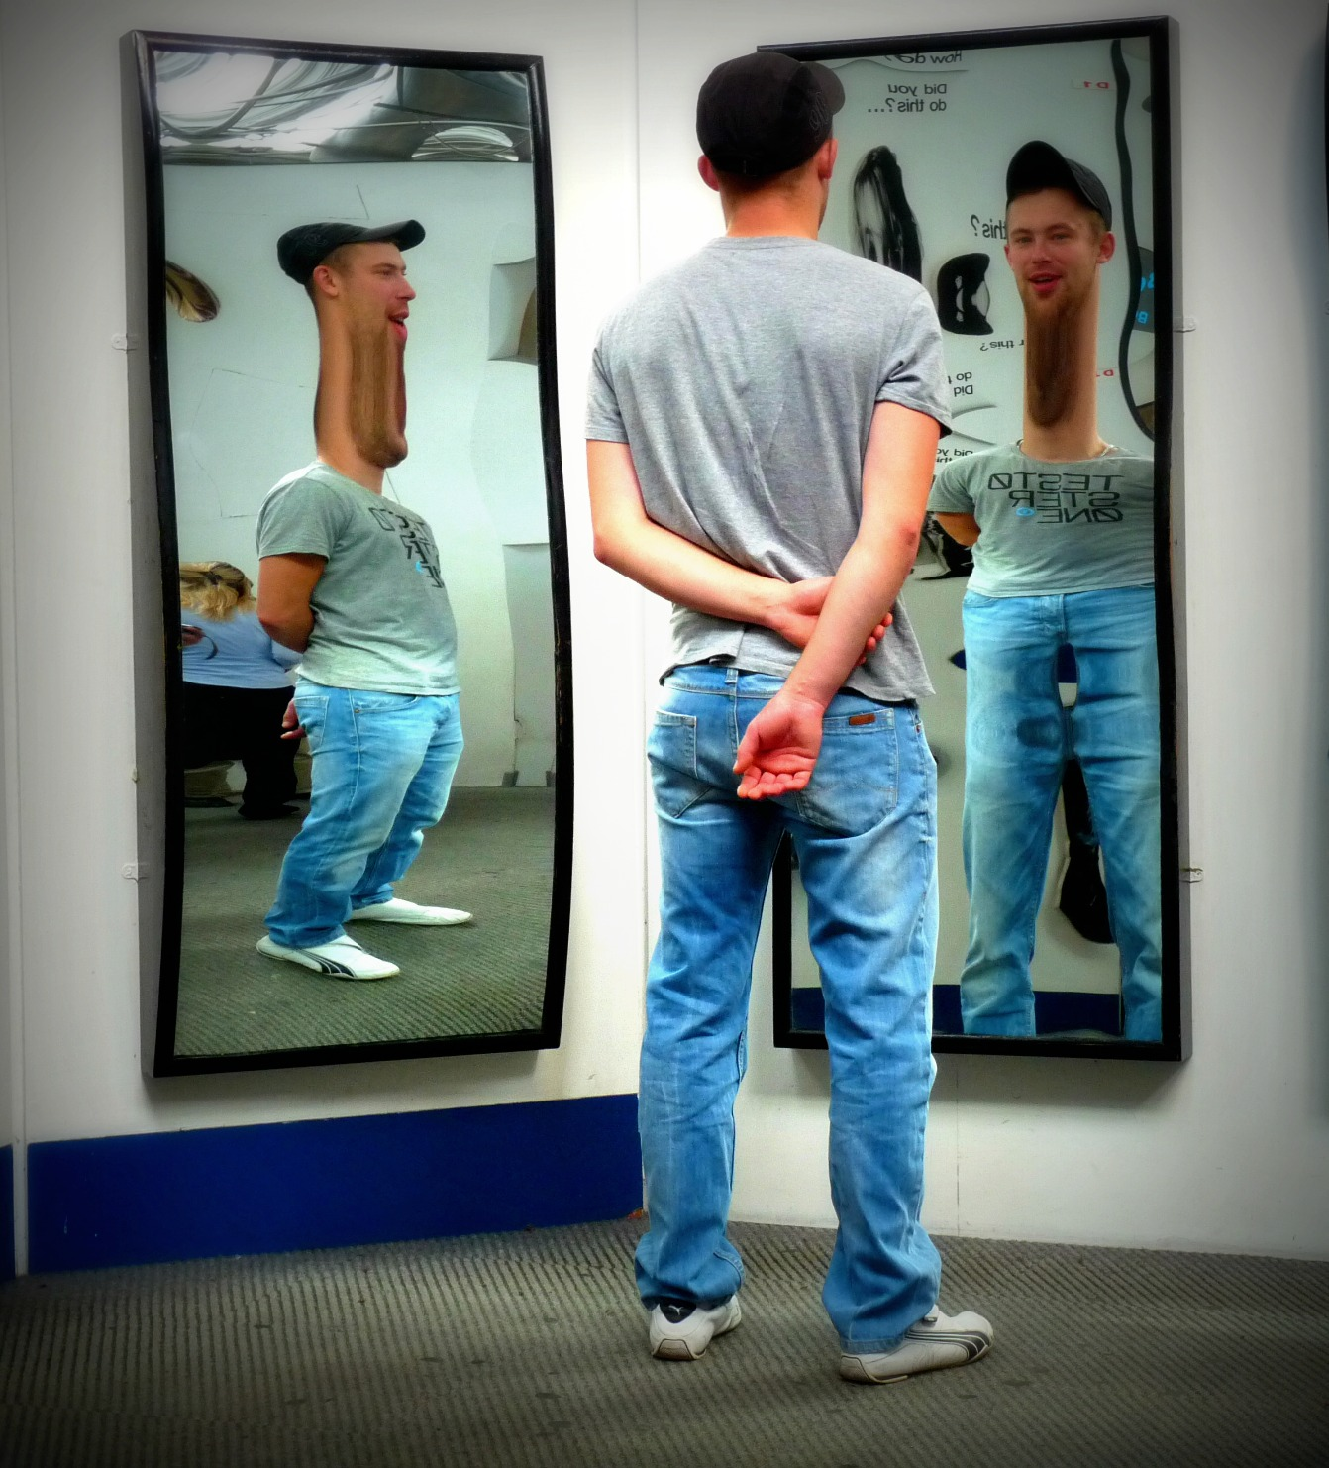
Self-view
RelationSmart
A key cognitive element driving human behavior is our self-view. Self-view includes self-concepts and self-esteem.
Self-concept
Self-esteem
Our perception of our attributes and who we are
Our evaluation of our self-concept

Slide 11








Reflected Appraisal
We interpret the way people respond to us and imagine what they think of us.
We develop feelings about and respond to the perceived judgments of others.
We imagine how we will appear to others in social situations to facilitate impression management, and influence the reflected appraisal of others.
In conflict, what concerns should we have about reflected appraisal?
How is reflected appraisal a tool?

Slide 12

Signification
RelationSmart
The level of significance we place on some thing influences the power that thing has in influencing our thoughts and behavior.
The more significance we place on someone, the more their appraisal matters to us.
We will work harder to manage the impressions of those who hold the highest significance to us.
We will lower the significance of some in order to mitigate the sting of their disapproval.

Slide 13





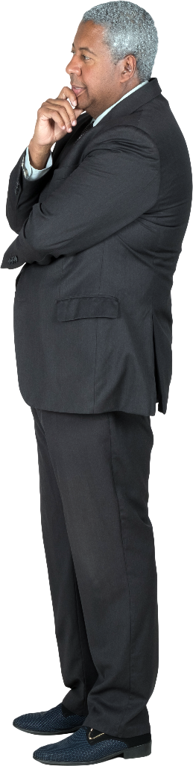
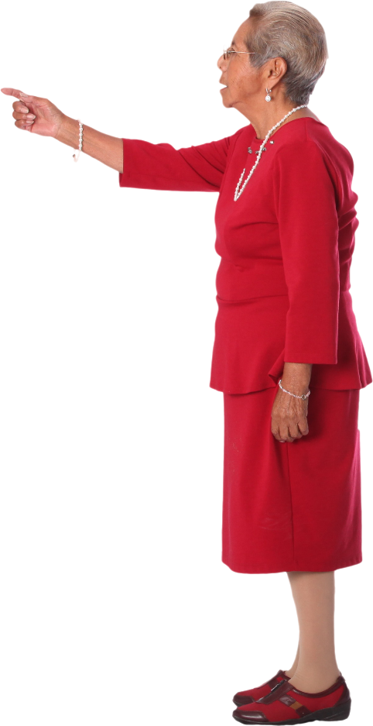
Attribution/Appraisal Model
RelationSmart
Thoughts about
Appraisal & Message
Self-concept
Self-esteem
Self-concept
Self-esteem
Thoughts about
Appraisal & Message
Messages
Signification of other
Signification of other
Attributions about other
Attributions about other
Reflected Appraisal
& Impression Management

Slide 14
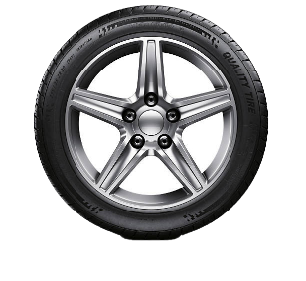
Integration: Where the rubber meets the road in relational conflict success
An integrated state in conflict is marked by disputants’ empathy for each other.
Integrated disputants show concern for the other, as well as themselves.
Integration leads disputants to view good outcomes for others as good for them, too.
Integrative relationships tend to support our self-view and feelings of self-efficacy.
Commonality
Self-disclosure
Trust
Motivation
We like people who are like us. Connecting people through their narratives creates commonality focusing on similarities rather than differences.
Learning about others makes them more understandable and predictable. Questioning and reframing answers will drive parties to disclose even more.
Trust grows as our expectations are met. Set expectations in your process, then acknowledge and celebrate follow-through to build trust.
We want to feel good about ourselves. Focus on wins and minimize challenges. Coach best practices and reward progress.

Slide 15
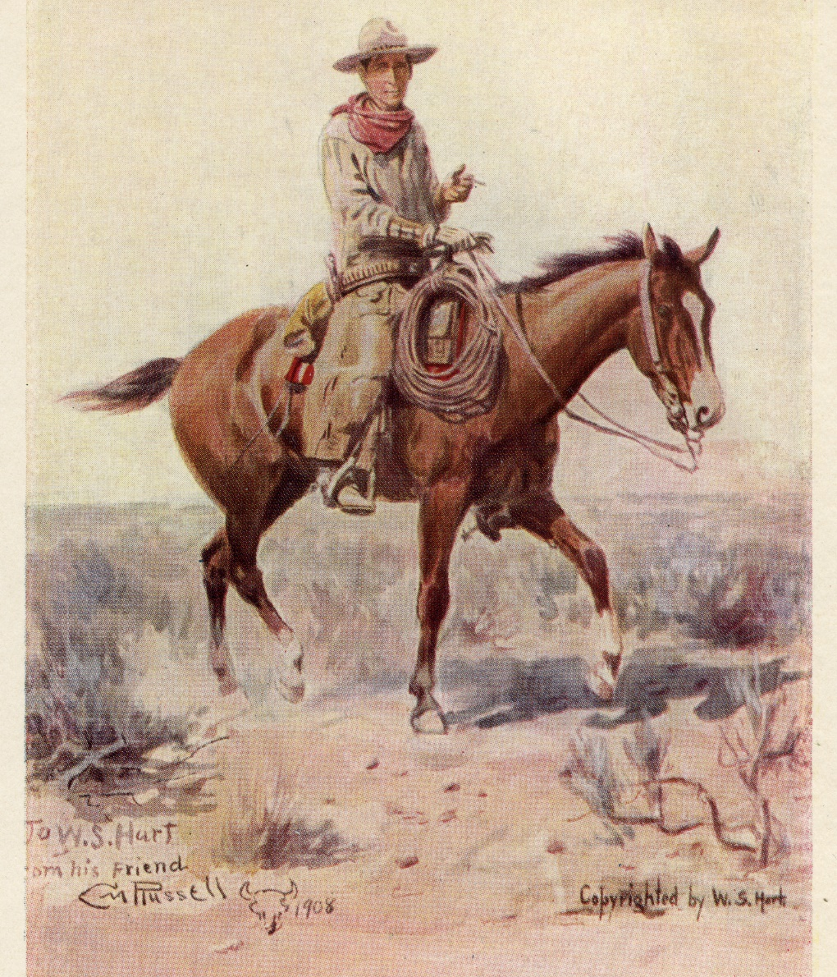
Case Study #1
Born at the turn of the century, Charlie was a real cowboy. I went to work for him and often stayed at their ranch in high school. He was my best friend’s father and one of the toughest, hardest working people I have ever met. After supper he would pull out his fiddle and the family would play music until dark. If we were lucky, Charlie would talk about the old west and some of the characters and events from his interesting, but hard-scrabble life. He was near 70 and I was 17. Still, he could outwork every person on the farm. He was a man of few words and his reflected appraisal mostly consisted of a nod of approval or a quick shake of the head for disapproval, but that was plenty. I admired him, so I worked hardest and chose my words and behaviors more carefully when he was around. His nods of approval meant the world to me, and his disapproval was devastating. Because of that, I didn’t get much negative feedback about my behavior.
Explore my and Charlie’s relationship in terms of attributions, attribution errors, self-views, reflected appraisals, and signification.
What strategies do we have that can work to influence areas of Attribution/Appraisal model that will increase the likelihood of meaningful interaction?

Slide 16


Case Study #2
Frank and Nancy are estranged brother and sister who are two years apart in age. After the death of their mother, they met to settle her estate. The Will requires them to work out an equitable division. The first attempt lasted less than a half hour and ended in a big fight over a painting they both want. You are hired to intervene and in your intake interviews you discover that Frank’s and Nancy’s parents were physically and mentally abusive to them both. Frank left for a career in the Army when Nancy was 15 and never returned. Nancy married at 17 and moved away.
They had minimal contact with their parents after that, and not much more between them than a few meetings, holiday cards, and phone calls. You sense an emotional divide between the two, and in your first joint meetings you learn they each believe that they got the worst of the verbal abuse and violent behavior of their parents. Nancy mentions how she was tasked with caring for her mother because of Frank’s absence. Frank mentions how he has had to help his parents financially many times since leaving, and especially the last few years, because he is more financially secure than his sister who teaches 2nd grade.
Explore Nancy’s and Frank’s relationship in terms of attributions, attribution errors, self-views, reflected appraisals, and signification.
List questions or lines of inquiry that might lead to integration between the two siblings.
Are there any areas we should be concerned about broaching?

Slide 17
Role Play
During a mediation break, you meet individually with a parent who has claimed that the school is failing to follow her son’s IEP in ways that demonstrate equitable treatment in the classroom. She has disclosed her mistrust in the school administration’s motives concerning the rights of her child. The current problem-solving session has been marked by many interruptions. She was highly critical of every idea offered by school members on the IEP team. You know that the school had missed a state-mandated deadline that required correction action by the State Agency, and she has stated recently there was a decision made without her participation. The relationship is strained.
In your group:
Using the perspectives presented today, develop some theories about what might be behind the parent’s angst and behavior.
Develop some questions, statements, or strategies you might offer to help this person move into a more collaborative posture.

Slide 18

Reading List
Reading List
Uncertainty Reduction- Charles Berger and Richard Calabrese
Cognitive Dissonance- Leon Festinger
Attribution Theory- Fritz Heider
Psychological Level-Communication: Jeffrey Zeig
Transactional Analysis: Eric Berne
Looking Glass Self: Charles Horton Cooley
Symbolic Interaction: G.H. Meade, Herbert Blumer
Self-efficacy: Albert Bandura

Slide 19
- Thank You -
RelationSmart
Pulling Back The Curtain On Motives And Discovering
The Whys Behind Conflict Behaviors
Randall Reese, M.S., C.P.M.

