Slide 1
Prevention of Disputes through IEP Facilitation: A Collaborative Project between an SEA and LEA
Geralynn Olvey, Ed.D., Retired Executive Director of Special Education, Exceptional Student Education Specialist, Marion County Public Schools, FL
Mary Anne Fleury, Ph.D., Assistant Professor of Special Education
Black Hills State University
Notes:
Hello Everyone,
Welcome to Week 2 of your practicum experience!
I know most of you do not know where you will be yet, and as the Office of Field Experience has a new director, we ask for your patience. Practicum placements will begin to be set up after Labor Day. This will still give you plenty of time to experience a great practicum.
This week, the text focuses on Inclusion. This is a topic that causes a lot of concern, frustration, and conflict in Special Education on the part of parents, educators and administrators. Why? Because it can look different for each child, and programming is based on the needs of the child. In your practicum experience, you will observe inclusion that may look different in each classroom.
Our goal in Special Education is not to fit the child into a program, but to ensure that programming meets student needs.
Let’s talk about what inclusion is, what it is not, and what it should be…..

Slide 2
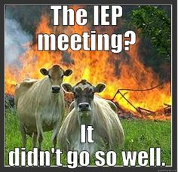
Challenges in Special Education
Most special education conflict centers on the development of the IEP.
A natural imbalance of power exists that results in parents feeling undervalued in the IEP process.
School staff members, administrators, and families often become focused on disagreement and engaged in a relationship strained by unresolved conflict.
School districts are spending over $90 million per year nationally on conflict resolution.
Notes:
Challenges

Slide 3
Notes:
MAF
Timing-> 1 minute
So what they did was…
Next->Our solution: Facilitative Skills

Slide 4
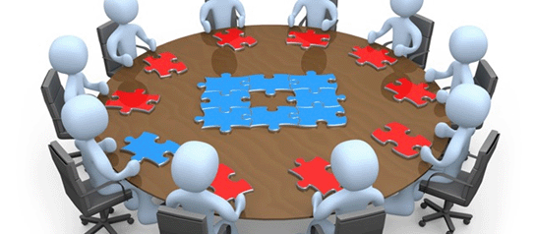
Our Solution: Facilitative Skills for all IEP Stakeholders
When are facilitative skills helpful?
EVERY day.
At EVERY IEP team meeting.
BEFORE disagreements become disputes.

Slide 5
Benefits of Using Facilitative Skills
According to the American Bar Association, benefits include:
Parties get to decide: All parties, who know the student, control the outcome.
Fosters continuing relationships: Facilitation does not dismantle relationships, it bolsters them.
Facilitation deals with feelings: It respects that a child is at the heart of every disagreement.
Outcomes are durable: There is a higher level of satisfaction, resulting in more durable agreements.
Lower cost: Informal issue resolution is ALWAYS less costly than more formal options. Cost is measured on the human and financial dimensions.

Slide 6
What is IEP Facilitation?
Option for using an impartial third-party facilitator to promote effective communication
Focuses on the development of the IEP
Ensures everyone at the table has a voice
Encourages active listening by all participants
Voluntary process, with both parties agreeing
Collaborative and solution-focused
Is a promising best-practice used by many states for alternative dispute prevention

Slide 7
Purpose of
Facilitation
Maintain open communication among all members, using active listening skills
Assist team in understanding resistance and resolving conflicts through consensus decision-making
Needs of the Child
Help IEP team members develop and ask clarifying questions
Help team members stay on task and on time
Notes:
MAF
Timing->2 minutes
Next-> IEP Facilitator request process

Slide 8
To provide a funded support system and toolbox of options, for ALL special education stakeholders in order to increase a more collaborative IEP process and positive relationships.

Slide 9
Our Collaboration
Formation of the Alternative Dispute Resolution Advisory Board (ADRAB)
Focus:
National research
Development of curriculum
Educator training
Parent resources
Restorative justice practices
Joint collaboration between local school districts and the department of education including:
Directors of Special Education
Higher education
Educators
Colorado Department of Education specialists
Parents/Parent Training and Information Center representatives
Community agency personnel

Slide 10
Deeper Collaboration between the SEA and an LEA
Increased need in district
Director joined ADRAB
Partnered to provide training to staff
Partnered to provide information to Special Education leaders in the state
Utilized statewide facilitators
Worked with state to improve practices and curriculum

Slide 11
Colorado’s Dispute Resolution Statistics
Note: The Special Education population in Colorado grew by 19,278 from 2010-2018.

Slide 12
Scaling Up
Statewide need identified
Board created
Curriculum developed
Creation of ADR Specialist position
Training for all districts, as requested
Facilitative Skills training
Facilitator training
Follow-up supports
Key district staff to co-train
Collaborative contract with Parent Training and Information Center
Statewide facilitator need identified
4 part-time facilitators hired and trained
Electronic request process developed
Electronic evaluation developed
Monthly facilitator workgroup meetings

Slide 13
Ultimate Goal
To build sustainability through
Facilitation Skills for All!
Use of Facilitation Skills By All IEP Members
Impartial Facilitator From the District, a Neighboring District or Community Agency
Impartial Statewide Facilitator
Notes:
Timing->2 minutes
HO Give participants the facilitative continuum handout. Go over the range of options illustrated in the HO Clarify the rest of today is about what ALL meeting participants can do to help a team function better – it’s the skills everyone can use, it’s not learning how to be the neutral 3rd party facilitator in someone else’s meeting.
Next-> Options for skill building classes:

Slide 14
Colorado’s ADR Data Snapshot Fall of 2017-Present
Trainings
Over 1000 trained in the Improving IEP Teams: Skills for Resolving Conflict
Over 200 trained as neutral IEP Facilitators
Skills taught at multiple conferences and shortened trainings in districts
99.5% of participants’ survey responses found the training extremely helpful in their day-to-day IEP meetings, with the visual tools as very valuable.
Facilitations
392 requests for statewide facilitators
Has this reduced the likelihood that other Dispute Resolution options will be utilized?
87% of respondents in the IEP meetings facilitated by a statewide facilitator said it was likely.

Slide 15
Taste of the Training!

Slide 16
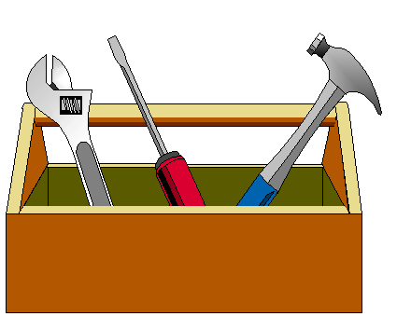
Powerful Tools
Use VISUALS!
Increases understanding
Keeps teams on track
Charting to create visual memory
FAPE Continuum to focus areas for discussion
Predefined agenda to plan time and stay on target
Conflict wheel to target primary source of issues
Power of intentional words to build trust/team
Key questions to identify underlying interests
Listening skills to help everyone be heard
Reviewing skills after each meeting

Slide 17
IDEA Basics- Guiding Principles
Terminology
The language of special education.

Slide 18
IDEA: Know with Precision
Free Appropriate Public Education
Least Restrictive Environment
Special Education & Related Services

Slide 19
The FAPE Continuum
Evaluation
Present Levels & Need
Measurable Goals
Services in the LRE
Accommodations Modifications
Educational Benefit
Speech Language Services
Google folder
Handout

Slide 20
It Begins with a Comprehensive Evaluation
Without a clear understanding of the student’s educational needs, it is impossible to determine FAPE.
Educational needs means academic, functional, social, or behavioral.
This is a probing question model.
Google Folder
Handout

Slide 21
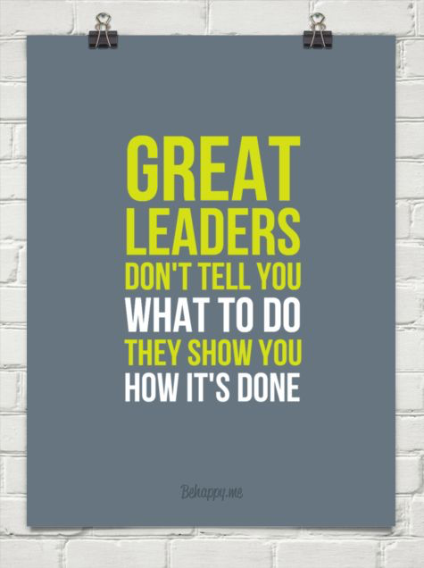
Agendas
Are living documents.

Slide 22
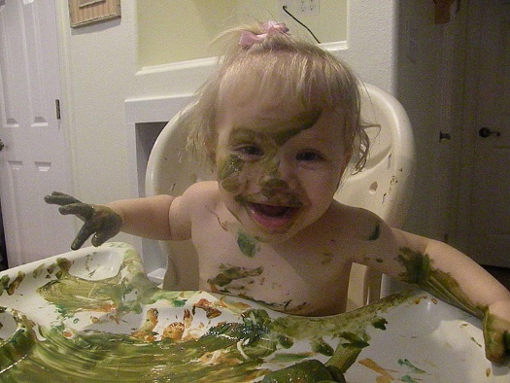
Conflict It’s okay to let it get messy!
Conflict is a signal or message that something is not working and needs to be different.
~ Talk Through Conflict Using Interest-Based Problem Solving, Education Service Center Region 4 (2011). ~

Slide 23
Conflict Wheel
When we understand the source of conflict, we can find a way to work through it.
Different sources of conflict produce different challenges.
Find the PRIMARY source(s) of the conflict to find a solution.
https://prezi.com/9ol7pfemugmr/?utm_campaign=share&utm_medium=copy
Google folder
Handout

Slide 24
Active Listening Techniques

Slide 25
YOUR WORDS: Affirms the speaker.

Slide 26
Mirror ~ Use the speaker’s words ~ Helps the speaker feel heard

Slide 27
REFRAME
Reframe
Negative to Neutral:
Remove the Toxicity
Notes:
Timing-> 1 minute
This one of the most useful facilitation skills you can develop and use. The entire purpose of reframing is so you can move negative information to neutral so the information can then be used to help the team move forward. Just because there is negativity in the initial thought does NOT mean there isn’t valuable information to learn and leverage in and behind the comments.
Reframing is a tool you can use when a bomb gets dropped in your IEP meeting.
Let’s learn more about…
Next->Reframing

Slide 28
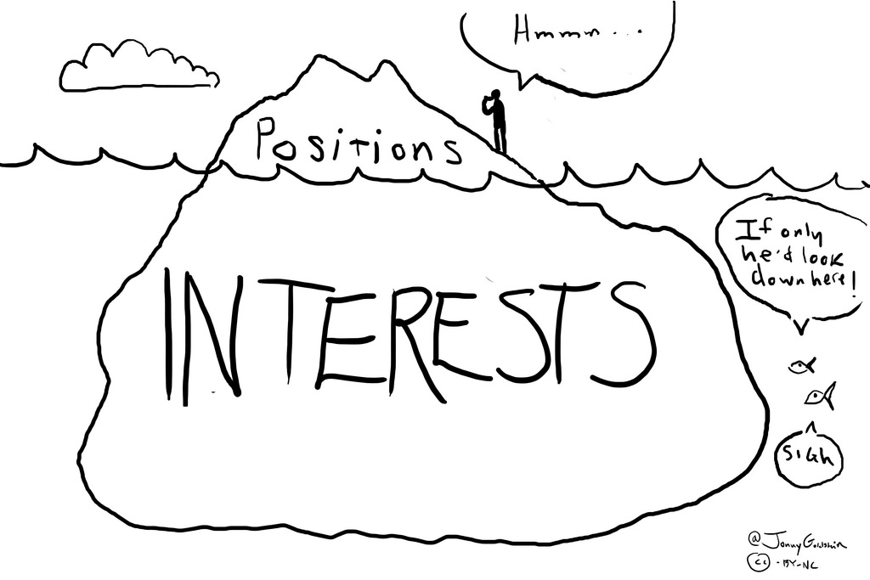
Positions vs. Interests
Look Below!

Slide 29
Focus on Open Ended
Open Ended
Most bang
for your buck!
Clarifying Questions
Problem Solving
Directed Yes/No

Slide 30
Space of Change
The concept of space is both mental and physical. Be strategic in creating the space of change.
Speak when you are angry and you will make the best speech you will ever regret.
~Ambrose Bierce
Notes:
Timing-> 1 minute
This concept is both mental and physical. It refers to balancing power between parties, dealing with high emotions, being sensitive to cultural issues, and preparation of the physical environment to encourage full participation of the parties. Be intentional. Create the space of change, in order to increase openness to other ideas.
Love this quote! Does anyone in this room resemble that remark? I know I sure do!
Next-> Let’s dig deeper into what we can do to help create the Space of Change for an IEP team.

Slide 31
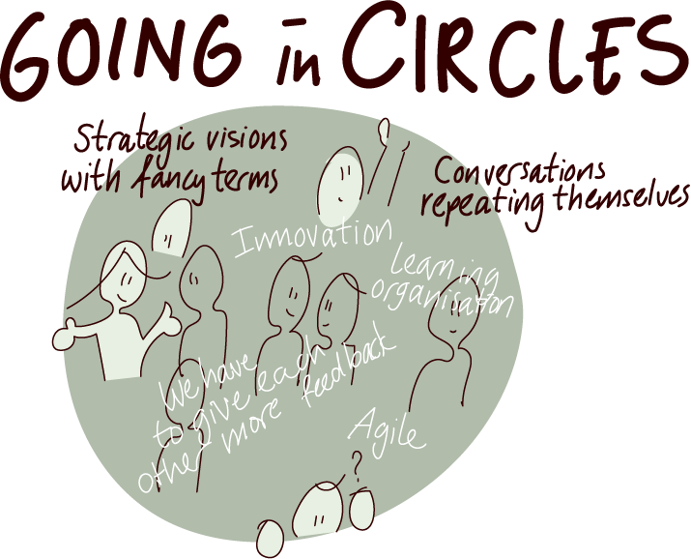
Space of Change
Creating the space of change refers to:
Balancing power
Preparing the physical environment
Cultural sensitivity
Silencing mind chatter

Slide 32
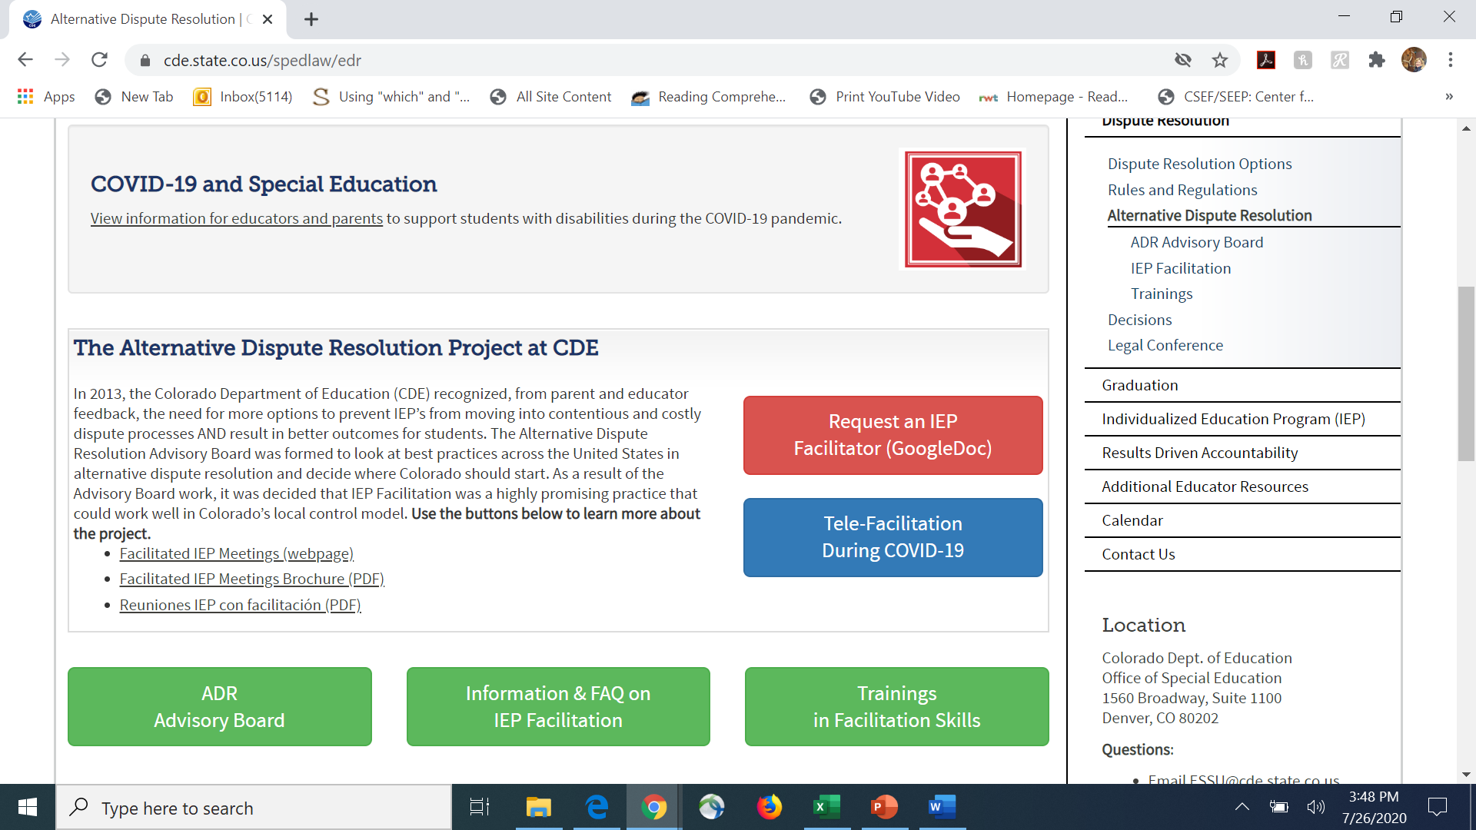
Alternative Dispute Resolution

Slide 33
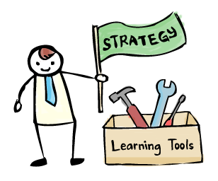
The Facilitator Request Process
IEP Facilitation Request received.
Agreement of both parties is secured.
A statewide facilitator is assigned, or one who is trained in the area will be identified.
Facilitator contacts district and parents to develop a mutually agreed upon agenda.
Before the meeting, Agreement to Participate in IEP Facilitation form is signed by both parties.
Facilitator begins with introductions and review of the agenda, allowing for revisions to be made at that time.
Evaluation is distributed following the meeting.
Important to keep the Director in the loop about any needs

Slide 34
Additional Resources
CDE website on IEP Facilitation: http://www.cde.state.co.us/spedlaw/fiep
PEAK Parent Center: www.peakparent.org
CADRE: A Tale of 2 Conversations Study guide & Videos: http://www.directionservice.org/cadre/TaleStudyGuide.cfm
Nature vs Nurture: Our Brain’s Response to Conflict: http://www.directionservice.org/cadre/fowlercookwebinar.cfm
CADRE Resources on IEP Facilitation: http://www.directionservice.org/cadre/ctu/processdefs14.cfm?thisid=12
Notes:
Timing-> 2 minutes
Next-> PEAK services…

Slide 35
Questions?
Mary Anne Fleury, Ph.D.
Assistant Director of Special Education
Black Hills State University
mary.fleury@bhsu.edu
605-642-6329
Geralynn Olvey, Ed.D.
Retired Director of Special Education
Exceptional Student Education Specialist
Marion County Public Schools, FL
skoego@aol.com

