Slide 1
Preparing for OSEP’s Differentiated Monitoring Activities of Your State's Dispute Resolution System with CADRE’s Resources
Melanie Reese & Kelly Rauscher
CADRE
CADRE Symposium 2022

Slide 2
Welcome
Please introduce yourself to the folks at your table:
your name, where you call home, your professional role, and most importantly, what recommendations you have for one of the following:
Binge TV
Potluck Offering
Activity for Family Gatherings

Slide 3
3
Who’s Here?

Slide 4
4
How We Roll
We all come to this work with varying degrees of knowledge and experience. We encourage you to share and learn from each other during this workshop and beyond. We invite you to:
Practice explaining your system with your peers
Share lessons learned
Ask questions
Maintain anonymity (share the message but not the messenger)
Exchange contact information with each other
Post questions to CADRE’s listservs for state agencies
Contact CADRE for additional support opportunities

Slide 5
5
Objectives
Review the Process for OSEP’s DMS 2.0
Explain your System and Demonstrate Effectiveness
Explore Tools to Check Alignment of your State’s DR System with the IDEA Regulations

Slide 6
6
OSEP’s Differentiated Monitoring System (DMS) 2.0
Beginning in Federal fiscal year (FFY) 2021, Part B and Part C programs in States will be monitored by OSEP in a five-year cycle. OSEP will monitor all States on their general supervision systems. This includes monitoring States’ dispute resolution systems.
Compliance
and Results

Slide 7
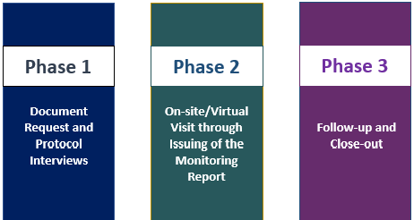
The DMS 2.0 Process
7

Slide 8
Opportunity Knocks
Hmm…

Slide 9
DMS Preparation Options and System Improvement
Tasks at hand:
Explain your DR System and How it Integrates with General Supervision
Demonstrate Compliance with IDEA
Multiple pathways to the work. Consider:
Interests and goals
Timeframe and capacity
Agency priorities
Current context and culture

Slide 10
Time Investment
Allocate sufficient time.
Create mechanisms to regularly engage in the work.

Slide 11
System Improvement in Preparation for DMS 2.0
Assess Needs & Identify Priorities
Plan
Implement
Monitor/
Adjust
Evaluate Impact

Slide 12
Resources
OSEP Protocols
OSEP DR Self-assessments (Part B & C)
CADRE’s Dispute Resolution Process Manuals as companion tools (Part B & C)
CADRE’s Dispute Resolution Data Drill Down Tool
Colleagues
Listservs
SEA/LA Legal Council
Learning Communities
12

Slide 13
Organization of DMS Protocols
Overarching Questions
General Information
Possible Follow-up Questions
Areas (or issues) for Follow-up
D. What are the State requirements regarding the scope of allegations and relief that may be included in a State complaint?
34 C.F.R. § 300.151; 34 C.F.R § 303.432; Questions B- 5 through B- 9 of the IDEA Part B Dispute Resolution Q&A (July 2013)
The State may not refuse to resolve a parent’s State complaint challenging a public agency’s eligibility determination.
The State must resolve State complaints alleging that a public agency has not provided FAPE to an individual child or a group of children in accordance with Part B.
How does the State resolve a State complaint challenging a public agency’s eligibility determination?
How does the State resolve a State complaint that concerns a matter that could also be the subject of a due process complaint?
The State only resolves complaints filed on behalf of individual children.
The State limits the remedies a complaint investigator may order (e.g., compensatory services).

Slide 14
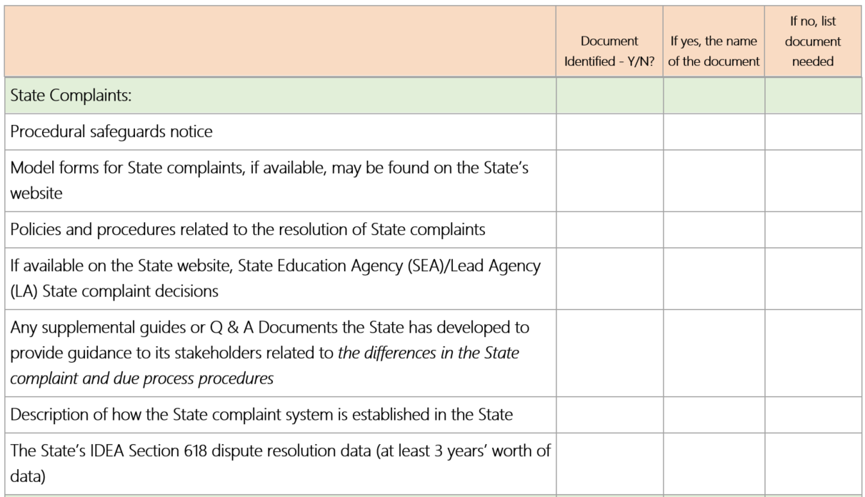
OSEP Monitoring: Document Reviews*
* List is not exhaustive

Slide 15
Submitting Documents
Suggestions from OSEP on Submitting Documents
Use the Document Request Template to list the name/resource to be considered for the component area
Send documents for one component area together in one email/zip
Develop an online file system that groups documents by component area
Use an identifier on the document or resources that clearly identifies which component it would be connected (e.g., DR-SC, DR-DP, DR-M)

Slide 16
Explaining your System to OSEP
OSEP differentiates its approach for each State based on the State’s unique strengths, challenges, and needs.
The DMS Protocols are designed to demonstrate to OSEP your unique dispute resolution system.
16

Slide 17
What Do They Say?
STATE COMPLAINT
Parent Center
Web
Forms
Procedural Safeguards
Personnel
Final Reports
Internal Manuals
Practices
Tracking
Corrective Actions
LEAs or Providers
17

Slide 18
Stakeholders & Local Components to DMS
OSEP emphasized their intention to incorporate stakeholder feedback into their monitoring activities, and that dispute resolution will be a topic for discussion.
Stakeholders:
Parents and Parent Centers
State Advisory Panels
Protection and Advocacy Organizations
Local Educational Agencies/Providers
18

Slide 19
Considerations for Stakeholder & Local Components
How does the State share dispute resolution information with stakeholders?
How does the State meet its dispute resolution reporting requirements?
How does the State seek out and incorporate input from stakeholders?
19

Slide 20
Explaining Your DR System
Artifacts
What artifacts are publicly available? What do they say about your DR System?
What additional artifacts will you provide?
How will you organize documents?
Data
What does your publicly available data show? What doesn’t it show?
What additional data do you collect that can help explain your system? How might you use it?
20

Slide 21
Explaining Your DR System, cont.
Messenger
Who will explain various aspects of your Dispute Resolution System ?
Message
What information will be shared?
How will it be shared? What tools might be used?
Tips
Practice explaining and responding to the protocol questions.
Ask for feedback.
Was the information clear?
Did the information contradict any artifacts?
Consider how information might be shared with the stakeholders OSEP will interview.
What is their understanding of the State’s DR policies, procedures, and practices?
Is clarification needed?
21

Slide 22
Possible Evidence
Internal Procedural Manuals
Procedural Safeguards Notice
Model Forms
Website Information (SEA/LA)
Written Materials
State Policies
Data
Documentation
Final Decisions
Meeting Notes
Tracking System
Signature Forms
Email/Correspondence
Evaluations
Follow up activities
Trainings
Practice
Interviews
Interviews
Informal memos
22

Slide 23
Red Flags
= Contradictions
Documentation
Practice
Interviews
23

Slide 24
Integrated Monitoring System
In groups:
Discuss how information is shared, with whom, and the mechanisms used, to keep information flowing between DR and Monitoring. Consider:
Regularly scheduled meetings
Access to data software solution (what type of reports can be created?)
Other?
24

Slide 25
Scavenger Hunt: Model Forms and your DR Websites
With a partner, look at your states’ model
forms for:
Mediation - State Complaints - Due Process
What information is required on the form? Is there additional information requested beyond what is required?
How easy are they to locate?
How accessible are the forms and the information?
What does your website communicate about your DR system?
25

Slide 26
Findings Related to Forms
Complainants were required to use the model form.
Timelines delayed as complaints received had to be put on the form before timeline began.
States required additional information in order to file the form and didn’t mark it as “optional” information (e.g., disability, date of last IEP meeting).
26

Slide 27
State Complaint System
27

Slide 28
Explain your WSC Timelines
You have been asked to explain your WSC process from the moment you receive a complaint to the release of the findings.
Receipt
Closed
28

Slide 29
Findings Related to Timelines
A State set aside issues in a State complaint that was also subject to a DPH, but the State did not have a mechanism for resolving those issues after a hearing officer dismissed the DPC or did not rule on the substance of the complaint (e.g., A State relied on parties to notify them that the DPH did not address the issue).
A State that has procedures that set aside a State complaint when parties were engaged in mediation regardless of whether the parties agreed to extend the 60-day complaint resolution timeline to engage in mediation.
Once an SEA had set aside a State complaint to allow parties to engage in mediation, the State did not have a process to ensure that when mediation was not successful, the complaint was resolved within 60 days after the complaint was filed.
29

Slide 30
Extending and Resolving State Complaints
What are the circumstances in which your state would extend the WSC timeline?
What are the different ways that a State complaint is resolved?
Does your State have an appeal process for WSC?
Does the appeal impact timelines?
Does the appeal impact implementation of corrective actions?
30

Slide 31
Findings Related to Extensions and Resolutions
State granting extensions for exceptional circumstances without respect to a particular complaint (e.g., administrative convenience; personnel shortage).
Even if the State had an appeal process, the report must still be issued within the 60-day timeline.
States did not make an independent decision on each allegation (e.g., accepted the LEA’s resolution and closed complaint).
The State’s written decisions did not include all requirements, including addressing for each allegation: findings of facts and conclusions and the reasons for the State’s final decision.
31

Slide 32
Findings Related to Scope of Allegations
Allegations regarding FAPE were dismissed or not investigated.
States were not investigating allegations that were system-wide, instead focusing on only individual level allegations (when impact to other students was apparent).
32

Slide 33
From the WSC Protocol: Improving Results
Additional Questions for Consideration :
What outreach efforts has the State conducted to promote State complaints as an effective way for parents and others to resolve their issues?
What has the State done to try and improve the dispute resolution system in addition to evaluating its effectiveness?
How does the State provide training and/or share what it has learned from State complaint decisions with LEAs/EI providers and stakeholders? How do State complaint decisions impact change in the state?
33

Slide 34
Due Process System
34

Slide 35
The Myth of the Great Wall
35

Slide 36
DMS 2.0 Protocol Questions around Resolution Sessions (shortened)
How do you track the 15-day timeline to hold the resolution meeting?
How do you track the 30-day resolution process timeline?
Have there been any complaints over implementing resolution meeting requirements, and if so, how did you resolve them?
How does the State ensure there is a public agency representative with decision-making authority in the resolution meeting?
What happens if a resolution meeting has not been scheduled within timelines? Do you impose sanctions/enforcement actions on public agencies who do not comply?
What training or procedures have been put into place to make sure that public agencies properly implement the resolution process?
How do you work to improve resolution meeting timeliness and outcomes?
Given that resolution meetings are an LEA responsibility for Part B programs, what type of communication exists between LEAs and the SEA with respect to the implementation of resolution meetings?
36

Slide 37
State Monitoring of Extensions
The State must ensure that the extension:
is for a specific period of time (not open ended)
occurs at the request of a party
What mechanisms are in place for the State
to monitor extensions and ensure they are appropriately issued and followed?
37

Slide 38
DMS 2.0 Protocol Questions around Extensions (shortened)
What are the circumstances that would warrant an extension?
How does the State ensure that the extension is for a specific period of time (not open-ended)?
What steps does the State take if a due process hearing decision is late?
Does the State have any additional limitations or criteria for extensions?
How is the length of the extension recorded?
How does the State track due process hearing extensions?
If the State finds that a hearing officer is inappropriately extending timelines, what action is taken?
38

Slide 39
Reporting Your 618 Data
39

Slide 40
Implementation of Decisions
The State must:
ensure a hearing officer’s decision has been implemented
accept a State complaint that a hearing officer’s decision was not implemented
40

Slide 41
DMS 2.0 Protocol Questions around Implementing Decisions (shortened)
How does the State ensure that a hearing officer’s decision has been implemented?
What evidence does the State review to substantiate implementation of the hearing officer’s decision?
After the hearing officer’s decision is issued, does the State follow up?
Does the State impose sanctions/enforcement actions on public agencies that cannot demonstrate timely implementation of hearing officers’ decisions?
If the State receives a State complaint alleging that a hearing officer’s decision has not been implemented, how does the State investigate the complaint?
41

Slide 42
Dual Filing of DPH and WSC
How does the State resolve a State complaint that concerns a matter that could also be the subject of a due process complaint?
The State must have procedures to track the resolution of any due process complaints that contain the same issue if a State complaint is being held in abeyance.
42

Slide 43
Protocol Questions around Dual Filing of WSC and DPH (shortened)
Does the State place all State complaint allegations on hold when a due process complaint is filed on the same issue, even if some of the issues are not addressed in the due process complaint?
How does the State resolve a State complaint that concerns a matter that could also be the subject of a due process complaint?
How does the State track the resolution of a due process complaint that includes an issue in a pending State complaint?
What are the procedures to ensure that the outcome of a due process complaint that includes the same issue in a pending State complaint is analyzed to determine whether that issue was addressed in the hearing decision (or must be resolved by the SEA through the State complaint procedures)?
43

Slide 44
System Improvement Strategies in Preparation for DMS 2.0
Assess Needs & Identify Priorities
Plan
Implement
Monitor/
Adjust
Evaluate Impact
44

Slide 45
Identify Strengths and Issues
Identify strengths and find opportunities to highlight these areas (make sure that these strengths are in fact compliant with IDEA)
Identify issues of non-compliance
Identify out-of-date documentation
Identify inconsistent messaging
Reflect on your State’s system. What potential issues are you currently aware of?
45

Slide 46
Understand the Issue(s)
Not all issues are created equally.
Is the issue simple or complex?
If complex, ask:
Who is affected by this issue?
Why is this happening? What are the most likely causes?
When and where does the issue show up?
What data/evidence supports our claims?
What happens if issue isn’t addressed?
What happens if issue is addressed?
Who may be affected by the potential solutions?
46

Slide 47
Prioritize Issues
You have identified several areas of concern and understand the issues better. What, if anything, do you tackle now?
Consider:
What might it take to address each issue?
Who would need to be involved in decision making, planning and implementation?
What level of stakeholder involvement is needed?
What are the implications for the change?
What resources are needed (including time)?
Consider addressing non-compliance issues with easy fixes first.
47

Slide 48
Addressing Issues
Narrow your focus. Consider addressing one issue at a time.
Map out activities, person(s) responsible, and deadlines.
Carve out time to complete activities.
Have regular check ins.
48

Slide 49
Explaining and Improving your Dispute Resolution System
Leveraging this Process to Better Explain and Improve your System
CADRE’s Dispute Resolution Process Manuals as companion tools
CADRE’s Dispute Resolution Data Drill Down Tool
49

Slide 50
System Assessment and Improvement
50

Slide 51
Features: IDEA Regulations
Explains required SEA procedures under IDEA

Slide 52
Features: Key Citations Linked
Imbedded Links to Key Citations
IDEA Regulations
Federal Register Comments to the Regulations
Federal Guidance and Key “Dear Colleague” Letters
Relevant Other Federal Guidance

Slide 53
Features: System Improvement Prompts
Coaching Questions

Slide 54
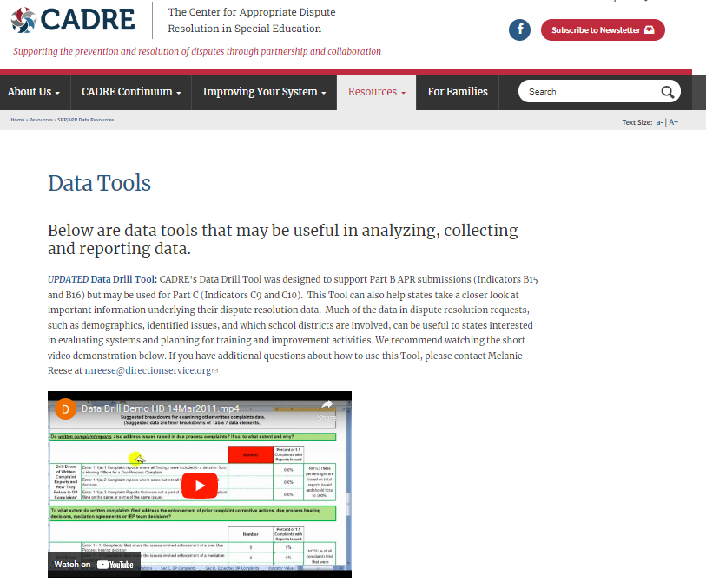
CADRE’s DR Data Drill Down Tool
https://www.cadreworks.org/resources/data-resources/data-tools
54
Prcts at right must total 100%

Slide 55
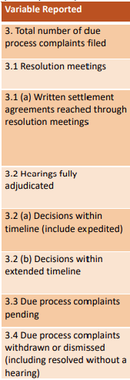
618 Data Offers Incomplete Picture
Mediation
State Complaints
Due Process
55

Slide 56
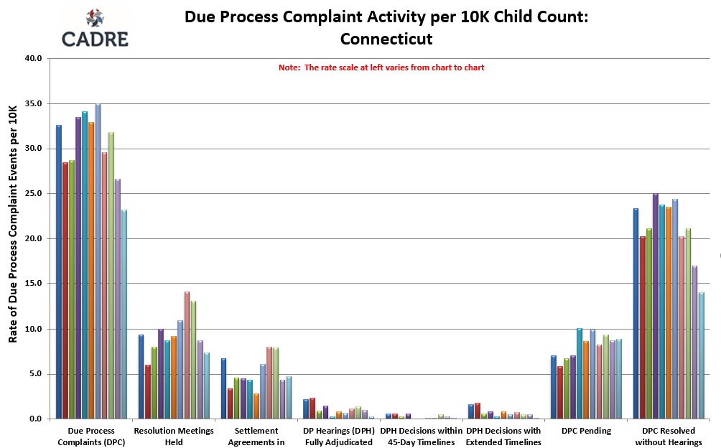
CADRE State Comparison and Longitudinal Data
56

Slide 57
Analyzing Existing DR Data
Review and compare State DR activity across years
What processes are used most often?
Trends in use? (e.g., demographics, disability categories, regions of state)
Consider trends in context of changes in DR policies/rules (e.g., stay put), website accessibility, use of more collaborative approaches, pandemics
57

Slide 58
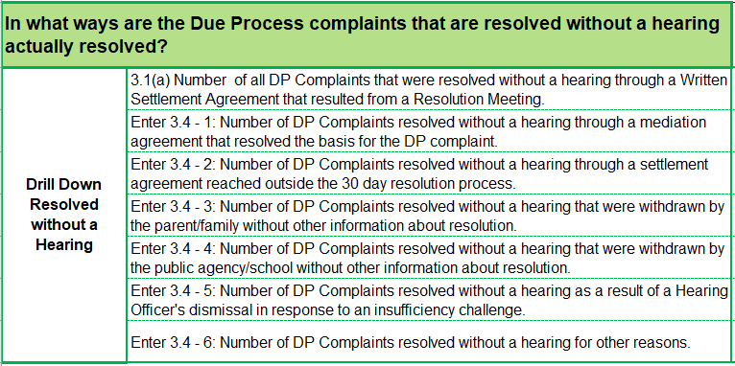
What is the Story Behind the Reporting Requirements?
58

Slide 59
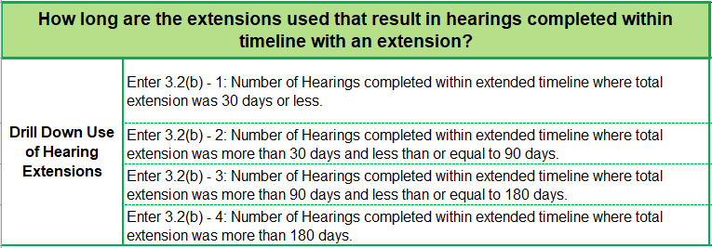
Telling a More Complete Story
59

Slide 60
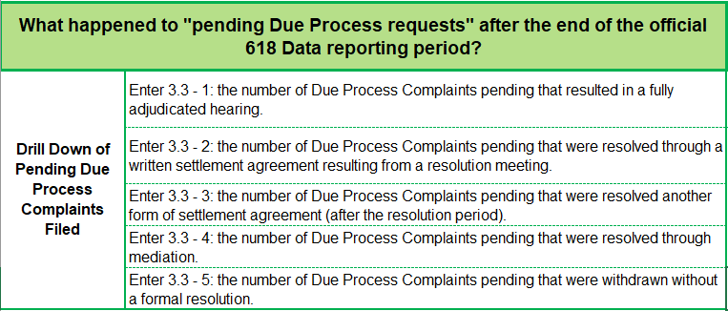
What Happens to the “Pending” DPH Requests?
60

Slide 61
Info You Likely Have but May Not Be Tracking…
What types of issues are being raised in Due Process Complaints, Written State Complaints, & Mediations?
Are specific processes utilized based on underlying legal issue or remedy sought?
Who requests/declines mediation?
How many unsuccessful mediations resulted in DP filed on same issues?
How long were the parties in active dispute prior to a complaint being filed?
61

Slide 62
Need Resources?

Slide 63
Find us at: cadreworks.org
63

