Slide 1
Ombuds Programs title slide
Ombuds programs: a flexible and responsive resource for families and schools
CADRE 2022 Symposium
Timothy Hedeen, Ph.D.
Marietta, Georgia
tim@hedeen.org

Slide 2
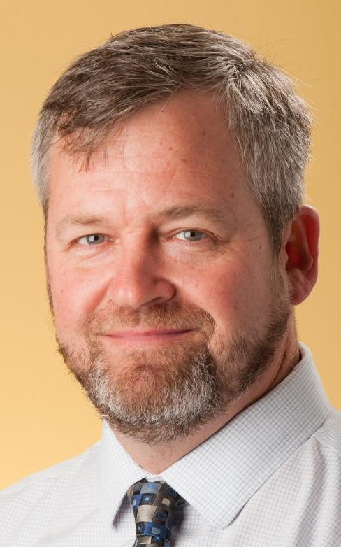
Agenda
Introductions
Our opening reflections
Context: the CADRE Continuum
One term, many functions, a few types
A showcase of existing offices
Your ideas, question, plans…
Open frame/Q&A
Agenda
2

Slide 3
Opening questions, reflections
Where do we frequently see…
Misunderstandings of roles or policies?
Disagreements over plans or programs?
Perceptions of unfair or unequal treatment?
Unaddressed or unresolved conflict?
Persistent problems or concerns?
Unrecognized or emergent trends?
Strained relationships, marked by mistrust?
Opening reflections
3

Slide 4
Session description
Ombuds offices serve many valuable purposes in education:
assisting parents* to navigate complex policies or systems,
helping schools to recognize novel or emergent challenges,
supporting districts and families to address concerns fairly and cooperatively whenever possible.
Ombuds practitioners integrate the skills of constructive conflict engagement and collaborative problem solving with their extensive knowledge of relevant policies and professionals across a district.
In case you're interested to learn more about creating, sustaining, or expanding an ombuds office, this session is for you!
Description
* some but not all; consider Denver
4

Slide 5
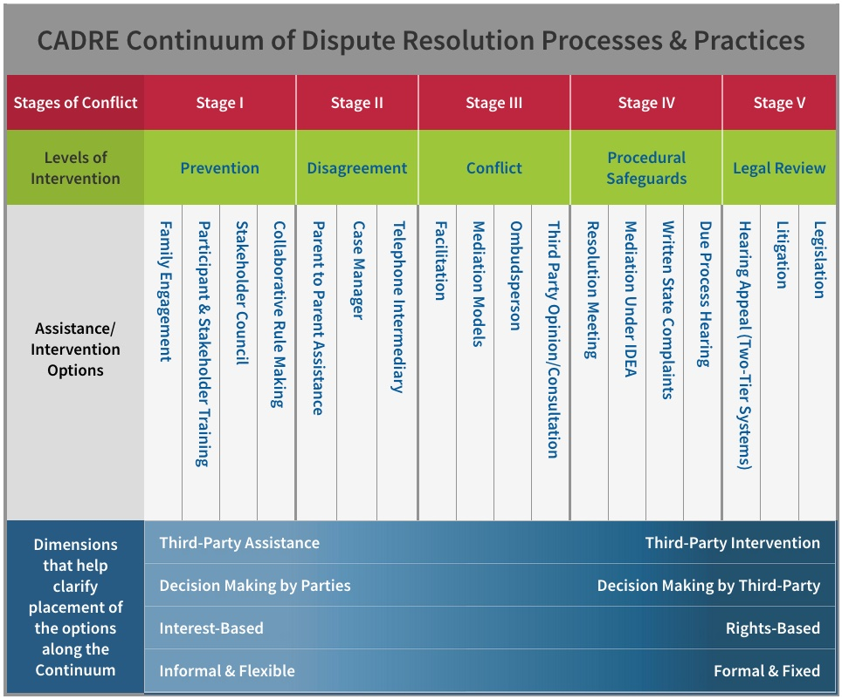
CADRE Continuum of dispute resolution processes
https://www.cadreworks.org/cadre-continuum
Context: the CADRE Continuum
< < < < Ombuds > > > >
5

Slide 6
One term, many functions
Ombuds
(or Ombudsman or Ombudsperson)
Internal
External
Families
Employees
constituents
One term, many functions
Clarifying policies
Explaining procedures
Identifying options
Credible review process
Ensuring fair treatment
Advocating
Consulting about hypotheticals (“generic approach”)
Observing climate/culture
Upward feedback
functions
Education
Government
Corporations
International org’s
context
6

Slide 7
Ombuds types
Classical/traditional/legislative
• Hold agencies accountable to the public; assist in oversight of those agencies.
• Conduct investigations and use subpoena power.
• Issue public reports. [note these two relate to “credible review process”]
• Advocate for change within the entity and publicly.
Advocate
• Represent constituents’ interests regarding policies implemented by the establishing entity, government agencies, or other defined organizations.
• Initiate action when merited in an administrative, judicial, or legislative forum.
Organizational
• Provide informal processes as specified in an office charter, including listening, considering options and referrals, acquiring/sharing information on policies.
• “Look into” concerns impartially and independently (sometimes with a “generic approach”), whether at the individual or organizational level.
• Facilitate constructive engagement of conflicts and other difficult issues.
• Deliver “upward feedback” to designated leadership, sometimes through reports.
7

Slide 8
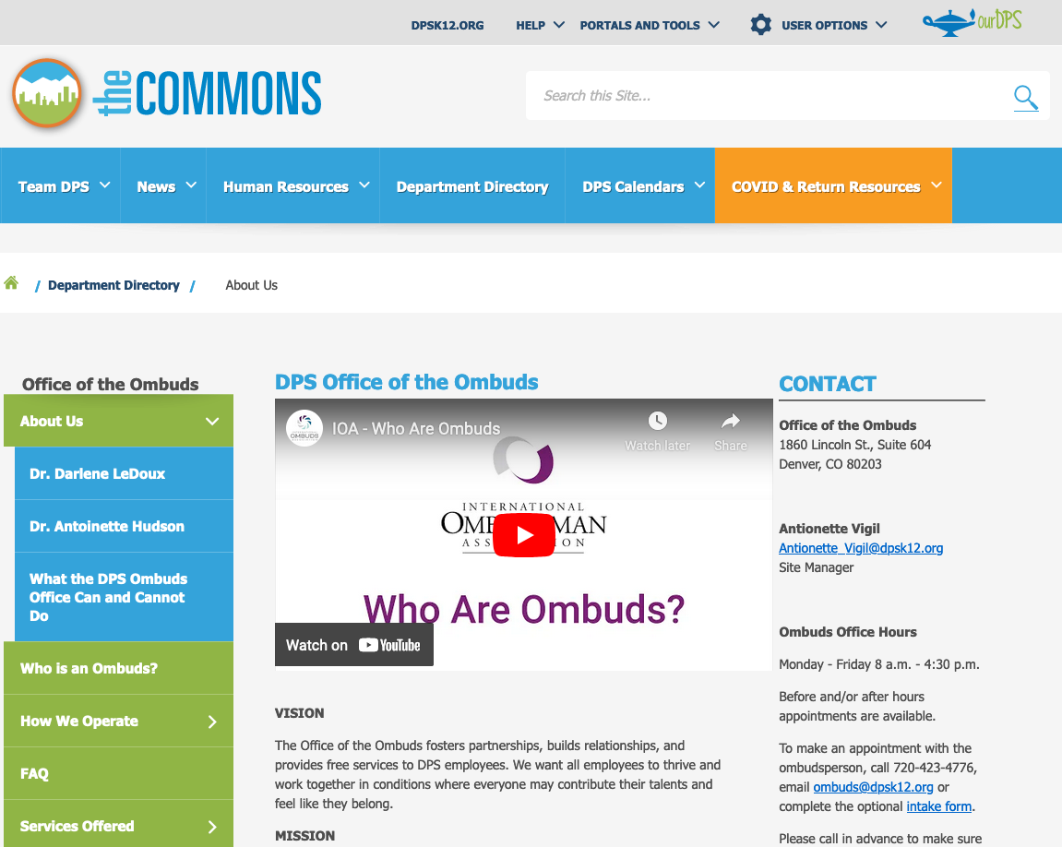
Denver Public Schools
http://thecommons.dpsk12.org/Page/3037
8

Slide 9
Denver office mission
Denver Public Schools
http://thecommons.dpsk12.org/Page/3037
9

Slide 10
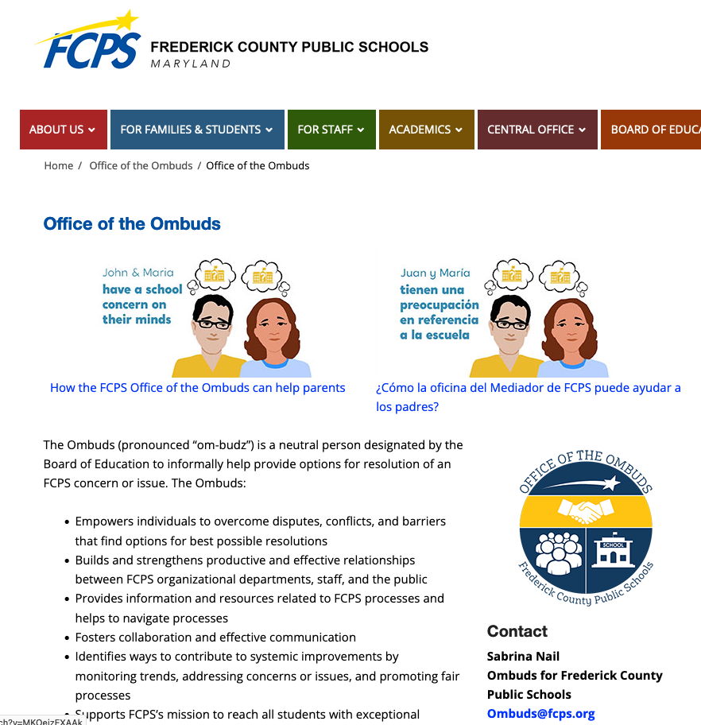
Frederick County (Maryland) PS
https://www.fcps.org/ombuds
10

Slide 11
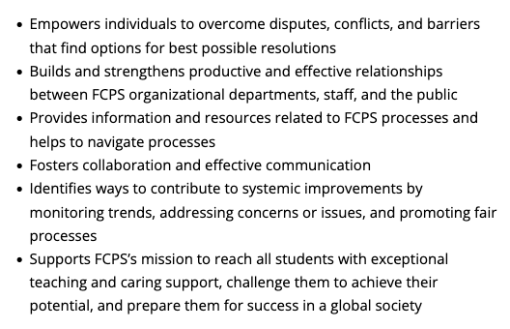
FCPS services, link to video
Frederick County (Maryland) PS
https://www.fcps.org/ombuds
Watch video at https://www.youtube.com/watch?v=MKOeizEXAAk
11

Slide 12
FCPS notes from colleague
I was fortunate to correspond with Sabrina at FCPS just a month ago. I asked a few questions…
How much of your ombuds portfolio of cases is related to special education?
About 10%
Which types of issues, questions or concerns do you observe most often?
Not being heard, not knowing about IEP process, disagreement with IEP.
Any recommendations for districts considering establishing an ombuds office?
Find a good K-12 Mentor, have a working knowledge of special education process.
Frederick County (Maryland) PS
12

Slide 13
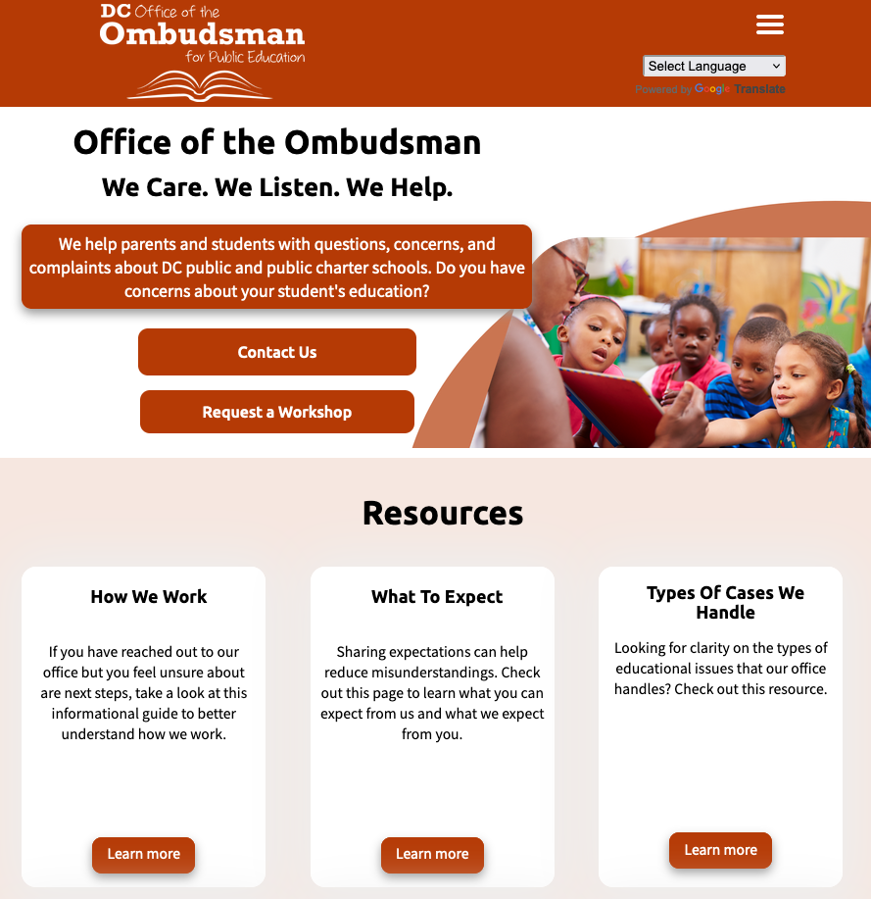
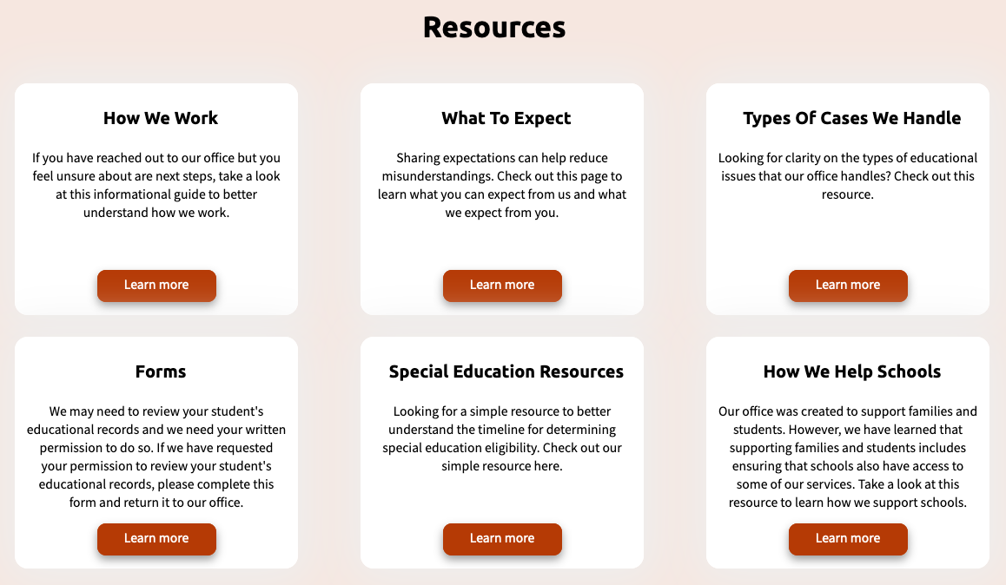
DC Office of the Ombudsman…
https://educationombudsman.dc.gov/
…for Public Education
13

Slide 14
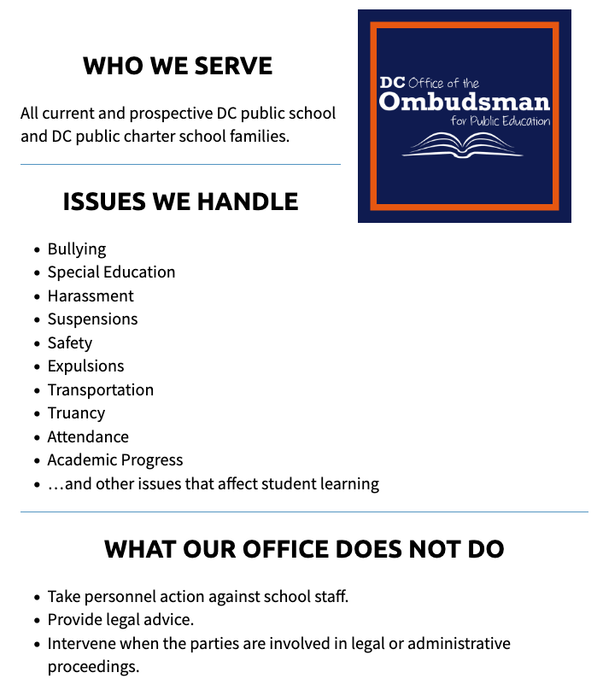
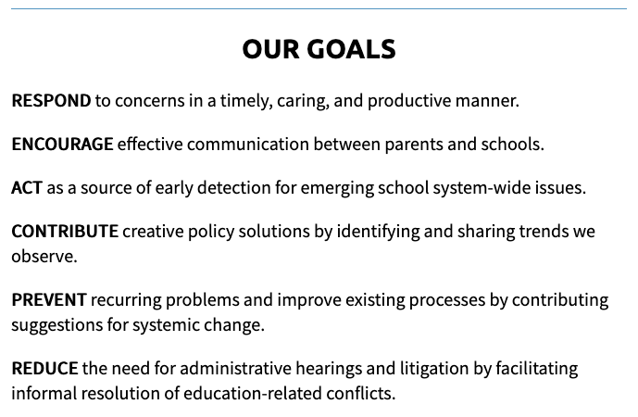
DC Office of the Ombudsman…
https://educationombudsman.dc.gov/page/services-support
14

Slide 15
Step by Step guide to Special Education services
DC Office of the Ombudsman…
https://educationombudsman.dc.gov/sites/default/files/dc/sites/
educationombudsman/page_content/images/SpEd%20Timelie.png
15

Slide 16
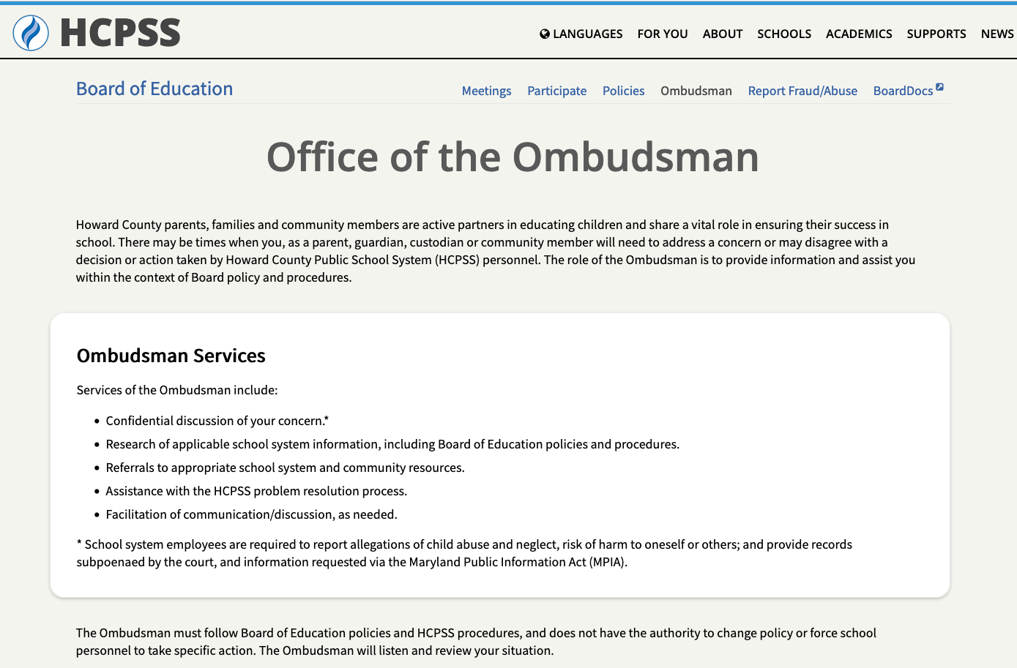
Howard County (MD) Public Schools
https://www.hcpss.org/board/ombudsman/
16

Slide 17
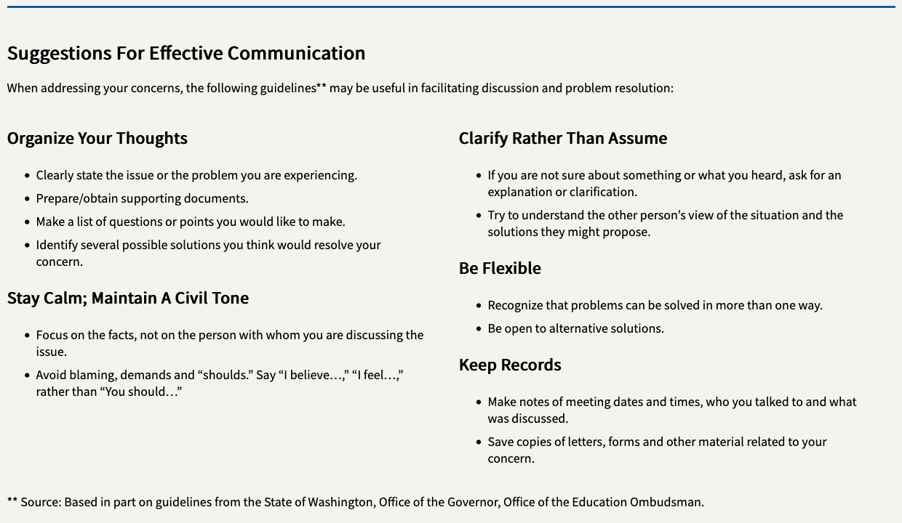
Let’s visit a few offices…
https://www.hcpss.org/board/ombudsman/
17

Slide 18
Washington State Gov’s Office…
Watch video at
https://www.youtube.com/watch?v=2PxiSEI9HIo
https://www.oeo.wa.gov/en
18

Slide 19
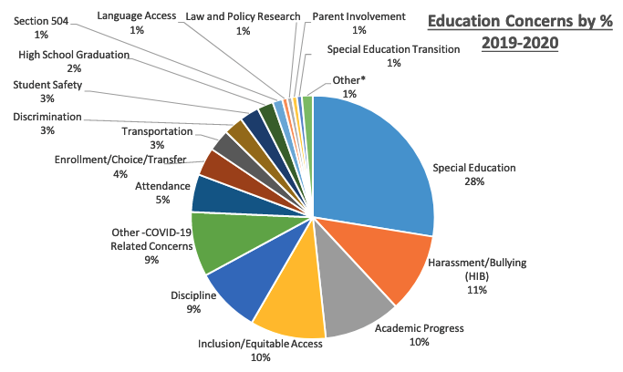
Washington State Gov’s Office…
https://www.oeo.wa.gov/sites/default/files/public/OEO_Annual_Report_2019_2020_Final_English.pdf
19

Slide 20
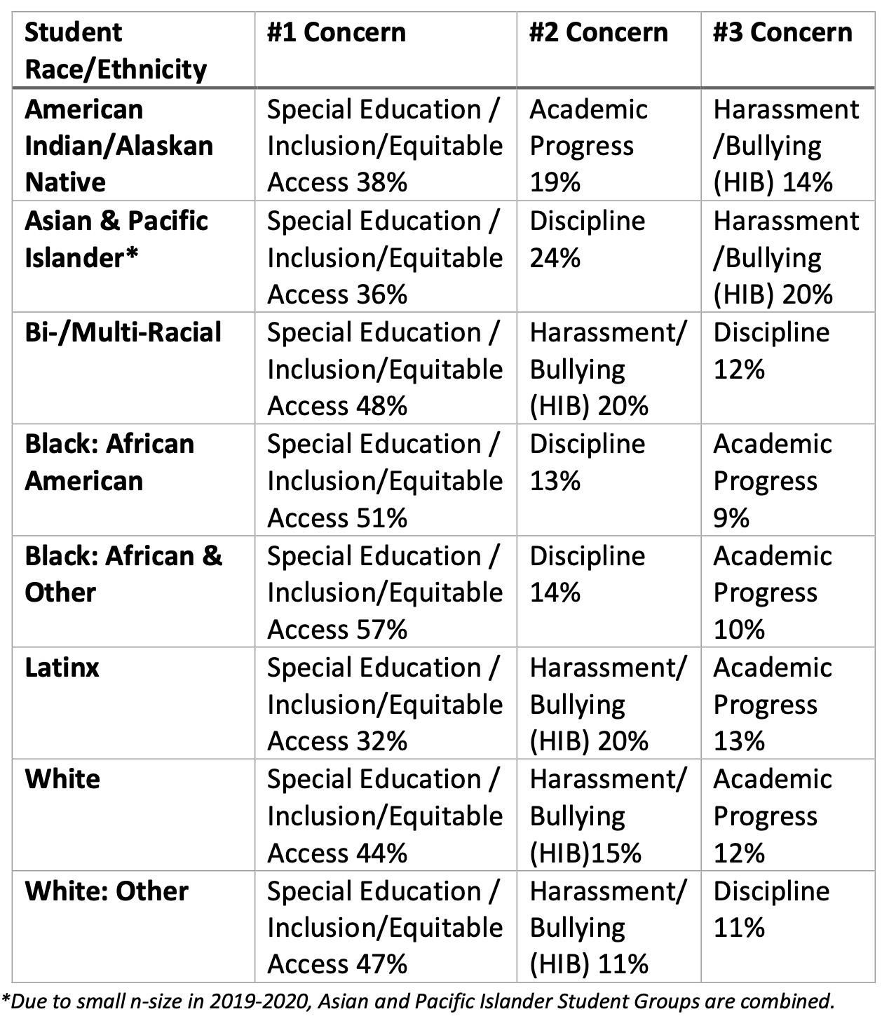
Washington State Gov’s Office…
20

Slide 21
Circling back before moving forward
You’ll recall (from
perhaps 45 minutes ago?)…
… as you consider your district, might an ombuds help?
21

Slide 22
Insights from Dispute System Design
The field of “DSD” offers a sequence for our consideration:
Recognize need or opportunity
Involve stakeholders
Assess well
Prioritize goals
Consider upstream initiatives
Design system
Raise awareness
Implement system
Evaluate, revise system
In case you (or your district) might explore the value or role of an ombuds, spend some time with #1 and #2…
And never lose sight of #5!
22

Slide 23
Useful resources
International Ombuds Association (IOA)
https://ombudsassociation.org
K-12 Ombuds Toolkit
https://www.americanbar.org/groups/dispute_resolution/resources/
A Practical Guide to Organizational Ombuds (2022) by Chuck Howard
https://www.americanbar.org/products/inv/book/417842533/
Ombuds Blog
https://ombuds-blog.blogspot.com/
23

