Slide 1
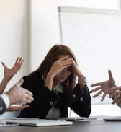
Let’s Deal With Conflict! Bridging The Research To Practice Gap For Collaborative IEP Team Outcomes
Amy Kilpatrick, Tracy Gershwin, and Robin O'Shea
2022 CADRE Symposia
October 26-28: Denver, CO

Slide 2
The Five Strategies
Collaborative Preparation
Graphic Recording
Student Facilitated IEP Meetings
Culturally Responsive Practices
Restorative Practices

Slide 3
STRATEGY ONE: COLLABORATIVE PREPARATION

Slide 6
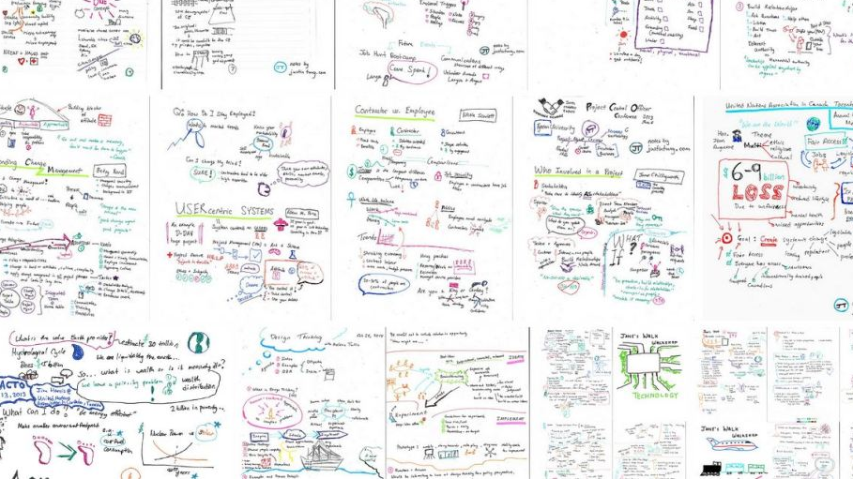
STRATEGY TWO: GRAPHIC RECORDING
This Photo by Unknown author is licensed under CC BY.

Slide 7
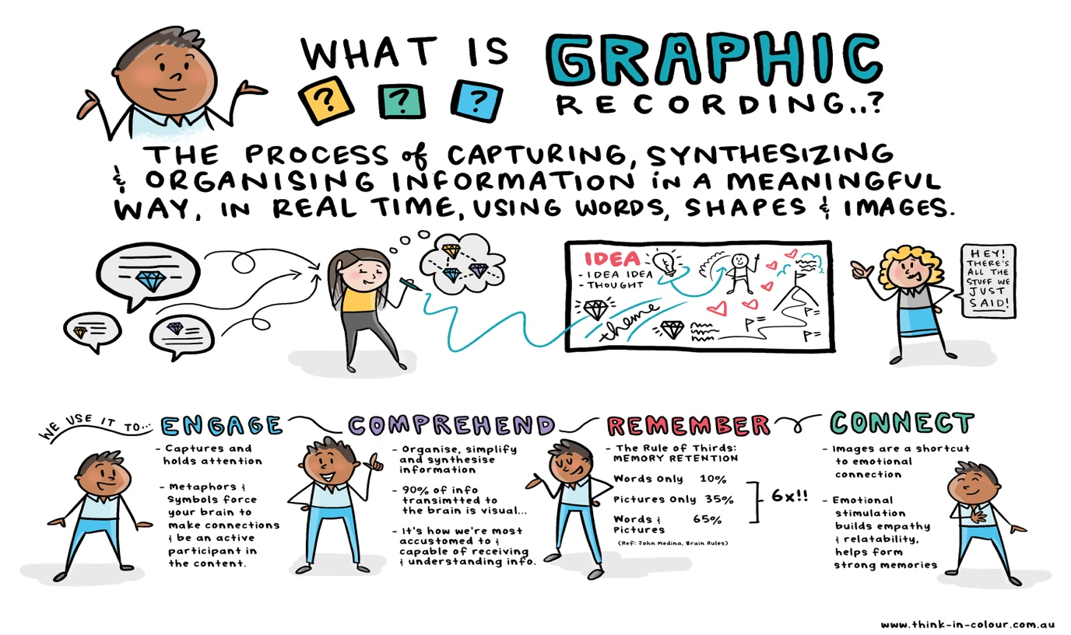
J. Gee, Retrieved March 19, 2019, from http://www.think-in-colour.com.au/services/graphic-recording/. Copyright 2019. Reprinted with permission.
Notes:
Graphic recording is an informal method where one team member, called the scribe, captures, synthesizes, and organizes information in a meaningful way using common terms, graphics and images as the conversation occurs from all team members
Graphic recording organizes the information, engages the participants and facilitates comprehension.

Slide 8
Graphic by Key2Ed, 2020
Notes:
In this example, the scribe writes the information on a large flip-chart, whiteboard, or projected computer screen to visually synthesize the discussion. Using this method during meetings promotes understanding, increases communication, and coordinates teamwork (Gergle, Kraut, & Fussell, 2013).
Team members who use graphic recording report feeling valued each time their thoughts are recorded for all to consider. IEP team members report one benefit of projecting informal recording rather than the IEP document itself gave them the feeling that their input was valuable and a truly a part of developing the IEP.
Critical barriers reported in IEP meetings include unequal power dynamics, confusion, discrepant views of the student,linguistic differences and lack of trust. Using a visual display to capture all team members input, clarify terms that are recorded, slow down the process to ensure understanding helps to combat these barriers.
Cho and Gannotti (2005) reported that all of the mothers interviewed for their study agreed that their limited English ability was not a barrier as long as professionals were willing to take the time to communicate with them by listening carefully and rephrasing the parent’s words in correct English to clarify and avoid misunderstandings. Using a graphic recording system promotes these practices. When the charter records jargon, or a complex proposal. The team members naturally consider the text and begin to discuss and clarify.
Muller and Vick’s (2017) research, describes this technique as collaborative. Team members view the information together which provides a reminder of key discussion points and encourages active participation (Mueller & Vick, 2017). Furthermore, the visuals aid in complex decision making and keep the group focused on one task (Paul, Haseman & Ramamurthy, 2002; Gergle, Kraut, & Fussell, 2013).

Slide 9
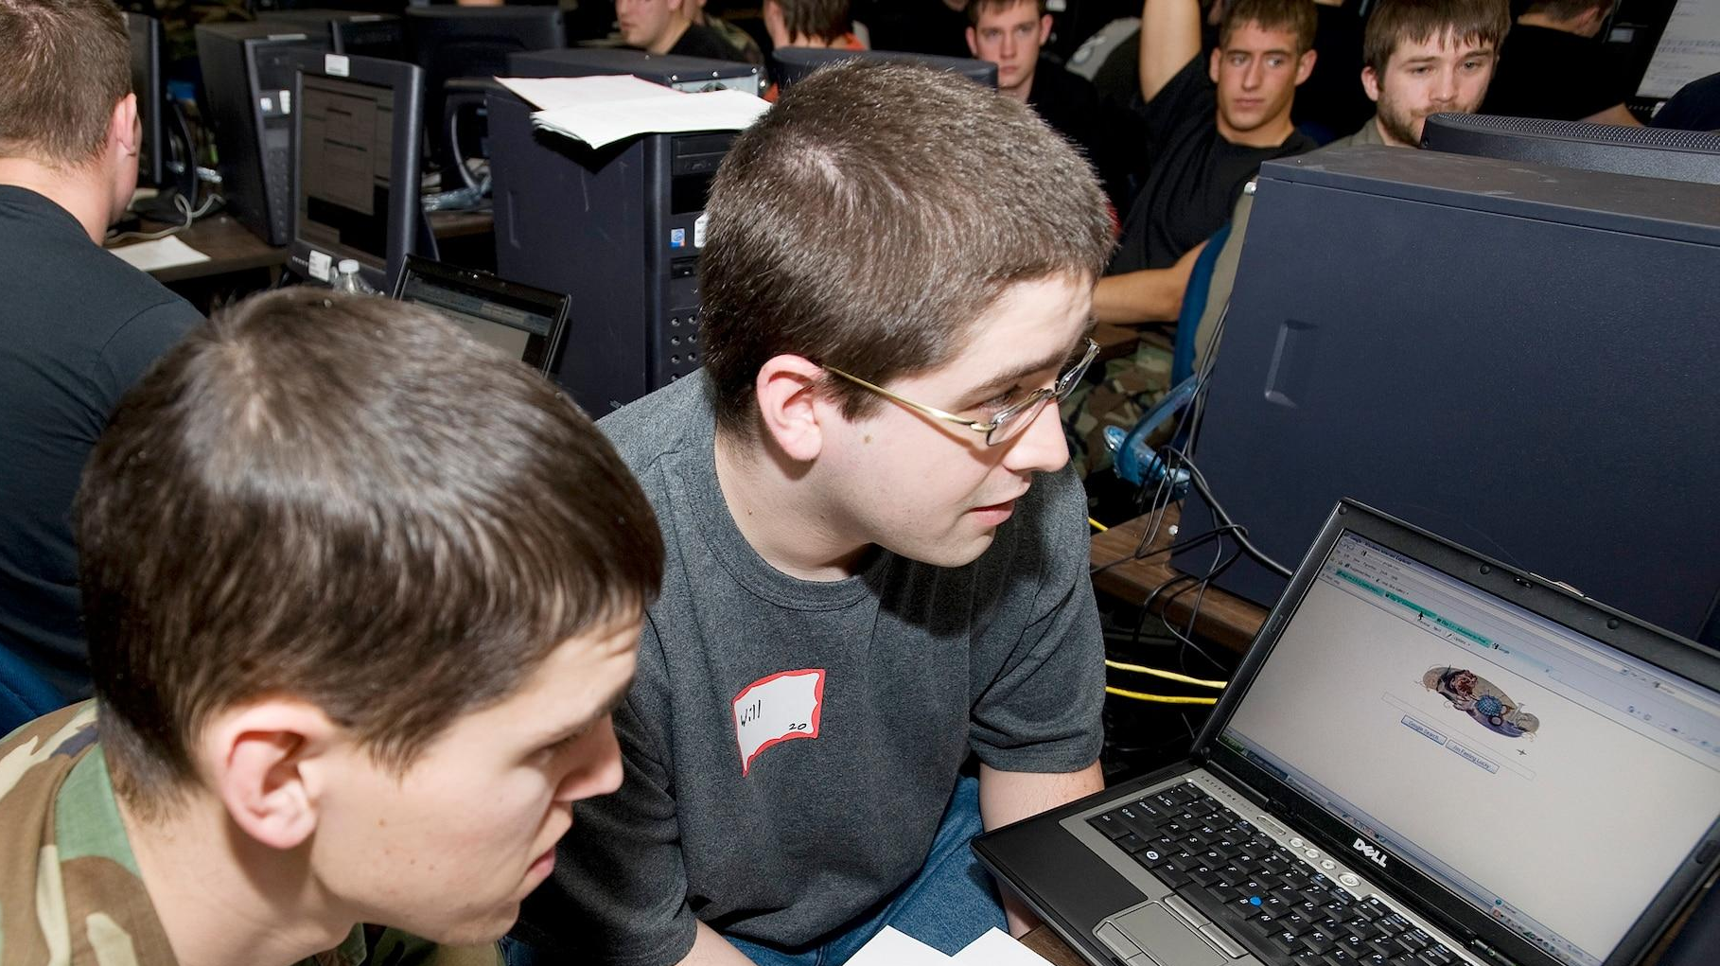
STRATEGY THREE: STUDENT-FACILITATED IEP MEETINGS

Slide 11
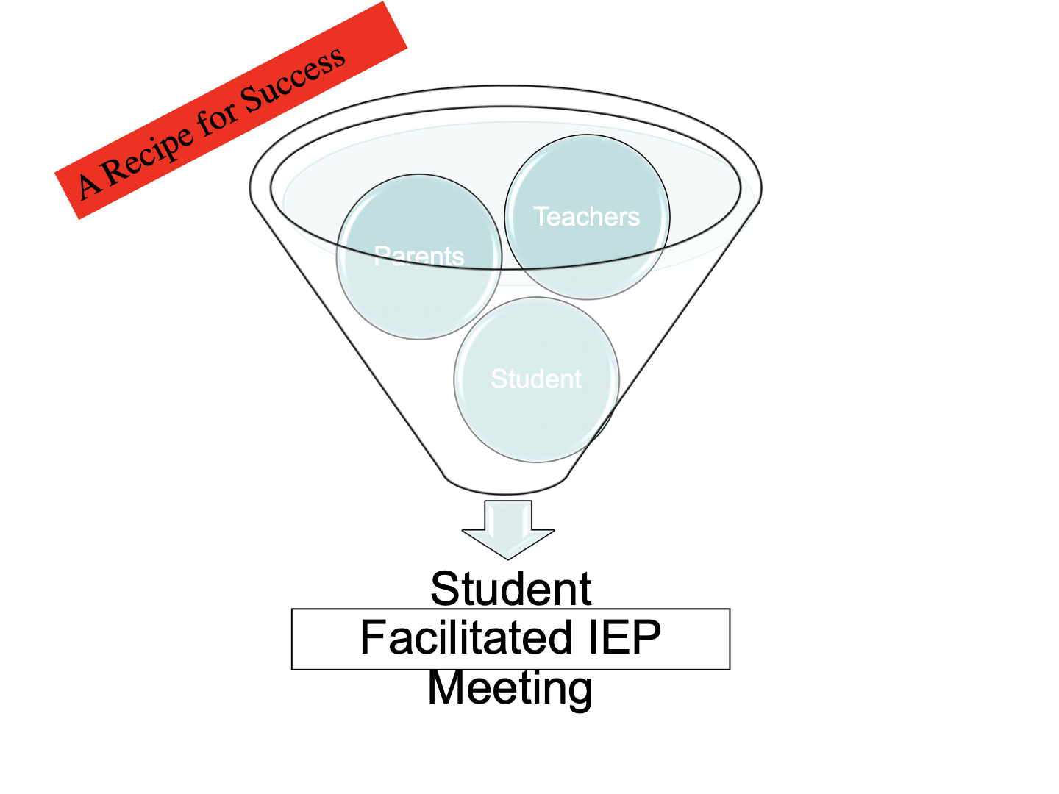

Slide 12
STUDENT FACILITATED IEP MEETINGS
Student involvement helps students become self-determined.
Self-advocacy is an important part of preparing students for involvement.
Team members can benefit from the student sharing knowledge.

Slide 13
STRATEGY FOUR: CULTURALLY RESPONSIVE PRACTICES
Notes:
From Lanya’s study:
What the literature says about Student involvement:
Active students participation in their IEP meetings helps ensure IEP meetings are student-focused.
There are benefits to student involvement, even at a young age (Martin et al., 2004).
In practice, students are often not involved in their IEP meetings until the transition age or 14 or 16 (Wagner et al, 2012).
Teaching students to actively participate in their IEP meetings and how to monitor goal achievement are successful strategies for fostering self-determination and self-advocacy skills (Test et al., 2004).
There are barriers to student involvement, such as lack of clarity of roles.
Student involvement helps build social and communication skills, and decision making/goal setting skills.
During the study
Student engagement was high in IEP meetings.
All team members mentioned how helpful it was to have student actively involved.
Student involvement has increased over time.
Student learned how to prepare for meetings mostly from his mom.
General education teacher helped prepare him for his most recent meeting.

Slide 14
Common Barriers to Collaboration for Families of Culturally or Linguistically Diverse Backgrounds
•Inequity
•Unrealistic expectations
•Lack of cultural responsiveness
•Lack of/Inappropriate accommodations related to language, including lack of skilled interpreters (despite being federally mandated)
•Insufficient information about special education processes
•Little respect for familial expertise and contributions
•Deficit views of families and children
•IEPs and parents’ rights documents written in ways that are difficult to understand (at a graduate education level)
•Power imbalances with school personnel
•Assessment results and other paperwork not translated in time for IEP meetings

Slide 17
IEP MEETING SUPPORT:
Before the meeting:
After the Meeting:
During the Meeting:
Meet and explain to parents the timeline, their rights, what is involved in the IEP process, and how they can participate.
Meet with interpreter at least 30 minutes prior to the meeting to provide a glossary of relevant terms, acronyms and to discuss how often the professionals should pause for converting oral messages.
Have IEP team members introduce themselves and state their roles in the meeting.
Pay attention to parents' verbal and nonverbal cues.
Explain instructional methods to families and clearly describe how services specifically meet students’ needs rather than just presenting service options without any context.
Inform parents what will happen after the IEP meeting, such as when they will receive a copy of the proposed IEP and what their rights are if they disagree with the IEP.
Provide a written meeting summary and invite parents to call, e-mail, or meet if they have questions.
Have the translated IEP available to parents in a timely manner.

Slide 18
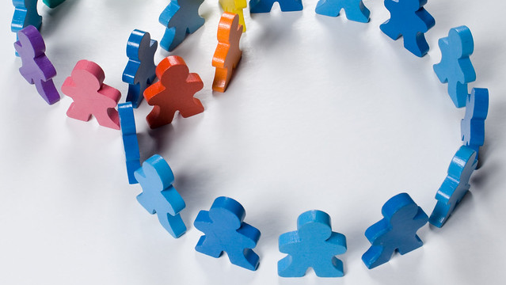
STRATEGY FIVE: RESTORATIVE PRACTICES USED TO MITIGATE CONFLICT AND REPAIR RELATIONS
This Photo by Unknown author is licensed under CC BY-SA-NC.

Slide 19
The Challenge
Special education teachers are responsible for setting the tone of family-professional partnerships and leading them in a positive direction.
Teachers report that communicating with parents is one of the most stressful parts of their job.
Teachers and administrators often feel they are unprepared to develop working partnerships with parents.
Notes:
1. Henderson, Mapp, Johnson, and Davies (2007)
2. MetLife Study
3. Epstein 2011

Slide 20
Common Barriers & Triggers of Conflict
Educator hesitation (lack of confidence) to interact with families.
Fear / avoidance of conflict.
Lack of a systematic procedure for handling conflict.
Limited contact to build trust – only communicate when there is a problem.
Educator and parents have different perspectives of the student or the student's needs.
Notes:
No judgement, we’ve all experienced at least some of these issues.

Slide 21
What are Restorative Practices?
RPs are based on principles and processes that emphasize the importance of positive relationships and restoring relationships when a conflict has occurred.
The aim of RPs is to develop community and manage conflict and tensions by building relationships and repairing harm.
Notes:
Restorative Practices are adopted from the concept of restorative justice in the criminal justice field.
The difference between Restorative Justice and Restorative Practices is that RJ is reactive, responding to something bad that happened.
Restorative Practices are both PROACTIVE and reactive.
There are a lot of definitions of Restorative Practices, but the most important point is that RP emphasizes positive relationships and repairing relationships when some sort of conflict or damage of trust has occurred.

Slide 22
Why Use Restorative Practices?
Once an IEP team has gone through a formal dispute resolution process, unresolved and intense feelings of hurt, anger, betrayal, and broken trust often linger.
The team will struggle to rebuild a functional family-professional partnership when the underlying conflict is unresolved.
By employing basic RP, teachers can contribute to the healing of the relationship and prevent conflict from escalating.
Notes:
We know that formal and even informal dispute resolution processes often leave lingering bad feelings on all sides. If those things are not dealt with , then they sort lay in wait to come out at the next problem.
Even the most basic use of RP can help to mend relationships after a disagreement. Of course, when used as a preventative, the relationship typically has enough built up trust to weather disputes in a cooperative way.
Professionals who only use the reactive without building the social capital beforehand are less successful than those that also employ the proactive.

Slide 23
Key Elements of Restorative Practices
Communication, mutual understanding, problem solving
Respect for individual perspectives, empowerment, equality
Focus on collaborative decision making
Meet obligations, follow-through on commitments
Systematic, fair process

Slide 24
“There has been long-standing consensus that very few, if any, disputes (even a divorce) involve greater emotional tension than a parents' desires and attempts to secure adequate educational programs and services for their child.”
Rosenfeld, S. , 2012, p.549

Slide 25
Thank you!

