Slide 1
From Conflict to Collaboration:
Essential Conflict Management Skills
CADRE Conference 2022
Denver, Colorado
October 26, 2022, 2–5 p.m.
Presented by Kathy Murphy and Joy Jordan
Conflict Resolution Program, Institute for Public Administration

Slide 2

Workshop Purpose
Explore conflict perceptions and causes.
Discover the five conflict management styles.
Determine how to select the appropriate style.
Review communication techniques when collaborating with others.

Slide 3

Workshop Outcomes
Participants will:
Distinguish between the 5 conflict management styles.
Recognize their preferred style(s).
Understand how to select the appropriate style.
Utilize effective communication techniques to encourage collaboration.

Slide 4

Workshop Agenda
Conflict Perceptions & Causes
Five Styles
Break
Small Group Discussion
Practice
Effective Communication

Slide 5

How We Will Cover These Topics
Through self awareness and reflection and by sharing with others, we will explore essential interpersonal skills that help us foster authentic conflict management skills.

Slide 6

Why These Skills Matter
Conflict management skills…
  encourage empathy
  improve understanding
  build trust
We need these skills for our personal lives and professionally as facilitators, mediators, educators, and leaders.

Slide 7

Perception of Conflict
When I think about conflict, I feel…
?
?
?

Slide 8
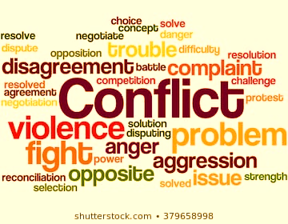
Perception of Conflict
Negative Perception
=
Negative Response
Negative Outcome

Slide 9
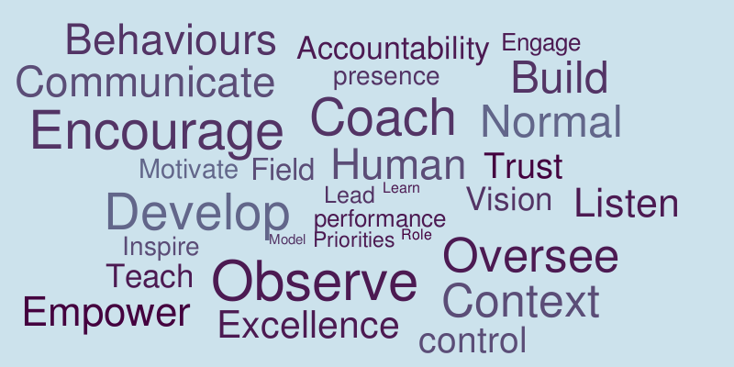
Perception of Conflict
Positive Perception
Positive Response
Positive Outcome

Slide 10
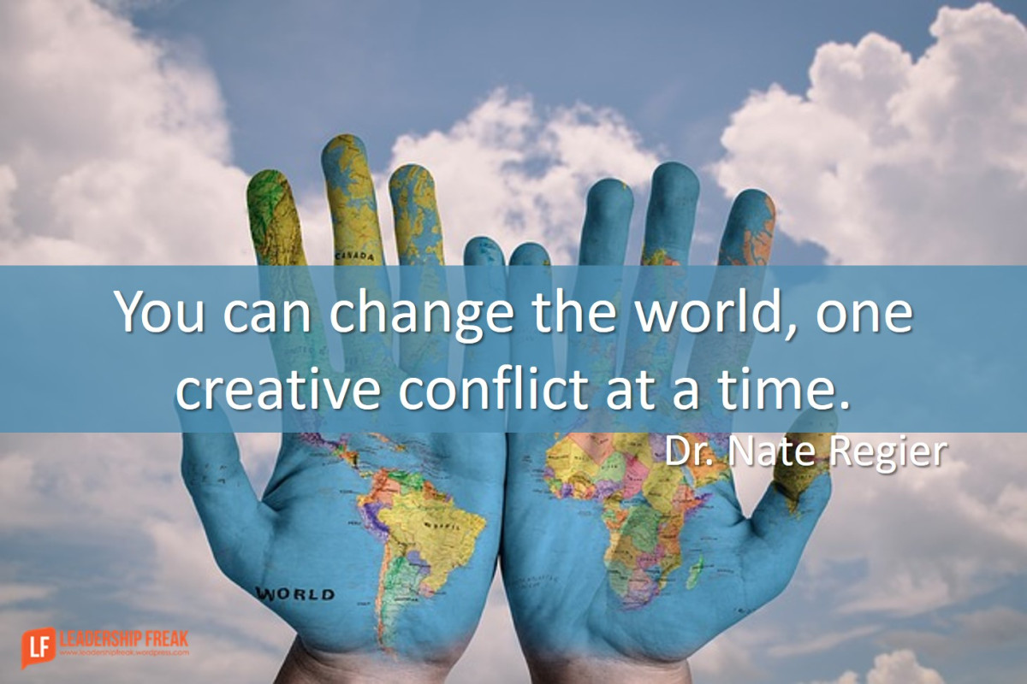
Conflict is Normal
Everyone has conflict.
Conflict is an opportunity for positive change.

Slide 11




Types of Conflict
Intrapersonal | Interpersonal
Intragroup | Intergroup

Slide 12
















Interpersonal Conflict
Occurs between two people.
The parties need one another to accomplish their goals.
One party usually feels the other is preventing them from getting something they want.

Slide 13
Causes of Conflict
  Clashing Personalities
  Differing Values
  Change
  Unresolved Issues
  Unmet Expectations
  Making Assumptions
Notes:
Clashing Personalities
How we interact and communicate
Making Assumptions
What we think will happen
Differing Values
What we see as most important
Unmet Expectations
What we hope will happen
Change
When the status quo is altered
Unresolved Issues
When past disagreements affect the present

Slide 14


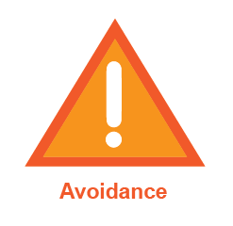

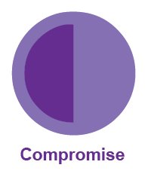
Conflict Management Styles
      Accommodation
      Avoidance
      Compromise
      Competition
      Collaboration

Slide 15
Conflict Management Style
Accommodation
Accommodating is giving in to the other person. You give up what you want in order to let them get what they want.
Accommodating is putting aside one’s own needs and concerns in order to satisfy the needs of the other person.

Slide 16
Conflict Management Style
Avoidance
Avoidance is knowing there is a conflict but choosing not to deal with it.
Avoiders do not acknowledge or discuss the conflict with the other person and may avoid the person with whom he or she is having the conflict.

Slide 17
Conflict Management Style
Compromise
Compromise splits the difference 50/50.
Each person gets and gives up a little of what they want.
It is an attempt to seek middle ground.

Slide 18
Conflict Management Style
Competition
Competition assumes that for one person to win the other person must lose.
The goal of competition is to get what you want AND make sure the other person does not get what they want.

Slide 19
Conflict Management Style
Collaboration
Collaboration is talking through differences to uncover what each person needs rather than what they want.
Collaboration generates unique solutions that satisfy the needs of both people.

Slide 20
Conflict Management Styles Group Discussion
Introduce yourself
Share why you use this style
  What works well?
  What doesn’t?

Slide 21
Conflict Management Style
Accommodation
PROS
The person who wins gets what they wanted.
Can end the conflict quickly.
It can demonstrate you care more about the person than the conflict.
CONS
The Accommodator may be reluctantly accommodating due to…
Expectations of quid pro quo may lead to disappointment.
Consistent use may lead to resentment.

Slide 22
Conflict Management Style
Avoidance
PROS
It can be less stressful for an Avoider to avoid than to engage.
Conflict might dissipate.
CONS
Causes stress for the person who wants to address the conflict.
May escalate and expand the conflict.

Slide 23
Conflict Management Style
Compromise
PROS
Can end a conflict quickly.
Each person feels like they got “something” aka a partial win.
CONS
Each person may feel like they had to give up something.
The solution may not actually work for either side.

Slide 24
Conflict Management Style
Competition
PROS
The Competitor gets what they wanted.
The Competitor feels good about winning.
CONS
The non-competitor loses—gets nothing they wanted.
The non-competitor may feel disrespected and devalued and reluctant to engage again.

Slide 25
Conflict Management Style
Collaboration
PROS
Both sides win.
Both sides are satisfied with the outcome.
Each person gains experience with using this style.
CONS
It takes time.
At least one person needs to use/model effective communication skills.

Slide 26
Selecting the Appropriate Style
Importance of
Relationship
Importance of Goal

Slide 27
Conflict Management Style
Accommodation
Use when…
The relationship is more important than the goal.
You want to reach a quick solution.
You are okay with giving into the other person in this situation.
Importance of
Relationship
Importance
of Goal

Slide 28
Conflict Management Style
Avoidance
Use when…
The goal and relationship are not important.
Potential harm outweighs potential benefits – you may exacerbate the situation.
Change is not possible or realistic, such as policy or personality.
Importance of
Relationship
Importance
of Goal

Slide 29
Conflict Management Style
Compromise
Use when…
The relationship and goal are both somewhat important.
You need a quick solution.
You are willing to give up some of what you want in order to get some of what you want.
Importance of
Relationship
Importance
of Goal

Slide 30
Conflict Management Style
Competition
Use when…
You are willing to devalue the relationship in order to achieve your goal.
Achieving your goal is paramount and so is making sure the other person does not achieve their goal.
Importance of
Relationship
Importance
of Goal

Slide 31
Conflict Management Style
Collaboration
Use when…
The relationship and goal are both important.
You want to find a solution that works for you and the other person.
You are willing to be flexible and move beyond what you “want” to what you “need”.
Importance of
Relationship
Importance
of Goal

Slide 32
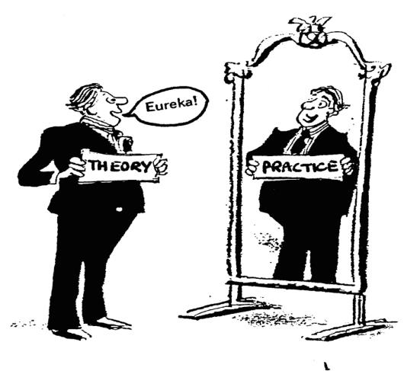
Conflict Management Styles Practice

Slide 33

Effective Communication Skills
That Support Collaboration
Listening to Understand
Addressing Concerns Respectfully
Acknowledging Emotions

Slide 34
Effective Communication Skills
That Support Collaboration
Listen to understand how they feel and what is important to them.
Communication occurs thru…
Words 7%
Body 55%
Tone 38%
Filter
Sender
Filter
Filter
Receiver

Slide 35
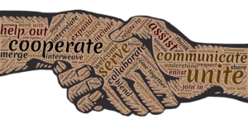
Effective Communication Skills
That Support Collaboration
Address your concerns by speaking from your heart about yourself.
Use neutral language.
Be clear, honest, and succinct.

Slide 36

Effective Communication Skills
That Support Collaboration
Emotions are at the core of the conflict.
Acknowledging emotions is the easiest way to diffuse them.

Slide 37
Thank You!
Kathy Murphy
kmmurphy@udel.edu
Conflict Resolution Program | Institute for Public Administration
Biden School of Public Policy & Administration | University of Delaware
Visit Us Online: www.bidenschool.udel.edu/ipa/serving-delaware/crp
Joy Jordan
jvjwil@udel.edu

