Slide 1
Advanced Mediation Skills
Advanced Mediation Skills
CADRE 2022 Symposium
Timothy Hedeen, Ph.D.
Marietta, Georgia
tim@hedeen.org

Slide 2
Session description
Mediating a special education case is much like hosting a dinner party: the invite list is curated carefully while the table is set intentionally, the conversation is spurred thoughtfully and moderated only lightly.
Occasionally a guest might feel uncomfortable speaking up, so the host might gently create an opening; sometimes a group will get stuck on an unpleasant topic, so the host might artfully shift the focus…
In this interactive session we’ll engage advanced mediator skills related to preparing disputants, crafting questions, inviting and delivering process guidance, and considering the appropriate roles of pressure and influence.
Description
2
image: www.nytimes.com/guides/tmagazine/how-to-host-a-dinner-party

Slide 3
Session agenda
9:30am
Introductions: who are we? why are we here?
Inviting guests: disputant preparation
Setting the table: building trust
Encouraging conversation: crafting questions
Nudging guests: recognizing emotions
Being affable: reciprocal coaching
Winding down: mediator pressure?
Open frame
Agenda
12:30pm
3

Slide 4
My context (introduction)
I’m a Professor of Conflict Management and former University Ombuds at Kennesaw State University. I provide mediation services through court and private programs, deliver trainings in the areas of conflict resolution and communication, facilitate group and public policy decision making and planning, and conduct research and evaluation on dispute resolution and justice policy.
I serve as a senior consultant to CADRE and on the editorial board of Conflict Resolution Quarterly. I’ve served on the Commission on Dispute Resolution of the Georgia Supreme Court, the Section Council of the American Bar Association’s Section of Dispute Resolution, and on the editorial board of Family Court Review. I’m a past chair of the Board of Directors of the National Association for Community Mediation.
My context
For all of the above—three decades’ experience as a mediator and trainer, two decades’ service to CADRE—I still find it presumptuous (if not audacious) to describe any training as “advanced.”
4

Slide 5
Title slide: Inviting guests: preparation
Inviting guests: preparation

Slide 6
Under-preparation?
Let’s think-pair-share:
Think: Take a moment to reflect on cases in which you perceived that a party was un- or under-prepared. What had they not done, which would have served them well to have done?
Pair: Turn to a partner, share (with appropriate anonymization!) your reflections.
Share: We’ll re-gather in the full group, hoping to hear a brief recap from each pair.
Under-preparation?
6

Slide 7
Orientation does not equal preparation
Mediation providers recognize that mediation is often novel and unfamiliar to their clients; this is true across practice areas. We’ve developed flyers and orientation sessions, yet these seem short of the mark.
Beyond learning the mediator’s role and the process flow, how might parties prepare themselves to negotiate? …to ride an emotional roller coaster? …to make effective decisions and commitments?
Building on our reflections from the last discussion, what might we do to support our clients in the future?
Orientation ≠ Preparation
7

Slide 8
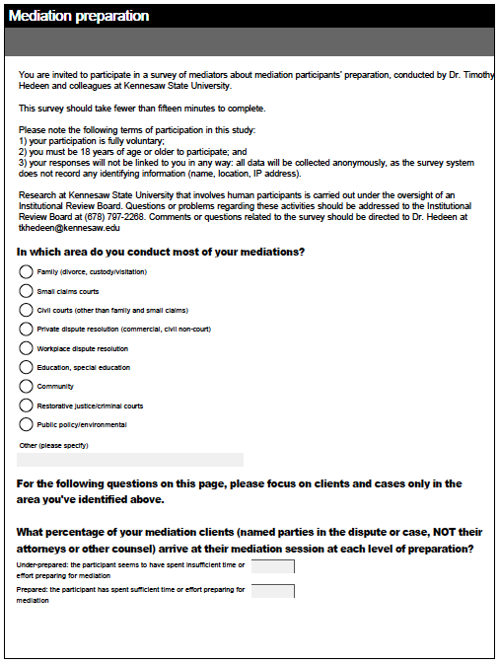
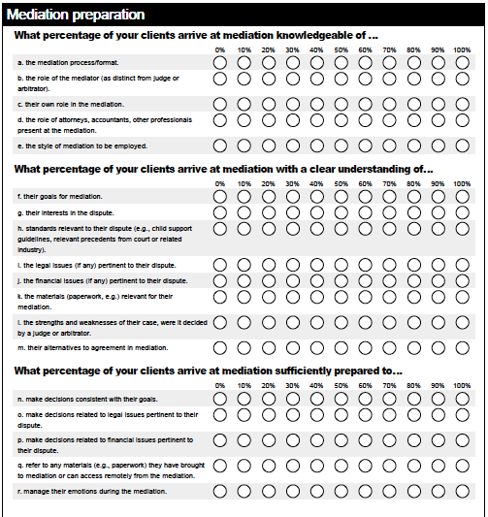
Mediators on Parties’ Preparation
Through surveying mediators across a range of mediation contexts (N=372) , we found the following:
What percentage of your clients (named parties, not attorneys or others) arrive at mediation prepared?
Mediators on Parties’ Preparation
53.0%
… thus 47.0% were perceived to be un- or under-prepared!
8

Slide 9
Most commonly overlooked prep steps
Five most commonly overlooked preparation steps
Strengths and weaknesses of own case (147)
Other party’s interests in the dispute (126)
Strengths and weaknesses of other party’s case (101)
Party’s interests in the dispute (97)
The role of the mediator (86)
Mediators on Parties’ Preparation
Hedeen, Donner, Stura, and Indovina, 2021
9

Slide 10
Most valuable prep steps
Five most valuable preparation steps
Party’s interests in the dispute (170)
Party’s goals for mediation (162)
Strengths and weaknesses of own case (134)
Ability to make decisions consistent with their goals (118)
Other party’s interests in the dispute (103)
Mediators on Parties’ Preparation
Would you like to make any notes for your future practice?
10

Slide 11
Title slide: Setting the table: building trust
Setting the table: building trust

Slide 12
Mediators and trust
How does a mediator earn the parties’ trust?
Take a moment to jot down a few things you do to generate trust.
Mediators and trust
12

Slide 13
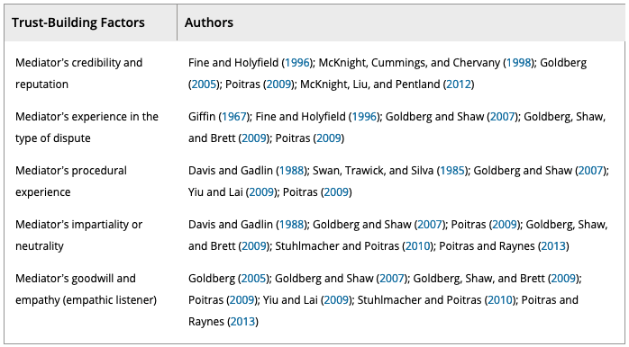
Factors that Generate Trust
Factors that Generate Trust
Riera Adrover, Cuartero Castañer & Campus Vidal, 2020, p.355
13

Slide 14
Four essential factors
Goodwill and empathy: perceiving goodwill on the part of the mediator; perceiving the mediator to be motivated; feeling listened to and understood by the mediator; and analogic communication by the mediator (looking into our eyes, leaning toward us, etc.).
Credibility and reputation: the mediator’s professional credibility and reputation; the mediator’s appointment by a public authority and/or recognized service; and the mediator’s consistency and predictability (not behaving in an unexpected way).
Chemistry: the mediator’s manner; the chemistry (connection) I feel with the mediator; the creation of a relaxing setting; the mediator’s sincerity and kindness.
Mastery: the mediator’s capacity to understand the dispute; the fact that the mediator shows him/herself to be familiar with the dispute; the mediator’s self-confidence; the mediator’s honesty; and the mediator’s capacity to manage the mediation process.
Four “essential” factors (p < 0.01)
from Riera Adrover, Cuartero Castañer & Campus Vidal, 2020
14

Slide 15
Other significant factors
Warmth and consideration: the mediator’s warmth; the mediator listens to me and shows consideration for my feelings and concerns; the mediator understands and supports me; the mediator focuses on my motivations and concerns.
Mediation principles: the mediator observes the principles of mediation (not interrupting, not suggesting, etc.); the mediator’s neutrality or impartiality; the mediator does not disclose private aspects relating to the other party at private session with me, even if he/she has their permission; the mediator focuses on parties’ shared goals; and the mediator fosters good relations between parties with a view to possible future negotiations.
Explaining the mediation process: perceiving the mediation process to be fair; the mediator steers and supervises the mediation process; the mediator acknowledges that he/she has made a mistake; and the mediator explains the mediation process in an unhurried way.
Other “significant” factors (p < 0.05)
from Riera Adrover, Cuartero Castañer & Campus Vidal, 2020
15

Slide 16
Mediators and trust: your implications
Any implications you might draw from those lists for our work in special education?
Would you like to make any notes for your future practice?
Mediators and trust
16

Slide 17
Title slide: Encouraging conversation: crafting questions
Encouraging conversation: crafting questions
(and offering reframes or reformulations)

Slide 18
Questions are powerful
Take great care with your questions. As advised in The Mediator’s Handbook, consider the purpose, relevance, and opening of each…
Purpose: understanding or steering?
Relevance: “if not, don’t ask”
Opening: “What” or “How” (open-ended)
Not “Why” (accusatory)
Questions are powerful
from Beer & Packard, 2012
18

Slide 19
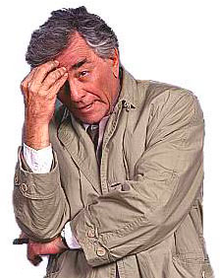
Questions demand discipline!
FOLLOW-UP PROMPTS
--------------------------------
I’m confused, could you sketch that out?
Help me understand…
Tim’s favorite
BATNA-STYLE PROMPT
--------------------------------
What will you have, if you don’t reach an agreement here today?
Questions demand discipline!
Tim’s favorite
RE-DIRECTION PROMPT
--------------------------------
I’m sorry, I think I asked you the wrong question. What I meant to ask is…
Got any favorite questions to share with us?
from Beer & Packard, 2012
19

Slide 20
Reframing
Reframing is not a universally-endorsed mediator practice. And I find it very valuable.
Some illustrations and distinctions are in order…
Armon Sweat on whiskey
Andrew Mwende on poverty
Beer and Packard on rewordings
Reframing
20

Slide 21
Reframing whiskey
Texas legislator Armon Sweat, speaking in 1952:
If you mean whiskey, the devil’s brew, the poison scourge, the bloody monster that defiles innocence, dethrones reason, destroys the home, creates misery and poverty, yea, literally takes the bread from the mouths of little children;
If you mean that evil drink that topples Christian men and women from the pinnacles of righteous and gracious living into the bottomless pit of degradation, shame, despair, helplessness, and hopelessness, then, my friend, I am opposed to it with every fiber of my being.
Reframing whiskey
21

Slide 22
Reframing whiskey, continued
However, if by whiskey you mean the lubricant of conversation, the philosophic juice, the elixir of life, the liquid that is consumed when good fellows get together, that puts a song in their hearts and the warm glow of contentment in their eyes;
If you mean Christmas cheer, the stimulating sip that puts a little spring in the step of an elderly gentleman on a frosty morning; if you mean that drink that enables man to magnify his joy, and to forget life’s great tragedies and heartbreaks and sorrow;
If you mean that drink the sale of which pours into Texas treasuries untold millions of dollars each year, that provides tender care for our little […] children, […] , our pitifully aged and infirm, to build the finest highways, hospitals, universities, and community colleges in this nation, then my friend, I am absolutely, unequivocally in favor of it.
Reframing whiskey
22

Slide 23
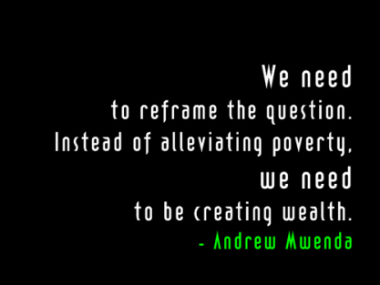
Reframing poverty
Reframing poverty
23

Slide 24
Mediator restatements
Method | What to do
Repeat, highlight | Echo a subset of their words, with a rising intonation to make it a question.
Paraphrase, restate | Repeat back the essence of what someone says, minus their biased or inflammatory words.
Reflect back, acknowledge | Paraphrase, and include nonverbal and emotional content.
Summarize | Organize a number of point or actions into a short, coherent list.
Reframe | Describe their situation with an alternate interpretation, or reorganize into new categories.
Mediator restatements
from Beer & Packard, 2012, p.128
24

Slide 25
Formulations & Reformulations
In their 2021 article “How mediators use reformulation practices to de-escalate risky moments,” the authors examine how summaries, paraphrases, and reframings can steer discussion.
When mediators reformulate disputants’ talk, their professional vision shapes how mediations progress, and disputants’ uptake (or the lack of it) guides the directions they take.
Whether it is bracketing off a touchy subject or disrupting a troublesome behavior loop, mediators’ reformulation practices tell us about these mediators' professional vision through the story of observable practices.
Formulations & reformulations?
from Maxwell & Ingram, 2021
25

Slide 26
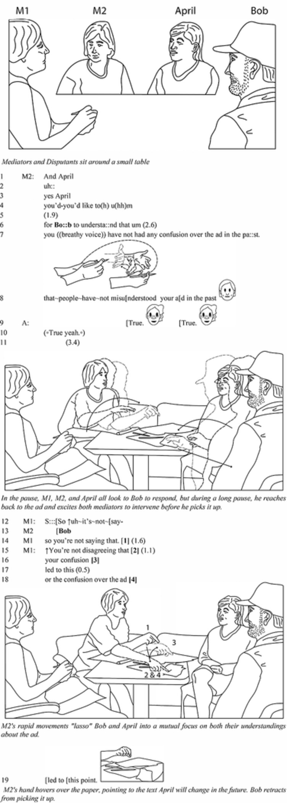
Formulations
“Formulations reflect what has been said and set a trajectory for what follows, enabling mediators to articulate problem statements, foster common ground, elide troublesome processes, disambiguate stances, condense or reframe statements, probe for more information, or control discussion topics.” (my emphasis)
Formulations
from Maxwell & Ingram, 2021
26

Slide 27
… and reformulations
Mediators are often perched in a three-point space when they reformulate disputant discourse:
They can highlight something in the immediate discourse that needs to be explored further.
They can reach back or hold on to something in earlier discourse that might be useful in the present (wherever they are in the process).
They can explore (multiple) representations of talk for what they reveal about the disputants’ future actions, needs or goals.
… and reformulations
from Maxwell & Ingram, 2021
27

Slide 28
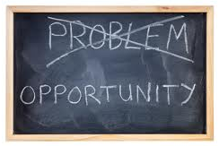
Your insights and experiences?
Reframing, restatement may shift the focus…
From positions to underlying interests
From judgments to concerns
From a blame to a need
From the past to the future
From individual problems to shared issues
Your insights and experiences?
Take a moment to revisit your mediation practices. Any highly-productive or –constructive reframings or reformulations?
Any you might commend to the rest of us?
28

Slide 29
Title slide: Nudging guests: recognizing emotions
Nudging guests: recognizing emotions

Slide 30
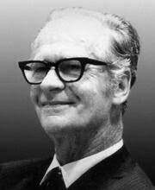
Emotions in mediation
We all know that emotions are useless and bad for our peace of mind and our blood pressure.
– B.F. Skinner, 1948
Williams and Hinshaw open with Skinner’s claim before reviewing our field’s treatment of emotions:
“mediation theorists have recognized the importance of emotions in the mediation context – for providing insight to underlying interests, for creating psychological barriers to resolution, and even for facilitating agreement. But where do these emotions ‘come from?’ ”
Emotions in mediation
from Williams & Hinshaw, 2018
30

Slide 31
Emotions in mediation, continued
Before we delve further into the literature, let’s discuss the role of emotions in mediation…
Whether as one group or in subsets, let’s mine our own experience and wisdom:
When have we seen emotions (strong expressions) serve constructively in a mediation (or facilitate IEP)?
When have we seen such as disruptive?
(Bonus points if your experiences relate to anger!)
Emotions in mediation
31

Slide 32
Anger, beyond and within mediation
“Anger activates a motivational system intended to overcome blocked goals, remove obstacles, and punish transgression, serving to resolve conflicts of interest in favor of the angry individual.
… serves the cognitive function of alerting us when others place insufficient weight on our welfare... the angry person will inflict costs or withdraw benefits unless the target places sufficient weight on her welfare.
… can make people indiscriminately punitive, indiscriminately optimistic about their likely success, more self-confident, and more likely to make snap decisions based on heuristics (decision-making rules) rather than engaging in careful, effortful thought.
… can increase dispositional attribution, leading angry individuals to perceive that others (rather than the situation or the self) are responsible for negative events. Interestingly, anger also tends to intensify certainty about what happened.”
Anger, beyond and within mediation
from Williams & Hinshaw, 2018
32

Slide 33
Anger, beyond and within mediation, continued
Conflict often occurs as a result of perceived transgression and also when people believe that the actions of others present obstacles in the way of achieving their own goals. Thus, if anger evolved to facilitate positive fitness outcomes in the face of obstacles and transgressions, it is no surprise that dispute resolution is a fertile ground for activating an anger response.
… mediators must understand that emotions cannot be “resolved,” they can only be experienced, released, reconsidered, and understood. Thus, mediators should accept and acknowledge a party's anger…
… the person expressing anger knows that the mediator is working to understand the entirety of the conflict and its presenting problems. (failing to do so “results in decreased faith and trust in the mediator”)
Anger, beyond and within mediation
from Williams & Hinshaw, 2018
33

Slide 34
Title slide: Being affable: reciprocal coaching
Being affable: reciprocal coaching

Slide 35
Offering and inviting coaching
In his article “Reciprocal Coaching to Reduce the Risk of False Failure in Mediation and Support from Social Science for Coaching Ideas,” Wayne Brazil issues “a few prefatory clarifications”:
this essay addresses mediations in civil cases (1) in which all parties are represented by counsel and (2) that will not need to surmount any further challenges to get to trial.
some of the coaching ideas described could be discussed in joint session, others would be presented only in caucus.
while many of the ideas arise from social science research on integrative negotiation contexts, these may work when only distributive outcomes are available.
Offering & Inviting coaching
from Brazil, 2014, pp.168-169
35

Slide 36
Offering and inviting coaching, continued
Awareness of cognitive biases, EANTs *
Process—not content or substance!
Tips based on successful negotiators **
Offering & Inviting coaching
Mediator
Client/atty
Ideas about altering the process
Suggestions on how the mediator may play a more constructive role
* ethically ambiguous negotiation tactics
** next slides
36

Slide 37
Four suggestions (first two)
Rackham’s studies of successful negotiators led to four suggestions, useful for negotiators and coaches alike:
Move freely among issues without insisting on addressing them in a particular sequence and without forcing linkages between them.
Ask more questions than you might otherwise be inclined to ask, and frame them as openly as possible—so they are real questions, not poorly disguised arguments.
Four suggestions, 1 of 2
37

Slide 38
Four suggestions (last two)
Test your understanding more often than you might be inclined, either through asking questions or by offering short summaries of your perception of the status of the negotiations, of the reasoning behind the parties’ positions, of matters to which parties have agreed, etc.
Avoid gratuitous “irritator” comments, i.e. gratuitous positive characterizations of the speaker’s own acts or proposals, e.g., our “generous” offer; our “fair” or “reasonable” proposal, etc.
Four suggestions, 2 of 2
Rackham summarized in Brazil, 2014, pp.213-214
38

Slide 39
Read opening script; how might it work for you?
You’ve (hopefully) got a handout with Wayne’s script for opening mediation.*
Please read this mediator’s opening. Consider whether or how such an approach—or parts of it—might fit your practice.
Wayne’s opening; your thoughts
* it also appears after the References slides at the end of this slide deck.
39

Slide 40
Winding down: mediator pressure
Winding down: mediator pressure

Slide 41
Mediator pressure?
How might a mediator exert pressure on a party in mediation? In the special education context, between a district and a family, how might a mediator ‘nudge’ parties?
Mediator pressure?
In other mediation contexts, a mediator may have various points of leverage: expressing skepticism or doubt about a proposal, threatening to declare a party negotiated in bad faith, insisting that parties stay until agreement is reached, predicting that a judge or arbitrator will subsequently disapprorve…
41

Slide 42
Mediator pressure, continued
What are the limits of appropriate pressure by a mediator?
Mediator pressure?
42

Slide 43
Winding down this session
Winding down this session
[Reference list, reciprocal coaching
mediator’s opening follow]

Slide 44
References list
Inviting guests: disputant preparation
Hedeen et al., 2021, “Setting the Table for Mediation Success: Supporting Disputants to Arrive Prepared,” Journal of Dispute Resolution https://scholarship.law.missouri.edu/jdr/vol2021/iss1/7/
Setting the table: building trust
Riera Adrover, Cuartero Castañer & Campus Vidal, 2020, “Triangulation of Salient Studies to Date on Trust-Building in Mediation,” Negotiation Journal https://onlinelibrary.wiley.com/doi/10.1111/nejo.12329
Encouraging conversation: crafting questions
Maxwell & Ingram, 2022, “How Mediators Use Reformulation Practices to De-escalate Risky Moments,” Conflict Resolution Quarterly https://onlinelibrary.wiley.com/doi/10.1002/crq.21319
Beer & Packard, 2012, The Mediator’s Handbook (4/e), New Society Publishers https://newsociety.com/books/m/the-mediators-handbook
References, 1 of 2
44

Slide 45
References, continued
Nudging guests: recognizing emotions
Williams & Hinshaw, 2018, “Outbursts: An Evolutionary Approach to Emotions in the Mediation Context,” Negotiation Journal https://onlinelibrary.wiley.com/doi/10.1111/nejo.12222
Being affable: reciprocal coaching
Brazil, Wayne, 2014, “Reciprocal Coaching to Reduce the Risk of False Failure in Mediation and Support from Social Science for Coaching Ideas,” Ohio State Journal of Dispute Resolution https://kb.osu.edu/handle/1811/80853
Winding down: mediator pressure
Hedeen, 2005, “Coercion and Self-determination in Court-Connected Mediation: All Mediations Are Voluntary, But Some Are More Voluntary than Others,” Justice System Journal https://www.tandfonline.com/doi/abs/10.1080/0098261X.2005.10767773
References, 2 of 2
45

Slide 46
Reciprocal coaching opening, 1 of 3
I'd like to suggest what I think is a useful way to conceptualize the goal of this mediation. Our primary goal is not to settle your case. Instead, our primary goal is to identify as reliably as possible what is possible through this process. What we want to do is to identify the best terms that are accessible through negotiation. It is only if we succeed in accurately identifying those terms that we will position each of you to compare rationally your alternative paths forward: agreeing to a settlement or proceeding to trial. Once we have identified what is possible through mediation, it will be up to each of you to decide, independently, whether to end this case by mutual agreement or to proceed with the litigation.
To maximize the odds that we will achieve our goal it is essential that everyone who is participating today share responsibility for the productivity of our process.
As we move through the day, each of you will be thinking about your positions, your interests, the relevant law and evidence—but we also need you to be thinking about the process itself. At each juncture, what would be healthiest for the process? What seem to be the principal barriers to getting a deal—and how might we best work to overcome those barriers? Are there ways we could proceed that would increase our chances of success? Should we change formats? Should the parties meet without their lawyers? Should only the experts meet with the mediator? Should we shift our attention to a different subject or to a different possible component of a deal? How is the other party likely to react to or interpret a contemplated proposal or move? Are there additional people we should involve, or is there additional information we should share, or for which we should ask?
Reciprocal coaching opening, 1 of 3
46

Slide 47
Reciprocal coaching opening, 2 of 3
In sum, we need to keep asking ourselves how we should shape or adjust our process so as to improve the likelihood that we will learn, as accurately as possible, what is possible. We have a much better chance of succeeding in this if all of our minds are thinking about these things than if it is only my mind that focuses on what is best for the process.
We will have a better mediation if we think of mediation as a team sport. But it is a team sport with an unusual feature. Every participant is simultaneously a player and a coach. One of my jobs is to offer coaching suggestions as we move through the day; for example, I might make observations, based on my experience, about how the other parties are likely to understand or respond to some move or idea that is being considered. I would like all of you to play the same role. Coach me; suggest ways I might play the most constructive role. If you have an idea about how we might best proceed, tell me about it and we can consider it together. If it would make you more comfortable, pull me aside so we can think about your idea privately before we plunge ahead.
Several years ago it occurred to me that one way to understand a primary objective of my coaching during mediations is to help reduce the risk of "false failure." False failure occurs when, in theory, there are terms "somewhere out there" on which the parties could agree, but we fail to find those terms because we make some unnecessary, avoidable process mistake.
Reciprocal coaching opening, 2 of 3
47

Slide 48
Reciprocal coaching opening, 3 of 3
The kinds of mistakes I'm talking about include:
posturing too much or for too long,
playing informational cards too close to the vest,
interpersonal or psychological errors (for example, saying something that needlessly offends another party or taking positions that leave other participants too little room to achieve something),
failing to see that shifting to some other format, or having principals or experts talk directly to one another, would create new opportunities or would better meet certain needs,
sending misleading signals or misreading signals that others send, or
falling victim to a common cognitive trap like reactive devaluation or confirmation bias.
As we proceed through the mediation today, let’s keep these potential sources of false failure in mind. Each of us should be on the lookout for them; each of us should help us avoid them. In other words, let's coach one another about how to handle the process most productively.
Reciprocal coaching opening, 3 of 3
48

