Slide 1
Goals Together for Partnership: A Multiple Case Study Implementation Project of a School-Wide Family-School Partnership Model 2022 CADRE Symposium October 26-28: Denver, CO
Tracy Gershwin, Ph.D., Professor, University of Northern Colorado
Kathleen Kyzar, Ph.D., Associate Professor, Texas Christian University

Slide 2
Session Goals
Understand key issues influencing family-school partnership (FSP) programming
Describe the Goals Together for Partnership (GTP) Model
Articulate stakeholder perceptions of GTP
Offer next steps for GTP
NOTE: This content was produced under U.S. Department of Education, Office of Special Education Programs, Award Nos. H323A150009 – 18 and H328M140017. The views expressed herein do not necessarily represent the positions or policies of the U.S. Department of Education. No official endorsement by the U.S. Department of Education of any project, commodity, service, or enterprise mentioned in this product is intended or should be inferred.

Slide 3
Key Issues Influencing Family-School Partnership Programming

Slide 4
Background and Significance of GTP
Research-to-practice gap
School-centric thinking
Intentionality related to partnerships
Access to resources

Slide 5
The GTP Model

Slide 6
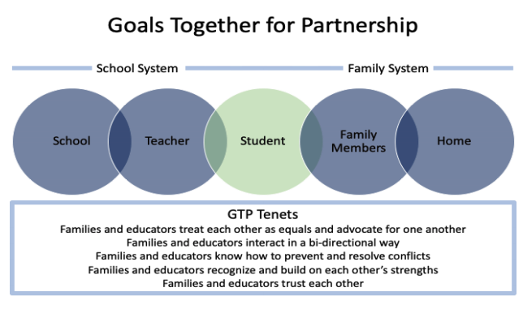

Slide 7
Goals: Infuse the Tenets within all cultural aspects of a school in which families and educators interact to improve student engagement

Slide 8
Research Evidence for the GTP Model
Teachers and family members have access to current partnership research and to learning opportunities that enable them to grow in their family-school partnership knowledge and skills.
Teachers and families believe that partnerships are important, and they actively work to improve their partnerships in an intentional and reflective way.
Teachers and families have access to the necessary partnership-related resources and supports within their school system.

Slide 9
GTP Implementation Model
GTP LEADERSHIP TEAM
Principal
2 teachers
2 family members
GTP IMPLEMENTATION TEAM
Teachers from each grade level
Family-member partners

Slide 10
Leadership Team Member Responsibilities
Completion of Online Module Training Series to learn foundational concepts
Attendance of 1 and 1½ day Summit Symposium
Identification of Implementation Team Members
Development of Implementation and Evaluation Plan in line with needs and culture
Regular meetings with team and researchers
Provision of TA Support to school community
Participation in two interviews, two focus groups, and completion of brief surveys

Slide 11
Implementation Team Responsibilities
GTP Training provided by school’s GTP Leadership Team
Implement GTP Plan, as determined by Leadership Team
Completed survey regarding partnership perceptions

Slide 12
Partnership Goal Setting
Step 1: Set attainable GTP Tenet Goal
Step 2: Identify concrete actions toward GTP Tenet Goal
Step 3: Anticipate obstacles and identify solutions
Step 4: Carry out GTP Tenet Goal
Step 5: Reflect and adjust GTP Tenet Goal

Slide 13
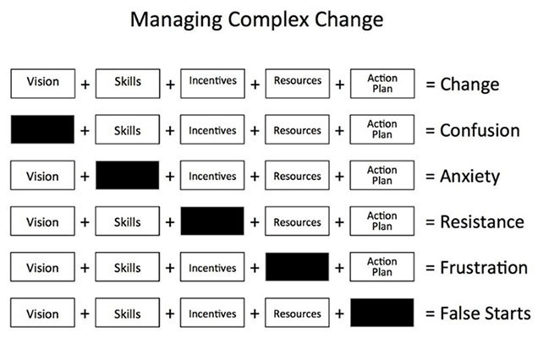
Knoster’s Change Model

Slide 14
Train-the-Trainer Model
GTP Learning Modules
GTP Action Planning Materials
Parent-Teacher Conference Materials
GTP Implementation Team Recruitment Materials
Templates for Check-Ins
Survey templates
Goal Setting Guidelines and Templates
Websites/Partnership Resources
Data Collection Forms

Slide 15
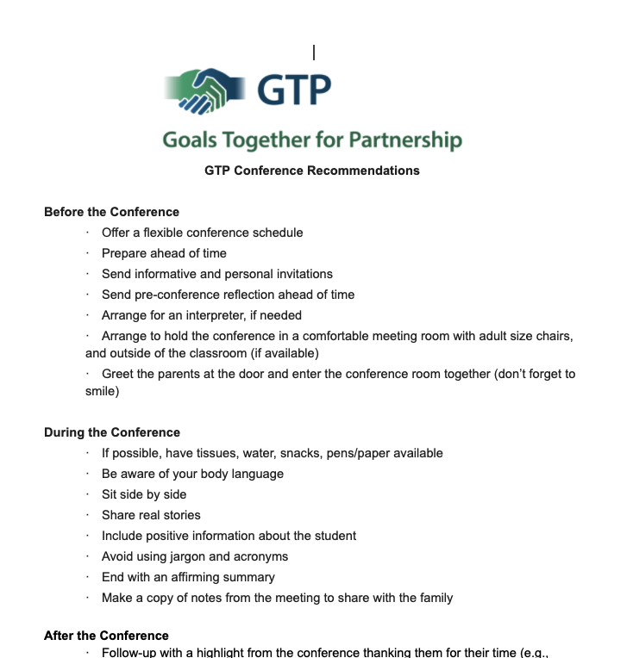
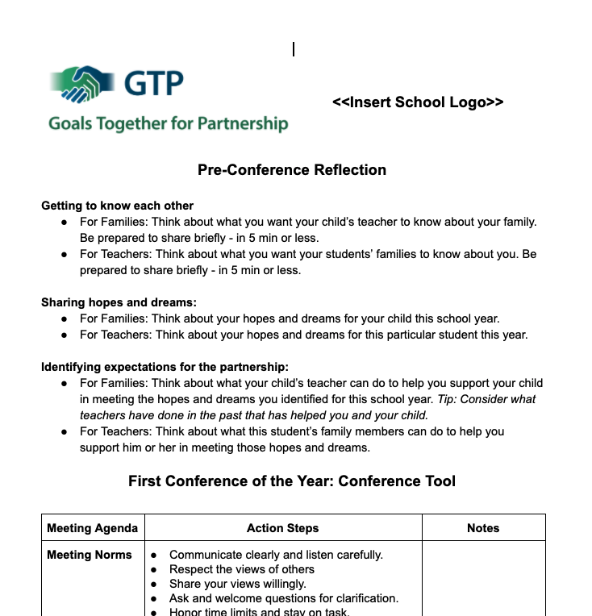
GTP Conference Resources

Slide 16
Stakeholder Perception of Partnerships and GTP Implementation

Slide 17
Guiding Questions and Method
Questions:
What features of the GTP Process are required to ensure that it is usable in elementary school settings?
What are resultant trends in the perceptions of family-school partnerships for teachers and family member participants?
Method:
Mixed-method research guided by action research design
Data sources: interviews, artifacts, focus groups, surveys

Slide 18
Three Participating Schools in One Midwest State
Spruce (Suburban) | Willow (Rural) | Pine (Urban)
45.5% White, 23.4% Latinx, 22% Black/African American, 6.8% Hawaiian/ Pacific Islander | 61.7% White, 7.6% Latinx, 4.7% Black/African American, 19.9% Asian American | 67.4% White, 15.5% Latinx, 4.5% Black/African American, 3.8% Asian American
Title 1 | Title 1 | Title 1
14:1 | 15:1 | 17:1
205 Students | 643 Students | 582 Students
14 Teachers | 43 Teachers | 35 Teachers

Slide 19
Leadership Team Participant Characteristics
 | Principals (n = 3) | Teachers (n = 6) | Family Members (n = 6)
Gender
Male | 1 | 0 | 0
Female | 2 | 6 | 6
Race
White | 3 | 6 | 6

Slide 20
Implementation Team Participant Characteristics
 | Teachers (n = 49) | Family Members (n = 26)
Gender
Male | 0 (0%) | 2 (7.7%)
Female | 49 (100%) | 24 (92.3%)
Race
White | 47 (95.9%) | 26 (100%)
Other | 2 (4.1%) | 0 (0%)

Slide 21
Family Member-Specific Characteristics
Characteristic | Leadership Team Family Members (n = 6) | Implementation Team Family Members (n = 26)
Parent (bio, step, foster, adoptive) | 5 (83.3%) | 24 (92.3%)
Education
High school graduate | 1 (16.7) | 7 (26.9)
Associate/Bachelor’s Degree | 4 (67.7%) | 8 (30.8%)
Graduate Degree | 0 | 10 (38.5%)
Married/Living with a Partner | 5 (83.3%) | 22 (84.6%)

Slide 22
Family Member-Specific Characteristics
Characteristic | Leadership Team Family Members (n = 6) | Implementation Team Family Members (n = 26)
Eligibility Free/Reduced Lunch | 4 (66.7%) | 5 (19.2%)
Frequency Volunteer Time
Never | 0 | 7 (26.9%)
Once or twice a year/semester | 4 (66.6%) | 19 (73%)
Monthly or more frequently | 1 (16.7%) | 0

Slide 23
Family Member-Specific Characteristics
Characteristic | Leadership Team Family Members (n = 6) | Implementation Team Family Members (n = 26)
Frequency of Communication with Teacher
Once or twice a semester (fall/spring), or less | 0 (0%) | 6 (23.1%)
Once or twice a month | 1 (16.7%) | 7 (26.9%)
Weekly or more frequently | 4 (66.7%) | 13 (50%)

Slide 24
Teacher-Specific Characteristics
Characteristic | Leadership Team Teachers (n = 6) | Implementation Team Teachers (n = 49)
Tenure at Current School (in years)
1-5 | 4 (66.7%) | 33 (67.3%)
6-10 | 0 (0%) | 12 (24.5%)
11+ | 2 (33.3%) | 4 (8.2%)

Slide 25
Teacher-Specific Characteristics
Characteristic | Leadership Team Teachers (n = 6) | Implementation Team Teachers (n = 49)
Perceptions regarding extent of pre-service preparation for partnership
Not at all or a little | 2 (33.4%) | 8 (16.3%)
Somewhat | 1 (16.7%) | 14 (28.6%)
Adequately | 3 (50.0%) | 17 (34.9%)
Completely | 0 (0%) | 10 (20.4%)

Slide 26
Teacher-Specific Characteristics
Characteristic | Leadership Team Teachers (n = 6) | Implementation Team Teachers (n = 49)
Frequency of communication with families
Once or twice a semester (fall/spring), or less | 1 (16.7%) | 8 (16.3%)
Once or twice a month | 2 (33.3%) | 18 (36.7%)
Weekly or more frequently | 3 (50.0%) | 23 (46.9%)

Slide 27
Implementation Activities
Spruce
Embedded GTP within school improvement plan
Teachers met and collaboratively prepared a plan to share with parents, and subsequently met with parent partners
Follow up steps for mid-year conferences, cancelled due to COVID-19
Willow
Presented Tenets and GTP Overview to PTA
PTA purchased “YOUmatter” t-shirts and bracelets
Faculty training provided by GTP Leadership Team
E-mail to families in preparation for conferences in line with GTP conference materials
Pine
Embedded within tiered instructional support framework
Created a visual and video explaining 5 Tenets for the school community (bookmarks accompanied)
Utilized GTP Conference Materials for fall conferences

Slide 28
Perceptions of the GTP Model
Perceptions of the GTP Online Modules were mixed: “necessary background information,” “efficient,” “user-friendly,” … yet also “lengthy,” “repetitive,” “time consuming,” and “could be improved with more vignettes and visuals.”
Summit Symposium provided time and space for team collaboration and helped with implementation.

Slide 29
Fidelity
The following GTP aspects were not utilized:
Tenet Goal Setting Process
TA Support from Researchers
Project Management Tools
Implementation occurred during the 2019-2020 Year, COVID-19 Pandemic resulted in building closures and online instruction starting in March 2020

Slide 30
Perceptions of the GTP Model
GTP Improves Partnerships
GTP Leads to Intentionality
GTP Leads to a Mindset Change
Implementation Challenges:
A new approach
Teacher and family buy-in
Time

Slide 31
Perceptions of the GTP Model
Key factors for implementation:
A strong leader or leadership team is necessary for implementation.
Intentional and frequent communication with families is important.
Bi-directional interactions are necessary for meaningful partnerships.
Stronger relationships are an outcome when partnerships focus on student/family success.

Slide 32
Next Steps

Slide 33
Next Steps
Replication which addresses shortcomings regarding design and usability of GTP:
Partnership Goal Setting process and Online Modules
Lack of diversity in sample
Number of new initiatives/PD activities at school & level of autonomy for new initiatives

Slide 34
Next Steps
Additional considerations for replication study:
Supplementary training emphasizing: project management tools, participatory action research (PAR) principles, implementation science, ongoing evaluation
Mechanism for monthly deliverables
Equity in leadership team member roles/responsibilities
Stronger preliminary processes enabling teams to identify clear reasons for participating that are grounded in internal (not external) motivation

Slide 35
Questions? Comments?

Slide 36
Thank you!
tracy.gershwin@unco.edu

