Slide 1
What does the child really need?
Moving beyond “medically necessary” and
“educationally appropriate” service recommendations
Ed Feinberg, Ph.D.
Early Intervention Consultant – Bethesda, Maryland
Deborah Badawi, M.D.
Behavioral Developmental Pediatrician, Associate Professor of Pediatrics, University of Maryland School of Medicine, Baltimore, Maryland
Jonathan Beyer, J.D.
Lead Counsel for the Europe Region Department of Defense Education Activity
Rene Averitt-Sanzone, M.S.
Executive Director, The Parents’ Place of Maryland, Glen Burnie, Maryland

Slide 2
Who is with us today?

Slide 3
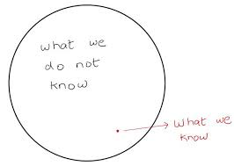
Service Intensity
Research provides mixed results
Nearly impossible to do controlled studies
How do age, diagnosis, environmental context impact service frequency?

Slide 4
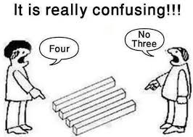
Recommendations
Default is to recommend “frequent” services
Usually recommend multiple weekly sessions
Usually recommend specific therapies
One on One Assistant
Separate school a/o classroom
Notes:
Jonathan – weave in legal stuff – IEP checking boxes
Independent Recommendations
3rd bullet - though this contradicts single provider models for some programs

Slide 5
School Recommendations
Default appears to be a predetermined frequencies of services
Usually recommend group therapy
Usually recommend a consultative model
Notes:
External Constraints – do that as a flip chart activity – after have a slide with these examples on them…….“to defend” this the staff levels are the staff levels; Unions; not truly family centered; family/school partnership; time and day of meetings; transportation;

Slide 6
External Constraints
Staff Levels
Unions
Transportation
Time and Day of the Meetings
Notes:
External Constraints – do that as a flip chart activity

Slide 7
A school meeting is called…
So, now what?
Notes:
Jonathan - Facilitated by all

Slide 8
Case Study
Notes:
Debbie - Open to conversation from the audience – flip chart Ed

Slide 9

So Much Jargon!!!
Special Education terms
(IEPs, LRE, …)
Insurance Terms
(Allowable charge, Medicaid, Premium, …)
Medical Terms
(ABR, HIE, ID, …)
Notes:
Jonathan - Handouts

Slide 10
Legal Lingo
IDEA. A FAPE “free appropriate public instruction” includes both special education and related services. 20 U.S.C. § 1412(a)(1). Special education is specially designed instruction to meet the unique needs of a child with a disability. § 1401(26). Related services are the support services required to assist a child to benefit from that instruction. § 1401(29).
IEP. “The IEP is the means by which special education and related services are ‘tailored to the unique needs’ of a particular child. Endrew F. at 3 (quoting Rowley. 458 U.S. at 181).

Slide 11
What THE court said:
Board of Ed. of Hendrick Hudson Central School Dist. Westchester City v. Rowley, 458 U.S. 176 (1982).
The U.S. Supreme Court held that a child receives a FAPE if the IEP sets forth an educational program “that is reasonably calculated to enable the child to receive educational benefits.” 458 U.S. at 207.
Endrew F. v. Douglas County Sch. Dist., 580 U.S. (2017).
“To meet its substantive obligation under the IDEA, a school must offer an IEP reasonably calculated to enable a child to make progress appropriate in light of the child’s circumstances.”
Notes:
Endrew F. addresses the FAPE requirement for children whose progress is not necessarily aligned
with the regular classroom goals. Rather, the IDEA “requires an educational program reasonably
calculated to enable a child to make progress appropriate in light of the child’s circumstances.”
At 15.
• In other words, “the goals may differ, but every child should have the chance to meet challenging
objectives.” 14. The Court created no clear rule for what “appropriate progress” will look like,
and “the adequacy of a given IEP turns on the unique circumstances of the child for whom it was
created.” At 16.

Slide 12

What will progress mean?
William A. v. Clarksville-Montgomery County, School System, 127 F.4th 656 (6th Cir. 2025)
• Found denial of FAPE school failed to teach student to read
Student had been served with multiple technological tools and accommodations in IEP
But all the accommodations masked a lack of progress in reading

Slide 13

A Family’s Perspective
How might a parent/family feel?
How do parents/families process this information?
What might parents/family believe about school recommendations vs. outside?
Best vs. Appropriate
Alphabet Soup
Notes:
Rene - –“not truly family centered; family/school partnership;

Slide 14

A Family’s Perspective continued……
Professional Recommendations aka “I am the expert….”
Expert vs Expert
Overwhelmed and Tug of War
Base of conflict?
Give some examples from experiences with families……..
Notes:
Rene

Slide 15
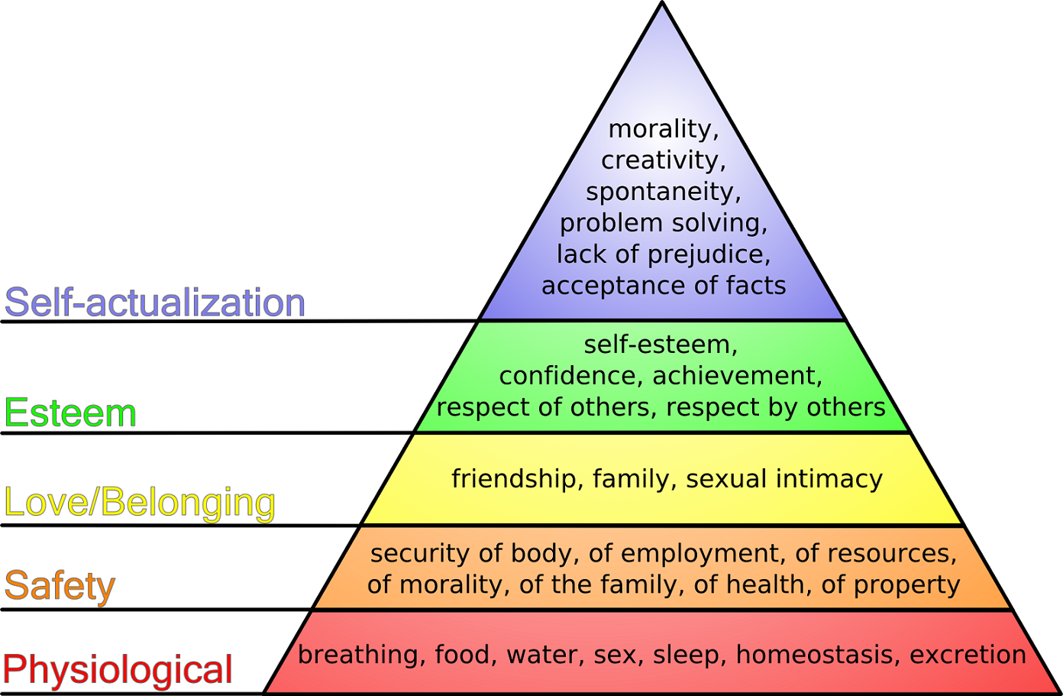
Maslow’s Hierarchy of Needs
Notes:
Rene
If the bottom parts aren’t addressed the top parts won’t happen bc the ultimate goal is to have a team that works cohesively. Trust or mistrust of the system – also watch privilege – about building relationships

Slide 16
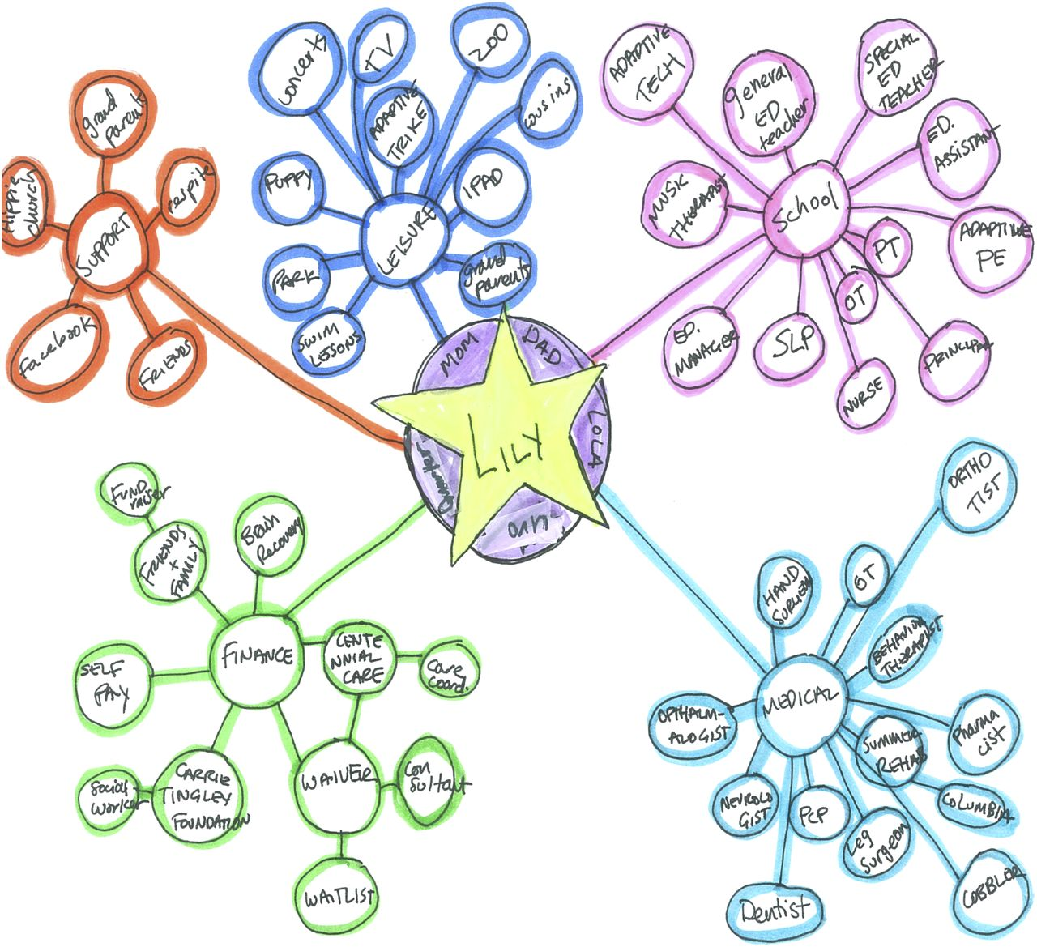
Care Map
Notes:
Rene
Care Map – because so many times this is what families are experiences all of these silos………

Slide 17
How do we create an integrated model?
Notes:
Ed et al –
Have a few thoughts in the hopper……..can come up with later

Slide 18

Thoughts and Discussion!
Notes:
Ed et al

Slide 19

Find Your Parent Center
Notes:
Rene –

Slide 20
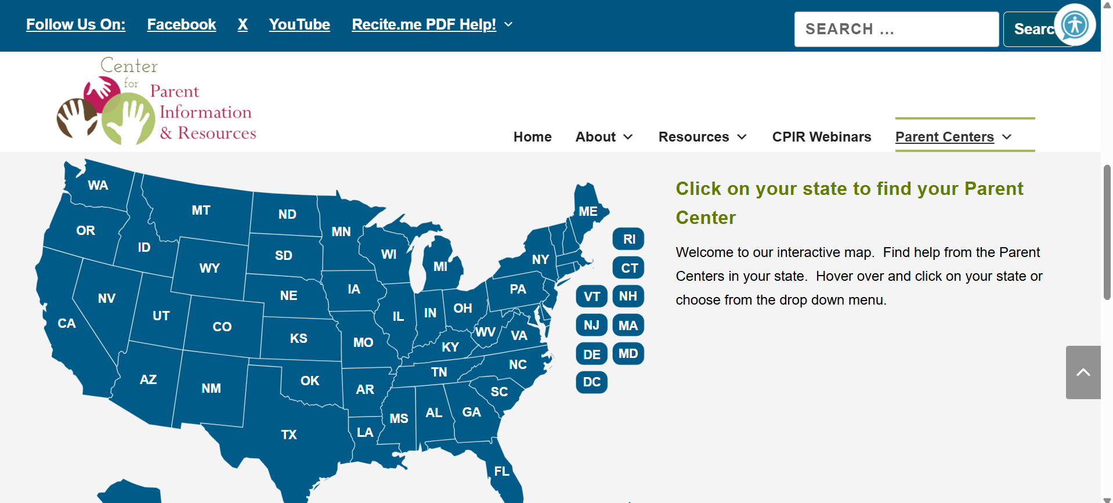
Find Your Parent Center
Notes:
Rene

Slide 21

Please let us know how we did today!
Scan the QR code with your phone or click here!

Slide 22
Thank you!

