Slide 1
The IEP for Success Companion Guide for Educators:
Practical Tools for Connection, Belonging, and Student Voice
October 2025
Notes:
We are wondering if you are interested in presenting your 90-minute session proposal, “The IEP for Success Companion Guide for Educators: Practical Tools for Connection and Belonging” as a 3-hour session instead. We would welcome bringing in elements of your other session proposal around student self-determination, as well. Is this something you are interested and able to do?
Title: The IEP for Success Companion Guide for Educators: Practical Tools for Connection, Belonging, and Student Voice
Time: 3 hours
Description (150 words or less)
Join the High-Quality IEPs for an engaging introduction to the IEP for Success Companion Guide for educators. This guide helps to lay the foundation for prevention strategies in the dispute resolution continuum. This session offers a comprehensive walkthrough of the guide, providing practical tools and strategies for creating student-centered IEPs that prioritize connection, belonging, and meaningful participation.
Participants will learn to:
Enhance self-awareness to understand how personal actions influence outcomes.
Apply effective organizational strategies to manage the IEP process with confidence.
Create opportunities that increase student agency and true engagement
Navigate challenging conversations with a focus on issue resolution rather than conflict.
Leave with actionable insights and techniques to ensure every student’s voice is at the heart of their IEP journey, fostering engagement, autonomy, and success. Whether you’re an educator, administrator, or advocate, this session will equip you with essential skills to transform the IEP process.
Three Learning objectives:
Understand how to use the IEP for Success Companion Guide to support the development of student-centered IEPs that promote connection, belonging, and participation.
Explore strategies to build educator confidence in centering student strengths, interests, preferences, and needs throughout the IEP process.
Apply self-assessment tools from the guide to reflect on personal beliefs, current IEP practices, and identify areas for professional growth.

Slide 2





California System of Support
The High Quality IEP and Pathways to Partnership (grant projects) are part of the California System of Support and led by East County SELPA, Santa Clara County SELPA Tehama county SELPA, and Ventura County SELPA . The projects are funded by the California Department of Education (CDE) and the California Collaborative for Educational Excellence (CCEE).

Slide 3
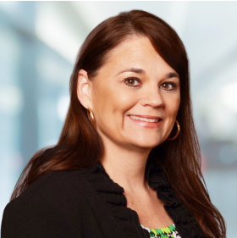
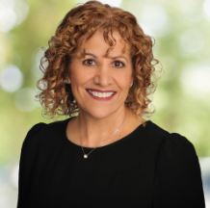

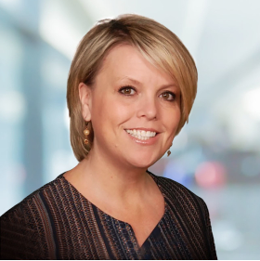



Presenters
Heather DiFede
Stacy Alvey
Executive Director
Director
Jennifer Yales, Ed.D.
Noreen Rodriguez Lippincott
Hinda Nadif, Ed.D.
SELPA Executive Consultant
Program Administrator
Program Administrator

Slide 4


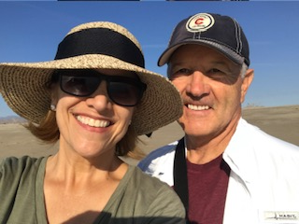
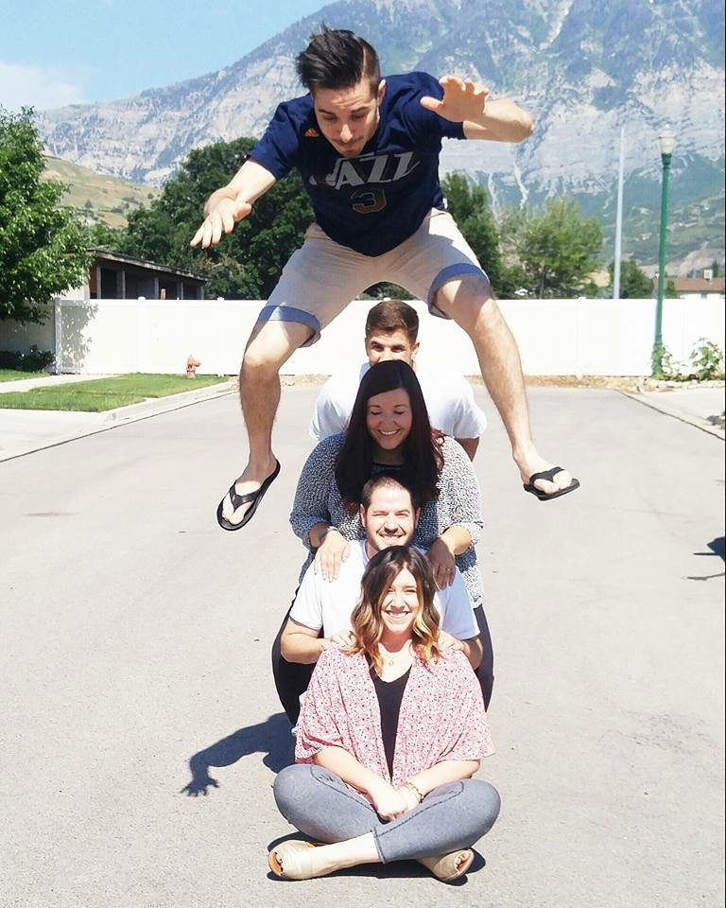

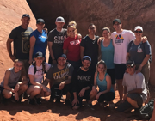

About Stacy Alvey
Connect - Collaborate - Support
Wife, Mother & Grandmother
Musician
&
Lifelong Learner
Experience: School Psychologist, LCSW, Mental Health Coordinator, SELPA Director Family & School Collaboration
Passionate about ADR
Family
is everything
Podcast lover
Director
Family & School Collaboration
Stacy Alvey, LCSW, PPS

Slide 5
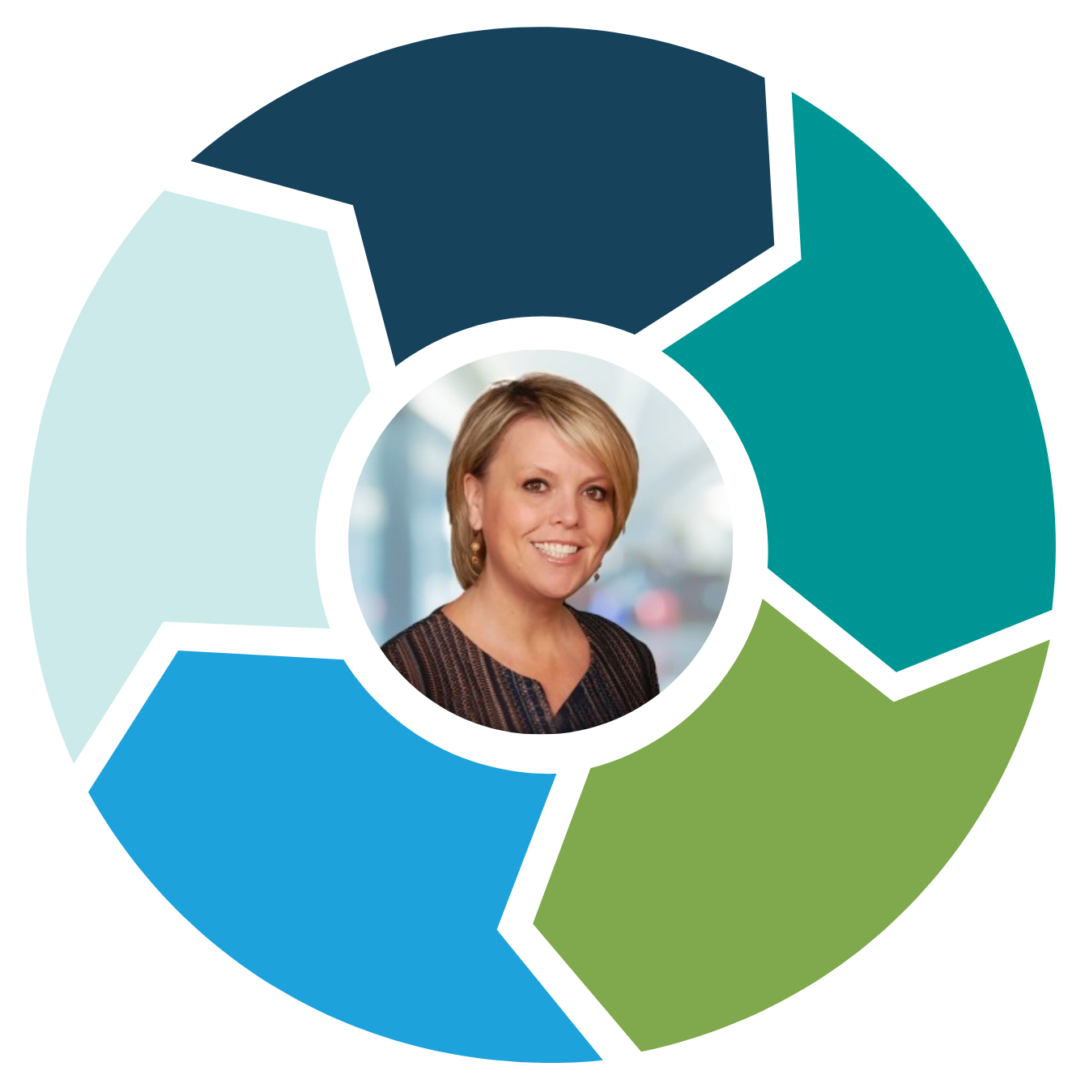

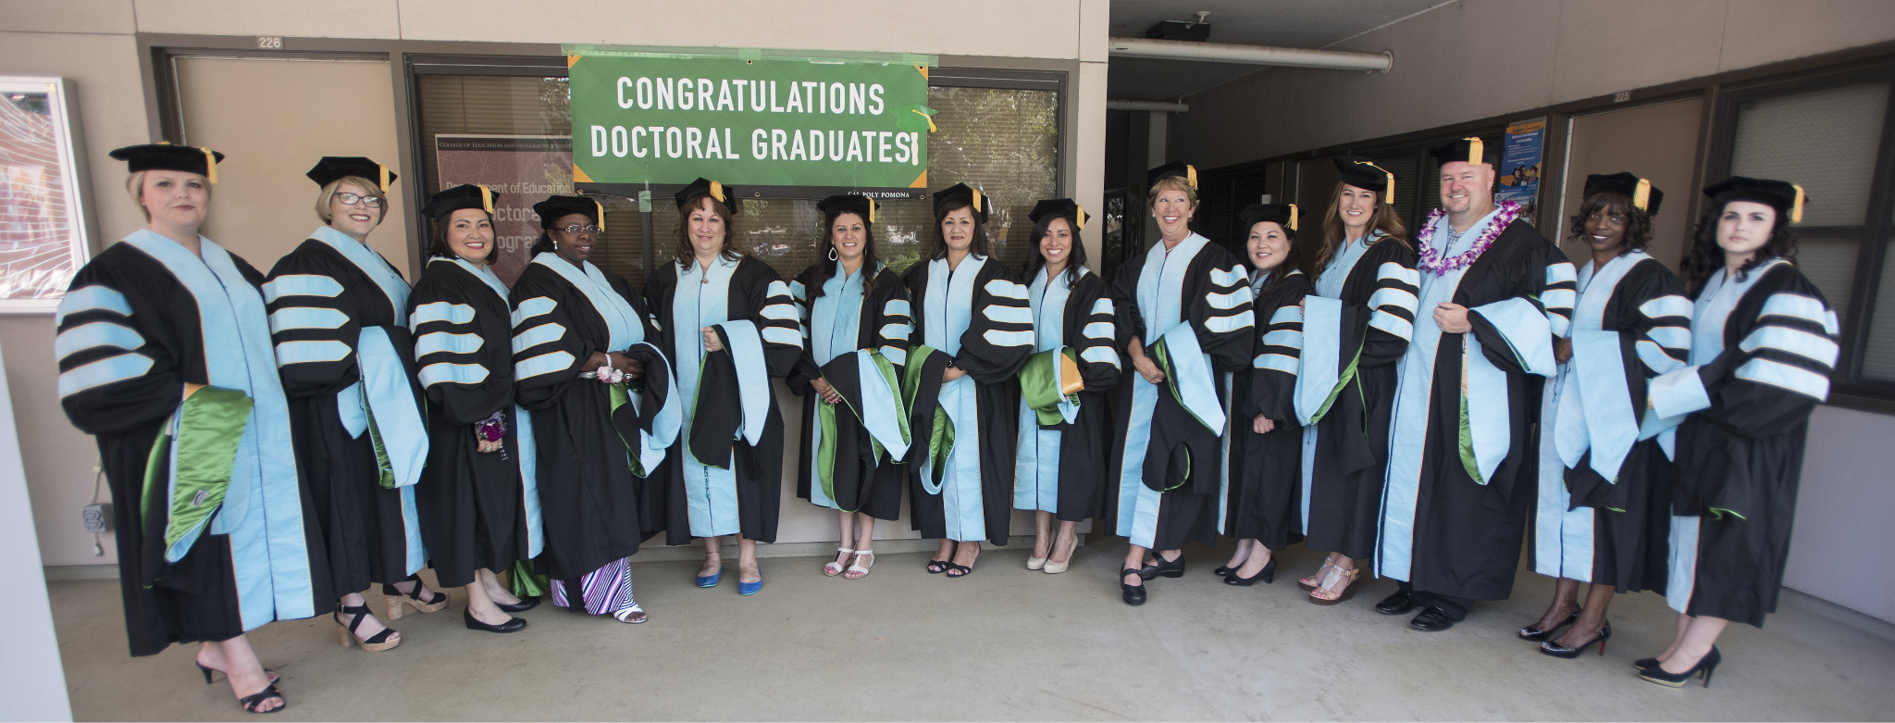
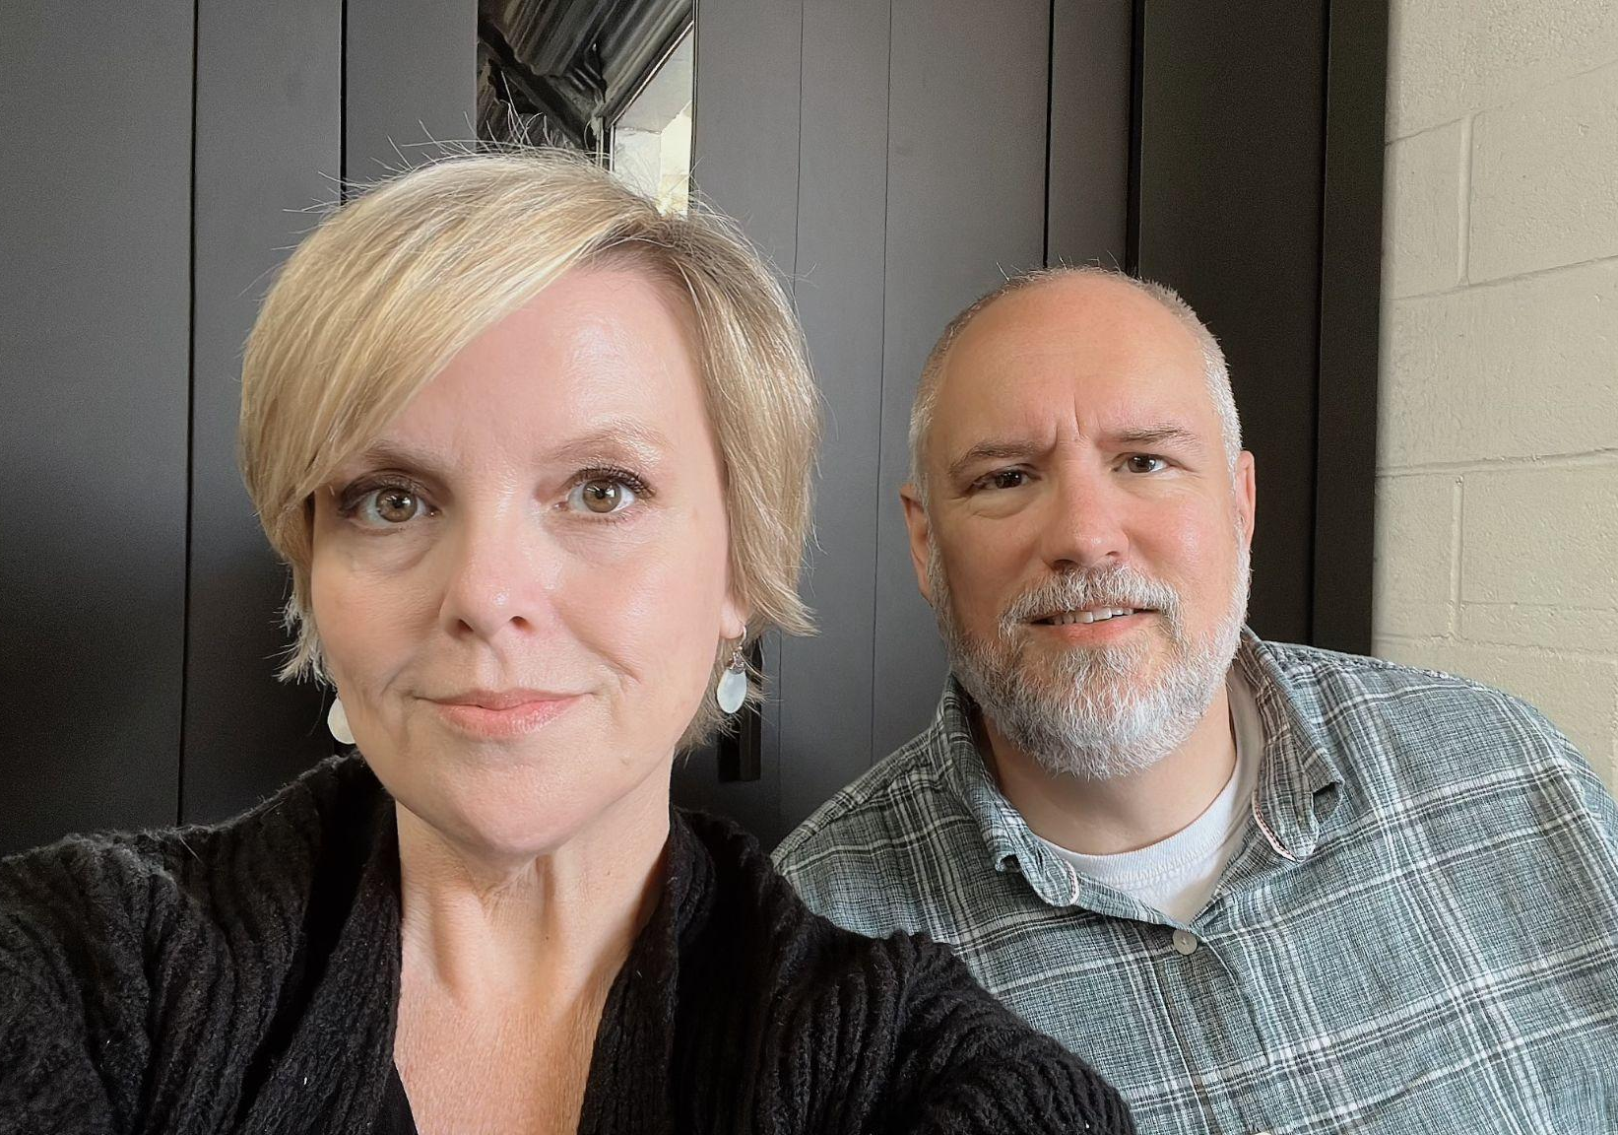
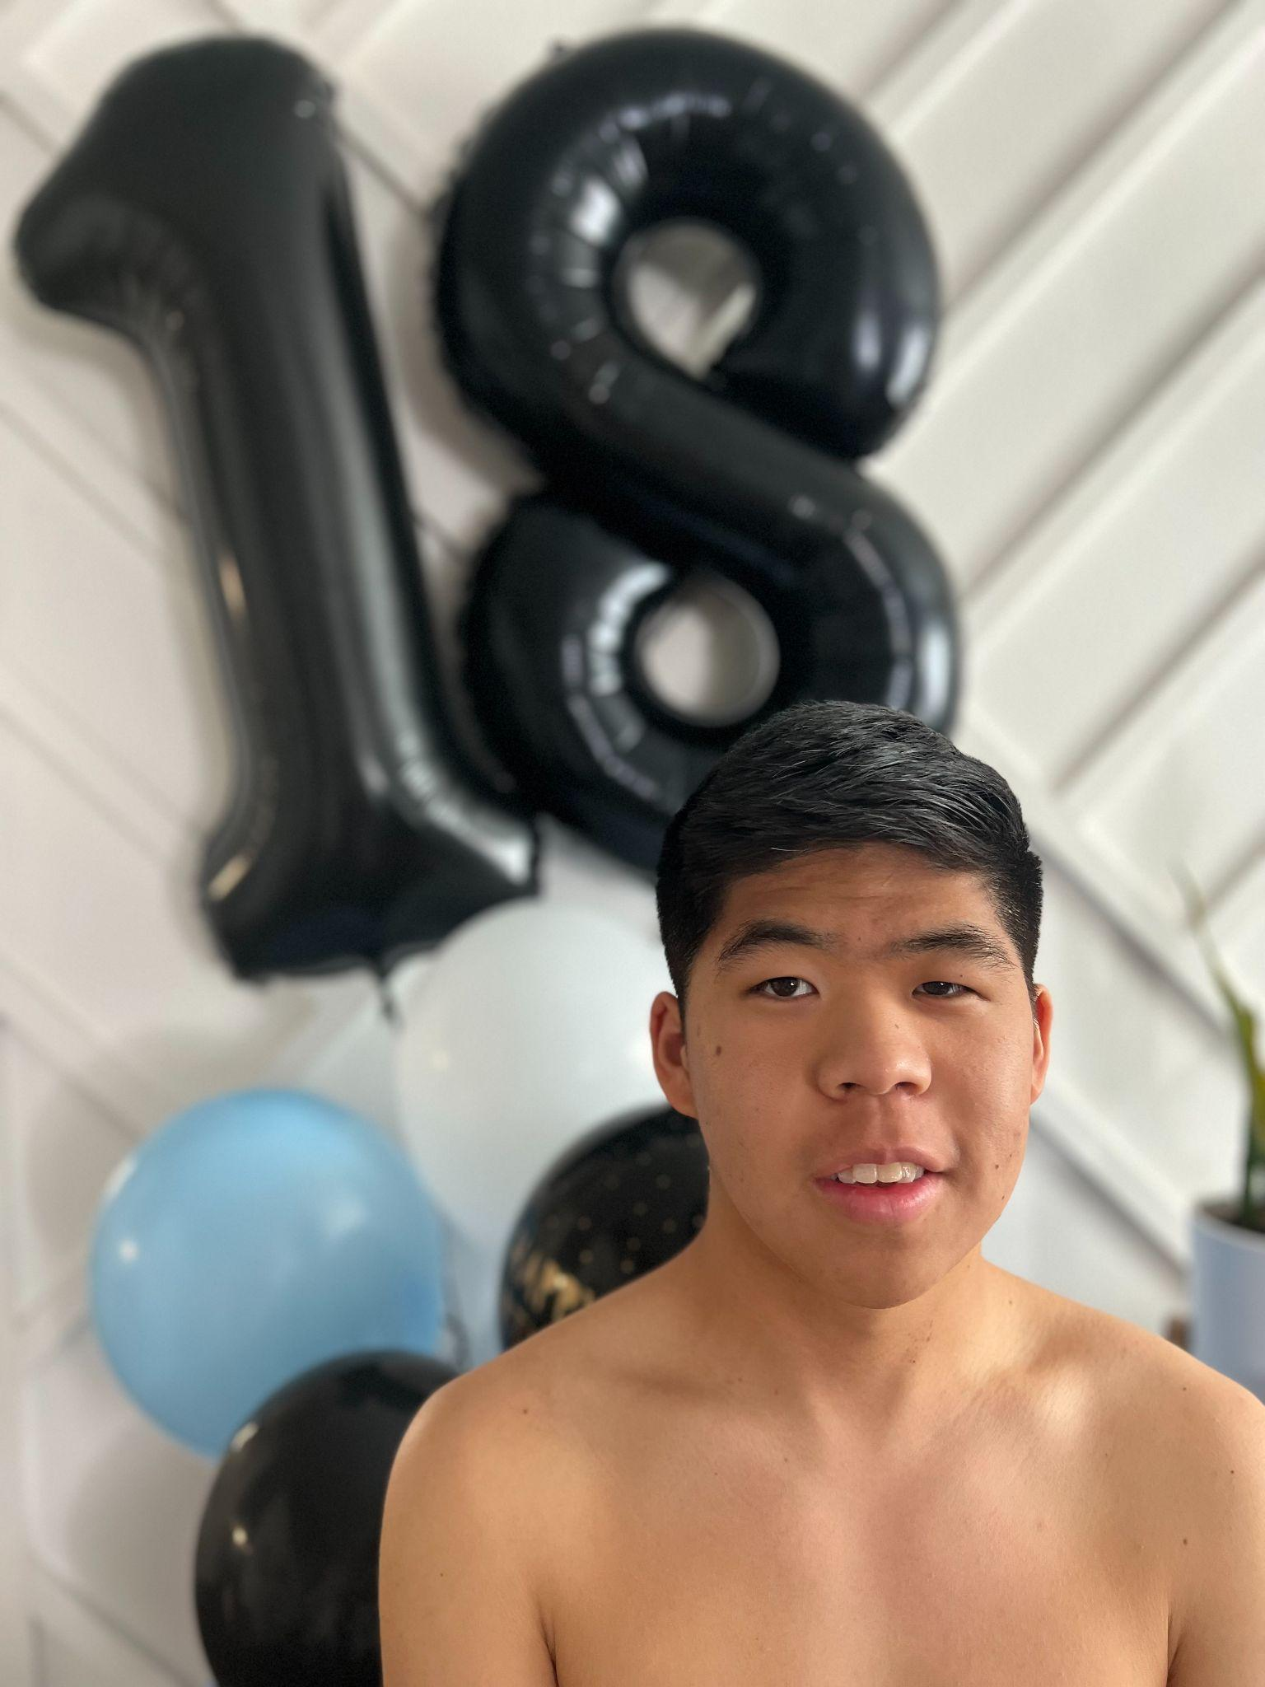


About Jennifer Yales
Creativity * Authenticity * Community
Core Values
Experience: school psychologist, program specialist, coordinator, program admin & SELPA Director
Dr. Yales
Educator
Leader & Coach
Wife & Daughter
Mother
Married 25 years
Adoption
Jennifer Yales, Ed.D.

Slide 6

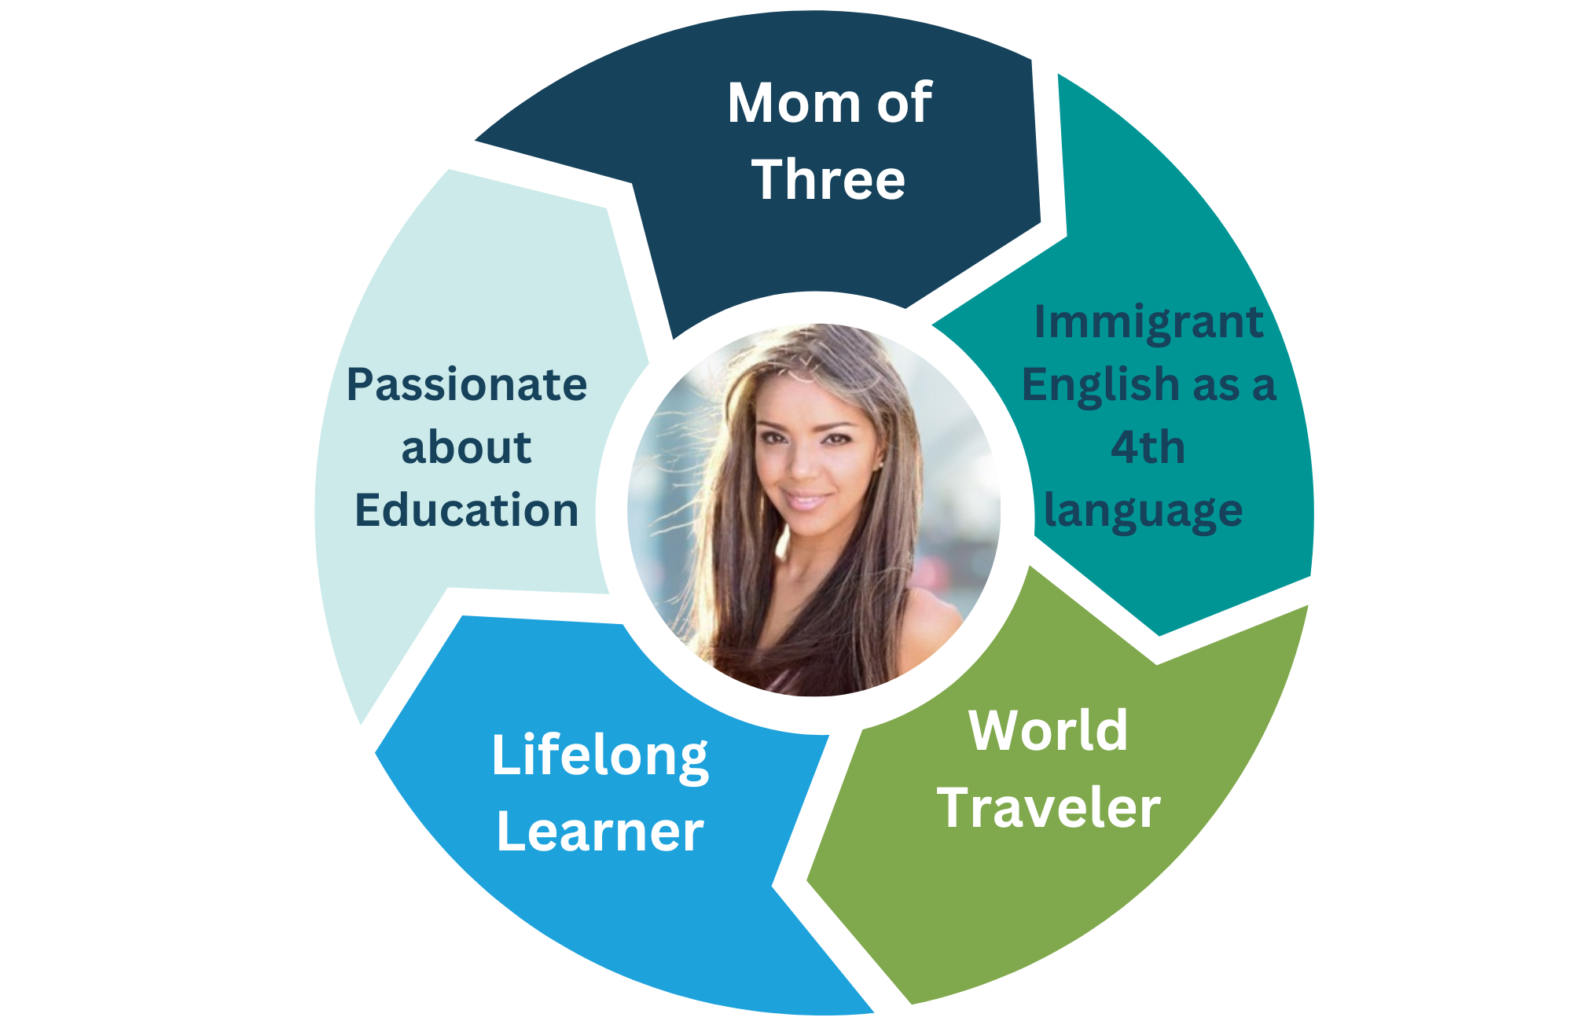
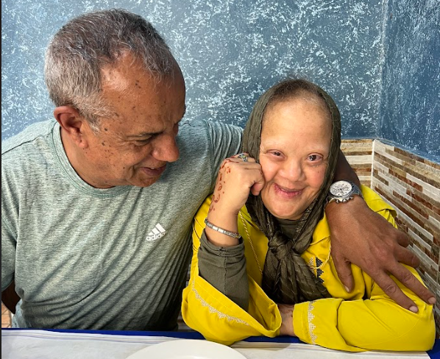
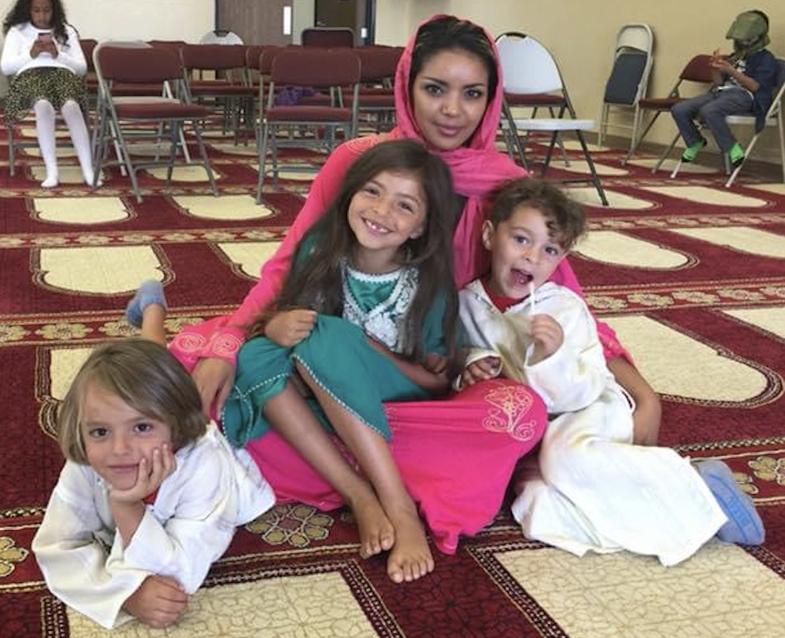
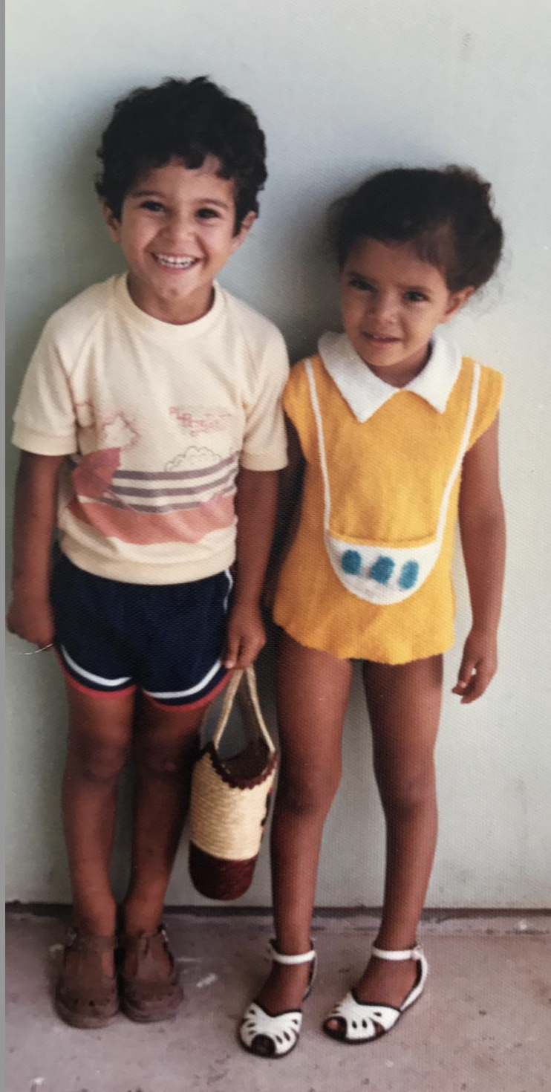

About Hinda Nadif
MY STUDENTS
Hinda Nadif, Ed.D.

Slide 7
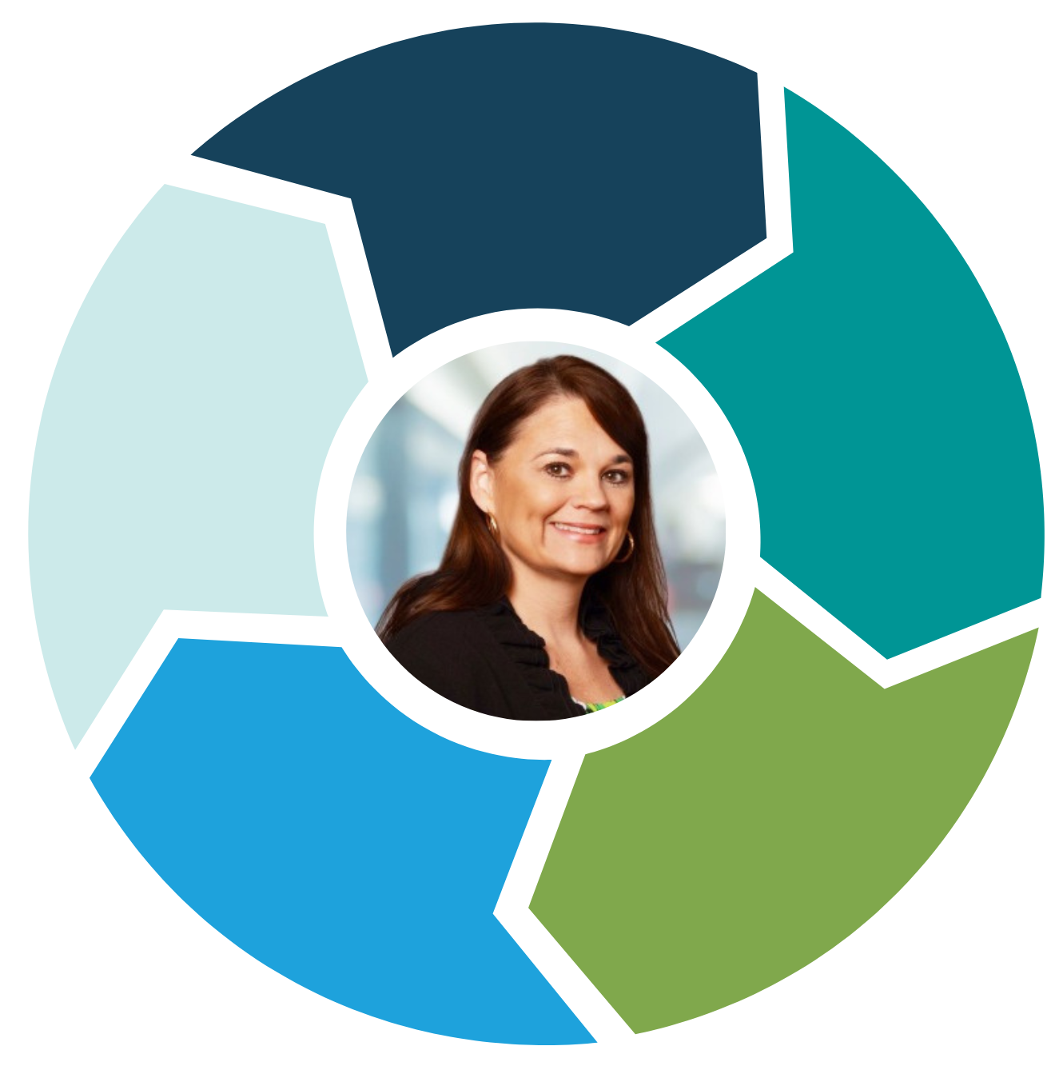





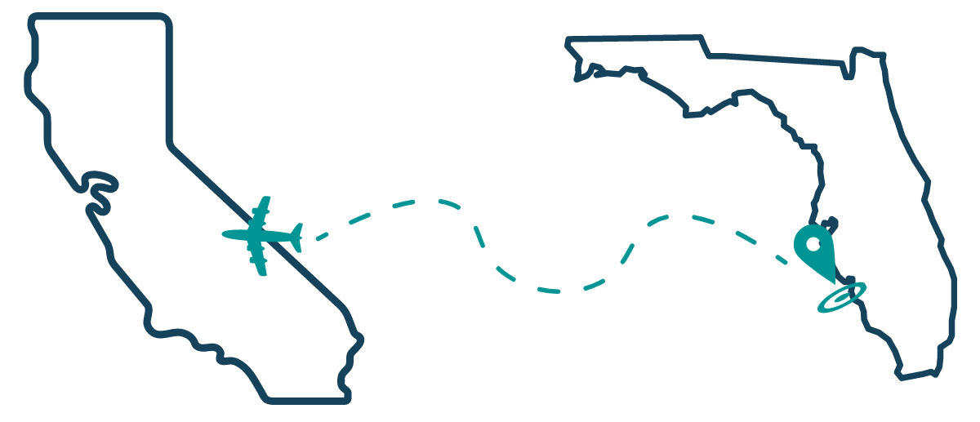
Heather
Experience: career spanning 30+ years serving as: educator, program specialist, coordinator, special education director & SELPA Director, and now with HQ IEPs full-time
Educator
Connector
Mom
Indoor Skydiving
Game Show fan
That’s me!
Helper
Heather DiFede
Notes:
Noreen https://youtu.be/c6rP-YP4c5I?si=0T-ioekHK0XTLbNW walk up song -

Slide 8




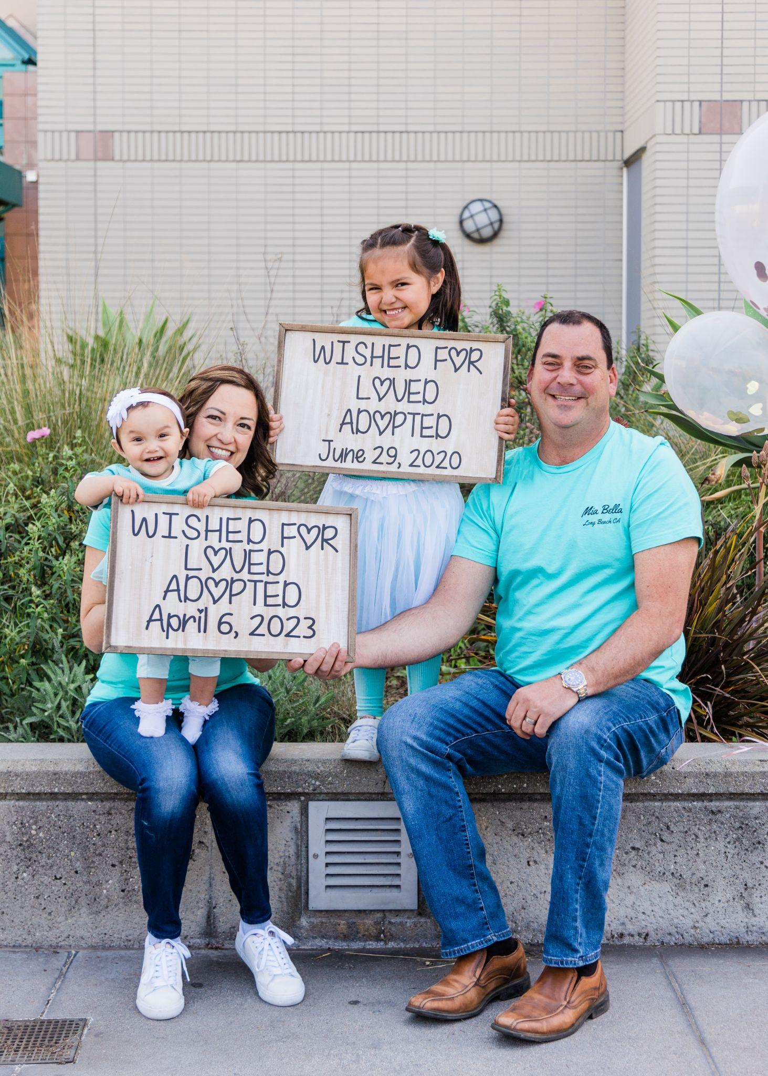
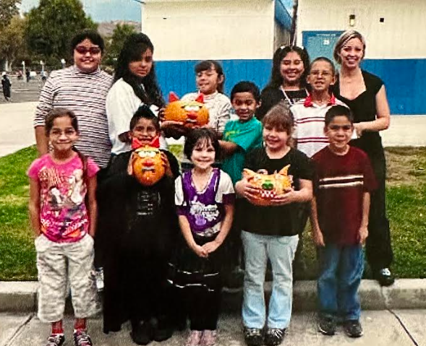
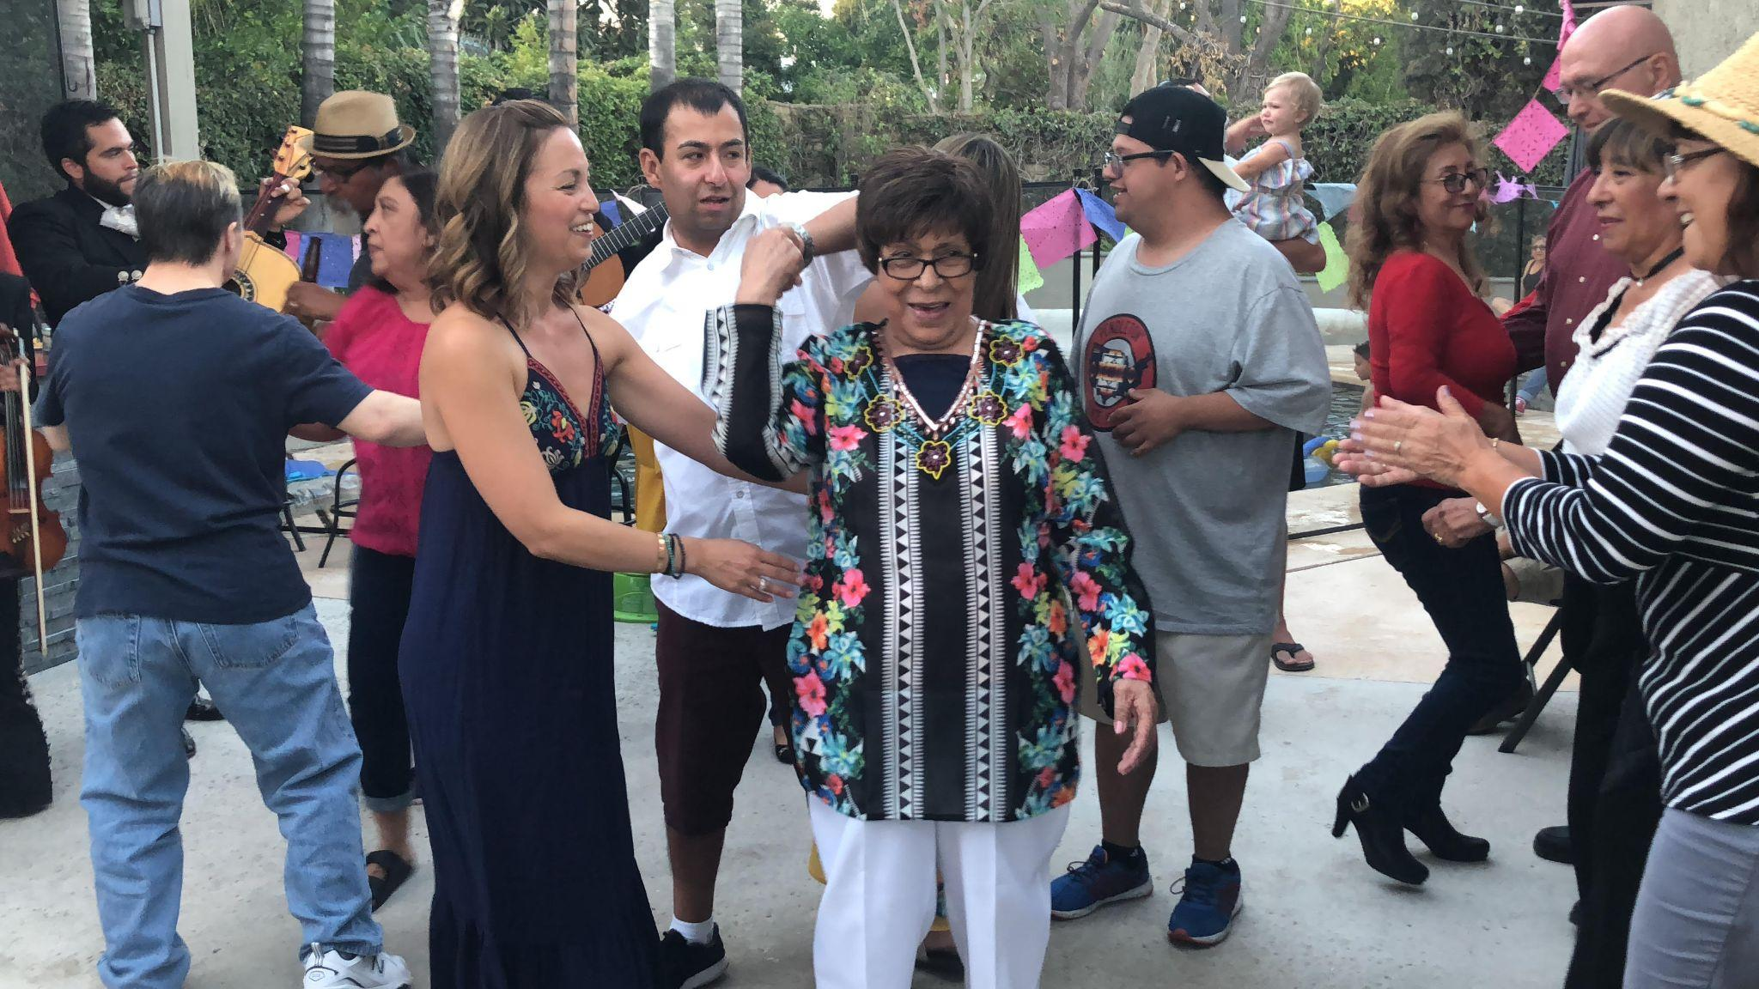
About Noreen Lippincott
Noreen Rodriguez Lippincott
Adoptive mom
of 2
Experience:
General education
SDC & RSP teacher,
program specialist,
program admin
Sister of
exceptional
brother
Learner
teacher
coach
Bi-racial,
multi-religious
Born in Mexico,
Spanish first
language
23 years in education
Notes:
Noreen https://youtu.be/c6rP-YP4c5I?si=0T-ioekHK0XTLbNW walk up song -

Slide 9
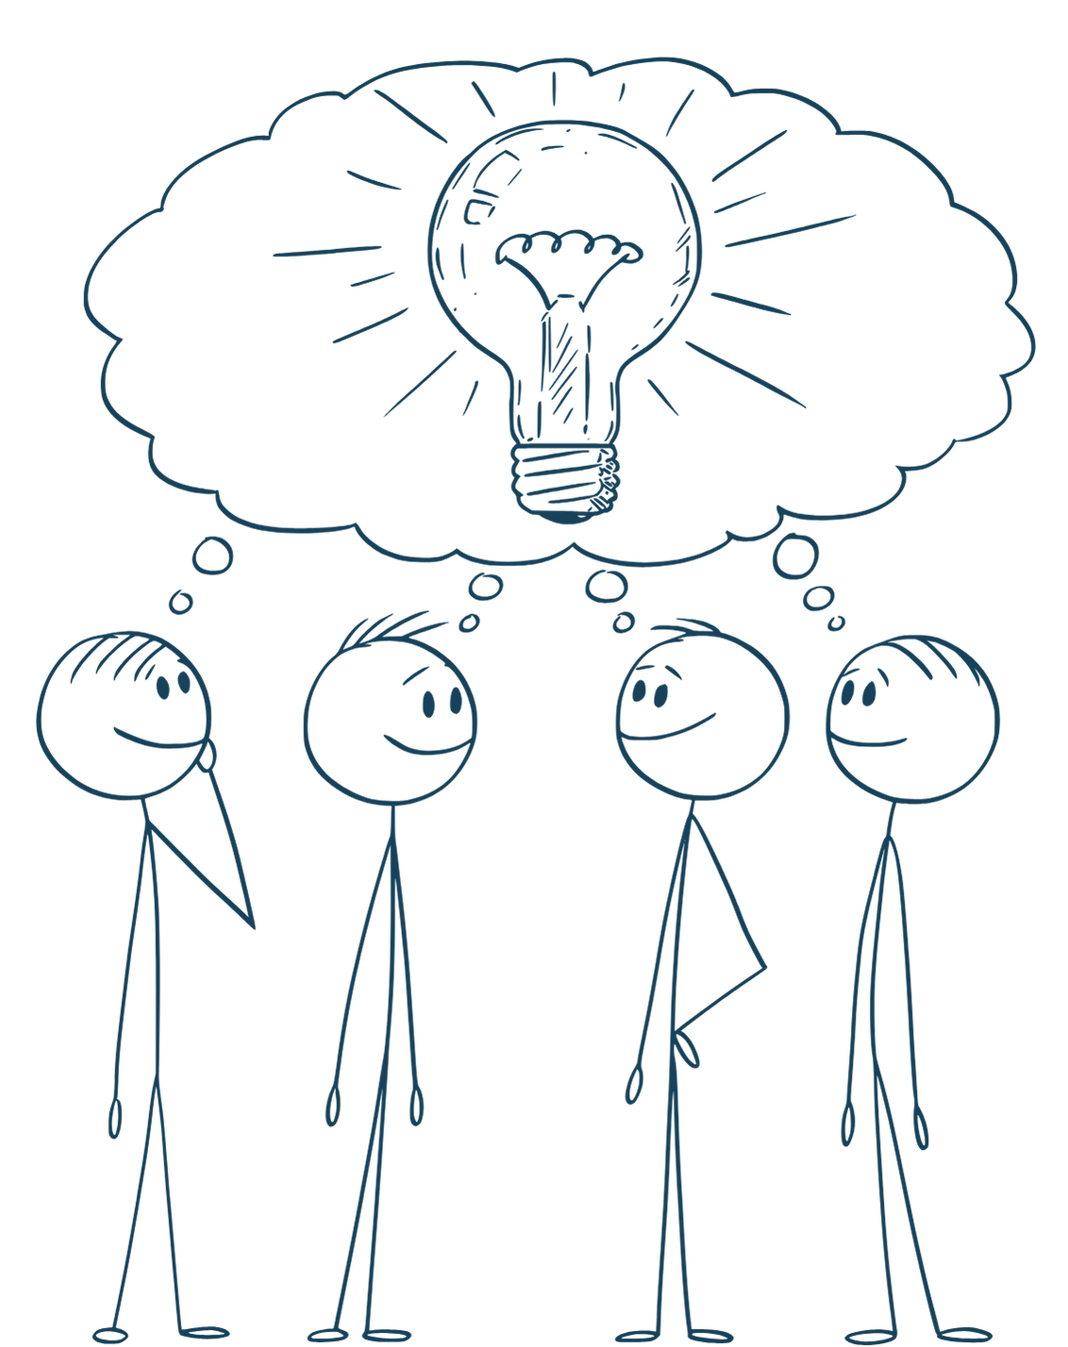
Our Hope for Today’s Training
This training may feel different from what you’ve experienced before. While you may be used to sessions led by attorneys focused on what to do or not do, our approach weaves legal guidance throughout while also offering practical, student-centered strategies we hope you find both useful and meaningful.
Throughout the presentation, ask yourself: How might this training (in whole or part) fit into my local context?

Slide 10
Objectives
By the end of this session, participants will:
Understand how to use the IEP for Success Companion Guide to support the development of student-centered IEPs that promote connection, belonging, and participation.
Apply self-assessment tools from the guide to reflect on personal beliefs, current practices, and identify areas for professional growth.
Explore strategies that build educator confidence in centering student strengths, interests, preferences, and needs throughout the IEP process.

Slide 11
How we got here
Notes:
state data
purpose of the grants:
HQ IEPs - pull slides
SIL presentation
Pathways- pull slides
https://docs.google.com/presentation/d/1GeMG9oosJGjoO_wPnfxdSDsugycExJBXmlLcg5Kkdcs/edit?usp=sharing
24-40
https://docs.google.com/presentation/d/14SlesFyBVp5tTaNyIItFeMS4R_C13Uhw/edit?slide=id.g31cae386743_0_30#slide=id.g31cae386743_0_30
slides 33-36
46-52
61-62

Slide 12
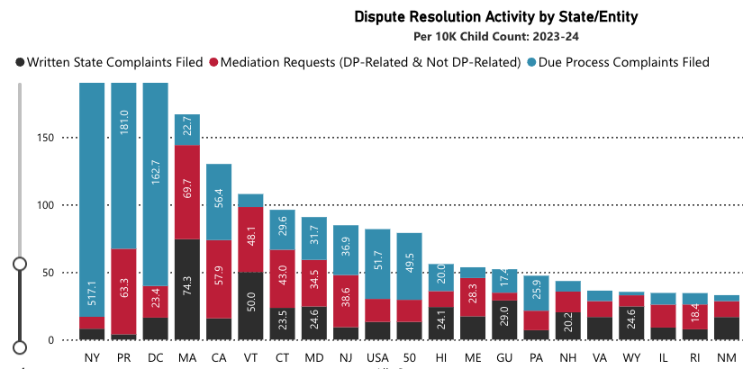
California
Fifth highest dispute activity in the nation

Slide 13
Gap Analysis:
Connecting Resources Survey
IDEA/Special Education Law
IEP organization and preparedness
Meaningful participation and engagement during the IEP
Present levels
Special factors
Measurable annual goals
Supports and services
Transition Services
Partnering with parents to implement the IEP
Monitoring
Asked if they have:
Online Trainings
Live Trainings and/or
Resources (handouts, pamphlets, etc.)
Surveyed California System of Support (SSOS) Resource Leads Partners

Slide 14
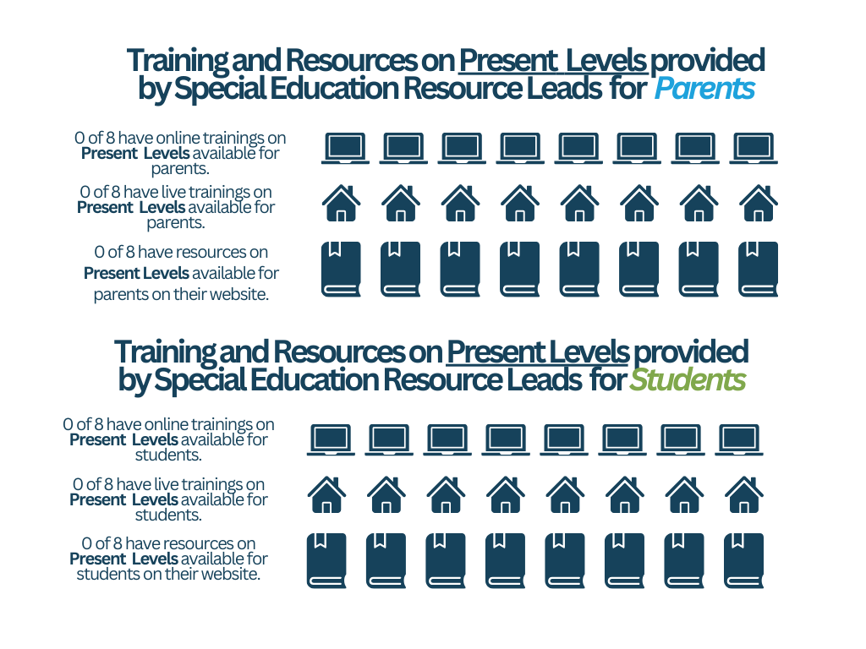
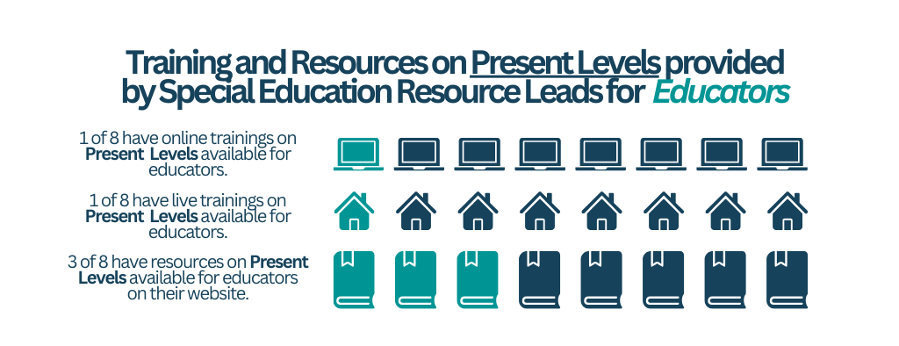
Gap Analysis Results
Present Levels

Slide 15
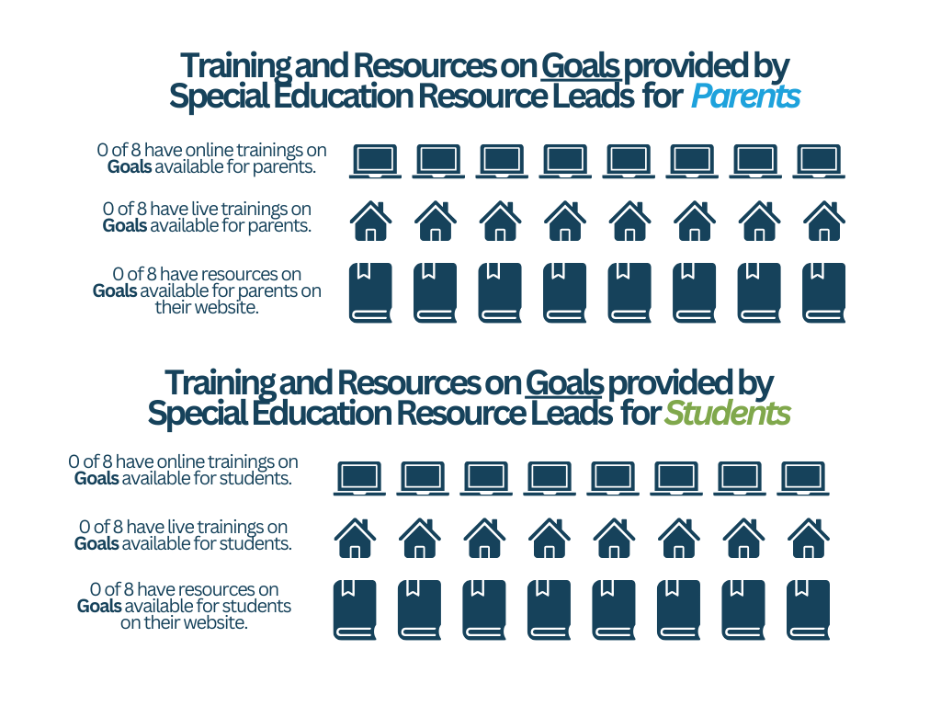
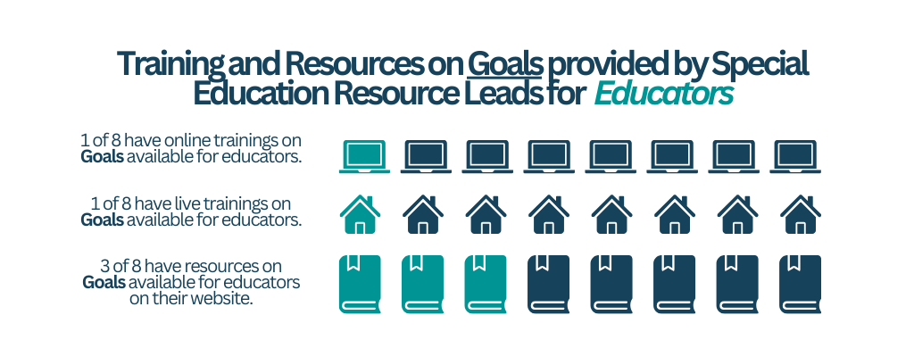
Gap analysis: goals
Gap Analysis Results 1
Goals

Slide 16
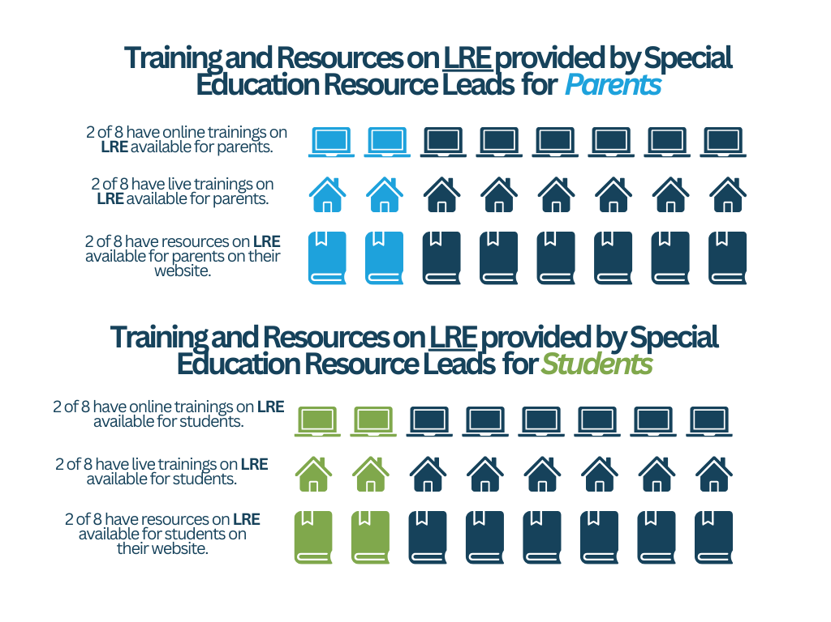
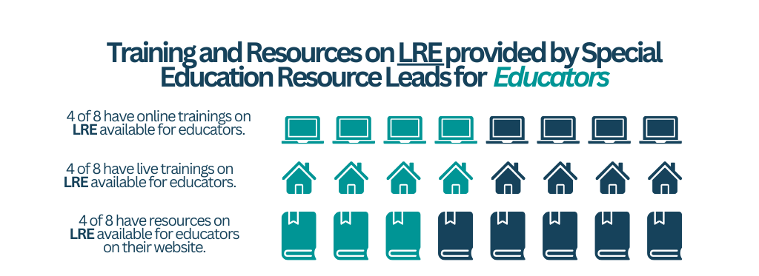
gap analysis results: LRE
Gap Analysis Results LRE
Least Restrictive Environment (LRE)

Slide 17
parent responses
HQ IEP Open Survey
We asked parents: “What resources/supports would you like to
see as part of the IEP journey on this website?”
“Parent training, do/don’ts.”
“Education on the law and parent rights. “
Themes
IEP basics | Inclusive opportunities | Parent training
Parent resources | Connection to parent agencies | Meaningful engagement
“Easy to understand guidance for parents on what they can do and ask for.”
“How to organize and keep records. I‚ would like to see the difference between modification and accommodation explained. I would also like to see what inclusion is supposed to look like.”

Slide 18
Open survey: educators
HQ IEP Open Survey
We asked educators: What resources/supports would you like to see as part of the IEP journey on this website?
“Explanations of things in plain language.”
“Laws. What are the laws that mandate services for identified needs?”
“Checklists, infographics.”
 | Themes
Examples (agendas, etc.) | Parent training resources | IDEA law and parental rights
Simplify the IEP / IEP basics | Goals | Best Practices
“Resources for new special educators.”
“Consistent and best practices for IEP writing and how to lead an IEP.”
“IEP basics.”
“An overview of steps/process for those who are new to IEPs- who the key players are in a meeting, what they are responsible for doing.”

Slide 19

what we know: investigating the problem
Investigating The Problem:
What we know
California Statewide Individualized Education Program (IEP) Workgroup (12/20 - 7/2021) recommendations:
Clear guidance is needed to to adopt best practices for active participation in a student-focused, strengths-driven IEP process
More general education teacher participation is needed
Development and dissemination of resources and training to build the capacity of IEP team members
IEP statewide template

Slide 20
High Quality IEPs Project – Research Findings:
There is a strong need for a single, centralized location where resources on developing and implementing high-quality IEPs can be accessed.
Parents, students, and educators currently lack a clear and consistent path to find information about the major components of the IEP.
Families and educators are actively seeking more guidance on the IEP process, educational benefit, and how all elements of the IEP connect to support student success.

Slide 21

Pathways to Partnership information
Began July 1, 2023
Collaborative effort between Ventura County SELPA & Tehama County SELPA
Collaborate with educational partners to build collective capacity, expertise and resources in the prevention and resolution conflict with a student-centered focus

Slide 22
Pathways to Partnership Goals
Goals
#2 - Educational partners statewide will demonstrate increased effectiveness as evidenced by decreases in CDE complaints, Office of Administrative Hearing (OAH) filings, and increased in the use of mediation and other informal prevention and resolution strategies on the continuum.
#1 - Educational partners statewide will demonstrate increased capacity as evidenced by creating collaborative culture across the systems through communities of practice.

Slide 23
Pathways to Partnership Educator Resources
Gap Analysis Results: Where are educators and parents going for help?
Dispute Resolution Support and Resources
Most support accessed formal state and regional agencies, such as:
SELPA offices
CDE
Family Empowerment Centers (FECs) - most consistently praised development
Informal peer networks
Social media
Notes:
From focus group participants - N=34 consisting of an individual with a disability, parent support personnel, ADR practitioners, parents, school administrators, district administrators, SELPA staff and SELPA Adrministrators (comprised the largest group)
From survey responses, N=78 consisting of Most respondents were SELPA directors (n = 33), followed by district and LEA administrators (n = 13). Additional participants included other SELPA staff (n = 7), school administrators (n = 4), school staff (n = 3), parent support personnel (n = 2), and parents of students with disabilities (n = 4). Eight respondents selected “Other” to describe their roles. This distribution suggests the survey captured primarily administrative and systems-level perspectives, with more limited input from families and direct service providers.
As shown in Figure 3 below, survey respondents reflected a broad geographic distribution across California’s 11 SELPA regions.

Slide 24
Pathways to Partnership Making a Difference
Gap Analysis Results: How is P2P making a difference?
Dispute Resolution Support and Resources
Relationship-centered training
Statewide and Regional Communities of Practice
Regional Implementation Leads
Resource coordination
Direct partnership with CDE’s Constitutent Support Services Unit
Notes:
From focus group participants - N=34 consisting of an individual with a disability, parent support personnel, ADR practitioners, parents, school administrators, district administrators, SELPA staff and SELPA Adrministrators (comprised the largest group)

Slide 25
Pathways to Partnership Barriers to Dispute Resolution
Gap Analysis Results: Barriers to Dispute Resolution
Dispute Resolution Support and Resources
Lack of awareness & understanding of special education systems and ADR processes, especially among families
Parents are unaware of who to contact
Parents feel that school had greater access to procedural knowledge and legal resources
Unaware of available ADR options for educators and families
Lack of trust in the system
Lack of specialized training for staff & administrators
Notes:
From focus group participants - N=34 consisting of an individual with a disability, parent support personnel, ADR practitioners, parents, school administrators, district administrators, SELPA staff and SELPA Adrministrators (comprised the largest group)

Slide 26
Pathways to Partnership Recommendations
Gap Analysis Results: Recommendations
Expand & sustain statewide and regional communities of practice
Develop and share ADR models that can be easily adopted or locally adapted
Train-the-trainer programs and asynchronous professional development models
Targeted training for administrators, general education staff, and other service providers.
Training for dispute resolution practitioners
Clarify the role and availability of RILs, ensuring LEAs, SELPAs, and other partners
Notes:
From focus group participants - N=34 consisting of an individual with a disability, parent support personnel, ADR practitioners, parents, school administrators, district administrators, SELPA staff and SELPA Adrministrators (comprised the largest group)

Slide 27
Our Why

Slide 28

Grounding Activity
Notes:
Let’s take a minute or two to journal or think independently . . .
Think about a time when you have felt that you belonged . . . what did it feel like, sound like, what qualities do you remember?

Slide 29
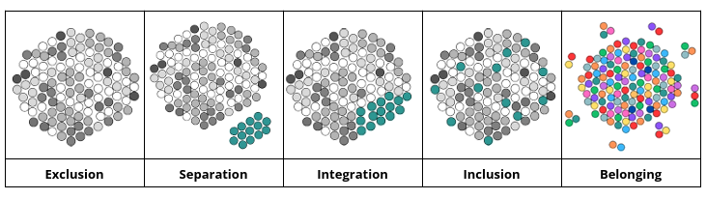
The Importance of Belonging
For students who receive special education services—especially those who have faced barriers—belonging opens doors to opportunity, confidence, and joy. IEP teams have the power to make that belonging real, and the time to act is now.
Notes:
For 50 years, people with disabilities and their allies have fought for the right to learn alongside their peers. A student who is separated may be physically present, but disconnected from their peers and the learning environment. A student who is integrated may share the space with other students, but not the dialogue. A student who is included may have a seat in the classroom but still feel like an outsider. When a student truly belongs, they know they matter. Their identity is valued, their ideas influence the community, and their presence enriches everyone.

Slide 30
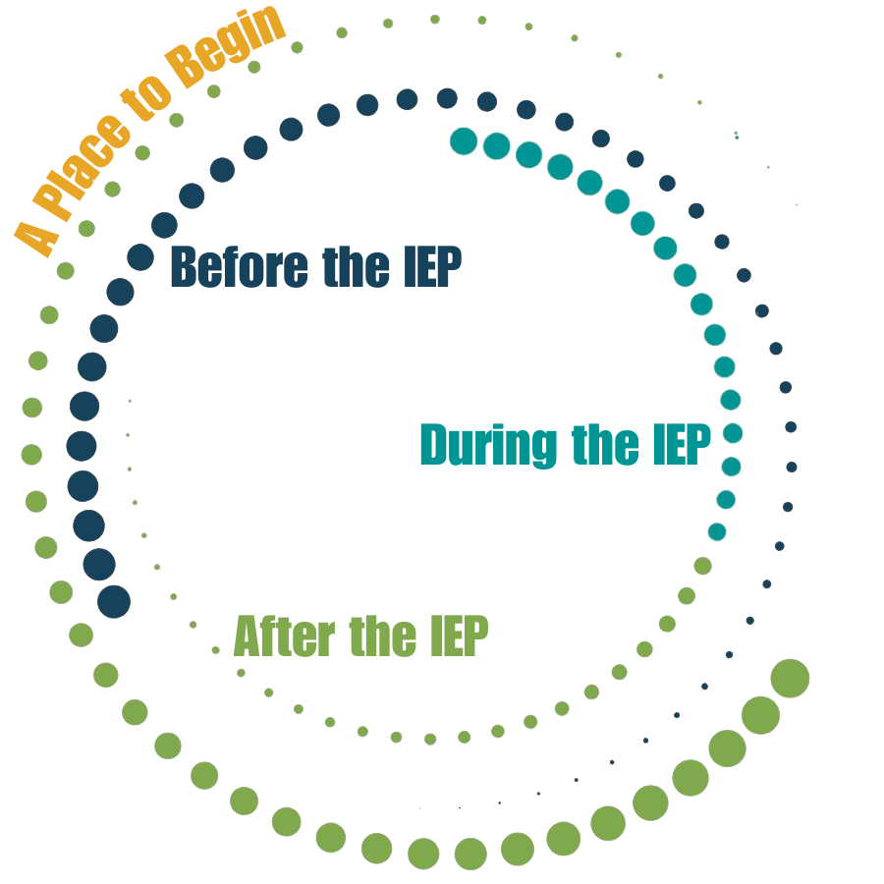
We recognize:
The IEP is a Journey
There are many faces and experiences of the IEP team
Parent
Student
Educators
All members have value

Slide 31
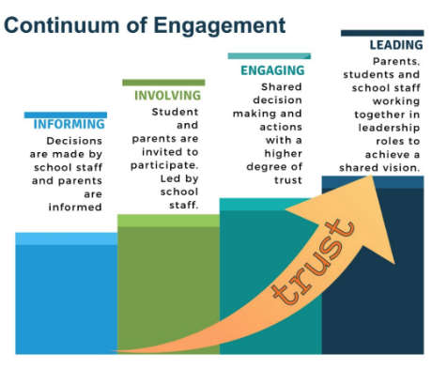

Our Why
We strive to:
foster student-centered and asset-based IEPs
embrace collaboration
create meaningful and inclusive experiences for all IEP team members
increase meaningful engagement for all IEP team members
build trusting relationships
Notes:
This essential resource provides a structured approach to fostering student-centered, collaborative, and legally compliant IEP meetings. It equips educators with the knowledge and tools needed to create meaningful and inclusive experiences for students and families, ensuring that the IEPs they create together are not just procedural documents but transformative opportunities for student growth and empowerment.

Slide 32
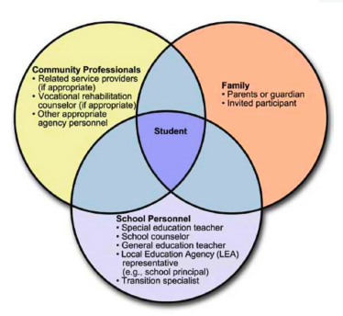
We all have a role.

Slide 33

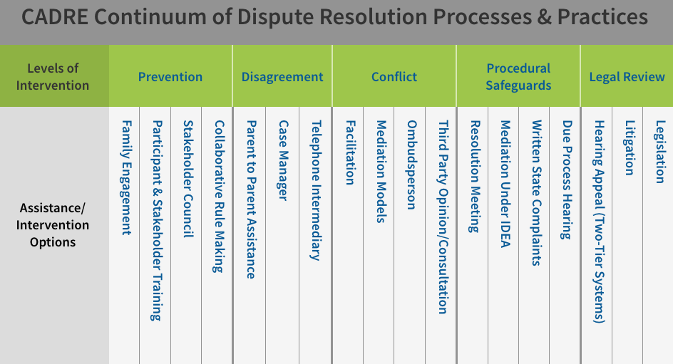

CADRE Continuum of Dispute resolution
“Perhaps the best and easiest way to manage conflict is to prevent it in the first place. Increasing the capacity of systems and individuals to meaningfully collaborate and problem-solve offers a proactive strategy for conflict management. ”

Slide 34
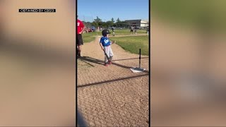
Let’s get started with some fun!

Slide 35

What would be your walk-up song?
With an elbow partner share your walk-up song . . . why did you choose this song? How does the song make you feel?

Slide 36
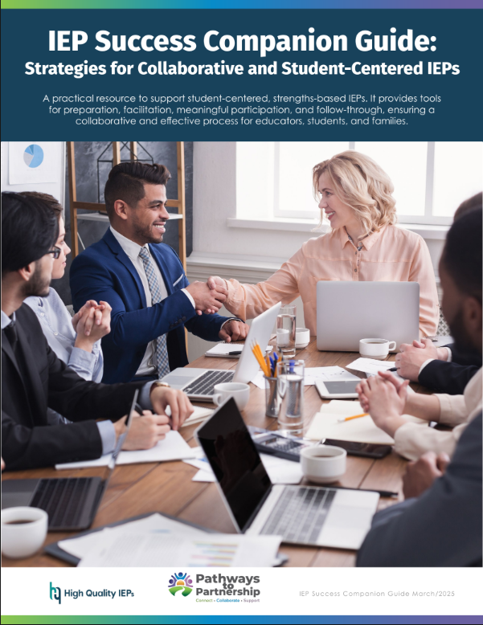

IEP Success Companion Guide Cover Page
Introducing . . .
Notes:
Provide a structured approach to fostering student-centered, collaborative, and legally compliant IEP meetings. It equips educators with the knowledge and tools needed to create meaningful and inclusive experiences for students and families, ensuring that the IEPs they create together are not just procedural documents but transformative opportunities for student growth and empowerment

Slide 37


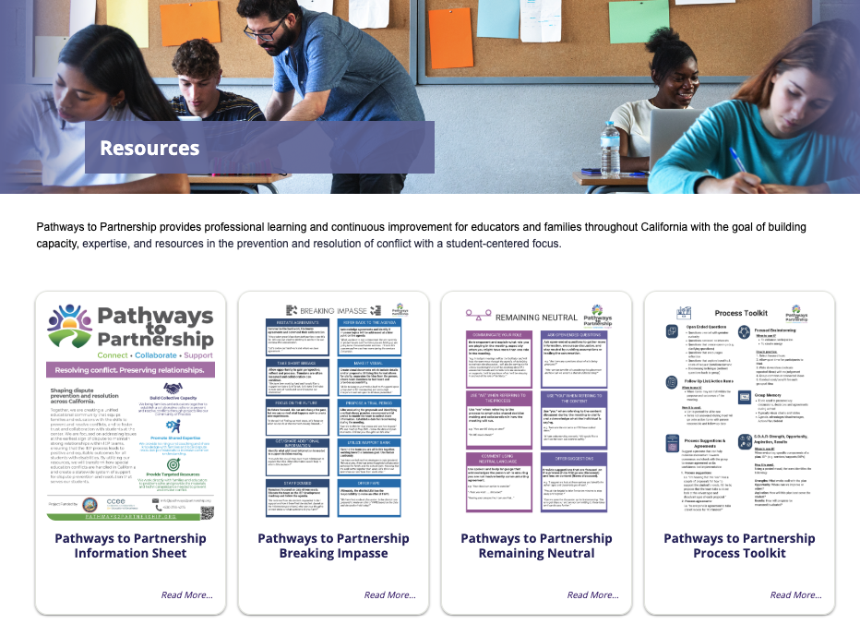
Where can I find this resource?
highquailtyieps.net
pathways2partnership.org

Slide 38



Let’s go on an IEP journey . . .
1
2
We will go through the presentation with a lens on these two roles:
Educators and Parents
Students
Notes:
we’ll walk through the lens of the adults and then the students

Slide 39
A Place to Begin
Creating awareness in ourselves as educators and parents.

Slide 40
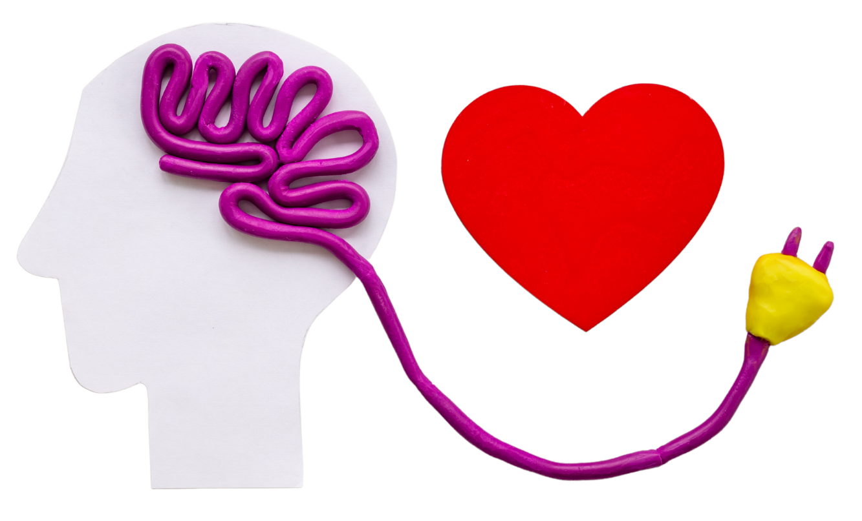
Creating Self-Awareness
Just as we teach self-awareness as a crucial competency to our students, we must begin by developing it ourselves. By surfacing and examining our own beliefs through heightened self- awareness, we can better understand our actions and their impact on others.

Slide 41

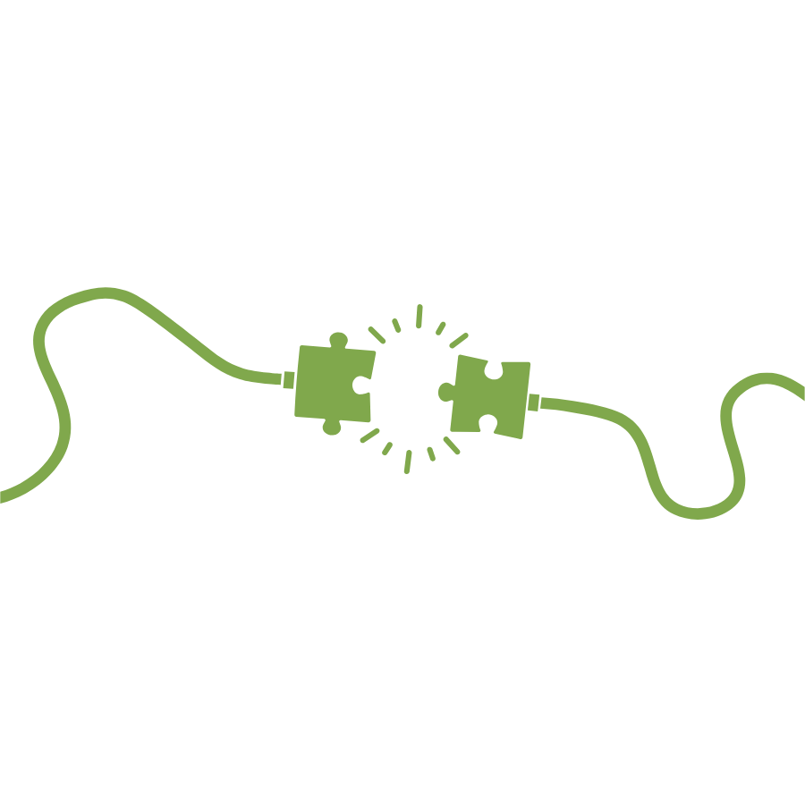
The importance of creating self-awareness
my beliefs
Notes:
what our beliefs influence our ways of being and, ultimately, our actions
Tools that reveal how our experiences, social construct/identify and mental models can lead to biases, affecting our interactions with others and how we contribute to group dynamics.
Self-awareness
mental models (brain) -shape how we understand the world and influence
social identity (body - social identities)
emotions
mindset

Slide 42
We do this by creating self-awareness
Why is self-awareness important?
Identity
Self-knowledge about purpose, values, and roles in the community
Emotional intelligence
Growth mindset
Strong and fair relationships
Becoming self-aware about our beliefs helps shape our ways of being and ultimately drives our behaviors towards our students, parents, educators, and—most importantly—ourselves.

Slide 43
Understanding Self-Awareness
Mental Models
Bias
Social Identity
Emotions

Slide 44


Activity
Take out a piece of paper and pen.
As you listen to the story, jot down any thoughts, feelings, or connections that come up for you. Capture what feels meaningful— there are no right or wrong answers.
Notes:
As you listen to this story, notice any thoughts, feelings, or connections that come up for you. Write down anything that stands out—whether it’s an idea, a memory, a question, or an emotion. There are no right or wrong answers—just capture what feels meaningful to you.

Slide 45

Activity cont.
Take a moment to look back at what you wrote. What’s one thought, feeling, or connection you’d like to share with the group? You don’t have to share everything—just what feels most meaningful to you.
Notes:
Disclaimer: Not everyone might be in a place to discuss this topic in a group setting- that’s ok, feel free to hang out here.
For those heading into breakout rooms, When discussing in small groups, be courteous, respectful, assume goodwill and understand we are all learners.
if time, what experiences do attribute them to

Slide 46

Mental Models
Mental models refers to internal frameworks that shape how we understand and interact with the world.
Mental models are often developed subconsciously from society and people around us. By surfacing them we put them in “check,” so to speak.

Slide 47
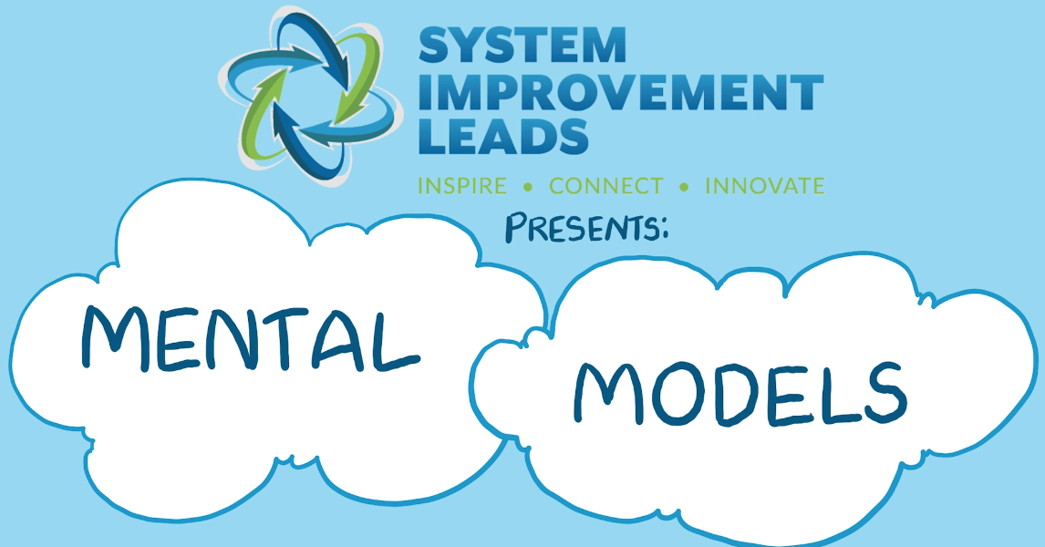
System Improvement Leads Mental Models
Notes:
https://vimeo.com/809199780?fl=pl&fe=vl

Slide 48

Video about student
Let’s watch a video about Matthew.
This is the student I shared with you earlier.
As you watch the video:
Does this align with what you wrote earlier? How does what you see confirm what you imagined or differ?
Notes:
Share out
What we just saw reminds us that a student is always more than what’s written in their paperwork and more than our mental models. When we focus only on deficits, we miss the strengths, talents, and possibilities that truly define who they are. Matthew’s story is a powerful reminder to look beyond the words on the page or the image we hold of the disability and see the whole child.

Slide 49
reflection activity
Did seeing the student change or alter your initial image or “mental model?”

Slide 50

Why is it important to surface mental models in the context of an IEP?
Mental models influence our behaviors and can:
be limiting
cause us to over simplify or generalize
lead us to pass judgement or make decisions not always based on facts
become implicit
limits our perspective
Notes:
Did this happen when you did the activity?

Slide 51
Moving forward . . .
Think about ways you can continuously surface your mental models to challenge our sometimes deeply internal images of how the world works.
How will you support your colleagues and staff in bringing to light this very important topic?

Slide 52
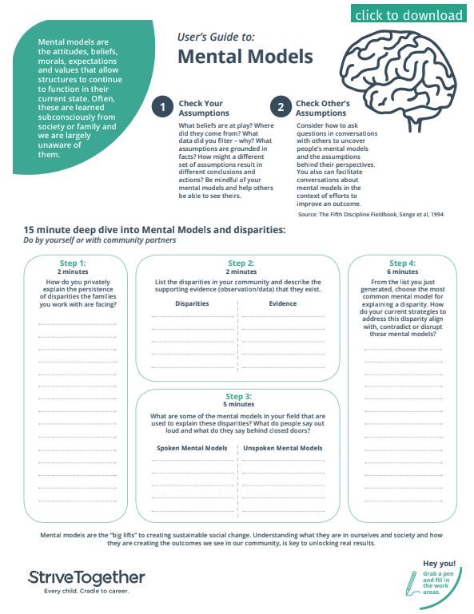
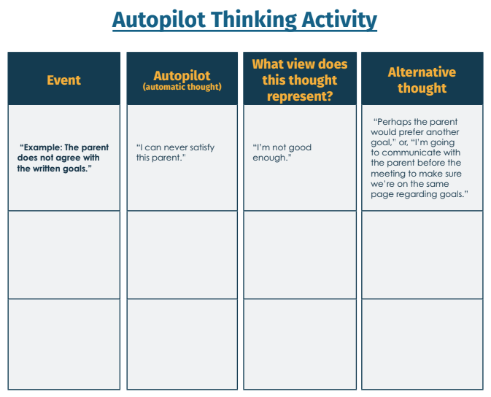
Activities to build our self- awareness

Slide 53
Bias
Bias, or the preference for a particular person, group, or perspective, are not usual based on fact but a combination of factors (e.g. age, gender, culture, social norms).
Bias
Although we all have them, biases (explicit and/or implicit) shape our thoughts, behaviors and decisions. Implicit biases can come in many forms:
race
age
gender
ability

Slide 54
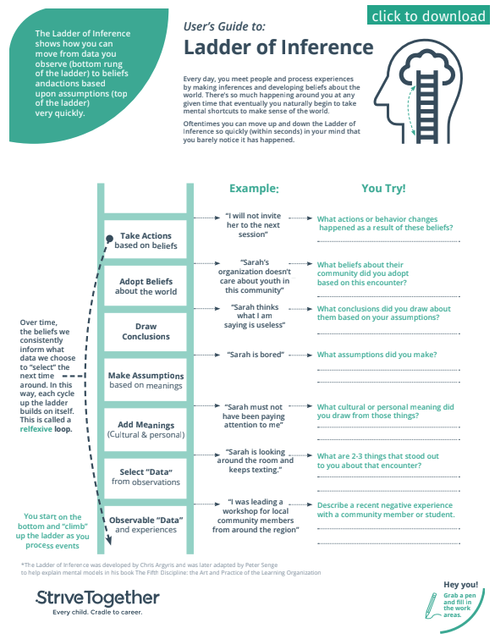
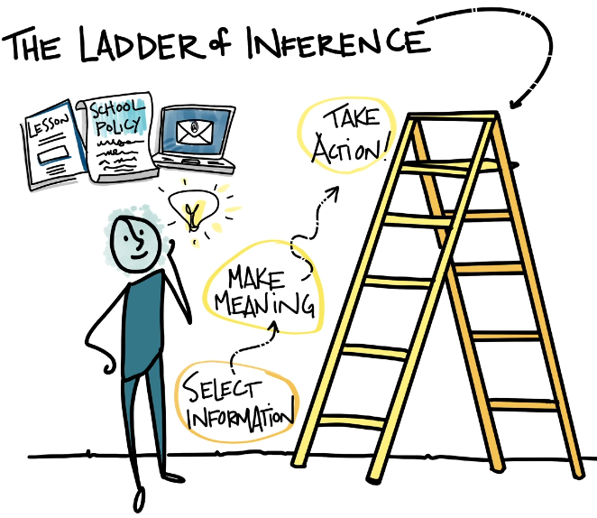
Activities to build our self- awareness: The Ladder of Inference
Activities to build our self- awareness

Slide 55
Social Identity
Social identities is the sense of who we are based on our group memberships. They are socially constructed (race, gender, religion, etc.)
Social Identity
Our social identities shape how we view the world and influence our interactions with students, families, and colleagues. By examining these influences, we can better understand what drives our actions and perceptions.

Slide 56
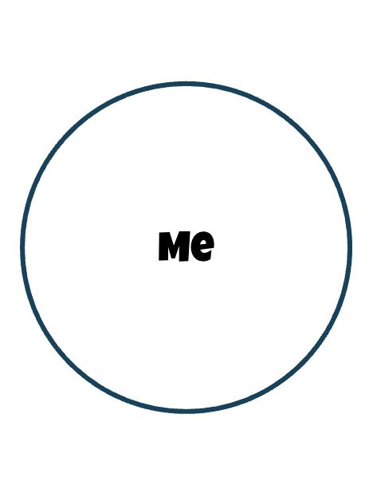
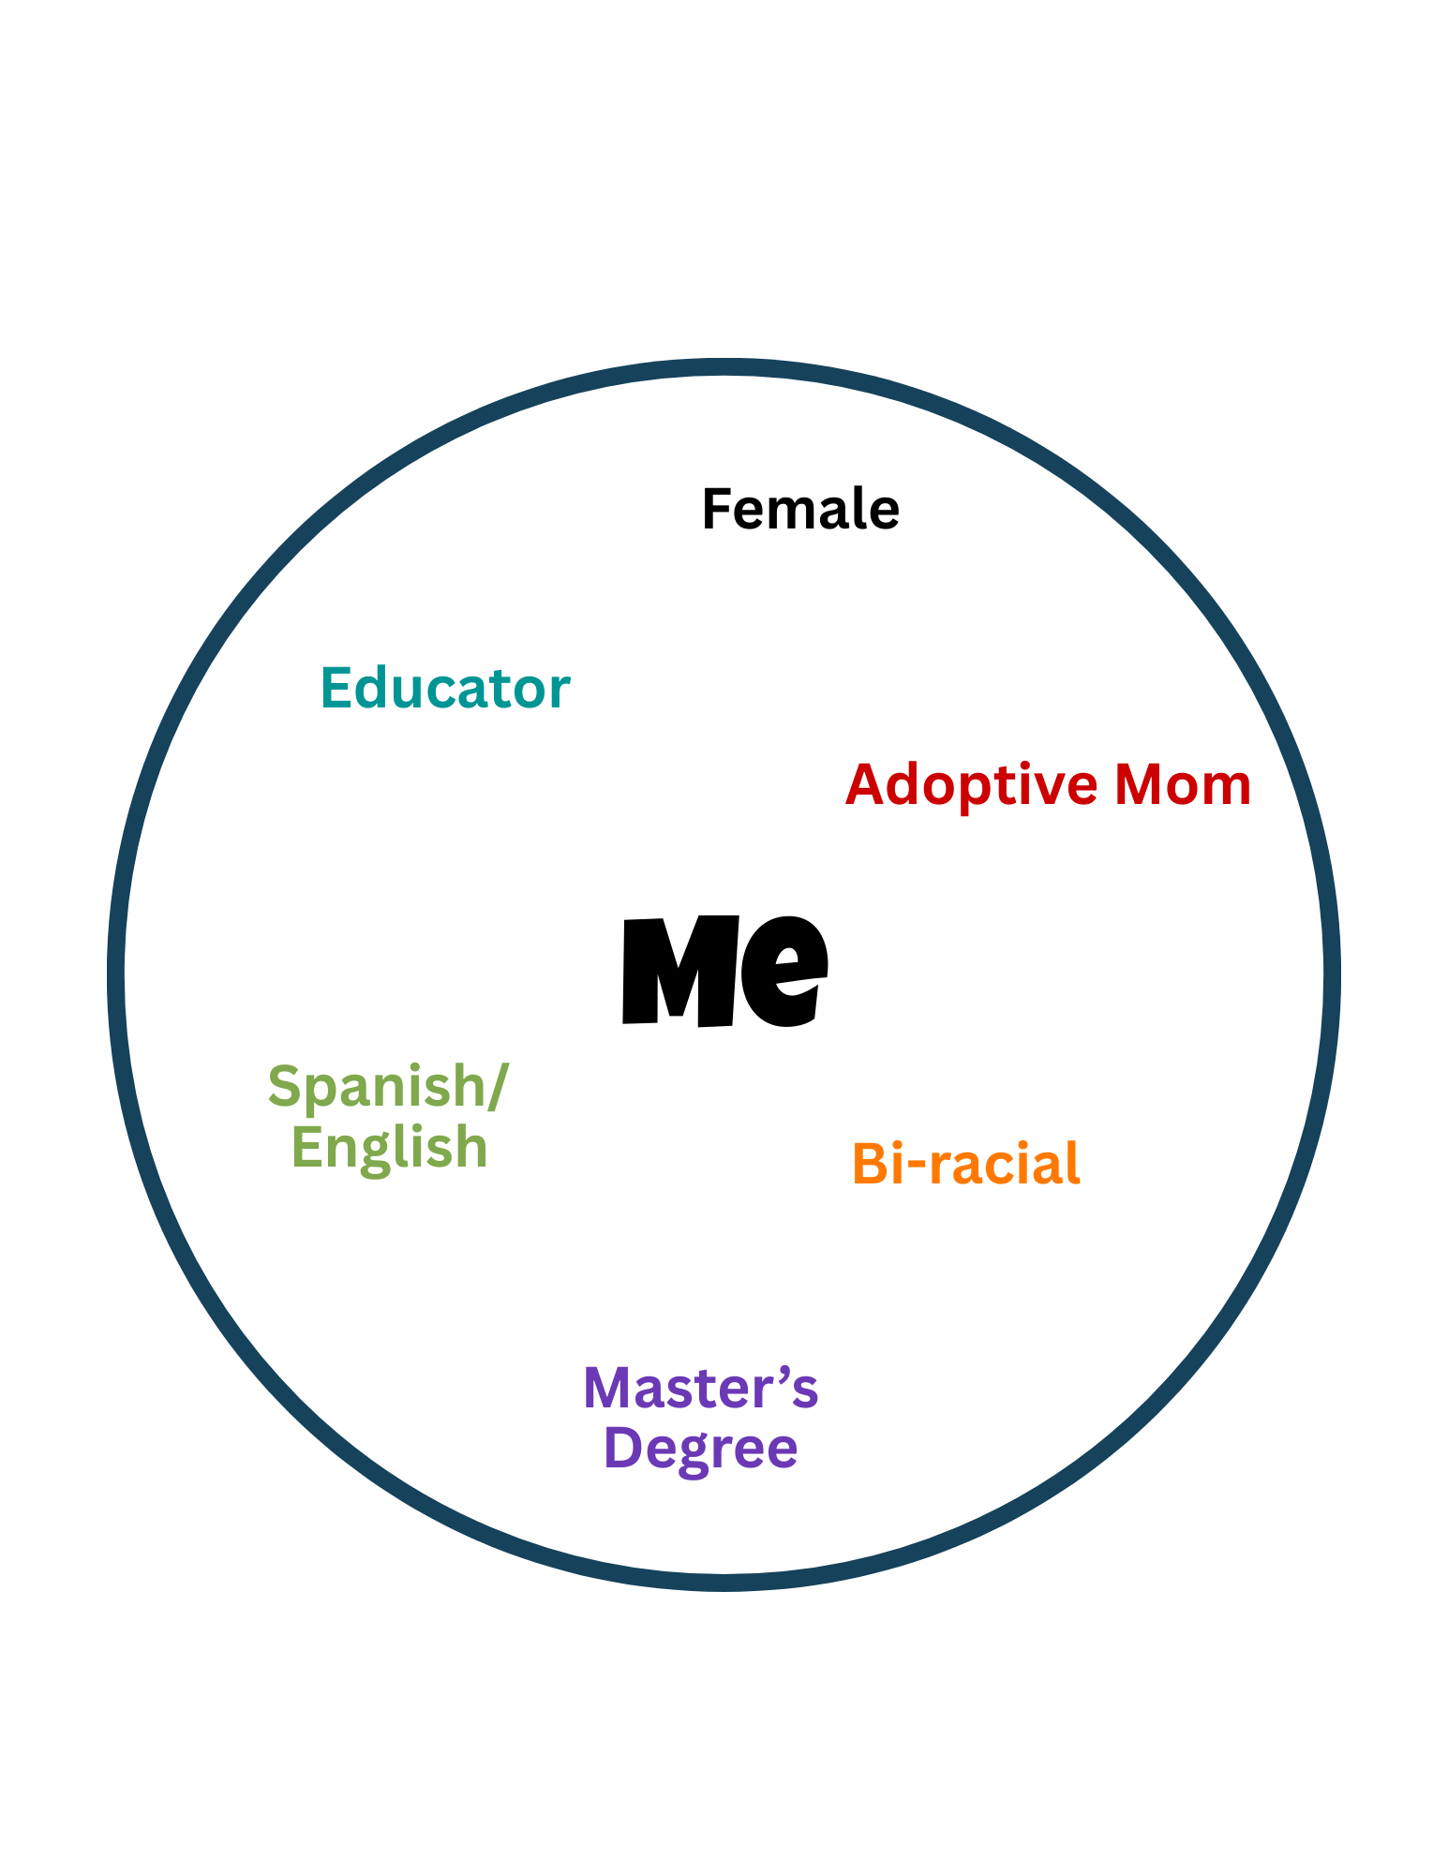
Social Identity activity
Activities to build our self- awareness

Slide 57
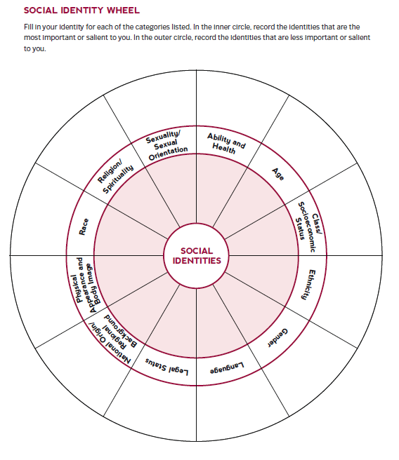
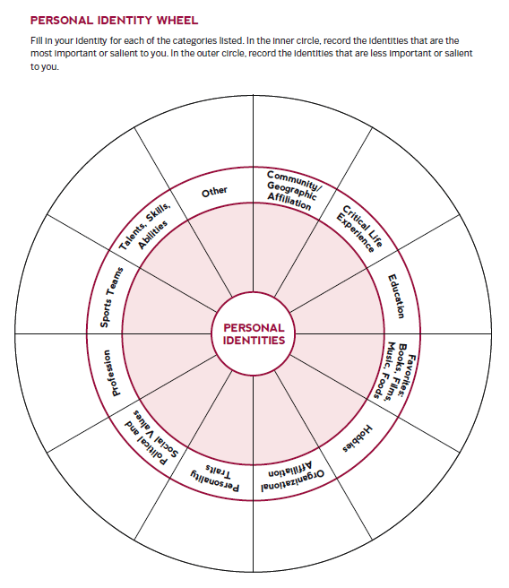
Activities to build our self- awareness: Social Identity Wheel
Activities to build our self- awareness, continued

Slide 58
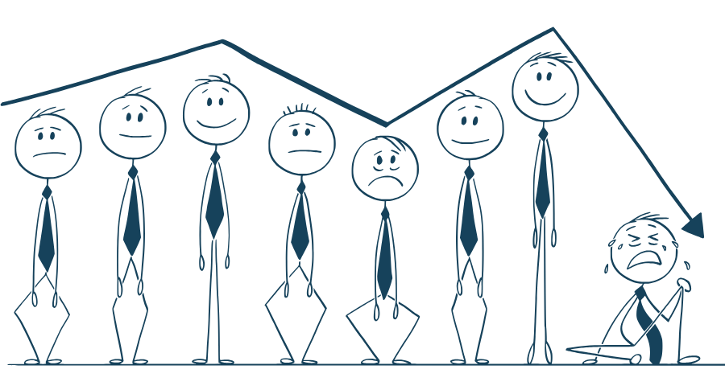
Have you ever been in an IEP meeting where people have had emotions?
Have you ever been in an IEP meeting where people have had emotions?

Slide 59
Identifying Emotions
Identify Emotions
Emotions are a physiological response (data from our body) that helps us understand our needs, values and experiences. When we recognize them we can explore them and what the data is trying to tell us.
Emotions shape how we act, influence what we believe, and appear in our behavior.

Slide 60

Our feelings are tied to the beliefs we hold.
my beliefs
In IEPs, emotions often stem from past experiences and the mental models we bring into the meeting.
By understanding our mental models, we can respond with empathy and focus on strengths rather than react from emotion.
Let’s talk more about mental models!
Notes:
Our feelings are closely connected to our beliefs and ultimately influence our behaviors. In the context of IEPs, we often encounter situations that evoke strong emotions—these emotions are shaped by our past experiences and the mental models we hold about students, disability, and the IEP process.

Slide 61
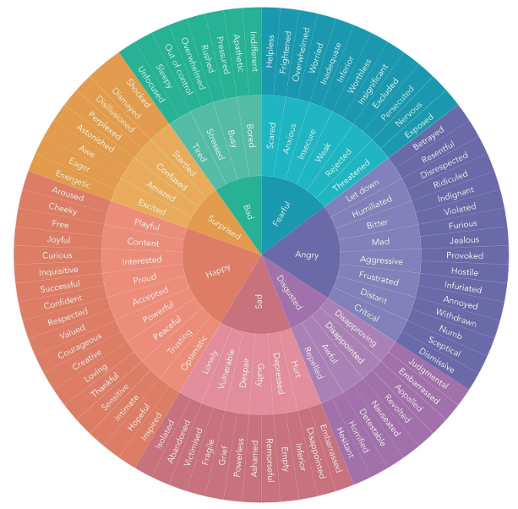
Activities to Build our Self- Awareness: Feelings wheel
Activities to Build our Self- Awareness

Slide 62
Putting it all together
An educator’s beliefs can significantly affect students with disabilities, influencing their academic success and well-being.
Our beliefs influence our ways of being, and ultimately, our actions.
By cultivating self-awareness and engaging mindfully, we can create spaces that encourage collaboration, respect diverse perspectives, and prioritize the needs and voices of students, ensuring that the IEP process remains both inclusive and effective.

Slide 63
A Place to Begin: Self-determination
Creating awareness in our students. Preparing students to assume the lead through self-determination skills
A Place to Begin

Slide 64
Participation Requirements Under IDEA
For Students
IEP Team - “Whenever appropriate, the child with a disability.”
Transition Services - “beginning no later than the first IEP to be in effect when the child turns 16, or younger if determined appropriate by the IEP team.”
“the public agency must invite a child with a disability to attend the child’s IEP Team meeting if a purpose of the meeting will be the consideration of the postsecondary goals for the child and the transition services needed to assist the child in reaching those goals under §300.320(b).”
“If the child does not attend the IEP Team meeting, the public agency must take other steps to ensure that the child’s preferences and interests are considered.”
Transfer of rights at age of majority - Beginning not later than one year before the child reaches the age of majority under State law [18 years], the IEP must include a statement that the child has been informed of the child’s rights under Part B of the Act, if any, that will transfer to the child on reaching the age of majority under §300.520.

Slide 65
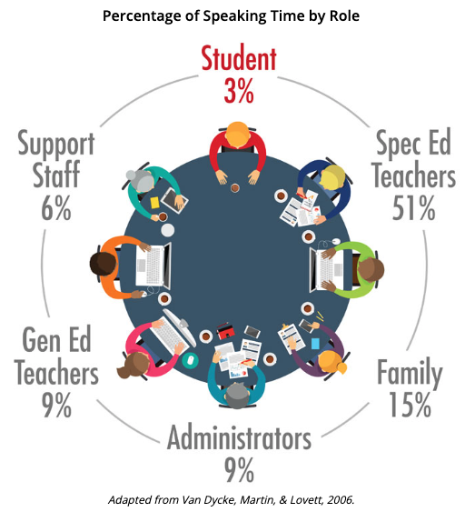
Current Reality
Percentage of Speaking Time by Role

Slide 66







Can you imagine?
. . . the opportunities that would come forward if we lifted the voices and contributions of more of the IEP team (including the student)?

Slide 67
Why is this important?
All of our time and efforts in our support to the student to create a shared vision for/on behalf of the student is about their future.
There comes a time when they will need to have their own vision of their future, create goals and live their own lives to the best of their ability.
We are here to teach and reinforce skills so our students are ready to assume their role as the lead in their destiny/future to the maximum extent possible

Slide 68
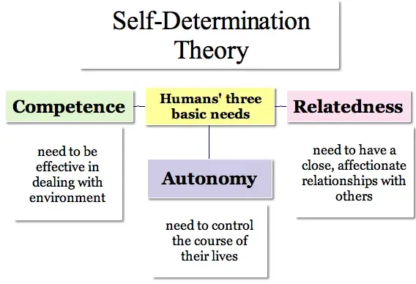
Self-Determination
Self-determination refers to the ability of individuals or groups to make choices and decisions about their own lives, free from external influence or coercion. It is a framework that individuals have the right to determine their own destiny, set their own goals, and make choices that reflect their own values and preferences.
Self-determination emphasizes the importance of:
Competence
Autonomy
Relatedness (connection)

Slide 69

ASCEND Logo

Slide 70


Awareness
Self-awareness means to understand who we are, what we feel, and why we do the things we do. It's like having a mirror inside our minds that helps us see ourselves more clearly.

Slide 71


Self-advocacy
Self-advocacy means speaking up for yourself and your needs. It's about expressing your thoughts, feelings, and desires in order to stand up for what you believe is right or fair. This could involve asking for help, asserting your rights, or advocating for your own well-being and interests.

Slide 72


Confidence
Confidence is a belief in yourself and means that you know that you have the ability to make your own choices and control your own life. It’s trusting that you can set goals, make decisions, and take actions that lead you toward what you want, even when things are challenging.

Slide 73


self-expression
(Self)-expression is showing who you are through your words, actions, and creativity. It’s how you share your thoughts, feelings, and personality with others, like through art, music, writing, or the way you dress.

Slide 74


Navigate
To navigate means to find your way or chart a course toward a goal or destination. It involves assessing where you are, understanding the resources and tools available, identifying potential challenges, and making decisions to move forward effectively. Navigation often requires adaptability, problem-solving, and resilience.

Slide 75

Determination
Determination means never giving up, even when things get hard. It’s about believing in yourself, working through challenges, and finding ways to reach your goals. For students, it might look like asking for help, trying new strategies, or staying focused on what you want to achieve. For educators, it’s supporting students to build confidence and showing them that they have the power to succeed, one step at a time.

Slide 76
reflection for student self-awareness and the importance
Can you see how building self-determination skills in students strengthen their self-awareness?
Notes:
reflection - did this bring anything up for you with the student they work with or a parent their own student

Slide 77
Before the IEP
Preparing ourselves for the IEP (educators and parents).

Slide 78

Transactional vs. Transformational
Notes:
As we build on the trust and relationships, and When teams are truly engaged we move from transactional IEPs to more transformational IEPs.
By thinking of the IEP as a journey and not a singular event (or transaction) we want to move towards this journey that is continuous, iterative, involves multiple perspectives and stories that is strength-based and focuses on the whole child.

Slide 79
Activity: Preparing for the IEP
Imagine you are preparing for an upcoming IEP. What are your top two priorities/tools?

Slide 80






Preparing for the IEP Meeting
IEP Meeting Logistics
Invitation/Meeting Notice
Excusal Form
Agenda
Meeting Norms
Preparing for In-Person Meetings
Preparing for Virtual Meetings

Slide 81


Preparing for In-Person or Virtual Meetings
The environment in which an IEP meeting is held can significantly impact the effectiveness and comfort of the participants.

Slide 82

Preparing for Meetings
Before your IEP meeting, create a vision.
I will be successful if I prepare for the IEP by __________.
How will this make me feel?
IEP team members will feel _____________ based on how prepared I am to ______________.

Slide 83

Preparing Parents for IEP Meeting

Slide 84
Before the IEP: Preparation
Preparing our students for the IEP meeting.
Before the IEP

Slide 85


Preparing Meetings:
Students

Slide 86
Break

Slide 87
During the IEP
Participating in the IEP meeting (educators and parents).

Slide 88

The Role of
Host vs. IEP Facilitator
Host:
often assumed by the case manager
preparation for the meeting
guides the team through the agenda
IEP Facilitator:
specialized training
neutral third party

Slide 89

Grounding the IEP

Slide 90


IEP Note Taking
IEP Note Taking

Slide 91

Using a Bridge Board
Collaborative outcomes/next steps
Items to be addressed

Slide 92


The Power of Listening
The Power of Listening

Slide 93


Promoting Meaningful Participation
Navigating Differences/ Disagreements During an IEP Meeting

Slide 94
Please add title?
Need activity
During the IEP:
What behaviors escalated conflict? What strategies supported resolution?
What are some questions to ask for prevention?
Maybe a video of conflict

Slide 95

Legal Compliance and Accountability through Educational Benefit

Slide 96



Compliance and Accountability: 1
Compliance and Accountability

Slide 97


Compliance and Accountability:2
Compliance and Accountability

Slide 98


Compliance and Accountability: 3
Compliance and Accountability

Slide 99


Compliance and Accountability: 4
Compliance and Accountability

Slide 100


Compliance and Accountability: 5
Compliance and Accountability

Slide 101
During the IEP: Participating
Participating in the IEP meeting (students).
During the IEP

Slide 102

Building Meaningful Participation in Students

Slide 103

Let’s Walk Through Some Examples of Student Participation in the IEP Journey
Consider a student you’re familiar with as we walk through these examples. Where might they start to participate?

Slide 104



Building on my strengths
interview
ask questions

Slide 105




Before the IEP 2
observe
collect data

Slide 106





Student provides some input prior to the IEP

Slide 107



Student provides some input prior to the IEP 2

Slide 108


During the IEP - student presents some information

Slide 109



During the IEP - student presents some information prek
Meet Teacher Vanessa!
Students Stepping Into the Spotlight!
Notes:
https://www.instagram.com/reel/DJGJuxwxqlu/?utm_source=ig_web_copy_link&igsh=MzRlODBiNWFlZA==
Child older literally walk in to do their song, being videoed and shown at the IEP meeting,
There are variations-think back to that student engagement continuum we shared yesterday.
How do we feel when we hear an empowering/motivating song? Are we more confident? This is just one of many strategies that could be used as a grounding activity. It could also be everyone sharing a positive about the student.

Slide 110





During the IEP - student presents some information 2
Notes:
Collage of students sharing their strengths and using tools to communicate. One, another uses an AAC device, a group of students and teacher present strengths on a screen, and two examples of “All About Me” student profiles are shown.

Slide 111

During the IEP - student led IEP -following a script

Slide 112


During the IEP - student leads IEP

Slide 113

Where will you start?
What resonated with you for the student you considered before we started showing the examples of student participation?

Slide 114
After the IEP
Follow-up and implementation (educators and parents).

Slide 115
Reflecting on the IEP
Now that the Individualized Education Program (IEP) meeting has concluded, it’s time to reflect and gather feedback. Preparing for and conducting an IEP meeting takes significant effort, and collecting feedback and reflecting on the process can help:
deepen your understanding of the IEP process,
strengthen trust and collaboration with team members,
support student-centered planning,
enhance the implementation of the IEP, and
encourage continuous improvement.

Slide 116


Take Action
Consider using an action plan template to outline post-IEP meeting tasks, ensuring clarity and accountability.

Slide 117





Ways to Gather Feedback
Surveys or questionnaires
Follow-up meetings
Phone calls
Email
Home-school communication logs

Slide 118


Potential Feedback Focus Areas 1
Potential Feedback Focus Areas
General Satisfaction and Communication
Reflect on participants’ overall experience and level of contentment with the IEP process, including how effectively they felt information was shared.
Supports and Resources
Reflect on how well individuals felt supported throughout the IEP journey, including by being given access to resources and information.

Slide 119


Potential Feedback Focus Areas 2
IEP Process Understanding
Reflect on how well individuals understood each stage of the IEP process.
Potential Feedback Focus Areas
Participation and Inclusion in the IEP Process
Reflect on how involved, respected, and valued the participants felt in planning and decision making.

Slide 120


Potential Feedback Focus Areas 3
Potential Feedback Focus Areas
Implementation of IEP Supports and Services
Reflect on how participants felt about the clarity of the IEP plan, fidelity of implementation, accessibility of resources, and perception of impact.
Progress and Feedback
Reflect on how well participants felt progress was tracked and communicated, and whether instructional adjustments were made as necessary based on collected data.

Slide 121



Feedback for Strengthening IEP Outcomes
Parent(s)
Educators
Students

Slide 122

Feedback Consolidation
Based on the analyzes of your data:
Decide which area you would like to grow.
What conditions would support your growth in this area?
What strategies could you utilize to grow?

Slide 123

Implementation
Effective implementation of an IEP is critical in ensuring that students with disabilities receive appropriate support and services to succeed academically.

Slide 124

systematic approach to progress monitoring
IEP Implementation: Monitoring the Progress of Measurable Annual Goals
IEP Implementation Monitoring the Individual Transition Plan (ITP)
IEP Implementation: Monitoring of Supports and Services: Accommodations and Modifications
IEP Implementation: Monitoring of Supports and Services: Participation in Local and Statewide Assessments
IEP Implementation: Monitoring of Supports and Services: Indirect and Direct Special Education and Related Services

Slide 125


Additional Support
Connecting LEAs to additional support as needed on dispute resolution following the continuum:
Site->LEA->SELPA->State

Slide 126
After the IEP: Implementation
Follow-up and implementation of the IEP (students).
After the IEP

Slide 127



After the IEP - goal tracking
After the IEP
Notes:
add survey their experiences reminder

Slide 128






The Importance of Gratitude

Slide 129




Reflection
Reflection
Reflect with an elbow partner:
What resonated with you today?
Name one take-away* you’re inspired to share with your IEP team.
Notes:
Thinking about to “belonging” where we first started . . . what will you take away to increase belonging /meaningful participation in your IEP teams?

Slide 130






Social Media
Let’s Get Social!
pathways2partnership.org
highqualityieps.net
info@pathways2partnership.org
info@ highqualityieps.net
pathways2partnership
hqieps
Pathways to Partnership
High Quality IEPs
HQ IEPs

Slide 131
Thank you

