Slide 1

“If we invite them, they will come . . . but then what?”: Strategies for Successful Large Group Engagement
Randall Reese, M.S.
CADRE Symposium
October 21-23, 2025

Slide 2

The Plan
Things we will do and cover:
Who we are and why we are here
When facilitation is useful
Why facilitation works
Specific problems in facilitation and strategies for mitigating them
We will practice and discuss content along the way

Slide 3





About Your Facilitator
B.A. Communication
Education:
M.S. Human Performance Technology
Communication &
Dispute Resolution
Founding Faculty
Career:
Mediator/ Facilitator – IMA President Performance Engineer
Senior Consultant

Slide 4
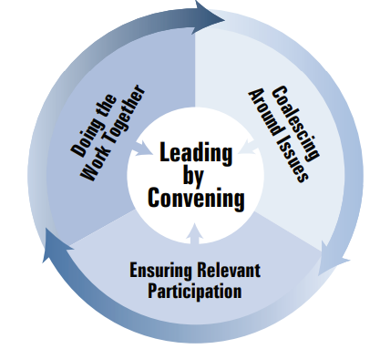
The Promise of Effective Engagement
Leading by Convening
Brings expertise, experience, influence, and authority to work together.
Encourages the sharing of perspectives, as well as the opportunities for leadership.
Focuses on relationships and technical elements of change.
Holds that this investment in process increases buy-in and the likelihood of sustainability.
https://wested.ent.box.com/s/y8qy4pzkuwhmvgynnac9b9r37w5uptks
Notes:
Osep- doesn’t focus upon groups in conflict

Slide 5
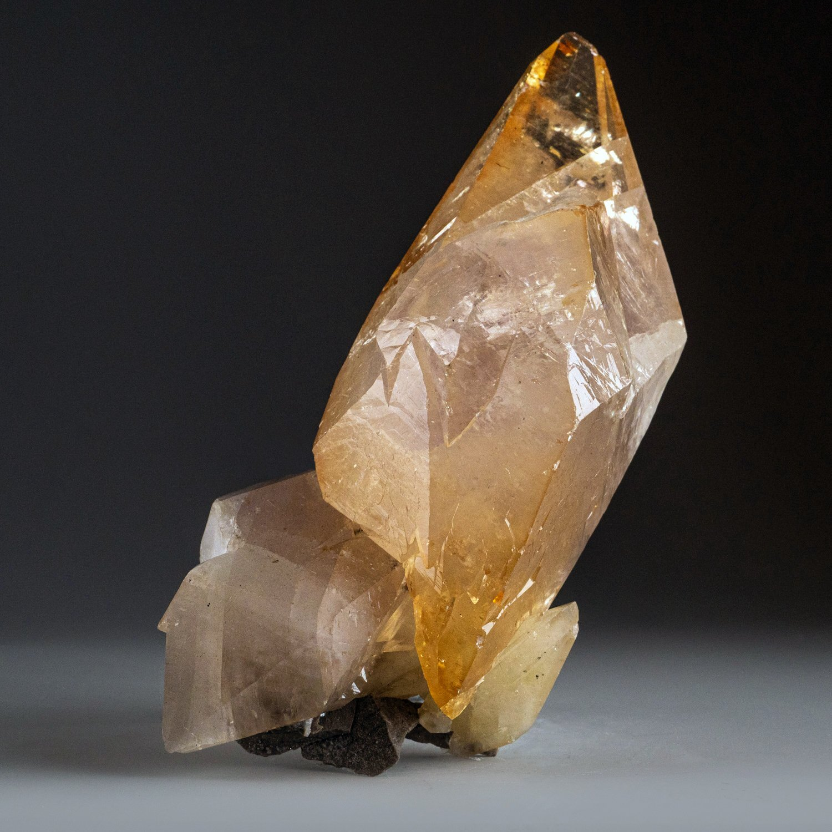
Key Premise: Buy-in Increases Sustainability
Why?
More Accurate Picture of Problem
Promotes Innovation
Creates Shared Vision
Expands Resources
Increased Tolerance for Risk
Builds Community
Fosters Ownership
Notes:
Like a crystal, everyone has a different perspective.
Game: Guess what Melanie has on the slide

Slide 6
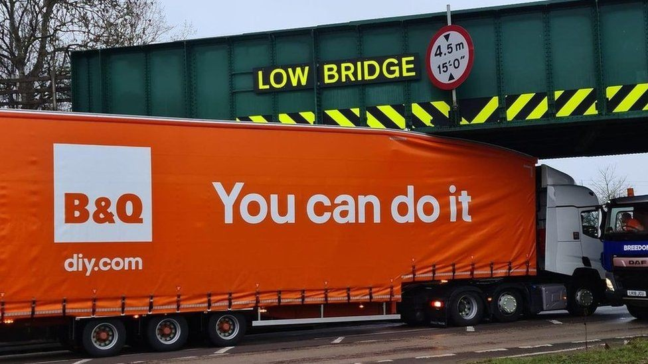
What could possibly go wrong . . .
. . . when we bring highly-invested, diverse, passionate and committed people to view complex issues and imperfect systems together in a large group?
Notes:
Group brainstorm from experiences in groups

Slide 7
CONFLICT Defined by our experience:
How do most people define conflict?
Notes:
1. FIGHT, BATTLE, WAR “an armed conflict”
2 a. Competitive or opposing action of incompatibles : antagonistic state or action (as of divergent ideas, interests, or persons). “a conflict of principles”
2 b. Mental struggle resulting from incompatible or opposing needs, drives, wishes, or external or internal demands. “His conscience was in conflict with his duty.”
3a. The opposition of persons or forces that gives rise to the dramatic action in a drama or fiction. “The conflict in the play is between the king and the archbishop.”

Slide 8

How We Talk About Conflict: Metaphors of War and Games
Battle of wits
Demolished my argument
Blew up at me
She was a ticking time bomb
He ambushed me
I was out-maneuvered
It was a slam dunk
Build coalitions
I need a better strategy
It was a surprise attack
You’re not on my side
You win that point
Keeping score
Lost that point
I was outplayed
She strong-armed me
He piled on
Attacked my position
I was defenseless
I need a new line of attack
Verbal battles
What’s the game plan?
I was unarmed
We were outgunned
That came out of left field
Went in guns a-blazing
See: Lakoff & Johnson, McCorkle & Gayle

Slide 9
Conflict Defined by Mediators
Hocker and Wilmot (1985):
“a struggle between at least two interdependent parties who perceive incompatible goals, scarce resources, and interference from the other party in achieving their goals”
McCorkle and Reese (2016):
“a struggle among a small number of interdependent people arising from perceived interference with goal achievement.”

Slide 10







People are Motivated by Goals
Goals can be relational and/or material.

Slide 11
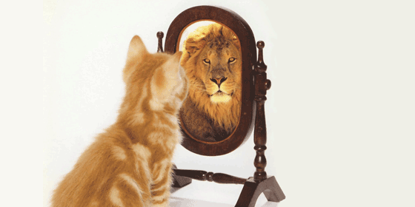
Key Point about Relational Goals
A person’s strongest relational goal
is self-acceptance
(or the perception
of an acceptable
self-concept)
Notes:
Self-Efficacy

Slide 12

Self-view
A key cognitive element driving human behavior is our self-view.
Self-view includes our self-concept and self-esteem.
The self is not something inherent or fixed, but rather something that is constantly constructed and performed in social interactions.
- E. Goffman
Self-concept
Self-esteem
Our perception of our attributes and who we are
Our evaluation of our self-concept

Slide 13

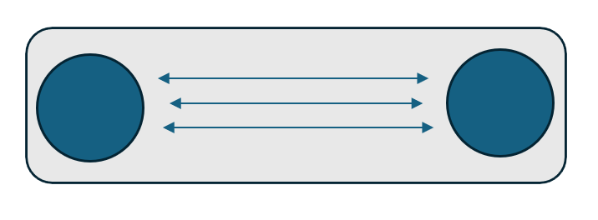
Interaction: Where Identities Form
Reflected Appraisal: Data we get from others that we interpret as informative to understanding how others see us.
Signification: The importance we put on the person and what they think of us.
Stigma: Qualities that cause one to discount the importance of others
When we perceive the reflected appraisal of others as an attack on our self-concept, we tend to stigmatize them and their thoughts. When these attacks are perceived by both parties the attacks will likely escalate.
The self-as-object arises out of the individual's experience of other selves outside of herself. - G.H. Meade

Slide 14
We Build our Self-concept through Social Comparison
Values, Beliefs, & Attitudes
BEHAVIOR
INTERACTION
Significant Others
B
V
REFLECTED APPRAISAL
A
INTERACTION
Aggregate Others
(e.g., society, cultures)

Slide 15
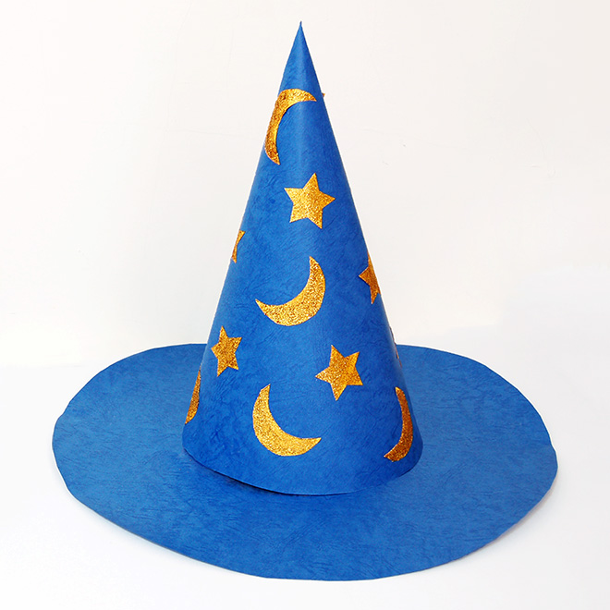
Facilitator Hats
Architect
Traffic Cop
Cheerleader
Legitimizer
Problem Explorer
Hunter/Gatherer
Educator/Trainer
Reality Tester
Scapegoat
Aikido Master
Effective facilitators must:
understand the nature of conflict
be skillful communicators
have adaptable process skills
Notes:
Architect: Creates Agenda, sets the stage, makes the plans
Traffic Cop: Directs the flow of communication, Starts and Stops the process. Pumps the breaks, puts on gas, redirects the flow. May make people circle around the block or take a detour.
Cheerleader: Being a participant is hard work. It can be frustrating, boring sometimes, feels like your spinning wheels or it’s hopeless. The facilitator has to be the hopemonger.
A Legitimizer: This is validation role. It is particularly important when there are power differences at play or people are feeling disenfranchised, unheard, or there have been or are still inequities. Legitimizing may mean validating feelings. Identifying interests. Giving space and time for voice. It means recognizing power and working to mitigate imbalances. helps all parties recognize the right of others to be involved in negotiation
Problem Explorer enables participants to examine a problem from a variety of viewpoints- assists in defining basic issues and interests- looks for mutually satisfying options
Hunter/Gather helps identify resources and links participants to outside experts
Educator Trainer: Infuses skill-building into the event such as communication skills, negotiation, and problem solving techniques
Reality Tester: helps build reasonable and realistic settlements- questions and challenges parties who have extreme and unrealistic goals
Scapegoat: may take some of the responsibility or blame for an unpopular decision that the parties are nevertheless willing to accept- may take responsibility for an unworkable outcome
Aikido Master: Reframes, reduces tension, channels the energy through redirection

Slide 16
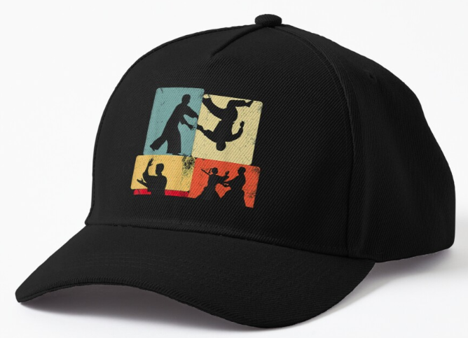
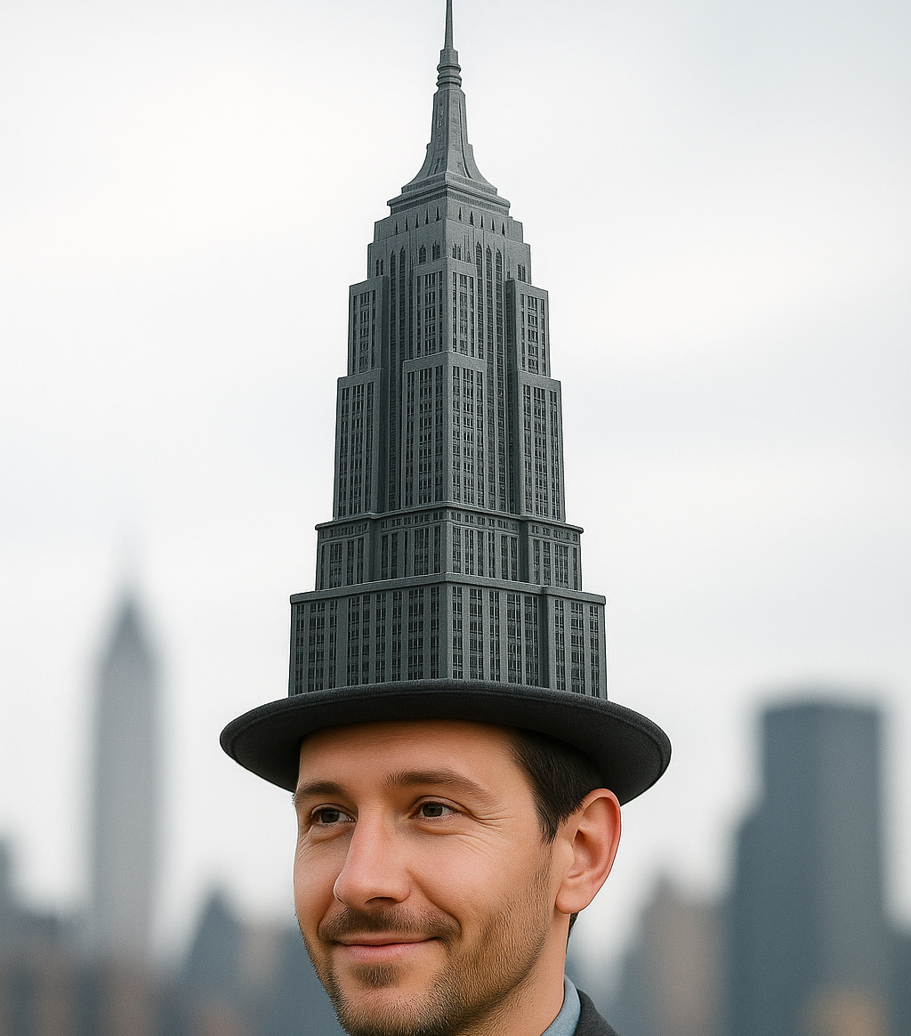
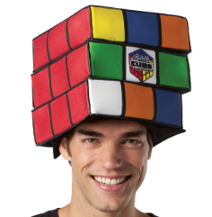

Four of Many Hats
Aikido Master
Architect
Reality Tester
Problem Solver
Notes:
The four hats that you wanted me to cover were these:
Aikido Master: Reframes, reduces tension, channels the energy through redirection
Architect: Creates Agenda, sets the stage, makes the plans
Problem Explorer enables participants to examine a problem from a variety of viewpoints- assists in defining basic issues and interests- looks for mutually satisfying options
Reality Tester: helps build reasonable and realistic settlements- questions and challenges parties who have extreme and unrealistic goals
It was a really fun exercise for me – and I started off doing one at a time. Found that unworkable. So you’ll get them in random and repeating order, starting first with the Aikido Master.

Slide 17
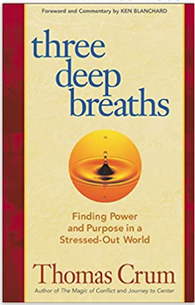
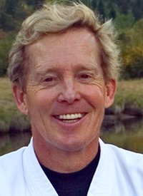
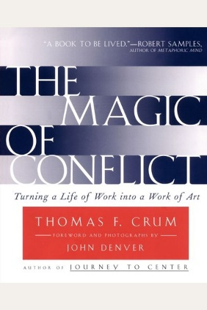
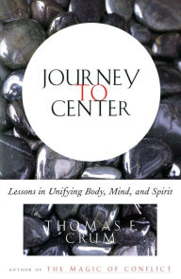
Hats off to Thomas Crum: Aikido Master & Conflict Engagement Guy*
“The essence of Aiki is about being so present that you can see the energy that is there, so that you can work with it, and energize it.”
Translated literally, Aikido means “directing and blending of energy.”
* My description, not his.
Notes:
Thomas Crum came to Boise State in the early 90s. By that point he was a successful author, consultant in the fields of conflict resolution, peak performance and stress management. He is probably retired now, but at the time he lived in Aspen, and his first career was as John Denver’s body guard. He comes from the perspective of self-work and mental Preparation. He is indeed an Aikido Master and brings those principles to understanding of conflict.
His teachings rocked my world as a baby mediator and facilitator, and it’s really framed how I approach group engagement work. His teachings made me ask who am I in the room. What is my role? What is my responsibility. What do they need? Focus? Calm? Direction?
Crum argues that one can’t do that unless one spends some time working on developing a presence of mind, and the ability to feel the energy – to connect to it.
I find it very helpful to think of my goal to move the energy. I may live in Eugene, but I’m not a new agey kind of gal. But this guy has got something and it very much informs my work, and those with whom I’ve worked who have attended his trainings.
I am not qualified to teach you this how to do this, but I can just share what I got from it.

Slide 18
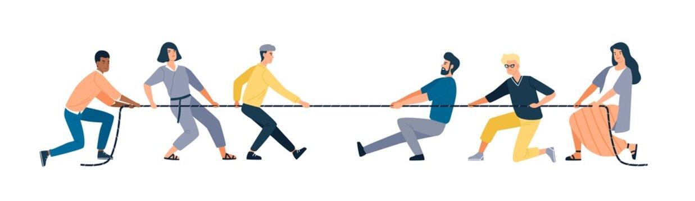
Conflict Doesn’t Equal Contest
How do you win?
Contest is:
Competition
Power Over
Force
Outplay
Win/Lose
Notes:
What is this game? How do you play? How do you win?
Classroom activity: Would bring in a rope and lay it on the ground. I would put a line of tape down and ask for four volunteers. Usually football players would jump up. Instructions: Pick up the rope. Two on each side of tape. Game ends when everyone is on one side of the tape.

Slide 19
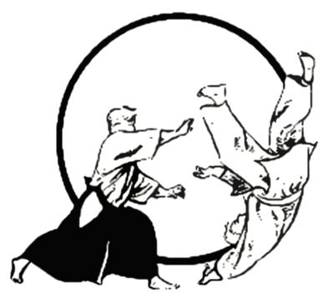
Conflict is a Dance
Conflict is Energy
All of life, including an attack, is energy with which to dance.
An attack is just another of the endless gifts of energy to be used creatively and harmoniously.
We can honor and acknowledge the energy given instead of oppose it.
We can accept the energy and redirect the flow instead of being pushed around by it.
Notes:
https://www.youtube.com/watch?v=S_-zK6MNlQs
Dance: 6:43 – 7:50
Conflict is Energy: It’s neutral. It just is. It’s normal, natural and inevitable.

Slide 20
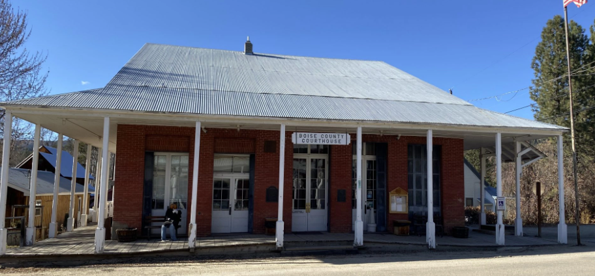
Idaho City, ID – Pop. 445 (65 Attendees)
CASE: This rural old mining town has a very independent spirit. Many people have dogs, and very few have them secured. A pack of feral dogs were harassing the community, and neighbors turned against each other and the pets, sometimes violently. The Judge insisted on a town meeting to work on solutions. Sixty-five angry citizens showed up (many armed). They had divided into camps of fearful neighbors (some for their pets, and some for their own safety).
Notes:
Help me think through how to set up this meeting and what we need to do.

Slide 21
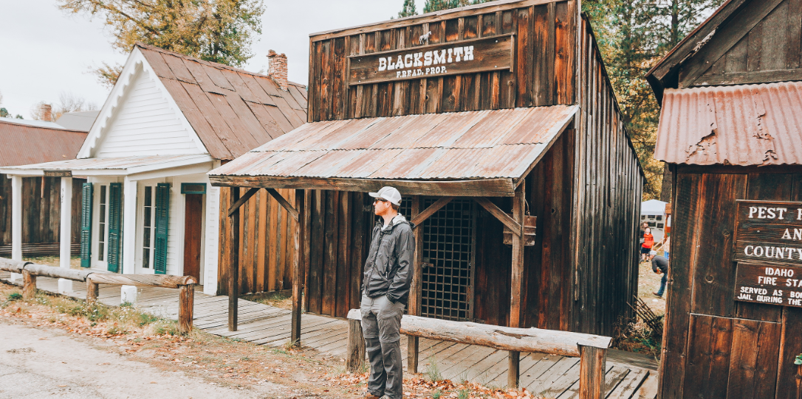
Key Takeaways: Idaho City
Set Boundaries
Make Everyone Equally Uncomfortable
Champion Hope

Slide 22
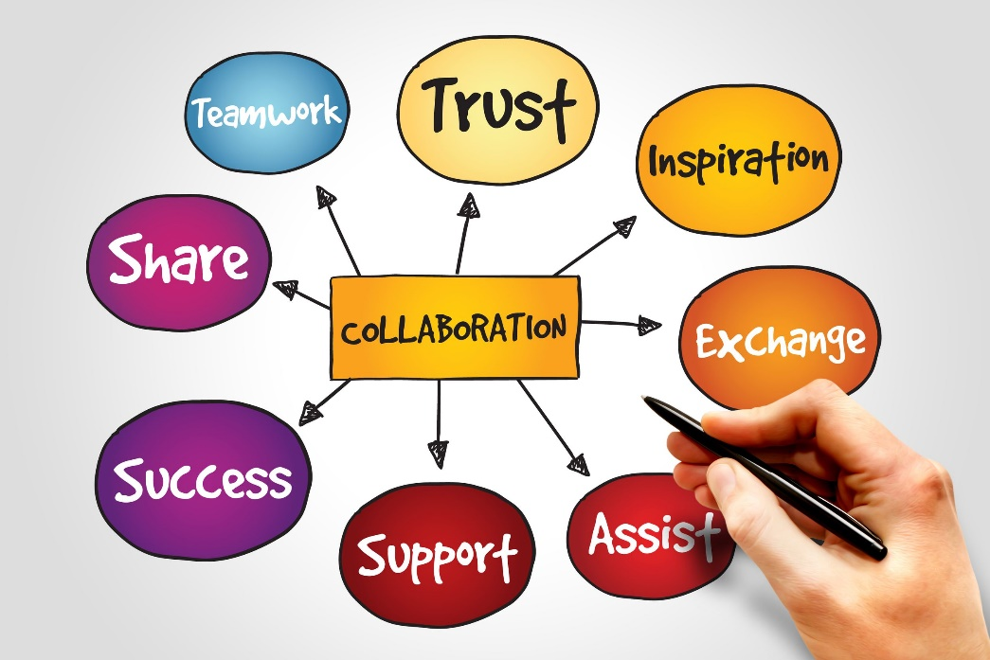
Takeaways
Winning and losing are goals for games, not for differences of opinion.
Learning, growing, and cooperating are goals for healthy interactions.
Resolving conflict is rarely about who is right. It is about acknowledgment and appreciation of differences.
Conflict managers can channel energies with others toward resolutions.

Slide 23

The Architect: Setting the Stage
Considerations:
Room: facilities, power spots, distractions
My role
Everyone can participate as equally as possible
Relationships and history
Power dynamics
Expected levels of contention
Time pressures
Ability to move around
Clear understanding of deliverables and expectations
Notes:
If I want the best chance at collaboration, what is the environment I want for the meeting? What should I consider about the physical space? What should I keep in mind about the psychological space?
There’s so much more than can fit on this slide, even with .4 font. Here are my top ones, however.

Slide 24
What to Consider?
Case: State Hospital Association Meeting
A statewide, nonprofit association of hospital and healthcare leaders meeting to establish their ranked budget priorities for limited state funding dollars.
Attendees: 25 Hospital Administrators from 4 state regions, representing 50+ hospitals. Also attending: 20 Board Members, and the Executive Committee of the Association.
Multiple Challenges: urban/rural; well-funded/under-funded; shortages; internal competition; political agendas; state funding needs; lobbying agendas; differing healthcare needs for population; history of not playing nice. Oh, and EGOS!
Notes:
Put on the architect hat. What are the top considerations as I build my space.

Slide 25
Different Approaches to Group Norms
Minimalist
Engage in respectful and productive communication
. . . with an agreement to revisit if necessary
Pre-set
Present a list of expectations about:
- Preparation
- Communication
- Time use
- Topics
- Decision- making process
Created
Open it up for group discussion and input.
Facilitate agreement.
Notes:
Benefits ?
Downsides ?
New facilitators and mediators have a tendency to try to reduce the possibility of conflict.
Which is best? “It depends”

Slide 26
Level of Trust
High Trust
Level Formality Needed
Low Trust
Notes:
My general philosophy . . .
Still, with 100 rules or two, there is no guarantee of clear sailing.
Trust could be the trust they have in each other. The trust in me. The trust in the process. The theory of uncertainty reduction shows that people seek to reduce uncertainty in order to predict. If we can predict, we feel safer, and trust more.
Formality doesn’t have to mean ground rules, or agreed up norms. It could be the formal structure, the nature of the interactions, the time limits, and so on.

Slide 27
Staying Centered in Facilitation
“What could go wrong?”
Can turn into a complaint system
Differing opinions can make agreement hard
Hidden or competing agendas
Lack of perspective sharing
Getting too bogged down in abstract ideas vs. practical steps
Wrong people at the table
Competing goals
Passion can make people resistant to other’s ideas
Antagonistic communication styles
Notes:
All of this may happen. People will get emotional when they’re passionate. People do arrive at these meetings with agendas. Disagreements can arise. You may find that you’re using the wrong process . . . .
And what do you do when you find you’re riding a dead horse?
The facilitator is the focal point who leads people through all of this. The goal is to be the calmest person in the room. You’re not going to distract me or throw me.
Thomas Crum’s approach rocked my freaking world with the knowledge that I can be centered in chaos. Mentioned before he was
John Denver’s body guard. Showed a video where he was at a concert, and the crowd started surging toward John Denver. I’ve tried to find the video online, but couldn’t. But basically it was this guy, squaring off with the crowd, and it just parted, with John following directly behind him.
If I can have a little bit of that working for me, I’ll take it.

Slide 28

Centeredness (according to Crum)
Centeredness is:
Mindfulness
Emotional and Physical Stability
Balance
Being Present
Focus
Connectedness
Appreciation
A Point of Power
A Choice
Notes:
Here are some short clips from his trainings where he explains finding and holding on to one’s center.
Thomas example:
4:18 – 7:58
13:16- 14:40
https://www.youtube.com/watch?v=S_-zK6MNlQs
3:27 to 5:01

Slide 29
Problem Solving & Decision Making Cycle
Identify and Diagnose
Develop Possible Actions
Evaluate Alternative Solutions
Identify the Most Appropriate Solution
Evaluate and Follow-up

Slide 30
Identify & Diagnose
Identify and Diagnose
Develop Possible Actions
Evaluate Alternative Solutions
Identify the Most Appropriate Solution
Evaluate and
Follow-up

Slide 31
Defining the Problem
1
2
3
Separating the Issues, Positions and Interests
Getting People on the Same Side of the Table
Identifying the Criteria for Good Decisions
Notes:
Mediation skills, baby!

Slide 32
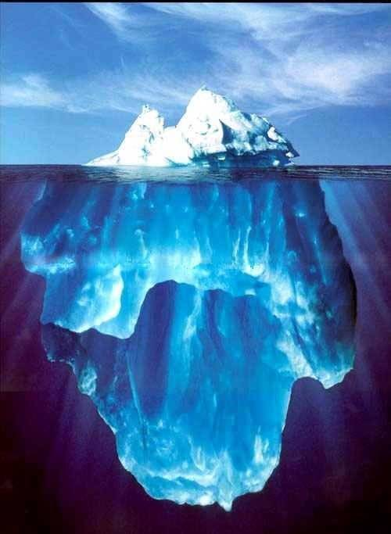
Understanding the Problem
Issues
TOPICS
Positions
WANTS
Interests
NEEDS

Slide 33
Recognize the Positions and Uncover the Interests
Positions are the solutions offered.
“I expect ...”
“I want ...”
“You should ...”
“This is what must happen ...”
Interests are the motivations.
“I need ...”
“I value ...”
“I fear ...”
“I hope ...”

Slide 34
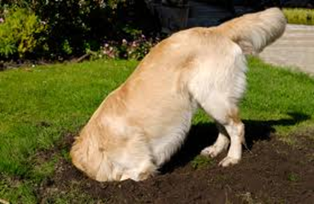
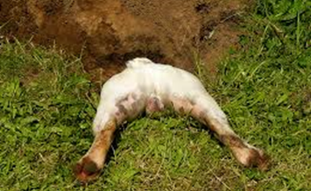
Facilitator questions to dig under positions to find the interests
What need is this position attempting to satisfy?
What is motivating the person?
What is the person emphasizing so it will be heard and understood?
What is the person afraid will happen if a demand is not fulfilled?
Notes:
When faced with conflict, sometime I find it helpful to dig deeper.

Slide 35
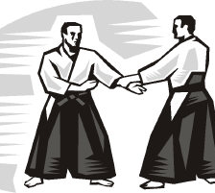
A Couple of Aikido Moves
The Mutual Interest Statement
Looks like whatever we decide needs to address both _____________
as well as __________.
Notes:
I use “we” a lot --

Slide 36
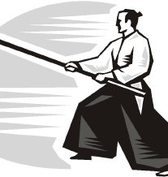
Engagement When Criticized
1. Seek more information.
2. Guess, if necessary.
3. Agree with the speaker:
Agree in principle, or
Agree with the facts, or
Agree with the speaker’s perception.
4. Identify next steps.

Slide 37
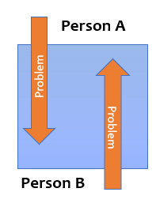
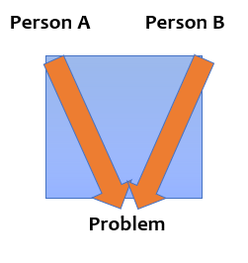
Changing the Energy
When people disagree, they often see the other person as the “problem.”
The goal is to put the “problem” on the other side of the table and work together to resolve it.

Slide 38
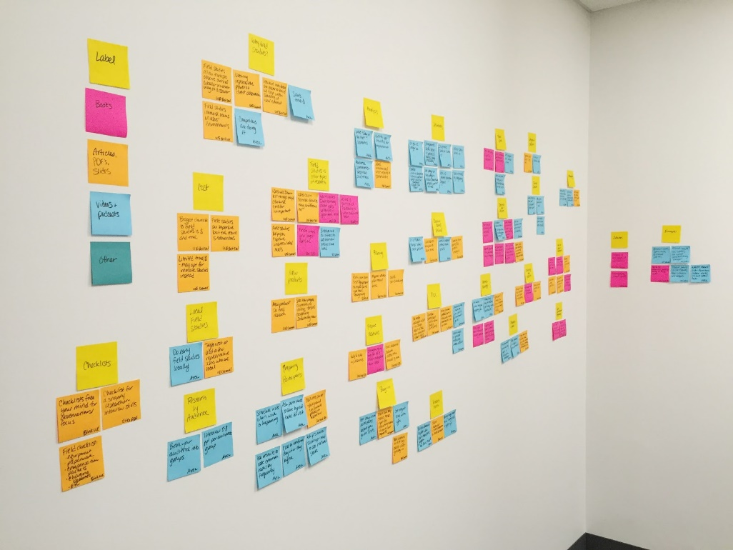
Overcoming the Desire to Own Solutions
Hospital Association:
Establishing Ranked Budget Priorities
Your ideas belong to everyone.
Notes:
Had to overcome egos and peeing contests. People have a tendency to hold on to ideas they present and I was really worried about it with this group with their posturing that I had observed and been told about. Tried to mitigate that in the set up.
Instructed them to: Sit alone with a notepad, and brainstorm as many ways to spend the expected money that meets more than one entity’s interests share today. Can’t just meet their own. This criteria had been previously established.
As you have ideas, put them on the board. Don’t worry if they get duplicated, but if see yours already there, don’t add. If it’s enough different, do add.
Then we took a Break: Melanie would identify themes. “Building/Staffing/Lobbying/Equipment” One by one we put them in the categories. We had six or seven, as I recall..

Slide 39
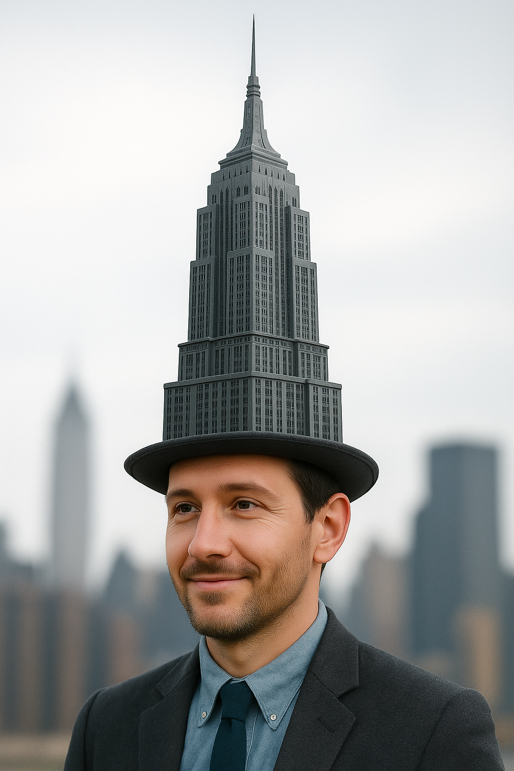
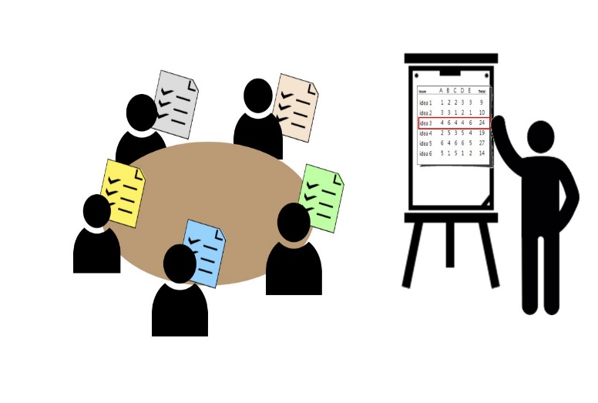
Nominal Group Technique
Silent Generation of Ideas
Round-robin recording of ideas
Discussion of Ideas
Ranking of Ideas
Tallying
Review of Ranking
Notes:
One

Slide 40




Modified Nominal Group Technique
Mixed interest groups
Categories at the table
Groups rotated; one person stayed behind to explain (or facilitated)
Groups first had to understand the suggestion.
Groups could add, modify, or just add stickers to ideas they liked
Each table had 10 stickers, each round. They had to decide where to put the stickers.
Rotated all groups and tallied.
Notes:
We then met as a large group and posted the large sheets. Everyone got five more dots to distribute however they chose. At this point there were clear leaders. But we still made room for some appeals for moving items to the next level. By the next phase, we had list with about 20 items. We needed to get to five.

Slide 41













Case: Sage Grouse Initiative
CASE: Because sage grouse numbers were declining to the point where they were likely to be listed as an endangered species, meetings were held to create state plan to avoid listing. There was lots of interest in land use by many vested parties, with plenty of blame for why there was a decline. Southern Idaho’s first meeting had 65 people show up at a small grange hall. Roughly 45 of the attendees were ranchers and they want to discuss how decisions will be made. The ranchers proposed voting.
Notes:
What are the pre-existing conflicts I will need to be aware of?
What are the power differences here?

Slide 42
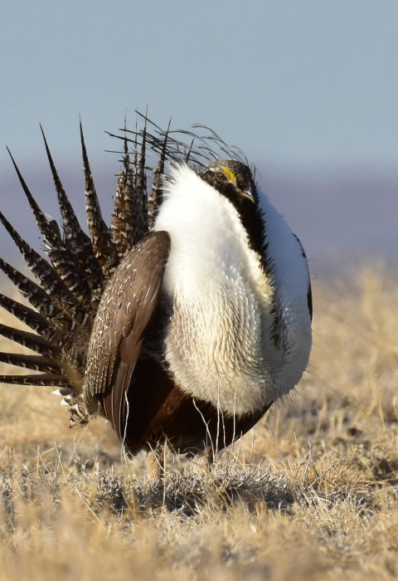
Key Takeaway: Sage Grouse Initiative
The content may be theirs, but the process belongs to me!

Slide 43
Moving Toward Decision Making
Identify and Diagnose
Develop Possible Actions
Evaluate Alternative Solutions
Identify the Most Appropriate Solution
Evaluate and Follow-up
What do we want to encourage and what do we want to avoid as the group makes decisions?

Slide 44
Lots of Decision-making Methods
Paired Comparison
Random Chance
Power
Averaging
Intuition
Pro/Con
Voting
Value-Based
Third Party
Scientific Method
Affinity Diagrams
Notes:
1. Affinity diagrams
Key use: brainstorming/mind mapping
When engaged in brainstorming ideas, how can you avoid information overload? Affinity diagrams help leaders and teams visually organise numerous ideas and data points in a simplified visual form.
2. Analytic hierarchy process (AHP)
Key use: complex decisions
This decision-making technique combines ultiple Criteria decision-making technique with Paired Comparison and a splash of maths to explore multiple criteria and options which might result in a single overall goal. The AHP decision making technique is normally reserved for group solutions to complex challenges.
15. Scientific method
Key use: taking a scientific approach to business decisions
The scientific method of decision making can also be called a heuristic method, since it’s best used in circumstances where you don’t need 100% perfection first time round.
We all learned the drill in school – hypothesis, method, results, conclusion. There are a few more steps to the scientific method, but in essence the format is the same as that of science experiments in school.
Using the scientific method in 7 steps:
Question – formulate a question
Research – do background research to gather as much clarity as possible
Hypothesis - Based on your research, form a hypothesis, or statement you want to test the validity of
Experiment – test, test, test!
Observations – collect data from the experiment
Results – formulate results based on the data you’ve collected
Conclusion – determine the validity of your hypothesis

Slide 45
Reality Tester
Identifying the Criteria for Good Decisions
Those interests that were identified become the basis of knowing if a decision is workable.
Ask, “Will this actually meet our needs and what could go wrong?”

Slide 46
Reality Test Decisions
Earlier you said you needed _______, explain how this decision gets you to that end?
Let’s go back to what you identified as important. You mentioned ______. I don’t see that in this solution. Does this still work for you?
Let’s fast forward two months from now. Will this solution still be sufficient?
Do you foresee any resistance to this solution with those who aren’t here? How will you address it?
Notes:
Super Pepper

Slide 47

De-personalizing Decisions
Dotmocracy
Everyone received 7 dot stickers.
They place dots next to options presented that they like (they may place any number of their dots on any number of the options)
If they are passionate about one, they could lobby to have it go to the next round. We move about ½ over to next round.
We did three more rounds. Next they had 5 stickers. Then reflection and discussion. Then 3 stickers, followed by reflection and discussion. Finally one sticker.
We had three easy winners. Then we had a list to go back to choose two more.
Notes:
We finished by early afternoon. They had set aside two full days for this process.
Variations include:
using different colour dots to signify different values, e.g. green for "like" and red for "dislike".
using different colour dots for different types of participants e.g. blue for management and red for staff.
vote with negative dots (resistance

Slide 48
Some Random Facilitating Tips
Own the process.
Get agreement often on the small stuff.
Make realistic promises.
Be professional, but still friendly.
Remain neutral; admit biases.
Take care of business.
Let attendees talk and avoid the impulse to rescue..
Don’t be afraid of the conflict.
Pay attention to the nonverbals.
Find the joy!
Notes:
Own the process. It’s yours. If it needs to be adjusted, do it. It belongs to you. Butterknife.
Get agreement on the small stuff. Praise sincerely, but often. The “Yes Response” is a real thing in sales.
Don’t over promise. “We should have a decision by lunchtime” – bad idea.
Be professional, yet equally friendly.
Remain neutral, admit biases. Ask them to call you out if you appear partial.
Take care of business. Participants look to the facilitator as the person in charge. This means managing logistics, answering questions, dealing with disruptions, and keeping the sessions running on time. It also means dealing with the unfortunately occasional, uncooperative or distracted participant and keeping participants focused on the task. If someone crosses the line, handle it. Big fan of the strategic break.
Let attendees talk, struggle a bit. Avoid the desire to rescue. Wait for answers. Silence is not a crisis to fix.
See the opportunity in conflict
9. Nonverbals are part of a conversation. Make sure you’re listening.
10. Find the joy

