Slide 1
Conflict Coaching As Mediation or IEP Support: Preparing Parties to Optimize ADR Processes
CADRE Conference, October 2025
Tricia S. Jones, Ph.D.
And
Timothy K. Hedeen, Ph.D.

Slide 2

Welcome! We’re so glad to have you here.

Slide 3
Goals for Today
Considering An Abbreviated Conflict Coaching Process
Coaching Parties To Participate in IEPs and Mediations
Mediator and IEP Facilitators Infusing Conflict Coaching Elements Into Mediation/IEP

Slide 4
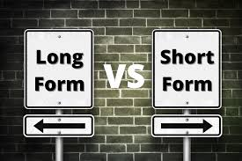
Very Abbreviated Model

Slide 5
The Comprehensive Conflict Coaching Model – Short Form (Very Abbreviated Model)
Preparatory
Conversation
Stage 1:
Discovering the Story
-Initial story
-Refining story
-Testing story
Stage 2: Exploring 3 Perspectives
-Emotion (Basic)
-Power (Interdependence)
-Identity (Roles/Respect)
Stage 3:
Crafting the Best Story
-Initial story
-Refining story
-Testing story
Stage 4:
Enacting the Best Story
-Engagement
-Feedback
-Negotiation
-Other ADR
The Parallel Process: Learning Assessment

Slide 6
Stage Adaptations – Prep Convo (2-3 minutes)
Time frame of conflict
Immediate need
Heightened concern
Emphasize ability to use further processes
Confidentiality
Voluntary/Transparent
Clarification of Role Critical

Slide 7
Stage Adaptations – Stage One (10 minutes)
Stay with Basic Questions (Handhold Stage One)
Key Refining
Urgency
Changing nature of conflict
Possible expansion to more parties
Key Testing
Hostile Attributions (Assumptions about intentional, hurtful behavior)

Slide 8
Stage Adaptations – Stage Two (10-15 minutes)
Emotions
Key Emotions Questions
Power
Interdependence
Identity
Roles and/or Respect

Slide 9
Stage Adaptations – Stage Three (10 minutes)
Start Ideal (if resistance move to Realistic)
Certainty Questions to Realistic
Key Testing (whether finished)
1-10 scale or equivalent
Workable?
Possible?
Effective?
Confident?

Slide 10
Stage Adaptations – Stage Four (10 minutes)
Check-In – How Ready to Plan?
Action Planning
Skills Development Options (choose most critical)
Engagement
Feedback
Negotiation

Slide 11
Stage Adaptations – Ending the Session (2-3 minutes)
Summary of Action Plan (if any)
Inquiry About Needed Additional Sessions
Inquiry About Referrals/Information on Referrals to other ADR processes
Inquiry About Check-Ins
Reminder about Confidentiality
Questions?
Affirmation

Slide 12
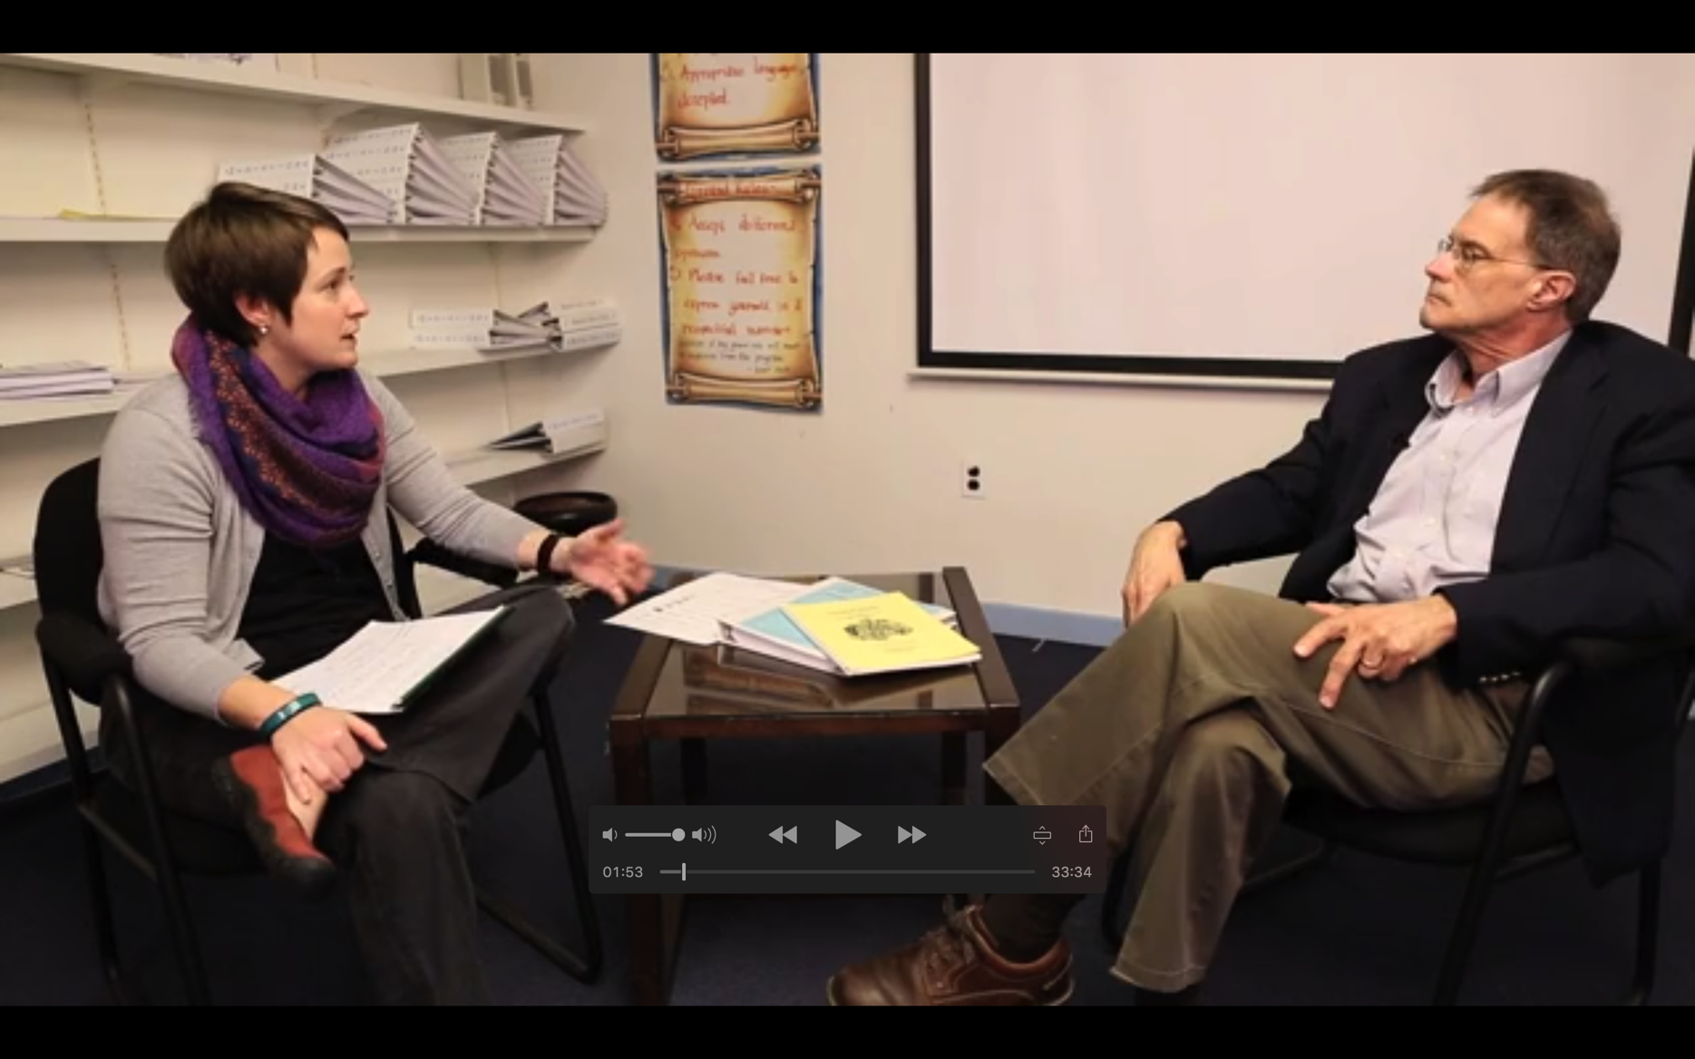
Video Examples – Peer Conflict Coaching SPED

Slide 13

When Would This Be Helpful? How Would This Be Helpful?

Slide 14


What are the challenges and advantages with your IEP Processes?
How Could Conflict Coaching Elements Help?

Slide 15
Common Challenges with IEP Meetings
Problems
Solutions
Power imbalances – parents not “heard”
Lack of Collaboration
Lack of Time
Disagreements over Goals and/or Interventions
Lack of Trust
Give parents/family different voice
Give parents/family more control over process
Clarify IEP process before hand
Clarify roles of parties

Slide 16


What are the challenges and advantages with your mediations?
How Could Conflict Coaching Elements Help?

Slide 17

What are the challenges and advantages with other processes?
How Could Conflict Coaching Elements Help?

Slide 18

How Coaches Can Prepare Parties for Mediation or Facilitation or Other ADR
What Are These Processes
Why Would You Use Them?
How Can You Use Them Well?

Slide 19
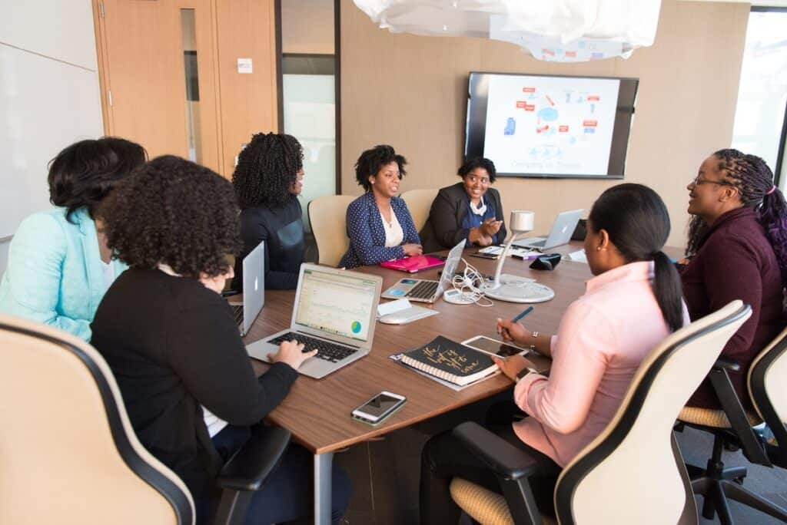
What Are These Processes?
How much do parties understand these processes?
How well are they prepared for them?
How well do their initial experiences often go?

Slide 20
Sanderson & Goldman 2023 Remedial and Special Education, vol 44(3)
Using 1,183 responses from a national survey, we addressed the following research questions: (a) How satisfied are parents with their child’s current IEP? and (b) What characteristics of the parent, child, family–professional partnership, and IEP meeting predict greater parent satisfaction with their child’s IEP? Approximately 40% of parents reported some degree of dissatisfaction with their child’s IEP. Several child characteristics were associated with the most extreme levels of satisfaction. Results of a regression analysis indicated that, for this sample, parent, child, family–professional partnership, and IEP meeting characteristics significantly predicted parent satisfaction, with characteristics of the IEP meeting among the strongest predictors.

Slide 21

Very Little Current Research on Parent Satisfaction with Mediation

Slide 22
Explain the Processes
A coaching conversation about IEP and/or Mediation Processes can be very helpful.
Explain possible processes
Explain how they work
Explain when and how they can be accessed
Explain how the party can best participate in them.
How much of this do you do now?
Share some of your best practices at your table.

Slide 23

Coaching Parties to Maximize Their Success in Mediation/IEP

Slide 24
Helping Them “Engage” Well in IEPS and Mediation – Expanding the Roadways Conversation
What Are There Presentation Goals?
What Are There Substantive Goals?
How Can They Validate the Other?
How Can They Handle Difficulties?
How Can They Give Feedback?
How Can They Negotiate?

Slide 25
Presentation Goals
How do I want to be seen?
Introductory Comments
Who
With what experience
With what expertise
With what roles
How will I respond if I’m not being seen as desired?

Slide 26
Substantive Goals
What do I really want/need out of this?
What do I really want for others?
What do I really want for the relationship?
How will I behave in this conversation to
Show I want these results?
Increase the likelihood of getting these results?

Slide 27

Perspective Taking and Validation
Affirmation
“I appreciate”
“Thank you for . . .”
“I realize”
“I see”
Positive Statement of Their Perspective/Their Goals

Slide 28

Perspective Taking and Validation
Questions
Prepare 1-2 affirming and open-ended questions for other parties
Start with “How” and “What”
Ask more about “What’s Working”
Ask more about “Why It Matters To Them”
Ask them about “what you don’t understand”

Slide 29

Potholes – Handling Difficulties
Plan for Requests:
To slow down
To repeat
To take a break
To share discomfort
“I am feeling concerned about the information you just presented”

Slide 30
Potholes – Handling Difficulties
Plan for Disrespect
Plan for Disagreement
With Issues
With Assumptions
With Responsibility
With Goals

Slide 31

Giving Feedback
1-2 KEY Issues
Positive Language
Specific
About behavior
Depersonalized
Ask for their Perspective
Request Change
Change to . . .
Because
Can You/Will You?

Slide 32

Planning Negotiation
1-2 KEY Issues
Deal-breaker Interests
Brainstorming Options
Criteria for Selection
BATNA (Best Alternative to a Negotiated Agreement)

Slide 33
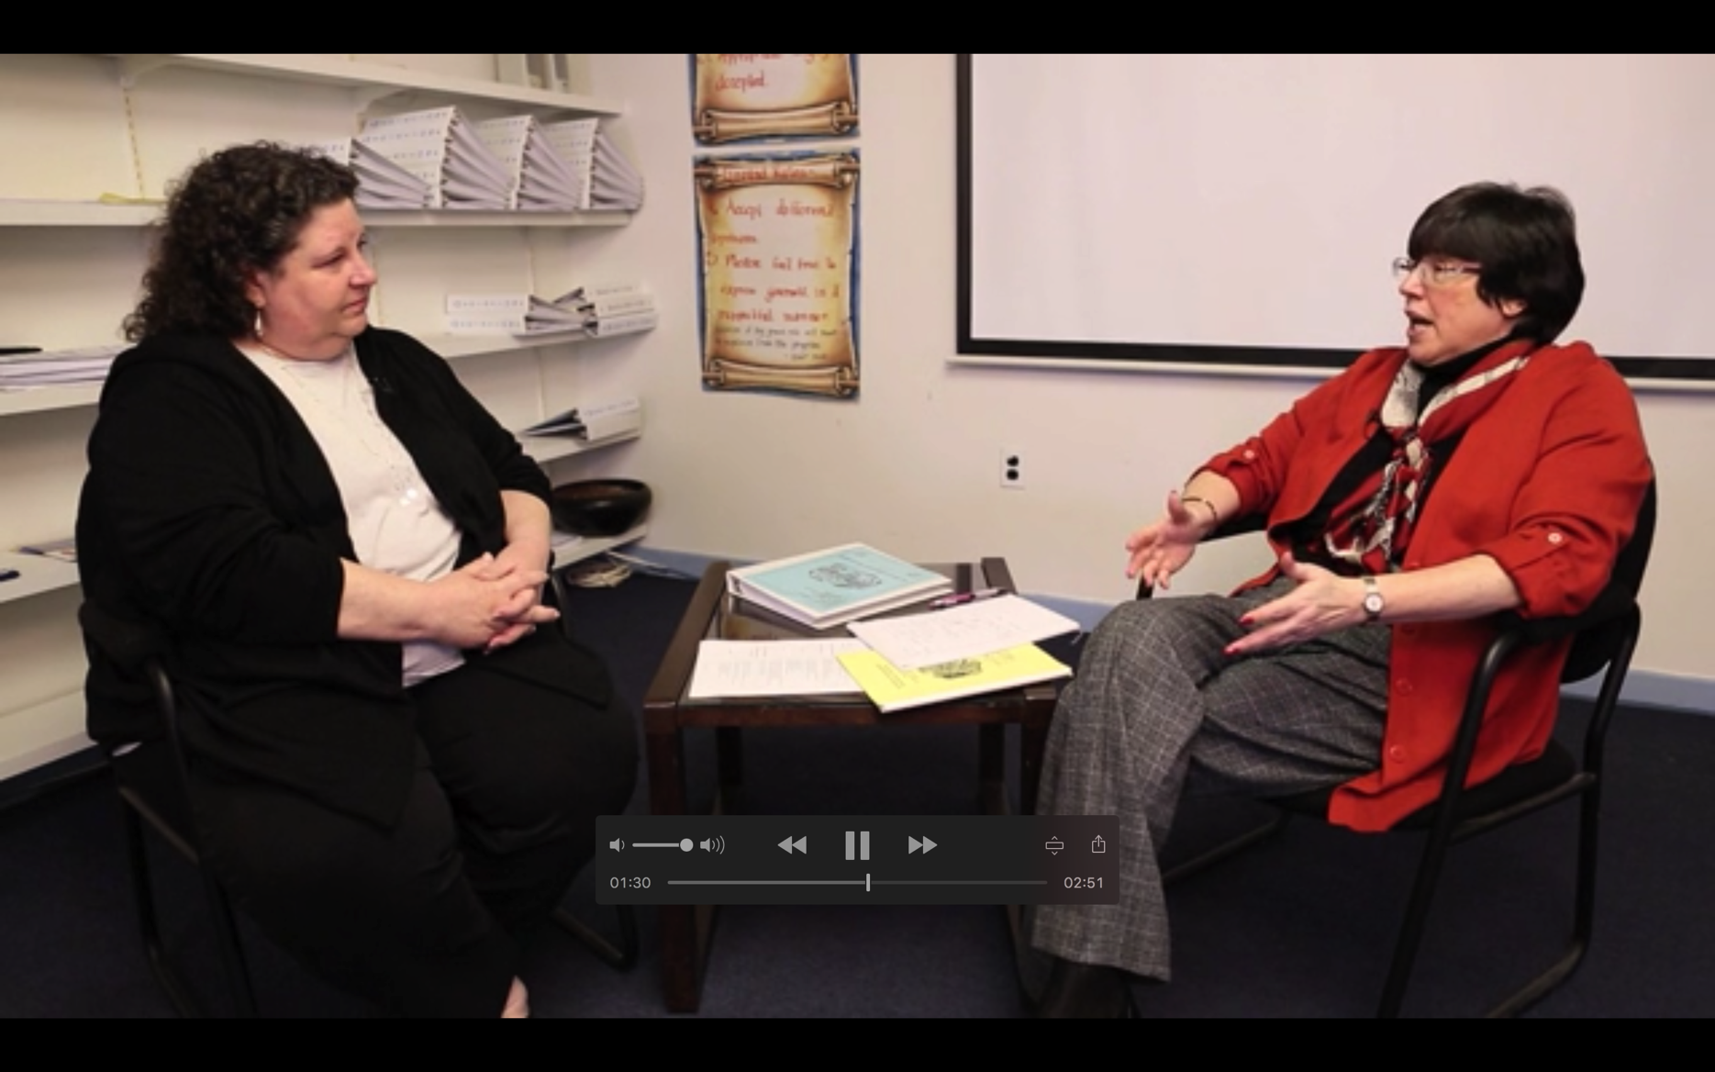
Let’s Revisit Trish – Volunteers to Help Prepare Her for the IEP

Slide 34
Volunteers
Presentation Goals
Substantive Goals
Validation/Affirmation
Validation/Questions
Potholes – Requests
Giving Feedback

Slide 35

Helping Them Problem Solve
Collaborative Negotiation

Slide 36

Helping Them Problem Solve
Focus on Interests/Needs
Seek Common Ground
Create Solutions
Set Clear Action

Slide 37
Focus on Interests and NOT Positions
Positions -
Are predetermined outcomes or demands
Example: “You have to let me have a say in this school”
Example: “You have to follow my rules for me to listen to you.”
Interests –
Are the needs and concerns that underlie the position
Example: “This community is important to me and I am concerned about its future.”
Example: “I need to have control over how this school is run in order to do my job as principal.”

Slide 38
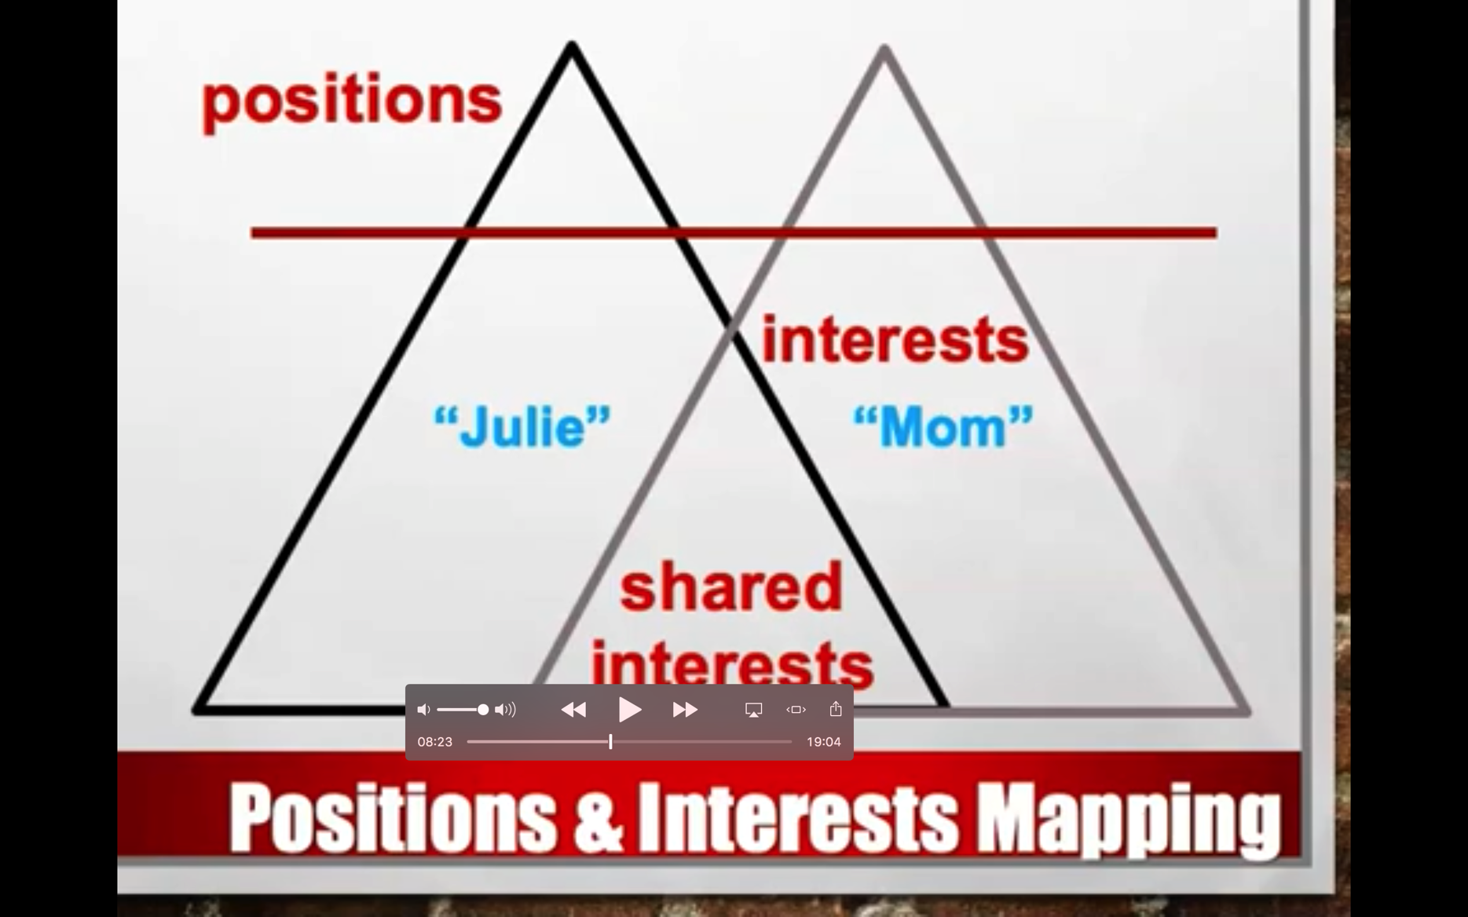
Interests Mapping

Slide 39
A Hypothetical Situation
Sara and Dwayne have a 10 year old son, DeJahn, (their only child) who has been identified as having severe ADHD and moderate autism. Sara and Dwayne divorced four years ago and tensions of supporting their son contributed to the divorce. In addition, there was domestic violence that resulted in restraining orders which limited contact. Since the divorce Sara has had sole custody and has been the primary caretaker. She has a relatively stable and constructive working relationship with DeJahn’s elementary school and his district. They have been strongly supported emotionally and financially by Sara’s mother. Last year Dwayne married Tanya and both have now been granted shared custody but with limitations. Dwayne and Tanya believe that the school has not been providing adequate support and intervention for DeJaun and want to have him receive more. They are threatening to escalate the case against Sara and the school district.

Slide 40
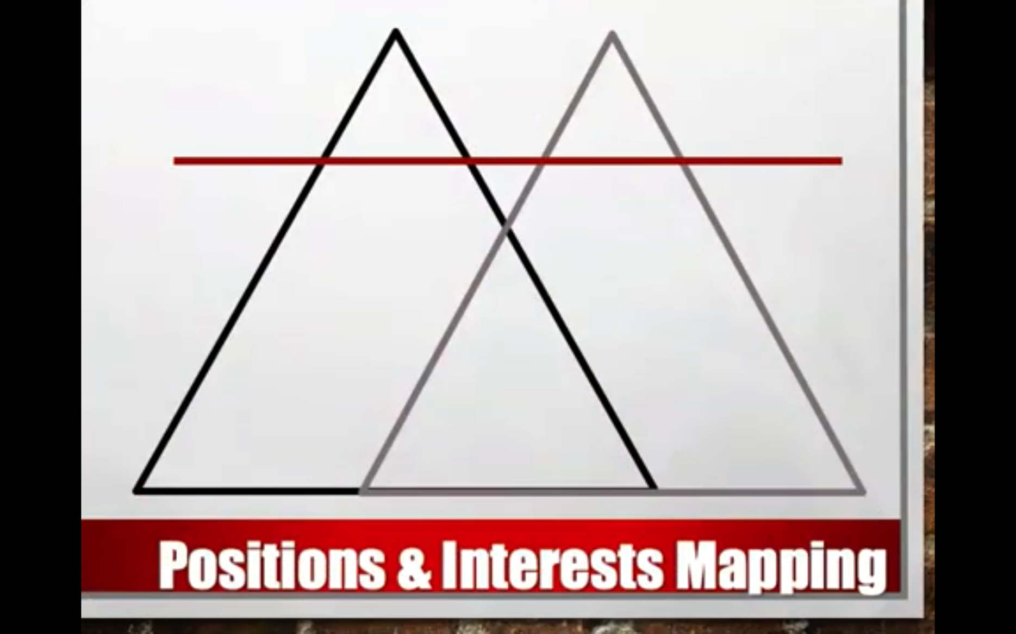
Help Them With an Interests Exploration – Let’s Talk

Slide 41
Prioritize Interests and Seek Common Ground
Which are Essential – DEAL BREAKERS
Which are Preferred – Important but not Critical
Which are Desirable – Nice but Not Necessary

Slide 42
Helping Shift from a Position to an Interest
Why is that important to me?
How will that help me meet my needs?
How will this help:
Me?
The other person?
The relationship?
The organization?

Slide 43

Brainstorm Solutions
This is a process of creating as many solutions as possible BEFORE you evaluate them to decide which are the best options.
Otherwise, good ideas never have a chance to be suggested and discussed because people are too busy arguing over the first ideas introduced.
Photo by Leon on Unsplash

Slide 44
Test Options
Get several ideas on the table, then…
Gut response?
Fit with interests?
Workable?

Slide 45
Make a Clear Plan for Action
WHO
WHAT
AGREES TO DO
HOW
(MUCH)
WHEN

Slide 46
Have a Back-Up Plan
What happens if you can’t come to agreement?
Help them develop a “back-up” plan – what they will do if they can’t negotiate the conflict
Have them think about the upsides and downsides of the back-up plan

Slide 47
Let’s Help Sara Prepare for Mediation with Dwayne – As a Group
Interests Exploration
Sara’s/ Dwayne’s
Priorities
Brainstorming Solutions
Testing Options
Back-Up Plan

Slide 48

What Coaching Elements Mediators and Facilitators Can Infuse
Caucus:
Exploring Drivers of Conflict
Visioning

Slide 49
Caucusing Infusions
Exploring Drivers of Conflict
Identity
Emotion
Power
Trust
Visioning

Slide 50

Check In With Identity
What roles are affecting this conflict? (roles)
Do you feel pulled between certain roles in terms of what to attain?
Can you be your best self in this situation? (self-respect)
What is important for you to stand up for? (values)
Will you be able to stand up for what matters to you?

Slide 51

Check in with Power
How much do you need the other party to resolve this conflict without appealing?
How much do they need you?
How much choice and voice do you feel you have now?
How ready are you to make a choice and move forward?
What roadblocks are still there?

Slide 52
What Affects Your “Need”
Scarcity
Importance
Substitutability
Dependency
Power

Slide 53

Check in with Emotion
How are you feeling about the conflict?
What needs are driving the emotions?
How are the emotions affecting your actions?
Positively? Negatively?
What would make it feel better?

Slide 54

Check In With Trust Issues?
How much do you trust each other on:
Doing Your Expected Tasks (Contractual)?
Communicating Openly, Honestly and Responsively (Communicating)?
Having the Skills and Knowledge to Do What Is Needed?(Competence)?
How do you know that? What do you see or hear that leads you to that assumption?

Slide 55

What Is Your Trust Vision?
Ideally what will be the trust relationship if you move forward as desired?
What will remain the same?
What will be different (what when where and how of trust behaviors?)
What protections will be in place (in the case of distrust)?
What accountability will be in place?
What will help make that a reality?

Slide 56

Thank You!!

