Slide 1
The Best Conflict Resolution:
Avoidance
The Center for Appropriate Dispute Resolution in Special Education
National Symposium on IDEA Dispute Resolution
October 21, 2025
Andrew Feinstein, JD, Feinstein Education Law Group (CT)
Shirley K. Klein, MS, PD, Darien (CT) Public Schools
Scott McCarthy, PhD, Darien (CT) Public Schools

Slide 2
What is a conflict?

Slide 3
The essence of conflict is a disagreement or struggle between two or more parties with opposing needs, goals, or interests

Slide 4
Authentic v. Apparent Conflict

Slide 5
An authentic conflict is one in which the opposing parties seek unilateral control of an outcome.

Slide 6
In the realm of special education, there are few authentic conflicts. More often, there are differing perceptions.

Slide 7
Experience has shown, the school and the parent often have the same goal: Addressing the child’s academic, social, emotional, and developmental needs with exceptional student outcomes.

Slide 8
Perceived conflicts become zero-sum games.
Communication Fatal Flaw:

Slide 9
This presentation will provide the skills and strategies to avoid conflict and work collaboratively with the party/parties who previously would have been perceived as the opponent(s).

Slide 10
Even authentic conflicts can be resolved: Through multi-faceted agreements.

Slide 11
A dispute over a single variable which both sides seek cannot be resolved to the satisfaction of both parties.
In contrast, the conflict may be resolved if other variables are in the equation.

Slide 12
The listening and validation techniques explored in this presentation, foster trust and communication.

Slide 13
These techniques also provide the parties with the information needed to make multi-faceted agreements.

Slide 14
Consider: You can only control your own behavior. You cannot control the behavior of the other person at the table. That said, you can utilize techniques to create the conditions which will increase the likelihood of fostering positive relationships and outcomes.

Slide 15
Modeling listening and respect may not guarantee a positive outcome; however, it is far more likely to produce positive reciprocal responses.

Slide 16
Utilizing Evidence-based DBT Strategies to Avoid Escalation and Increase Understanding

Slide 17
Prevention Framework Application to Conflict Avoidance

Slide 18


Slide 19
Validation
It strengthens relationships
It reduces emotional dysregulation
It shows that you:
  Are listening
  Understand (or are trying to understand)
  Are being non-judgmental
  Care
Validate before problem-solving

Slide 20
Three Types of Invalidation
A person’s thoughts, feelings, and behaviors are indiscriminately rejected
Lower-level expressions of emotion are ignored or punished, and emotional escalation is sometimes given more attention (intermittently reinforced)
The ease of problem solving and meeting goals is overstated or oversimplified

Slide 21
Validation: Why?
Critical Assumption
People’s thoughts, emotions, and perspectives are always valid
If you are about to disagree with someone, use validation to express that you understand (or are trying to understand) their perspective. Then…offer another point of view and work to engage their understanding of your point of view.

Slide 22
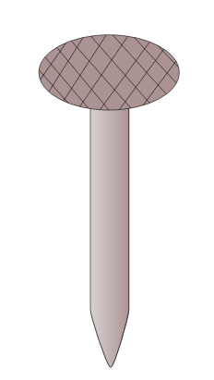
Validation Sounds like….
Not like….
It makes sense you feel…
I can understand why you want to…
This sounds really upsetting.
Of course, you are feeling…
This is so tough!
I bet you’re feeling…
What’s the big deal?
You’re being too sensitive
Just calm down!
Don’t worry about it, you’ll get it next time!
There are bigger problems in the world!
Don’t be so angry.

Slide 23

Validation Level One
Being Present, Unbiased Listening and Observing
Remembering What Has Been Shared
Engaging, Nodding, Making Eye Contact, Open Body Posture

Slide 24

Validation Level Two
Accurate Reflection
“What I’m hearing is…am I right?”
Confirm what is said is what is heard.

Slide 25
Validation Level Three
Articulating the Nonverbalized Emotions, Thoughts, or Behavior Patterns
“I know how much you have worried about how your daughter is performing in reading and I can imagine it is concerning not seeing her make the progress you had hoped she would have made.”

Slide 26
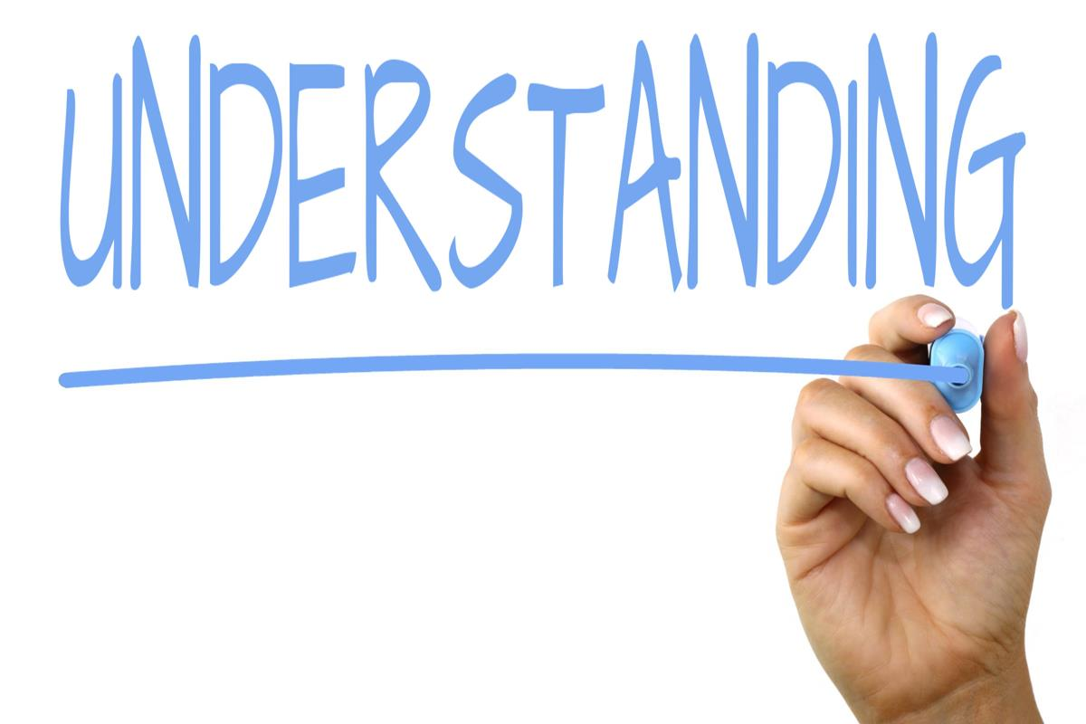
Validation Level Four
Understanding in Terms of Past Learning
“Given everything you have experienced, it makes sense that you would feel/think/do _____”

Slide 27
Validation Level Five
Understanding Perspective in Terms of Present Context
“Anyone would feel this way”
“I would be surprised if you didn’t feel this way”

Slide 28

Validation Level Six
“Radical Genuineness,” Sharing the Experience as Equals
“I get it”

Slide 29
Why Is Validation Key?
It Helps us with Perspective Taking
Prerequisite for Non-judgemental Communication
Allows us to Connect before we Correct

Slide 30
Other Conversation Considerations
Accept One’s Role in Solving a Problem
Disentangle Emotions from Decisions
Focus on Outcomes over Requirements/Demands
  Allow Teams to Be Creative
  Find Solutions That Meet the Needs of All Parties
  Offer Something: The Notion of Approximation
Be Mindful of Long-term Relationship with Families, Colleagues, Teams
Finding a ‘Kernel of Truth’

Slide 31
Application & Considerations
Establishing the Conditions for Validation (e.g., Zoom Meeting Access, Seating at Meetings)
Professional Learning Frameworks
Conflict Prevention at Multiple Levels

