Slide 1
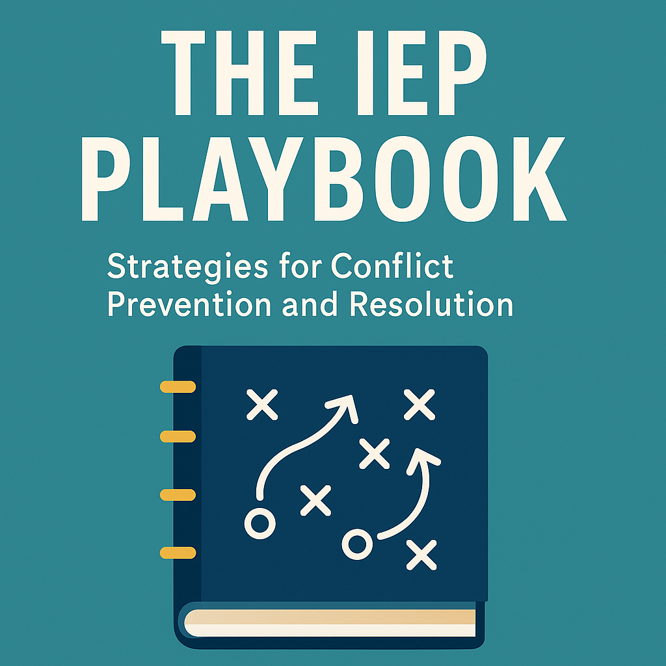
Teaching the IEP Process:
Bridging Legal Knowledge and Practice for Conflict Prevention (and Resolution)
Tracy Gershwin, PhD, BCBA-D & Tena Green, IEP Facilitator & Family Advocate
CADRE| October 21, 2025 | 9:30am–12:10 pm PDT

Slide 2

Objectives
Explain why educators need explicit preparation in conflict prevention and resolution within the IEP process.
Apply research-based strategies for trust-building, collaboration, communication, and conflict resolution that support equitable and trusting partnerships between family members and educators.
Provide an example curriculum through an IEP playbook of actionable practices that bridge the gap between legal mandates, research, and educators' real-world skills to lead effective, student-centered IEP meetings.

Slide 3
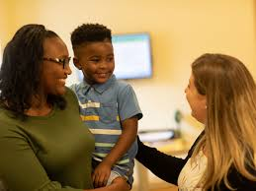



Family Member-Educator Relationship Defined
“A child-centered connection between individuals in the home and school settings who share responsibility for the growth and development of children” (Clark et al., 2010).

Slide 4
Perspectives (backed by research)
Family Member Perspectives
In a systematic review of the research literature, Johnston and Burke (2023) found that families of students with disabilities in low-resourced communities described communication with professionals as absent and lacking in openness and friendliness.
Teacher Perspectives
In a survey of 1,497 special education teachers, Fowler et al. (2019) reported teachers’ low confidence in collaborating with families whose background differed from their own. Others report that teachers view family collaboration as among the most anxiety-provoking aspects of their job (Markow et al., 2013; Pressley, 2021).

Slide 5


Barriers to Family-Educator Collaboration
Preservice
Family-related knowledge and skills are covered minimally in coursework (Kyzar et al., 2019; Miller et al., 2013; Patte, 2011).
Inservice
Lack of models and mentors for self-reflection, information, and support (Knight-McKenna et al., 2017; Lasater et al., 2021).

Slide 6
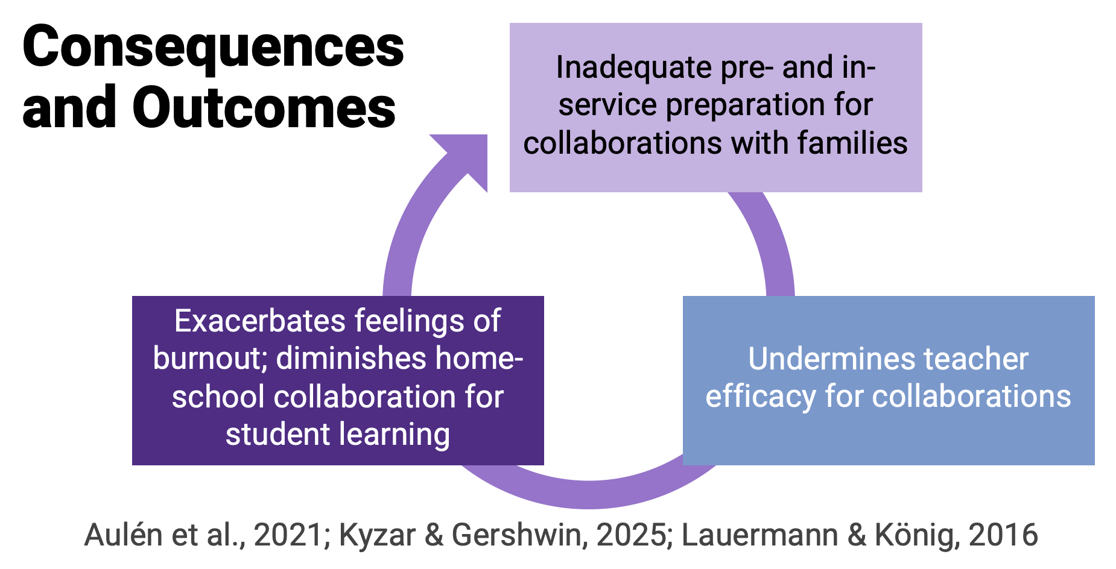

Slide 7
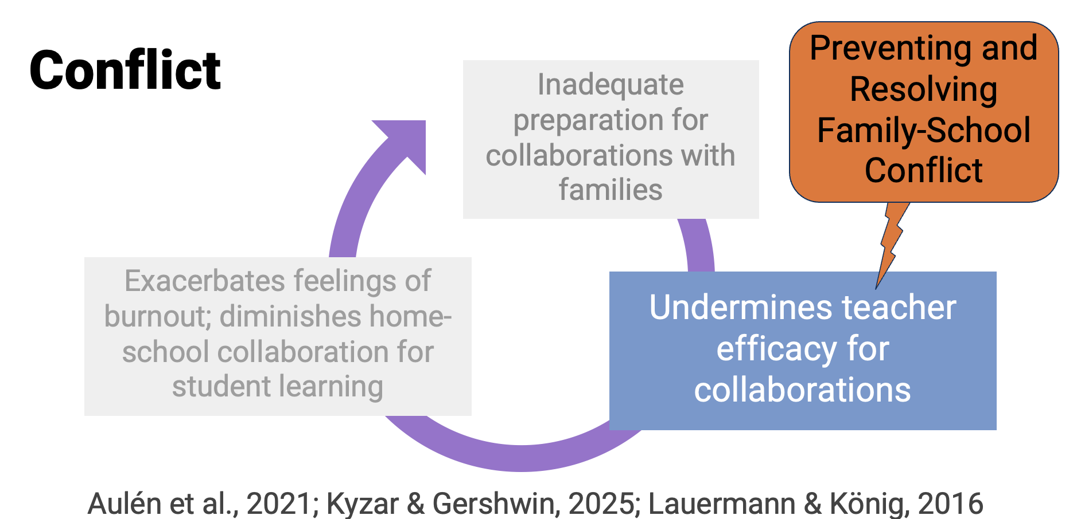

Slide 8
Conflict
Definition | Notable Features | Source
The interaction of interdependent people who perceive incompatible goals and interference from each other in achieving these goals. | Emphasis on perception & interdependence. | Folger, Poole & Stutman (2021, p.4)

Slide 9
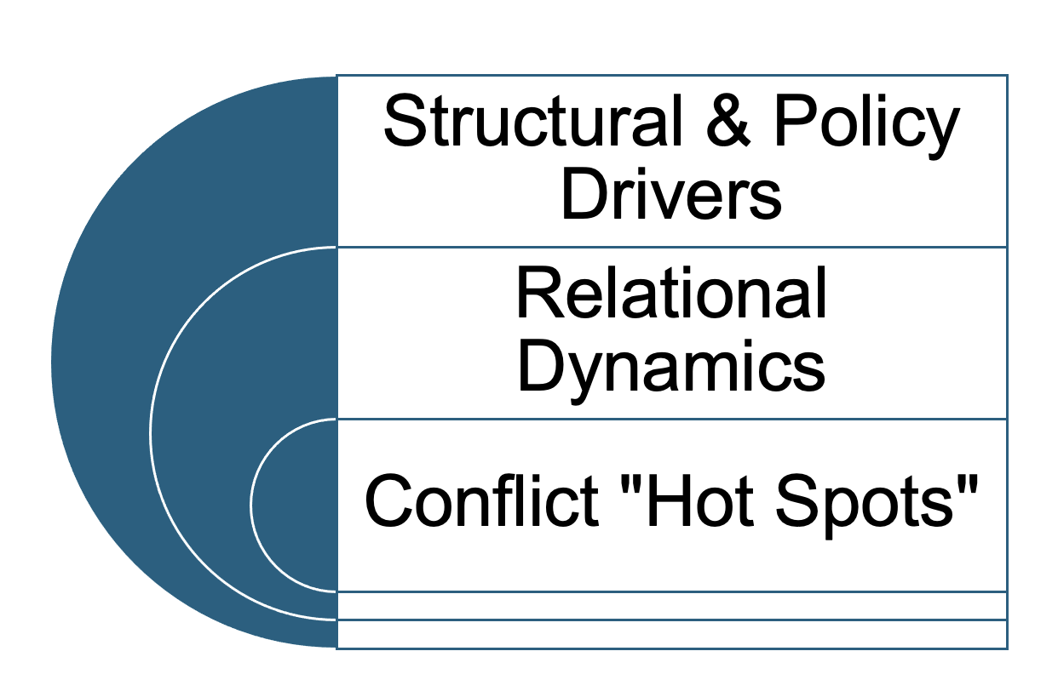

A Layered View of Conflict in Special Education
Adaptive Outcome
Maladaptive Outcome

Slide 10
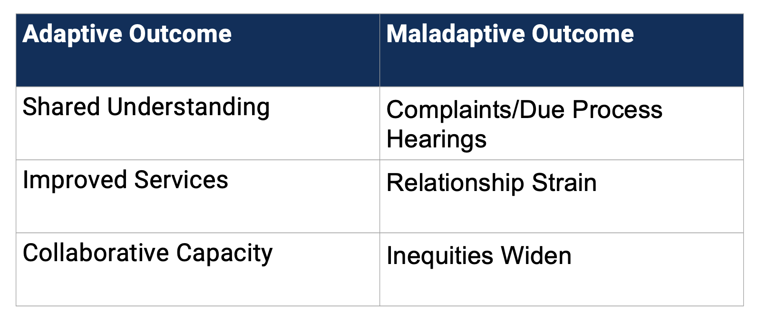
Family-School Conflict Outcomes

Slide 11
Educators Need a Game Plan:
Offense and Defense Team Skills Based on Research
Proactive and reactive strategies are both essential to the IEP process success
Decades of research on IEP meeting experiences, outcomes, and conflict indicate the benefit (and need for) proactive and reactive strategies throughout the IEP process.
Proactive strategies can prevent the breakdown of trust and reduce the likelihood of disputes, and reactive strategies can provide support WHEN conflict arises and resolve the conflict.
Educators need guided and supportive, proactive, and reactive strategies to ensure student-centered, legally sound, and collaborative IEP process outcomes.

Slide 12

To Be Clear….
We are ALL on the same team

Slide 13
IEP Playbook: The Science Behind the Plays
Grounded in research, policy, and evidence-based practices
Conflict Prevention & Resolution
Educational Research
Educational Policy Foundations
Growth Mindset
IEP Facilitation and mediation
Restorative & Relationship Repair
Student Self-Determination
Conflict Coaching

Slide 14
Skills You Build With Practice
Offense (Prevention)
Rulebook Knowledge → Know the plays (IDEA: letter + intent).
Offense + Defense → Build trust, anticipate challenges, and respond thoughtfully.
Trust → The team glue that keeps everyone playing together.
Communication → Clear calls that make the plays work.
Mindset + Self-Awareness → Keep your head in the game, even under pressure.
Student MVP → Always remember the star player of the IEP.
Defense (Resolution)
Conflict Awareness → Spot when trust is breaking down.
Timeout Strategies → Pause, reset, and de-escalate.
Resolution Tools → Mediation, facilitation, and collaboration that maintains the focus on the MVP.

Slide 15
Mindset Matters:
Getting Your Head in the Process
Understand brain science and appraisal theory.
Apply the Appraise → Emote → Cope framework to show how mindset influences collaboration and decision-making.
Equip educators with tools for emotional regulation to prevent defensiveness and promote constructive dialogue.
Practice the mindset shift: Engage in guided activities to build, and practice emotional resilience.

Slide 16
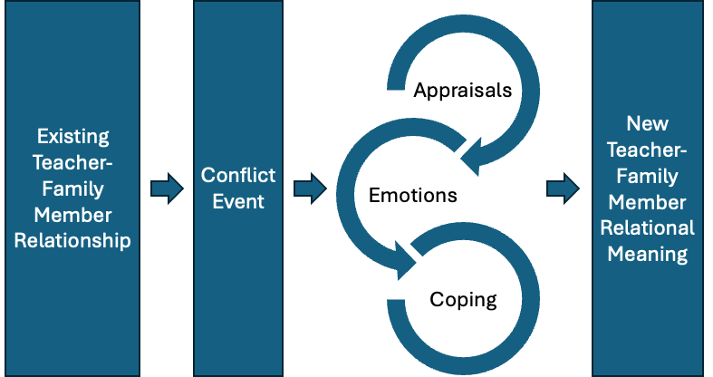
Appraise → Emote → Cope Framework

Slide 17
Check Your Blind Spots:
Building Self-Awareness on the Team
Recognizing bias and reflecting on your own lens to strengthen equity
Explain
Explain how unchecked biases influence decision-making, family engagement, and student access to equitable services.
Identify
Provide strategies for identifying and reducing implicit bias, including cultural humility practices and perspective-taking.
Practice
Practice bias-checking and self-awareness.

Slide 18
Know Your Position on the Team
Every player on the team has a valuable role
Identify the roles and responsibilities of each IEP team member, especially families and the student.
01
Understand how different perspectives and expertise contribute to effective IEP development and implementation.
02
Practice clarifying and communicating your role while valuing the contributions of other team members.
03

Slide 19

Kick Off:
Partners First, Paperwork Second
Building connections with families and educators so that the student leads the play
Learn why trusting student–family–educator partnerships is the foundation of effective IEP meetings.
Understand research about family and educator positive and challenging experiences with the IEP process.
Develop the ability to analyze past and current partnerships to identify those “on the sidelines.”

Slide 20
Trust as the Playbook Foundation:
Building Strong Teams from the Start
Why trust should be the non-negotiable foundation of every IEP team
Apply the Sunshine Model to strengthen family–professional partnerships throughout the IEP process.
Identify and describe common barriers to trust between the family and school.
Role-play conversations to build trust before, during, and after challenging moments.
Explore how trust shows up across cognitive, affective, and behavioral domains.

Slide 21
Rulebook Review:
Law & Order, IEP Unit
The importance of understanding and bridging the letter and intent of IDEA
It is important for educators to be able to explain the IDEA in plain language, clarifying the law's letter and intent.
Describe procedural safeguards and compliance pitfalls.
Analyze IEP scenarios for compliance vs. intent.

Slide 22
Coach Them to Run the Play Between
Policy and Practice
From compliance checklists to collaborative plays that support students
School, Family, and Community Partnerships (Epstein et al., 2018)
Dual-Capacity Building Framework (Mapp & Bergman, 2021)
Sunshine Model of Trusting Family-Professional Partnerships (Haines et al., 2017; Turnbull et al., 2022)
Individuals with Disabilities Education Act (IDEA): Principle of family participation
Every Student Succeeds Act (ESSA): Provisions for family engagement

Slide 23
Stats Don’t Lie: Goals You Can Measure
Clear goals. Real data. Stronger teamwork
Master SMART goals using Condition + Behavior + Criteria.
01
Learn how vague goals fuel mistrust and disputes.
02
Practice rewriting vague goals into measurable ones.
03

Slide 24
Running the Plays: The Golden Thread
Connecting evaluation, goals, services, and placement into a coherent plan
Understand how evaluation leads to goals -> services -> and placement.
Learn to spot coherence gaps across IEP sections to ensure fidelity.
Practice tracing a student’s IEP “thread” from data to placement.

Slide 25
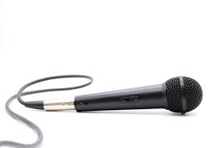
Sharing the Mic:
Co-Writing Goals Like a Team
Making shared decision-making real through collaborative goal writing
Define shared decision-making throughout the IEP process.
Walk through the collaborative goal-writing process.
Explore strategies to prevent power imbalances and ensure all voices are included.
Provide tools for facilitating IEP goal development.
Simulate co-writing one annual goal with family/student input.

Slide 26
Culture Isn’t a Checkbox:
Playing Without Assumptions
Practicing cultural humility to engage every family authentically
Explore
Explore intersectionality and culturally responsive practices.
Learn
Learn how cultural humility prevents misunderstandings.
Practice
Practice applying culturally responsive practices throughout the IEP process using case studies.

Slide 27
Clear Calls: Jargon Schmargon
Using plain, human language to prevent conflict
Learn how overuse of jargon excludes families and escalates conflict.
Provide practice scripts and strategies for plain-language communication.
Translate jargon-heavy IEP text into “family-friendly” wording.

Slide 28
Call the Play: Communication that Connects
Building clarity, listening skills, and responsiveness for IEP teamwork
Identify the role of communication in preventing and resolving conflict.
Learn strategies for active listening, paraphrasing, and validating family perspectives.
Explore tools for structuring difficult conversations (agendas, norms, “parking lots”).
Pair up for role-play conversations where one person practices listening, paraphrasing, and responding constructively.

Slide 29
Student MVP:
Centering the Learner’s Voice on the Team
The student’s perspective is the most valuable player in the IEP
Explore strategies for meaningful student participation across ages and abilities.
1
Understand how centering student voice increases engagement, ownership, and motivation.
2
Provide tools for preparing students to share their perspective in ways that fit their strengths.
3
Draft a plan for integrating student input into goal-writing and meeting facilitation.
4

Slide 30
Game Day:
IEP Meetings With Meaning
Preparing for, facilitating, and following up on IEP meetings as a team
Prepare for, run, and follow up on IEP meetings as a team.
Use checklists and norms to guide smooth facilitation throughout the IEP process (before, during, and after the meeting).
Practice creating an agenda and meeting norms for an IEP meeting.

Slide 31

When the Play Breaks Down:
Meetings, Mistrust, and Misunderstandings
Understanding why breakdowns happen and how to respond.
Analyze why trust breaks down during meetings.
Recognize patterns that escalate conflict.
Learn and practice when and how to respond to breakdowns.

Slide 32
Timeout: Conflict Happens, Now What?
Using dispute resolution strategies and de-escalation when conflict arises
Learn conflict de-escalation strategies and facilitator phrases.
Understand dispute resolution pathways.
Role-play conflict resolution strategies and practice (run your drills).

Slide 33
Real Talk: Post-Game Film Review
Learning from real cases to apply lessons in practice
Examine real and composite case studies of IEP meetings to identify successes and breakdowns.
Practice analyzing what strategies worked, which were challenging, and why.
Apply lessons learned from case reviews to improve future IEP collaboration and conflict prevention.

Slide 34
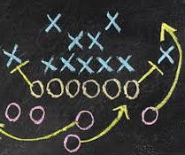
Grab-and-Go:
Playbook Tools and Templates
Ready-made checklists, scripts, and resources to use in daily practice
Provide ready-to-implement templates, scripts, and checklists to prepare for IEP meetings.
Practice adapting tools to fit diverse student and family contexts.
Build a personalized “toolkit” of Playbook resources for ongoing professional use.

Slide 35
Thank You!
Tracy Gershwin, PhD, BCBA-D
tracy.gershwin@unco.edu
Tena Green, Parent Advocate
tenamgreen@gmail.com

