Slide 1
Seeing a Better Future: Conflict Coaching in Your Special Education Dispute Work
CADRE Conference October 2025
Tricia S. Jones, Ph.D.
And
Timothy K. Hedeen, Ph.D.

Slide 2

Goals:
Introduce Conflict Coaching
Helping Them “See” the Future Change
-Where they want to go:
Conflict and Vision Mapping
Trust Visions
Appreciative Inquiry
How They Can Get There

Slide 3



Getting to Know You – At Your Table
Choose one of the questions below and share with your colleagues a short answer to that question in terms of your recent experience in your special education work.

Slide 4
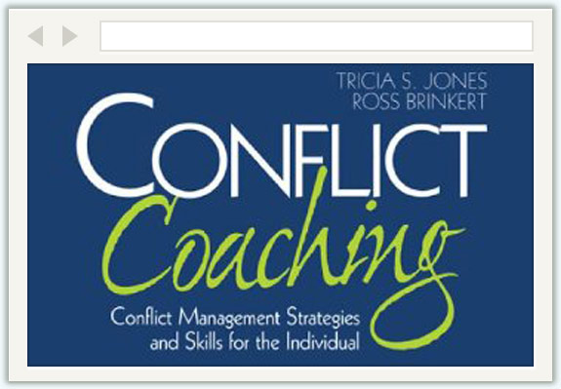
Introducing Conflict Coaching As An ADR Process

Slide 5
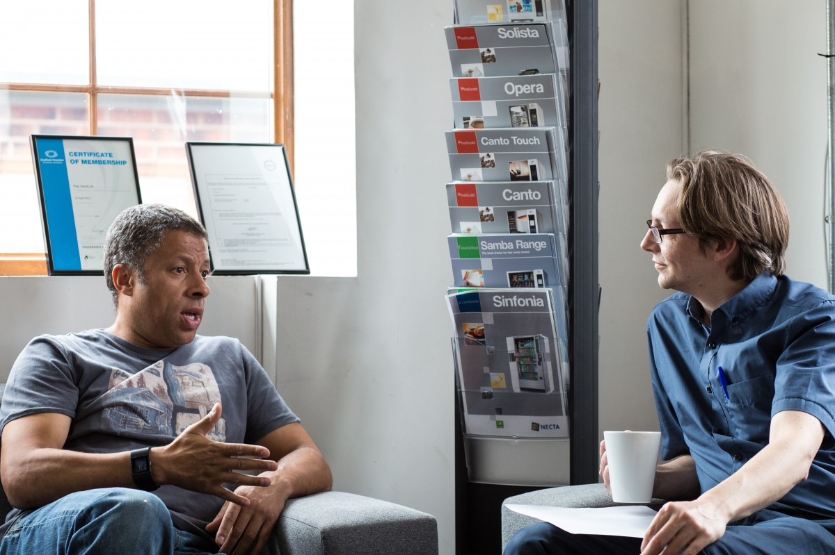
Conflict Coaching Defined
Conflict coaching is a one-on-one ADR process to help the party:
Understand and analyze their conflict from self and other perspective.
Identify preferred direction for relationship and conflict situation.
Develop specific skills to enact the preferred direction.

Slide 6

Conflict Coaching Assumptions
Party maintains decision-making control
Voluntary, confidential, and transparent
Ideally part of a larger ADR system
Follows principle of efficiency – maximum benefit in minimum time

Slide 7

Why Conflict Coaching?
Early intervention
Preventative (and de-escalatory)
Focus on conflict analysis
Emphasis on perspective-taking
Builds skills and applications
Low cost
Online and in-person
Works well with other ADR processes

Slide 8

A Brief History of Conflict Coaching
Developed in 1995/96 as a response to no-shows in mediation programs
Since 2007/8 part of ADR Systems in
  Federal agencies (under ADRA/ MS 110)
  State agencies
  Private sector
  Education
Fastest Growing ADR Process

Slide 9


Workplace Conflicts
*Change Processes
*Team Conflict
*High Conflict Parties
*AA/EEO
Contexts of Conflict Coaching – Where Is It Working?
Family Conflict
*Co-parenting
*Divorce
*Elder/Other Care
*Family Business

Slide 10


Community/Court Conflicts
*Diversion
*Small Claims
*Housing/Eviction
*General Community
Education
*K-12
*Special Education
*Higher Education

Slide 11
What Is Your Experience With Conflict Coaching As An ADR Process?
Please use your phone to go to www.menti.com
Enter the code
XXXX XXXX
When the slides come on your phone enter your answers and we’ll see the results on screen

Slide 12
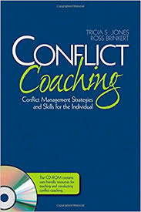
Conflict Coaching Process
Preparatory
Conversation
Stage 1:
Discovering the Story
-Initial story
-Refining story
-Testing story
Stage 2: Exploring 3 Perspectives
-Identity
-Emotion
-Power
Stage 3:
Crafting the Best Story
-Initial
-Refining
-Testing
Stage 4:
Enacting the Best Story
-Skills Development
The Parallel Process: Learning Assessment

Slide 13
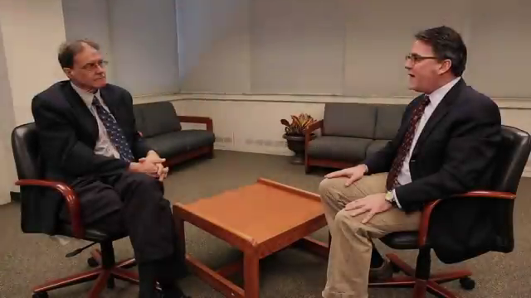
The Preparatory Conversation
A basic conversation is needed to…
  Explain conflict coaching
  Make sure the party wants to proceed

Slide 14
Stage 1: Discovering the Story
Inviting the Initial Story
-
What is the conflict?
Refining the Initial Story
–
Do we fully understand the conflict?
Testing the Initial Story
--
What perspectives or assumptions of the party may need to be challenged?
Narrative is powerful and persuasive.

Slide 15



Stage 2: Know the Conflict Drivers
Identity, Emotion, Power
  Who do I/they want to be respected as)?
  – Identity
How do I/they want to feel?
– Emotion
What can I/they make happen in this situation?
– Power

Slide 16
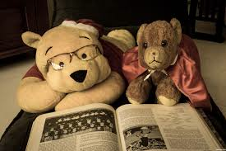
Stage 3:
Crafting the Best Story
Focus on “what can be” – the future
Visioning the desired future
  The Best Visions are detailed, clarified, refined
Help parties discuss realistic outcomes and coping strategies if change is difficult

Slide 17

Stage 4: Enacting the Best Story –Skills Development
Stage Four is the process of skills development – How To Make The Best Story Happen
Critical skills necessary to enact the “best” story
Skills development agenda
Skills development work

Slide 18
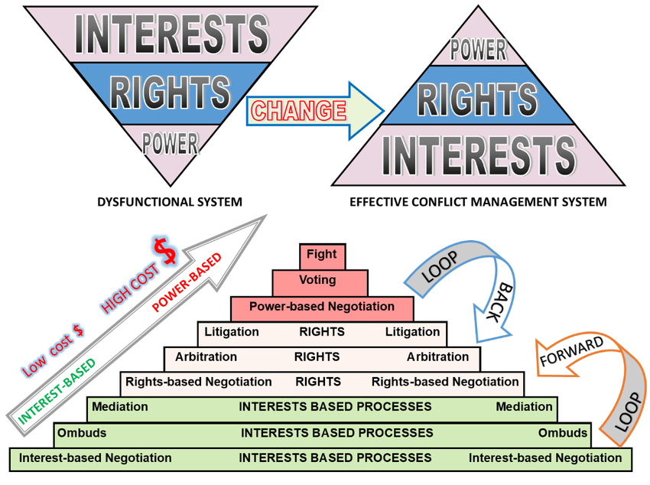
Conflict Coaching Integration Into Mediation and ADR Programs

Slide 19
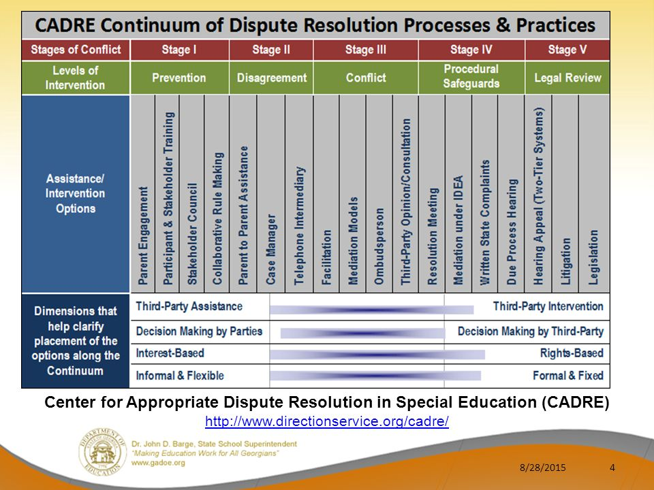

Slide 20
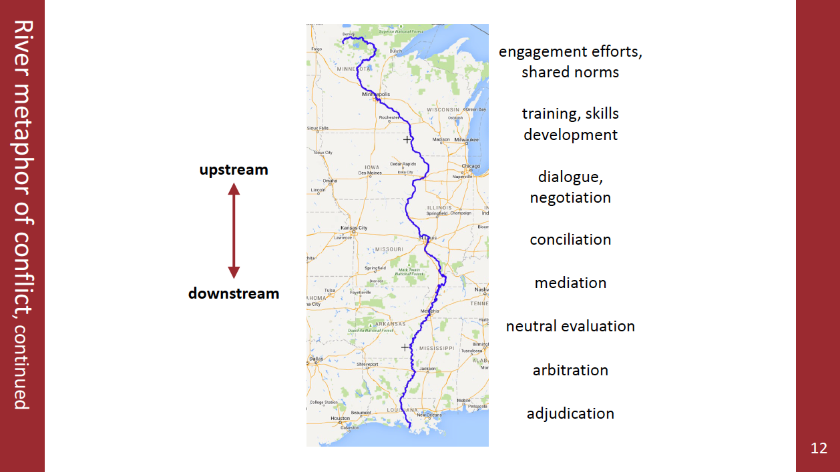

Slide 21
Conflict Coaching as Pre-/Post
Mediation and Pre-/Post
Facilitation
Identification of Conflict For Mediation/Fac
Conflict Coaching to Explain Process and Parties
Conflict Coaching to Identify Information to be Shared/Requested
Conflict Coaching to Explain Post Process
Conflict Coaching to Analyze Pre-Post Process and to Consider Next Steps
Mediation or Facilitation

Slide 22

How Can Conflict Coaching Support These Special Education Processes?
IEP Facilitation
Mediation
Resolution Meeting
Due Process Hearing
OTHER PLACES?

Slide 23
When is Conflict Coaching Helpful?
When people are entering special education processes
When people are transitioning between schools/with new service support teams
When things haven’t gone well; relationships/trust needs rebuilding
In preparation for IEP Facilitation, Mediation, Resolution Hearings, etc.
Attractive when one or both parties do not want to engage in informal mediation
Valuable for parties “stuck” in conflict
When teams or groups are in conflict that is interfering with effective service

Slide 24

CONFLICT MAPPING and
VISION
MAPPING

Slide 25

Focusing on Relationships – Stage One
-Who
- How Are They Related?

Slide 26
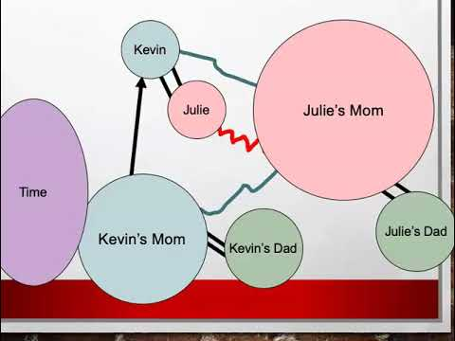
Conflict Mapping – The WHO
– The Relationships
Who is relevant?
How are they related?
Where are the tensions?
Where are the alliances
What are their roles or relevance in the conflict?
Thanks to Julie Marie Hyde
https://www.youtube.com/watch?v=iywM-o-ym1Y
Conflict Mapping

Slide 27
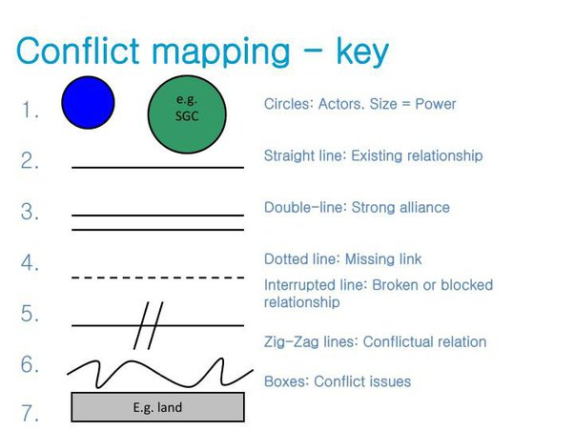

Slide 28
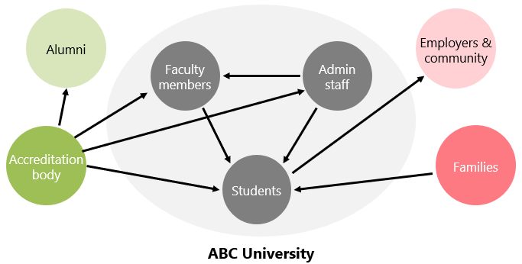
The “Who” Can be Groups and Systems

Slide 29
A Hypothetical Situation
Sara and Dwayne have a 10 year old son, DeJahn, (their only child) who has been identified as having severe ADHD and moderate autism. Sara and Dwayne divorced four years ago and tensions of supporting their son contributed to the divorce. In addition, there was domestic violence that resulted in restraining orders which limited contact. Since the divorce Sara has had sole custody and has been the primary caretaker. She has a relatively stable and constructive working relationship with DeJahn’s elementary school and his district. They have been strongly supported emotionally and financially by Sara’s mother. Last year Dwayne married Tanya and both have now been granted shared custody but with limitations. Dwayne and Tanya believe that the school has not been providing adequate support and intervention for DeJahn and want to have him receive more. They are threatening to escalate the case against Sara and the school district.

Slide 30
Let’s Flesh Out the Who
Educational System
Step Mother
Father
Father’s Lawyer
Educator
Grand-mother
Mother
Mother’s Lawyer

Slide 31
Let’s Flesh Out the “How Related”
Educational System
Step Mother
Father
Father’s Lawyer
Educator
Grand-mother
Mother
Mother’s Lawyer

Slide 32
Based on This Conflict Map. What General, Refining and Testing Questions Would You Ask as a Conflict Coach?
What General Questions Would You Ask?
What Refining Questions Would You Ask?
What Testing Questions Would You Ask?

Slide 33
Does This Map Change Per Issue?
Assume there are two key issues in the conflict:
1. The role of the father in shared decision-making in DeJahn’s education
The interventions desired by Sara and Dwayne/Tanya

Slide 34
Shared Decision-Making
Step Mother
Father
Father’s Lawyer
Educational System
Educator
Grand-mother
Mother
Mother’s Lawyer

Slide 35
Desired Interventions
Educational System
Step Mother
Father
Father’s Lawyer
Educator
Grand-mother
Mother
Mother’s Lawyer

Slide 36
With these additional tools you enable the party to consider how relationships change given the driver
Stage 2:
-Identity
-Emotion
-Power
-Trust

Slide 37
Identity Drivers
Father
Educational System
Step Mother
Mother
DeJahn
Grand-mother
Mother’s Lawyer

Slide 38
Identity Questions That May Arise
How does your role as mother/father change in this situation with shared custody?
How well can you be “mother/father/stepmother/grandmother” to DeJaun if the legal battles take precedence?
What does the struggle now mean to the possible ability to be your best self in the future? Their ability to be their best selves?
OTHER?

Slide 39
Emotion Drivers
Father
Step Mother
Mother
DeJahn

Slide 40
Emotion Questions That May Arise
How are you feeling about this conflict now concerning possibility of shared custody? How are they?
What are these “new”/additional emotions causing you to do or not do? Them?
How are these behaviors coming from emotions undercutting or supporting your desired identities and power/influence/agency?
OTHER?

Slide 41
Power Drivers
Step Mother
Father’s Lawyer
Father
Educational System
Legal
Grand-mother
Mother
Mother’s Lawyer

Slide 42
Power Questions That May Arise
What are the advantages/disadvantages of the emphasis on legal strategy as a means to power? For you? For them?
What kind of power would it be good for you and Dwayne to share? Why?
What do you know about the educational system’s power that supports your power struggle with Dwayne/Sara?
What don’t you know about the educational system’s power that can hurt you?
OTHER?

Slide 43
Trust Drivers
Educational System
Father’s Lawyer
Step Mother
Father
Educator
Grand-mother
DeJahn
Mother
Mother’s Lawyer

Slide 44
Trust Questions That May Arise
What is the trust history that explains this map? Particularly trust peaks and valleys in the key relationships?
Where is the distrust and why?
Where do you have moderate or high trust in the key parties?
What could you learn that would affect your current trust relationships?
OTHER?

Slide 45

Stage 3:
What would the future look like?

Slide 46
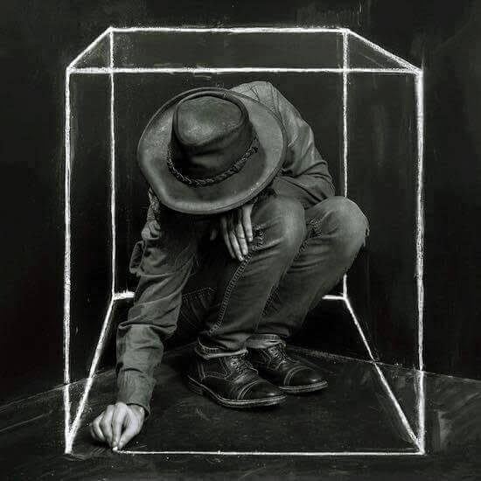
-How Are They Boxing Themselves In?
-How Can You Help Them Out Of The Box?

Slide 47
Stage 3: Crafting the Best Story
The coach helps the party identify and elaborate a vision -- different levels of this future can be explored to fit their need.
  an “ideal” future – what they ideally would want to have
  a “real”(istic) improvement – the best they realistically think they can achieve given the system in which they work
  a “needed” improvement – what they need in order to be able to cope with the conflict, decrease the discomfort

Slide 48
Remember Stage One?
Educational System
Step Mother
Father
Father’s Lawyer
Educator
Grand-mother
Mother
Mother’s Lawyer

Slide 49
Let’s Consider the Future
Educational System
Educator
Step Mother
Mother’s Lawyer
Educator
Father
Educator
Mother
Grand-mother
DeJahn

Slide 50

What Is Your Trust Vision?
Ideally what will be the trust relationship if you move forward as desired?
  What will remain the same?
  What will be different (what when where and how of trust behaviors?)
  What protections will be in place (in the case of distrust)?
  What accountability will be in place?
What will help make that a reality?

Slide 51

Stage 4:
Transitioning – Maps can be Helpful

Slide 52
Stage 4: Enacting the Best Story
Key Skill Areas
Conflict Styles
-identify styles
-consider fit
-teach adaptation
Communication Skills
-confrontation
-nonverbal communication
-confirmation
-comprehension
Negotiation
-interest based
-bargaining
-multiparty negotiation
-team negotiation
Other Dispute Resolution Processes
--preparing for mediation or arbitration
Emotional Competence Skills
Emotional Intelligence
Coaching for Optimism

Slide 53
Common Skills Needed
Engagement
Apology
Feedback
Conflict Styles
Interest-Based Negotiation
Using other ADR
Nonverbal Communication
Defensiveness
Communicating Respect
Dealing with Disrespect

Slide 54
Transitioning to Stage 4
Summary:
Transitioning starts with the coach summarizing the best/realistic/needed story the party has articulated
Action Steps Needed
The coach asks the party to step up or step down the action steps that would need to happen to get “from here” to “there” – from the current situation to the desired situation
Skills or Behaviors Needed
The coach asks the party to identify critical skills needed to enact the action steps or make the best story happen
Set Skills Development Agenda

Slide 55
What Actions/Skills Are Needed to Make This REAL?
Educational System
Educator
Step Mother
Mother’s Lawyer
Father
Educator
Educator
Mother
Grand-mother
DeJahn

Slide 56

Appreciative Inquiry for Teams
Focusing on
“What Works” rather than
“What’s Wrong”
Building a Future Vision and Action Strategy

Slide 57
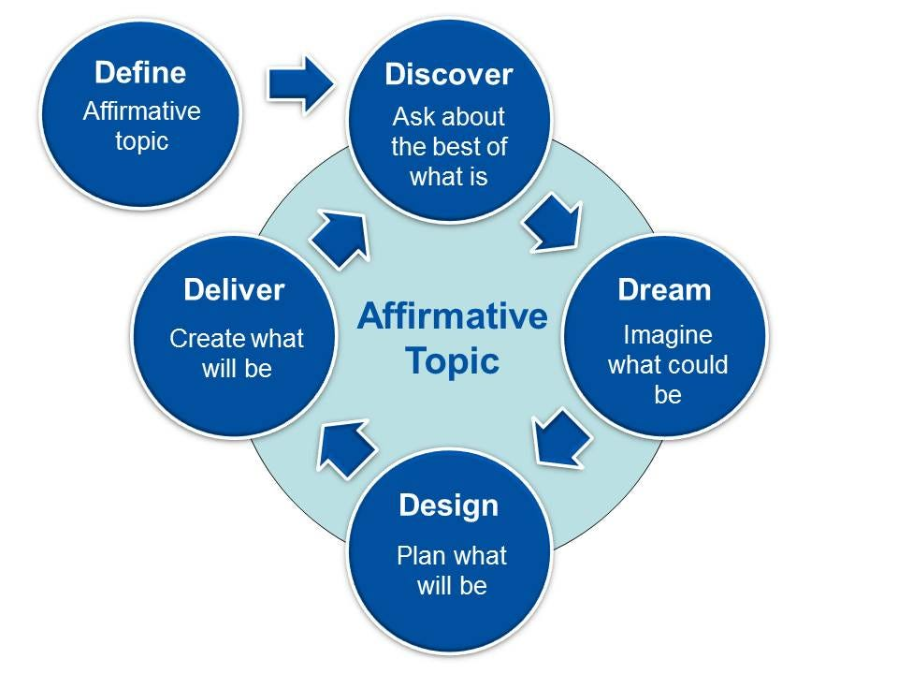
Helping Them Vision
Appreciative Inquiry

Slide 58
Appreciative Inquiry
To facilitate change through an inquiry process centered on what’s working rather than what is not.
  “What is Working Here?”
  Vs.
  “What Problems are we Having?”

Slide 59

Appreciative Inquiry Process
Discover—The best of what is, explore what is going right, where you succeed
Dream—Imagine what could be, envision the ideal future
Design—Plan what will be, bridge what is with what might be
Delivery/Destiny—Create what will be by innovating and improving ways to create the desired future

Slide 60
Discovery: Identify Strengths
  Describe a time when you were proud about the work you do. Why were you proud?
  What do you value most about being a member of this group? Why?
  What characteristics of this group do you want to make sure are retained through the change?
  What characteristics of this group do you want to enhance through this change?

Slide 61
Design: Provocative Propositions
Provocative Propositions are statements that describe an ideal state. They keep ‘the best’ at a conscious level.
Provocative Propositions describe the idealized future as if it were already happening.
  “Our staff have the strongest credential and professional development in the field.”

Slide 62
Design: Provocative Propositions
Focus on what the organization/team is currently doing to fulfill the Provocative Proposition
  What are we currently doing that get us there?
  What are we not doing that gets us there?
  What are we currently doing that blocks us from getting there?
  What are we currently not doing that blocks us from getting there?

Slide 63
Coaching Questions Examples
Discover
  When you talk about your organization/team, what do you brag about?
  What is it about your organization/team that makes you or others look at the world differently?
  What surprising successes have happened in your organization/team?
Dream
  What are your wishes, hopes and dreams for a better organization/team?
  What would the title be of the ideal future?

Slide 64
Coaching Questions Examples
Design
  Imagining a future that bridges the best of what is (Discovery) with the ideal (dream):
    How is your organization different from your competitors?
    What would you include in your annual report to stakeholders?
Deliver
  What action steps are needed to make these propositions reality?
  Whose buy-in and support do you need to create this new reality?

Slide 65
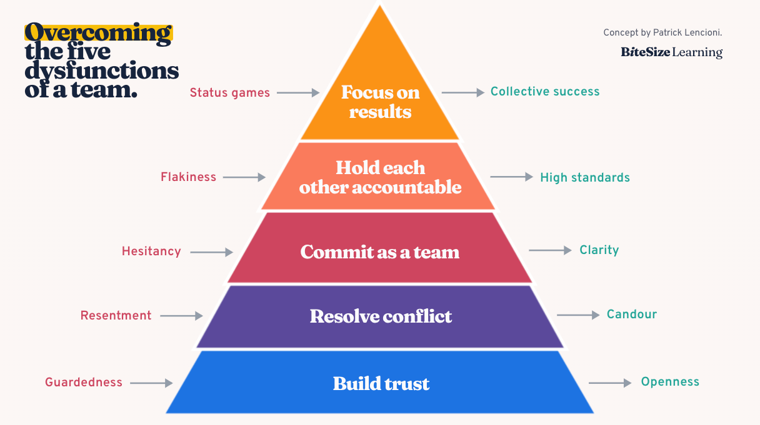
Lenconci’s 5 Kinds of Dysfunction

Slide 66
Coaching the 5 Dysfunctions within a Team
Conflict Coaching as an individual or collective intervention:
Do we trust each other?
Is it safe to disagree?
Are we all on the same page?
Are our keeping our standards high?
Do we put team results come before our personal status?
If the answer of any of these is no, conflict coaching can facilitate improvement

Slide 67

What is something you will be able to use tomorrow?

