Slide 1
Mapping Opportunities to Improve LEA Early Dispute Resolution Capacity
Angie Balsley, Ed. D.
CADRE Senior Consultant

Slide 2

Who is here?
Placeholder for pictures during intro
Notes:
Good Morning/Afternoon. Thank you for joining us today, Before we get started, we’d love to get a sense for who is in the room with us today?
We’re thrilled to be here with all of you. The collective knowledge and experience in this room is incredible.
Directors, Attorneys, Who else?
District size- rural, suburban, urban
States represented?

Slide 3
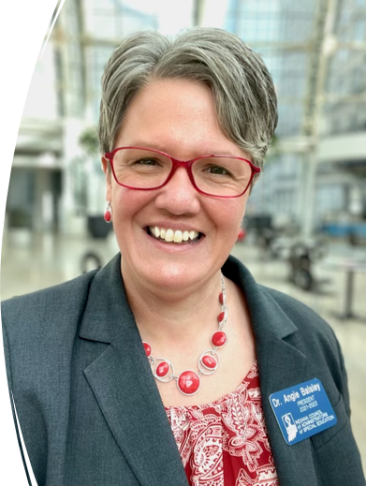
Angie Balsley, Ed. D.
Unified Leadership,
Founder & CEO
CADRE,
Senior Consultant
www.unifiedleadership.org
angie@unifiedleadership.org
574.933.3705
linkedin.com/angela-Balsley

Slide 4
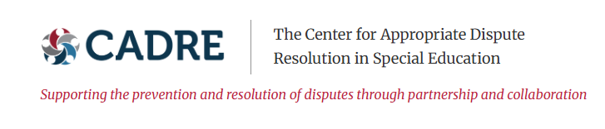
About CADRE
Notes:
About CADRE

Slide 5
CADRE’s Scope of Work
State Educational Agencies
OSEP-funded Parent Centers
Early Intervention Lead Agencies
CADRE Provides Technical Assistance via products and services to:
Families
Educators
Practitioners
Notes:
Since 1998, CADRE has served as the national technical assistance center under the U.S. Department of Education’s Office of Special Education Programs (OSEP), serving all 50 states and 10 entities/territories.

Slide 6
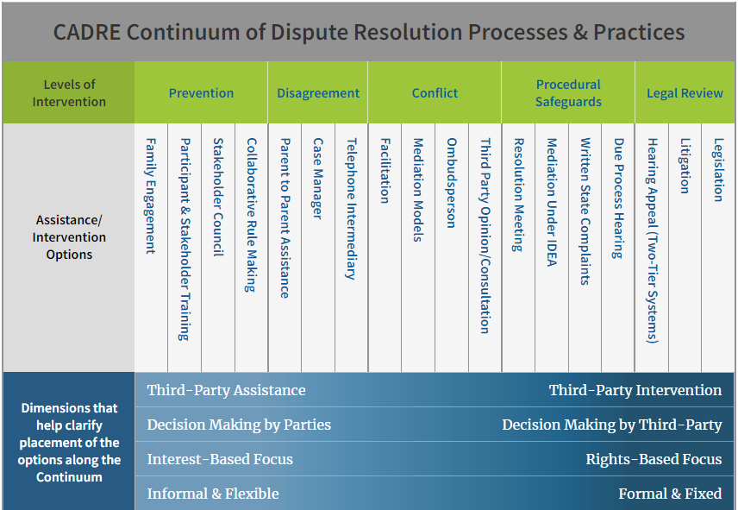

CADRE’s continuum
Early Dispute Resolution Options

Slide 7



History of Building Trust
CADRE’s 25-year history of building trusting relationships allows us privileged access to view dispute resolution from multiple vantage points.
Supporting the prevention and resolution of disputes
through partnership and collaboration
7

Slide 8

Our Time Together Today
Proactive Practices
Employ effective routine practices
Use a continuum of practices
Build relationships and empower parents
Engage in continuous improvement
Develop knowledge and skills
Notes:
See the handout at your table and/or in the conference portal.
These are themes that emerged from CADRE's study
We'll be talking about each theme in more detail
Could we bring hard copies of the Proactive Practices visual graphic? https://www.cadreworks.org/sites/default/files/Proactive%20Practices%207-25-24.jpg

Slide 9

Capturing Ideas During Today’s Session
Notes:
describe the T chart
Bottom third- draw a line across
Draw a line down the middle of the top 2/3
Label
Top left: Already doing (affirmation/identify strengths)
Top right: Consider doing (ideas that catch your attention that you'd like to think about deeper or take back to your team)
Bottom: Notes

Slide 10
The Rise in Dispute Resolution Activity

Slide 11
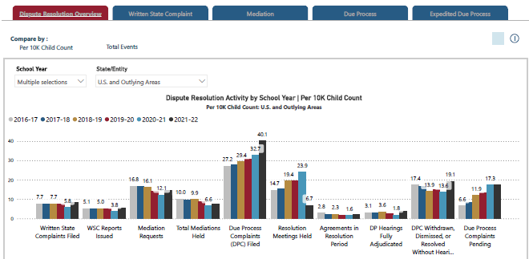
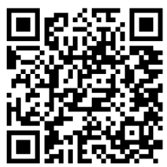
CADRE’s National and State Dispute Resolution Data Dashboard
Notes:
CADRE's Dispute Resolution Dashboard is organized into five areas. The landing page brings you to the Dispute Resolution Overview Page showing five tabs. The first is the dispute resolution overview tab housing the charts where all dispute resolution activity is combined. Here you'll find graphs for all dispute resolution activity by school year and states.
You'll also find the “Relative Use of Dispute Resolution Options” chart which will be explained later in this presentation. The other tabs present data for the four dispute resolution options individually. Specifically, written state complaints, mediation, due process and expedited due process.

Slide 12

Types of Comparisons and Charts
Compare by Event or by Child Count
Compare by School Year
Compare by State or Entity
Longitudinal Trends or Single Year Snapshots
Notes:
The Dashboard gives users the ability to compare states to each other, as well as to the national average. Additionally, it offers the ability to look at an individual state’s data over time. I will explain how to use the Dashboard to compare dispute resolution activity by event or by a state’s Child Count, how to compare across school years, how to compare states to other states or the national average,
how to examine the longitudinal trends or view single year snapshots, and finally I'll explain the "Relative Use of Dispute Resolution Options" chart. First, we’ll look at how to Compare by Event or Per 10000 Child Count.

Slide 13
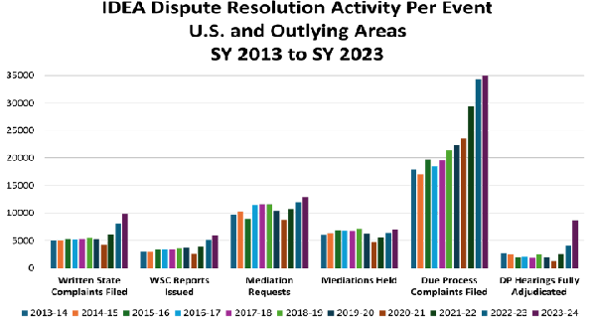
Nationally, dispute events have increased 89.6% over the last decade
13

Slide 14
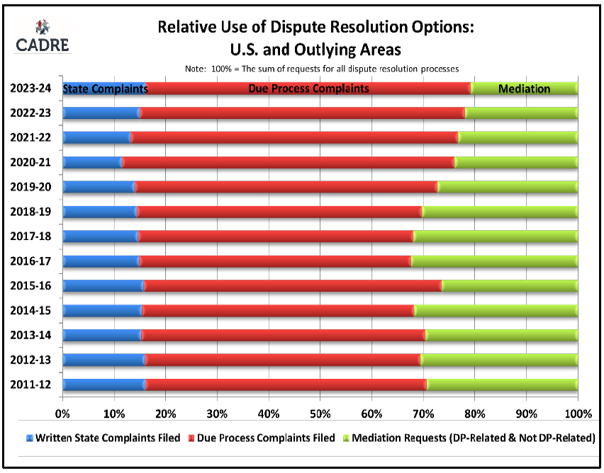
Relative Use of Dispute Resolution Options: U.S. & Outlying Areas

Slide 15
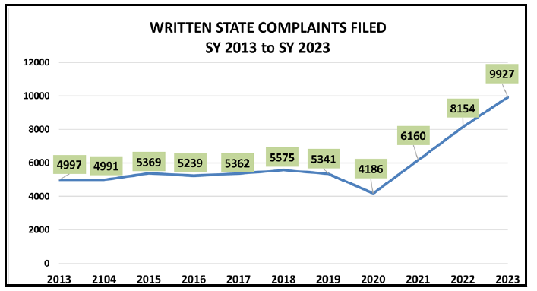
Written State Complaints Filed
Notes:
The number of WSC Filed remained relatively steady between SY 2013 and SY 2019, with an average rate of 5,267 WSCs filed per year during that period. However, since SY 2021, WSC filings have experienced a marked trend upward.

Slide 16
Moving the Needle with Early Dispute Resolution

Slide 17

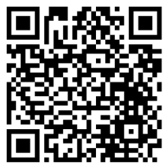
CADRE National Study
MOVING THE NEEDLE: Administrators’ Perspectives on School Districts' Needs and Opportunities to Improve Special Education Dispute Resolution Capacity
January 2025
Link to study: https://www.cadreworks.org/media/6708/download?attachment
Notes:
Introduce why the study was commissioned

Slide 18

The Importance of Early Dispute Resolution
Improved student outcomes
Better Relationships
Satisfied Parents
TEACHER RETENTION

Slide 19
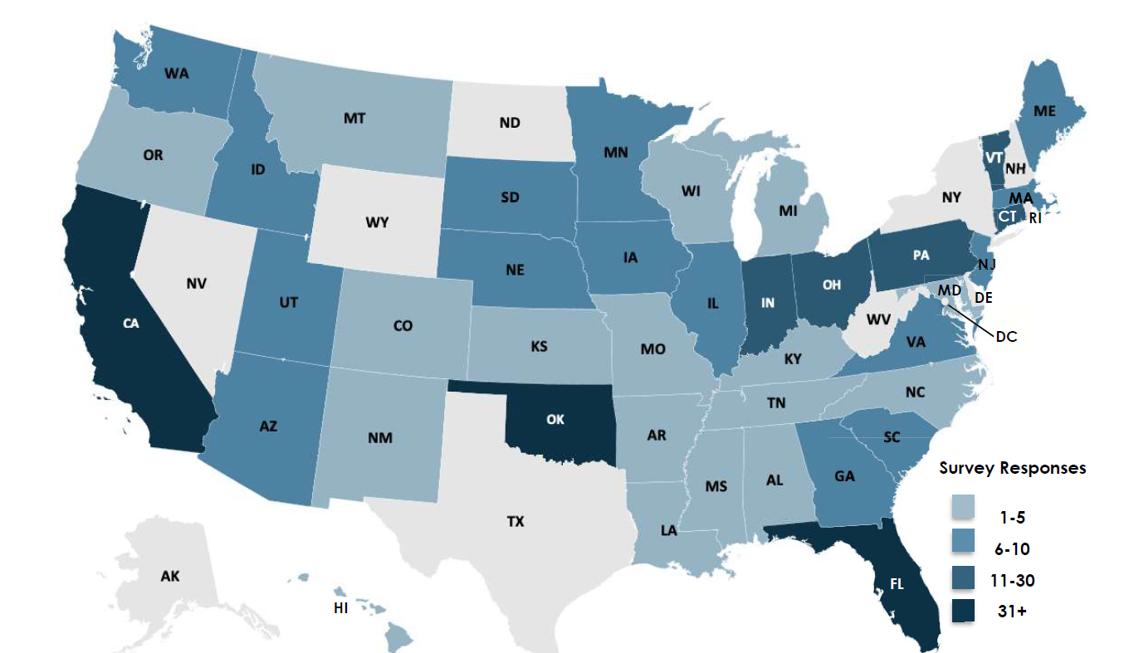
463 Respondents Across 43 States & Territories

Slide 20
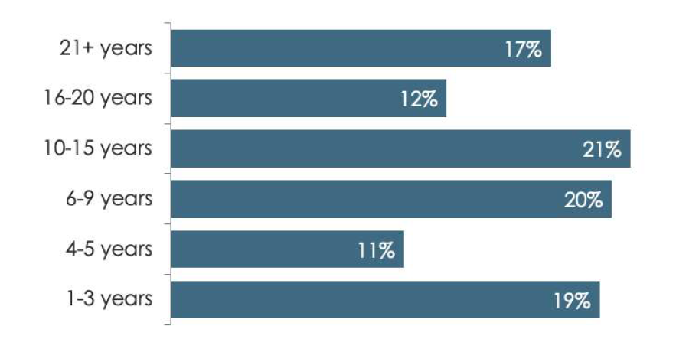
Respondents' Years Experience as Directors
Notes:
Angie

Slide 21
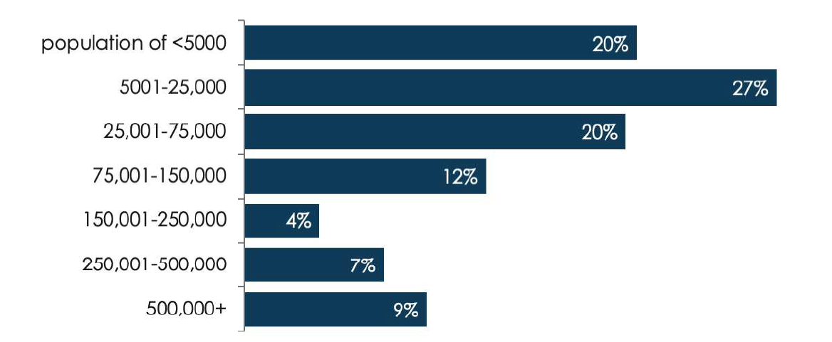
Survey Returns by Population Size
Notes:
Angie

Slide 22
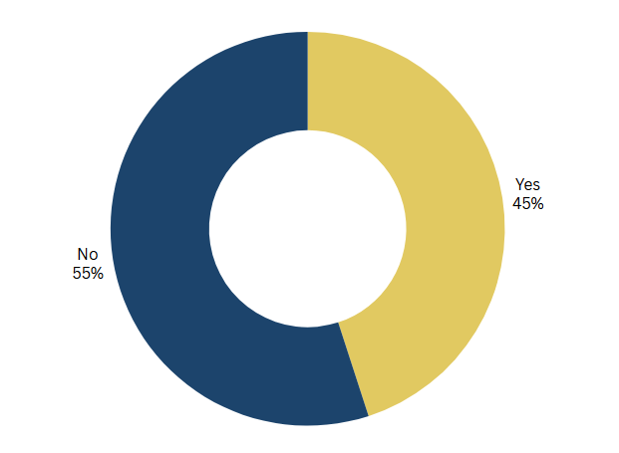
Has your district experienced an increase in special education conflict that cannot be resolved with an IEP meeting?
How does this compare with your area?
Notes:
Angie

Slide 23
District Capacity
98% reported that most relationships with families are positive.
95% shared that most IEP meetings are collaborative.
However, only 62% believed that their districts' IEP teams have the skills to effectively resolve conflicts when they arise
Notes:
Angie

Slide 24

Implementation Gap
Notes:
We’re going to share data and resources on effective practice.
But before we start, we’re acknowledging that a gap in implementation exists

Slide 25
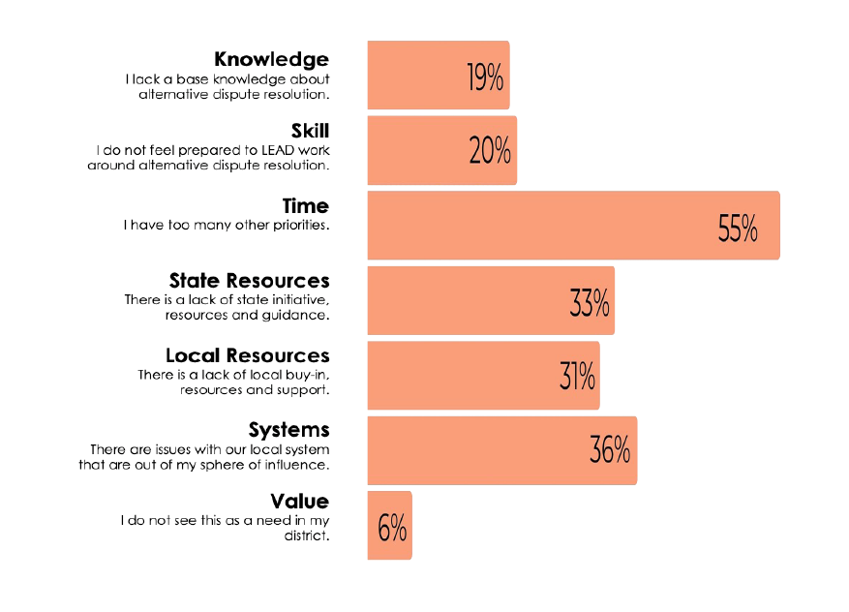
Barriers to Implementing Early Dispute Resolution at the Local Level

Slide 26

Address the Implementation Gap In Your District
Notes:
During this session, we’ve incorporated reflections and action planning into our discussion of the research and the tools.

Slide 27
Employ Effective Routine Practices
Notes:
The first proactive practice is to have effective routine practices in your district

Slide 28

Effective Routine Practices
Communication
Early & clear
Open & transparent
State and Federal Compliance
Processes
Effective & collaborative IEP meetings
Supportive administration
Leveling up concerns
Continuous Improvement

Slide 29

Discussion #1
What does your district do to ensure that communication is early, clear, open, & transparent?
Notes:
Elaborate on what they do well

Slide 30
Use a Continuum of Practices at the District Level

Slide 31
Early Dispute Resolution Practices
Early Dispute Resolution Options

Slide 32
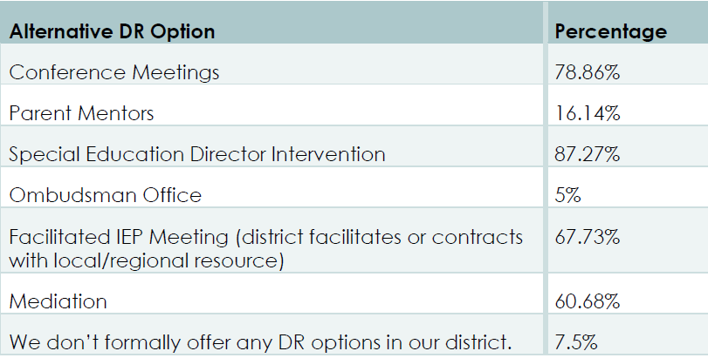
Use a Continuum of Dispute Resolution Practices

Slide 33

Facilitated IEP Meetings & Mediation
Most districts have access to facilitated IEP meetings and all have access to mediation.

Slide 34
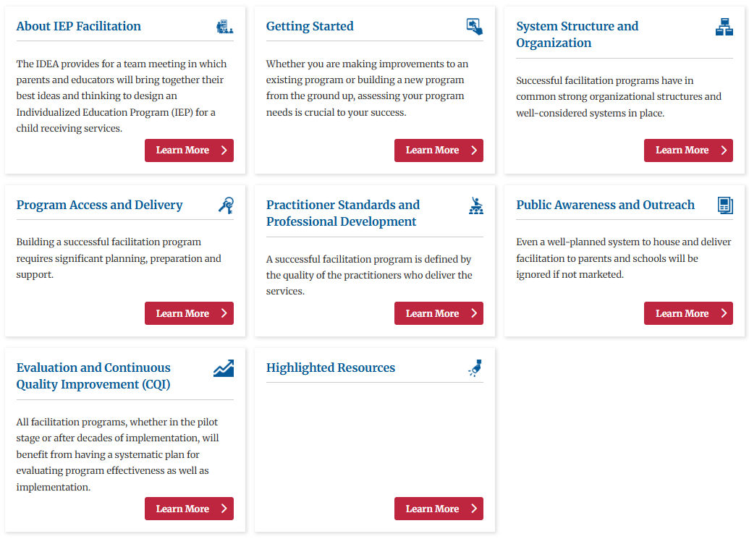

CADRE’s Guide to Facilitation Programs
34

Slide 35


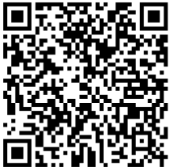

Resources for School Administrators & Staff

Slide 36
Discussion #2
What is a practice you could add to build the continuum of early and equitable dispute resolution practices in your district?

Slide 37
Build Relationships & Empower Parents

Slide 38

Build Relationships

Slide 39

Empower Parents
Educate parents on their rights and how to navigate the processes
Encourage the support of an advocate
Special Education Parent Advisory Council (SEPAC)

Slide 40

Do parents know how to connect with the director?
How do you ensure that families know who the director is and how to contact them?
How do you ensure they feel comfortable reaching out?

Slide 41
Partnering with Parent Centers & Community Agencies
Common characteristics
Willingness of parties to work together
A shared goal of ensuring students have what they need to be successful
Approach to collaborations
Seeking their advice
Utilizing their expertise

Slide 42
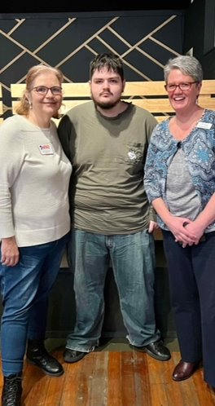
Underdeveloped Partnerships
60% of directors reported that they do not collaborate with the Parent Center in their area.
Send an introductory email to your Parent Center Liaison
Meet for coffee. You might make a friend!

Slide 43

Contracting a Parent Liaison
Notes:
Share Rosemary’s story
Gained support from superintendent by demonstrating how the cost is less than the cost of one due process hearing
Establish a contract and the roles of the liaison
Provides her contact information through schools

Slide 44


SEPAC’s to Build Relationships
Part I: Guide for local action
Part II: A resource guide for supporting local special education parent advisory councils
Part III: Resources
https://sepacguide.parentcenterhub.org/

Slide 45

Suggestion Box & Praises

Slide 46

Discussion
Where are there opportunities in your district to build relationships and empower parents?

Slide 47
Develop Knowledge & Skills
Notes:
Mel

Slide 48
Lack of Training in Leading Dispute Resolution
Directors' perspectives on adequate training:
"You learn it as you go and it feels clunky and uncomfortable."
"The lack of training on how to manage conflict resolution can cause directors to feel frustrated, offended, defensive and scared, especially if they are early in their careers."
Notes:
Mel

Slide 49

Provide Training
Legal literacy
Conflict engagement and resolution skills
Coaching others through conflict
Leading in high conflict

Slide 50

Who needs training?
Building-level Administrators
Teachers
Parents Advocates
Discussion:
What opportunities do we have to learn together with parents?

Slide 51

Sources of Support
Colleagues
Professional Associations, like CASE
Newsletters from organizations, like CADRE
Department of Education
Parent Centers

Slide 52



Accessing CADRE
Please pay attention to me!
82.4% of respondents
had not accessed CADRE’s
resources in the past

Slide 53

Use CADRE Resources to Develop Knowledge & Skills

Slide 54


CADRE's for Districts Webpage
https://www.cadreworks.org/for-districts

Slide 55

Don’t Reinvent the Wheel: Adapt it to your Ride

Slide 56

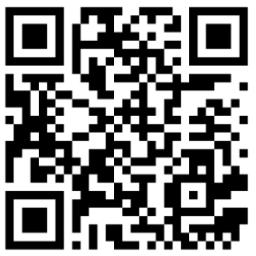
CADRE Webinars
CADRE offers more than 50 webinars to assist in professional development.
The Transformative Power of Engaging Parents as Partners
Productive Conversations Through Empathy
The Essential Role of Cultural Brokering: Engaging Diverse Communities and Stakeholders in Special Education and Early Intervention Dispute Resolution
To Trust or Not to Trust? Understanding the Science of Developing and Nurturing Trust in Family-Professional Partnerships

Slide 57
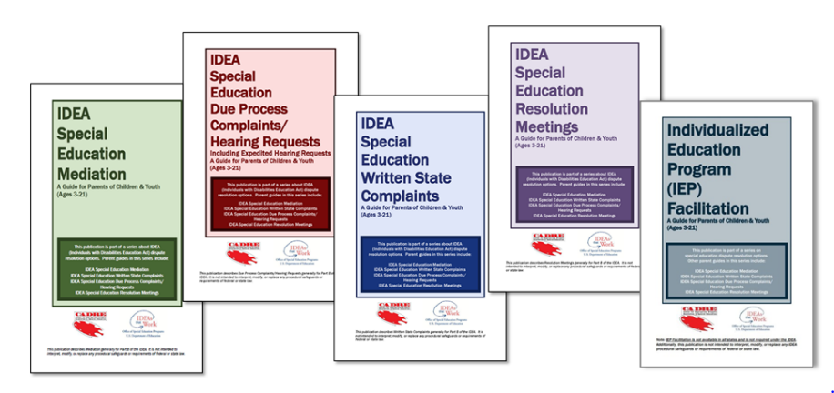

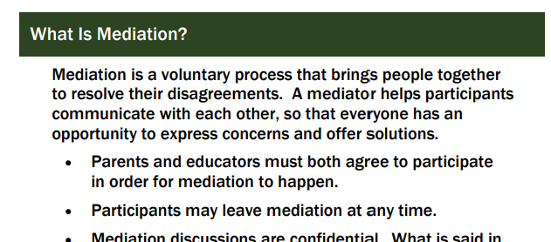
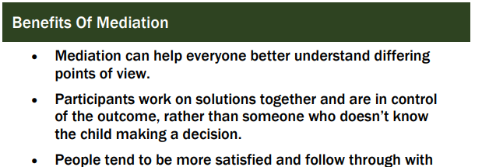
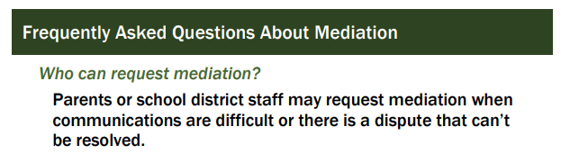
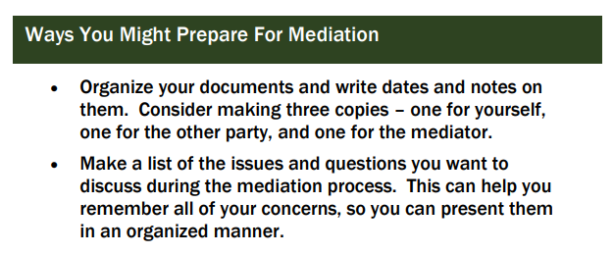
Building Legal Literacy in Dispute Resolution: IDEA Dispute Resolution Guides

Slide 58
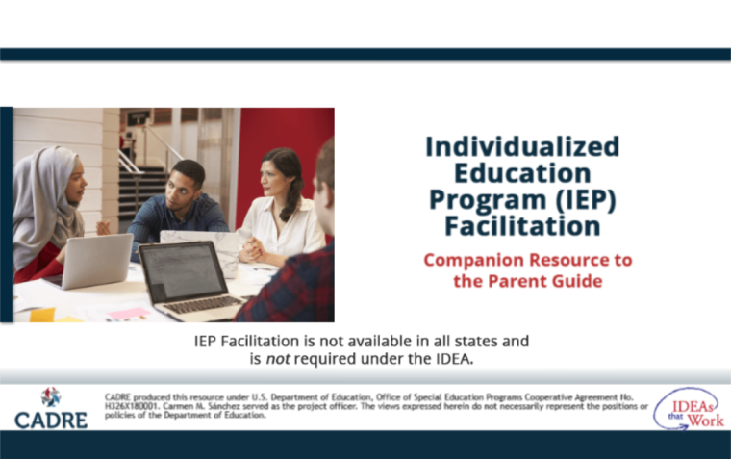



IDEA Dispute Resolution Guide Videos
IEP Facilitation
Mediation
Written State Complaints
Due Process Complaints

Slide 59

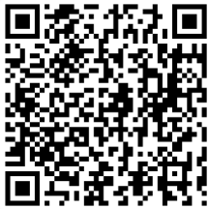
Working Together Series
Course 1: Intro to the Working Together Series
Course 2: IEP Meetings & Beyond
Course 3: Listening & Responding Skills
Course 4: Managing & Responding to Emotions
Course 5: Focusing on Interests to Reach Agreement
Available
in
Spanish!

Slide 60
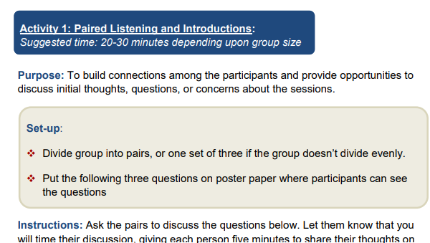

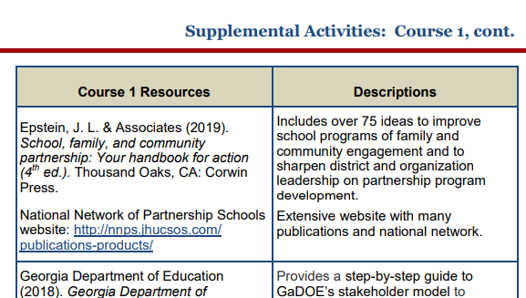
Facilitator’s Guide!
Mel
87 Pages of Activities, Supplemental Materials, Resources, Case Studies, and more!

Slide 61

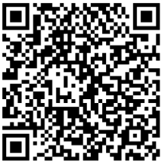
A Tale of Two Conversations
The two short videos (6-7 minutes) show a parent and a school administrator engaged in two different conversations:
one unproductive
and one productive.
Includes a Study Guide for individual or group exploration of the material.

Slide 62

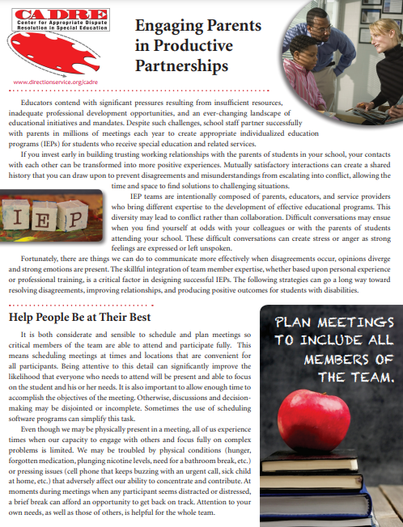
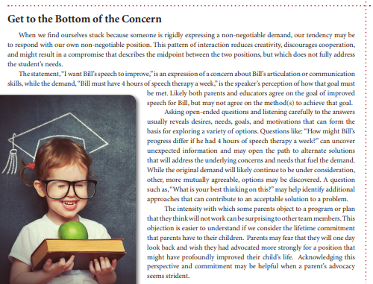
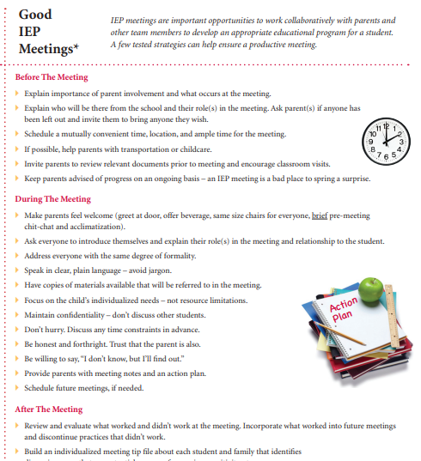
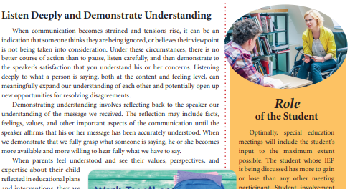
Engaging Parents: Tips for Running Meetings

Slide 63
Engage in Continuous Improvement
Notes:
The final Proactive Practice that emerged as a theme from the study is to Engage In Continuous Improvement

Slide 64
Directors' Learned Perspectives
Some directors viewed disputes as a personal reflection of their leadership. One director expressed “I wish I could have known not to take it personally.” However, through their lived experiences, directors discovered that conflict can be a useful tool. A veteran director stated “Over time, I have learned to take the emotionality out of it. It’s not about winning; It’s about the kid. If we’re doing the wrong thing, somebody will tell us and we’ll fix it. It’s important to keep the situation in perspective.”

Slide 65
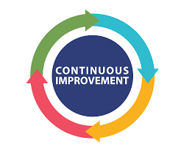
What Is Continuous Improvement?
Ongoing effort to enhance services and processes by making incremental improvements over time.
Regular evaluations and small, continual changes lead to better efficiency, effectiveness, and flexibility.
There will always be work to do and improvements to make.

Slide 66

Why Is Continuous Improvement Needed?
It helps organizations adapt to changing environments and technologies, meeting evolving expectations.
Improves quality and performance
Encourages a practice-stance towards problem-solving and innovation
Fosters a culture of learning and development which leads to sustained growth and success.

Slide 67

Building Local Level Capacity Portal
https://www.cadreworks.org/dr-coordination-leadership/building-local-level-capacity

Slide 68


District Self-Assessment for Collaborative & Early Dispute Resolution Processes
The assessment tool is in the conference platform and on the CADRE website.
https://www.cadreworks.org/resources/cadre-materials/district-self-assessment-for-collaborative-and-early-dispute-resolution
Notes:
To support districts with continuous improvement with collaborative processes and early resolution of disputes, CADRE has created a self assessment tool for districts to examine their current capacities and identify priorities for enhancing practices.

Slide 69
Why Use a Self-Assessment Tool?
Examines the capacity to effectively serve the interests of all those engaged in collaborative IEP processes and early dispute resolution.
_______________________
Identifies a baseline of the district’s strengths and opportunities for growth to aide in prioritizing areas for improvement.
_______________________
Encourages the teams to develop a roadmap and timeline for activities to improve their processes.
Notes:
Self Assessment Tools can be useful in determining the districts current capacity in collaborative processes and early dispute resolution by uncovering strengths and opportunities for improvements. The self-assessment can lead to actions that can increase collaboration, enhance compliance and efficiency, boost participant satisfaction, and foster a district culture conducive to the success of all students.

Slide 70

Diving Into CADRE’s District Early Dispute Resolution Self-Assessment Tool
Five Management Functions
Indicators
Ratings & Comments
Process for using the tool
Notes:
To support districts with continuous improvement with collaborative processes and early resolution of disputes, CADRE has created a self assessment tool for districts to examine their current capacities and identify priorities for enhancing practices.

Slide 71
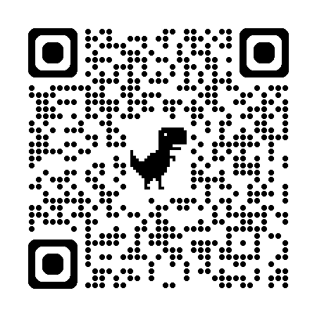
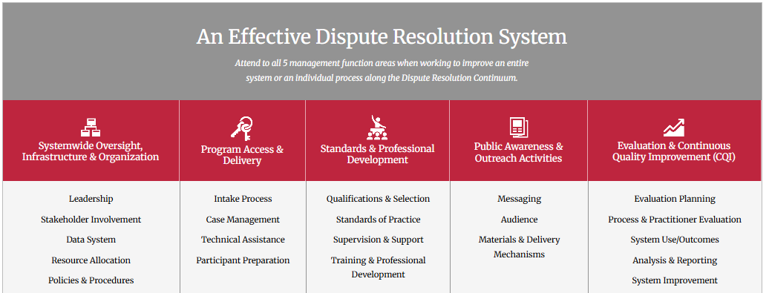
An Effective Dispute Resolution System Attends to All Five Areas

Slide 72
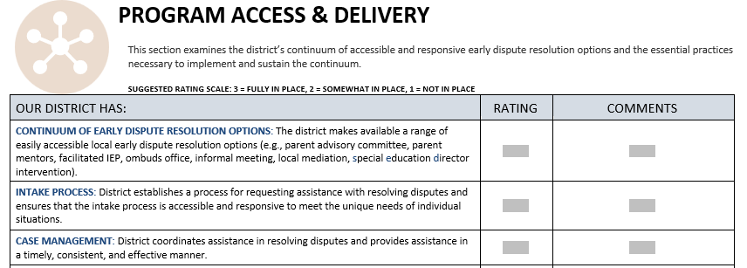
Indicators
For each Management Function Area, there are Indicators for districts to assess their effectiveness.

Slide 73

Coaching Questions
Broad questions are suggested to ease a team or group of collaborators into a discussion on a specific function area.
Example:
Program Access & Delivery
How do participants access and use collaborative and early dispute resolution processes? What’s working well? Where are there opportunities for improvement?
What additional supports could the district offer? Who would use them and how do we believe they would be beneficial?
Notes:
To support the utilization of the tool, CADRE developed a guide which includes strategies for successful completion of the assessment process, including coaching questions that can help ease a team or group of collaborators into a discussion on a specific function area.

Slide 74
Ratings & Comments
The rating rubric your team devises does not matter as much as the conversation and the process does!
Use the “Comments” section to make notes and provide evidence or examples. It is important to capture the meaning behind whatever rating was determined for recall later.

Slide 75
An Approach to the Assessment Process
Advantages of a Team Approach
Director independent review
Leadership team individual assessment with comments
Discussion among leadership team and common ratings

Slide 76
Benefits of a Skilled Facilitator Leading the Assessment Process
Communicates purpose
Fosters psychological safety and candor
Seeks evidence from the team
Keeps the process moving forward
Includes multiple perspectives
Generates a summary report
Provides guidance on strategic planning with the data collected

Slide 77

Including Additional Perspectives
Parents
Parent Centers
Teachers
School Administrators
Service Providers
Partner Agencies
Others?

Slide 78
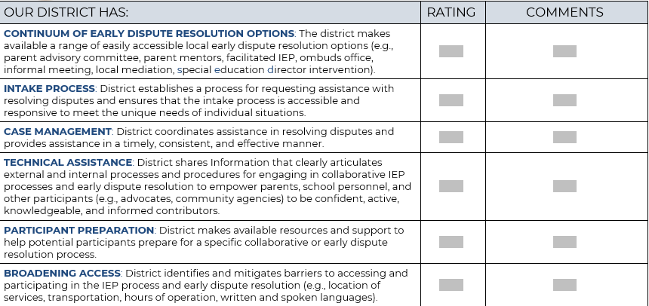
Your Turn: Program Access & Delivery
78
Notes:
Identify 1-2 areas to work on
Public Awareness & Outreach
Program Access & Delivery
They need a frame of reference from what is currently happening in their district. Likes them to think about their own district. Communicating on
Having someone volunteer to be the facilitator, notetaker, time keeper
Reinforces the thinking earlier in the presentation
In one of the function areas, go through indicators, then go through coaching questions and see how conversations differ
What was the feel, did you get as far? How would you use the coaching questions
Then be intentional about using the coaching questions in the second function area
“This time engage with the coaching questions or just with the indicators, whatever you think will be helpful or to move your group forward.”

Slide 79

Building Local-level Capacity Action Planning Tool
Identify your District’s Priority Area of focus.
Identify the Desired Results you hope to see and what is needed to achieve those results.
Set the Measurable Outcome-based Performance Target(s) you will work toward, possible data that can show progress toward your identified Performance Target(s), as well as what Data Sources (e.g., surveys, observation rubrics, interviews) might be used to collect data.
Identify activities to be implemented and resources necessary for each activity.
Assign a staff lead.
Identify initiation and completion dates for each activity.
Notes:
What do you do with the data once it is gathered?

Slide 80



CADRE’s Tools for Systems Improvement
Determining Priority Areas
This tool helps organize top priority areas of focus and encourages individuals completing the tool to provide rationale for selecting each priority area of focus.
Creating Readiness for Change
This resource provides readiness indicators that should be considered before implementing any significant changes to a system or process.
Getting to Desired Results
This worksheet provides some coaching questions to assist you with your planning process and the development of measurable performance targets (i.e., goals, benchmarks) to be achieved.
80
Notes:
Action planning tool is specific around knowledge, skill development and building capacity in that way.
It’s not really about local level type activities.
Self assessment tool is broader than the knowledge and skills.
Action Planning- for training and support to develop capacity and collaborate
Important to recognize that the action planning tool
Knowledge and skill sets that people might need, not about systems and processes

Slide 81

Taking Action
Notes:
What’s your next step?
Any take-aways?
Make yourself available to parents
Ensure meetings are friendly, efficient, and effective

